Slide 1
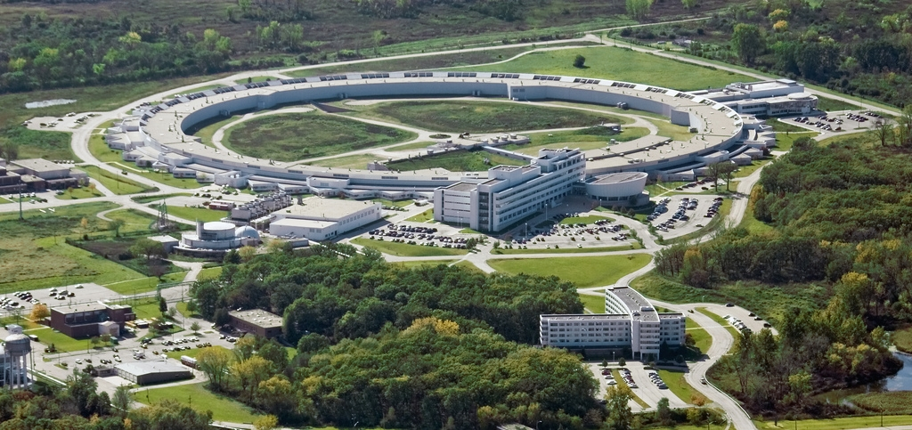
APS Upgrade
Brian Stephenson
Argonne National Lab
7 December 2010
Notes:
Thank you Eric – It’s a great pleasure today to tell you about the APS Upgrade. I’m guessing that I get this honor because I’m the managerial person at the APS with the oldest and deepest ties to the rest of the lab having been in Physics, Chemistry and Chemical Science and Engineering Divisions before moving to X-ray Science Division in January. So my goal here is to capture the excitement surrounding the APS Upgrade – and – more importantly to plant seeds for conversation and meaningful collaborations.
First a little background. Highly likely that some of you

Slide 2
The APS Upgrade will provide revolutionary, unique capabilities
Create the brightest source of penetrating x-rays above 25 keV
Using coupled innovative improvements in the accelerator and pioneering superconducting undulators
Deliver 100 times better temporal resolution, down to 1 picosecond
Using an innovative rf pulse-slicing capability
Deliver 100 times better spatial resolution reaching < 5 nm above 25 keV
Using innovative multilayer Laue lens optics and brighter more coherent source
Coupled instrumentation and beamline developments for imaging, scattering, and spectroscopy to address key scientific and engineering challenges

Slide 3
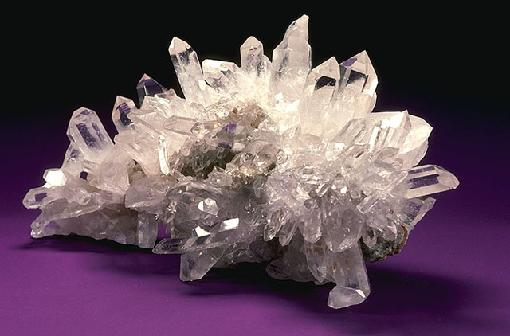
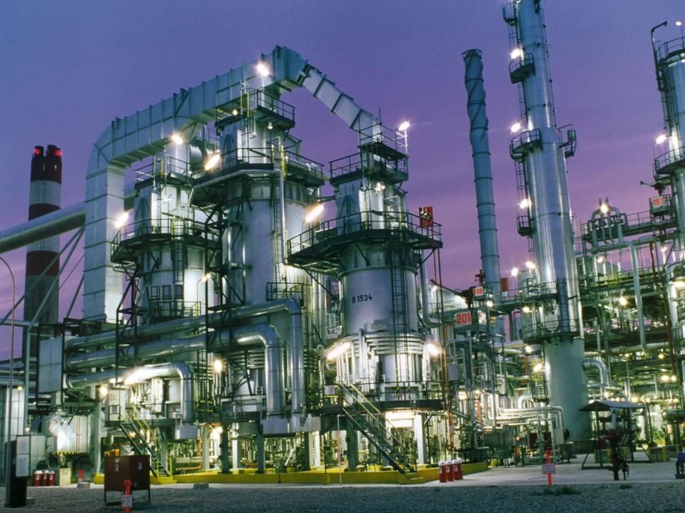
Absorption length (1/e) of 8 keV, 25 keV, and 60 keV x-rays for some energy-relevant materials
LiCoO₂
20% FePt
in Zeolite
SiO₂
0.05 mm
8 keV
0.13 mm
8 keV
0.01 mm
8 keV
25 keV
25 keV
25 keV
0.48 mm
3.6 mm
0.22 mm
20.2 mm
2.5 mm
4.5 mm
60 keV
60 keV
60 keV

Slide 4
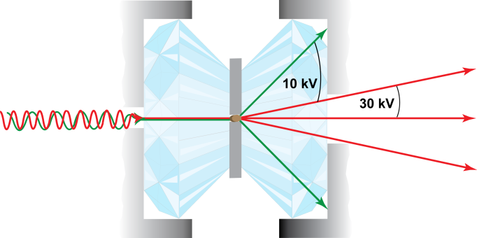
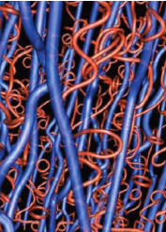
High-pressure research
Even simple materials show unexpected behavior, providing a route to new properties
ExampLE
Vortices in an exotic metallic superfluid predicted for hydrogen at 400 GPa* could be observed by APS-U. (Rus Hemley, Carnegie Institution)
* Babaev et al., PRL 95, 105301 (2005).
Besides penetrating through diamond anvils, higher-energy x-rays reduce Q-windowing.
Method: APS-U will more than double the range of pressure and temperature available for high-pressure studies of materials, by focusing x-ray nanobeams inside diamond anvil cells permitting high pressure and temperature gradients. High-pressure work flourishes at APS today and typically is done at 30-keV x-ray energy because of penetration and Q-windowing.
Relevance: High-pressure research provides a route to new materials properties − for example, more materials superconduct under pressure than at ambient. Center-Earth conditions could be reached for the first time. High magnetic field provides another control variable that can be explored at APS-U.

Slide 5
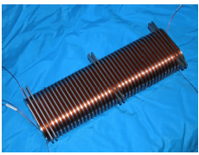
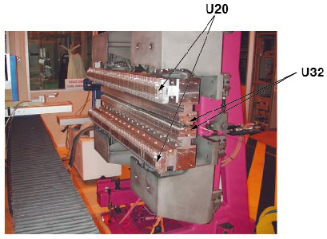
High brightness at high energy through optimized undulators
Provide the high brightness, low emittance, small source size, and beam stability to enable measurements in nanoscale volumes at x-ray energies above 25 keV
Convert to long straight sections to accommodate additional undulators and types of undulator
Provide optimized undulators in coordination with beamline enhancements and needs
Introduce superconducting undulators for maximum brightness and flux above 25 keV
Superconducting undulator
Long straight sections
Revolver undulators at ESRF

Slide 6
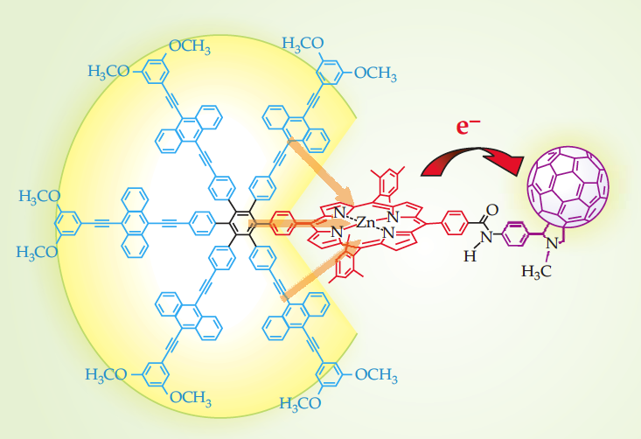
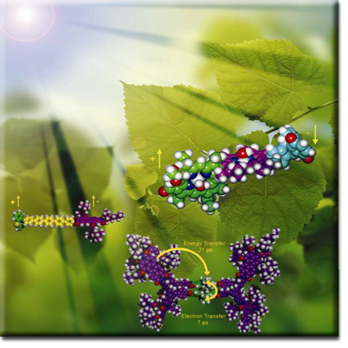
Ultrafast science – time-resolved spectroscopy & scattering
Faster timescales are needed to capture transient intermediate states in energy conversion.
Multiple timescales are needed to obtain full picture for complex systems.
ExampLE
Artificial photosynthetic system
ExampLE
1-10 ps
80 ps
Essential intermediate states during photon-to-electron transfer exist on the 1- to 10-ps time scale that are not yet structurally solvable.
15 ns
Kodis et al. JACS (2006)
SPX will enable snapshots of critical intermediate states to track energy conversion from photon to electron transfer to chemical reaction
Multiple timescales can be readily accessed with the 150-ns period between x-ray pulses
Notes:
Photosynthesis is arguably the most important chemical process on earth – converting sunlight to fuel.
Artificial photosynthesis is a longstanding goal particularly for the DOE.
Here an artificial photosynthetic system is pictured with a central hexaphenyl benzene core for surrounding wheel of antenna gather light in the visible.
Energy transfer on the 1-10 ps timescale to the porphyrin molecule – which acts as an electron donor - is followed by electron transfer to the fullerene acceptor.
The charge separated state lives for 15 ns before returning to ground state and losing the energy as heat. One would like to stabilze the charge transfer state to enable water splitting reactions.
See Crabtree and Lewis, Physics Today March 2007

Slide 7
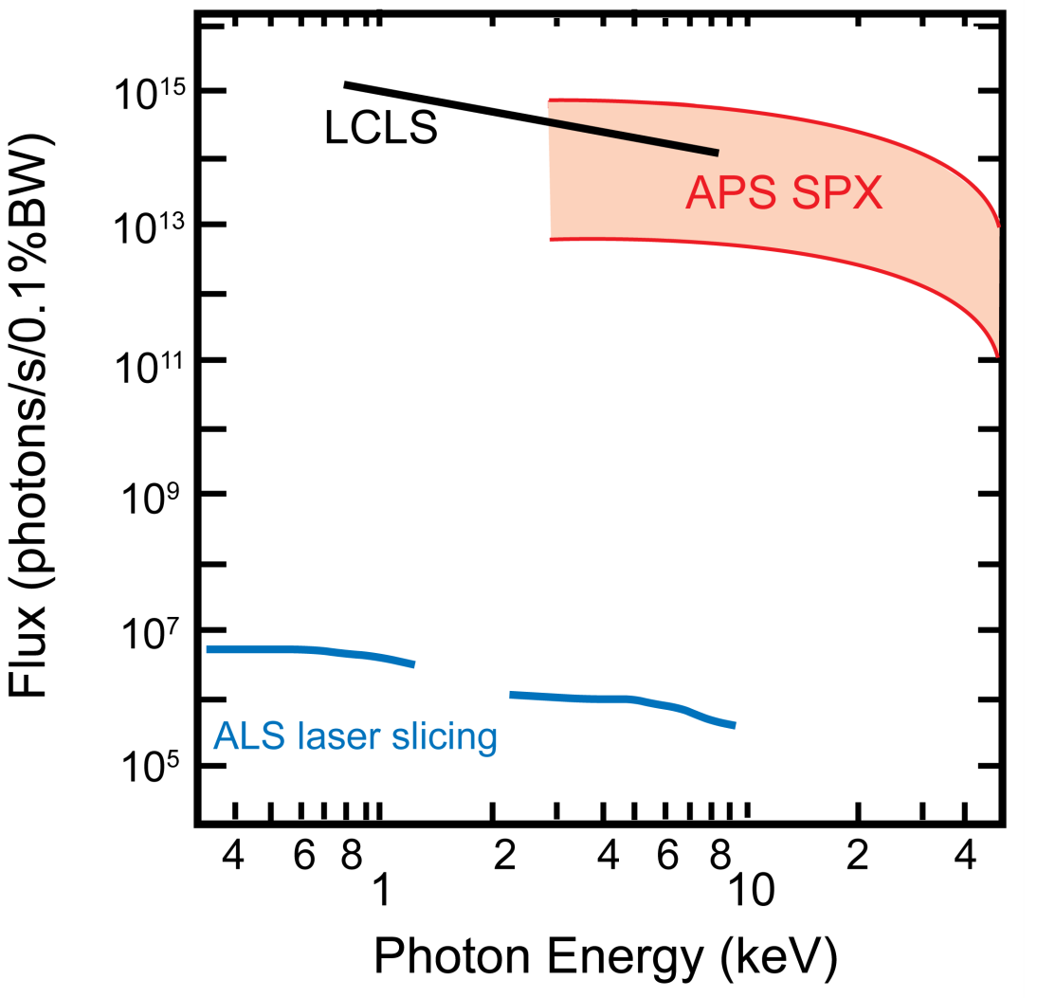
Ultrafast Dynamics – SPX is a new breed of ultrafast x-ray source
For “non-perturbative” x-ray probes, average flux is the figure of merit.
LCLS: 10¹² – 10¹³ x-rays/pulse 100 fs @120 Hz.
Synchrotron-based laser-slicing sources: 10-100 x-rays/pulse in 100 fs @ 1 kHz
SPX: 10⁴ – 10⁶ x-rays/pulse in 1 ps @ 6.5 MHz
APS SPX features:
High average flux, high repetition rate, stable, tunable, polarized x-ray pulses
X-ray probe is “non-perturbative”
High flux encourages development of advanced methodologies
High energy capable to 100 keV
Synchronization to 250 fs rms

Slide 8
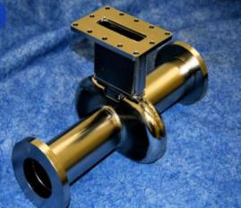
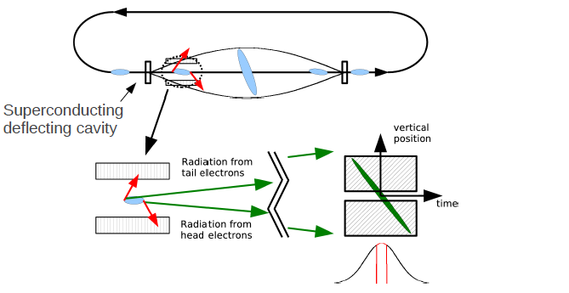
Innovative and unique source of 1-ps x-rays
Uses Zholents’ (now head of APS Accelerator Division) scheme for rf pulse slicing – first implementation on a light source, with exciting scientific applications and accelerator physics impact
A. Zholents, P. Heimann, M. Zolotorev, and J. Byrd, Nucl.
Instrum. Methods Phys. Res., Sect. A 425, 385 (1999).

Slide 9
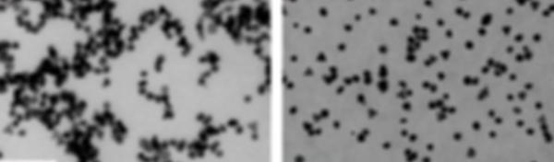
Optics approaching nanometer resolution above 25 keV Resolution of 5 nm or better is needed to understand active sites in operating catalysts
Simulation of a 120-nm-resolution, 30-keV x-ray image obtainable at the APS today inside reactive environment, shows neither individual particles nor their morphology.
Simulation of a 5-nm-resolution, 30-keV x-ray image from APS-U showing individual particles and differences in nanostructures key to activity.
100nm
Agglomerated, low surface area inactive
Dispersed particles active
No experiment today can image individual nanoparticles inside the realistic conditions of a chemical reactor. APS-U experiments will be key to fundamental understanding and will guide processing improvements in energy efficiency and minimized effluent.

Slide 10
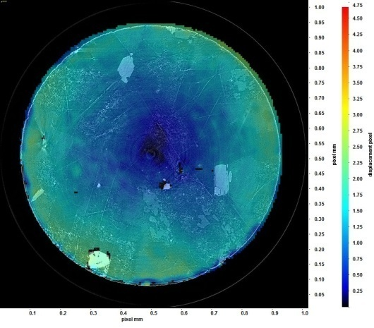
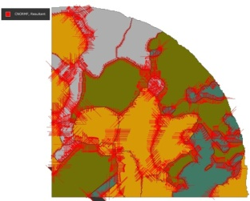
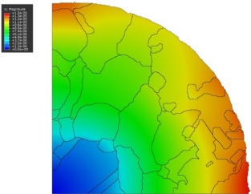
Challenge: micro-tomography of dynamic samples
Ultra fast 1μm resolution tomography
Example: Visualize thermal expansion in situ in materials.
 | New sCMOS (100 frames/s to disk)
Data processed | 385.3 | TB/day
Data distributed | 253.4 | TB/day
APS 2-BM
Current limitation is detector speed not x-ray flux.
X-ray flux permits tens of PBytes/day
High resolution "3D movies" of evolving samples
Tremendous challenges are in:
Data handling (distribution, archival)
3D rendering
Data reduction
Modeling
Thermal expansion cracking increases permeability of granite and is therefore important for engineering geothermal reservoirs and nuclear waste depositories.
Previous expt indirect: Fussels, Regenauer Lieb, Hough DeCarlo, Nature 459, 954 (2009)
From Francesco DeCarlo
Notes:
Few weeks ago we acquired 2 new detectors. These are CMOS and sCMOS (scientific CMOS) based able to collect and save data to disk at full size (2k x 2k)
at 100 frames/s. Data can be actually collected much faster (~ 50k frames/s) before running out of x-rays, but since with the current technology
we need to wait after data collection for the transfer to disk, in this slide I refer to sustained data throughput using the current 100 frames/s.
Regarding the images on the left:
Thermal expansion cracking increases the permeability of granite significantly and is therefore important for engineering of geothermal reservoirs and nuclear waste deposits. Previous experiments with Westerly granite quantified the process in indirect measurements and showed in post-experimental assessments where the fractures had propagated along grain boundaries and through grains (Fusseis, Regenauer-Lieb, Liu, Hough and De Carlo 2009).
The goal is to visualize thermal expansion cracks as they formed during heating with in situ synchrotron x-ray tomography experiments and quantify the effect on permeability of the sample from the tomographic data.
The reconstructions showed the formation and opening of grain boundary and intragranular cracks (left image). In particular, grain boundary cracks were clearly distinguishable in the tomograms and opened up to several microns. Most cracks formed early during heating, between 100 and 200 ºC; however, even between 300 and 395 ºC, cracks still nucleated. The formation and propagation of these cracks can often be followed over several temperature steps.
Analysis performed with Strainmaster DaViz 7.2 and Strainmaster DVC by LaVision.

Slide 11
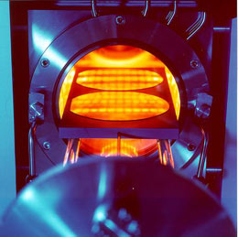
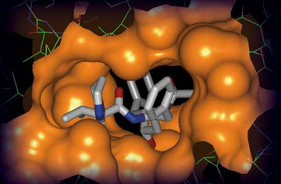
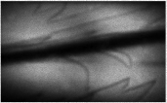
APS Upgrade Will Address the Grand Challenges
Can we harness photosynthesis for solar fuels?
Can we control nucleation to make better functional energy materials?
Is hydrogen an exotic metallic superfluid at 400 GPa?
Can we predict the geochemistry of carbon sequestration?
Can we design drugs that will effectively target disease?
Real materials under real conditions in real time
11

