Slide 1
Fermilab General Accelerator Development Program: Introduction and Strategic Context
Stuart Henderson
Fermilab
General Accelerator Development Review
January 24-26, 2011

Slide 2
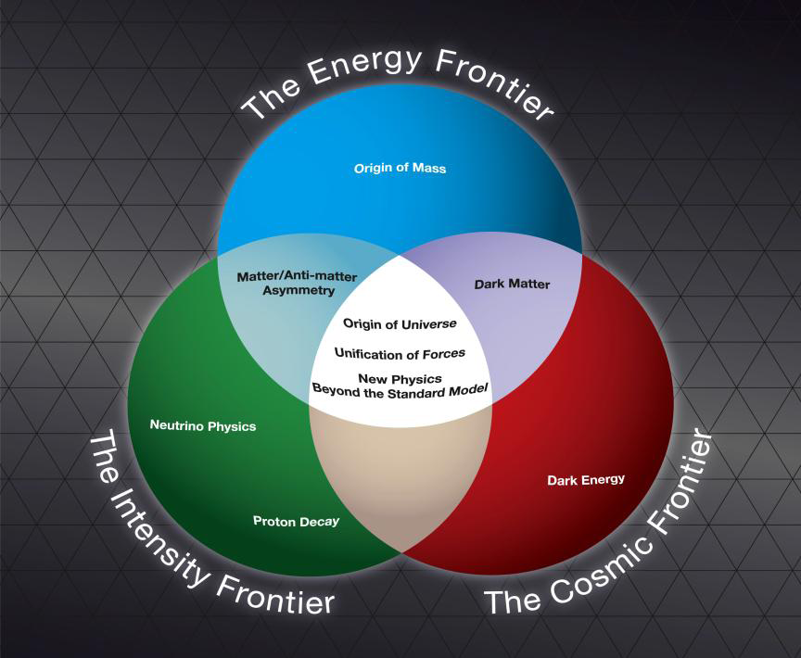
Strategic Plan for U.S. High-Energy Physics
The General Accelerator Development program at Fermilab is a central element of the long term accelerator-based mission of the Department of Energy’s Office of High Energy Physics, and the laboratory
Elements of the Strategic Plan are articulated in the P5 Report:
Energy Frontier: Exploit the Tevatron and support US contribution to LHC
Intensity Frontier: Upgrade existing neutrino capabilities and establish a world-leading program based on a high-power source at Fermilab
Technology Development, carried out within GAD is a central element of this strategy

Slide 3
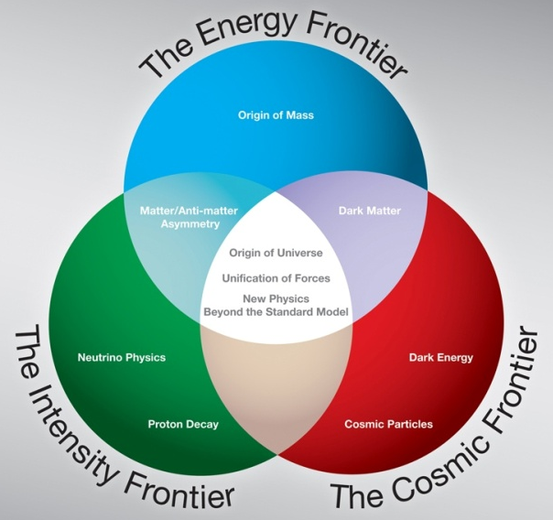
Fermilab Strategic Plan for Accelerator-Based Frontiers in Particle Physics
As the National Laboratory for particle physics, our mission is to
Enable the US community to tackle the most fundamental physics questions of our era
Place the US in a leadership position in the world
LHC Upgrades
ILC
Muon Collider
Energy Frontier
Tevatron
LHC
Intensity Frontier
Main Injector
Booster
Project-X
Neutrino Factory
http://www.fnal.gov/pub/science/frontiers/

Slide 4
Fermilab Strategic Plan
Energy Frontier
LHC
Tevatron
LHC Upgrades
ILC
Muon Collider
NuMI: 300kW @120 GeV
Booster
NuMI 700kW@ 120 GeV
Booster
Project X 2MW@120 GeV, 3 MW@3GeV, 200 kW@8 GeV
ν Fact
Intensity Frontier
120 GeV Neutrino Program
8 GeV Neutrino Program
 |  | Muon to electron conversion
 | Muon (g-2)
 |  |  | Rare Processes
 |  |  | Nuclear EDM
Time
….

Slide 5
Role of GAD in Fermilab’s Strategic Plan
Fermilab’s GAD program plays a central role in realizing the Strategic Goals of the U.S. HEP Community, DOE/OHEP and the laboratory by nurturing and developing those technologies that are critical for enabling the accelerator facilities of the future.
Energy Frontier:
Superconducting magnet technology development to produce ever-higher magnetic fields for LHC upgrades to luminosity and beam energy and muon colliders
Intensity Frontier:
Superconducting RF, injector and RF technology for future high-intensity high-power proton accelerators, as well as fundamental superconducting materials R&D
S. Henderson, Fermilab – General Accelerator Development Review January 24-26, 2011

Slide 6
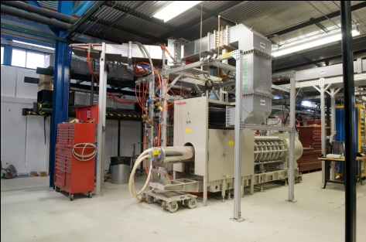
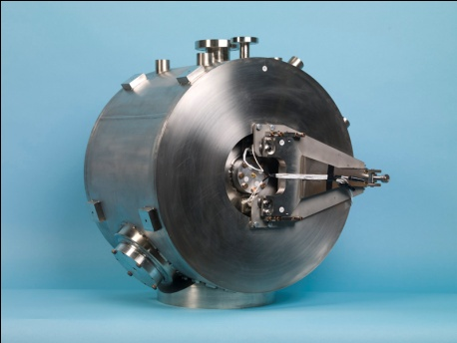
GAD Portfolio: Accelerator and Injector Systems Thrust
Goals
Demonstrate the critical technologies required for the low-energy front-end of a future high-intensity, high power proton/H⁻ Linac
Develop superconducting accelerating system components for high-intensity proton beams
Activities
Proton/H- Injector system for high-intensity pulsed beams
Constructed and commissioned “HINS” front-end, NC low-beta structures and vector modulator system
Normal and superconducting RF structures suitable for future high-intensity, high-power linear accelerators
Built capability through 3.9 GHz cavity/CM development
Ramped up single-spoke resonator work, focusing on structures at 325 and 650 MHz
S. Henderson, Fermilab – General Accelerator Development Review January 24-26, 2011

Slide 7
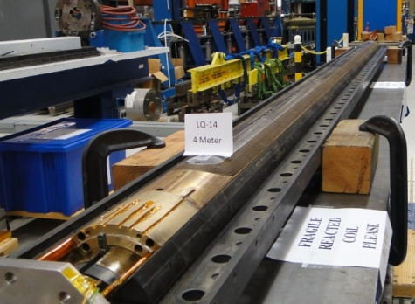
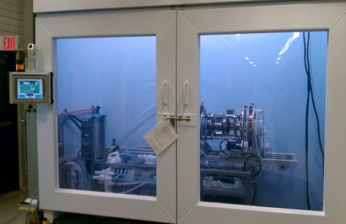
GAD Portfolio: Superconducting Magnets and Materials Thrust and Other Activities
Goals
Develop advanced SC magnets and baseline technologies for present and future particle accelerators
Understand and improve scientific and engineering aspects of SC strands and cables
Understanding the limits of Q and gradient of SCRF cavities through basic SC materials R&D
Activities: Superconducting Magnets and Materials
High-field magnets and supporting technology
Coil fabrication technology
Nb₃Sn development including 11 T CERN program
SC strand and cable
Fundamental R&D on SC materials and their limitations
The recently completed Integrated Cavity Processing Apparatus enables processing studies with single-cell cavities
Other Activities: Accelerator Modeling and Computational Support
S. Henderson, Fermilab – General Accelerator Development Review January 24-26, 2011

Slide 8
GAD Activities are Tightly-Coupled to the National Strategy
Fermilab GAD Activity
US HEP Strategy (P5)
The panel recommends support for the US LHC program, including US involvement in the planned detector and accelerator upgrades.
Lepton Colliders: The panel recommends…a broad accelerator R&D program …that includes continued R&D on ILC ...The panel also recommends R&D for alternative accelerator technologies, to permit an informed choice when the lepton collider energy is established.
The panel recommends a world-class neutrino program as a core component of the US program, with the long-term vision of a large detector in the proposed DUSEL laboratory and a high-intensity neutrino source at Fermilab.
The panel recommends proceeding now with an R&D program to design a multi-megawatt proton source at Fermilab and a neutrino beamline to DUSEL…
The panel recommends pursuing the muon-to-electron conversion experiment…
The panel recommends a broad strategic program in accelerator R&D, including work on ILC technologies, superconducting rf, high-gradient, normal-conducting accelerators, neutrino factories and muon colliders, plasma and laser acceleration, and other enabling technologies, along with support of basic accelerator science.
Develop high-field magnet technology, 11T dipole effort
Develop ILC and muon collider technology through their programs
Develop p/H- injector technology and SC RF structures and RF technology for accelerating high-power beams
Develop computational tools for Mu2e
Identify performance limitations and mitigation through fundamental SC materials R&D
Energy Frontier
Intensity Frontier
Accelerator R&D

Slide 9
Leveraging Fermilab’s Resources
The GAD program is embedded in, and leverages resources and infrastructure from, the much larger operations and R&D programs at Fermilab:
Accelerator facilities: The Fermilab complex is very flexible in its ability to deliver beam at a variety of energies to a variety of locations, simultaneous with ongoing operations
Accelerator personnel: Fermilab staff possess unique capabilities and skills in accelerator design, construction, and operations, beam dynamics, advanced accelerator R&D. Personnel are available to support the GAD program as required
S. Henderson, Fermilab – General Accelerator Development Review January 24-26, 2011

Slide 10
Leveraging Fermilab’s Resources, cont’d
Accelerator infrastructure: Very substantial test-stands, cryogenics, electrical, and low conductivity water infrastructure are available at Fermilab.
Local Universities and Laboratories: Several local universities, plus ANL, are active or potential participants in the Fermilab
Accelerator computation/simulations tools: A variety of advanced computation and simulation tools are available via the SciDAC sponsored national accelerator computational program, which is led by Fermilab.
S. Henderson, Fermilab – General Accelerator Development Review January 24-26, 2011

Slide 11
Budget/FTEs
 |  |  | FY09 |  | FY10 |  | FY11 |  | FY12* |  | FY13*
 |  |  | SWF (k$) | Total (k$) | SWF (k$) | Total (k$) | SWF (k$) | Total (k$) | SWF (k$) | Total (k$) | SWF (k$) | Total (k$)
Fermilab GAD |  |  | 9365 | 22.9k | 7149 | 16.9k | 6524 | 15.8k | 6207 | 18.1k | 6567 | 18.8k
 | Accelerator and Injector Systems
 |  | Non-SRF Activities | 2603 | 6413 | 1689 | 4131 | 1167 | 2376 | 400 | 875 | 200 | 438
 |  | SRF Activities | 2592 | 5842 | 1958 | 4325 | 2169 | 5626 | 2600 | 9046 | 2990 | 9869
 |  | 3.9 GHz Activities | 1552 | 3550 | 285 | 695 | 107 | 236 | 50 | 118 | 50 | 118
 | HP RF Systems
 |  | 325 MHz System | 501 | 1233 | 611 | 1494 | 600 | 1400 | 180 | 420 | 90 | 212
 | Superconducting Magnets and Materials
 |  | H.F. Magnets Program | 1343 | 2993 | 968 | 2107 | 1017 | 2326 | 1450 | 3560 | 1650 | 3998
 |  | SC Materials Program | 507 | 1771 | 916 | 2344 | 953 | 2398 | 1014 | 2530 | 1068 | 2647
 | Other Activities |  | 620 | 1087 | 721 | 1791 | 511 | 1436 | 514 | 1575 | 516 | 1592
S. Henderson, Fermilab – General Accelerator Development Review January 24-26, 2011

Slide 12
GAD in the Fermilab Context
As a single program laboratory, the GAD program at Fermilab is in a unique position
The GAD program is one element of the complete Laboratory Program; it is difficult to analyze it in isolation
The GAD program reacts to the larger forces at work within the laboratory
Flat or flat-flat funding scenarios
Growth of Projects made possible through reductions in Operations and R&D
As a single program laboratory, there are “interfaces” between all funding categories: Operations, Accelerator Science, GAD, Projects,
The GAD program, along with all other programs, is assessed twice per year, in the FNAL S&T Review, and annual DOE Site Visit
S. Henderson, Fermilab – General Accelerator Development Review January 24-26, 2011

Slide 13
Frequently Asked Questions about GAD
What are distinctive characteristics of GAD activities?
Technology development that is critical for enabling the accelerator facilities of the future
Has broad applicability and use beyond the confines of the specific Fermilab programs and projects
How does an activity move from GAD to project funding?
When the technology development ceases to be generic in nature
When the technology is applied directly to a specific project
How does it differ from Accelerator Science?
Accelerator Science emphasizes the beam and its properties, as well as transformative technologies for beam acceleration and manipulation
GAD emphasizes technology development, motivated by Accelerator Science
S. Henderson, Fermilab – General Accelerator Development Review January 24-26, 2011

Slide 14
Conclusions
Fermilab’s GAD Program is very strongly aligned with the US HEP Strategic Plan as articulated by P5
Development thrusts are central to the mission and future directions of the field and the US’s role in the Intensity and Energy Frontiers
Fermilab’s GAD program is a critical element in realizing the laboratory’s goal of building world leadership in intensity frontier physics enabled by a focused effort on superconducting RF technology
S. Henderson, Fermilab – General Accelerator Development Review January 24-26, 2011

Slide 15
Outline
Introduction
US Strategic Plan for HEP
Fermilab Strategic Plan
Role of Fermilab GAD in Strategic Plan
GAD Portfolio
Budget/FTEs
Leveraging Fermilab Resources
Distinction between GAD and other funding sources
GAD in the Fermilab Context: laboratory pressures, etc.

Slide 16
Science
Development
Project
Operation

