Slide 1
NuComp News
Lee Lueking
January 19, 2011

Slide 2
Outline
Disk report
GPCF Batch update
Prep for DOE Scientific Computing Review
Maintenance day tomorrow

Slide 3
Central Disk (BlueArc)
 | 2009 | 2010 | 2011 (replace) | 2012 request
MiniBooNE | P80 | 30 | 25(+13) | 0
MINOS | P150 | P30 | P30(+60) | 30
MINERvA | P10 | P20 | P40 | 30
Argoneut | P20 | 0 | 0 | 0
NOvA | P4 | P26 | P30 | 100
MicroBooNE | P2 | 0 | P5 | 30
LBNE (all) | 0 | P2 | P20 | 0
Mu2e | 0 | P2 | P2 | 0
g minus 2 | 0 | 0 | ?20 | 0
Psatisfied
Pin hand

Slide 4
GPCF Status
 | Int. Login status | Final Local Batch gpwnNNN | Comments
ArgoNeuT | 1 VMP | 16 priority slots
LBNE | 2 VMsP | 48 priority slots | Gpcf026 to gpwn pool
MicroBooNE | 1 VMP | 16 priority slots
MINERvA | If01-if04 2 VM’sP | As needed | If05 to be returned soon.
MiniBooNE | (not assigned) | 0
MINOS | Minos50-53P 1VM (for testing) | 0 | Minos54 to be returned soon.
Mu2e | 1 VMP+ 1 VM (for testing) | 16 priority slots
NOvA | 5 VM’sP+ 2 x gpcf nodes temporarily | 48 priority slots | Gpcf028-32 to gpwn pool

Slide 5
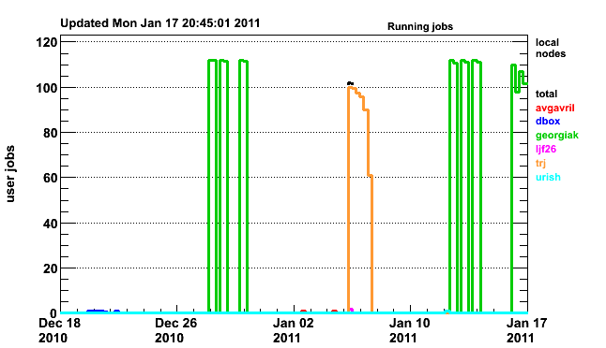
Batch Jobs on GPCF Cluster (month)
http://gpsn01.fnal.gov/condor_monitor/index_month_local.html

Slide 6
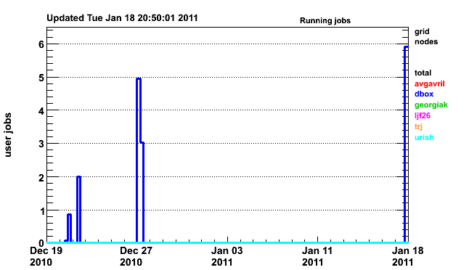
Batch Jobs on GRID (month)
http://gpsn01.fnal.gov/condor_monitor/index_month_grid.html

Slide 7
New Fermi GRID resources
New FY10 worker nodes have been well "burned in“
increasing the job slot allocations on the GP Grid cluster.
One possibility would be to "blindly" raise the job slot allocations as follows: Old New --- ---- 600 -> 1,000 300 -> 500 25 -> 50

Slide 8
Review of IF resource need projections CENTRAL DISK
 | 2010 | 2011 | 2012 | 2013 | 2014
MiniBooNE | 30 | 30 | 0 | 0 | 0
MINOS | 30 | 30 | 30 | 30 | 30
SciBooNE | 0 | 0 | 0 | 0 | 0
MINERvA | 20 | 40 | 30 | 30 | 30
Argoneut | 0 | 0 | 0 | 0 | 0
NOvA | 26 | 30 | 100 | 200 | 200
MicroBooNE | 0 | 5 | 23 | 0 | 0
LBNE | 2 | 18 | 10 | 10 | 10
Mu2e | 2 | 0 | 0 | 2 | 2
g minus 2 | 8 | 0 | 0 | 0
(EOL Replace) | 30 | 30 | 30 | 30 | 30
Total | 148 | 183 | 223 | 302 | 302

Slide 9
Review of IF resource need projections GRID SLOTS
 | 2010 | 2011 | 2012 | 2013 | 2014
MiniBooNE | 0 | 0 | 0 | 0 | 0
MINOS | 0 | 0 | 0 | 0 | 0
SciBooNE | 0 | 0 | 0 | 0 | 0
MINERvA | 75 | 200 | 0 | 0 | 0
Argoneut | 5 | 0 | 0 | 0 | 0
NOvA | 95 | 200 | 300 | 100 | 100
MicroBooNE | 0 | 30 | 30 | 0 | 0
LBNE | 50 | 100 | 50 | 50 | 50
Mu2e | 2 | 2 | 16 | 50 | 50
g minus 2 | 0 | 0 | 0 | 0 | 0
Replacements | 0 | 340 | 0 | 0 | 0
Total | 227 | 872 | 396 | 200 | 200

Slide 10
Maintenance Day Tomorrow (1/2)
IF/GPCF/GPVM/MB
The usual kernel updates and reboots.
Remount any altered BlueArc areas, if they were not available before a node was rebooted.
FermiGrid schedule: 1) adjust automount maps to reflect the changes in MINOS partitions on the bluearc. (work) 2) Kernel updates on all GP Grid head nodes and submission nodes (work) 3) removal of nfs-mounted auto.fnal mount in GP Grid yp server (work) and replacement with upsupdbootstrap rpm on all workers (FEF) 4) upgrade/reinstall of all remaining SLF4 GP Grid worker nodes to SLF5 (FEF).

Slide 11
Maintenance Day Tomorrow (2/2)
Central Storage (BlueArc) work
Perform Final Data Replication / Cutover. Tentatively scheduling for 1/20/2011 during normal Minos downtime. During the downtime, The following areas WILL NOT BE ACCESSIBLE: minos-nas-0:/minos/data minos-nas-0:/minos/scratch blue2:/minos/data
After final replication has finished, give Art Kreymer access to the new blue3:/minos/data area so he can move directories/symlinks around as needed. After Art Kreymer gives us confirmation that he is done, make the following new areas available to the minos collaboration: blue3:/minos/app blue3:/minos/data
FEF/local-sysadmins must re-mount these new areas *** These OLD AREAS WILL NO LONGER BE ACCESSIBLE *** minos-nas-0:/minos/data minos-nas-0:/minos/scratch blue2:/minos/dat
POST CHANGE: RECOVERY OF OLD AREAS Delete the old minos areas 2 weeks after cutover (02/03/2011) Implement snapshots (3 days queue) on Minos filesystems.

Slide 12
Next NuComp
February 10 or 17, 2011 (if we have topics to discuss)

Slide 13
finish

