Slide 1
Data analysis
Viktoriya Zvoda, Jan 27, 2011

Slide 2
QM 3 studies overview, LE033 data

Slide 3
QM 3 studies overview, E1LBNC data

Slide 4
A1 10-27-2010

Slide 5
A1 zoom 10-27-2010

Slide 6
A3 10-27-2010

Slide 7
A3 zoom 10-27-2010
FWHM=26urad

Slide 8
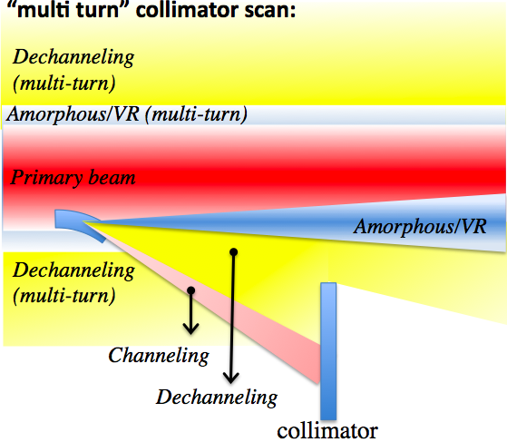
Principles of multi turn probability measurements in a circular machine
V.Previtali thesis

Slide 9
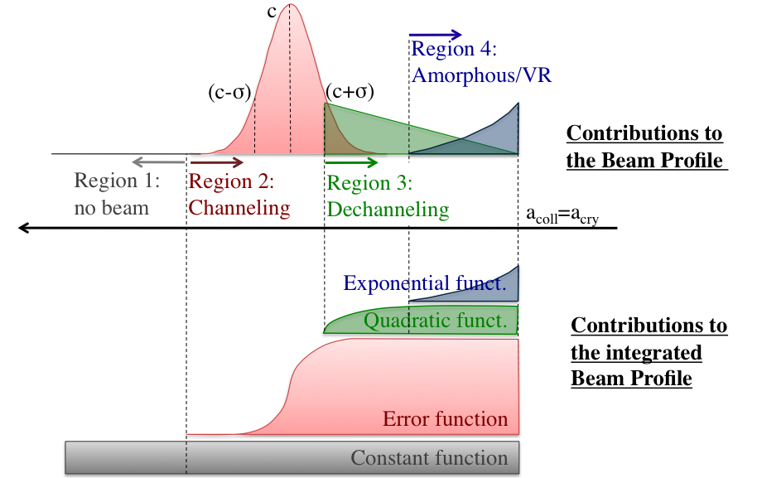
Contributions of different effects in collimator scan profile

Slide 10
Example of our collimator scan data

Slide 11
Normalized signal
A | 0.35418
Offset | 0.02144
CH efficiency | 68.692

Slide 12
LE033
date | scan # | A | A error | Offset | Offset error | CH eff, % | Ch eff error
10/21/2005 | C1 | 0.26245 | 0.01037 | 0.0575 | 0.0069 | 46.74 | 1.384
11/10/2005 | C1 | 0.34398 | 0.00648 | 0.0367 | 0.00457 | 65.126 | 0.839
10/3/2008 | C1 | 0.36938 | 0.0072 | 0.23913 | 0.0075 | 49.963 | 0.69
10/29/2008 | C1 | 0.338 | 0.0068 | 0.18645 | 0.00832 | 48.955 | 0.528
10/29/2008 | C2 | 0.36007 | 0.00926 | 0.13913 | 0.01117 | 58.101 | 0.735
10/29/2008 | C3 | 0.30507 | 0.00484 | 0.14168 | 0.00618 | 46.846 | 0.35
11/20/2008 | C3 | 0.33322 | 0.00765 | 0.22581 | 0.00711 | 44.063 | 0.819
12/10/2008 | C3 | 0.34903 | 0.01762 | 0.14531 | 0.01846 | 55.275 | 1.678
12/10/2008 | C10 | 0.3218 | 0.12204 | 0.2091 | 0.0053 | 43.45 | 23.878
12/10/2008 | C11 | 0.30408 | 0.0108 | 0.19625 | 0.00301 | 41.191 | 1.859
E1LABT
date | scan # | A | A error | Offset | Offset error | CH eff, % | Ch eff error
10/3/2008 | C1 | 0.30663 | 0.01206 | 0.04346 | 0.009 | 56.98 | 1.512
10/3/2008 | C2 | 0.23913 | 0.00716 | 0.04534 | 0.00505 | 43.292 | 0.927
10/29/2008 | C1 | 0.24007 | 0.01723 | 0.04273 | 0.00747 | 43.741 | 2.699
10/29/2008 | C2 | 0.20855 | 0.01266 | 0.03255 | 0.00552 | 38.455 | 1.98
11/20/2008 | C3 | 0.35418 | 0.00725 | 0.02144 | 0.00496 | 68.692 | 0.954
11/20/2008 | C6 | 0.25929 | 0.04525 | 0.08082 | 0.0035 | 43.776 | 8.7
12/10/2008 | C1 | 0.19698 | 0.02003 | 0.01328 | 0.00387 | 38.068 | 3.619
12/10/2008 | C2 | 0.1873 | 0.02238 | 0.03713 | 0.00636 | 33.747 | 3.84
12/10/2008 | C3 | 0.2484 | 0.01148 | 0.01056 | 0.01017 | 48.624 | 1.279
12/10/2008 | C5 | 0.35574 | 0.01931 | 0.0571 | 0.00589 | 65.438 | 3.273
12/10/2008 | C7 | 0.26722 | 0.00926 | 0.05699 | 0.00403 | 47.745 | 1.449
12/10/2008 | C8 | 0.31 | 0.08104 | 0.04507 | 0.0043 | 57.493 | 15.778
12/10/2008 | C9 | 0.2 | 0.07277 | 0.0324 | 0.00649 | 36.76 | 13.905
12/10/2008 | C10 | 0.32962 | 0.02142 | 0.03793 | 0.00548 | 62.131 | 3.736
12/10/2008 | C12 | 0.17105 | 0.00673 | 0.03034 | 0.00434 | 31.176 | 0.912

