Slide 1
Conference Area
Original CDR Scope: 4-25 person classrooms capable of reconfiguring to single 100 person classroom.
Furniture to be standard free-standing tables & chairs

Slide 2
Conference Area per CDR

Slide 3
Conference Area
Nov 2011: asked to consider expanding OTE Building Conference Area.

Slide 4
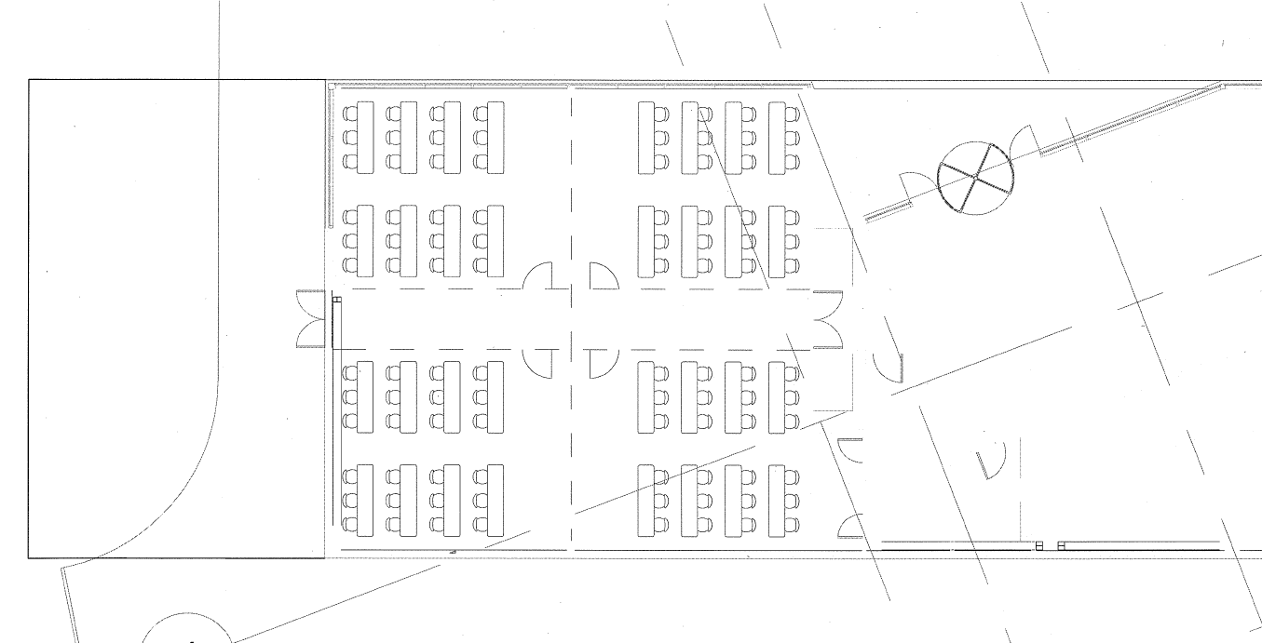
Conference Area Expansion
81’-0” +/-”
50’-3””
Proposed Expansion
Original CDR Conference rooms

Slide 5
Conference Area Scope Refinement
New Directions
175 person capacity
Desire for tiered or slope floor
Provide executive conference area suitable to hold FRA board meetings.
High quality w/ high level of a/v
Seating for 30 people at conference table + 30 people in chairs around perimeter
Breakout rooms
Secured break area
Dining

Slide 6
28Jan11 – Conference Enhancement Scope Meeting

Slide 7
Attendees
HOK
Scott Lumsden
Scott Stolarz
RBA
Michael Ross
Ross Barney
Fermilab
Bob Kephart
Rhonda Merchut
Gary Van Zandbergen
Reidar Hahn
Sheila Cisko
Randy Ortgiesen (p/t)
Kent Collins (p/t)

Slide 8
Discussion items
Lecture Hall furniture selection importance
Lecture space needs to be developed around desired furniture
Tablet arm vs. fix desk vs. motorized fixed desk
Fixed drop seating vs. post mounted seating vs. movable chair
Layout considerations (owner preference and priorities)
Size and alignment
Viewing site lines vs. distance to speaker
Level of finish clarity (level of acoustical treatment)
Amount of day lighting (based upon projected usage)
Budgetary impact (Furniture and Fixed equipment Cost)
Floor arrangement (Tiered vs. Sloped vs. Flat)

Slide 9
Discussion items
Impact to overall building (owner preference and priorities)
Support space increases (toilets, storage, pre-function, & food service)
Exit widths need increased (occupancy driven)
Budgetary impact to revise building core
Exterior image adjustments and proportion impact.
Layout considerations (owner preference and priorities)
Size and alignment
Support space increases (toilets, storage and food service)
Level of enhancement clarity
Budgetary impact

Slide 10
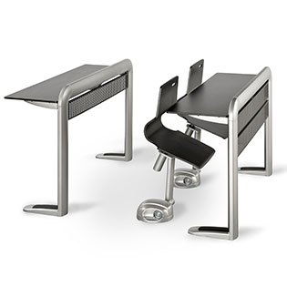
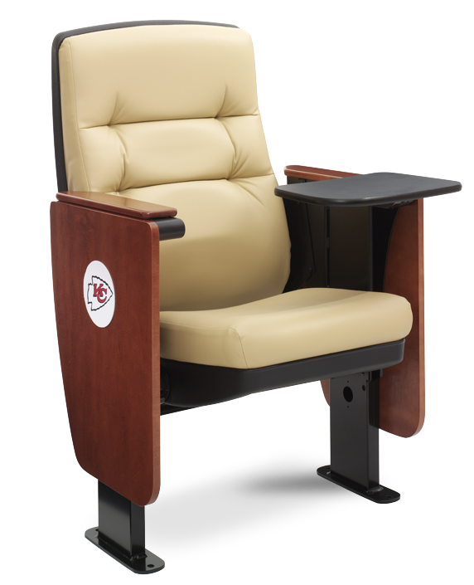
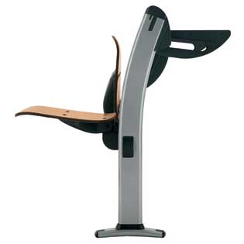
Lecture Hall Seating Options

Slide 11
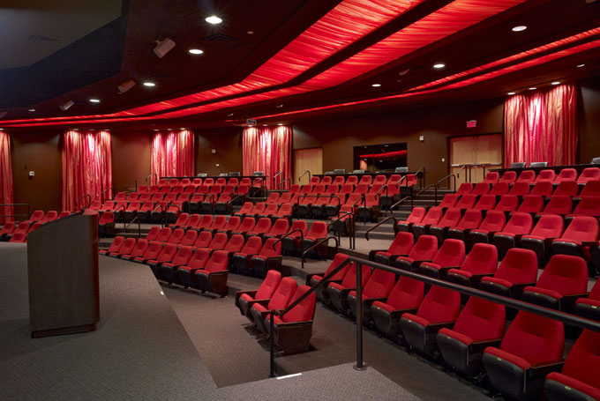
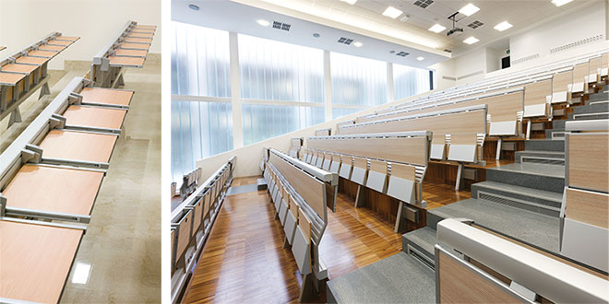
Lecture Hall Work Surface Options

Slide 12
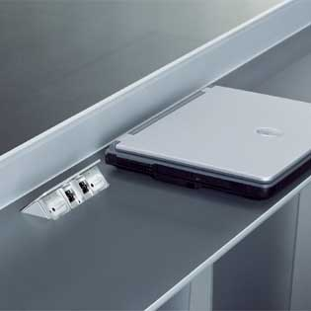
Lecture Hall Furniture Options

Slide 13
Lecture Hall Options

Slide 14
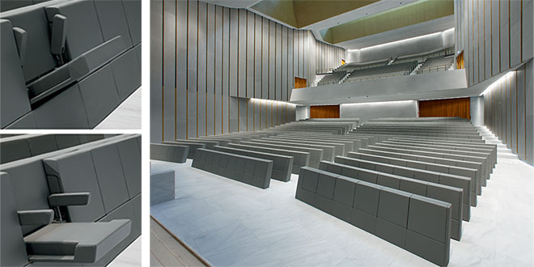
Lecture Hall Options

Slide 15
Lecture Hall Options

Slide 16
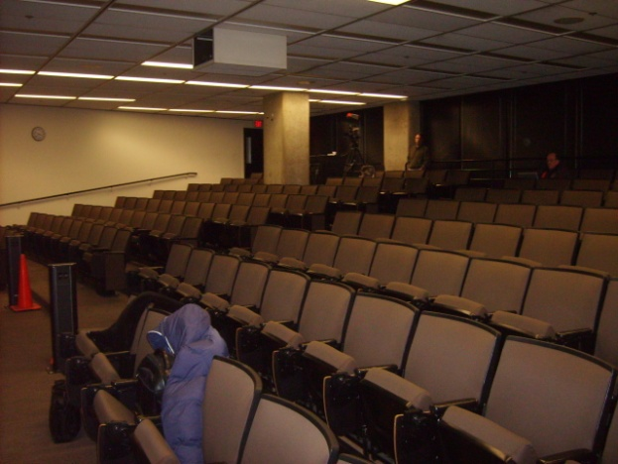
Drop in Option 1 – (sim. WH 1W)

Slide 17
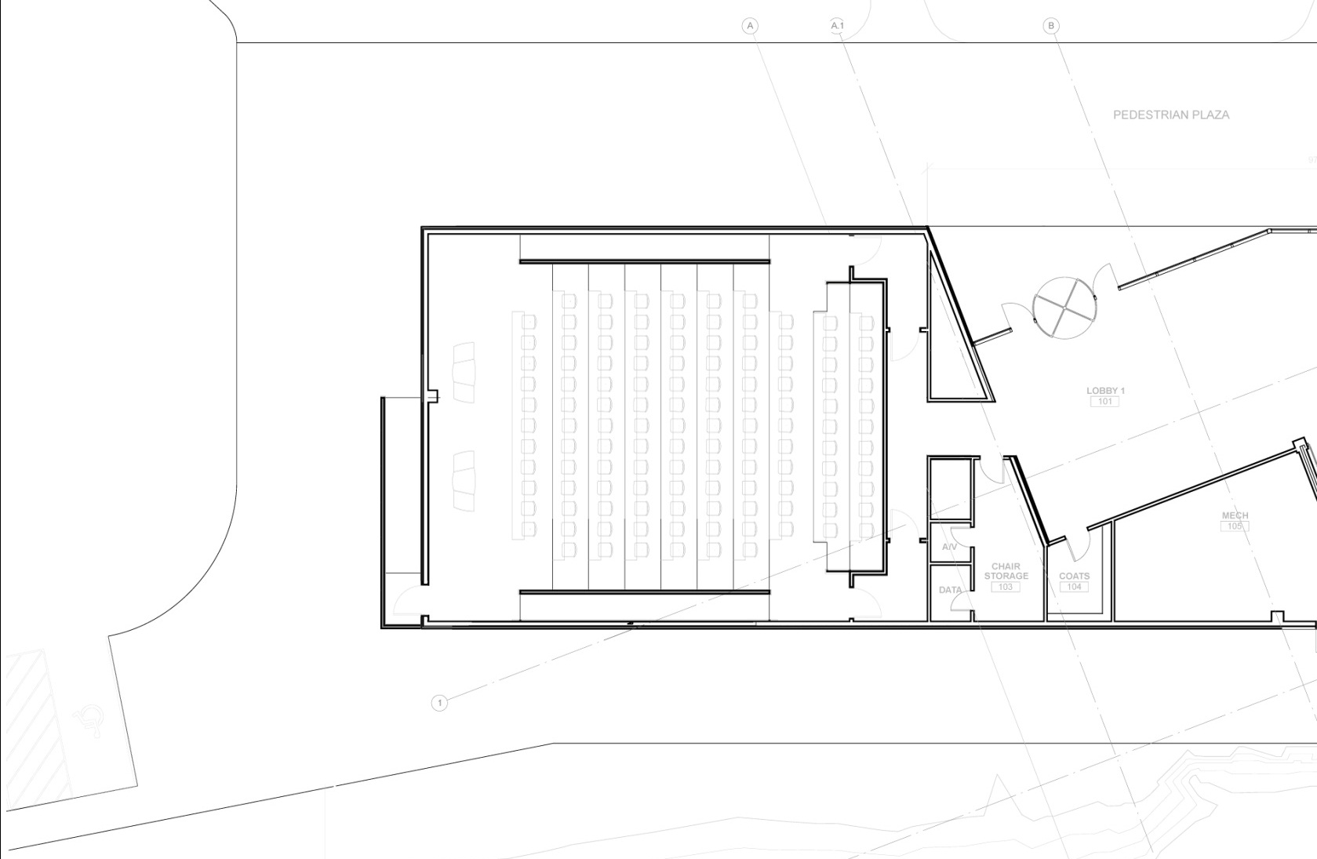
Drop in Option 2 – College of DuPage

Slide 18
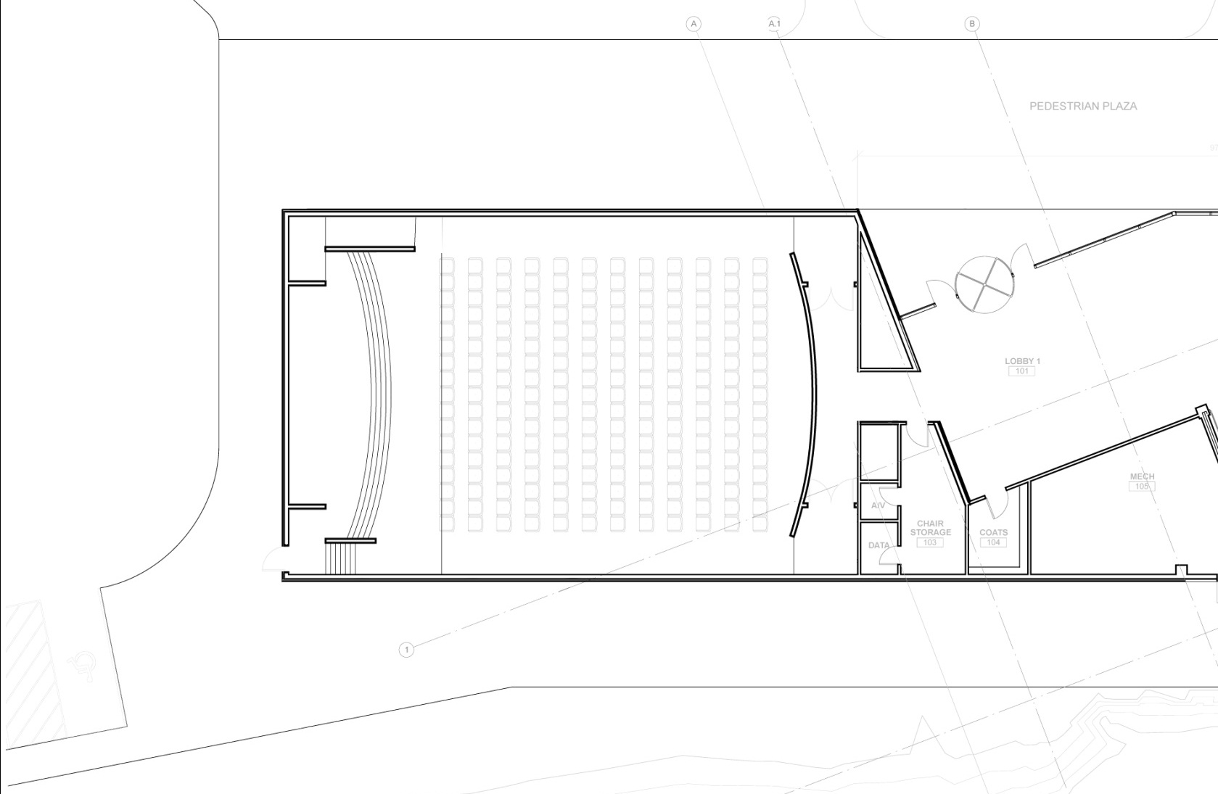
Drop in Option 3 – Slope Floor/Stage

Slide 19
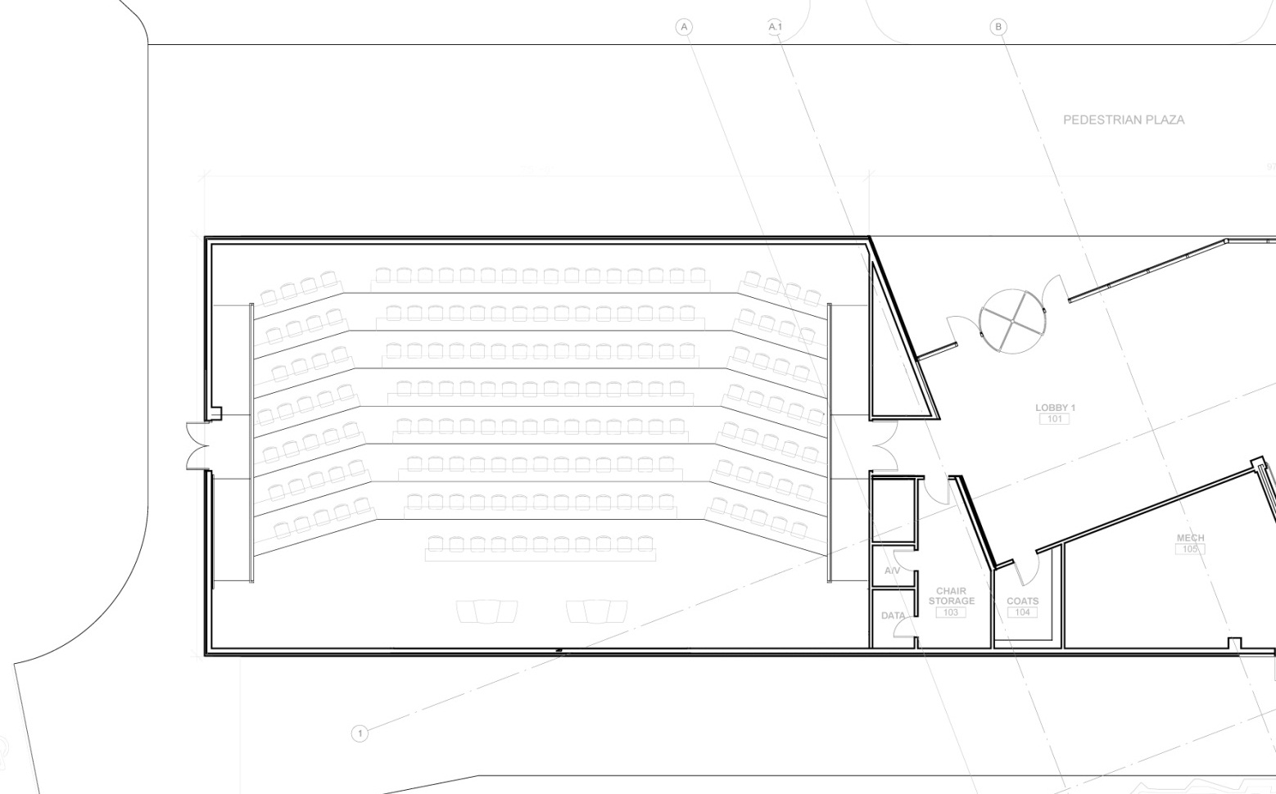
Option A -

Slide 20
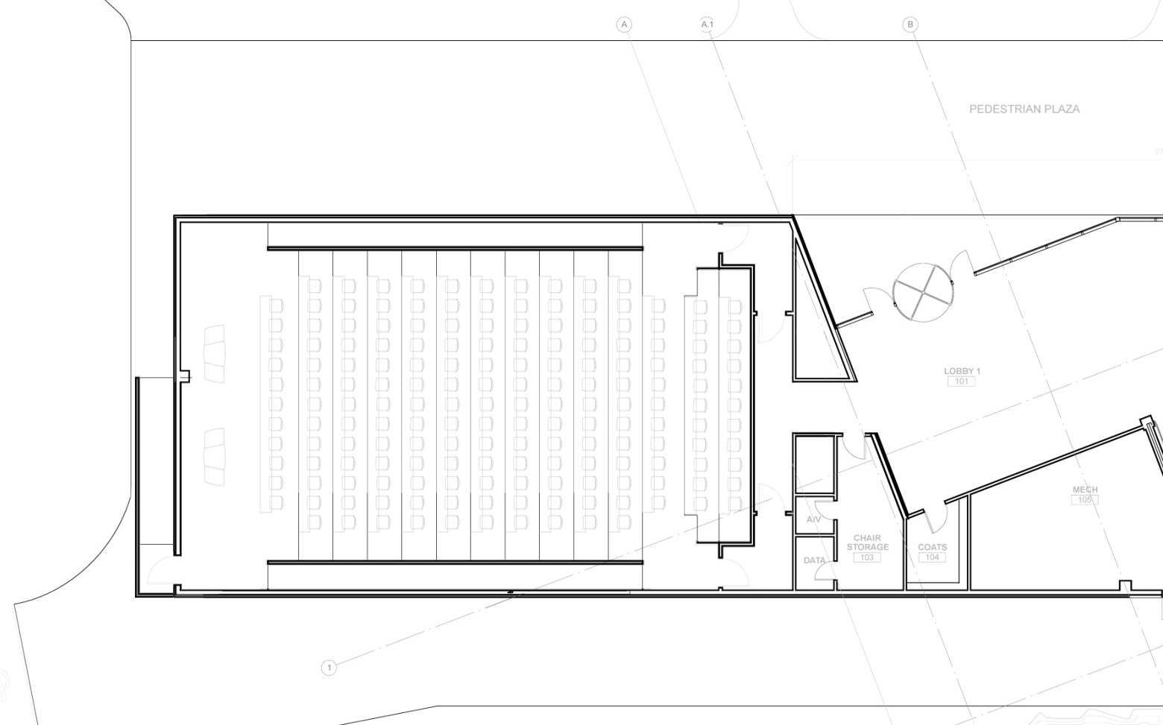
Option B -

Slide 21
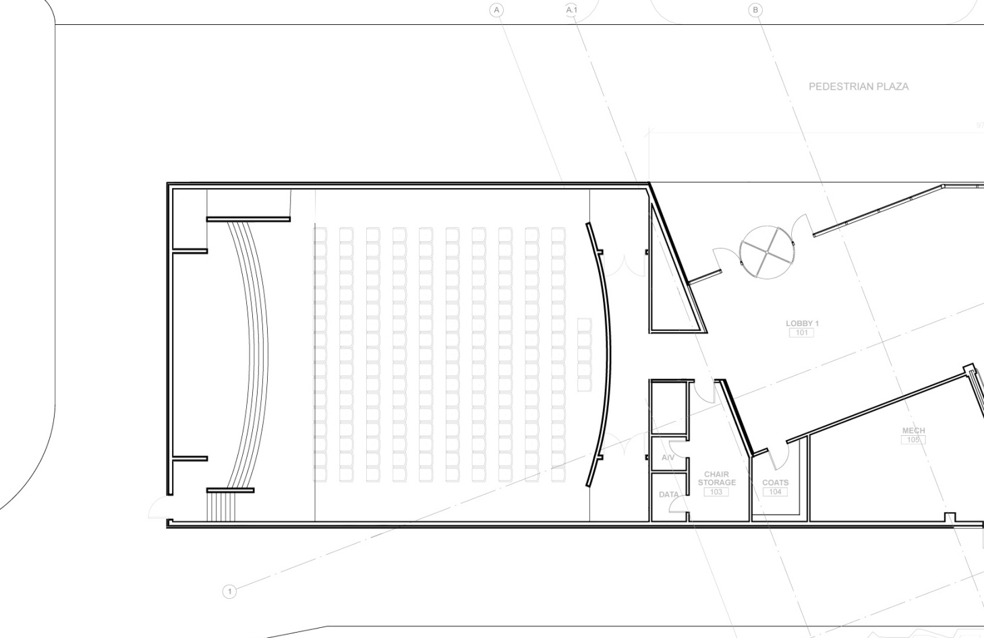
Option C -

Slide 22
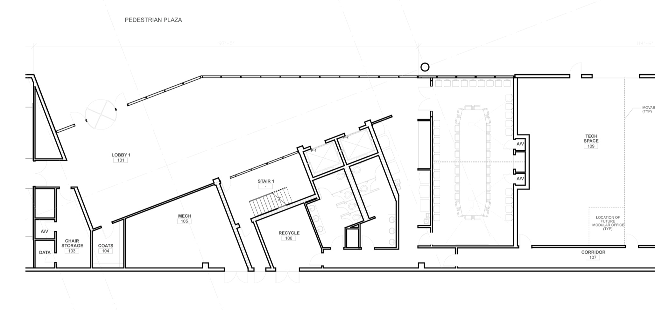
Conference 30/30 Option- A

Slide 23
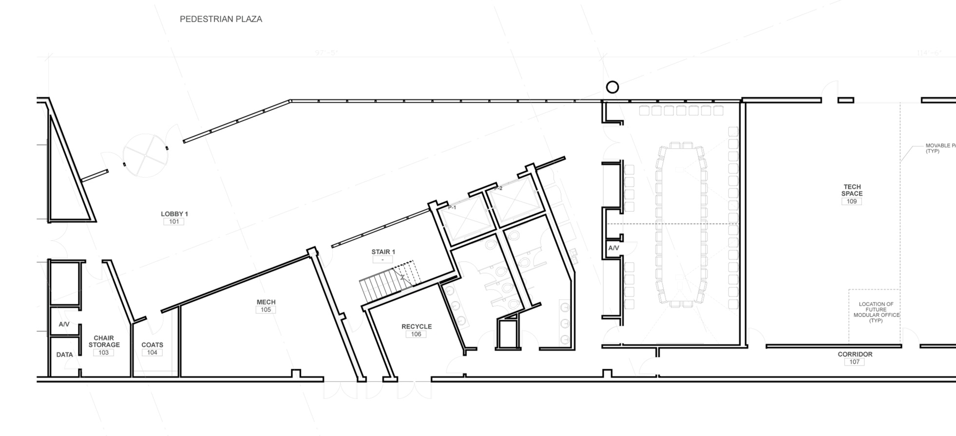
Conference 30/30 Option - B

Slide 24
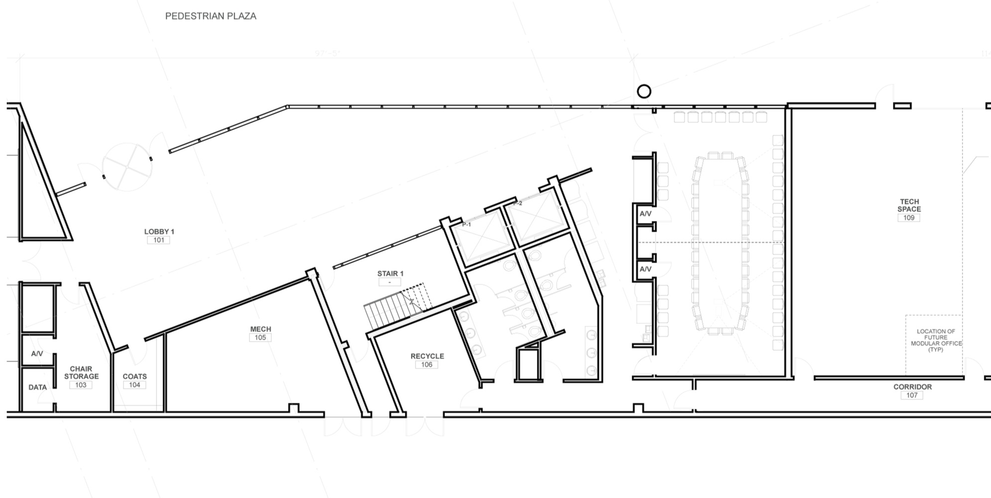
Conference 30/30 Option - C

Slide 25
Going Forward
Issue HOK RFP for full concept development, prepare change control doc’s.
Incorporate into building concept design
Impact to overall building (owner preference and priorities)
Finalize size and alignment
Building core & support space increases (toilets, storage, pre-function, & food service)
Exit widths increase (occupancy driven)
Exterior image adjustments and proportion impact.
Level of enhancement clarity
Budgetary & schedule impact

Slide 26
Exterior Impact & Fenestration

Slide 27
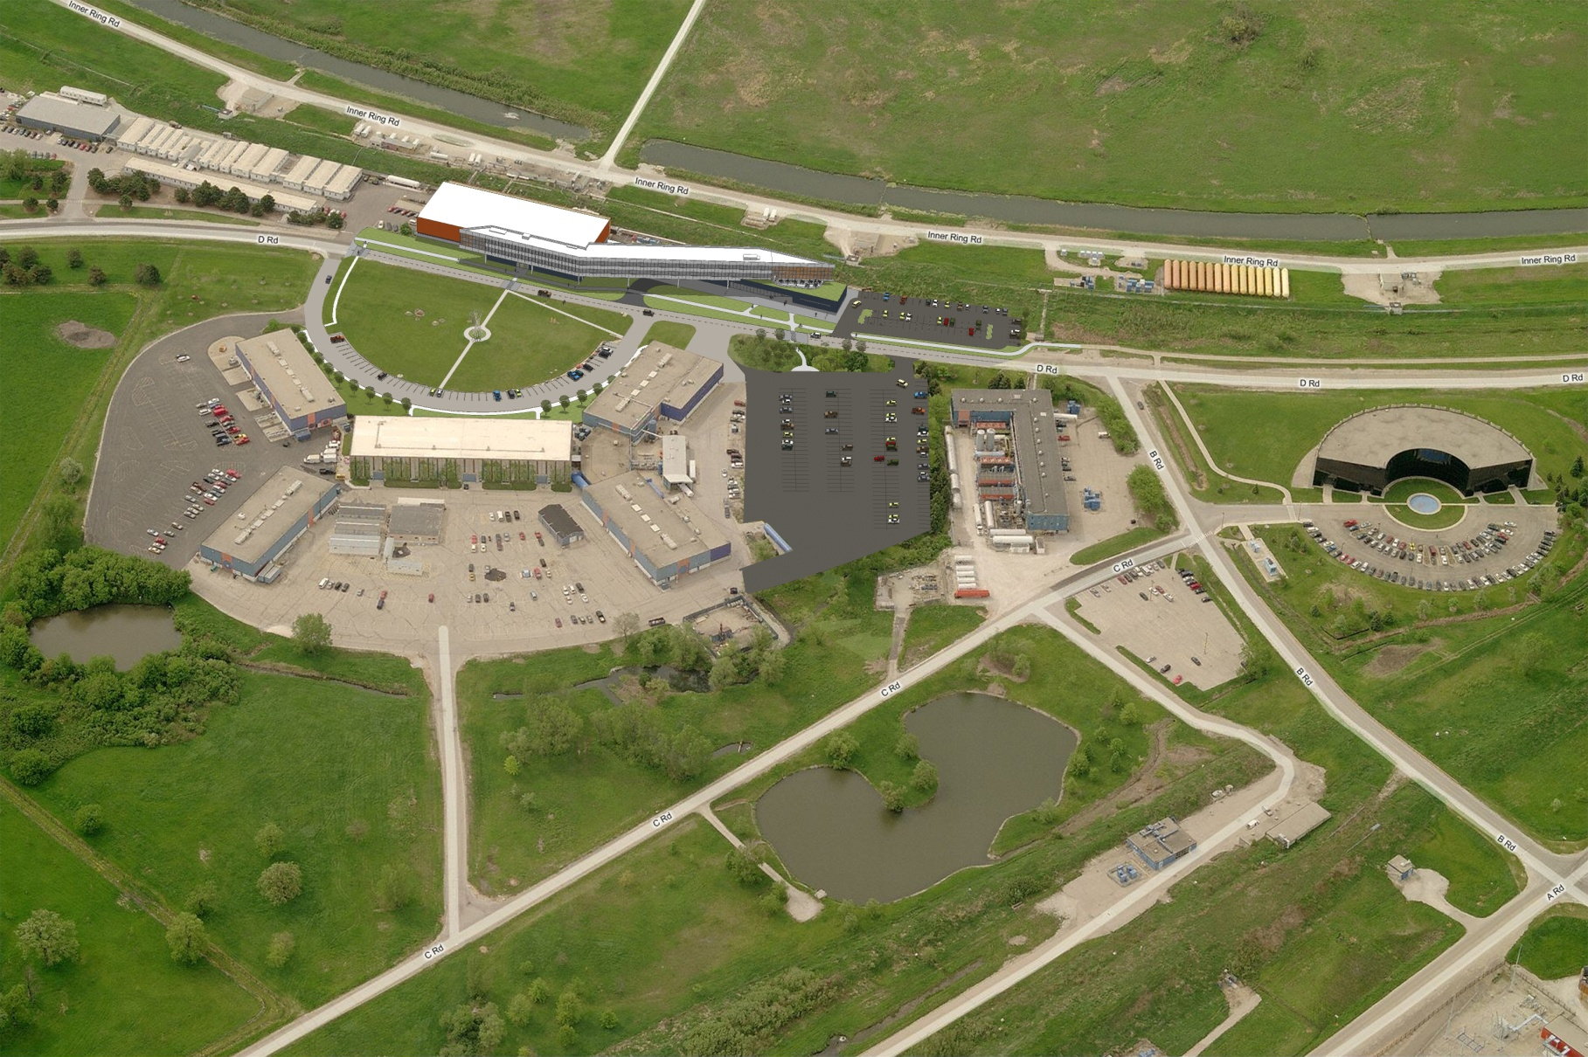
Site A

Slide 28
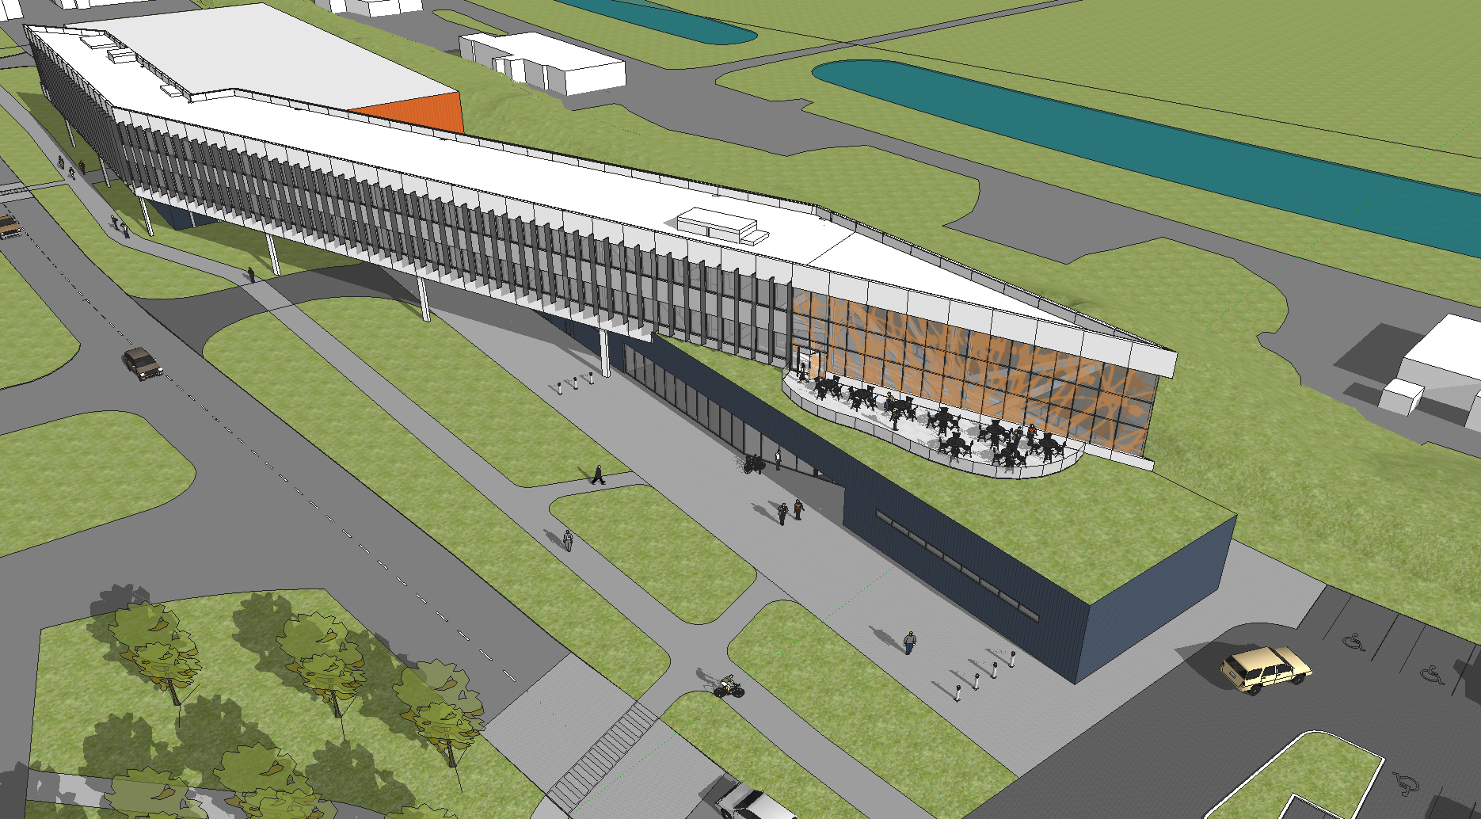
Image / Material Identity

Slide 29
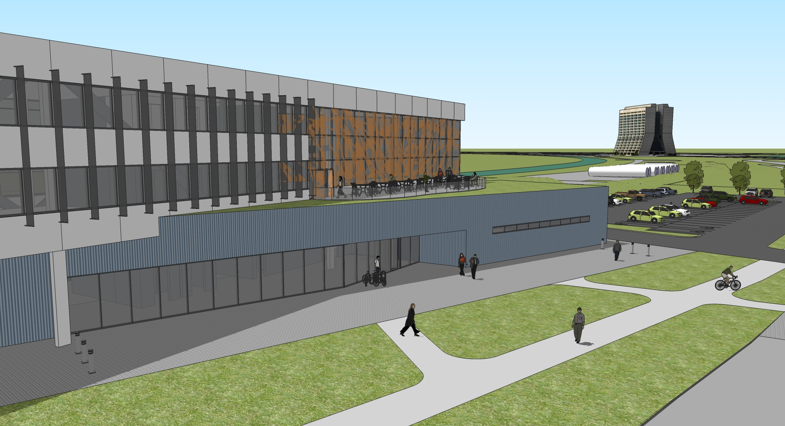

Slide 30
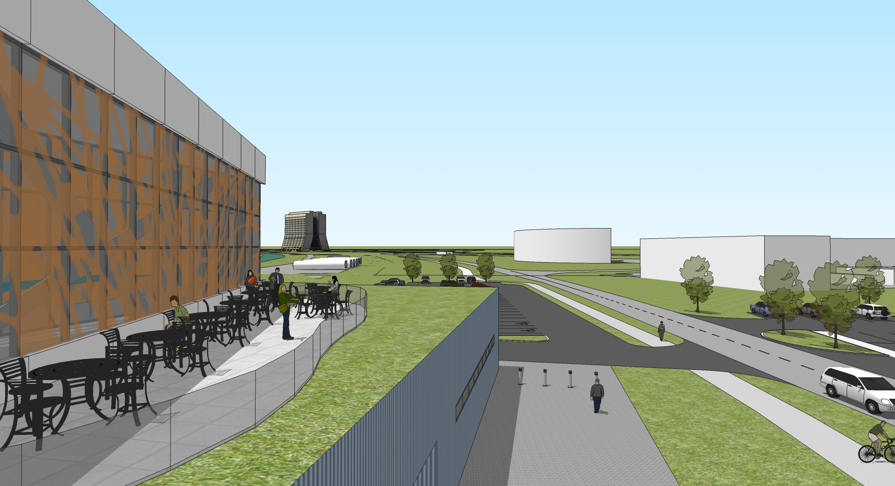

Slide 31
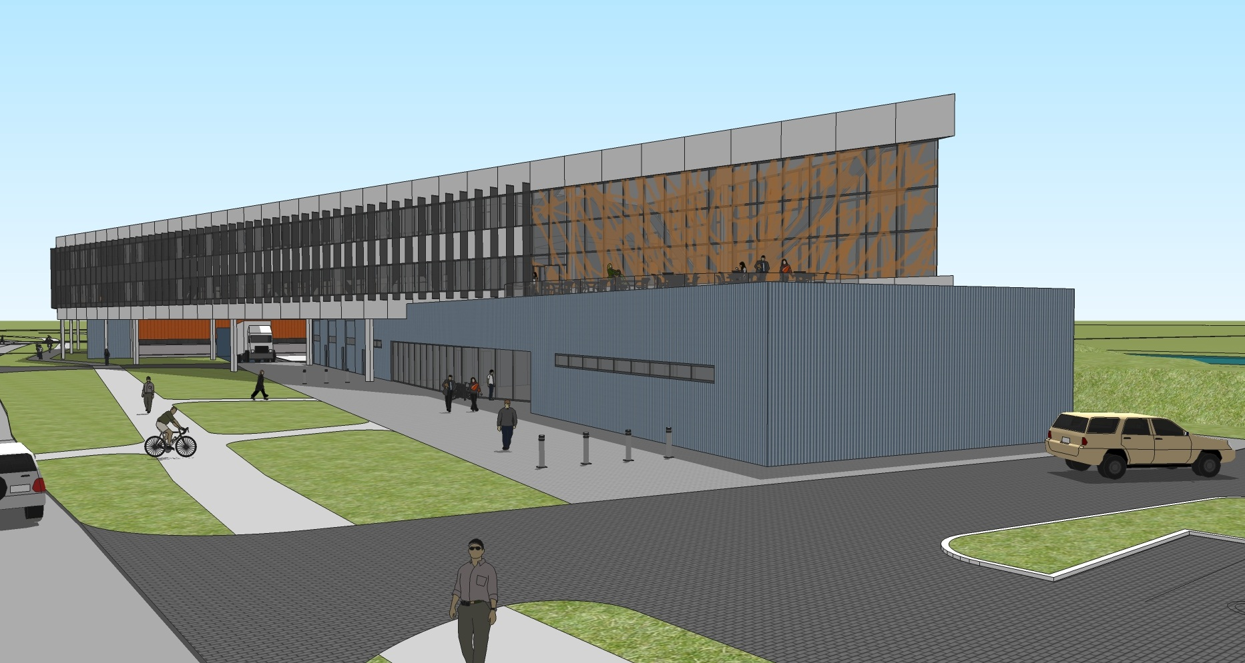

Slide 32
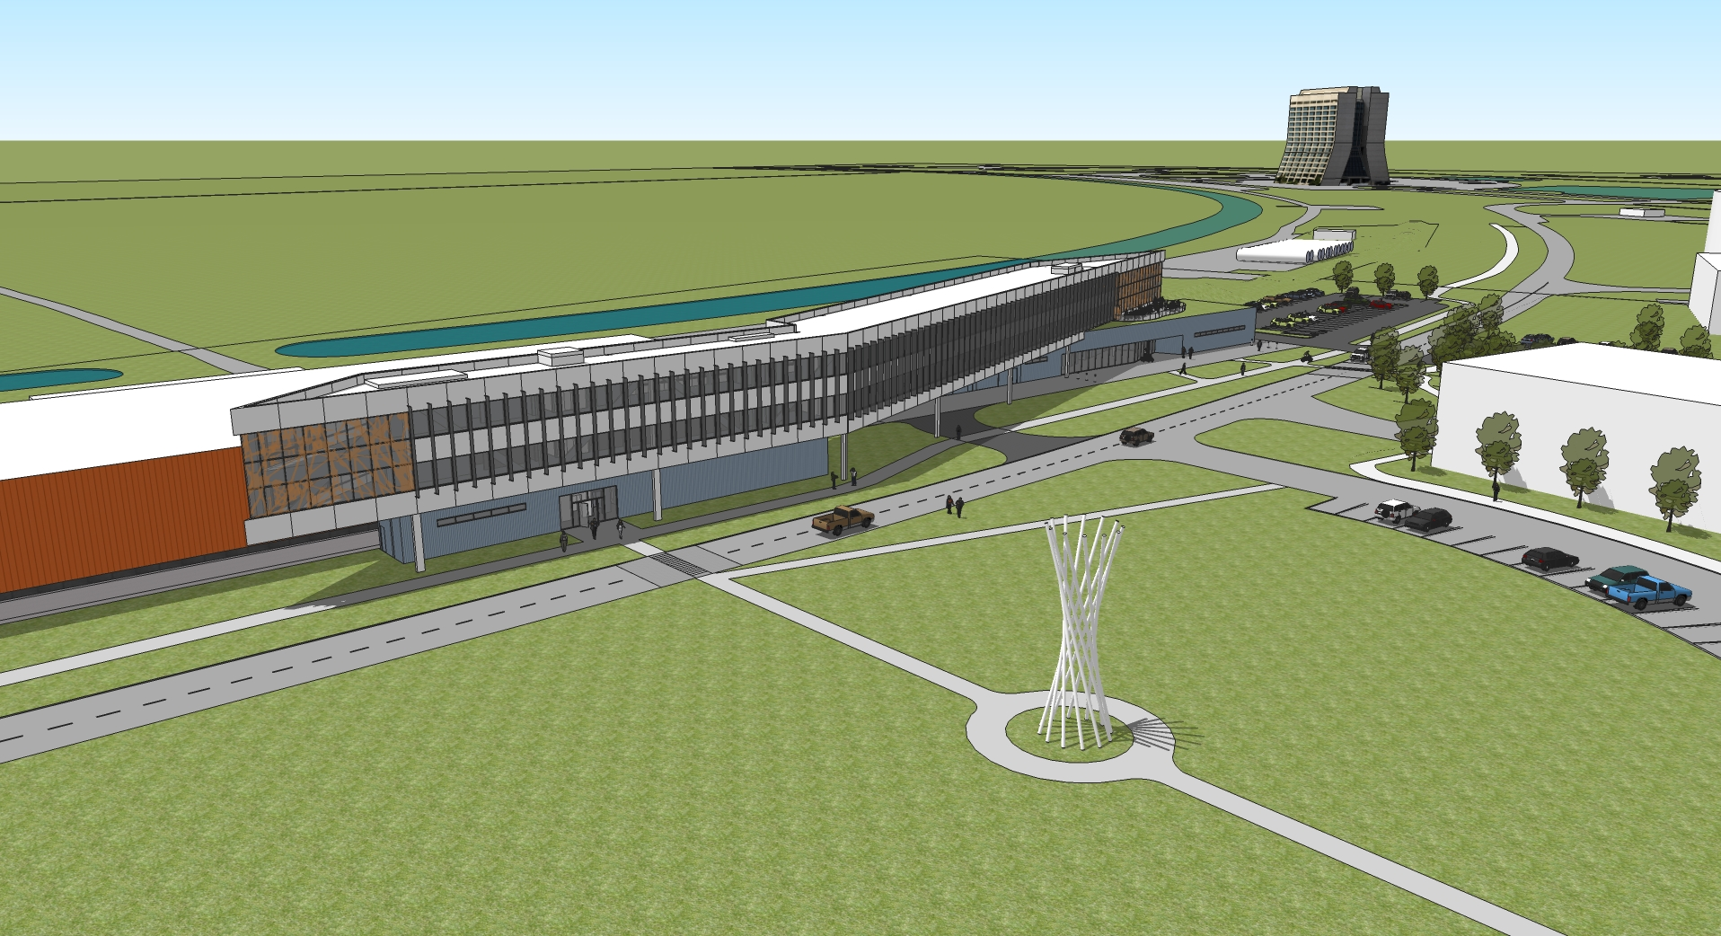

Slide 33
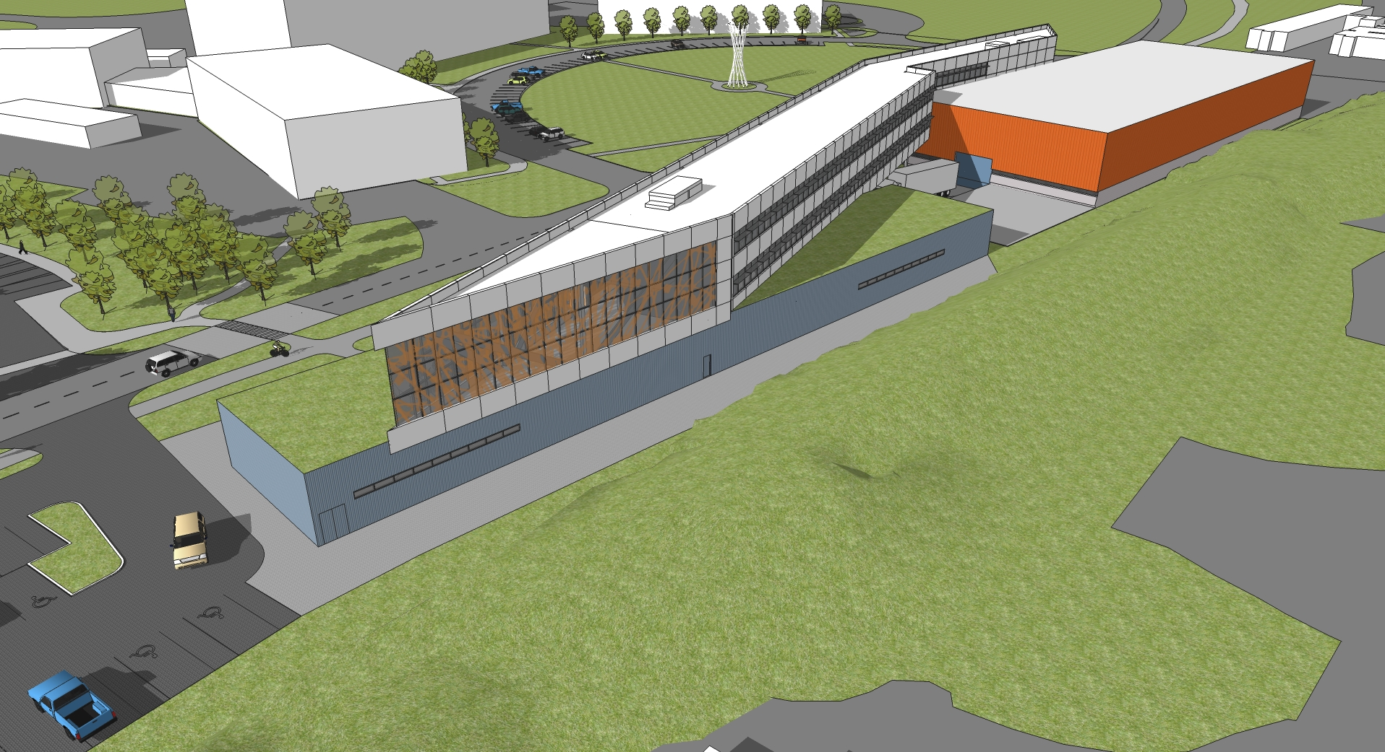

Slide 34
