Slide 1
OTE Building PMG Report 02/07/2011
(December 2010 & January 2011 update)
Rhonda Merchut

Slide 2
Overall Project Summary Status:
12/16/10 HOK team conducted all day CDR meeting including breakout meetings with RBA, Proj Dir, FESS-Eng, Ops, R&G, CDF, AD.
OTE bi-weekly (every other week) design meetings on-going. Includes HOK, RBA, FESS-Eng, Ops, Services, CDF, AD, CD

Slide 3
Overall Project Summary Status:
OTE Building Concept Validation Report draft review meeting held 1/26/11 w/ RBA, FESS-Eng, Ops, R&G, CDF, AD.
  (Final report rec’d 2/4/11.
“The HOK review of the OTE concept report, prepared by the RBA lead team, is very favorable as the documents and information provided were completed to point that allowed our verification studies to be conducted at an appropriate level for the conceptual phase.”
“Based upon our review of the concept design report HOK, and our affiliate engineers, recommend the project proceed forward and allow the preliminary phase effort to resolve any items that may need additional development, discussion, resolve and/or research.” )

Slide 4
Overall Project Summary Status:
OTE Design Coordination work by Ross Barney Architects (Design Concept Architects) underway.
OTE Building Preliminary Design base drawings underway

Slide 5
Overall Project Summary Status:
Evaluation of main ring bypass radiation shielding underway.
OTE Education/Conference Area scope evaluation underway.
Coordination of related projects on-going.

Slide 6
Table of Recommendations – Corrective Action Plan
# | Recommendations | Assigned to | Status/Corrective Action | Due Date | Closed
2.0 | Project Preparedness
2.1 | Cost and Scope
1. | The use of the DOE escalation rate for FY12 is not a recognized best practice. Facility and construction escalation costs have historically been significantly higher than DOE rates. It is recommended more appropriate escalation rates be used for the cost estimate. | Merchut | Comment withdrawn by J. Budd per email 10/14/10. 5.4% Escalation indicated in PP adequate. |  | 10/14/10

Slide 7
# | Recommendations | Assigned to | Status/Corrective Action | Due Date | Closed
2. | Additional scope items need to be identified, estimated, and prioritized so in the event favorable bids are received during the construction RFP a clear plan is in place for allocating the additional funds. | Merchut | Additional Scope items identification & design included as part of HOK scope of work. Postponed until prelim design complete | Prelim: 2/1/11 5/1/11 Final: 7/14/11

Slide 8
# | Recommendations | Assigned to | Status/Corrective Action | Due Date | Closed
2.1 | Cost and Scope
3. | Project currently plans include continuation of RBA as LEED project manager to insure the project obtains Gold certification. Project should consider assigning responsibility for LEEDs Gold certification as part of the HOK design contract. In the same manner that “design to cost” is a contract requirement, “design to LEEDs Gold” could also be a delivery requirement. | R. Merchut | LEED Manager responsibility to provide final design documents to achieve LEED Gold, with all supporting documentation, tracking, shop drawing verification, & final systems verification included in HOK scope of services. RBA project coordination RFP is to provide review & oversight of HOK LEED work. |  | 11/18/10

Slide 9
# | Recommendations | Assigned to | Status/Corrective Action | Due Date | Closed
2.0 | Project Preparedness
2.2 | Schedule
4. | Create an integrated overall IARC schedule which includes accelerator operation decision points, scheduled shutdowns, the utility upgrade project, and the OTE design and construction schedules. | R. Merchut B. Aprile AD CDF | Baseline integrated schedule for utility upgrade project and OTE created and will be updated and expanded on-going during final design & construction. Accelerator shutdown dates have not been determined - dependent on Tevatron run, funding. Start of construction scheduled after Tev close 9/30/11 | 6/2/11 | 11/10/10

Slide 10
# | Recommendations | Assigned to | Status/Corrective Action | Due Date | Closed
2.0 | Project Preparedness
2.2 | Schedule
5. | Review the OTE project schedule to assure that adequate time is included for performing reviews, addressing recommendations and obtaining signoff/approval of final procurement documents. | R. Kephart R. Merchut | The additional Director’s Review at the end of final design is incorporated into the schedule. Add’l time DOE approvals to be determined and added. | 5/6/11 | 11/10/10

Slide 11
# | Recommendations | Assigned to | Status/Corrective Action | Due Date | Closed
2.0 | Project Preparedness
2.2 | Schedule
6. | The impact of vibration due to construction on accelerator operations has not been clearly understood. The committee recommends pre-drilling a prototype casing foundation to measure the impact on operations. | R. Merchut CDF AD | Prototype caisson drilling will be performed when foundation design is better understood during final design phase. The timing of the prototype will be coordinated with AD & CDF, to insure drilling occurs during end of beam run. Schedules dependent on Tevatron run. Prototype caisson will NOT be pursued. Caissons work to be after 9/30/11. | Spring 2011 | 1/19/11

Slide 12
# | Recommendations | Assigned to | Status/Corrective Action | Due Date | Closed
2.0 | Project Preparedness
2.3 | Management and Oversight
7. | There should be CDF and AD people on the IPT. | R. Merchut P. Czarapata | Dervin Allen has been added for CDF. AD representative to be identified. Duane Newhart added as AD representative. | 12/15/10 | 12/15/10

Slide 13
# | Recommendations | Assigned to | Status/Corrective Action | Due Date | Closed
2.0 | Project Preparedness
2.3 | Management and Oversight
8. | Retain the Project Managers control over change to a reasonable level, and make the PMG function as the change control board for larger changes. This eliminates the separate change control board and removes the need to check with the PMG for changes that require broader consideration. | R. Kephart R. Merchut | The Project Plan has been revised to eliminate the separate Change Control Board. The PMG is now identified as the Change Control Board. |  | 10/29/10

Slide 14
# | Recommendations | Assigned to | Status/Corrective Action | Due Date | Closed
2.0 | Project Preparedness
2.3 | Management and Oversight
9. | Project management should convene a working group or mini-review where operations experts can work with the FESS to ensure the proposed building construction steps fit the schedule and minimally impact operations, e.g. CDF, TD, Road D, fire response, etc. | R. Merchut | To be conducted during Concept validation. Additional reviews will take place as the design develops | 12/30/10 7/14/11 | 12/30/10

Slide 15
# | Recommendations | Assigned to | Status/Corrective Action | Due Date | Closed
2.0 | Project Preparedness
2.3 | Management and Oversight
10. | There should be a review prior to submitting an RFP for the construction contract to ensure that the cost, schedule and interface conditions are well understood. | R. Merchut | A Director’s Review at the conclusion of Final Design has been added to the schedule. | 7/21/11

Slide 16
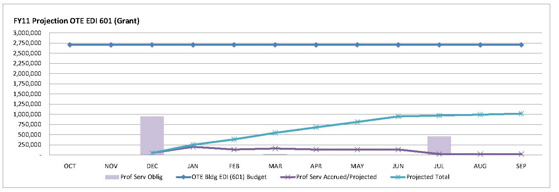
Fiscal – EDI Professional Services

Slide 17
Schedule
Resource loaded schedule in progress
Tracking Milestone | Definition | Target Date | Date Accomplished
OTE Building
CDR Complete | RBA delivers CDR document | 6-Oct-10 | 6-Oct-10
Director’s Review | Review by FNAL mgmt of Proj Plan | 13-Oct-10 | 13-Oct-10
Engineering Start | Proj Plan approved, directorate sign-off | 18-Nov-10 | 16-NOV-10
A/E start | Proposal negotiations complete, PO issued | 18-Nov-10 | 3-DEC-10
Concept Validation |  | 30-Dec-10 | 7-Feb-11
30% Final Design OTE building |  | 30-Mar-111
Pre-Final Design OTE Building |  | 8-June-11
CC Review Building Final Design |  | 29-June-11
Eng Drawings complete | CCR comments incorporated | 15-Jul-11
Director’s Review | Review by FNAL management for cost, schedule, & interface conditions per 10/13/10 Director's Review | 21-Jul-11

Slide 18
External Milestones
IASU: Final Design Complete 1/28/11 2/7/11
Accelerator Shutdown(s):
  Interim Shutdown 3/7/11thru 3/11/1 (9:00am): Install circuit breaker at CDF Panel PHP B012 for future San Sewer lift station (IASU).
  Final Close 9/30/11: Start Building construction after all systems shut down.

Slide 19
Risk Management
External Risk Status
FCC Sanitary Sewer Improvement project to be procured with IASU to have both projects under the control of one contractor.
IASU Wetlands investigation underway. Letter request for JD from DOE to COE sent o/a 1/6/11. Environmental consultant has indicated sites are isolated and do not appear to be COE-jurisdictional wetlands. Proceeding on this basis. Awaiting confirmation from COE.
IAU Oversight – Funding status

Slide 20
Procurements
Issue RFP for Conference Center Expansion Design
Issue RFP required for Thermal Conductivity Testing for Ground-Loop Heat Exchanger
Issue RFP for IASU/FCC San Sewer construction contracts.

Slide 21
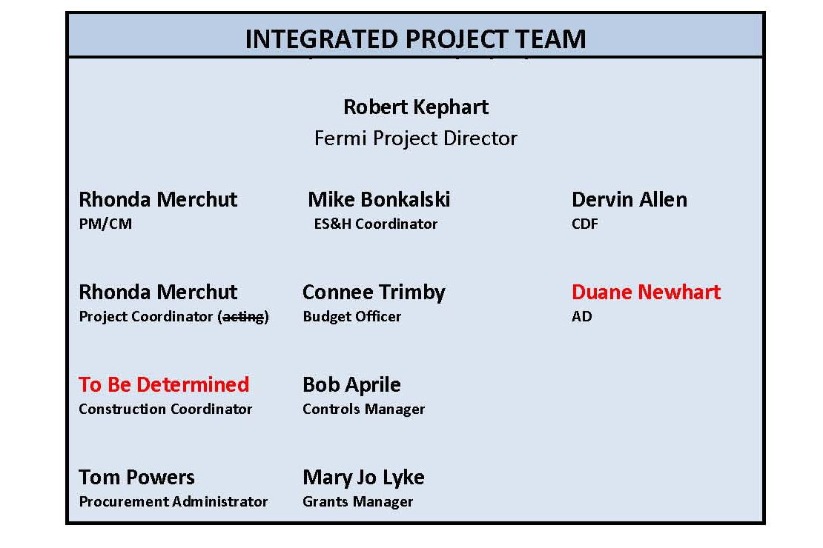
Labor Resources

Slide 22
Change Request
None at this time
Anticipated Future:
  Tiered Conference/Lecture Center for 175 people to replace current 4-25 person class rooms.
  30/30 Executive Conference Room in lieu of 1 Tech Space

Slide 23
Issues
Conference Room expansion scope finalization.
Wetlands impact from revised parking layout
Radiation – Main ring bypass.
Structural understanding of CDF snow loading, fire separation protection of roof.
DOE Directive for $2M – impact of full-year continuing resolution?

Slide 24
Look Ahead
Continue working on Integrated Project Schedule.
Continue with Preliminary Design
Exterior materials selection.
Refine Conference Center design including impact of life safety (exiting), plumbing fixtures (surge effect), mechanical systems.

