Slide 1
SPS transverse wideband feedback plans
under the LIU project
“ecloud feedback”
Hofle
16.05.2011

Slide 2
LHC Injector Upgrade Project
“LIU”
Chamonix 2010 → review of strategy for LHC injector upgrade,
change of strategy, focus on upgrade of existing
accelerators to remove bottlenecks (beam brightness!)
During 2010 → SPS Upgrade task force evaluated proposed projects for SPS
End of 2010: LIU project formed (Leader R. Garoby)
LIU-SPS project leader: B. Goddard

Slide 3
Goals and Means
LIU-Project:
To increase performance
Brightness ä
Increase injection energy in the PSB from 50 to 160 MeV, Linac4 (160 MeV H⁻) to replace Linac2 (50 MeV H⁺)
Increase injection energy in the PS from 1.4 to 2 GeV, increasing the field in the PSB magnets, replacing power supply and changing transfer equipment
Upgrade the PSB , PS and SPS to make them capable to accelerate and manipulate a higher brightness beam (feedbacks, cures against electron clouds, hardware modifications to reduce impedance…)
To increase reliability and lifetime (until ~2030!)
(tightly interleaved with consolidation)
Upgrade/replace ageing equipment (power supplies, magnets, RF…)
Procure spares
Improve radioprotection measures (shielding, ventilation…)
R. Garoby
March 2011

Slide 4
SPS-LIU Organization
Beam dynamics
Instabilities
Intensity limitation studies
Impedance
Longitudinal issues
Feedbacks
Simulations
Specifications
RF system upgrade
Wide bandwidth FB
e-cloud limits
Impedance upgrade
Instrumentation
e-cloud mitigation
Mitigation necessity
Surface treatments
Aging studies
Vacuum issues
Simulations
Specifications
Coating technology
Magnet chambers
Instrumentation
Beam loss, protection, TLs
Beam loss scenarios
Collimation studies
Scraper studies
Beam dump design
Extraction protection
TL and LHC injection protection
Specifications
Collimation system
Scraper upgrade
Beam dump
Instrumentation
Extraction diluters
TL protection devices
B. Goddard
March 2011
E.Shaposhnikova
J.M.Jimenez
M.Meddahi
Operational issues
Beam deployment
Radioprotection
General services
Powering
Layouts and DBs
Optics files
Integration
Planning
EVM, APT, MTP
Shutdown coordination
Consolidation
Safety, risk
B.Goddard (deputy E.Shaposhnikova)
LIU-SPS coordination meeting
Hardware and other implementation workpackages
200 MHz RF
Magnet chamber e-cloud mitigation
Collimation system
Wide band feedback
Beam instrumentation (SPS and TLs)
RF low level control upgrade
ZS test area
Extraction diluters
Transfer line collimators
Scraper upgrade
Beam dump relocation/redesign
Further impedance reduction
New extraction kickers
ZS upgrade
Update layout and optics DB
Update of drawings

Slide 5
Timeline for project deliverables
For 2011/12
  LHC nominal beam ready for all spacings
  Studies with nominal emittance, ultimate intensity
  Studies with small emittance, nominal intensity
For 2014 startup (after LS1)
  Ultimate intensity, nominal emittance with 50 ns and 75 ns beams
  Studies with lower emittances/ultimate intensity
For 2018 startup
  Ultimate intensities and 2.5 um emittance for 50 and 75 ns beams
  Ultimate intensities and nominal emittance for 25 ns beam
  Studies with lower emittances/higher intensity
B. Goddard
March 2011

Slide 6
Preliminary timeline – long 2013 shutdown
B. Goddard
March 2011

Slide 7
How can transverse feedbacks help achieving LIU goals ?
Existing coupled bunch transverse feedback system (1)
existing transverse feedback for SPS a “must” ← coupled bunch instabilities above
5x10¹² protons total intensity (resistive wall impedance, stainless steel chamber)
LHC nominal beam has a maximum of 3.3x10¹³ protons total intensity in the SPS
fast growth rates (number !) mitigated partially by choice of low fractional tune
H: 26.13, V: 26.18
existing SPS transverse feedback last upgraded end of 90’s, bandwidth up to 20 MHz,
damping times for lower frequencies as fast as 0.5 ms (20 turns)
upgrade of existing transverse feedback also planned under LIU project

Slide 8
How can transverse feedbacks help achieving LIU goals ?
Existing coupled bunch transverse feedback system (2)
specifications for this upgrade are under study
clearly upgrade will include more modern digital processing with online
diagnostics options as realized in the LHC transverse feedback system
increase number of bits for digitization (from 12→ 16) → better S/N ratio
improved performance for single bunch operation (peak hold on bunch)
contribute to better conservation of emittance, in particular important for
studies with high intensity, small emittance bunches

Slide 9
New wide band transverse feedback system (1)
addresses transverse oscillations within bunches that may or not
be correlated to motion of adjacent bunches , focus on vertical plane
complementary to existing transverse feedback
two different types of instabilities are addressed:
TMCI - transverse mode coupling instability - impedance driven
single bunch effect, occurs beyond ultimate bunch intensity
(ultimate in LHC is 1.7x10¹¹ per bunch)
ecloud – single bunch instability occurring with trains of bunches
is problem for emittance beyond nominal intensity per bunch
for 25 ns bunch spacing (nominal in LHC is 1.15x10¹¹ per bunch)

Slide 10
New wide band transverse feedback system (2)
Study under LARP:
demonstrate the feasibility of damping head-tail motion with a feedback system:
leading to final specifications for a full system
LARP study complements CERN effort, allows CERN to profit from experience in
US labs, in particular with fast digital techniques (hardware effort very much appreciated)
LIU project also considers the following mitigations:
ecloud: coating of the vacuum chambers → expensive large, scale project
TMCI: low γ_{T} optics (integer tunes 26→20), but higher RF voltage will be required
advantages of feedback:
has moderate cost when compared to above upgrades
can be switched off and on according to needs
demonstration in SPS would also be a prerequisite for consideration of such a system
in LHC, should a need to have it come up

Slide 11
Resources under LIU project
for transverse feedbacks in SPS
combined resources in proposals currently earmarked for transverse feedbacks
(wideband and upgrade for existing TFB):
suggested timeline: complete construction 2015, commissioning in 2016
10 man-years (CERN staff)
2.3 MCHF (with some additional overhead depending on choice of location)
plus contribution of LARP for R&D in the framework of the feasibility study
resources include a work package to relocate the existing transverse dampers
location in ring for wideband transverse FB and relocation of existing FB
strongly depends on the amount of power needed for the wide-band
(ecloud) FB
specifications and design report in 2013, natural decision point to go forward

Slide 12
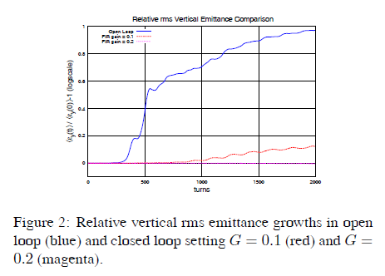
WARP simulation results (LARP)
“rms beam size” evolution:
cured for high gain
R. Secondo et al.
PAC ‘11

Slide 13
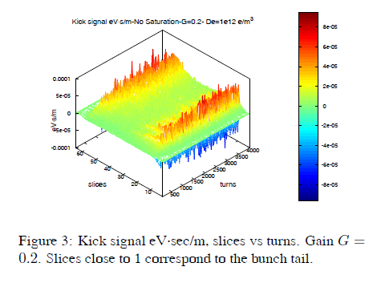
WARP simulation results (LARP)
kicks needed from wide band FB are
large for head and tail, but constantly needed
(surprise, driven by numerical noise ?!)
important to understand for estimate of required kick strength
correct specification of
kick strength essential
to decide on location
In SPS ring
→ scale of power system
R. Secondo et al.
PAC ‘11

Slide 14
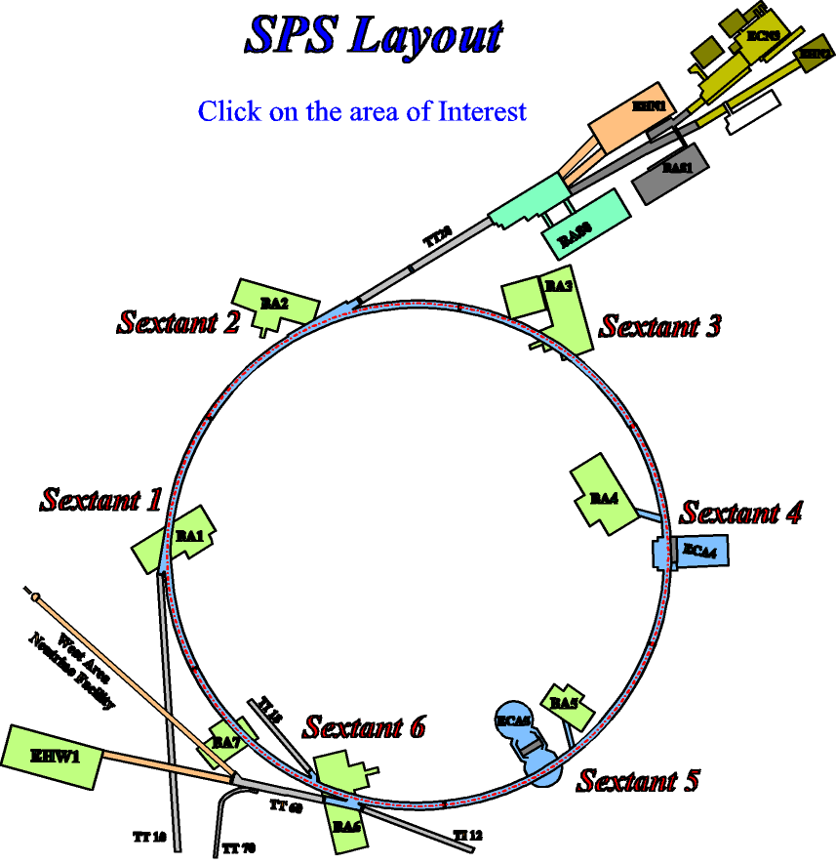
Possible locations for transverse feedbacks in SPS
base line location
for wide band TFB
slow extraction
radiation high
current transverse FB
RF, low radiation
injection
extraction CNGS/LHC
special instrumentation
no RF infrastructure
LSS3 layout to be studied
by working group under LIU
led by E. Montesinos (BE-RF)
extraction LHC
alternative location

Slide 15
transverse feedbacks
3
3
Cavities (200 MHz and 800 MHz, LIU upgrade)
→ being analyzed by LIU project
800 MHz
4
3
3
800 MHz
4
transverse feedbacks
future layout option for SPS LSS3

Slide 16
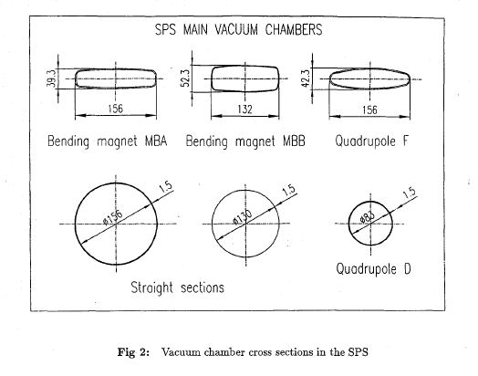
SPS aperture

Slide 17
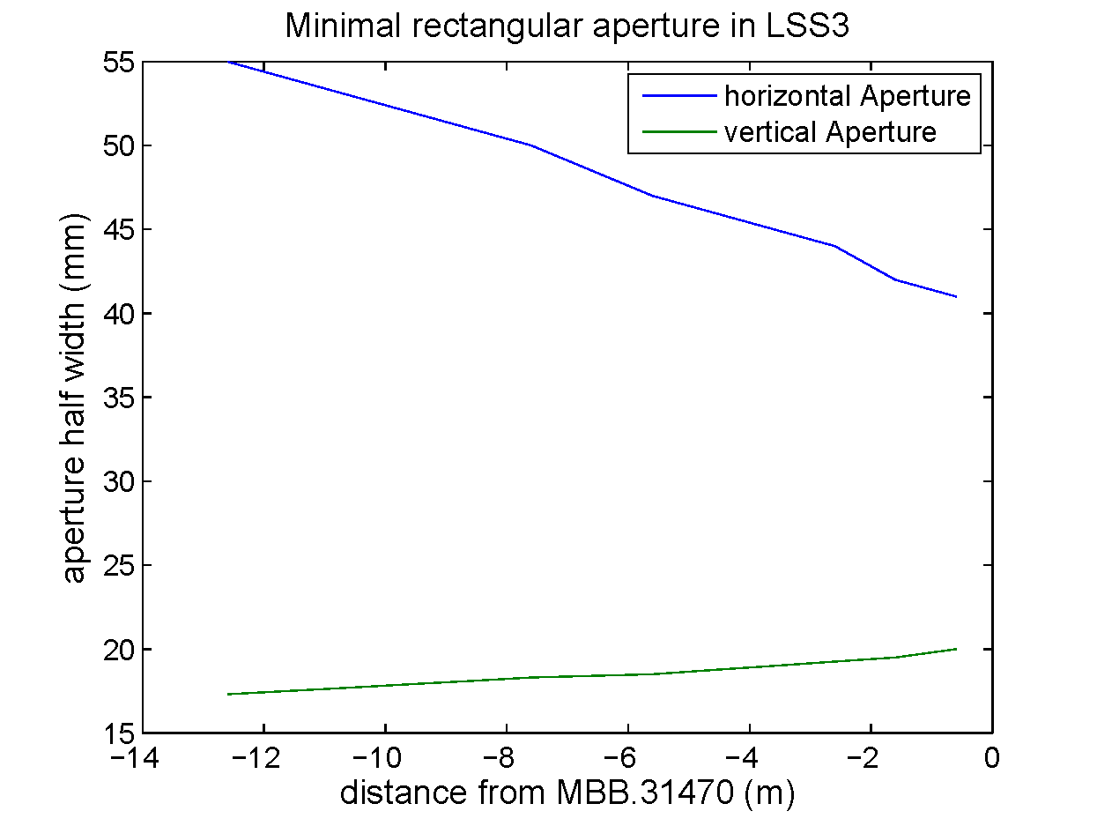
Aperture available for feedback kickers
and pick-ups in dispersion suppressors
aperture available
determined by fixed
target beams (14 GeV/c)
circular or rectangular
vacuum chamber possible
→ input to design of kicker
H. Bartosik
Y. Papaphilippou

Slide 18
SPS layout considerations
Pick-up close to QD
installing new pick-up at QD with circular aperture
high vertical beta function (~100 m)
frequency reach: 83 mm diameter: cut-off: 2.1 GHz
Not so many free locations in LSS3
Kickers close to MBB magnets ?
MBB: flat more rectangular chamber, better for vertical kicker:
cut-off frequency of relevant TE mode (132 mm width): 1.2 GHz
good if bandwidth < 1 GHz
Scenario under discussion:
new pick-up(s) as CERN project under LIU
design study / construction of a kicker as a joint LARP/CERN effort
space considerations: more freedom in LSS5 than in LSS3
added cost for LSS5, but lot’s of space available for amplifiers in the tunnel
LIU project need to come to conclusion on LSS3 options

Slide 19
Focus simulations on requirements for kick strength
Initial simulations with Headtail (gain, bandwidth) → FB feasible
recent results from WARP code confirm feasibility, questions about
kick strength required remain very important (see previous talks)
cross check with CMAD (SLAC) ongoing
resume Headtail simulations with FB at CERN ?
→ will discuss tighter coordination and options at this LARP meeting
sending student from US to CERN for short period of time, is it an option ?
advantage of Headtail → contains impedance model of SPS,
applicable to TMCI and combined effects (multi-bunch / single-bunch)

Slide 20
Summary
LIU project supports R&D for wideband feedback, part of baseline
Resources are foreseen to complete demonstrator for wide band feedback
Question on required kick strength very important to judge on final cost
and chose a layout option for the tunnel (LSS3 versus LSS5)
LARP hardware effort very much appreciated, opens door to probe bunch dynamics
in machine studies, logical next step after the simulations

