Slide 1
LHC Synchrotron-Light Monitors:
Status and Possible Upgrades
Alan Fisher
SLAC National Accelerator Laboratory
LARP CM16
Montauk, NY
2011 May 17

Slide 2
CERN Collaborators
Stéphane Bart-Pedersen
Andrea Boccardi
Enrico Bravin
Stéphane Burger
Gérard Burtin
Ana Guerrero
Wolfgang Hofle
Adam Jeff
Thibaut Lefevre
Malika Meddahi
Aurélie Rabiller
Federico Roncarolo
I want to thank Federico and Adam for sending data taken since my last visit in January.

Slide 3
Synchrotron-Light Monitors
Four applications:
  BSRT: Imaging telescope, for transverse beam profiles
  BSRA: Abort-gap monitor
    Verifying that the gap is empty
    Monitoring RF cleaning of the gap
  LDM: Longitudinal-density monitor
  Halo monitor (possbile upgrade)
Two particle types:
  Protons
  Lead ions
Three light sources:
  Undulator radiation at injection (0.45 to 1.2 TeV)
  Dipole edge radiation at intermediate energy (1.2 to 3 TeV)
  Central dipole radiation at collision energy (3 to 7 TeV)
  Consequently, the spectrum and focus change during ramp

Slide 4
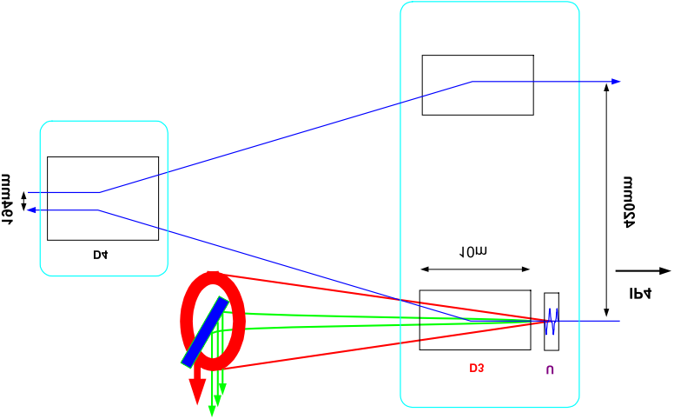
Layout: Emission and Extraction
Cryostat
70 m
194 mm
To RF cavities and IP4
To arc
1.6 mrad
420 mm
D4
10 m
Extracted light sent to an optical table below the beamline
D3
U
560 mm
26 m
937 mm

Slide 5
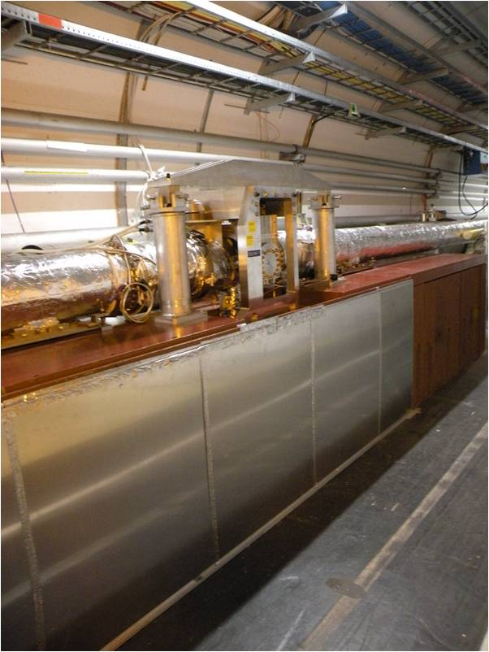
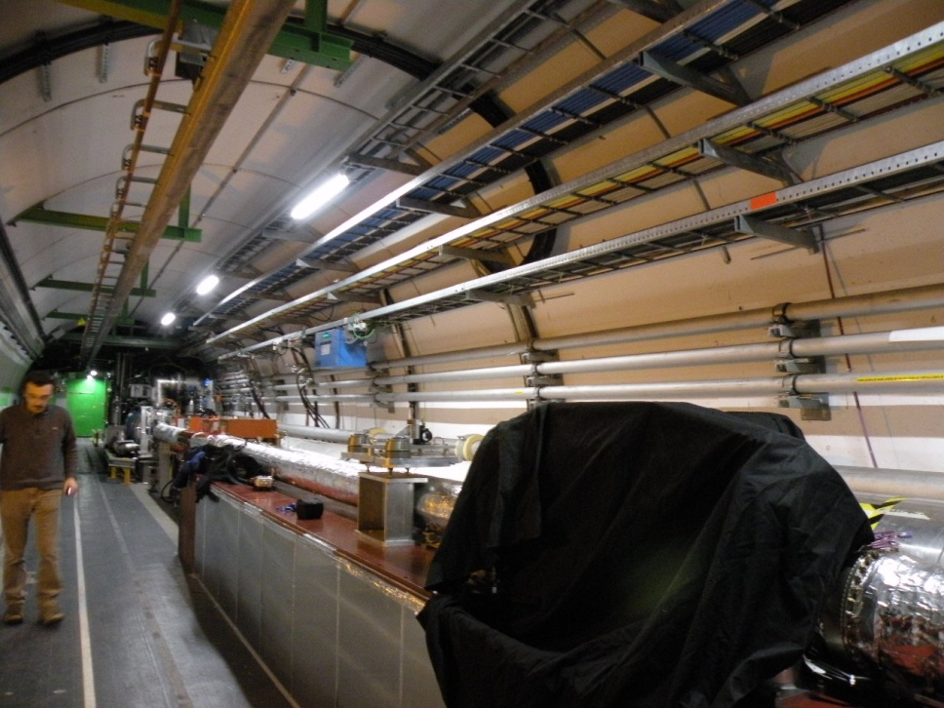
BSRT for Beam 1
Door to
RF cavities (IP4)
Undulator and dipole
B1 Extraction mirror
(covered while hunting
for a light leak)
Beam 1
Beam 2
Optical Table

Slide 6
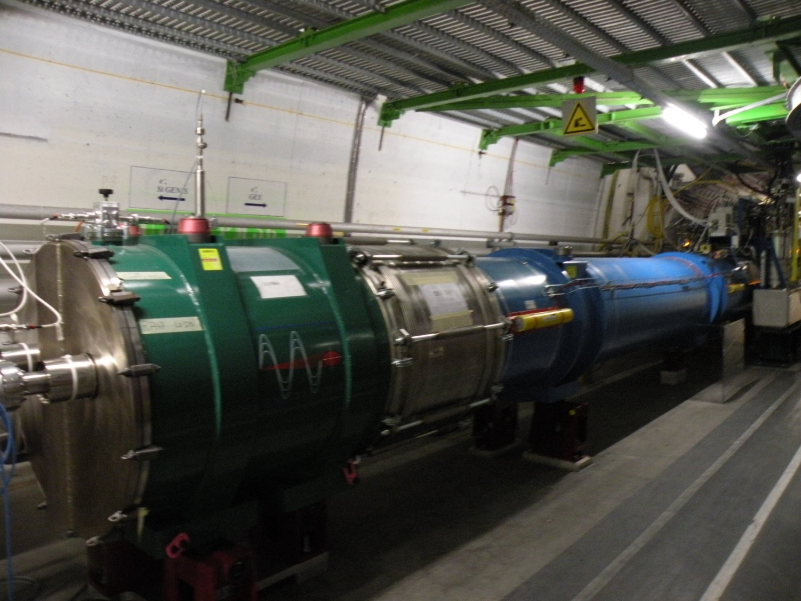
Undulator and Dipole
Dipole
Undulator

Slide 7
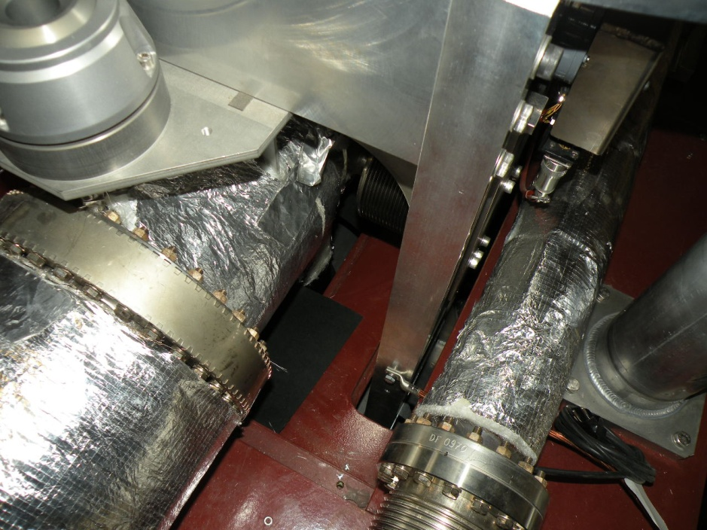
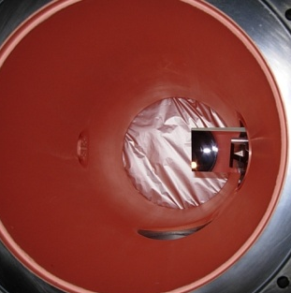
Extraction Mirror
B1 Extraction
Mirror
B2 Extraction
Mirror
Beam 1
Beam 2

Slide 8
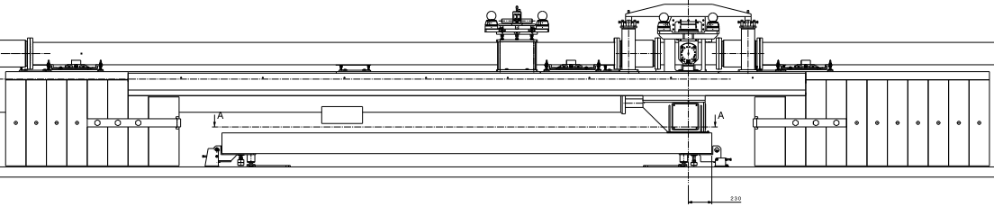
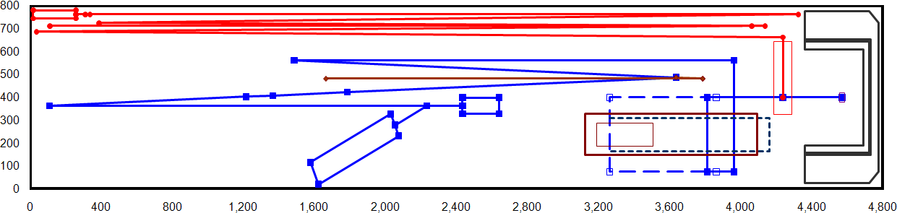
Optical Table
Extraction mirror
Beam
Optical Table
Shielding
Alignment laser
Calibration light and target
Color filters & attenuators
Light from extraction mirror
PMT and 15% splitter for abort gap monitor
F1 = 4 m
F2 = 0.75 m
Intermediate image
Fast & slow cameras
Slit
2-stage focus
trombone
Longitudinal-density monitor
Table Coordinates [mm]

Slide 9
Progress Since CM15
November-December 2010: First run with lead ions
  Synchrotron light images from lead
November: Duplicate optical table set up in lab
  Detailed study of imaging
January 2011: Shutdown work in the tunnel
  New “slow” camera with a 25-ns gate, intensifier for “fast” camera
  Camera translation stage added for precise focus
  Thorough check and adjustment of component positions and alignment
  Longitudinal density monitors
March-May: Measurements with beam
  Bunch-by-bunch beam size
  Longitudinal structure
Summer: Testing upgrade ideas at SLAC (SPEAR3 ring)
  Halo monitor and rotating mask

Slide 10
First Images of Lead Ions at Injection
2010 Nov 10: Light from 17 bunches, integrated over 20 ms
Images are faint, since most emission is infrared at this energy
  Original prediction: 1-s integration needed for a clear image of a single bunch
    Equivalent to 20-ms integration of 50 bunches
    1-s integration directly on the CCD would require only an additional logic pulse
Streaming video at 50 Hz (20 ms)
Numerical accumulation over a few seconds

Slide 11
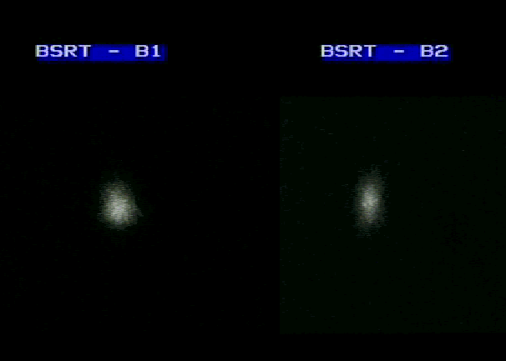
First Images of Lead Ions during Ramp
2010 Nov 5: Light from one bunch during ramp
Images taken at 2.3 TeV (equivalent proton energy)
  More light: Emission shifts into the visible at higher energy

Slide 12
Simulated vs Measured Light Intensity
⎯ BSRTS HOR.
- - Simulation p+
⎯ BSRTS VER.
⎯ Measured AGM p+
- - Simulation Pb Ions
- - AGM
Pb Ions
Abort-Gap Monitor (AGM) and BSRTS
Visible Photons per Charge
Visible Photons per Charge
Intensity per charge (equiv. AGM counts at 3200V)
Intensity per charge (equiv. AGM counts at 3200V)
- - Simulation Pb ions
⎯ Measured AGM Pb Ions
Abort-Gap Monitor (AGM)
Beam Energy [GeV]
Beam Energy [GeV]
At least a factor of 10⁴ between protons and ions at injection energy.
Nevertheless, it was possible to image the ions at injection.

Slide 13
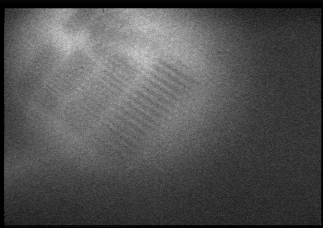
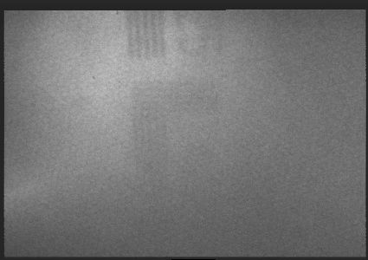
Nov 2010: Duplicate Optical Table
New table in the lab with a copy of the tunnel optics
Resolution is adequate, but limited by camera and digitizer:
  Fixed hexagonal pattern from intensifier or fiber coupling
    Increased magnification can reduce blurring effect
  Digitizer grabs every 2nd line
    Made for transfer line, not ring
    Significant for high energy, where beams are small
    Blurs the hexagonal pattern
Also, to steer entering light onto table axis, add another motorized mirror
500-µm line width
400-µm line width

Slide 14
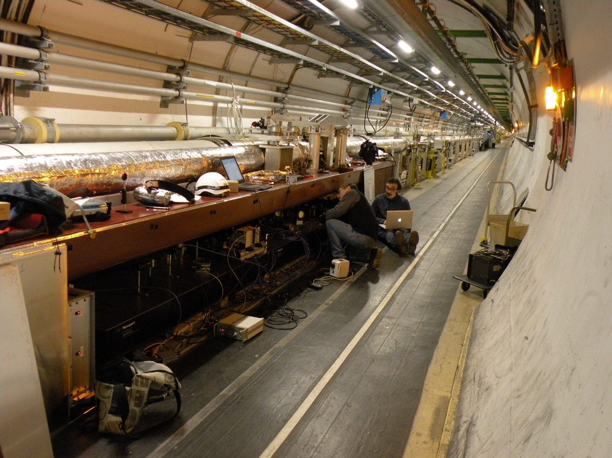
Jan 2011: Optics Work during Shutdown

Slide 15
Slow and Fast Cameras
Slow camera (BSRTS):
  Intensified camera from Proxitronic
  Newer version with video-rate (50 Hz) and gated modes
  Minimum gate of 25 ns at a maximum rate of 200 Hz
  Can gate a single bunch on every 55th turn: bunch-by-bunch emittance
  Status: In routine use
Fast camera (BSRTF):
  Fast framing camera from Redlake
  Maximum image rate of 100 kHz (for reduced region of the imager)
  Added a custom Photek fiber-coupled image intensifier with a 3-ns gate
  Intended for turn-by-turn measurements of individual bunches
  Status: Testing gain of fiber-coupling and intensifier

Slide 16
Calibration vs Wire Scanners
Wire Scanners (WS)
  Reference for LHC transverse profile measurements
  Can be used with just over 10¹³ protons without causing wire damage or a quench
BSRTS calibration vs WS
  Measured for each beam and plane, as a function of energy
  Corrections applied in quadrature to BSRT beam-size data
Corrections of 400–500 µm
  Possible sources: camera, digitizer, slit adjustment, diffraction
Norm. Emittance [mm·mrad]
Norm. Emittance [mm·mrad]
Notes:
Emittance units

Slide 17
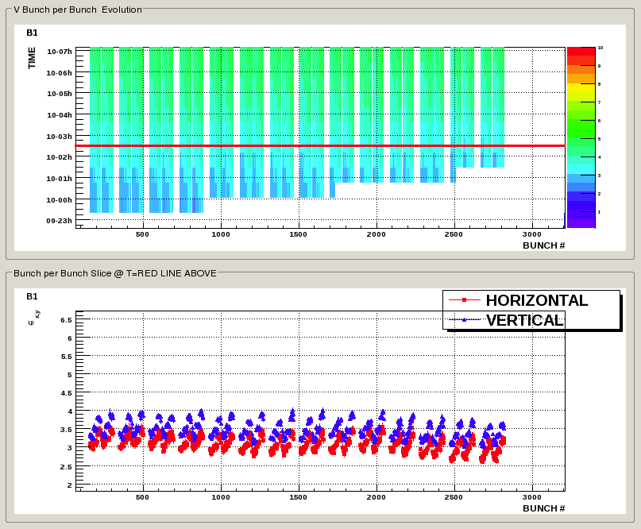
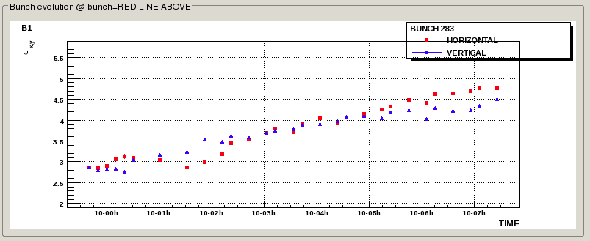
Monitoring LHC Emittance with BSRT
Transverse vertical emittance
versus bunch number and time
Bunch-by-bunch emittance
at a fixed time
Structure comes from injectors. Sawtooth pattern here repeats with PS period.
Norm Emittance [mm·mrad]
Single-bunch emittance vs time
Emittance reduction between two measurements on the same bunch gives estimate of statistical error.
Norm Emittance [mm·mrad]
Notes:
Vertical units

Slide 18
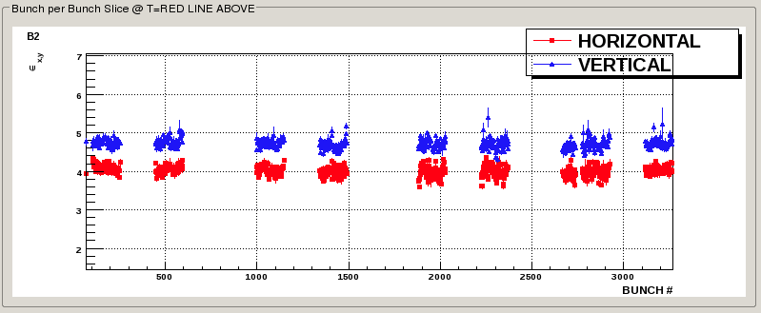
Improving Emittance using BSRT Data
After tuning injectors to make emittance along bunch trains more uniform

Slide 19
Longitudinal-Density Monitor
Monitor built by Adam Jeff
  Photon counting using an avalanche photodiode (APD)
  1% of the BSRT’s synchrotron light
  Histogram of time from turn clock to APD pulse, with 50-ps bins
  Now installed on both beams
Modes:
  Fast mode: 1-ms accumulation, for bunch length, shape, and density
    Requires corrections for photon pile-up, APD deadtime and afterpulsing
  Slow mode: 10-s accumulation, for tails and ghost bunches down to 5×10⁵ protons (4×10⁻⁶ of a nominal full bunch)
    Only 1 photon every 200 turns
LHC turn clock
Arrival time
Synchrotron light
TDC
APD

Slide 20
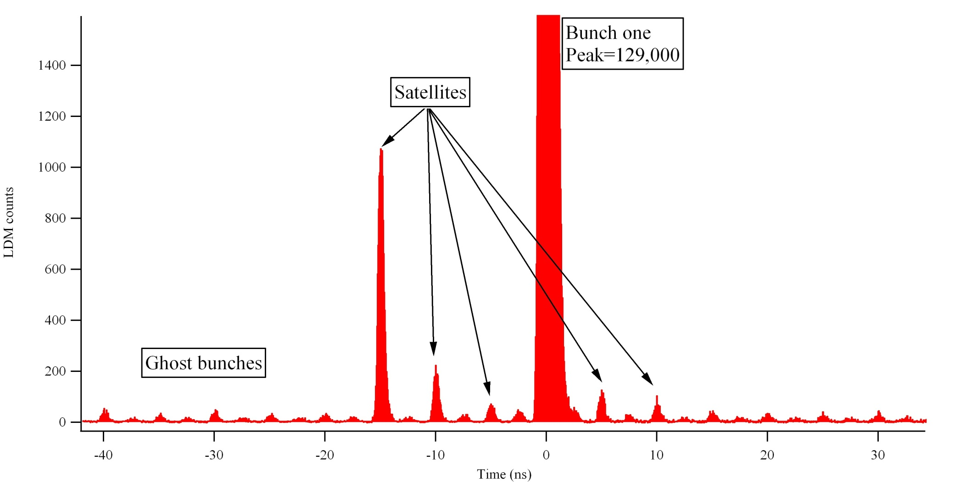
LDM Measurement
Ions with 10-min integration
Satellites
Capture/splitting errors in the injectors
SPS 200 MHz → 5 ns
Ghosts
Capture/splitting errors in the LHC
LHC 400 MHz → 2.5 ns
APD Counts
2.5 ns
Time [ns]
5 ns
LDM is the only LHC system able to see all structures from RF, with enough dynamic range and time resolution for monitoring satellites and ghosts

Slide 21
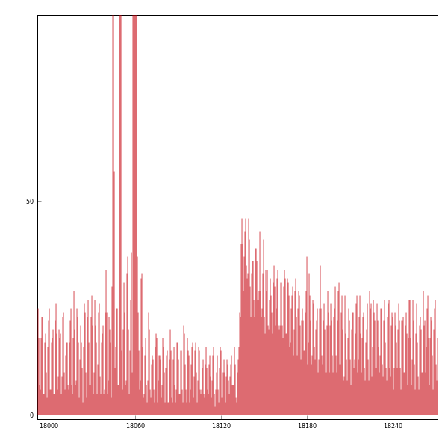
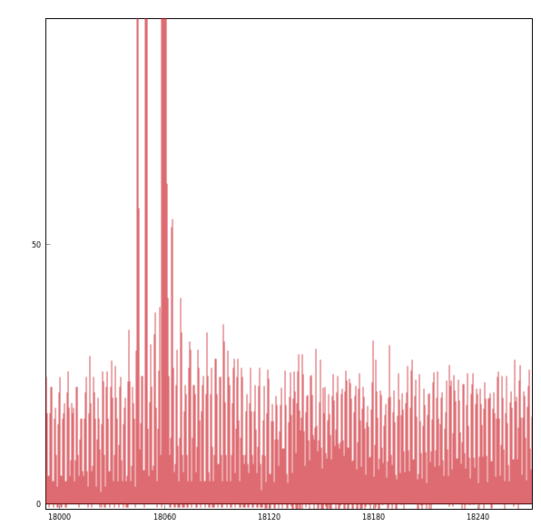
Deadtime and Afterpulse Correction
Measurement with beam
Before correction
After correction
Afterpulses
Nominal Bunches
Deadtime (77 ns)
APD Counts
Satellites
Time [ns]
Time [ns]
Notes:
units

Slide 22
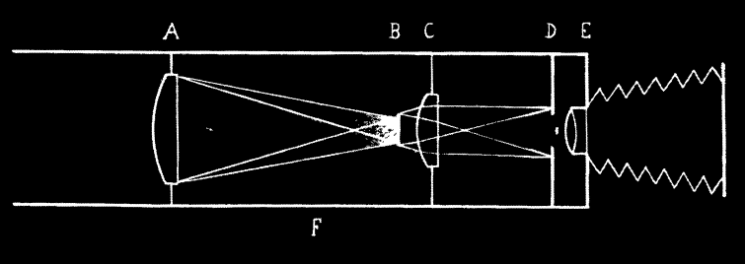
The Solar Corona and Beam Halo
Lyot invented a coronagraph in the 1930s to image the corona
  Huge dynamic range: Sun is 10⁶ times brighter than its corona
  Block light from solar disc with a circular mask B on image plane
  Diffraction from edge of first lens (A, limiting aperture) exceeds corona
    Circumferential stop D around of image of lens A formed by lens C
Can we apply this to measuring the halo of a particle beam?
Bernard Lyot, Monthly Notices of the Royal Astronomical Society, 99 (1939) 580

Slide 23
Beam-Halo Monitor
  Halo monitoring was part of the original specification for the synchrotron-light monitor.
  LARP’s involvement in both light monitors and collimation makes this a natural extension to the SLM project.
But the coronagraph needs some changes:
  The Sun has a constant diameter and a sharp edge.
  The beam has a varying diameter and a profile that is roughly Gaussian
An adjustable mask is needed. Two approaches…

Slide 24
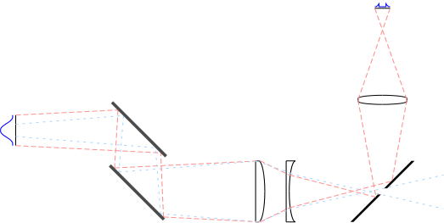
Fixed Mask with Adjustable Optics
Halo
image
Source
Steering mirrors
Zoom lens
Masking mirror
  But the SLM images a bandwidth from near IR to near UV
  Reflective zoom is difficult compared to a zoom lens
  Bandwidth is a problem for refractive optics
    Limited by need for radiation-hard materials
    But a blue filter is used for higher currents: Fused silica lenses could work

Slide 25
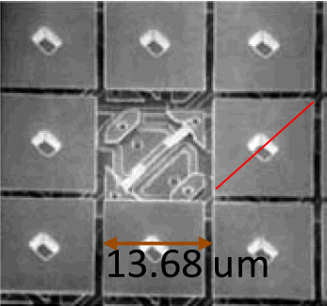
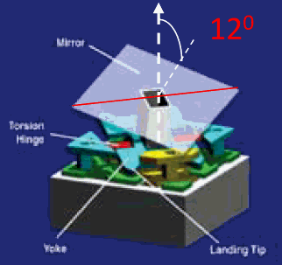
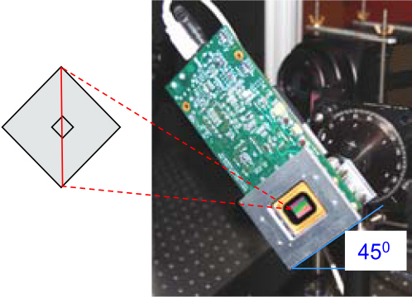
Digital Micro-Mirror Array (DMA)
  1024 × 768 grid of 13.68-µm square pixels
  Pixel tilt toggles about diagonal by ±12°
  Mirror array mounted on a control board, which is tilted by 45° so that the reflections are horizontal.

Slide 26
Digital Micro-Mirror Array vs Fixed Mask
Advantages of DMA:
  Flexible masking due to individually addressable pixels
    Adapts well to flat beams in electron rings
    But the LHC beams are nearly circular
Disadvantages of DMA:
  The pixels are somewhat large for the LHC
    F1 is far from source: Intermediate image is demagnified by 7
    RMS size: 14 pixels at 450 GeV, but only 3.4 pixels at 7 TeV
  Reflected wavefront is tilted
    DMA has features of a mirror and a grating
    Corrected by tilting camera face by 24°
      Known as Scheimflug compensation
Testing a DMA this summer on the SPEAR3 ring at SLAC

Slide 27
Rotating Mask
Bunch-by-bunch scans have limitations:
  2 sec/bunch for good statistics: Scanning 2808 bunches takes 1.6 hours
  The expensive gated cameras may eventually be damaged by radiation, once the rings are full
Instead, an optical analog of a wire scanner that:
  Scans a thin slit across the synchrotron-light image of the proton beam
  Detects transmitted light with a photomultiplier
  Sorts the PMT pulses by bunch number and by slit position
  Gets profiles of every bunch at 1 Hz
  3 slits at different angles on a rotating disc
    Horizontal, vertical and 45° profiles
    Beam size on major and minor axes, plus tilt of beam ellipse

Slide 28
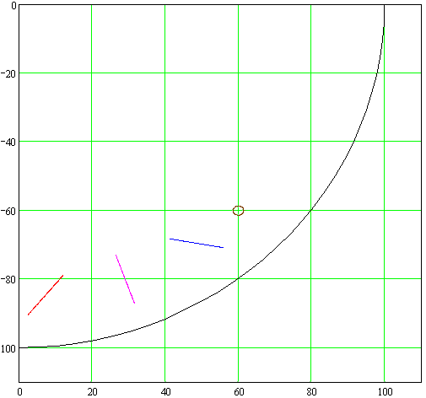
Movie: Mask Rotating across Beam
y [mm]
x [mm]

Slide 29
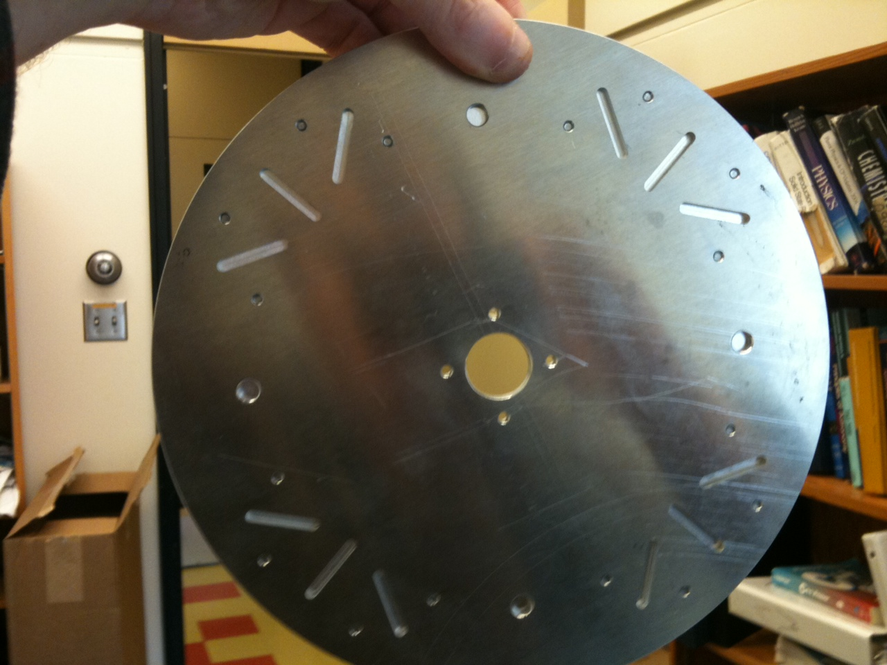
Photograph of Mask
4 sets of slots: Rotation at 0.25 Hz for 1-Hz data
Ready for testing this summer on the SPEAR3 ring at SLAC

Slide 30
Summary
Lead-ion beams were imaged with synchrotron light for the first time in November.
A table with a copy of the optics in the tunnel was set up in November for detailed studies of imaging.
Some improvements and additions to the optics were installed during the shutdown.
Bunch-by-bunch emittance measurements have been helpful in machine tuning.
The longitudinal-density monitors have been commissioned.
Tests of two possible upgrades, a halo monitor and a rotating-mask profiler, will begin this summer on SLAC’s SPEAR-3 ring.

