Slide 1
HQ Status and Test Results
BNL
Jesse Schmalze
Mike Anarella
Peter Wanderer
Arup Gosh
FNAL
Rodger Bossert
Dariusz Bocian
Guram Chlachidze
Giorgio Ambrosio
Emanuela Barzi
Sasha Zlobin
LBNL
Helene Felice
Paolo Feracin
Dan Dietderich
Ray Hafalia
Dan Cheng
John Joseph
Juan Lizarazo
Maxim Martchevskii
Xiaorong Wang
GianLuca Sabbi
Shlomo Caspi
LBNL
LARP Collaboration Meeting – CM16
BNL
Montauk May 16-18, 2011

Slide 2
Outline
The HQ program and Target
Past Test summary– HQ01- a, b, c
Recent Test summary – HQ01- d
Future plans

Slide 3
HQ Program & Targets
  Program
  Part of the US LHC Accelerator Research Program (LARP)
  Develop Nb₃Sn quadrupole magnet for the LHC luminosity upgrade.
Magnet
Extend Nb₃Sn magnet technology:
  TQ, 1 m long, 90 mm bore, 13T (1.9K) -> without field quality
  LQ, 4 m long, 90 mm bore, 13T (1.9K) -> without field quality
  HQ, 1 m long, 120 mm bore, 15T (1.9K) -> with field quality
HQ program target:
  160 (T/m) at 4.4K (HQ01d reached 170 T/m, 11.8T)
  175 (T/m) at 1.9K
  Good memory – no retraining
A collaboration between BNL/FNAL/LBNL and CERN:

Slide 4
HQ Progress
2008 July Selection of 120 mm quadrupole aperture for Phase 1
Sept. Cable and coil cross-section geometry finalized
2010 Apr. HQ01a test coils 1,2,3,4
71%-79%,141-157T/m (unusual ramp rate performance)
June HQ01b test coils 1,4,5,6
77%,153 T/m (electrical breakdown)
Oct. HQ01c test coils 1,5,7,8
      70%-138T/m (unusual ramp rate performance)
2011 Apr. HQ01d test coils 5,7,8,9
      86%, 170 T/m (mechanical limit)
Status: 13 coils completed , 4 HQ tests completed, 1 mirror test underway

Slide 5
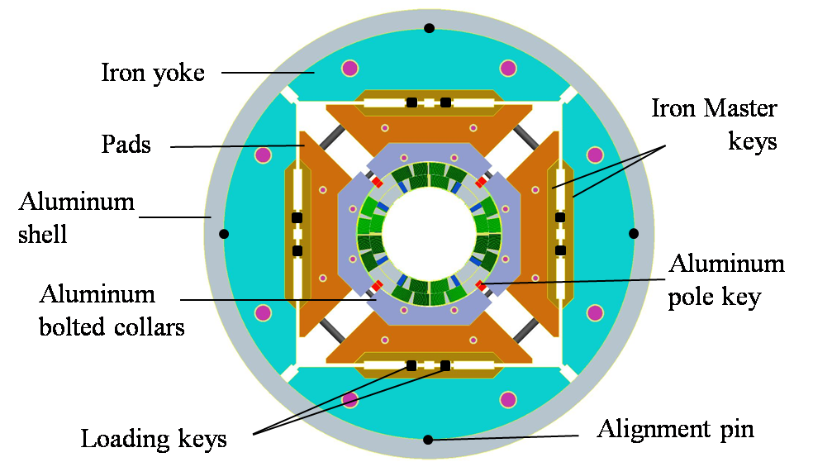
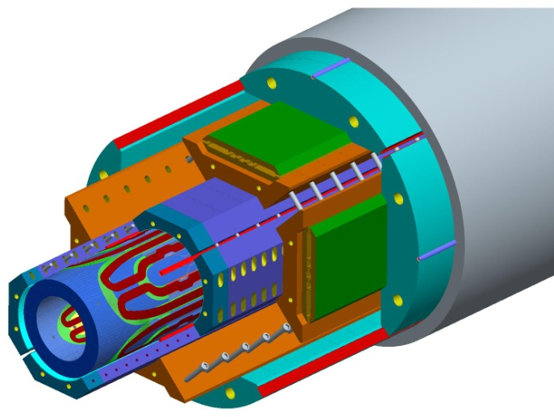
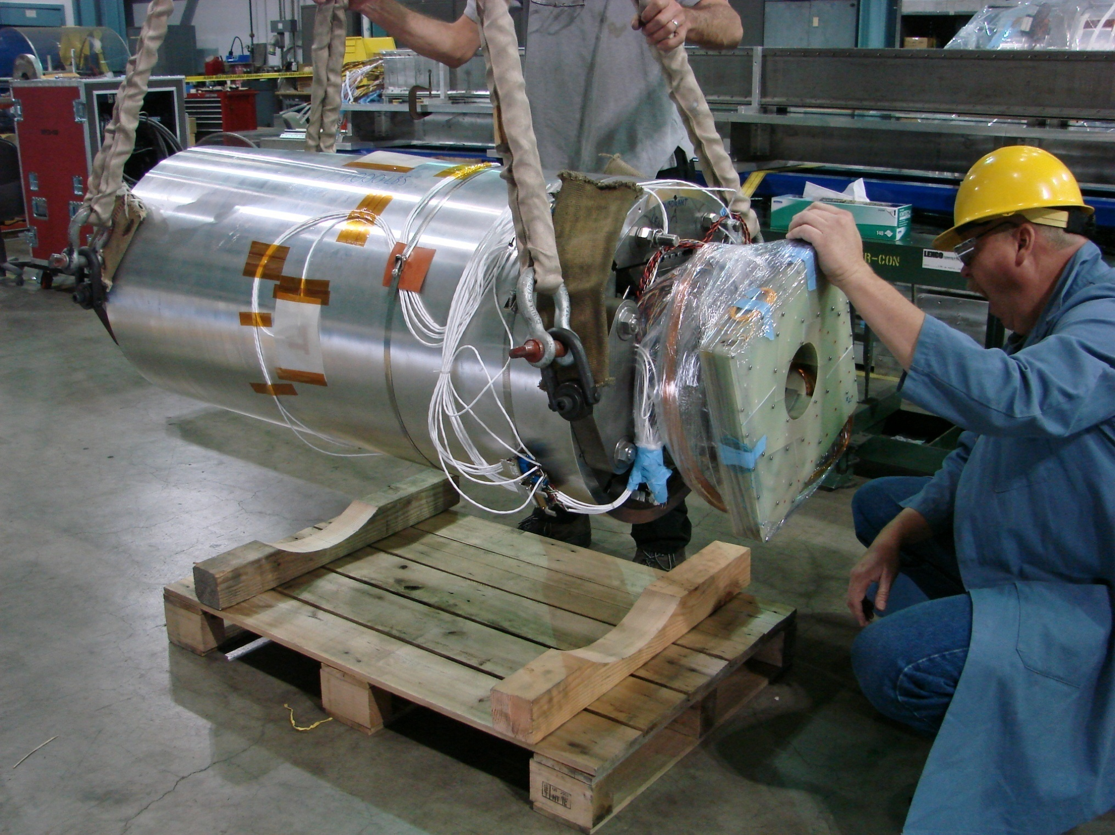
LARP – HQ Magnet
0.8 mm strand
15 mm wide cable
120 mm bore
4.4 K/1.9 K -195/214 T/m
4.4 K/1.9 K – 13.7/14.9 T

Slide 6
HQ01a,b,c,d - Test Results

Slide 7
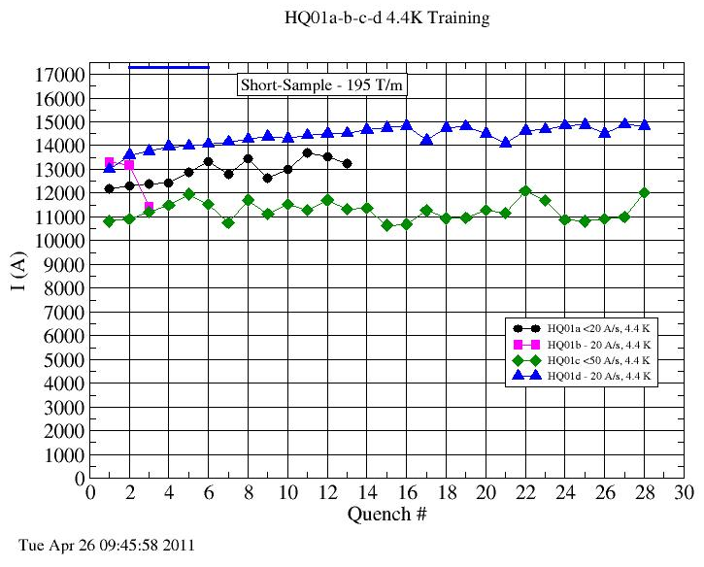
HQ01 Training quenches (4.4K)
HQ01a
13683A (157T/m, 79% of ss)
coils 1,2,3,4
HQ01b
13308A (153T/m, 77% of ss)
coils 1,4,5,6
HQ01c
11953A (138T/m, 70% of ss)
coils 1,5,7,8
HQ01d
14983A (170T/m, 86% of ss)
coils 5,7,8,9

Slide 8
Ramp-rate dependence

Slide 9
HQ01d Test Results

Slide 10
HQ01d – test results
Quench Location*
* details and discussion by Maxim Marchevsky

Slide 11
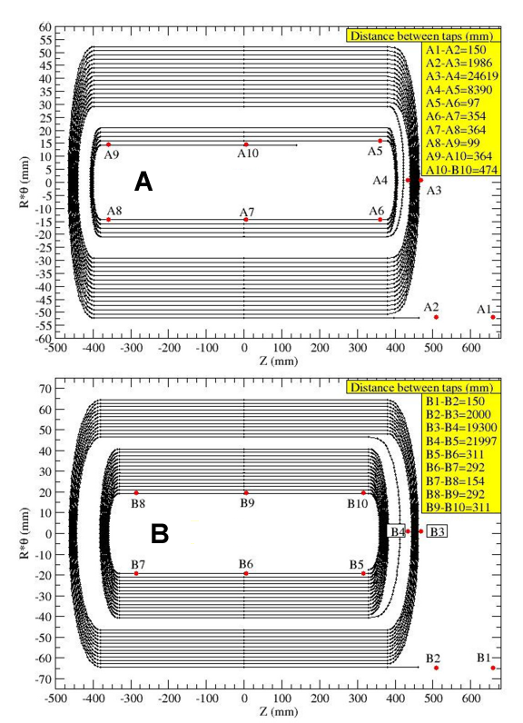
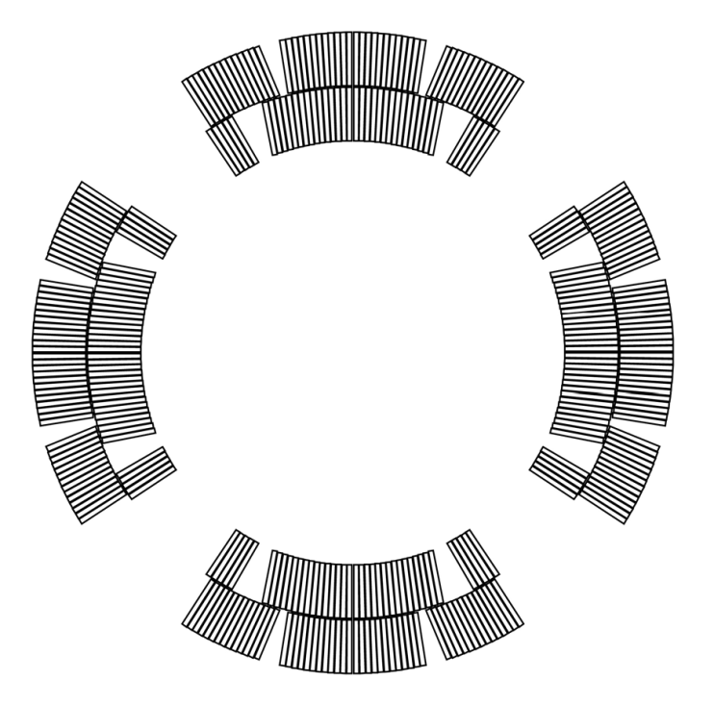
HQ01d – quench location summary
1
1
1
1
9
2
1
2
1
Inner layer
7
5
Outer layer
Quench velocity ~11.4 m/s ,
τ_{t-t} = 5.2 ms
5 mid-plane quenches
First coil 7 followed by 8
8
9

Slide 12
HQ01d – test results
Magnetic Measurement*
* details and discussion Xiaorong Wang

Slide 13
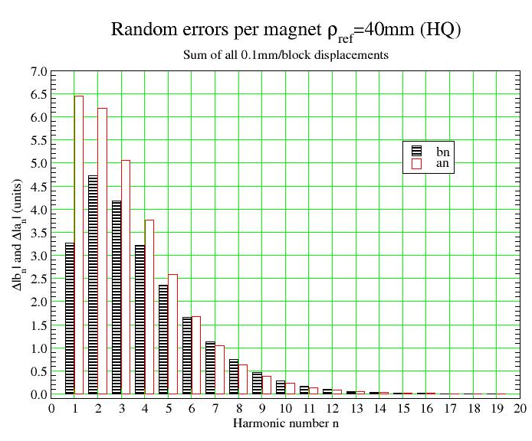
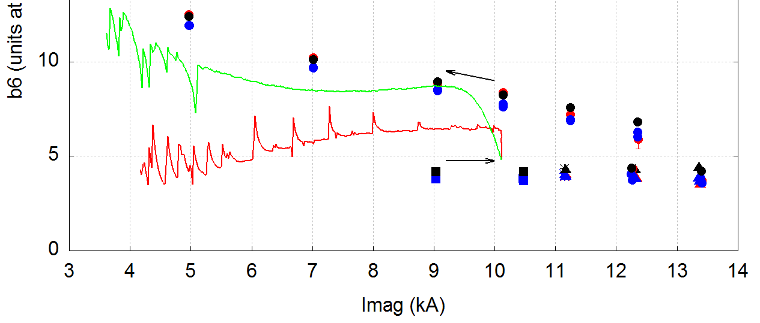
HQ01d magnetic measurement
Harmonics at 120 T/m (average up-down ramp)
Measuring coil radius and length = 21.55 mm, 100 mm long
Data shown at a reference radius = 40 mm, 2/3 bore
n | Normal (b_{n}) | Skew (a_{n})
3 | 0.21 | -3.17
4 | -0.63 | -4.16
5 | 0.93 | 0.33
6 | 5.61 | -0.17
7 | 0.96 | -0.57
8 | 0.44 | 0.02
9 | -0.12 | 0.30
10 | 1.88 | 4.23
b₆
Continuous ramping up at 10 A/s

Slide 14
HQ01d – test results
Structure*
* details and discussion Paolo Ferracin

Slide 15
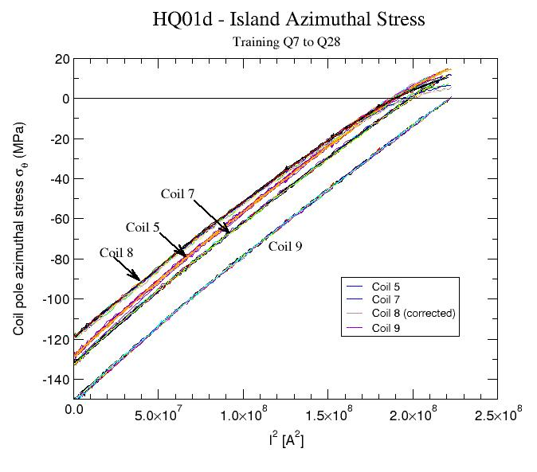
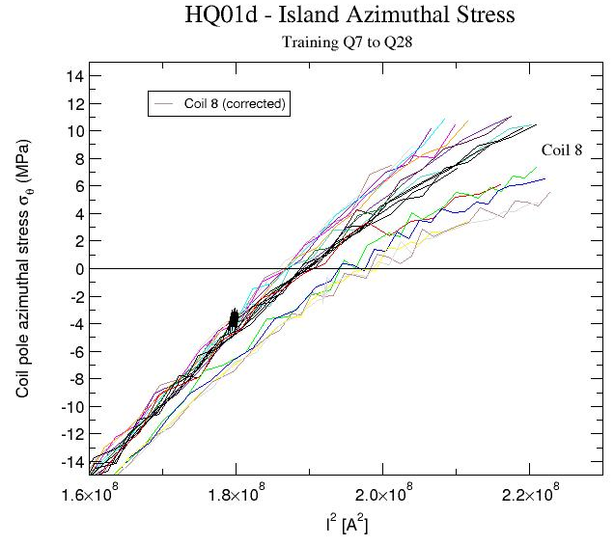
Coil azimuthal stress during excitation
Pre-stress intentionally low (reduce strain from high coil compaction)

Slide 16
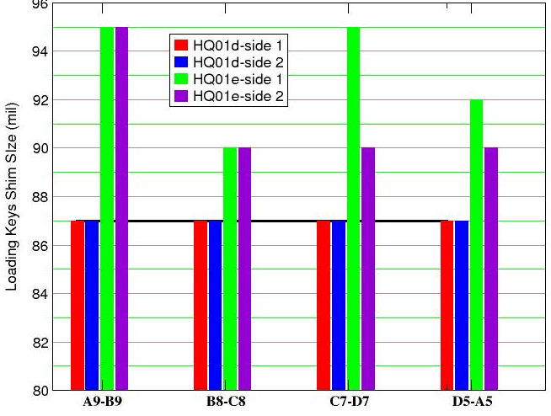
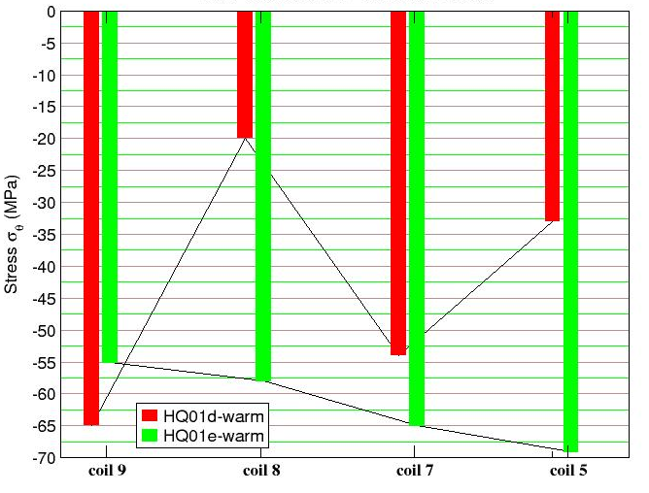
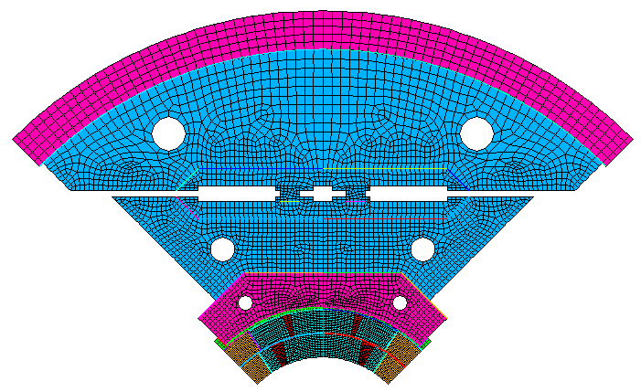
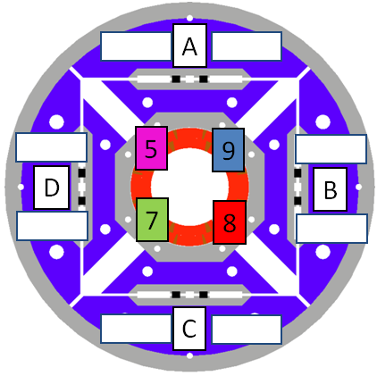
Next Step - improving stress uniformity
HQ01d to HQ01e
Fine tuning of stress
Need cold data
Need impact on field quality
ANSYS model for uneven keys
Nomenclature

Slide 17
HQ01d – test results
Heater studies*
* details and discussion Helene Felice, Tina Salmi

Slide 18
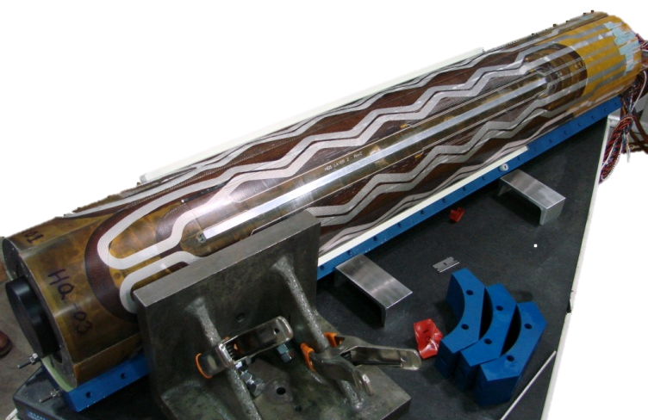
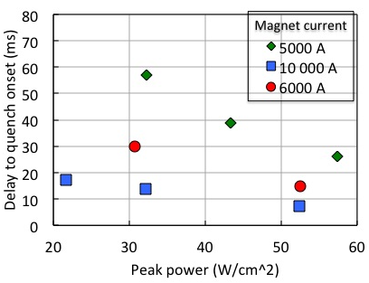
Protection heater studies
Study delay time to quench
Study deposited energy
Stainless steel protection heater strip on the outer layer

Slide 19
Summary of HQ Performance
And next step

Slide 20
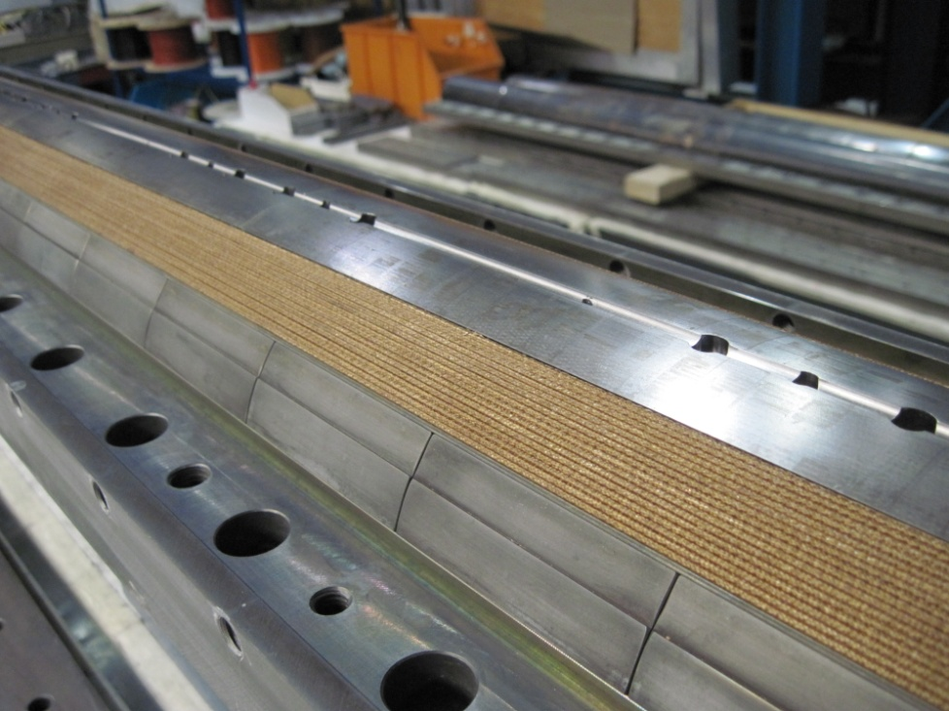
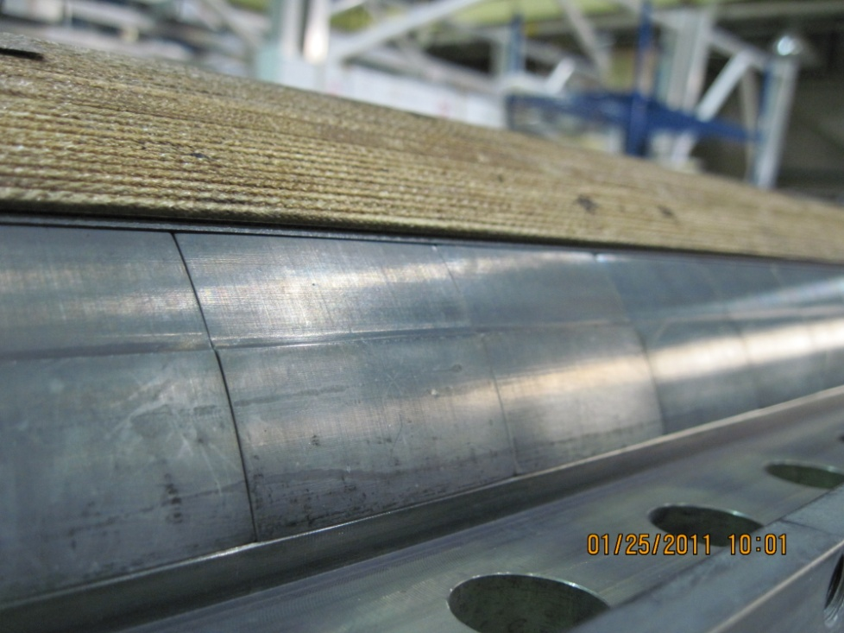
HQ coils are under excessive compaction
LQ 16
HQ13
Coil remains in reaction tooling
Coil springing out of reaction tooling
Jesse Schmalzle
HQ coils tend to spring out from their reaction tolling
Even with one turn less HQ coil #13 still tends to spring out

Slide 21
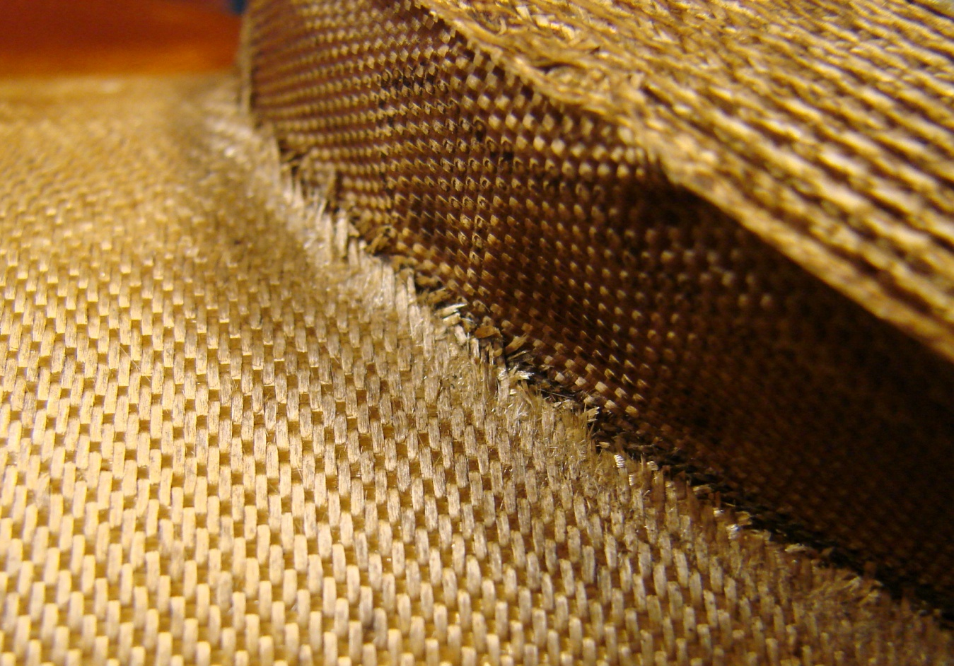
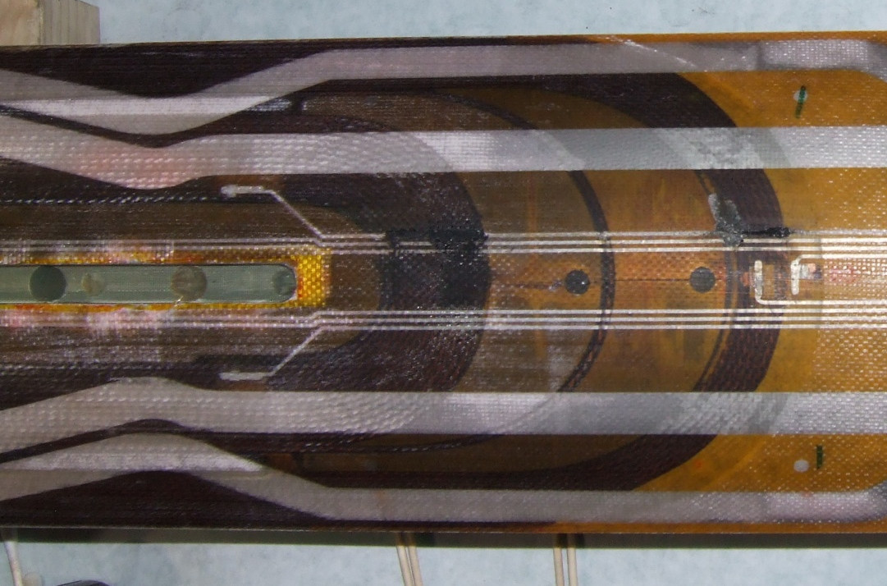
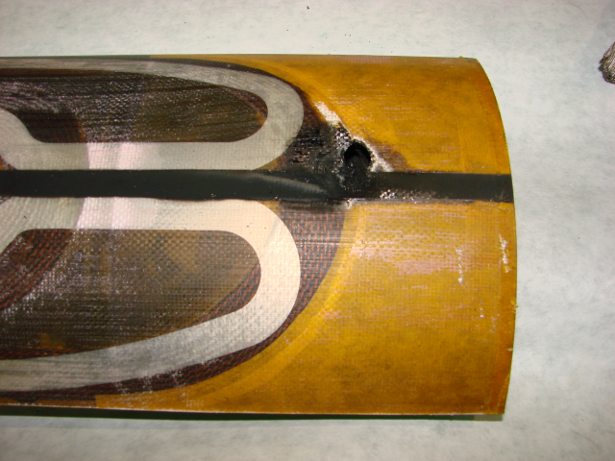
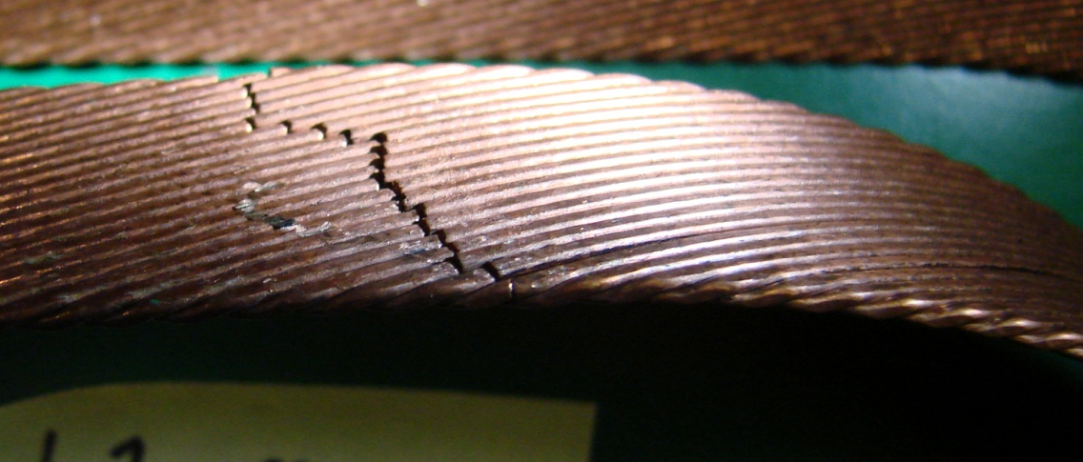
Consequences of excessive compaction
HQ01a (coil 2 to protection heaters)
Insulation fragmentation after reaction
HQ01a
Broken strands during reaction
HQ01b (coil 6 layer to layer and end-shoe)
21
Notes:
5/13/2011
s_caspi@lbl.gov
21

Slide 22
Performance Assessment
Observed limitations and deficiency:
Voltage breakdown (HQ01a,b tests)
Insulation damage (HQ01a,b tests)
Broken strands (coil #10)
Spring-back after reaction
Unusual ramp rate performance (HQ01c tests)
Low plateau magnet performance (HQ01c test)
A common cause –
Coils are under excessive compaction during curing and reaction

Slide 23
Future Plans
Reducing Coil Compaction *
* details and discussion Helene Felice

Slide 24
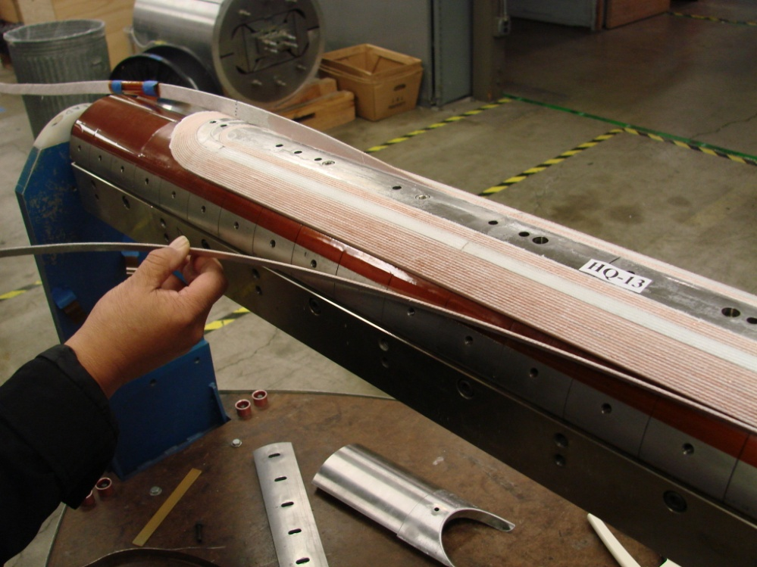
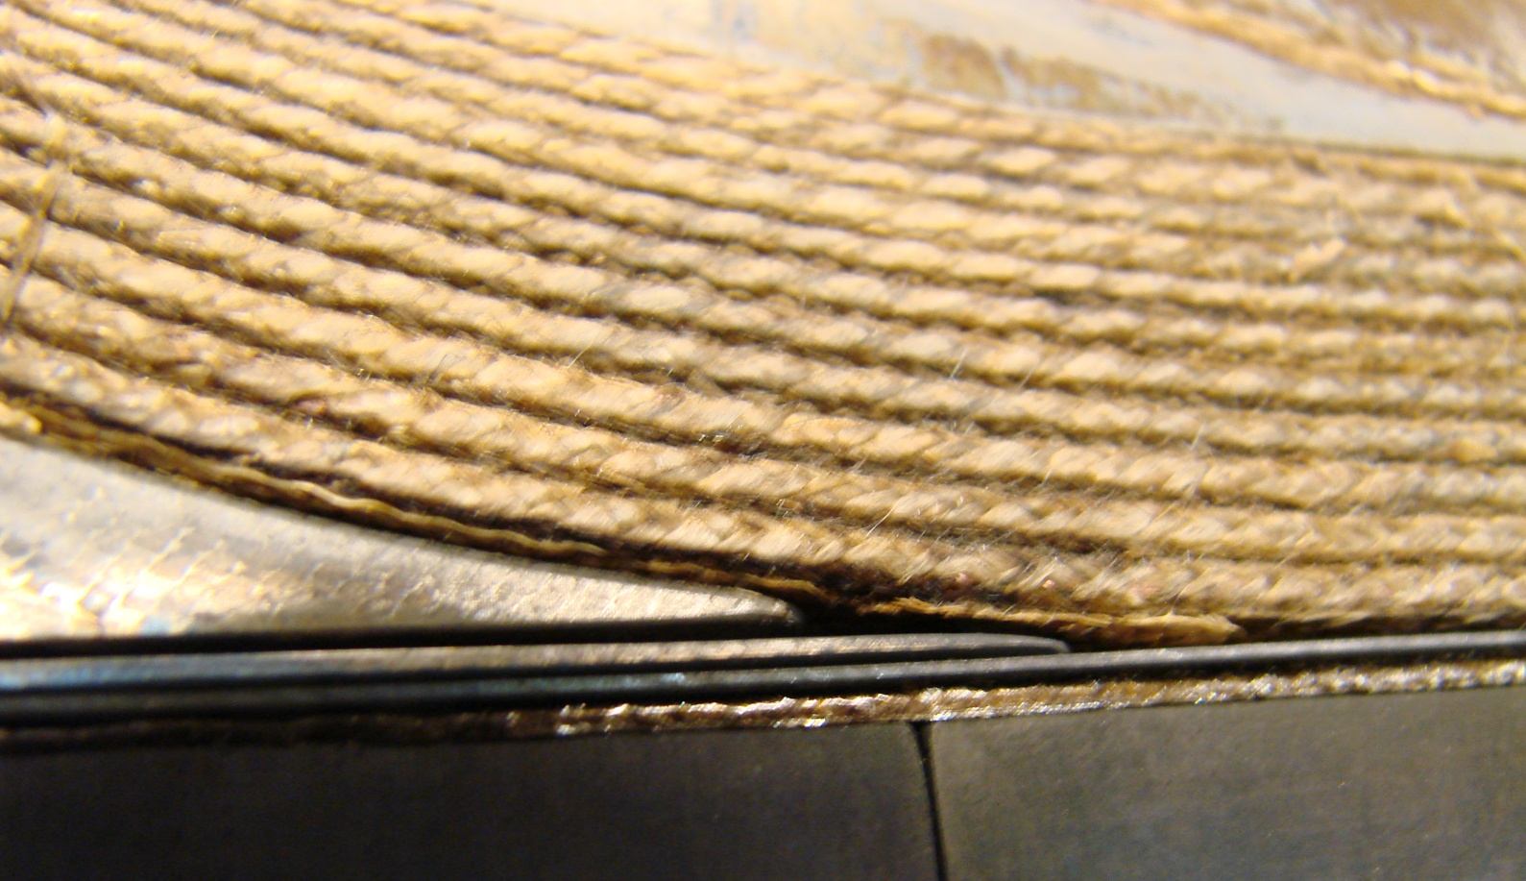
Reducing coil compaction
Near term : Coil #12 - last turn below mid-plane (mirror test underway)
(details and discussion Guram Chlachidize)
Coil #13 – removed one turn (next mirror test)
  Next step :
  Keep existing cross-section and HQ tooling
  Reduce strand diameter from 0.800 mm to 0.778 mm
  Reduce cable size
Allow expansion during reaction 5.6%-6% thickness and 1%-2% in width

Slide 25
HQ Summary
A 120 mm bore, Nb₃Sn quadrupole is underway construction and testing
  4 tests (HQ01a/b/c/d)
HQ01d reached 86% (4.4K) of short-sample (170T/m)
Coil compaction cause of performance limitation:
  Excessive strain puts coils at risk but some can perform
Future plans:
  Test special single coils in mirror configuration
  Reduce strand diameter and cable size
  Optimize and fine tune coil stress
  Test at 1.9K (FNAL, CERN)
  Revise protection heaters design and coil-end spacers

