Slide 1
DESIGN STUDY FOR THE LHC UPGRADE
WP3: MAGNETS
Montauk, 16th May 2011
High Luminosity LHC Design Study: LARP meeting
E. Todesco
CERN, Geneva, Switzerland
Thanks to O. Bruning, G. De Rijk, T. Nakamoto, J. M. Rifflet,
L. Rossi, P. Wanderer, R. V. Weelderen

Slide 2
TASK LIST
  1. Communication and management
  2. Nb₃Sn quadrupoles
  3. Separation dipoles
  4. Cooling
  5. Miscellaneous

Slide 3
TASK 2 – Nb₃Sn quadrupoles
Task Objectives
  Finalize the requirements for the HL-LHC inner triplet Nb₃Sn quadrupole
  Analyze the performance of existing Nb₃Sn models, in particular LARP HQ quadrupoles
  Conceptual design of the final aperture option (135 mm ? 150 mm ?)

Slide 4
TASK 2 – Nb₃Sn quadrupoles
Main issues to be studied
  Radiation resistance
  Magnet field quality
    Possibility of using magnetic shims to decouple mechanics from magnets
    Compare to targets
  Magnet length: possibility of splitting long magnets (10 m) in two short cold masses – estimate of the shorter distance between two coils
  Helium containment vessel for shell structure
  Magnet protection
This task will be mainly driven by LARP collaboration (BNL, FNAL and LBL). LASA will lead the quench protection study.

Slide 5
TASK 2 – Nb₃Sn quadrupoles
Deliverables
  M48 Report on design study of the Nb₃Sn inner triplet
Milestones
  M12 Requirements for Nb₃Sn inner triplet and comparison with present status of the art (to be started asap)
  M24 Study of magnetic shimming in HQ
  M36 Study of minimal distance between two coils in a cold mass
Relation to other WP
  Inputs from WP2. Moreover, this task feeds directly back to WP2 (e.g. required space for eventual absorber inserts at regions with higher losses etc which have an impact on the detailed IR layout).
Task leader: G. Luca Sabbi

Slide 6
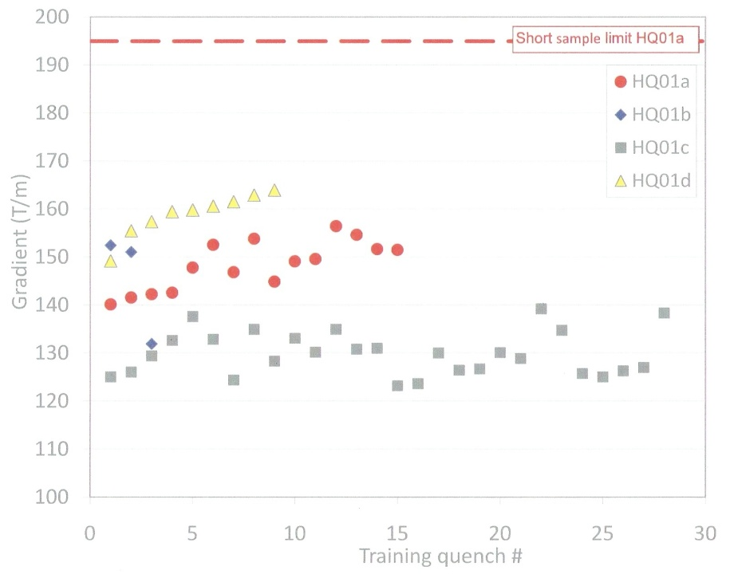
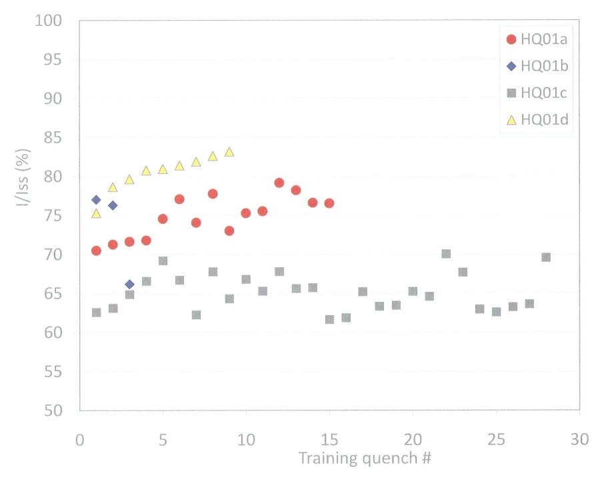
TASK 2 – GOOD NEWS FROM LARP
Latest news about HQ [more from Shlomo]
  This is the Nb₃Sn 120 mm aperture quadrupole – probably not the final aperture but testbench for checking all the requirements for going in the machine
  Started at 80% of short sample, and reached 86% after (170 T/m)
Nominal MQXC
Latest news on HQ training [S. Caspi, April 2011]

Slide 7
TASK 2 – WISHES
The aperture is the crucial parameter for us
  120 mm aperture models are being built (Nb-Ti and Nb₃Sn)
  150 mm proposed
  We should take a decision before the end of this year
    Even if not all information from beam dynamics is available
    Otherwise we will stay with 120 mm
Optimal aperture for the LHC triplet versus time

Slide 8
TASK 2 – SOME OPEN ISSUES
FROM LARP EXPERIENCE
Impressive progress in the past years
  Most magnets reach 80% short sample with very limited training
  Extension to 3.4-m-long coil successful
Open issues
  Sizing of the coil is critical
    HQ experience – important not only for performance but also for field quality
  Level of rejection of coils
    Today still too large and sometimes without understanding of why
  Full performance at 1.9 K not yet there
    No consensus in the community: instabilities due to filament size?/strand diameter? or manufacturing problems?
  Radiation resistance of magnet components
    Not yet ready for installation in an accelerator
  Field quality – random part much larger than Nb-Ti

Slide 9
TASK 3 – SEPARATION DIPOLES
Task Objectives
  Conceptual design of separation dipoles according to the specifications given by WP2 using either Nb₃Al or Nb-Ti. If a model is built, specify and follow-up the tests needed for assessing the design.
  Explore the possibility of using separation dipoles to create doglegs to increase the beam separation, thus allowing the installation of non-compact crab cavities.

Slide 10
TASK 3 – SEPARATION DIPOLES
Main issues
  Field quality
  Peak stresses at operational field (large aperture)
  Integration in the accelerator
  Radiation resistance
  Magnet protection
A similar type of technology would allow to further separate the LHC beams from the nominal distance of 194 mm to a wider one (400 to 500 mm).
This task is lead by KEK for the Nb₃Al part and by BNL for the Nb-Ti option. LASA will steer the studies on protection

Slide 11
TASK 3 – SEPARATION DIPOLES
Deliverables
  M48 Report on design study of the separation dipoles
Milestones
  M12 Requirements for separation dipoles
  M24 Conceptual design of Nb₃Al and Nb-Ti separation dipoles
  M36 Conceptual design of a crab cavity dogleg
Relation to other WP
  Inputs from WP2 and WP4. The task results feed also back to WP: the final length for the dipole magnets will impact the space available for local Crab Cavity installations and potential installations for the compensation of long-range beam-beam interactions.
Task leader: T. Nakamoto & P. Wanderer

Slide 12
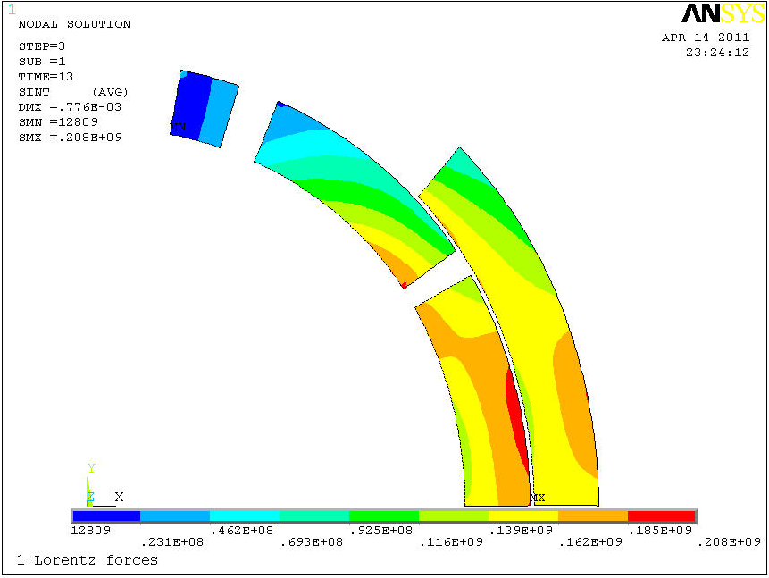
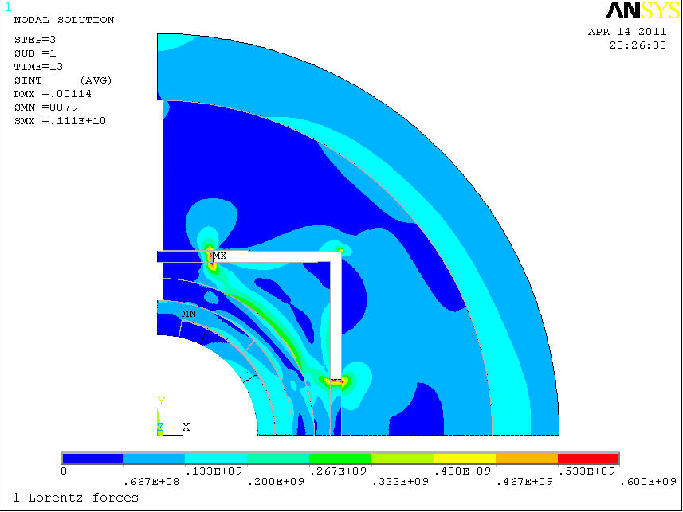
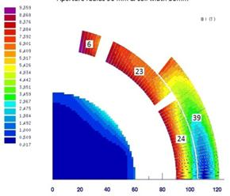
SEPARATION DIPOLES NEWS
KEK already sent Proj. Ass. (Q. Xu)
  At CERN since 1 March, preliminary work on separation dipole
    Analysing apertures from 120 to 180 mm with parametric approach
    Coil width from 10 to 30 mm
    Two cases studied in detail
  Margin: I would propose to stay at 67% of loadline
Preliminary study on 180 mm aperture D1 [Q. Xu]

Slide 13
TASK 4 – COOLING
Task Objectives
  Choose the operational temperature of the inner triplet quadrupoles and of the separation dipoles. Consider and compare both the superfuid and supercritical He options.
Task description
The cooling system of the Nb₃Sn inner triplet can operate either in superfluid (i.e., below 2.17 K) or in supercritical helium (i.e., above 2.17 K). Contrary to Nb-Ti magnets, Nb₃Sn can operate in supercritical helium at around 4.5 K with a limited loss in field gradient w.r.t. the superfluid option (about 10%). This would also solve the Nb₃Sn conductor instability issues that have been found by the US colleagues during the last decade.
As the heat loads envisaged today are more than one and a half order of magnitude above what is prevalent in the previous accelerators magnets designed for operation at supercritical helium (RHIC, HERA, Tevatron), it is mandatory to address the problem of cooling from the very beginning of the design of future quadrupoles.
Both the supercritical and the superfluid options should be analysed and compared. The program can be divided into different phases: (i) analysis of heat loads and status of the different cooling scenarios (ii) principle of heat removal system, thermohydraulic simulations and first experiments (iii) validation of the system.
A similar study should be carried out for the separation dipoles.
This task is steered by CERN for the superfluid part and by CEA-Grenoble for the supercritical part.

Slide 14
TASK 4 – COOLING
Deliverables
  M48 Report on design study of the cooling
Milestones
  M18 Study of the supercritical He cooling
  M36 Study of the superfluid He cooling
Relation to other tasks and WP
  Relation to tasks 3.2 and 3.3, and inputs from WP2.
Task leader: R. Van Weelderen

Slide 15
TASK 5 – MISCELLANEOUS
Task Objectives
  Design a two-in-one quadrupole for the outer triplet (Q4-Q6) with nominal beam separation (192 mm) and aperture as large as possible (80-100 mm), satisfying the electromagnetic and mechanical requirements. Design of a two-in-one quadrupole for the inner triplet in the case of a dipole first option.
  Review the Nb-Ti option for the inner triplet considering the new targets in luminosity, and follow-up the tests of the short model built within the SLHC-PP program.
  Analysis of the expected lifetime of resistive quadrupoles in IR3 and IR7. Study of possible solutions for the time scale of 2030 with in integrated radiation of 3000 fb⁻¹, both resistive and superconductive.

Slide 16
TASK 5 – MISCELLANEOUS
Task description
This task includes three different studies:
The conceptual design of a large aperture two-in-one quadrupole for the outer triplet. The present baseline of the LHC involves 70 mm aperture magnets (MQY) whose aperture could be a bottleneck. One should explore the possibility of having two-in-one quadrupoles with apertures in the range 80-100 mm, with the same constraint of the 194 mm beam separation. Electromagnetic and mechanical aspects should be analysed. This design also applies to the option of a two-in-one inner triplet in the option of a dipole first option. This subtask is steered by CEA-Saclay.
The analysis of the expected lifetime of the resistive quadrupoles used in the cleaning insertion (MQWA and MQWB). The first step is to have an estimate of the radiation load, together with the lifetime of the present hardware. Then solutions to extend the lifetime of present hardware up to 2030 or options to replace them will be analysed. This subtask is steered by CERN (TBC).
The Nb-Ti option for the inner triplet is the plan B in case that experience shows that the Nb₃Sn technology is not suitable. A considerable work has been done in the SLHC-PP framework, i.e. the so-called phase I, which aimed at a peak luminosity of 2.3 × 10³⁴ cm⁻² s⁻¹. A short model is being built. One has to check that the Phase I scenario and lay-out is compatible with the new targets of the HL-LHC. This subtask is steered by CERN (TBC).

Slide 17
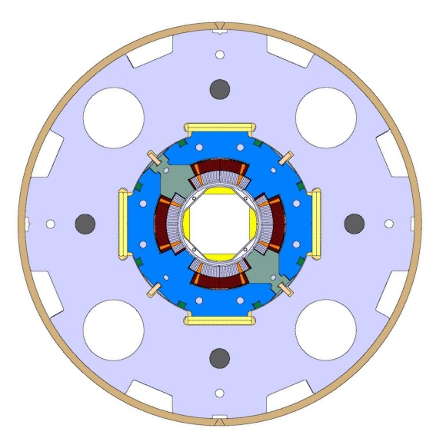
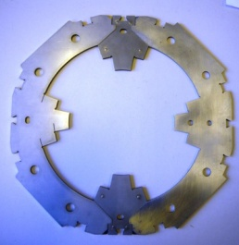
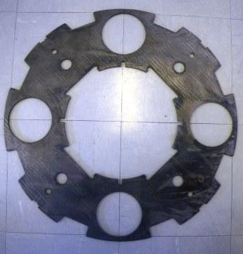
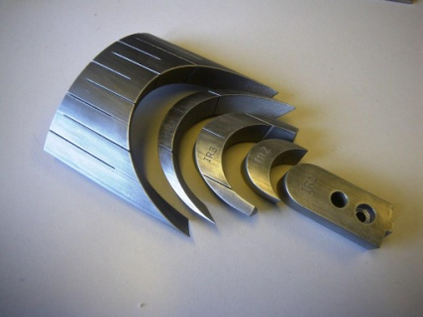
TASK 5 – MQXC NEWS
  First coils wound
  Press under commissioning
  Coil size measurements
  Collaring test coming one month
  Assembly in summer 2011
  Test end of the year
Warning
  Aperture decided July 2008
  First test end 2011
  3.5 years for a well-known technology!!
Follow-up of construction
  Field quality!
  Check design vs new requirements

Slide 18
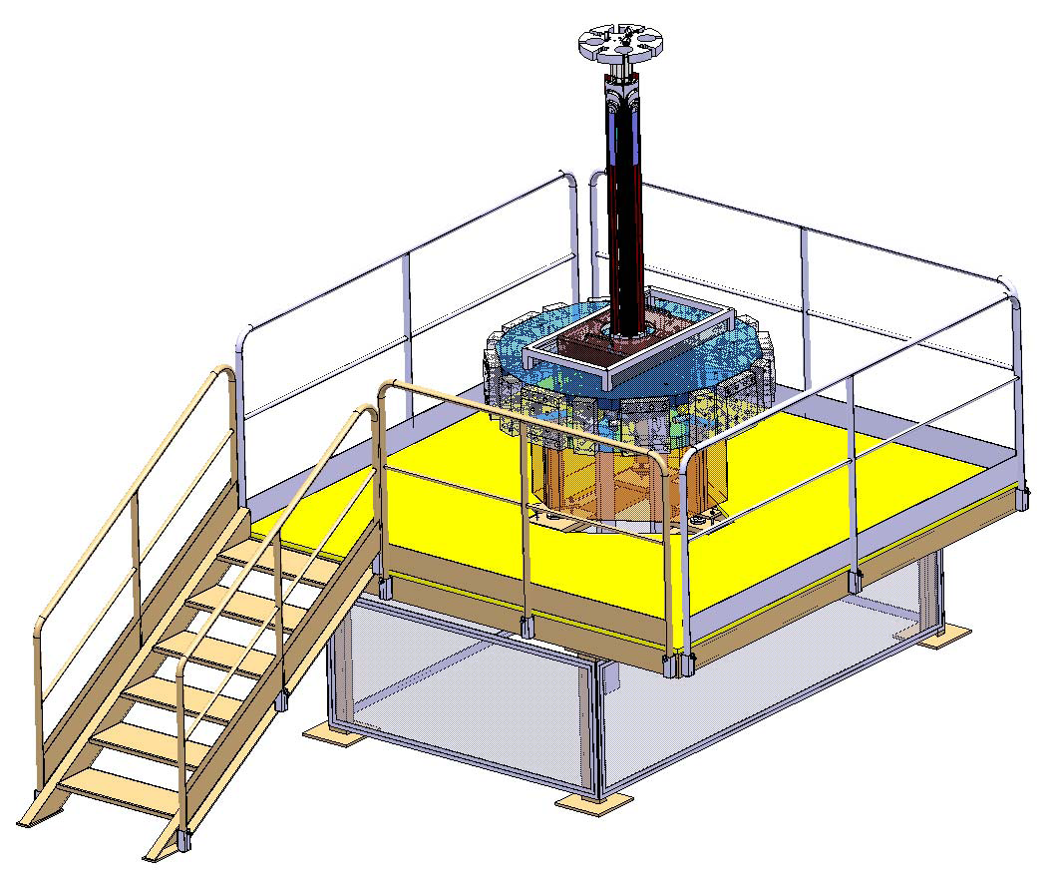
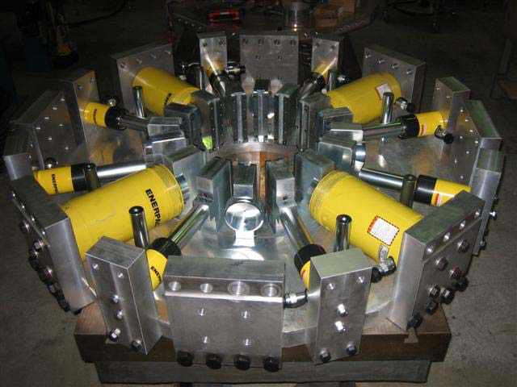
TASK 5 – MQXC NEWS
  Horizontal collaring press
Horizontal collaring press [J. Carlos Perez]

Slide 19
TASK 5 – MQXC NEWS
  Coil size measurements
Coil size measurements of MQXC [G. Kirby]

Slide 20
TASK 5 – MISCELLANEOUS
Deliverables
  M48 Miscellaneous issues in magnet design
Milestones
  M18 Review of the Nb-Ti option for inner triplet for new peak and integrated luminosity targets
  M36 Analysis of options for quadrupoles in cleaning insertions
  M36 Study of two-in-one quadrupoles for outer triplet
Task leader: J. M. Rifflet

Slide 21
OTHER REQUIREMENTS FROM WP2
What is missing
  Nested orbit corrector
    Project in progress: imagined for Phase-I, to be checked for new scenario
  SC corrector magnet packages in the triplet assembly

Slide 22
PARTNERS
EU:
  CEA Saclay (Fr) – Magnet design
  CEA Grenoble (Fr) – Supercritical cooling system
  LASA INFN Milano (It) – Magnet protection
World
  LARP: FNAL, BNL, LBL (Us) – Nb₃Sn quadrupoles
  BNL (Us) – Separation dipoles in Nb-Ti
  KEK (Jp) – Separation dipoles in Nb₃Al

