Slide 1
Single Particle Tracking as part of HL-LHC
Yunhai Cai
May 16, 2011
LARP CM16, Montauk, New York

Slide 2
Presentations for Magnetic Elements
Lie factors
engine in MARYLIE ( A. Dragt)
violates symplecticity when evaluates
Dragt-Finn
engine in TRANSPORT, MAD, COSY
(K. Brown and M. Berz), simple R-matrix
but high-order one violates symplecticity
Taylor map
TPSA
Symplectic
integrator
engine in TEAPOT, SAD, TRACY, LEGO,
PTC (E. Forest, R. Ruth, and K. Hirata)
preserves symplecticity
simple and based on several known solutions
emphasis on numerical process

Slide 3
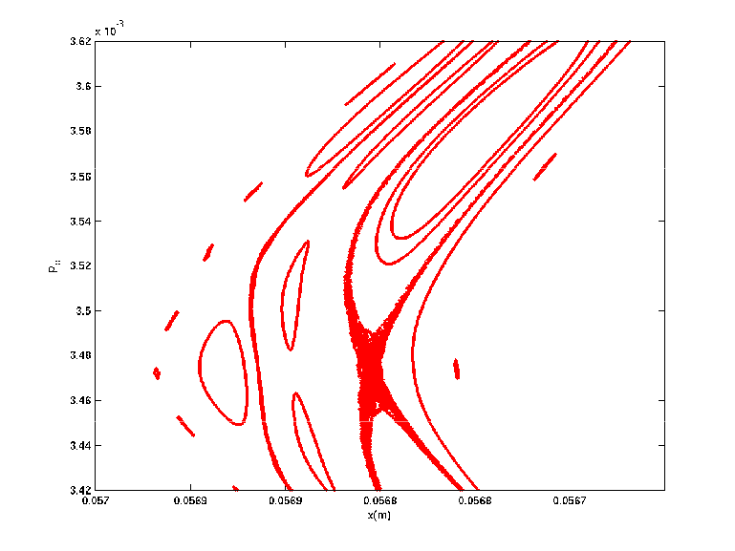
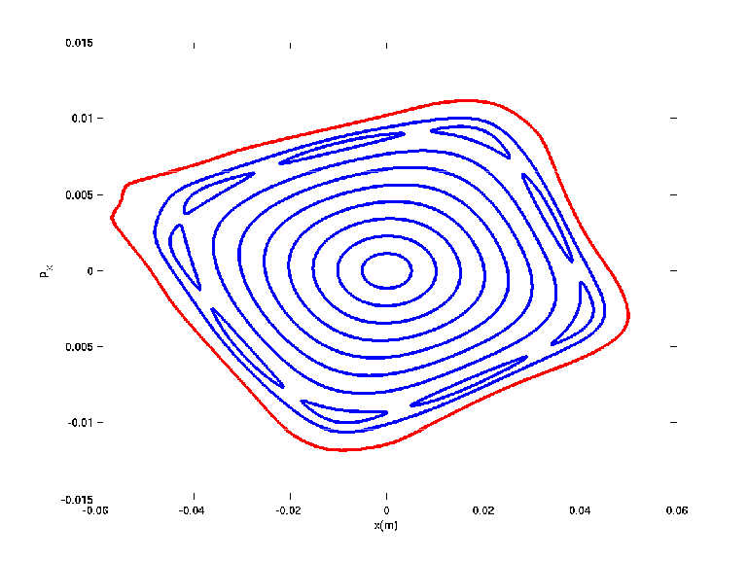
Characteristics of Phase Space
ν_{x}=0.23
p_{x}
Zoom in
x x
Stable region with largest amplitudes

Slide 4
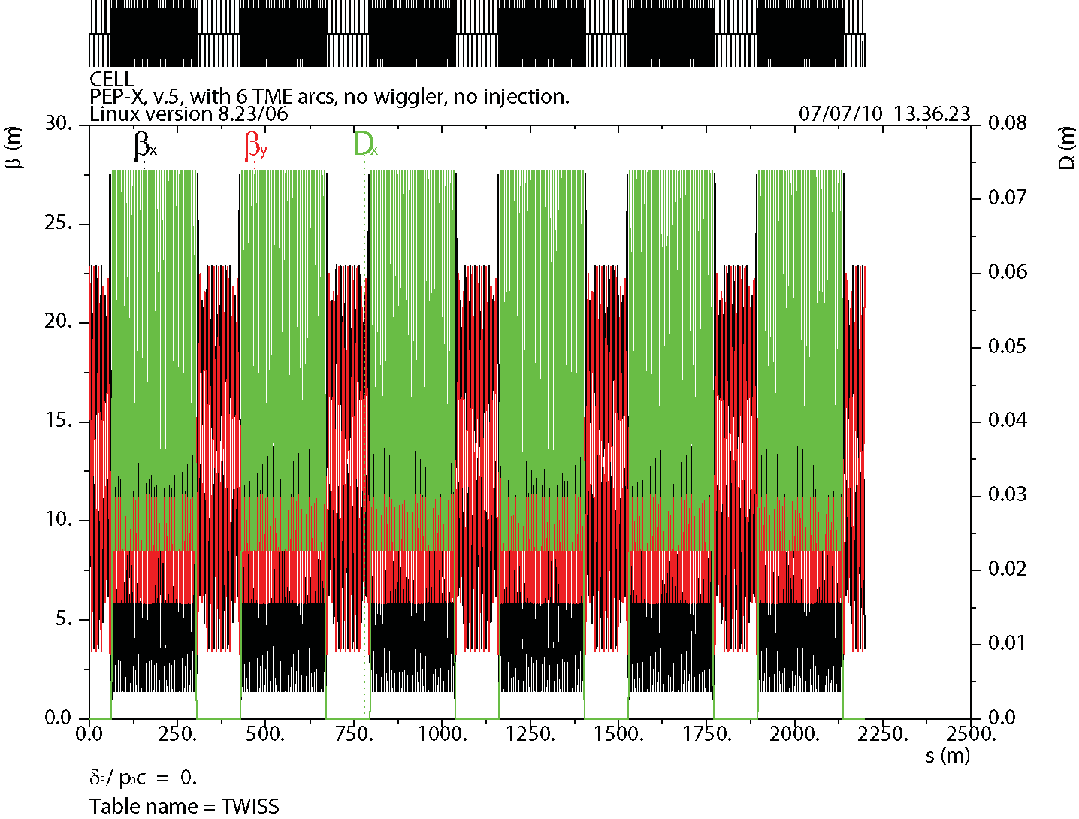
PEP-X Lattice Functions

Slide 5
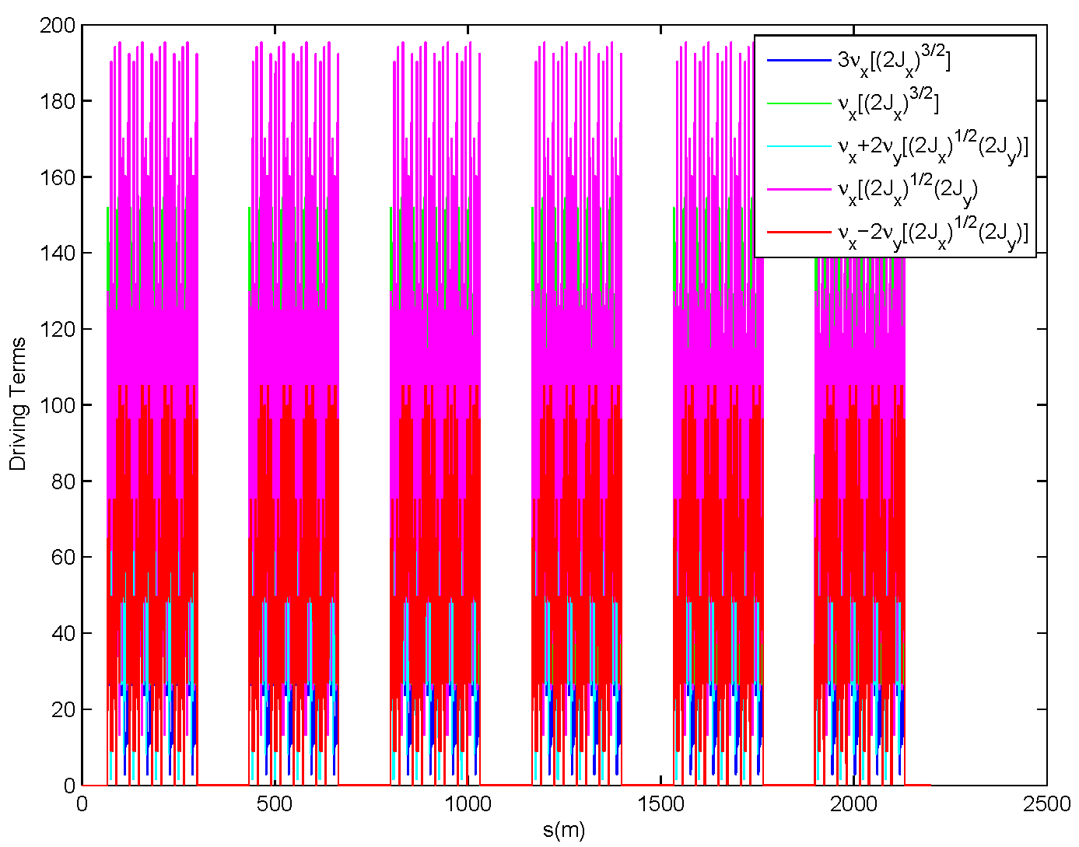
“Third-Order” Achromat (linear in sextupole strengths)
Nonlinear effects of sextupole magnets, calculated with LEGO. The results
show that eight 135⁰/45⁰ cells make a “third-order” achromat. The cancellations
are due to the phase advance of cells and do not depend on the strengths of
sextupole magnets, as along they are the same as in a family.

Slide 6
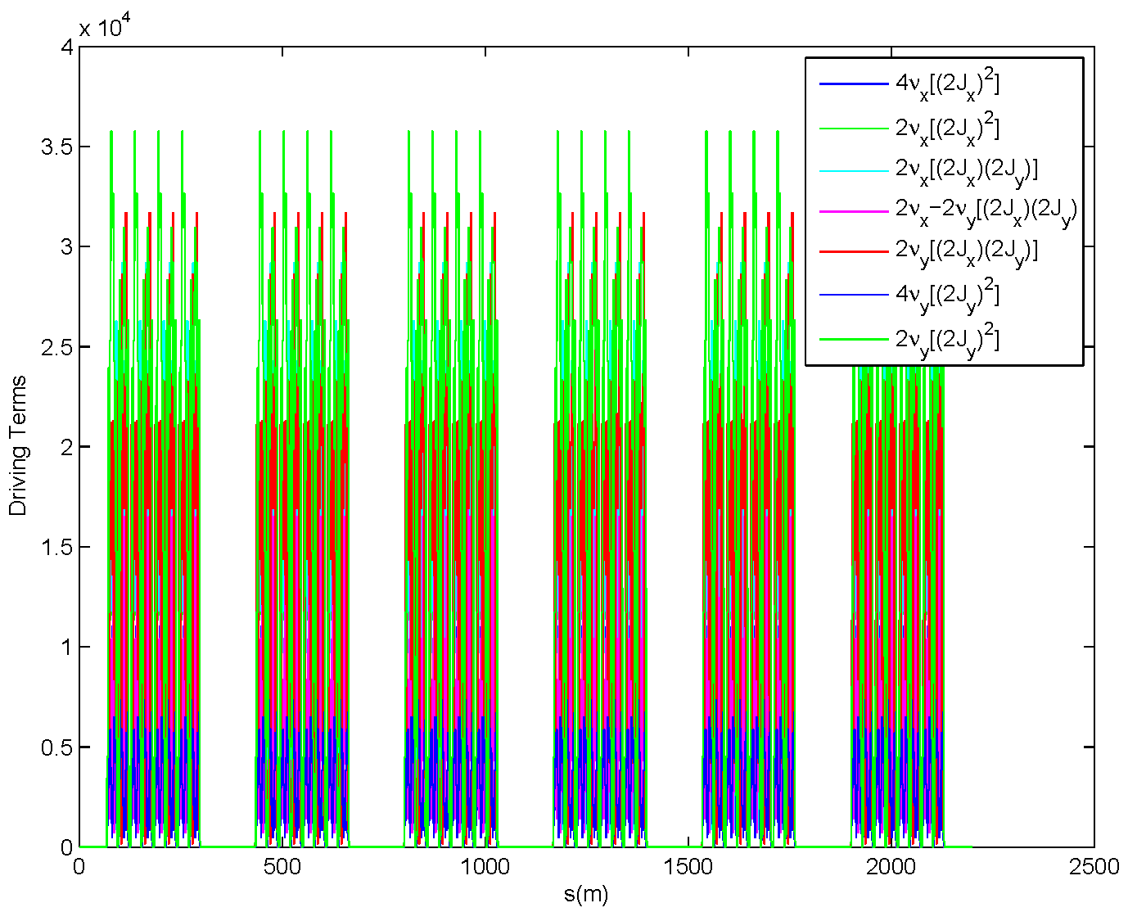
Fourth-Order Achromat? (quadratic in sextupole strengths)
Interferences among sextupole magnets, calculated with LEGO using Lie
method. The results show that eight 135⁰/45⁰ cells nearly make a “fourth-order”
achromat.

Slide 7
Motivations for Collimation System
Impedance of the phase I collimators (C) is over the budget for the nominal design current. This means that we most likely to select mental as collimator material for the phase II collimators.
But, due to the high energy and high intensity of the LHC beam to metallic collimator is easily melted in an accidental beam loss. Hence, we consider to use consumable collimators based on the design for linear collider for the phase II system.
Efficiency of the secondary collimators has to be to be improved to the level of 1x10⁻⁴. That means that the number of escaped protons from the secondary collimators relative to the number of impacted protons on the primary collimators is below 0.01%.
Needs to reduce the background in the particle detectors to a tolerable level. Collimators are an important part of the machine protection system.

Slide 8
Betatron Collimators in IR7
name | ds[m] | angle[degree] | L[m] | β_{y}[m] | α_{y} | δψ_{y}[degree]
TCP.D6L7.B1 | 0.00 | 90.01 | 0.02 | 76.66 | -1.10 | 0.00
TCP.C6L7.B1 | 2.00 | 0.00 | 0.02 | 81.10 | -1.15 | 1.42
TCP.B6L7.B1 | 4.00 | 126.91 | 0.02 | 85.76 | -1.21 | 2.77
TCSG.B6L7.B1 | 39.49 | 41.37 | 1.00 | 206.15 | -2.21 | 17.99
TCSG.A6L7.B1 | 43.49 | 141.12 | 1.00 | 224.18 | -2.32 | 19.04
TCSG.B5L7.B1 | 102.72 | 143.47 | 1.00 | 165.99 | 2.67 | 31.81
TCSG.A5L7.B1 | 106.72 | 40.68 | 1.00 | 145.63 | 2.48 | 33.28
TCSG.D4L7.B1 | 128.05 | 90.01 | 1.00 | 69.37 | 0.90 | 45.94
TCSG.B4L7.B1 | 197.98 | 0.00 | 1.00 | 133.15 | -1.25 | 101.94
TCSG.A4L7.B1 | 201.98 | 134.59 | 1.00 | 143.50 | -1.33 | 103.63
TCSG.A4R7.B1 | 205.98 | 46.30 | 1.00 | 154.47 | -1.40 | 105.19
TCSG.B5R7.B1 | 254.72 | 141.52 | 1.00 | 267.98 | -2.36 | 117.65
TCSG.D5R7.B1 | 313.23 | 51.39 | 1.00 | 158.25 | 2.92 | 128.97
TCSG.E5R7.B1 | 317.23 | 130.46 | 1.00 | 135.70 | 2.68 | 130.53
TCSG.6R7.B1 | 351.84 | 0.52 | 1.00 | 46.42 | 0.02 | 160.12

Slide 9
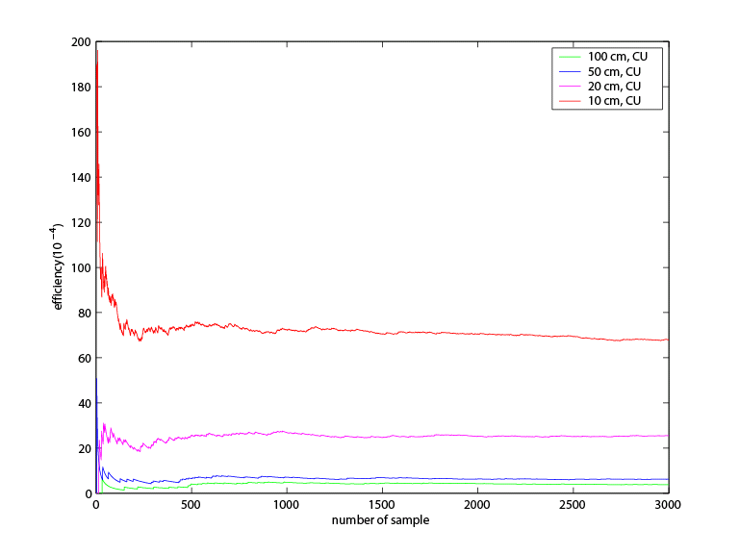
Copper as the Material of Secondary Collimators for Phase-II
Collision energy 7 Tev and collision lattice
Primary collimators at 6σ and secondary ones at 7σ.
Initial beam: 6.003(0.0015) in vertical plane
ν_{x}=64.31, ν_{y}=59.32,
ε_{x}=ε_{y}=0.5nm-rad
Simulated using code: SixtrackwColl updated and supported by Guillaume Robert-Demolaize at CERN

Slide 10
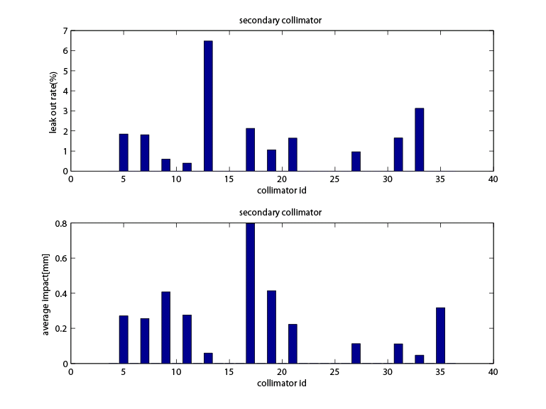
Leak out from Secondary Collimators
smaller β_{y} = 70m
For 15cm of interaction length of
copper, 2% leakage gives an
effective length of 60cm compared
with the actual length of 100cm. That
implies that there are significant protons
scattered through the edge of the
collimators due to the angular divergence.
Total number of proton leaked out is
1155 out of 144,446 absorbed.

Slide 11
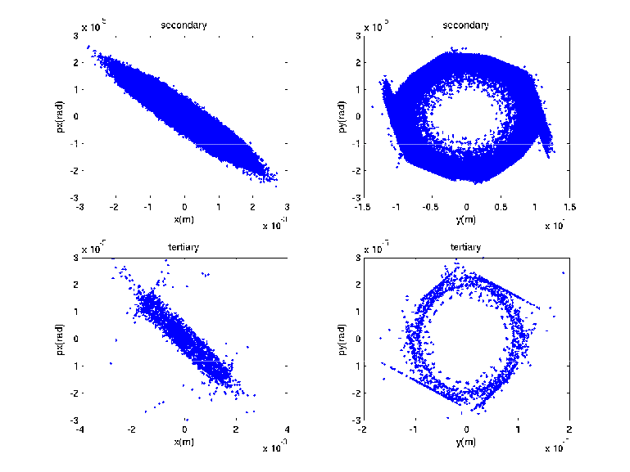
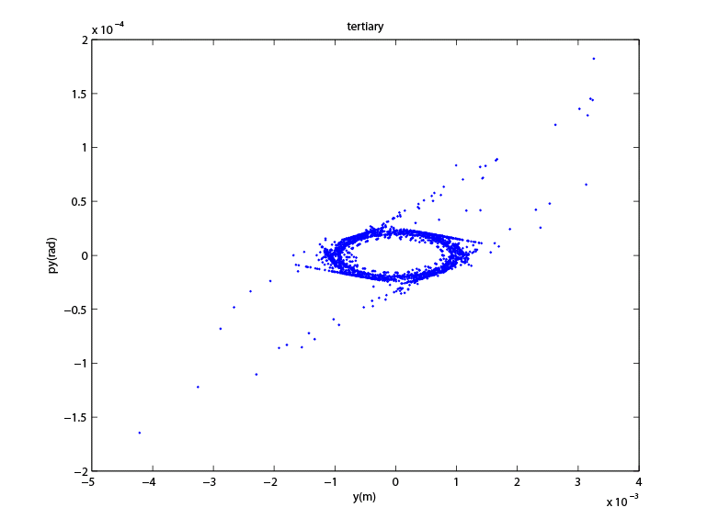
How Particles Escaped Collimation System?
Horizontal Vertical
Secondary
Tertiary
Route to large aperture

Slide 12
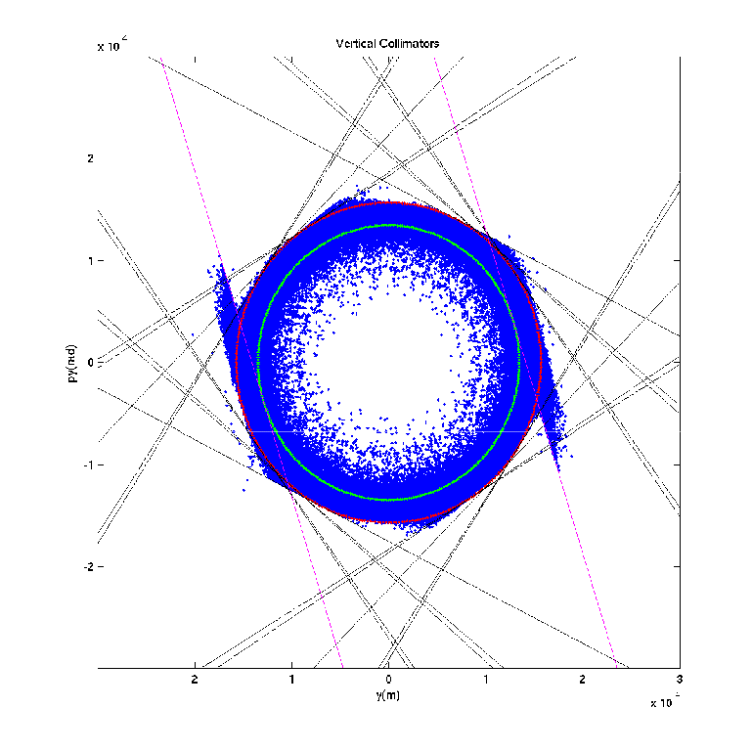
Vertical & Skew Collimators
Secondary halo in normalized
phase space at the end of
collimation system
Primary
collimator
Collimators are projected to
The end of collimation system
This is an independent check of the simulation code, since the collimators are plotted
according to the lattice functions calculated using MAD.

Slide 13
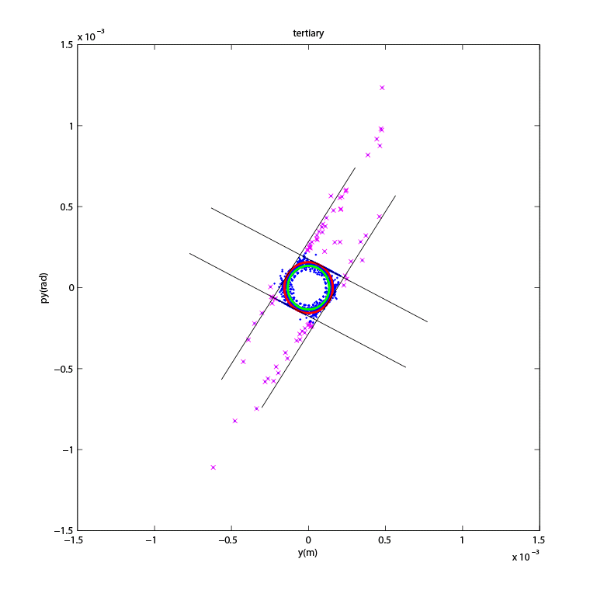
Tertiary Halo: Particles Escaped from the Secondary Collimators
TCSG.E5R7.B1: last skew collimator
Number of particles beyond
10σ is 73, which is consistent
with the efficiency calculation:
73/144446 = 5x10⁻⁴.
Tertiary halo at large amplitude
is generated by the large-angle
Coulomb scattering in the last
collimator.
If we add a tertiary collimator
at 8σ in the same phase as
the collimator: TCSG.D4L7.B1
after the secondary collimators,
the efficiency should be better
than 1x10⁻⁴.
TCSG.D4L7.B1

Slide 14
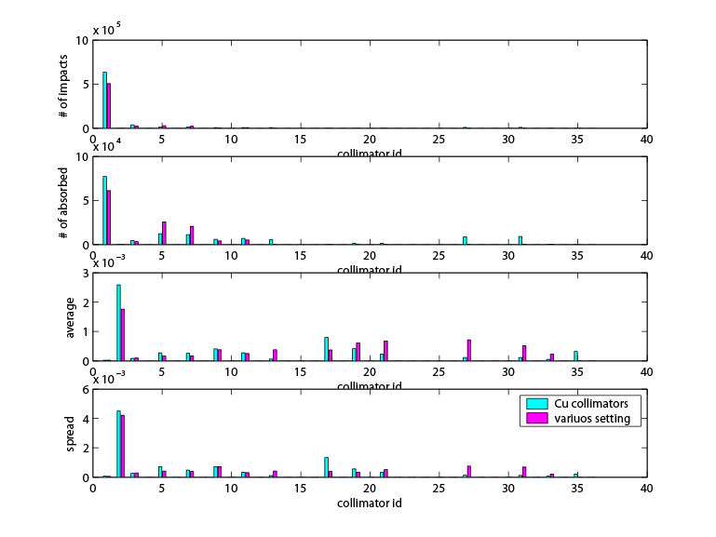
Comparison of the Loss Map
This will make the first two secondary collimators a little
harder to build.

Slide 15
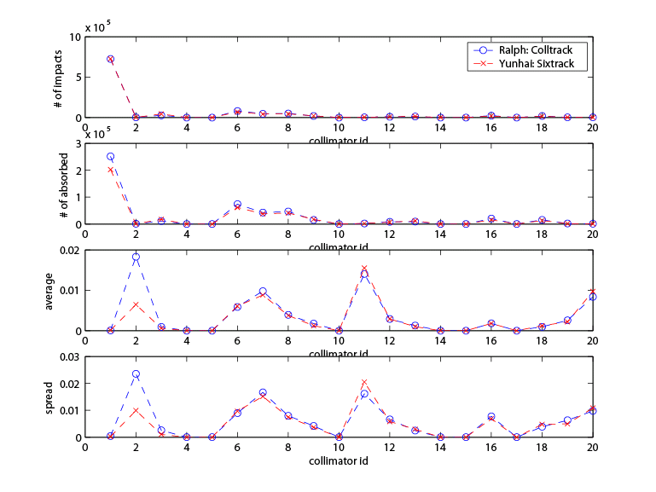
Benchmark to Ralph’s Simulation of Phase I Collimation System
# impacts
# absorbed
<impact parameter>
spread of impact
parameter
Injection energy: 450 Gev

Slide 16
Plan for Study
Evaluate dynamic aperture and performance of various options of lattices for HL-HLC
Given the collimation system, generate loss map as input to the study of the energy deposition
Make suggestions for further improvement of the upgrade lattices or maybe the collimation system

