Slide 1
Considerations for FET-based Broadband Chopper Modulator
Craig Burkhart & Tao Tang April 13, 2011

Slide 2
Modulator Parameters
162.5 RFQ frequency
6.15 ns bunch spacing
Maximum kicker pulse: ~12 ns
Maximum kicker PRF: ~80 MHz?
5 mrad deflection
Four, 0.5 m lattice locations at 180º separation
Kicker length: 30 cm?
Kicker aperture?
Kicker efficiency (effective electric field on beam): 0.7 to 1
Allowable perturbation to transported beam
Transverse energy
Transverse energy jitter
Better definition in Functional Specifications Requirements

Slide 3
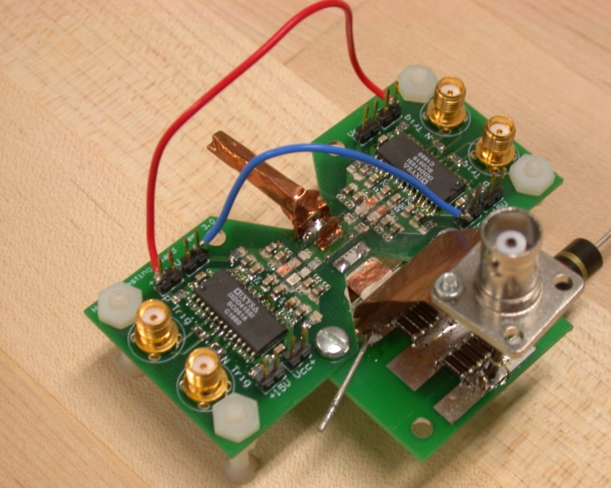
Hybrid Switch Module (HSM)
Hybrid FET/driver
Developed for ILC DR
Ultra-fast switching
Turn on ~1 ns
Turn off α RC_{OSS}
Select FET for load
1.2 kV max
35 A max
Limitations
Stability, pseudo linear regime
Average power

Slide 4
Ultra-fast Adder
Inductively combines HSMs in series
HSMs ground referenced, simplifies
Isolation
Charging
Triggering
Minimal degradation of HSM waveforms

Slide 5
HSM Stability
MOSFET junction is not fully saturated with carriers for several ns
Switching is in semi-linear mode
Variations in G_{m} will effect switching behavior
Many factors influence gain
Die temperature, and hence kick pattern
Manufacturing variations
Stability ~10% for broadband application

Slide 6
HSM Dissipation
Dominated by switching losses at high PRF
Switching loss is primarily dissipation of energy stored in device output capacitance
P = 0.5 C_{OSS} V²
Power hybrids are typically capable of dissipating 0.1 to 1 kW, but 2nd generation HSM must be fabricated and tested to determine capability

Slide 7
MOSFET Output Capacitance
Output capacitance is voltage dependent
Output capacitance is device dependent
Increases with FET ampacity (for a given V_{DSS} )
Increases with FET voltage (for a given I_{DS} )
Examples
APT1201R4
1200 V, 36 A, 310 pF (~150 pF effective)
P = (0.5) (150 pF) (1 kV)² (80 MHz) = 6 kW
IRF630N
200 V, 37 A, 89 pF (~47 pF effective)
P = (0.5) (47 pF) (0.18 kV)² (80 MHz) = 61 W

Slide 8
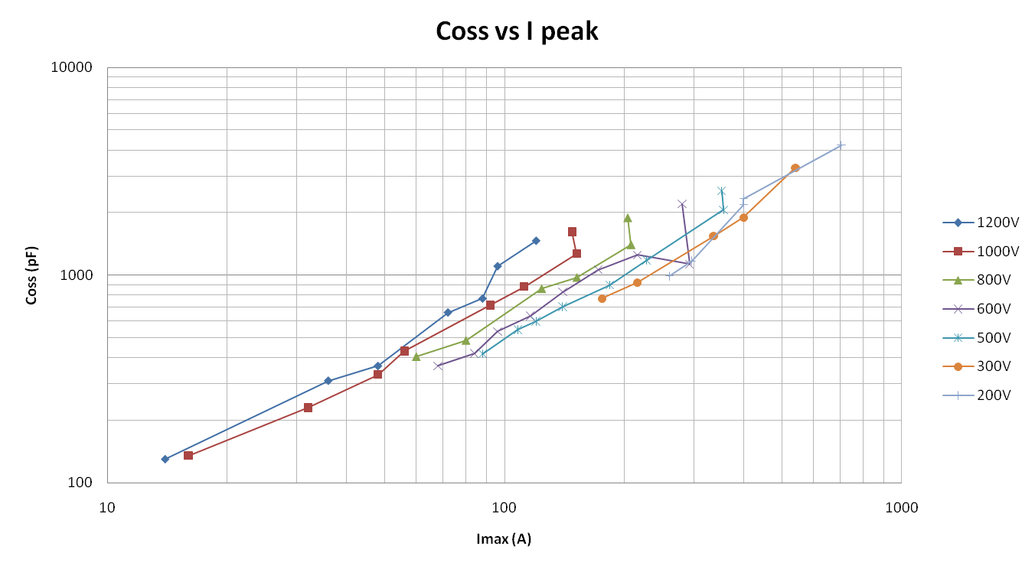
Output Capacitance Dependencies

Slide 9
Broadband Kicker Modulator Topologies
Traveling wave structures are resistive load
HSM turn on is fine
HSM turn off
RC ≈ (0.1 nF) (50 Ω) = 5 ns, too long
Consider line-type modulator, switch is only closing
Distributed electrode structures are capacitive
Need totem pole driver to discharge
Switches charge C_{OSS} of other

Slide 10
“Classic” Line-type Modulator
Pulse length: 2X propagation time of T1
Rise/fall time
Characteristic of M1, ~1 ns
Chopper voltage: HV/2

Slide 11
Possible Traveling Wave Alternative
Kicker normally “on”, HSM shunts voltage
Chopper voltage: HV
Increased kicker load power
HSM sets fall time, HV impedance sets RC

Slide 12
Totem Pole for Distributed Electrodes
Upper switch charges
Lower switch discharges
Switch load: C_{load} + C_{OSS}

Slide 13
Benefit of Series Totem Pole
Switch load: C_{load} + C_{OSS} /2
Series can be achieved using adder topology

Slide 14
Conclusions
Requirements require better definition
Hybrid MOSFET/driver has sufficient switching speed for broadband application
Thermal capacity of 2nd generation HSM must be evaluated
Switching losses must be minimized
Investigate approaches to reduce effective FET output capacitance
Alternative topologies

