Slide 1
Status of the SPL cryo-module design
V.Parma,
CERN, TE-MSC
On behalf of the SPL cryomodule development team
(CERN, CEA-Saclay, CNRS-IPNO Orsay, ESS)

Slide 2
Outline
SPL cryomodule goals and motivation
The collaboration effort
Main design features
Supporting system
Cryogenics scheme
Schedule
Summary and outlook

Slide 3

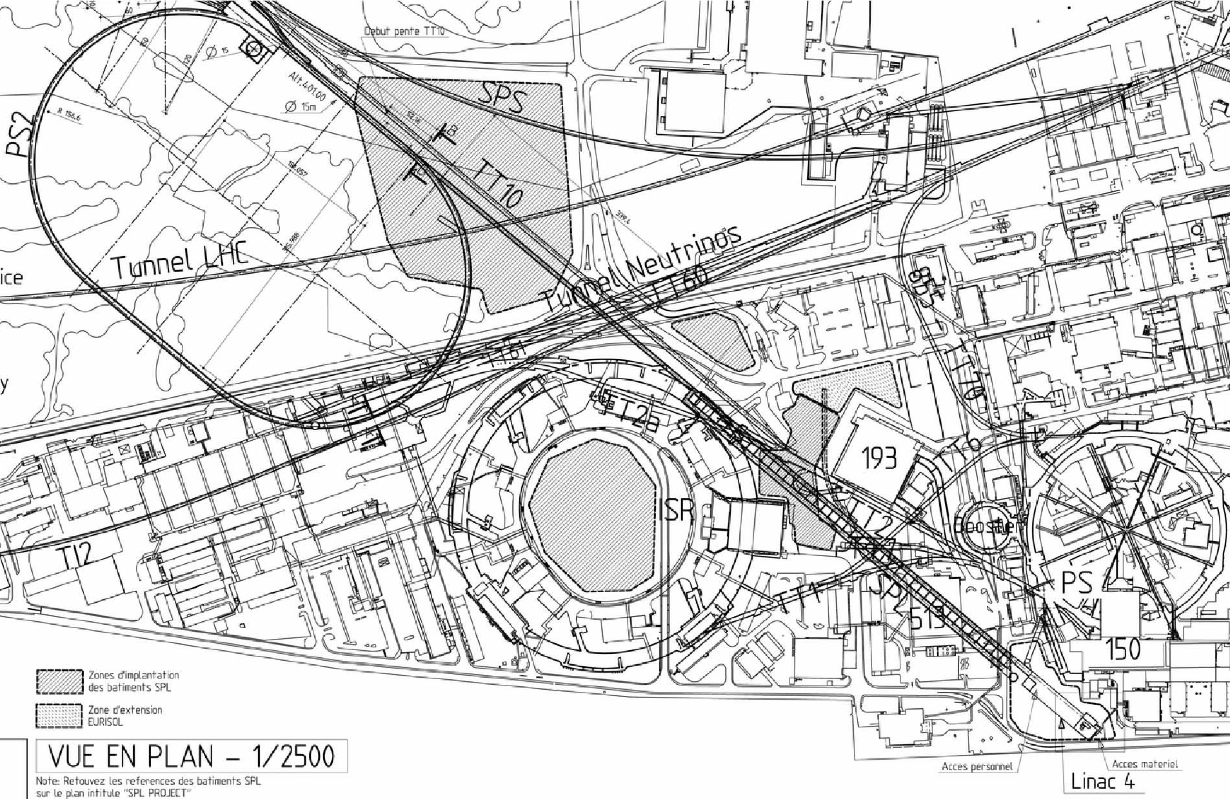
CERN’s injector complex (former plans)
SPS
(operational)
PS2
(former plans)
ISOLDE
(operational)
PS
(operational)
SPL
(former plans)
Linac 4
(in construction)

Slide 4
R&D for a high power SPL (HP-SPL)
General orientation:
Focus on R&D for key technologies for a high-intensity proton source (HP SPL) for a neutrino facility
In particular, as far as cryo-module development:
Development, construction and test of β=1 elliptical cavities, 704 MHz
Development, construction and test of RF couplers
Test of a string of 4 β=1 cavities in a machine-type configuration:
  Housed in helium vessels, equipped with tuners
  Powered by machine-type RF coupler
This program calls for the design and construction of a short cryo-module for testing purposes

Slide 5
Short cryo-module: Goal & Motivation
Goal:
Design and construct a ½-lenght cryo-module for testing of a string of 4 β=1 cavities
Motivation:
Test-bench for RF testing on a multi-cavity assembly driven by a single or multiple RF source(s)
Enable testing of critical components like RF couplers, tuners, HOM couplers in their real operating environment
Cryo-module-related goals:
Validation of design & construction issues
Learning of the critical assembly phases (from clean-room to cryostat assembly):
Validation through operational experience:
  Cool-down/warm-up transients and thermal mechanics
  Alignment/position stability of cavities
  Cryogenic operation (He filling, level control, RF coupler support tube cooling …)

Slide 6
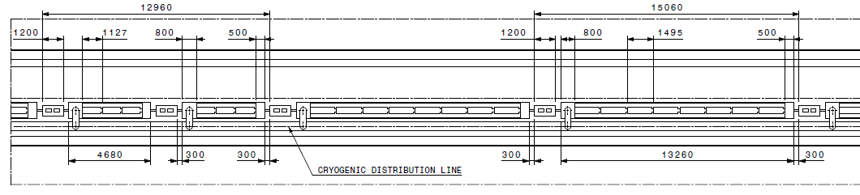
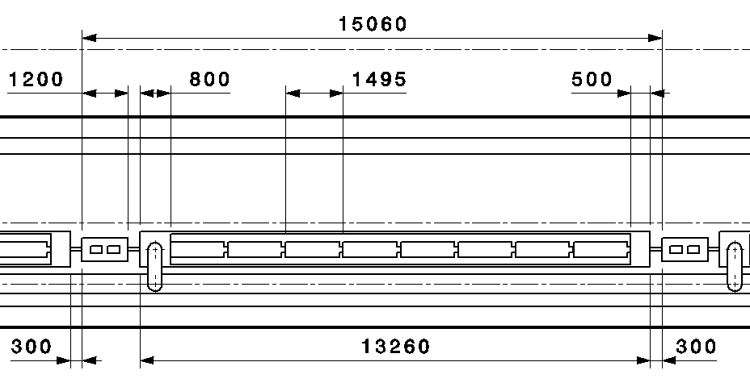
A possible SPL architecture
«segmented» with warm quads and a cryo distribution line:
warm quads
β =0.65 cryomodule (3 cavities)
β =1 cryomodule (8 cavities)
Short Cryomodule designed to
be compatible with a full-lenght
8 cavity cryomodule:
Mechanical design
Cryogenics (Heat loads,
T and p profiles)
4 cavities less

Slide 7
The cryomodule development: a collaboration effort
System/Activity | Responsible/member | Lab
Cryo-module coordination | V.Parma | CERN
Cryo-module conceptual design | V.Parma. Team: N.Bourcey, P.Coelho, O.Capatina, D.Caparros, Th.Renaglia, A.Vande Craen | CERN
Cryo-module detailed design & Integration CNRS | P.Duthil (P.Duchesne) + CNRS Team | CNRS/IPNO-Orsay
Cryostat assembly tooling | P.Duthil (P.Duchesne) | CNRS/IPNO-Orsay
Cavities/He vessel/tuner, RF coupler) | W.Weingarten/O.Capatina/S.Chel | CERN/CEA-Saclay
RF Coupler | E.Montesinos/S.Chel | CERN/CEA Saclay
Vacuum systems | S.Calatroni | CERN
Cryogenics | U.Wagner | CERN
Survey and alignment | D.Missiaen | CERN
SPL Machine architecture | F.Gerigk | CERN
ESS cryo-module requirements | W.Hees | ESS Lund (Sweden)

Slide 8
Main H/W contributions for short cryo-module
Institute | Supply
CEA – Saclay (F) | Design of β=1 cavities (EuCARD task 10.2.2) Design & construction of 4 helium vessels for β=1 cavities* Supply of 4 (+4) tuners* Testing of RF couplers*
CNRS - IPNO – Orsay (F) | Supply of prototype cryomodule cryostat components* Design & construction of cryostat assembly tools*
Stony Brook/BNL/AES team | (Under DOE grant) Designing, building and testing of 1 β=1 SPL cavity.
CERN | 4 (+4) β=1 cavities (supplied from European industry)
CERN | 4 (+4) RF couplers (2 types)
* Special French in-kind contribution to CERN

Slide 9
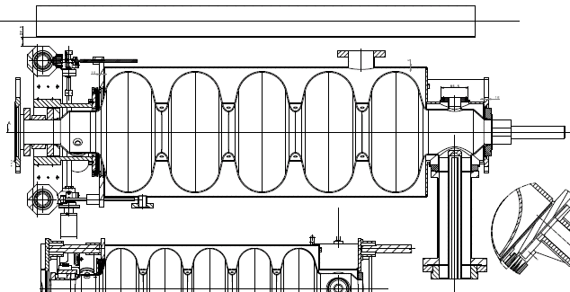
Cavity/He vessel/Tuner
to He bi-phase tube
HOM port
Inter-cavity support
He vessel in stainless steel:
RF coupler port
CEA Tuner
Inter-cavity hydraulic connection
Cavity (Nb)
Design not final!
Requirement | Value
β | 1
Frequency | 704.4 MHz
Qo | 10 x 10⁹
Gradient | 25 MV/m
Operat. T | 2 K
He vessel includes specific features for cryo-module integration:
inter-cavity supports,
cryogenic feeds
external magnetic shielding cryoperm™ (not shown)

Slide 10
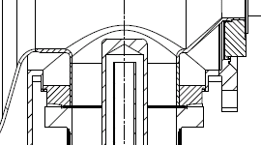
Cavity in st.steel He vessel
niobium
St.steel
Brazing Nb-St.steel

Slide 11
Short cryomodule: layout schematic
Connection to cryo distribution line
End
Module
Cryo fill line (Y), top left
Technical Service
Module
Phase sep.
Inter-cavity support
CW transition
Cavity additional support
RF coupler, bottom left side
1.7% Slope (adjustable 0-2%)

Slide 12
Cavity alignment requirements
Transversal position specification
BUDGET OF TOLERANCE
Step | Sub-step | Tolerances (3σ) | Total envelopes
Cryo-module assembly | Cavity and He vessel assembly | ± 0.1 mm | Positioning of the cavity w.r.t. external referential ± 0.5 mm
 | Supporting system assembly | ± 0.2 mm
 | Vacuum vessel construction | ± 0.2 mm
Transport and handling (± 0.5 g any direction) | N.A. | ± 0.1 mm | Reproducibility/Stability of the cavity position w.r.t. external referential ± 0.3 mm
Testing/operation | Vacuum pumping | ± 0.2 mm
 | Cool-down
 | RF tests
 | Warm-up
 | Thermal cycles
Construction precision
Long-term stability

Slide 13
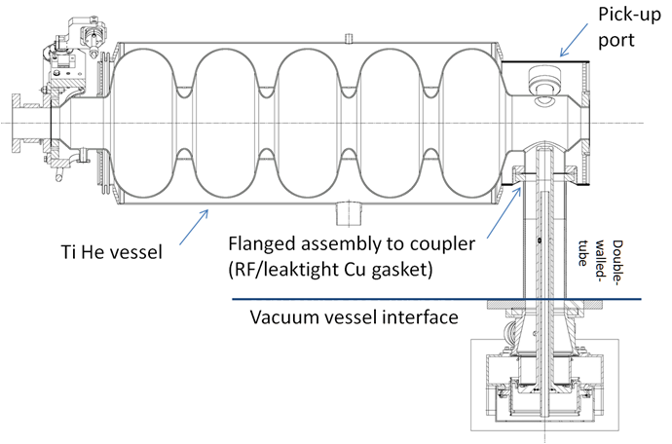
Supporting system
~540 mm
HP coupler | 1000 kW pulsed 50 Hz (20 ms) 100 kW average
Single RF window
2 Mechanical/leak test mock-ups underway to confirm this concept:
  1) Simple mock-up to assess leak-opening forces (@ RT): ready, testing in progress
  2) two-cavity string assembly in cryostat with N2 cooled double-walled tubes: (including vessel fixture features, inter-cavity support) . Planned for mid 2011.

Slide 14
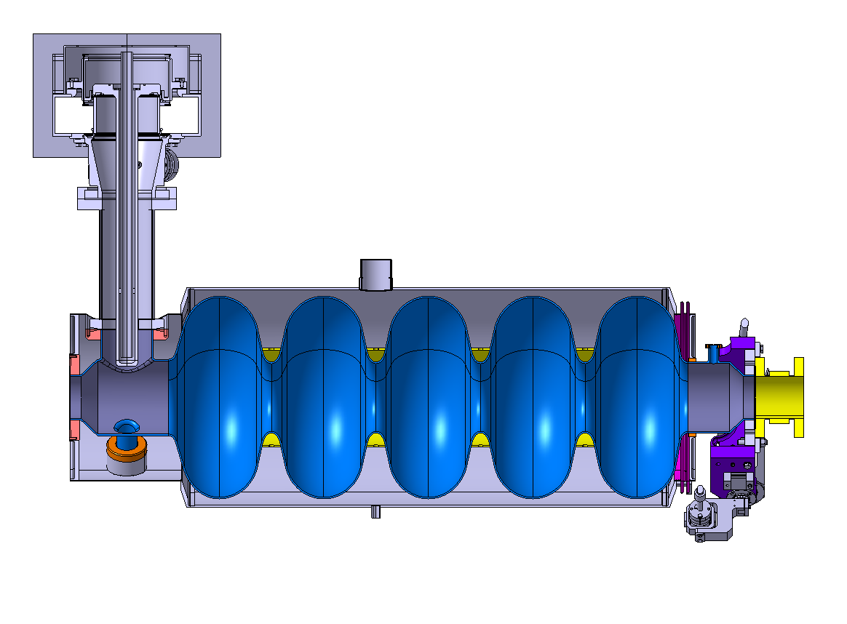
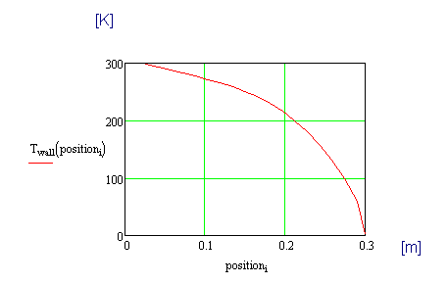
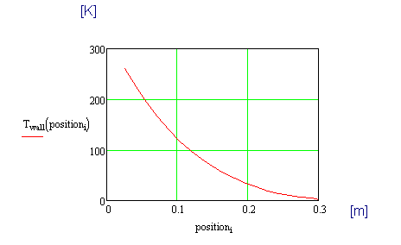
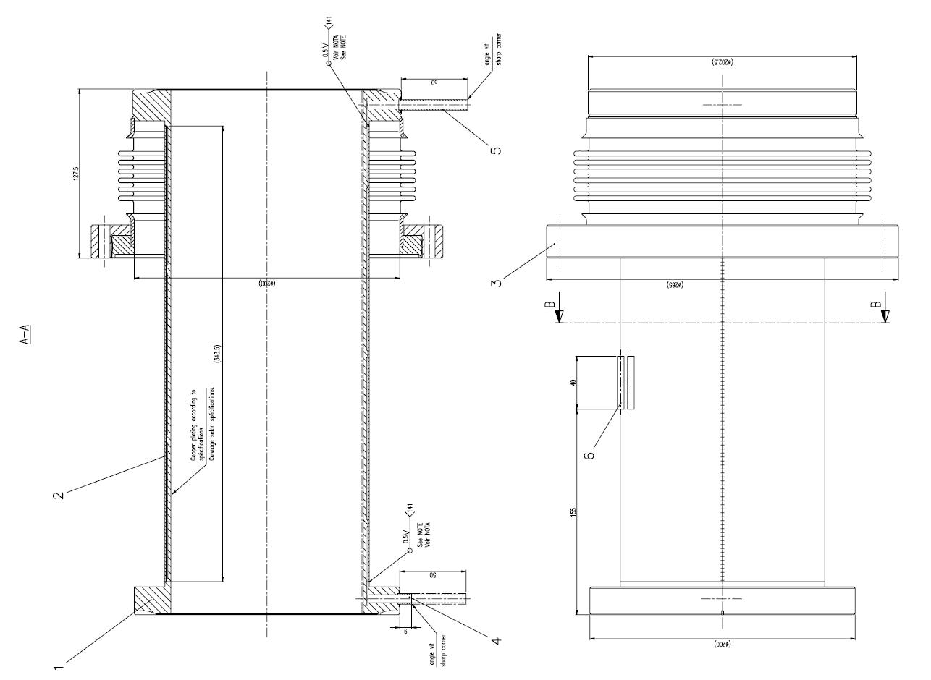
Actively cooled RF coupler tube
SPL coupler double walled tube, active cooling to limit static heat loads
  Connected at one end to cavity at 2K, other end at RT (vessel)
  Requires elec. Heater to keep T > dew point (when RF power off)
  No cooling T profile
  → 21W to 2K
Vacuum vessel
  Cooling (42 mg/sec) T profile
  → 0.1 W to 2K
Massflow mgram/sec | 21 |  | 23 |  | 28 |  | 35 |  | 42
Power | ON | OFF | ON | OFF | ON | OFF | ON | OFF | ON | OFF
Temp. gas out | 286 K | 277 K | 283 K | 273 K | 271 K | 242 K | 255 K | 205 K | 232 K | 180 K
Q thermal load to 2K | 2.4 W | 0.1 W | 1.7 W | 0.1 W | 0.4 W | 0.1 W | 0.1 W | 0.1 W | 0.1 W | 0.1 W
Q heater | 19 W | 32 W | 21 W | 34 W | 29 W | 38 W | 39 W | 41 W | 46 W | 44 W
ΔL | 0.1 mm (0.63-0.53)mm |  |  |  | 0.05 mm (0.66-0.61) |  | ~ 0 mm (0.67-0.67)
4.5 K
Heater
300 K
→ Yields a certain degree of position uncertainty (<0.1 mm?)
Helium gas cooling the double wall

Slide 15

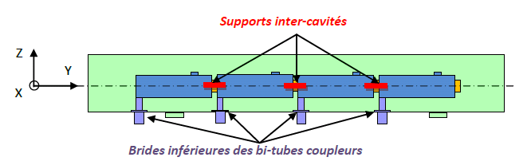
Supporting scheme
RF coupler double-walled tube as cavity support
Intercavity supports
RF coupler double-walled tube flange fixed to vacuum vessel
The RF coupler (its double-walled tube) provides:
fixed point for each cavity (thermal contractions)
mechanical supporting of each cavity on the vacuum vessel
The intercavity support provides:
a 2nd vertical support to each cavity (limits vertical self-weight sag)
relative sliding between adjacent cavities
increases of transvere stiffness to the string of cavity (increases eigenfrequencies of first modes) to higher frequencies)

Slide 16
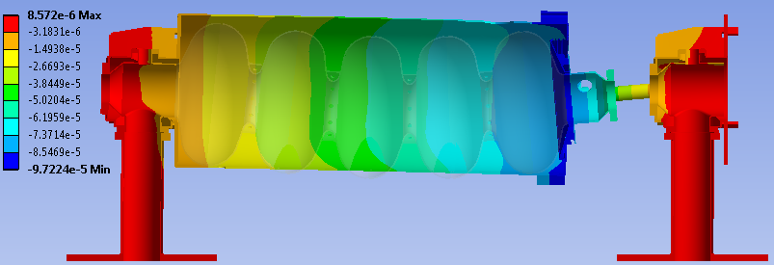
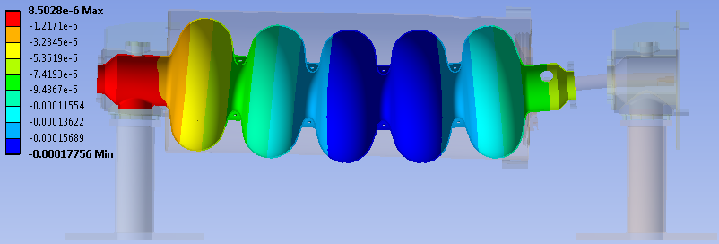
Introducing inter-cavity sliding support
Vertical displacement (colour) [m]:
in meters
Max: 0.097 mm
in meters
Max: 0.178 mm
Body deformation amplified 300x

Slide 17
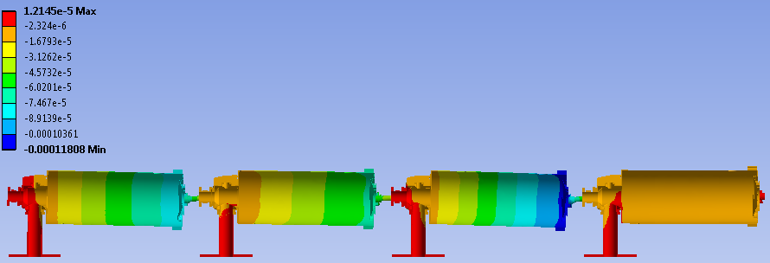
Inter-cavity sliding support
Vertical displacement (colour) [m]:
Max: 0.12 mm
Body deformation amplified 300x

Slide 18
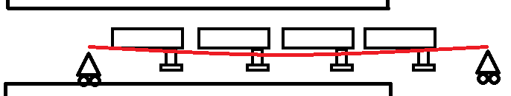
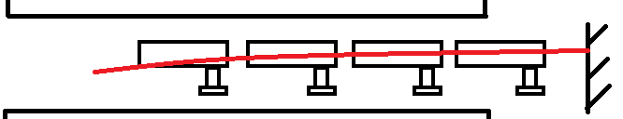
Assembly tooling – Principles
The length of the beam is ~7 m for the 4 cavities Short Cryo-module, and ~14 m for the 8 cavities cryo-module.

Slide 19
Cavity-to-vacuum vessel tolerances
 | Stack of construction tolerances
# |  | Angular tolerance (planarity or perpendicularity) |  | Radial tolerance induced by angular tolerance | Radial tolerance | Angle | Δz (@ cavity extremity 1100mm)
1 | Cavity flangeø152 | 0.3 mm (cavity design) |  | ± 0.6 mm | ± 0.1 mm (Th.Renaglia) | 0.122° | 3.5 mm / 3.1 mm
2 | Double-walled tube top flange ø152 | 0.02 mm (drwg SPLACSMC0024) |  | ± 0.04 mm
3 | Cu RF gasket ø152 | N.A. |  | N.A. | ± 0.05 mm (drwg SPLACSMC0025)
4 | Double-walled tube top flange ø500 | 0.02 mm (drwg SPLACSMC0024) |  | ± 0.02 mm |  | 0.06° / 0.037°
5 | Vac.vessel flange ø500 | 0.5 mm / 0.3 mm (experience LHC) |  | ± 0.42 mm / ± 0.25 mm | ± 0.25 mm (experience LHC)
 | TOTAL ΔXY |  |  | ± 1.48 mm / ± 1.31 mm
± 1.48 mm
At each cavity:
Vertical shimming
Angular shimming
3.5 mm

Slide 20
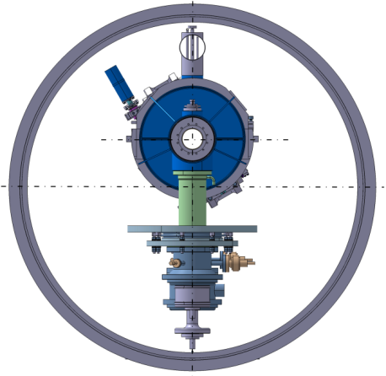
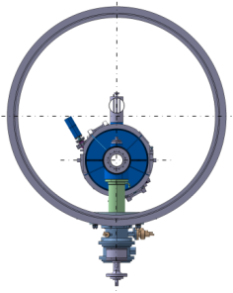
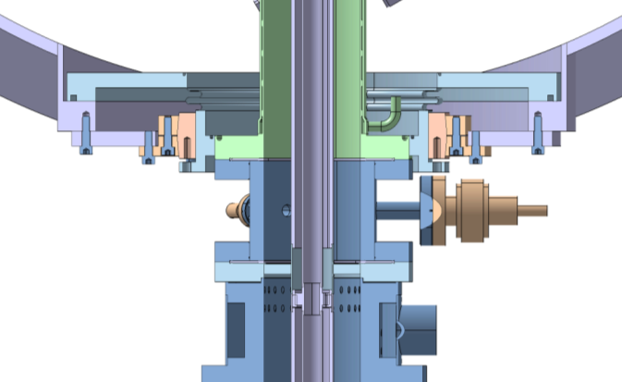
Assembly in vacuum vessel
~1200
210
Flange for mechanical support
Bellows for leak-tightness
Preliminary studies
IPNO-Orsay

Slide 21
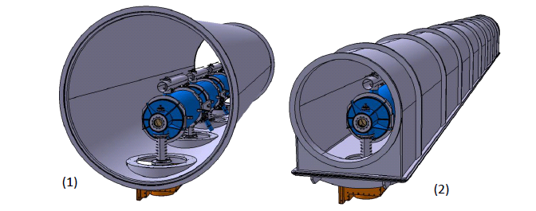
Vacuum vessel alternatives
IPNO-Orsay

Slide 22
2 K Heat Loads (per β=1 cavity)
Operating condition | Value
Beam current/pulse lenght | 40 mA/0.4 ms beam pulse | 20 mA/0.8 ms beam pulse
cryo duty cycle | 4.11% | 8.22%
quality factor | 10 x 10⁹ | 5 x 10⁹
accelerating field | 25 MV/m | 25 MV/m
Source of Heat Load | Heat Load @ 2K (per cavity)
Beam current/pulse lenght | 40 mA/0.4 ms beam pulse | 20 mA/0.8 ms beam pulse
dynamic heat load per cavity | 5.1 W | 20.4 W
static losses | <1 W (tbc) | ~ 1 W (tbc)
power coupler loss at 2 K | <0.2 W | <0.2 W
HOM loss in cavity at 2 K | <1 | <3 W
HOM coupler loss at 2 K (per coupl.) | <0.2 W | <0.2 W
beam loss | 1 W | 1 W
Total @ 2 K | 8.5 W | 25.8 W

Slide 23
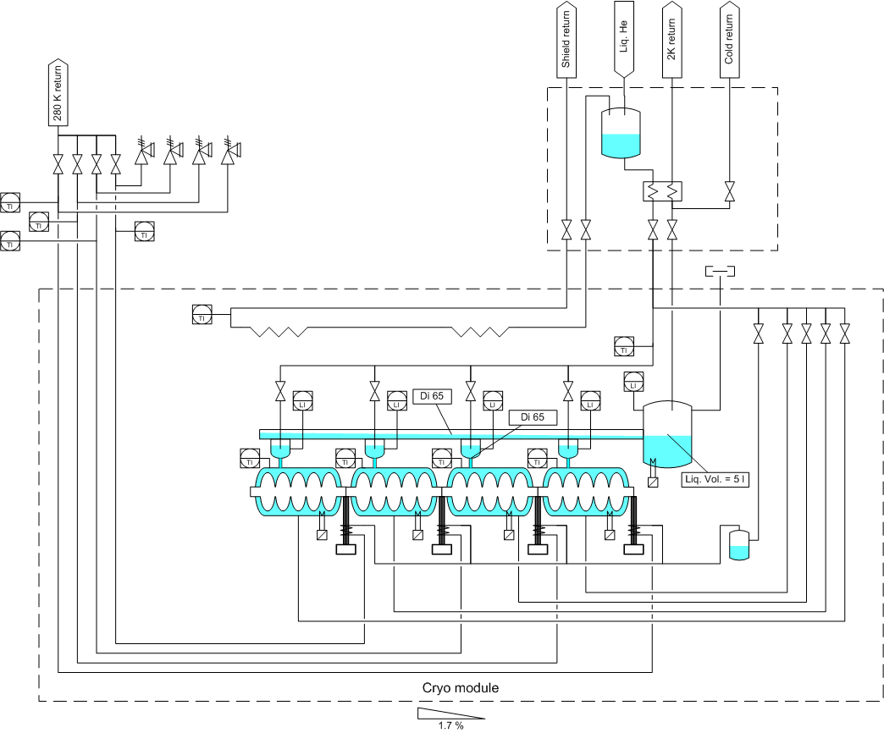
Cryogenic Scheme
E’
C
E
XB
C3
X
Y
C1
L
C2

Slide 24
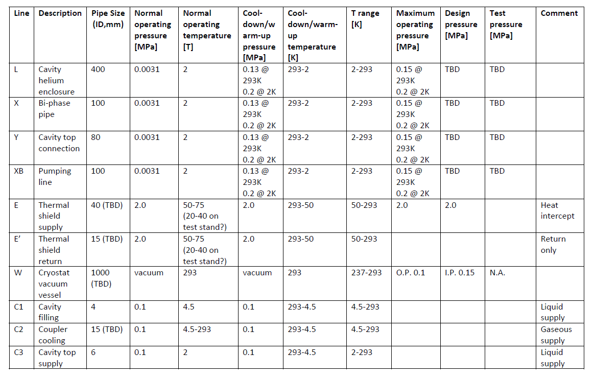
Pipe sizes and T, p operating conditions
...a few figures still to be settled

Slide 25
Schedule
2011
2012
2013
Q1
Q2
Q3
Q4
Q1
Q2
Q3
Q4
Q1
Q2
Q3
Q4
Cryogenics
Spec.
Design
Construction
Inst.
RF
Specifications
Installations
Desy
Coupler
welding, assembly
Clean room
RF power tests (CEA)
Cavities
Design
Spec. &
Call for tender
Production
Design review
Test in vertical cryo.
Insert. in He enclos.
Niobium
Cavities +Coupler
Cryostat
Conceptual design
Detailed design
Tech. Spec.
Production
Conceptual design review
Detailed design review
Cryostating
RF tests

Slide 26
Summary and outlook
Most of cryo-module requirements are now settled
Test-specific requirements (windows, instrumentation) well advanced
Conceptual choices made (cavity supporting, cryogenic scheme,…)
Still needing conceptual design work: magnetic shielding, thermal shield
2 Vacuum vessel concepts are being compared:
  Tube-type, large diameter (radial space constraint from cavity/tuner)→ preferred solution
  U type ESSS, construction complexity (=cost)
Assembly tooling concepts in progress
Mock-ups for testing supporting solution in preparation at CERN
Preliminary design review will take place in Summer 2011
Detailed design review End 2011
Procurement of cryostat components starting in 2012
Assembly of cryo-module in second half of 2013, followed by testing

Slide 27
Thank you for your attention!

Slide 28
SPARE SLIDES

Slide 29
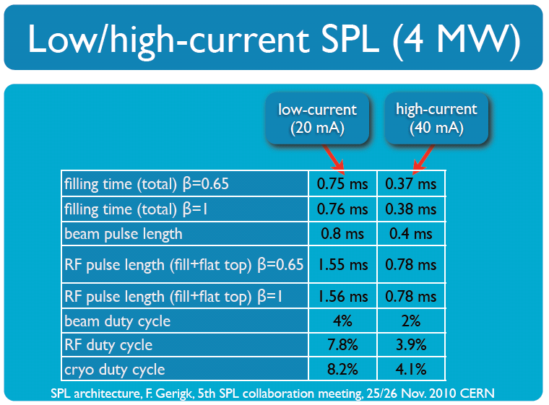

Slide 30
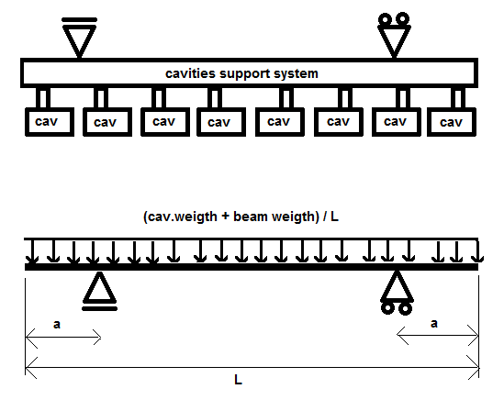
2. Supporting system – required stiffness
Calculations performed with the aim of estimating the stiffness which the support system (“Standard “supporting solution) of the SPL cavities would have to provide for the string of cavities to be kept inside a certain alignment tolerance.
Beam simply and symmetrically supported on two points, loaded by the weight of the cavities and by its own weight.
Loads are distributed uniformly along the beam
The cavities and the supports are considered to be rigid -maximum beam deflection is a measure of the maximum cavity misalignment.

Slide 31
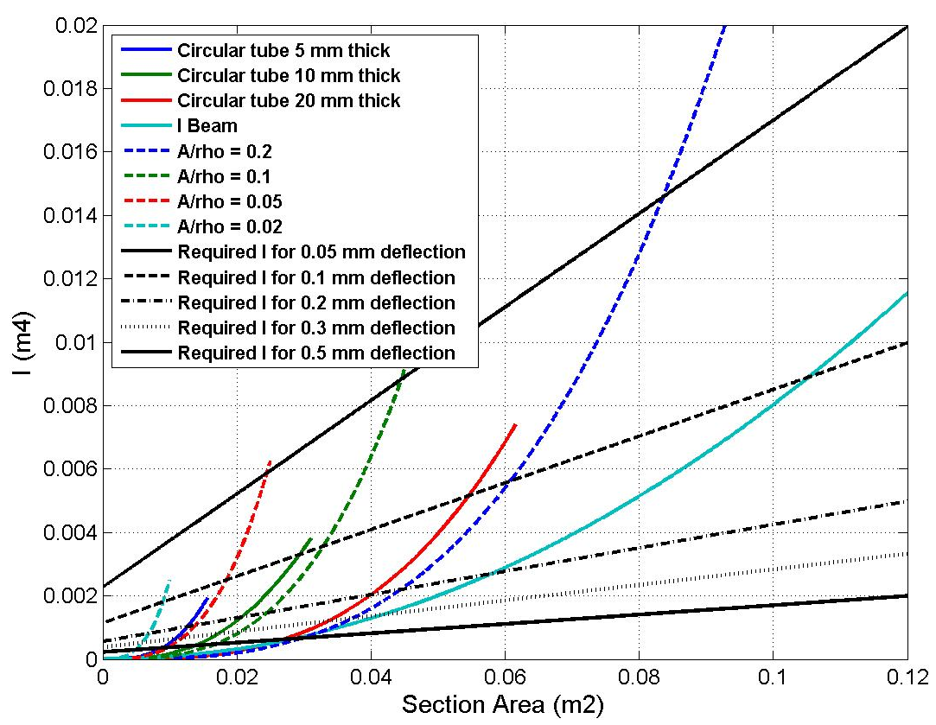
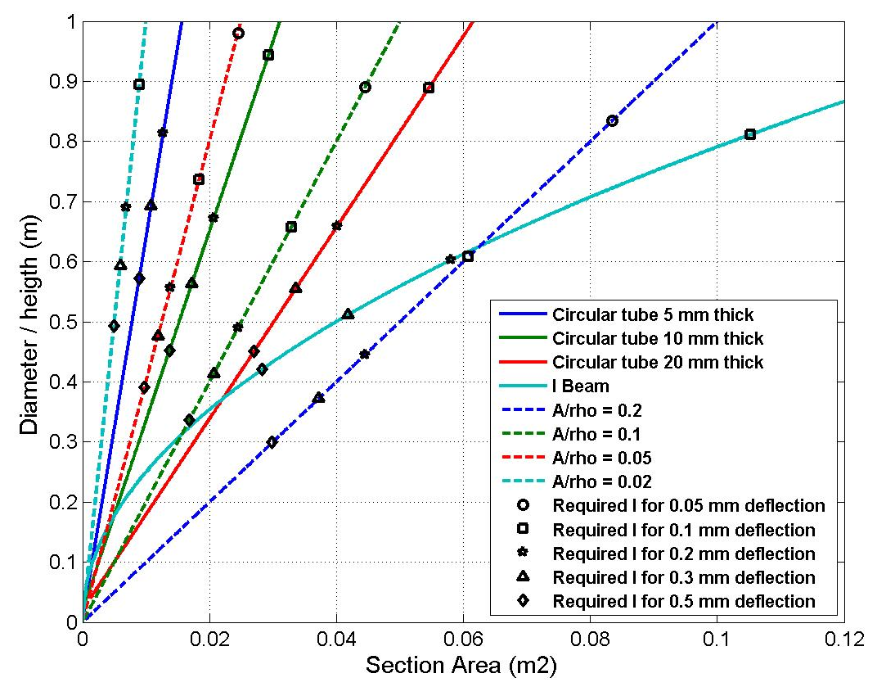
2. Supporting system – required stiffness
Required stiffness – different cross sections
L=13 m, m_{cav}=200 Kg, n_{cav}=8 , g=9.8 m/s²
Stainless steel 304 L: ρ=8000 kg/m³; E=1.93e¹¹ Pa

Slide 32
Supporting system – required stiffness
Third support? – Comparison with 2 supports
 | S [m²] | I [m⁴] | Deflection; 2 supports (analytical) [mm] | Deflection; 3 supports (FE beam analysis) [mm]
Circular tube tck. 6 mm diam. 300 mm | 0.0055 | 5.99E-05 | 2.3 | 0.358
Circular tube tck. 12 mm diam. 1000 mm | 0.0372 | 4.55E-03 | 0.075 | 0.018
- Three vertical displacements (simple supports)
- Loads remain the same.
- One support in the middle of the beam, the other two at a distance of 0.16 L from each end of the beam.

Slide 33
Conclusions
Drivers in our study:
Availability:
  Reliability/Maintainability. Components with technical risk and no in-situ repair (RF coupler, cavity/tuners):
  → quick replacement of complete cryo-module (spares needed)
Safety:
  Coping with incidents: accidental venting of cavities
→ warm, interlocked valves (cold valves do not exist)
“Segmented” layout with CDL has clear advantages
Additional advantages:
  Magnets can be warm: classical “off-the shelf”, easy alignment/maintainability/upgrade
  and cryo-module internal positioning requirements can ne relaxed (by a factor of 3)
Drawbacks:
  Less compact layout (~+10% extra lenght)
  More equipment (Cryoline, CWT, instrumentation...):
  Higher static heat loads (but dynamic loads dominate!)

Slide 34
HP-SPL architecture
R&D study for a 5 GeV, 4 MW beam power
Major interest for non-LHC physics: Fixed Target/Neutrino Factory (ISOLDE? EURISOL?)
0 m
0.16 GeV
110 m
0.79 GeV
186 m
1.4 GeV
~300 m
2.5 GeV
~500 m
5 GeV
Medium β cryomodule
High β cryomodules
Extraction
High β cryomodules
High β cryomodules
Debunchers
From Linac4
Extraction
To fixed target/μ factory
20 x 3
β=0.65 cavities
5 x 8
β=1 cavities
TT6 to
ISOLDE
6 x 8
β=1 cavities
to Eurisol
12 x 8
β=1 cavities
Length: ~540 m
HP-SPL beam characteristics

Slide 35
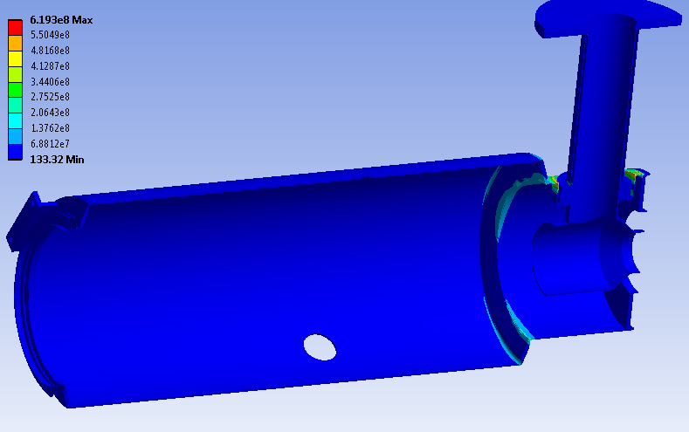
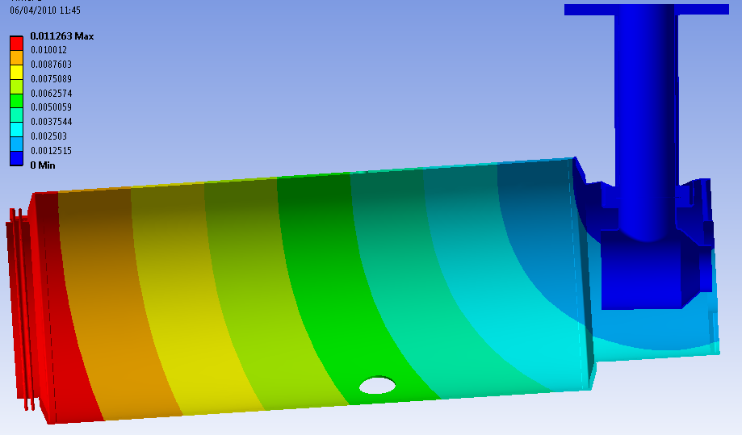
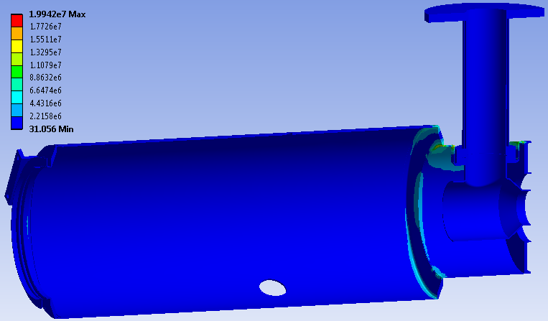
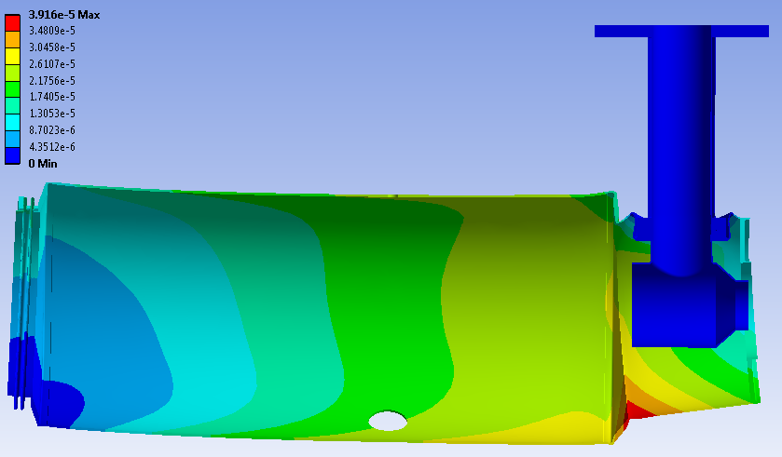
RF coupler as support
Max.stress (von Mises): 650 MPa
Max.displacement: 11 mm
RF coupler in cantilever
Max.stress (von Mises): 20 MPa
Max.displacement: 0.04 mm
RF coupler + intercavity guides

