Slide 1
Power Buildup Cavity at 355 nm for MegaWatt pulse powers
PI: Mark Notcutt
Boulder Precision Electro-Optics
5733 Central Ave
Boulder CO

Slide 2
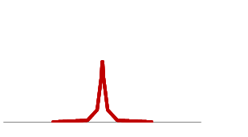
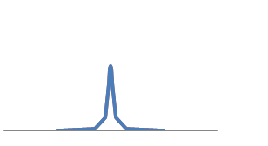
Buildup of circulation Power in a cavity
Spacing between both laser and cavity modes
Equals the repetition rate of the laser 402.5 MHz
The cavity has a wide span of equally separated resonances
(dispersion varies spacing insignificantly over 9 GHz)
The 50 ps laser pulse spans ~9 GHz
Frequency Spectrum
Red – Laser
Blue - Cavity
Df = fsr = rep rate
In the time domain, the cavity round trip time
Is equal to the pulse arrival (rep) rate
50 ps Pulse = 15 mm length, so must match cavity
Length to rep rate to ~ 15 mm

Slide 3
Power Buildup in a cavity contd
In the case that the cavity losses are much less than the mirror transmission,
all the incident light is coupled into the cavity and the circulation power is F/π times
the incident power .
The finesse, given approximately by F = 1/T (T= transmission), also determines the width
Of each resonance of the cavity, df = 402.5 MHz/ F, so for F = 1000, df = 400 kHz.
The laser oscillator has some noise processes that broaden the spectral width of each
Line. A fiber laser has a width typically of a few 10 kHz. Since you have to have the laser
Linewidth somewhat less (say 1/3) of the cavity linewidth (no fast servos here) THIS SETS THE LIMIT TO THE ACHIEVABLE FINESSE/BUILDUP FACTOR

Slide 4
Comparison of Power buildup cavities of Pulsed beams
Experiment | λ [nm] | Pulse length | Rep Rate [MHz] | Circulating Power [kW] | Finesse | Pwr Buildup
Max Planck | 532 | 100 fs | 130 |  | 1200 | 380
Max Planck | 1042 | 200 fs | 78 | 18/40/80 |  | 1800
JILA | 1070 | 100 fs | 136 | 2.5 | 1000 | 260
This proposal | 355 | 50 ps | 400 | 20 | 300

Slide 5
What are the parameters of significance?
Peak Power | 1 MW
Average Power within MacroPulse | 20 kW
Average Power | 0.7 kW
Energy Density per pulse | 1.6 mJ/cm2 |  | Will Mirror coating be damaged?
Mirrors absorb | 40 ppm | Of incident power
then | 1/0.03 W | absorbed in mirror | How much will the mirror heat? Will the mirror deform from heating?

Slide 6
Mirror Damage and Mirror Loss Measurements
 | Damage Fluence @ 6 ns [J/cm²] | Damage Fluence @ 50 ps [J/cm2] | Required Fluence for 1 MW [J/cm²]
SiO₂/Ta₂O₅ | 2 | 0.2 | 0.002
SiO₂/HfO₂ | 7.5 | 0.75 | 0.002
Coating Materials | Coating Scattering and Absorption [ppm]
SiO₂/Ta₂O₅ | 40
SiO₂/HfO₂ | 560
Only loss A causes
Mirror distortion
Mirror Loss data from
Advanced Thin Films

Slide 7
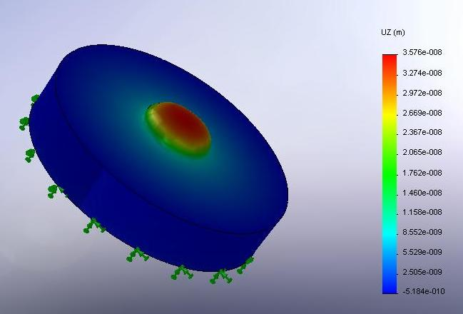
Mirror Material choice from thermal distortion calculations
Use Finite Element and analytical calculations to calculate first the temperature profile
In the mirror, and then the physical profile from thermal expansion. Lastly, the reduction
In coupling from the input laser beam to the new/distorted cavity mode is calculated
Material | Deformation (compare w/ 250 nm) [nm] | Peak Temperature Rise of mirror surface [deg C] | Change in Circulating power [%] | Thermal time constant [s]
Silica | 45 | 155 | 20 | 1
ULE | 3 | 594 | <1
Sapphire | 18 | 7 | 2.5 | 0.08
Silicon | 4.5 | 2 | <1 | 0.01

Slide 8
Practical Issues – vacuum quality
In the experiments that are done with buildup cavities, laser damage is an issue when pulse lengths are in the fs range, but this is less prevalent when pulses are > 10 ps.
Mirror losses increase as air is removed from the experiment, below a few Torr. The losses can be reversed by increasing the pressure above this value, or flowing O₂ onto the mirrors.
This effect is seen somewhat at 780 nm (Ti:Sapp) but markedly at 532 nm.
Possible explanations put forward:
Contamination from outgassed molecules
Mirror Damage from O₂ stripping
We take the approach of building a super clean cavity with low outgassing materials

Slide 9
Mirror Geometry
H Atoms
Mode should be 2 mm in diameter
And have a divergence of 3 mrad
To match the H atom beam doppler spread
And the beam width.
Not difficult to meet either one independently:
Not easy at same time.
Cavity Mode
2 mm
The size of a cavity mode is ~constant for many reasonable mirror
curvature combinations, and the instability limit must be approached to get a
Beam diameter 6 X larger than the confocal beam size.
One option: Concentric Cavity:
mirror focal Length = ½ cavity length
- must be very close to confocal to reach beam
Diameter dz ~ 0.15 mm
Divergence ~ 5 mrad
H Atoms
Cavity Mode
2 mm

Slide 10
Can solve for optimal cavity geometry
The beam divergence is given by:
Which fixes w₀
The distance from the waist z is calculated from:
Where the Rayleigh Range Z_{R} is:
And the mirror curvatures from:
Solving, gives mirror curvatures of -0.5 and 0.9 m, which is a robust
Combination against instability for small length changes

Slide 11
Buildup Factor Dependence
The Thermal Distortion of the mirrors is dependent only on the maximum circulating power (not on buildup factor)
The buildup factor depends on the Finesse, and is inversely proportional to the cavity linewidth
If the linewidth (phase/frequency noise) of each laser mode (the noise will be correlated across modes) is less than 50 kHz, than buildup factors of ~1000 are possible (OK with fiber lasers)
First experiment has finesse 300, buildup 100 X

Slide 12
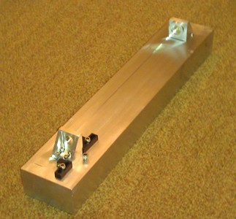
Summary
We have constructed a rigid cavity, from high vacuum materials, from sapphire mirror substrates, with finesse 300, to give 100 x buildup of the incident power.
We have calculated the optimal mirror curvatures, and will use those in future.
We are presently locking the cavity to the laser, using mirrors which are resonant at both 1064 nm and 355 nm.

Slide 13
Thanks
To Yun Liu and Chunning Huang for help with the project, and kindly letting me use their lab equipment at SNS ORNL
To Advanced Thin Films for help with mirror development
To DOE for an SBIR Phase II Grant under which this work is being done

