Slide 1
UV laser operated at 400 MHz repetition rate
Phase I SBIR, DoE Topic 16d
Ancillary Technologies for Accelerator Facilities
Advanced Laser Systems for Accelerator Applications
Contract no. DE-SC0004386
11 April, 2011
Q-Peak, Inc.
135 South Road
Bedford, MA 01730
Tel: (781) 275-9535
www.qpeak.com

Slide 2
Outline
Background of Q Peak, Inc.
Original specs in the SBIR solicitation
Modified specs with the use of enhancement cavity
Phase I goals
Phase I results
Calculation of frequency conversion efficiency
Road map to obtain 20-40 kW of peak power in UV
  Couple of approaches
Selection of one approach
Summary
2

Slide 3
Q-Peak Background And History
Previously Research Division of SEO, founded 1985
Spun out as Q-Peak, July 1, 1998, a subsidiary of SEO
Acquired by Physical Sciences Inc. (Andover, MA) on October 15, 2001
3

Slide 4
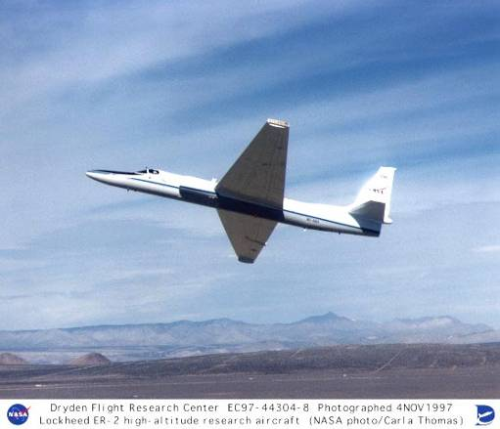
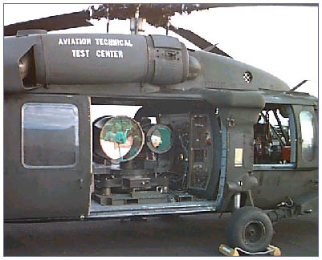

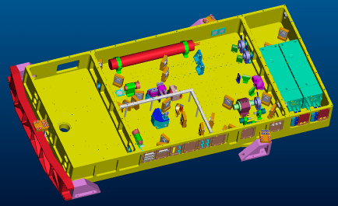
Technical accomplishments:
Government and Aerospace
Ti:sapphire for NASA LASE
Eye safe OPO for Army LR-BSDS
Ti:sapphire for airborne lidar
4

Slide 5
Q-Peak is a leader in Tm:fiber lasers
1 kW Tm:fiber laser for HEL-JTO

Slide 6
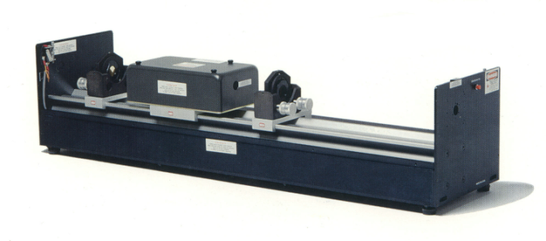
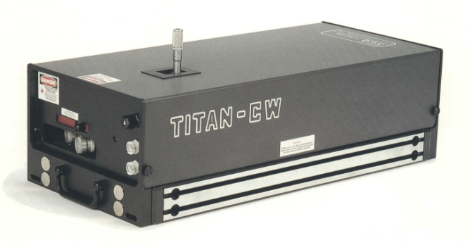
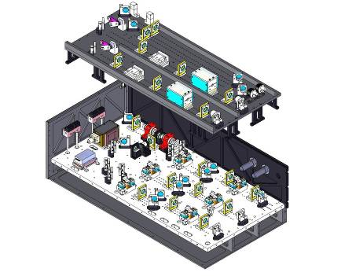
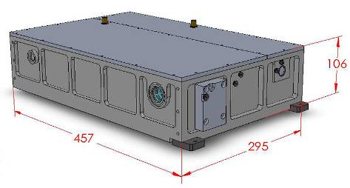
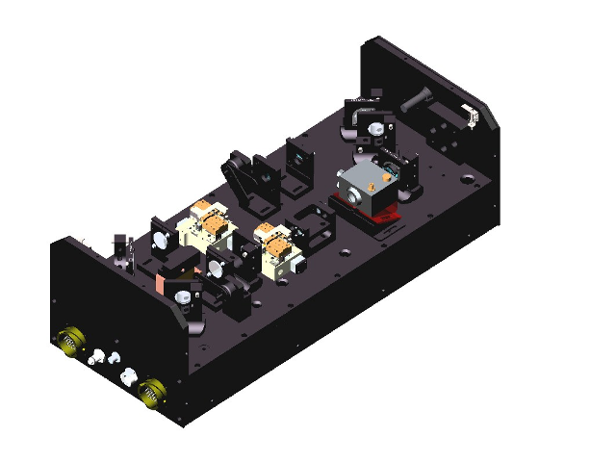
Commercial products developed by Q-Peak
Laser 1-2-3
Mid IR
Titan CW, P, ML
UV laser
MPS Gain Module
MPS Diode-pumped solid state lasers
Enhanced MPS Gain Module
5

Slide 7
Original Solicitation
ANCILLARY TECHNOLOGIES FOR ACCELERATOR FACILITIES----Advanced Laser Systems for Accelerator Applications --
high repetition rate (~400 MHz),
high peak power (~1MW),
picosecond 355 nm pulses to match the in-beam structure of the linac at Spallation Neutron Source (SNS),
Micro-mini-macro pulse format
  micropulses: 50 ps at 400 MHz,
  minipulses: 650 ns at 1.058 MHz,
  macropulses 1 ms at 60 Hz.
6

Slide 8
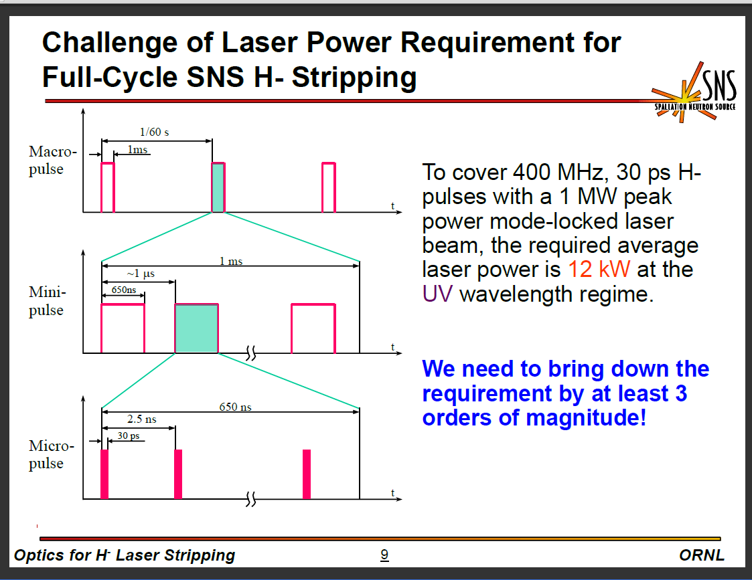
Pulse format proposed by SNS
7

Slide 9
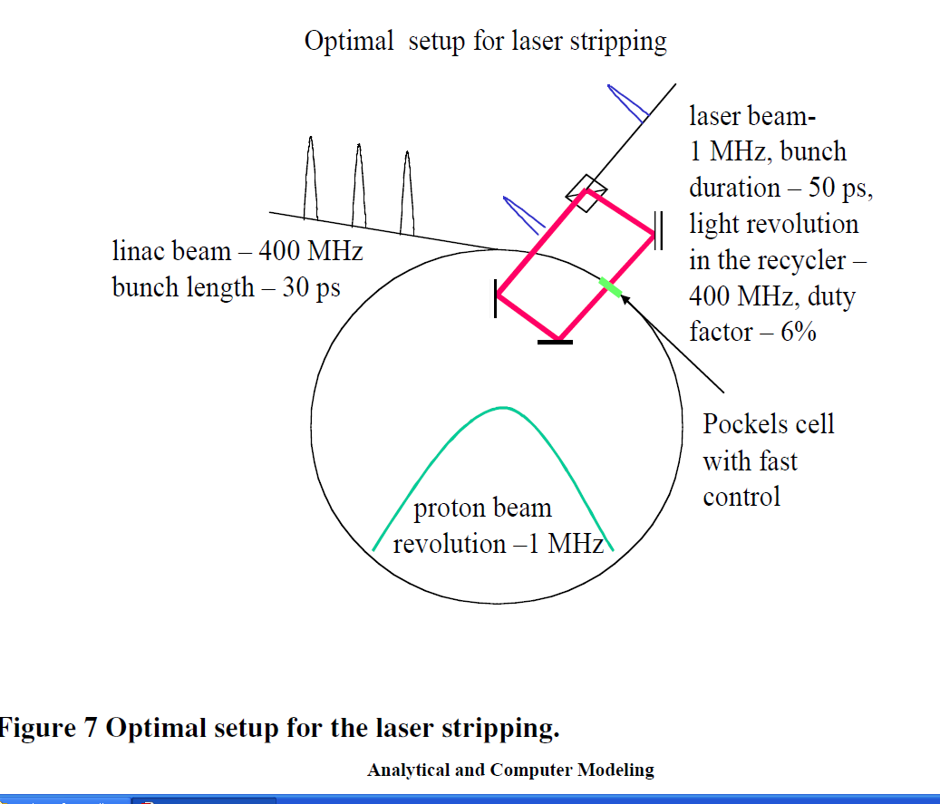
Reuse of laser pulse reduces laser requirements
8

Slide 10
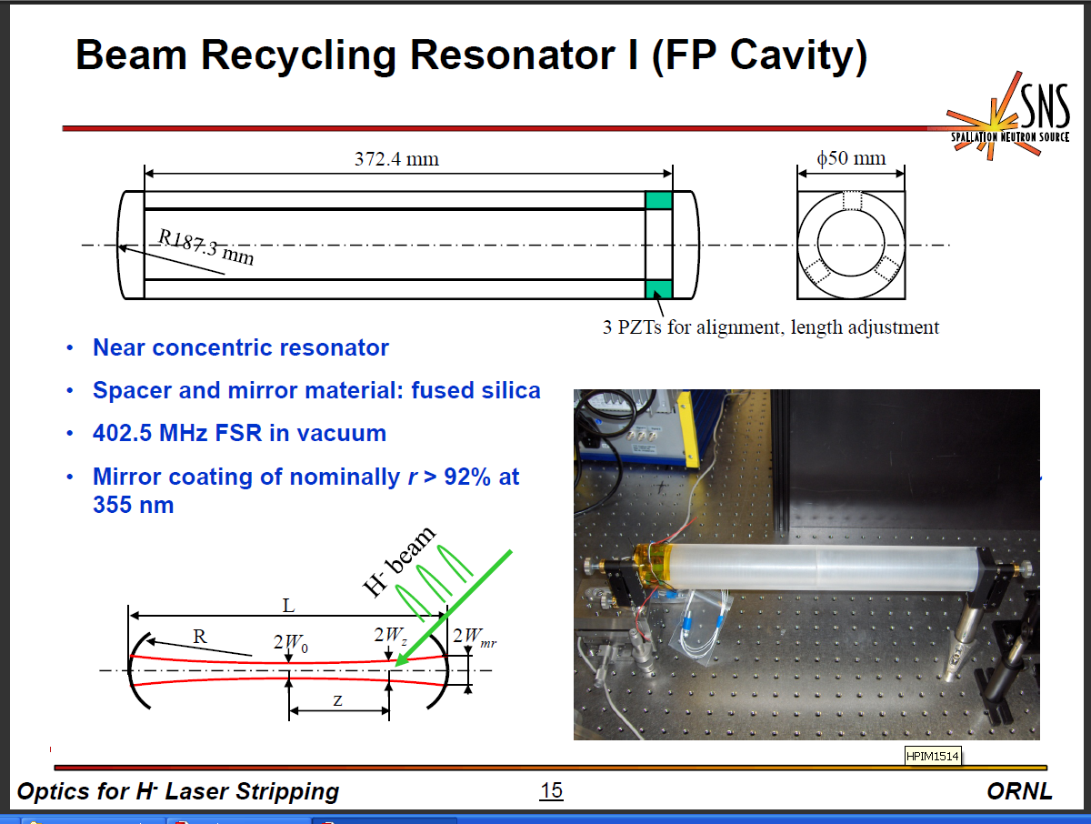
SNS work on enhancement cavities
9

Slide 11
Enhancement cavity with a Q of 50
Peak power in UV = 20 kW instead of 1 MW
Energy in a 50-ps pulse in UV = 1 μJ
Average UV power at 400 MHz = 400 W
UV Energy in a mini pulse of 650 ns = 1 x 260 ~ 0.26 mJ
UV Energy in a 1-ms macro pulse ~ 260 mJ
Actual UV power after micro-mini-macro format = 15.6 W
10

Slide 12
Phase I program objectives
Demonstrate up to 10 kW of peak power from a fiber amplifier without spectral broadening.
Design and calculate efficient frequency converter to UV region.
Design a scaled up laser to produce 60-100 kW of peak power in IR.
12

Slide 13
Experimental set up in Phase I
Output laser
Pump
laser
15 -20 kW
Dichroic
mirror
200 W
Seed
source
LMA fiber
amplifier
Free space
Pump coupling
Seed source: Modelocked, 5 ps, 100 MHz, 0.1 W, 1047 nm
Fiber Amp: Yb:silica, 30 μm core, 2 m length, conduction cooled
Pump: Counter propagated and free space coupled
13

Slide 14
Phase I Experiments
Spectra up to 5 kW of peak power without broadening
14

Slide 15
Spectra at different peak power
15

Slide 16
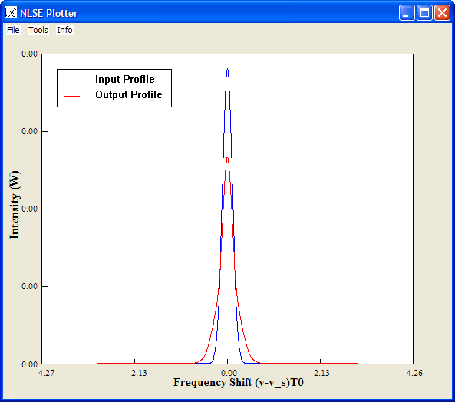
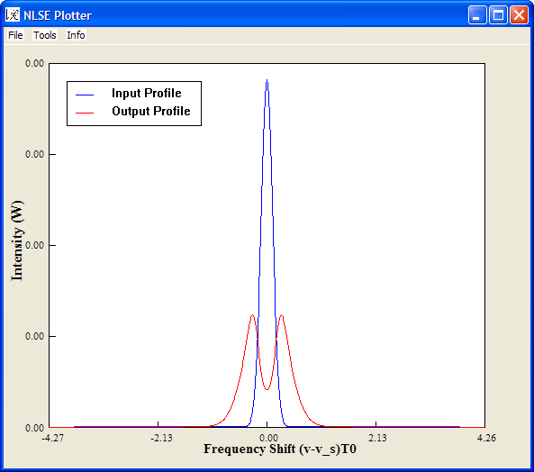
Calculation of Spectral Broadening
17 kW of output power
23 kW of output power
Using Agrawal’s code NLSE, from his web site
16

Slide 17
We successfully demonstrated the first objective of Phase I
Achieved 15kW of peak power with no spectral broadening.
Generated 20 kW of peak power, with slight spectral broadening, acceptable to generate UV light by frequency conversion.
17

Slide 18
Second objective; calculate conversion efficiency to UV
IR
laser
THG
SHG
30 kW
46.6 kW
23.3 kW
66.6 kW
33.3 kW
100 kW
With 30% conversion efficiency,
to generate 30 kW of UV we need 100 kW of IR
18

Slide 19
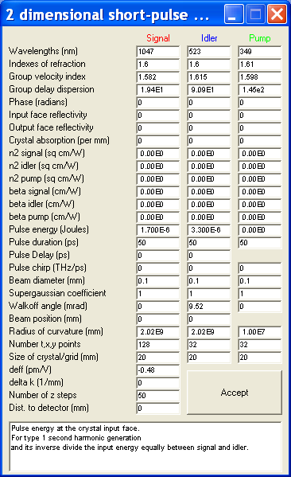
Calculated UV efficiency using SNLO
Type I SHG in LBO, NCPM
Type II THG O_{ω}+E_{2ω} = O_{3ω ,} CPM in LBO
19

Slide 20
THG Limiting factors
For a 20-mm LBO crystal:
Mixing acceptance bandwidths are :
  0.67 and 0.7 nm in 1047 and 523 nm, respectively.
  spectral broadening must be carefully controlled in fiber amplifiers
20

Slide 21
State-of-the-art in generating UV
Photonics West 2009 (LASE Conference) Dudley et. al.
  160 W at 355 nm at 8 kHz , M² of 18 and a pulse duration of 45 ns.
Q-Peak
  25 W of UV at 349 nm with a 35% conversion efficiency from a 7-ns pulse at 1047 nm.
21

Slide 22
Third objective; design 60-100 kW of IR laser
200 W
10-15 kW
60-100 kW
Seed
source
Bulk
Amplifier
LMA fiber
amplifier
200 W
7 kW
15 kW
60-100 kW
Seed
source
MPS Gain module
Bulk
Amplifier
LMA fiber
amplifier
22

Slide 23
Capability of fiber amplifier
Calculation of laser parameters
Pulse width | Repetition rate | Pump power | Output power | Energy per pulse | Peak output power
(ps) | (MHz) | (W) | (W) | (nJ) | (kW)
5 | 100 | 12.5 | 7.5 | 75 | 15
50 | 100 | 25 | 15 | 150 | 3
50 | 400 | 25 | 15 | 37.5 | 0.75
50 | 400 | 250 | 150 | 375 | 7.5
50 | 400 | 500 | 300 | 750 | 15
23

Slide 24
Q-Peak’s MPS gain module technology
Five pass through the crystal for high gain
Stacked pump diodes allow smaller foot print
24

Slide 25
Hyper Gain module using MPS technology
 |  | Current technology |  | Proposed
Parameter | Units | SGM | HGM | HYPGM
Crystal length | mm | ~30 | ~50 | ~50
Crystal aperture | mm | 2x6 | 2x6 | TBD
Total number of diode bars |  | 2 | 4 | 4
Power rating (per bar) | W | 40 | 40 | 125
Total diode pump power: Max Nominal | W | 80 64 | 160 128 | 500 400
Extractable power Max Nominal | W | 30 25 | 60 50 | 188 150
Dimensions | Inch | 2x2x2.5 | 2x3x2.5 | 2.5x3x2.5
25

Slide 26
Q-Peak capabilities
Flashlamp-pumped Nd:YLF amplifiers producing 1 J of energy
Diode-laser, side-pumped , Nd:YLF rod laser producing 220 mJ of energy
MPS amplifiers,
  producing 40 mJ of energy at 1 kHz
  producing 100 W power in CW

Slide 27
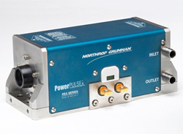
Final Stage of Amplifier
Side pumped Rod type bulk amplifier
Gain of 4-6 to generate 60-100 kW of peak power
Pump power of 3-4 kW
26

Slide 28
Deliverables
Q-Peak will develop and build a UV laser capable of producing 20-40 kW of peak power and deliver the laser to SNS.
Laser package concept is approximately
3 x 2 x 2 feet constructed on a breadboard.
Power supply and chiller in a mini rack

Slide 29
Summary
We propose a fiber and bulk hybrid approach to the full scale system
  Enhancement cavity with Q of 50
    Fiber amplifier = 7.5 - 10 kW
    MPS gain module = 15 - 20 kW
    Side pumped rod amplifier = 60-100 kW
    UV peak power = 20 - 40 kW

