Slide 1

Fermilab Laser Stripping Requirements
David Johnson (FNAL) Timofey Gorlov (ORNL)
Second Mini-Workshop on Laser Assisted H- Beam Stripping
Oak Ridge national Laboratory
April 11, 2011

Slide 2
Fermilab Injection Options
Recycler Ring
  Beam Energy 8 GeV kinetic (fixed)
Main Injector
  Beam Energy 6 GeV (min) 8 GeV (typical)
Macro bunch structure
  Six 1 mA - 4.3 ms (typ) injections at 10 Hz
  One 26 ms injection every .75 to 1.2 sec (long pulse mode)
Micro-bunch structure
  Was 325 MHz but now specified to be 162.5 MHz (see next slide)-> impacts average laser power.

Slide 3
Linac Bunch Structure for Recycler Injection
100 ms
MACRO Bunch
1. ms up to 26 ms
11.1 μs
Mini Bunch
10.3 μs
30 - 130 ps
Micro Bunches (325 MHz structure)
3.08 ns
Potentially missing beam
30 - 130 ps
Micro Bunches (162.5 MHz structure)
6.15 ns
Potentially missing beam

Slide 4
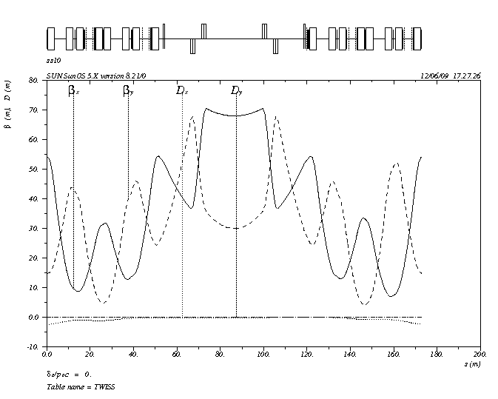
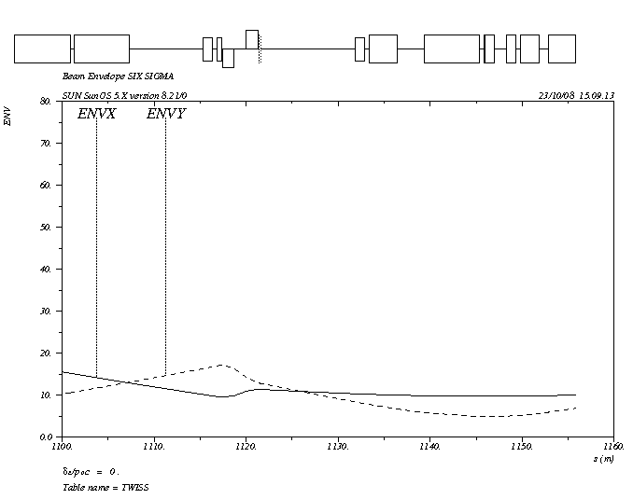
Beam parameters for Recycler/MI Laser Stripping Injection
Linac Beam
  Bunch length corresponds to +/- 12mm (80 ps) with and rms of about 16 ps.
  Assuming phase jitter assume maximum bunch length of +/-20 mm (130 ps) with an rms of 26 ps worst case.
  Best case, if longitudinal tails can be removed, a distribution result from tracking without errors gave a 6ps rms distribution
  For this calculation assume rms bunch length of 20ps.
Transport line parameters
  Beta x 20 - 40 meters -6 sigma truncated gaussian size between 5 and 8 mm
  Beta y 10 – 20 meters – 6 sigma truncated gaussian size between 4 and 5 mm

Slide 5
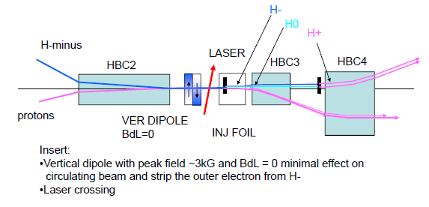
Potential layout for foil and laser injection

Slide 6
Assumed Injected Beam Parameters
Parameter | value
Energy | 8 GeV
Energy spread (rms) | 2.5x10⁻⁴
Micro bunch duration (rms)* | 6 ps (min) 26 ps (max)
β _{x} | 40 m → σ ~ 1.3 mm
β _{y} | 10 m → σ ~ 0.9 mm
D and D’ (both x and y) | 0
ε_{x,y} norm. rms emittance | 0.5 π-mm-mr
*Micro bunch length: minimum corresponds to tracking without errors and max are
the result of tracking with 1º phase and 1% gradient errors.
Estimations were performed for four wavelengths shown in the next slide assuming
a 20 ps rms bunch length.

Slide 7
Excitation Efficiency
Peak power levels of the Laser stripping process using the standard 3 step process in the absence of a magnetic field.
Timofey Gorlov

Slide 8
Laser Power Estimates for 8 GeV laser Assisted Stripping
Required Laser Parameters for 98% stripping Efficiency
*Timofey Gorlov (SNS)
Wavelength [nm] | 1900 | 1064 | 1900 | 1064 | 1900 | 1064
 | elliptical |  | circular |  | Strong Field
Incidence angle [deg] | 49.8 | 94.6 | 49.8 | 94.6 | 49.8 | 94.6
Peak Power, P0 [MW] | 1.1 | 5 | 1.1 | 5.5 | 2.1 | 10
Micropulse energy [mJ] | 0.08 | 0.3 | 0.08 | 0.4 | 0.14 | 0.7
Power at 325 Mhz [kW] | 26 | 100 | 26 | 130 | 47 | 230
Power at 162.5 Mhz [kW] | 13 | 50 | 13 | 65 | 24 | 115
Micropulse duration (rms) [ps] | 29 | 28 | 29 | 28 | 27 | 28
X-rms size [mm] | 4.3 | 5.0 | 2.1 | 2 | 2 | 2
Y-rms size [mm] | 1.9 | 1.9 | 2.1 | 2 | 2 | 2
X’-divergence [mr] | 1.4 | 0.6 | 1.7 | .8 | 0 | 0
Y’-divergence [mr] | 0.9 | 0.6 | 1.7 | .8 | 0 | 0

Slide 9
Implications for 6 GeV Injection
Estimates were performed for same H- beam parameters except with energy at 6 GeV for 2 wavelengths
  1900 nm – not possible to reach the n=2
  1064 nm (angle 79.25º)
    No magnetic field
      5 MW peak (not significantly different from 8 GeV)
    Strong magnetic field (1.4 T)
      8 MW peak

