Slide 1
Investigation on the Feasibility of Using a Laser Chopper for Project X
Dave Johnson, Vic Scarpine and Jinhao Rao; FNAL
Workshop on Laser Assisted H- Beam Stripping
April 11, 2011

Slide 2
Why look at this?
Project X has identified a low-energy H⁻ beam chopper as a critical component
  Requirement of a broadband, arbitrary-pattern beam chopper is difficult at 325 MHz and maybe also at 162.5 MHz
    Standard electric-field choppers push limits
    Are there other options?
      Lasers have been used for laser profile monitors; SNS, BNL…
        H⁻ + γ -> Hº + e⁻
      Can laser be used as a broadband chopper?

Slide 3

Laser Stripping vs Laser Chopping
Laser Stripping (3 step process)
Usually done at high energy:
~ few GeV
Laser chopping (2 step process)
H⁻
Needs to be done at low energy:
~ few MeV
H⁻
H⁰
H⁻ →
H⁰ + e⁻
γ

Slide 4
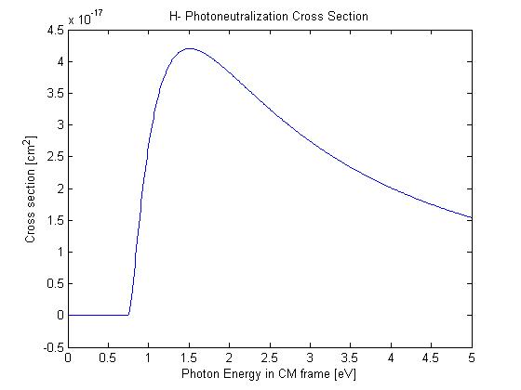
Photoneutralization of H-
Is it technically feasible to consider a laser chopping system for Project X?
  H- beam requirements -> How small can you make beam?
  Laser beam requirements -> How much power is needed?
Photoneutralization cross section of H- by incident photons of energy E is given by:
where σ_{max} is 4.2E-17 cm² and E₀ is 0.7543 eV.
At 2.5 MeV , β = 0.073 and γ = 1.00266, with ion velocity of 21.856 m/μs.

Slide 5
H⁻ - Laser Geometry
Assume the following geometry of the H- and laser beam.
[From: Shafer LA-UR 98-2643]
The photon energy seen by the H- electron in it’s rest frame is
Θ = 180 : head on interaction
The lab frame energy of a photon from Nd:YAG laser with a wavelength of
1064 nm is 1.165 eV is essentially the same in the CM frame for ~90 deg. angle
So, for Nd:YAG (1064 nm) Yb:YAG (1030 nm) laser interacting with
2.5 MeV H- @ ~90 deg the photoneutralization cross section is
3.66x10⁻¹⁷ cm² and 3.80x10⁻¹⁷ cm² , respectively.

Slide 6
H⁻ Neutralization
Assume the laser beam has a uniform irradiance and fully encompass’ the H⁻ beam.
When the probability of interaction is high, and the interaction mechanism is not dependent on intensity (i.e cross section is not dependent on laser flux) , the single interaction detachment rate, F₁, can be expressed as
where fluence is the number of photons per cm² at the interaction point, τ_{laser} is the laser pulse length, σ is the photoneutralization cross section [cm2] and τ_{crossing} is the transit time of the H- across the laser beam [sec].
The photon flux is transformed like the photon frequency (energy) which, which like the energy is ~ the same in the lab and CM.
where

Slide 7
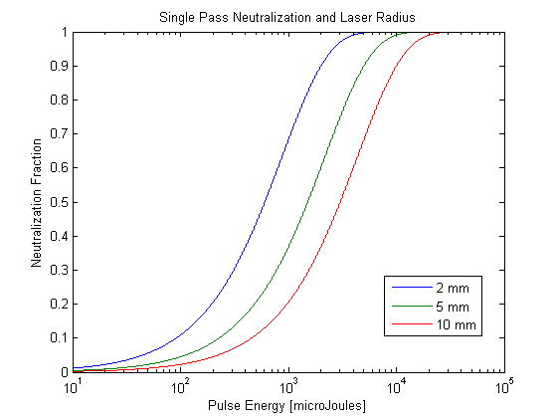
Single Pass H⁻ Photodetachment
Assume a laser pulse length , τ_{laser} , of 500 ps, the single pass neutralization fraction as a function of laser pulse energy for several laser beam radii may be calculated.
For ~100% neutralization need to have ~10 to 30 mJ per laser pulse
At 325 MHz rep rate this corresponds to a 3 to 10 MW laser !
Q-switch
10’s to 100’s mJ
10-100’s Hz
Laser Beam Radius
At this point everyone says it can’t be done.
But can these numbers be beat down ?

Slide 8
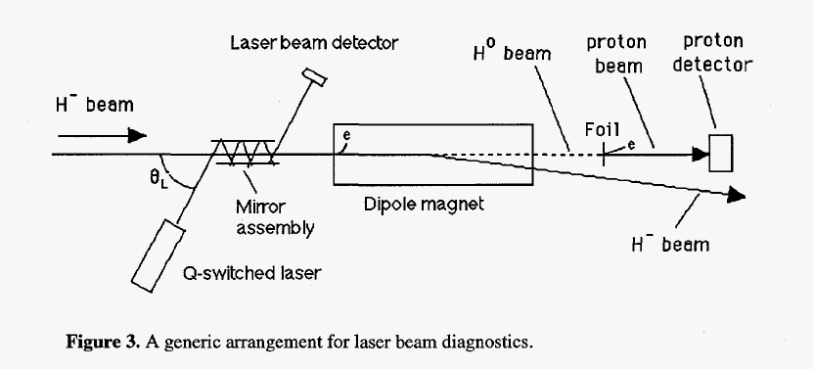
Looking at the equation for the Neutralization Factor (F₁), only two quantities are controllable, the photon flux and the crossing time,
To enhance the yield, requires
  increasing laser flux
    by increasing the pulse energy or
    reducing the interaction cross section or
  increasing the crossing time of the H- across the laser
    proportional to horizontal laser beam width and ion velocity
    by increasing the horizontal dimension of the laser beam while reducing the vertical dimension of the laser beam to keep the cross section constant
Another technique would be have the H- ions pass through the laser beam as many times as possible.
[From: Shafer LA-UR 98-2643]

Slide 9
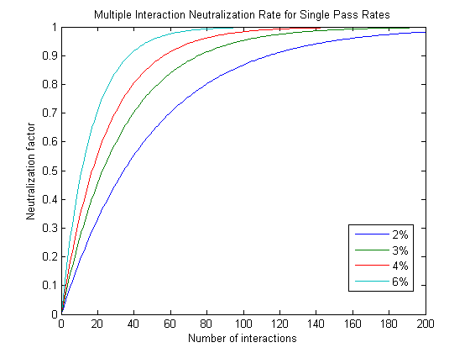
Multiple Interaction Neutralization Factor
If the laser passes through the H- beam N times, the fractional yield F_{N} of H⁰ is related to the fractional yield F₁ of a single crossing by :
where is
Assume 100% reflectivity on mirrors
Assume 200 uJ laser pulse on the input of the optical cavity
Each curve represents single interaction neutralization factor, F₁.

Slide 10
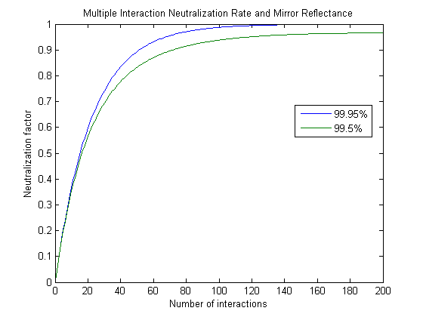
Impact of Finite Reflectance
For a given mirror reflectance R, the laser fluence available for interaction at each of the Mth interactions is modified by R^{M} such that
where
Then for N reflections
Assume :
200 uJ laser pulse on the input of the optical cavity
500 ps laser pulse length
5 mm laser beam radius

Slide 11
Cartoon of a
Potential Laser Chopper Layout*
Optional H⁺ Leg
RFQ
Laser Cavity
mirror
H0 Dump (.6m offset)
H-
mirror
Match to SSR0
Laser source
22.5 deg Achromat
*Not shown: quads or cavities
SSR0
Length between RFQ & SSR0 ~ 6m

Slide 12
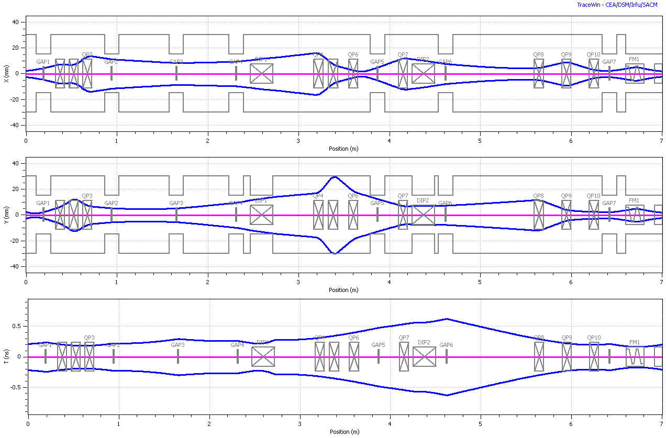
MEBT Insertion Example*
Laser Cavity
Dipoles
Laser input
Dump
Matched into SSR0
Vertical aspect of laser (5mm radius)
*Note: Optics not fully optimized
ε_{x,y}=0.25 π-μm ε_{Z}=0.3 π-μm

Slide 13
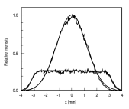
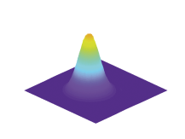
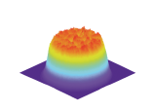
162.5 MHz Conceptual System
100 pJ (0.5-1ns) 162.5 Mhz
2.5 nJ (0.5-1 ns)
162.5 Mhz
10GHz modulator
162.5 MHz
CW 100 mW
Narrow line width
Seed laser
16.5 mW
400 mW
Pulse pattern
generator
Fiber Amp
Couple to
free space
optics
200 uJ (0.5-1 ns)
162.5 Mhz
2.5 nJ (0.5-1 ns)
162.5 Mhz
32.5 kW
4 W
Amplifier
Pre-Amp
Gain ~10
Coupling Optics
Top Hat
Converter
Input pulse to cavity:
~200uJ, 0.5-1.0 ns, 162.5 Mhz
Zig-zag cavity
100-200 reflections

Slide 14
Facility formally know as HINS
HINS (High Intensity Neutrino Source) is a unique Linac Injector R&D facility
  Outside of HINS, regular access to high-intensity, low-energy H- beam for R&D is limited
Potential exists to operate HINS as a low-energy, high-intensity H- test facility during Project X R&D phase
  Allows for the development of Fermilab projects as well as a facility for external collaborators
  An accessible test facility is critical for a number of Project-X R&D areas
Potential project areas:
  Beam diagnostics R&D
  Beam dynamics at low-energy
  Beam chopper R&D

Slide 15
HINS Beam Parameters
Particle | H+ then H-
Nominal Bunch Frequency/Spacing | 325 3.1 | MHz nsec
Particles per Pulse | 37.5 * | E13
Pulse Length | 3/1 | msec
Average Pulse Current | ~ 20 | mA
Pulse Rep. Rate | 2.5/10 | Hz
Bunch Current | 32 | mA
Bunch Intensity | 6.1 98 | E8 pCoul
* full un-chopped 3 msec pulse at klystron-limited 20 mA

Slide 16
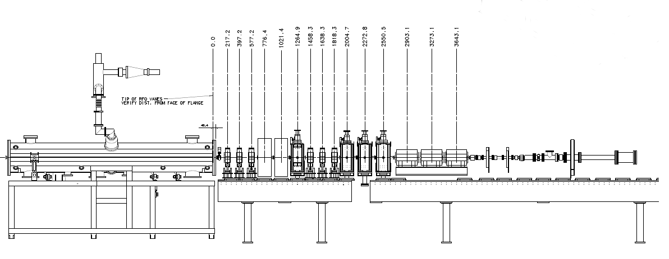
Six Cavity Test
To test vector modulator concept
Two buncher cavities
Quadrupole focusing instead of superconducting solenoids
Beam
Diagnostics
RFQ
Beamline

Slide 17
Beam Diagnostic Projects for Project X
Transverse Diagnostics
  Laser Transverse Profile Monitor* - previous collaboration with BNL
  Ionization Profile Monitors
  Electron Wire Transverse Profile Monitor
Longitudinal Diagnostics
  Wire Longitudinal Profile Monitor*
  Laser Longitudinal Profile Monitor* - collaboration with LBNL
  Broadband Faraday-cup* - collaboration with SNS
Halo Monitoring – transverse and longitudinal
  Vibrating wire* - from Bergoz Instrumentation
  Laser wire*
MEBT Emittance station
  Slit-collector*
  Laser Slit*
* Project X related instrumentation to be tested at HINS

Slide 18
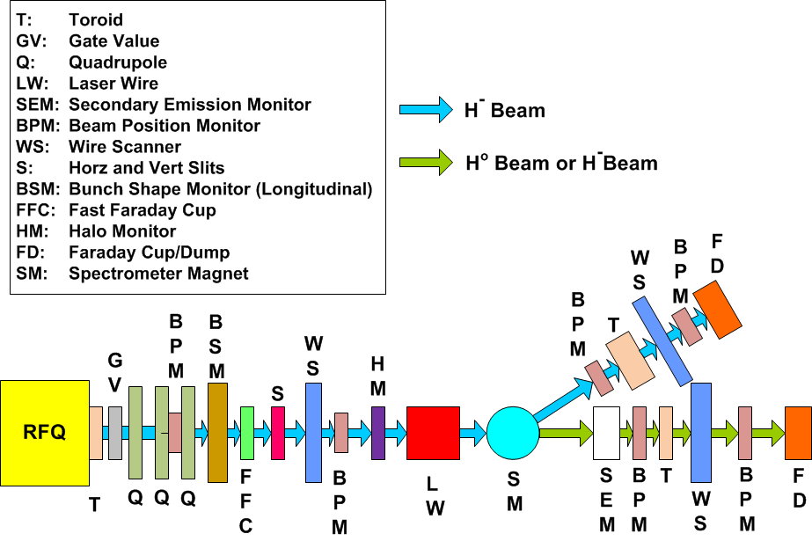
HINS Diagnostics Line

Slide 19
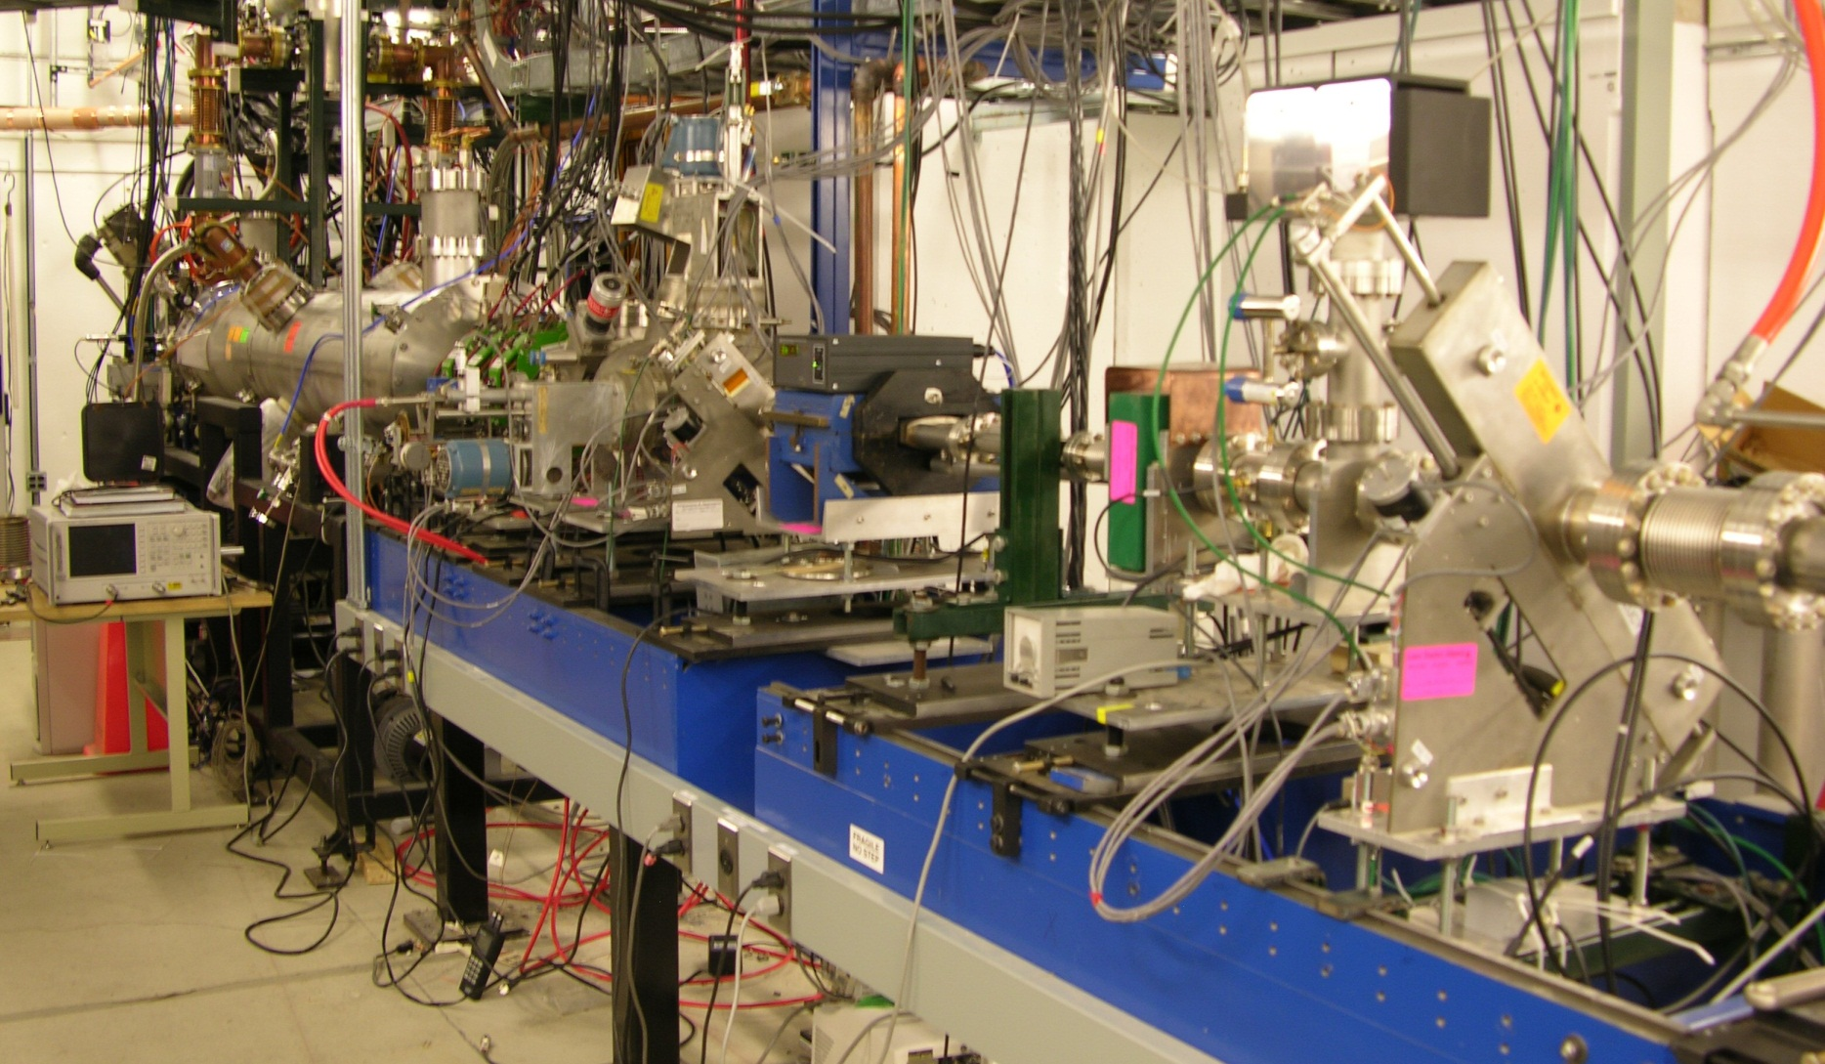
HINS Beamline
Source/LEBT
RFQ
2.5 MeV Diagnostics

Slide 20
“Typical” Laser Chopper Numbers

Slide 21
H- Beam Parameters
H- Parameters:
  Energy 2.5 [MeV]
  Linac current 10 [mA]
  Linac bunch intensity 3.84e+008 [ppb]
  Beta 0.073
  Gamma 1.0026
  H- velocity 2.18e+007 [m/s]
  RFQ frequency 162.5 [Mhz]
  Bunch spacing 6.15 [ns]
  Bunch length +/-13.5 [degrees]
  Bunch length (full) 1.008 [cm]
  Bunch length (full) 0.462 [ns]
  RMS beam size: H 0.17 [cm] V 0.17 [cm]
  100% beam size: H 1.00 [cm] V 1.00 [cm]

Slide 22
Laser Parameters
Laser Parameter Requirements entering interaction chamber:
  Laser Energy 2.00e-004 [Joules]
  Pulse length 5.08e+002 [ps]
  Laser spot size radius (top hat) 4.998e-001 [cm]
  Laser beam area 7.85e-001 [cm^2]
  Photon wavelength 1030 nm
  Photon Energy 1.93e-019 [Joules] -> 1.20e+000 [eV]
  Photo-detachment cross section 3.80e-017 [cm^2]
  Photons per pulse 1.04e+015
  Photon rate 2.04e+024 [photons/sec]
  Photon fluence 1.32e+015 [photons/cm^2]
  Photon flux 2.60e+024 [photons/cm^2/sec]
  Laser Peak pulse power 3.94e-001 [MW]

Slide 23
Multi-Pass Cavity and Laser Parameters
Distance between crossings 4.998e-001 [cm]
Distance between reflections on mirror 9.996e-001 [cm]
Optical cavity diameter 6.85e+000 [cm]
Incident angle 4.18e+000 [degrees]
Crossing angle 85.8 [degrees]
Lorentz Factor 9.97e-001
Rest frame photon energy 1.20e+000
Rest frame wavelength 1.03e+003
Crossing time 4.58e-010 [sec]
Number of passes 200
Photon flux in H- rest frame 2.59e+024 [photons/cm^2/sec]
Mirror Reflectivity 9.995e-001
Average Neutralization factor per interaction 4.00e-002
Total Neutralization 9.997e-001
Multipass insertion length 9.95e+001 [cm]
Average power of laser system 32.5 [kW]

Slide 24
R&D Activities
Refine MEBT/Insertion design
  HINS for testing
  Project X specific
  Impact on RFQ ?
Optical beam cavity
  Radiation damage?
Coupling optics to amplifier(s) and cavity
Laser gain amplifiers – collaboration with industry
Demonstrate variable width laser pulse generation
Better matching between H- beam and laser spatial profile
Synchronization of laser to beam
Neutralization studies at HINS
  Already planned for laser diagnostics

Slide 25
Keeping an open mind…
“It is difficult to say what is impossible, for the dream of yesterday is the hope of today and the reality of tomorrow.”
Dr. Robert H. Goddard

