Slide 1
Accelerator Based Backgrounds in a Muon Collider
Steve Kahn
Feb 23, 2011
Muon Collider Physics Working Group

Slide 2
Outline
Introduction
Description of our simulation
G4BL simulations
Mars simulations
Comparisons and comments.
Our Future Direction
Conclusions

Slide 3
Background on Muons, Inc. and NIU
Muons, Inc. is a small company composed primarily of physicists that earns a large fraction of its money from SBIR grants from DOE.
We have just been awarded (in June) a phase I grant in collaboration with Northern Illinois University to simulate accelerator backgrounds for a Muon Collider.
  This is a new project for us consequently we are light in results at this point. We are describing our plan of action.
  Our team include
    Steve Kahn, Mary Anne Cummings, Kevin Beard, Tom Roberts, Muons, Inc.
    Dave Hedin, Aaron Morris, NIU
    Joe Kominski, Lewis University
As part of my personal experience, I worked with Iuliu Stumer to calculate muon collider backgrounds circa 1997.
  For those calculations we used Geant 3.21
  These calculations along with MARS provided mutual confidence in the understanding of accelerator backgrounds to a muon collider.

Slide 4
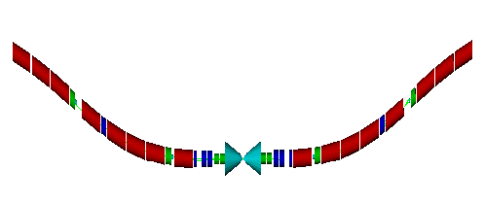
What Did We Promise in our SBIR?
The development of a Monte Carlo package to simulate muon accelerator backgrounds.
  The package should be able to accept a MAD lattice description.
  Provide particle fluxes.
  Output a file of background events for use with the physics analysis.
Verification of the MC package by comparing to MARS.
Evaluate the shielding necessary for a muon collider detector.
  What cone angle do we need?
Develop output format for background events so they can be used for physics analysis.

Slide 5
The Simulation Package
Simulate accelerator based backgrounds in the muon collider intersection region.
This package will use G4beamline. (Described last week)
  Also we plan to interface to MARS for verification.
The program input uses the MAD lattice description of collider beam
  We are currently the Eliana Gianfelice-Wendt’s recent lattice for our studies.
  Using the MAD lattice description allows rapid adjustment to changes in the collider lattice design.
Model material in beam line and detector interface.
  Reasonable description of magnet material and magnetic fields.
    Accommodate special kinds of magnets such as open mid-plane dipoles
    Dipoles are arcs! Significant magnet sagitta with 10 m long dipoles
  Masks and collimators
  Conic shielding
Requirements
  Establish muon closed orbit
  Assume that muon can decay anywhere along the orbit.
    Track decay electrons as primary particles
Scoring energy deposition.

Slide 6

Final Focus Region of
E. Gianfelice-Wendt’s New Lattice
a (cm)
QLB1
5σ_{y}
5σ_{x}
z (m)
Note the relatively small quench margin

Slide 7
Sources of Muon Collider Backgrounds
Electrons from muon decays.
  We expect 8.6×10⁵ muon decays per meter for both 750 GeV µ⁺, µ⁻ with 2×10¹² µ per bunch.
  These electrons are off momentum and could hit magnets, etc.
Synchrotron radiation from decay electrons.
Photo-nuclear interactions.
  This is the source of hadron backgrounds. This is largely neutrons.
Bethe-Heitler muon production: γA→µ⁺µ⁻X
  Source is energetic photons on beam line and shielding material.
Incoherent pair production: µ⁺µ⁻ →µ⁺µ⁻e⁺e⁻
  ~3×10⁴ pairs expected per beam crossing.
  Detector magnetic field should trap most of these.
Beam halo.

Slide 8
What exists to produce G4beamline input
BruitDeFond
BeamMaker
Background.in
BeamMaker.txt
G4beamline
Geant4
BruitDeFond produces an ASCII file of G4beamline commands that describe the ±75 m of muon collider interface region
BeamMaker produces a BLTrackFile that can be read by beam input card. This file contains e⁺ and e⁻ thrown with the Michel decay distribution.

Slide 9
The BruitDeFond Program
The BruitDeFond program creates an input file to G4beamline that describes the intersection region of a muon collider.
The collider configuration is meant to be flexible and uses the MAD element description.
  We currently have modeled ±75 m from the IP.
  We are currently using Eliana Gianfelice-Wendt’s recent lattice.
Magnet description is important. Currently all magnets are described by multipole command.
  Material is described my multiple tubes of Nb₃Sn, SS collar, Fe yoke.
  IR Quadrupole magnets are based on V. Kashikhin designs.
We have described the Tungsten conical shielding configuration with a scaling algorithm that allows conical angle studies.

Slide 10
The BruitDeFond Program
The BruitDeFond program creates an input file to G4beamline that describes the intersection region of a muon collider.
The collider configuration is meant to be flexible and uses the MAD element description.
  We currently have modeled ±75 m from the IP.
  We are currently using Eliana Gianfelice-Wendt’s recent lattice.
Magnet description is important. Currently all magnets are described by multipole command.
  Quadrupole description similar to Kashikhin design (used in the MARS analysis).
    Material is described my multiple tubes of Nb₃Sn, SS collar, Fe yoke.
  Dipole description is currently cosθ surrounded by a steel yoke.
    This will evolve to an open mid-plane model.
  5T solenoid field over the detector.

Slide 11
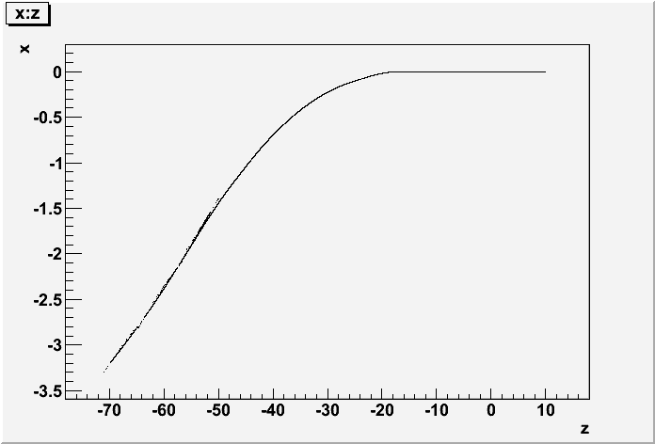
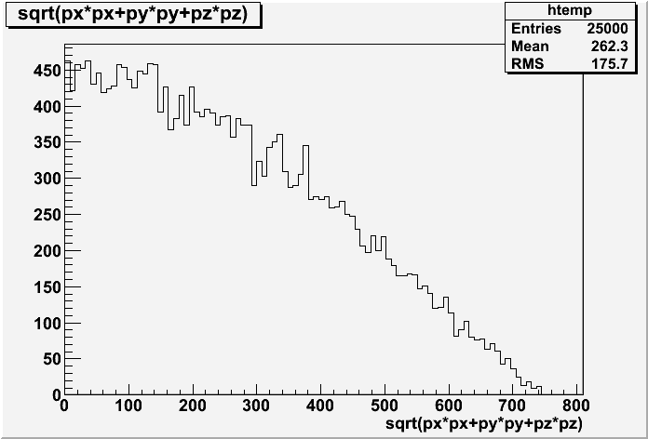
BeamMaker– A tool to provide background events to G4beamline
Decay electrons are fed to G4beamline uniformly along the muon reference orbit.
Electron energy generated using Michel decay and boosting from muon frame to lab.
A constant weight factor can be used to normalize background to the number of muons per bunch.

Slide 12
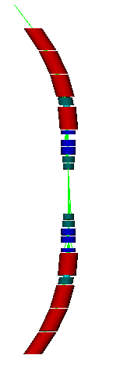
Preliminary G4BL Simulation of Collider Ring IR Magnets
Using G4BL to simulate the IR region of Eliana’s New Lattice.
e⁺ from 750 GeVμ⁺ decays uniformly along the beam line. Muons decay distributions using Michel description.
No synchrotron radiation currently included.
  These are included in Geant4, but have not been able to activate them.
Fields are generic multipole fields without fringing end fields. No field in magnet iron.

Slide 13
We can also use this program to produce MARS input for Verification
BruitDeFond
BeamMaker
MARS.INP
GEOM.INP
FIELD.INP
BeamMaker.txt
Mars15
BruitDeFond can generate MARS.INP and GEOM.INP files.
The extended geometry is description is used.
The field is described by the FIELD.INP file which is read by the MARS user subroutine “field” that we wrote.
We use the same BeamMaker.txt file for the MARS input.

Slide 14
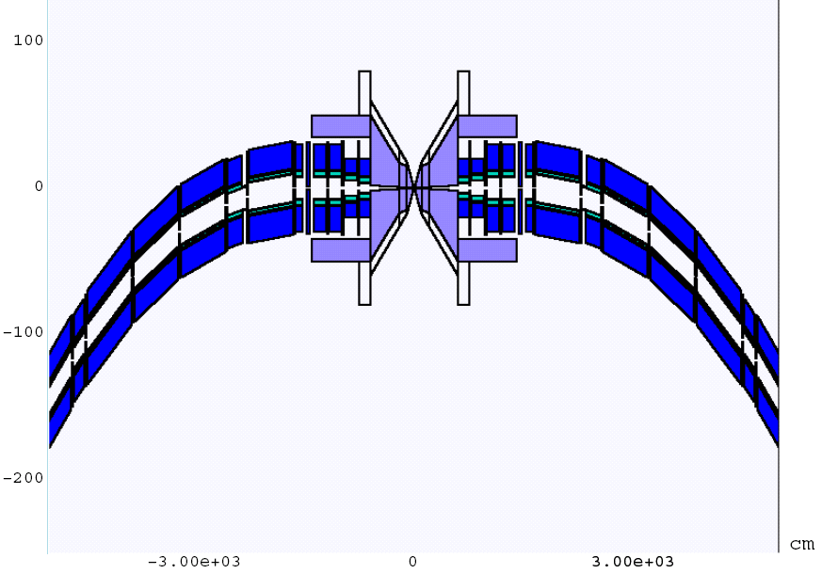
Mars Geometry Generated by BruitDeFond Package

Slide 15
Differences in Running Conditions
 | G4BL | Mars
Beam | BeamMaker File -30 m -> 10 m | BeamMaker File -30 m -> 30 m
Physics Lists | QGSP_ BERT, No _HP | Standard, NO MCNP
Event Sample | 10,000 events | 400,000 weighted events
Minimum Energy | 200 KeV for all particles | Neutrons 200 KeV ?? Gammas 800 KeV Electrons 3 MeV Charged Hadrons 3 MeV
Borated Poly-ethylene | It appears that B-CH₂ does not work right in Geant4 | OK

Slide 16
G4beamline Studies
Collider configuration as described.
Use 10° shielding cone.
10 K event samples with minimum KE set to 200 keV.
  This requires 3 days on NICADD cluster.
Events carry a constant weight to normalize to 2×10¹² muons/bunch.
Detector planes positioned at SiD locations.
  Vertex and tracker detector plane have equivalent SiD material description. Particles are scored as they pass through planes.
  Calorimeter material present, but no particle scoring.

Slide 17
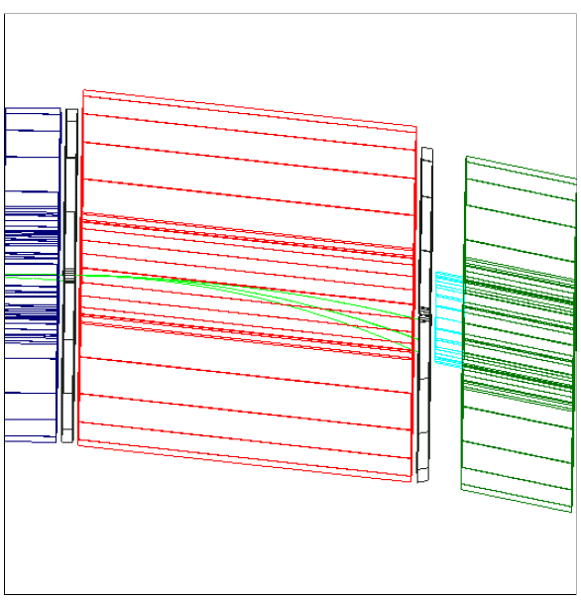
Figure Shows Typical Off-Momentum Decay Positrons in a Dipole Magnet
Sextupole
Quadrupole
Dipole Magnet
Collimating Mask
Quadrupole

Slide 18
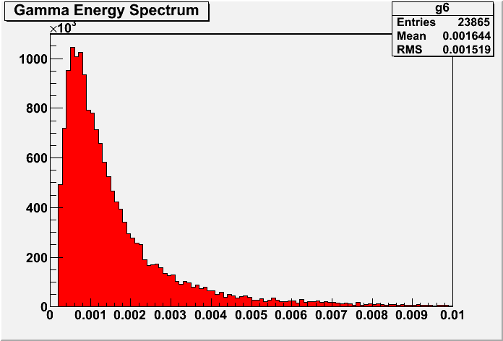
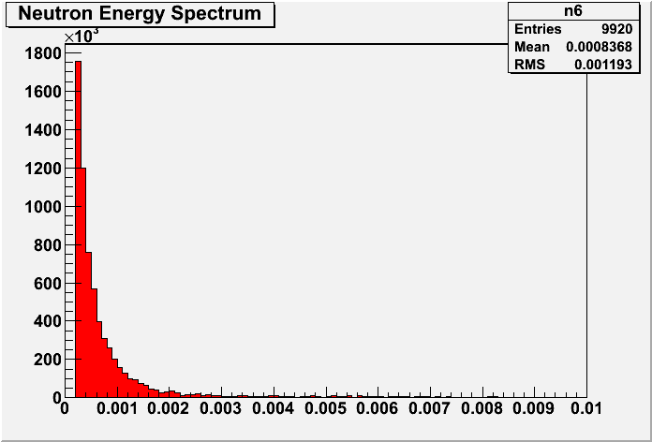
Energy Spectra of γ and n
GeV
GeV
Particle spectra at R=47 cm. There is a 200 keV minimum KE threshold.

Slide 19
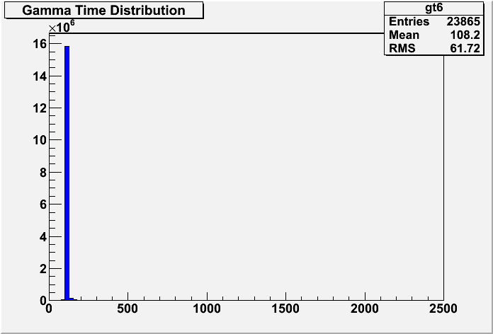
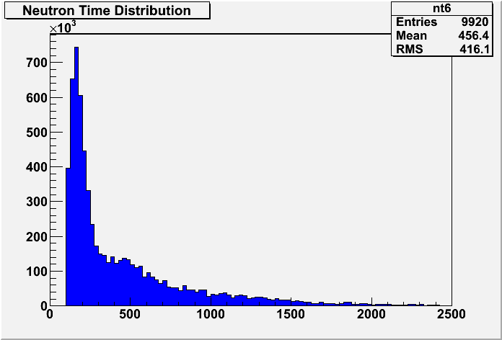
Time Distribution of γ and n crossing a plane at R=47 cm
ns
ns
Can cut neutron time tale with electronic gate

Slide 20
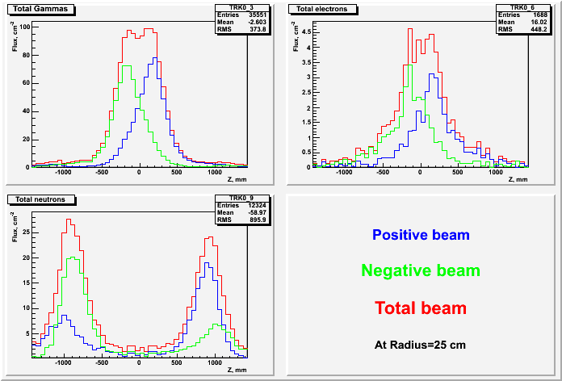
Particle Fluxes at r=25 cm
Neutrons come from the conical shields

Slide 21
G4BL: Fluxes at Radial Positions for 10° Cone
Particle Fluxes
Normalized Counts

Slide 22
Scaling the Cone
We wish to investigate the dependence of the detector backgrounds with respect to the shielding cone angle.
We have left inner radii and segmentation in z alone.
We have scaled the cone geometry by angle as shown below.
θ/2
θ/2
θ/7.5
θ
6 cm
1.05 m
2 m
6 m
J. Kozminski

Slide 23
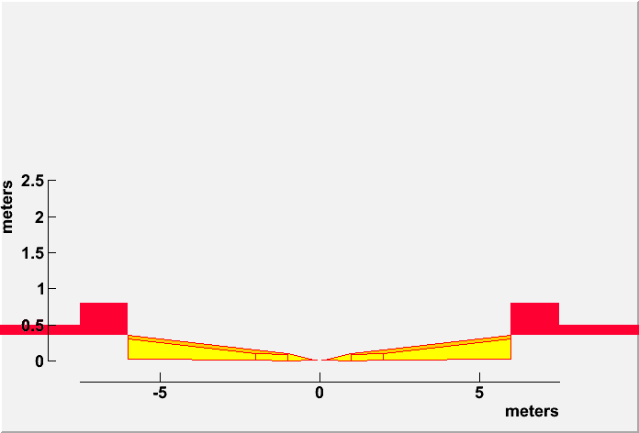
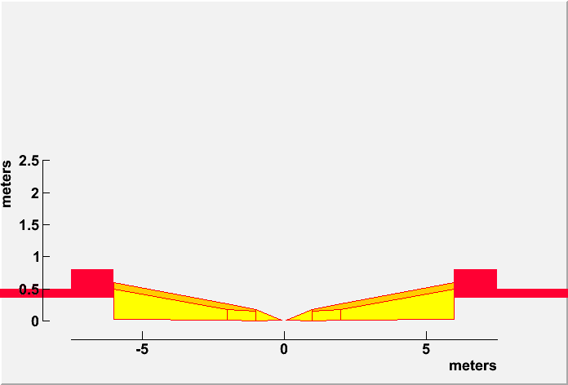
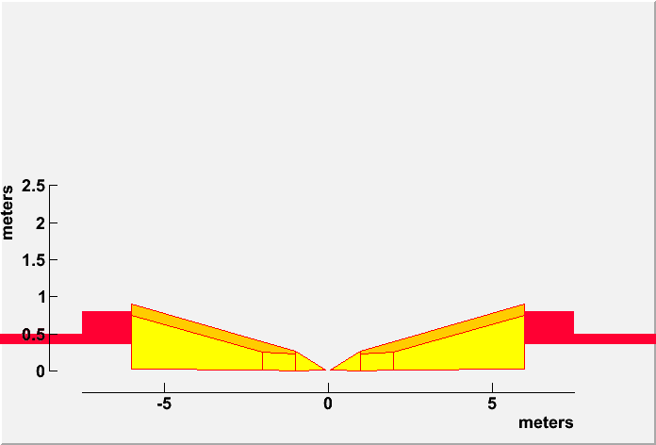
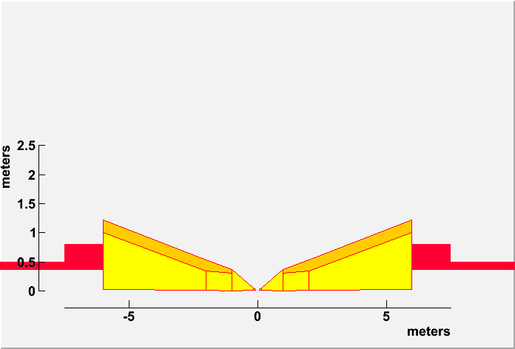
Using G4BL for Shielding Simulations
6° Cone
10° Cone
Examine conical shielding with angles from 6° to 20°
For each configuration we run 10 K e⁺ and e⁻.
  Each run takes 3 days on the NICADD cluster
  Minimum energy cut of 200 keV to stop tracking.
Fluxes are scored at a 47 cm cylindrical plane.
15° Cone
20° Cone

Slide 24
G4BL Fluxes as a Function of
Conical Angle
Particle fluxes at R=47 cm
Minimum particle kinetic energy: 200 keV

Slide 25
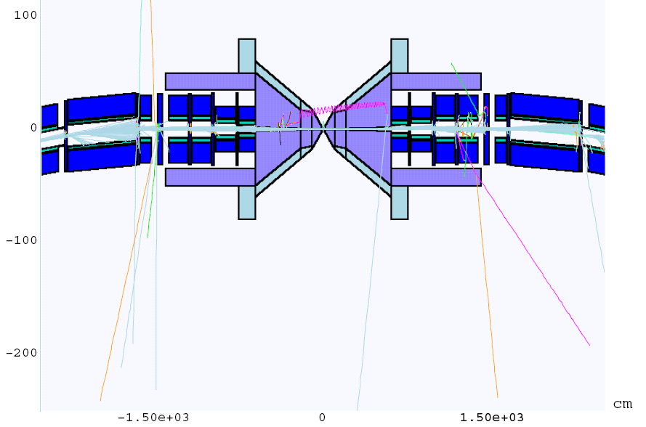
Mars: Run of ~20 Decay Muons

Slide 26
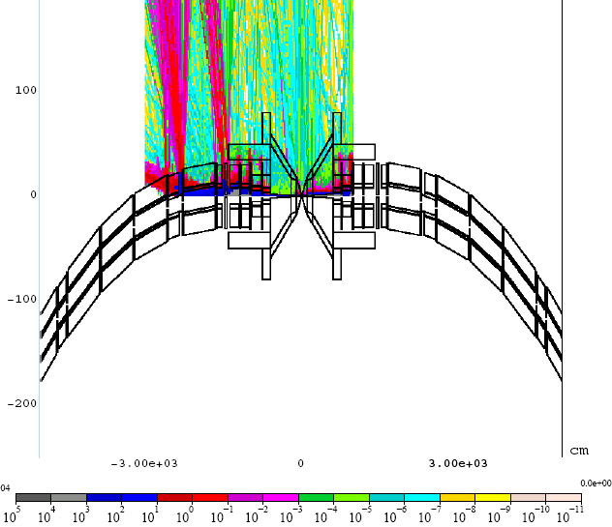
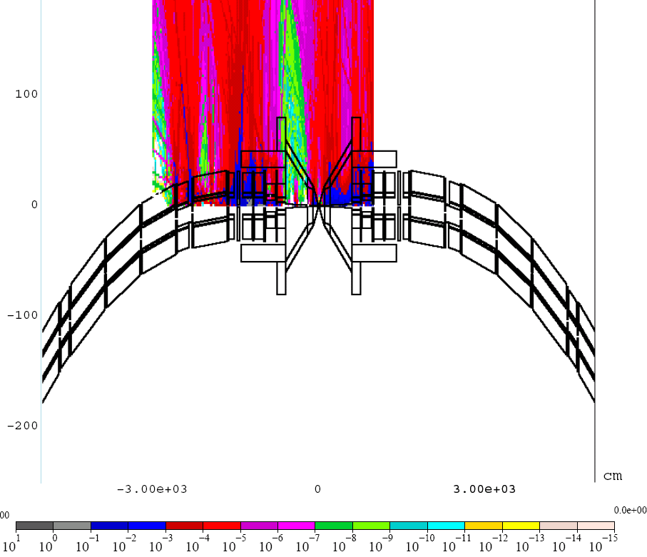
Gamma and Neutron Fluxes from Mars
Gamma Flux
Neutron Flux

Slide 27
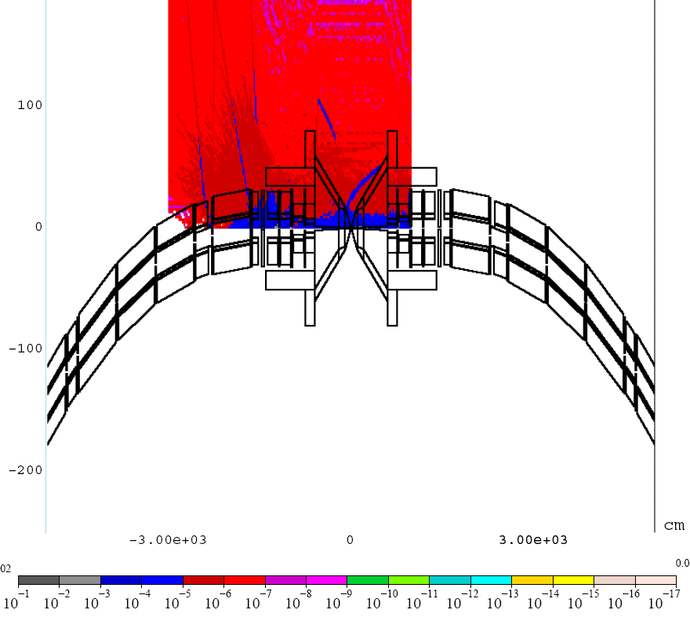
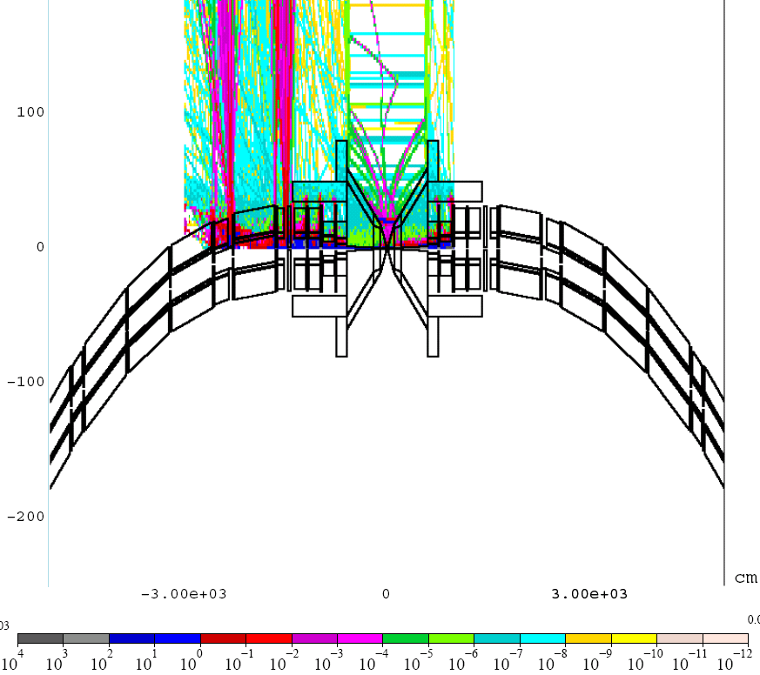
Mars: Muon and Electron Fluxes

Slide 28
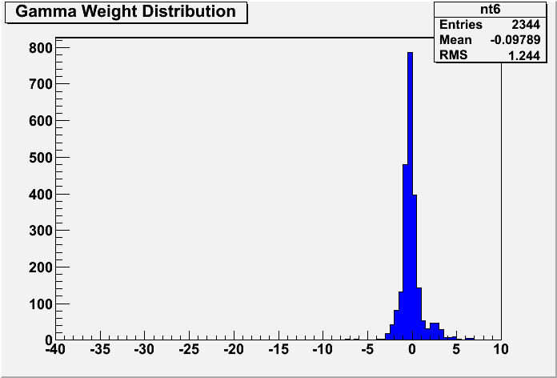
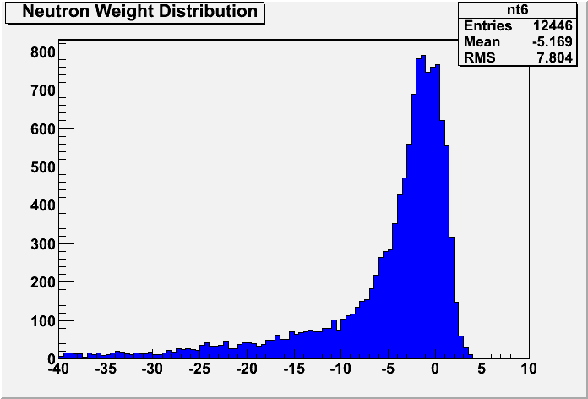
Mars: Weight Distributions of
Particle Hits
The distributions show the distribution of weights for gammas and neutrons
Neutron weights vary over 40 orders of magnitude.
Log₁₀(wt)
Log₁₀(wt)

Slide 29
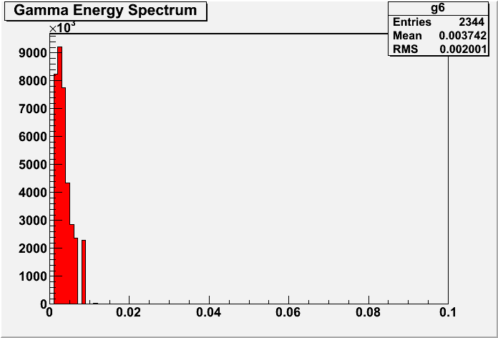
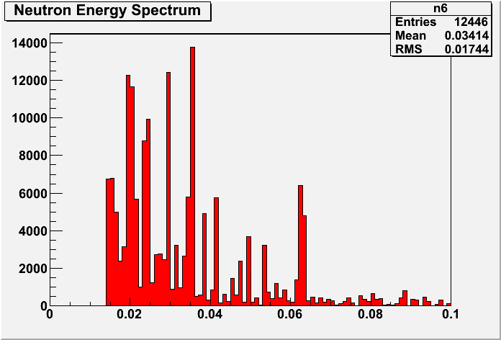
Mars: Energy Spectra of γ and n
Mars without MCNP seems to cut neutrons below 14 MeV, even if one requests a lower cutoff.

Slide 30
Mars: Fluxes at Radial Positions for a 10° Cone
Normalized Counts
Particle Fluxes

Slide 31
Mars Fluxes as a Function of
Cone Angle

Slide 32
Comparison of G4BL and Mars Fluxes
G4BL and Mars γ fluxes fall on top of each other.
  This implies that the relative normalization is OK.
The G4BL neutron flux is ~100 times larger than the Mars flux.
  The Mars sample only includes neutrons with KE>14.7 MeV.
  The G4BL sample is largely below 2 MeV
  Most neutrons are expected to be generated by the nuclear dipole resonance at ~10-20 MeV. This would yield lower energy neutrons.
  We need to run Mars with the MCNP option to obtain the low energy neutrons.

Slide 33
Future Plans for Phase II
Clean up items that may not have been finished in phase I:
  Boron issues.
  Other enhancements to improve the background package and G4beamline for background analysis.
Package BruitDeFond for use by others.
  Enter into a CVS repository. Current it exists on laptops.
  Instruction manual
Bethe-Heitler muon study.
  Aaron Morris is looking at Bethe-Heitler issues in our study.
  Muons can penetrate magnets and shielding and enter into detector region.
  We need a large sample of Bethe-Heitler muons, however the cross-section is not large.
    We may need to enhance the cross-section and weight those events
  A small number of high energy muons undergoing a catastrophic interaction can deposit isolated energy into a single calorimeter cell.
  Can fast time-of-flight or shower shape analysis distinguish Bethe-Heitler muons.

Slide 34
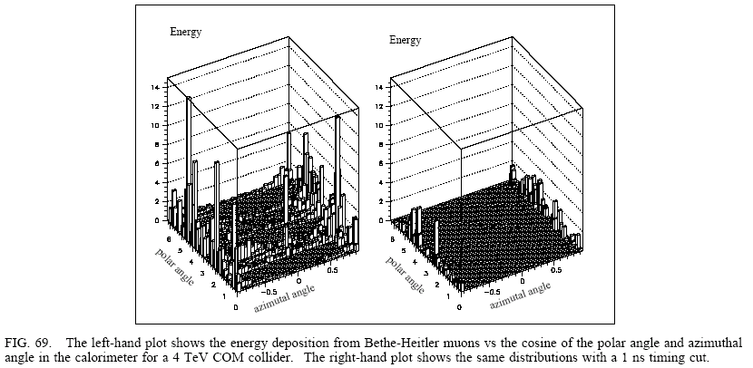

Slide 35
Future Plans (Cont.)
Perform a physics analysis by superimposing beam backgrounds onto physics events.
  The superposition should be done at the digitization level
  Use reconstruction techniques to see if backgrounds can be removed without corrupting.
  Evaluate the effect of beam backgrounds on specific physics channels.
  Can support university grad student or post doc to do these studies. (?)
Perform optimization of shielding to reduce backgrounds.
  The next slide shows shield shaping that was performed in the original study.
Optimize magnets to reduce energy deposition
Use shielding instrumentation to reduce cone angle.
  Analysis to demonstrate that it works.

Slide 36
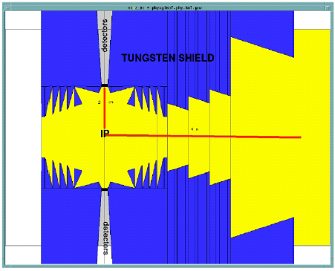
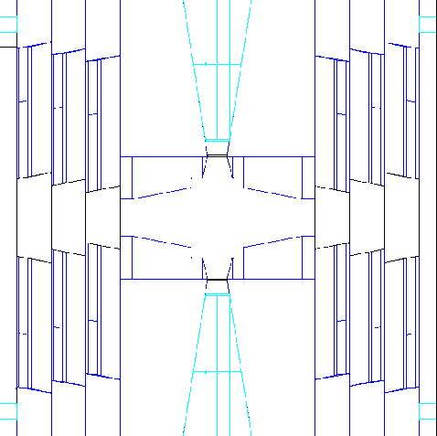
Interior Design of the Tungsten Shielding
The tungsten shielding is designed so that the detector is not connected by a straight line with any surface surface hit by a decay electron in forward or backward direction.
50×50 GeV case
250×250 GeV case
Borated Polyethelene
W
Cu

Slide 37
Accomplishments Continued
We have calculated particle fluxes at various locations in the detector region.
We have looked at the particle fluxes as a function of cone angle (see next slide from Joe).
  This slide may indicate that the “10°” cone may not be the ideal shielding. This could be a phase II consideration.

Slide 38
Conclusions
We have developed a simulation tool to investigate muon collider detector backgrounds.
Background particle fluxes from muon beam decays are calculated using G4BL.
  Comparison with Mars shows agreement for γ fluxes. Differences of neutron fluxes are understood.
The amount of background in the detector region is dependent on the conical shielding angle.
  Choosing the optimum angle is a trade-off between the size of the physics signal relative to the size of the background. Increasing the 10° cone angle to 15°(20°) reduces the background by a factor of ~2 (~4).

