Slide 1

RF Breakdown and Its Limitation
High Gradient Accelerator Structures R&D at SLAC
Muon Collider 2011
Juwen Wang
for S. Tantawi, V. Dolgashev, J. Nelson
and SLAC Team and Collaboration
June 29 2011

Slide 2

This work is made possible by the efforts of SLAC’s
  S. Tantawi , V. Dolgashev, J. Lewandowski, J. Neilson, J. Wang, A. Yeremian, C. Guo of Accelerator Technology Research
  E. Jongewaard, C. Pearson, A. Vlieks, J. Eichner, D. Martin, C. Yoneda, L. Laurent, A. Haase, R. Talley, J. Zelinski, J. Van Pelt,
  R. Kirby of Klystron Dept.
  C. Adolphsen, F. Wang of ARD
  S. Weathersby, C. Hast of ARD Test Facilities
  Z. Li of Advanced Computation
In close collaboration with:
  Y. Higashi, T. Higo of KEK, Tsukuba, Japan
  B. Spataro of INFN, Frascati, Italy
  W. Wuensch and CLIC team of CERN, Geneva, Switzerland
  J. Haimson of Haimson Research Corporation, CA

Slide 3
Outline
Introduction and History
  Challenges for High Gradient and US Collaboration
  Basics for Dark Current and RF Breakdown
  High Gradient Performance for Room Temperature Linear Collider NLC/GLC
Basic Physics Research on Short/Compact Accelerator Structures
  Basic studies on high gradient phenomena
  Pulsed Heating Experiments
  Material Studies
Basic Physics Research on Full Size Accelerator Structures
Design of Advanced Parallel Fed Standing Wave Accelerator Structure
Summary

Slide 4
  1. Introduction and History

Slide 5
The Challenge
What gradient can be reliably achieved using warm technology?
The original, optimistic view (PAC 1986) : E. Tanabe, J. W. Wang and G. A. Loew, “Voltage Breakdown at X-Band and C-Band Frequencies,” :
  The authors report experimental results showing that the Surface Electric Field limit at 9.3 GHz (X-Band) exceeds 572 MV/m in pulses of up to 4.5 microseconds
  Results predict an on-axis gradient of at least 250 MV/m
Reality sets in (by 2001):
  The operating limit determined by experiments on the NLC Test Accelerator showed that high gradient accelerator structure operating at X-band would not survive long term operation without computer/feedback protection and the breakdown rate above 65 MV/m can not be tolerated for a collider application.
The challenge: we wish to understand the limitations on accelerator gradient in warm structures
Our goal is to push the boundaries of the design to achieve:
  Ultra-high-gradient; to open the door for a multi-TeV collider
  High rf energy to beam energy efficacy, which leads to an economical, and hence feasible designs
  Heavily damped wakefield
S. Tantawi

Slide 6
Motivations to The US HIGH Gradient Collaboration
Our collaboration is to find the fundamental limitations on designing a high gradient collider with optimized structures.
We want to address the fundamentals, which include, but are not limited to:
  Frequency scaling
  Geometry dependence
  Materials
  Surface processing techniques (etching, baking, etc.)
  Theory

Slide 7
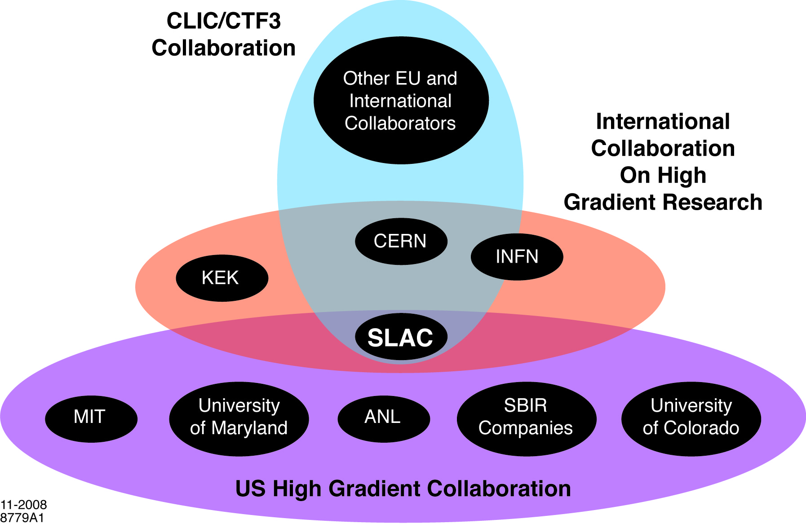
International Collaboration on High Gradient Research
INFN
KEK
CERN
Cockcroft
SLAC
NRL
S. Tantawi

Slide 8
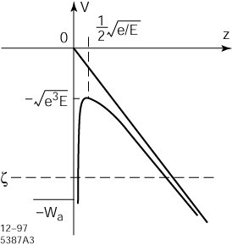
Dark Current - Field Electron Emission
Potential energy diagram showing the modified electric field potential barrier
DC Field electron emission from ideal metal surface:
x<0
x>0
Conduction electron obey Fermi-Dirac statistics -- Flux N(w_{x})dw_{x}
Tunneling probability can be calculated --- Time-independent Schrodinger
equation solution D (w_{x})
Integrate
Where the electric field E(v/m) and work function φ(eV)

Slide 9
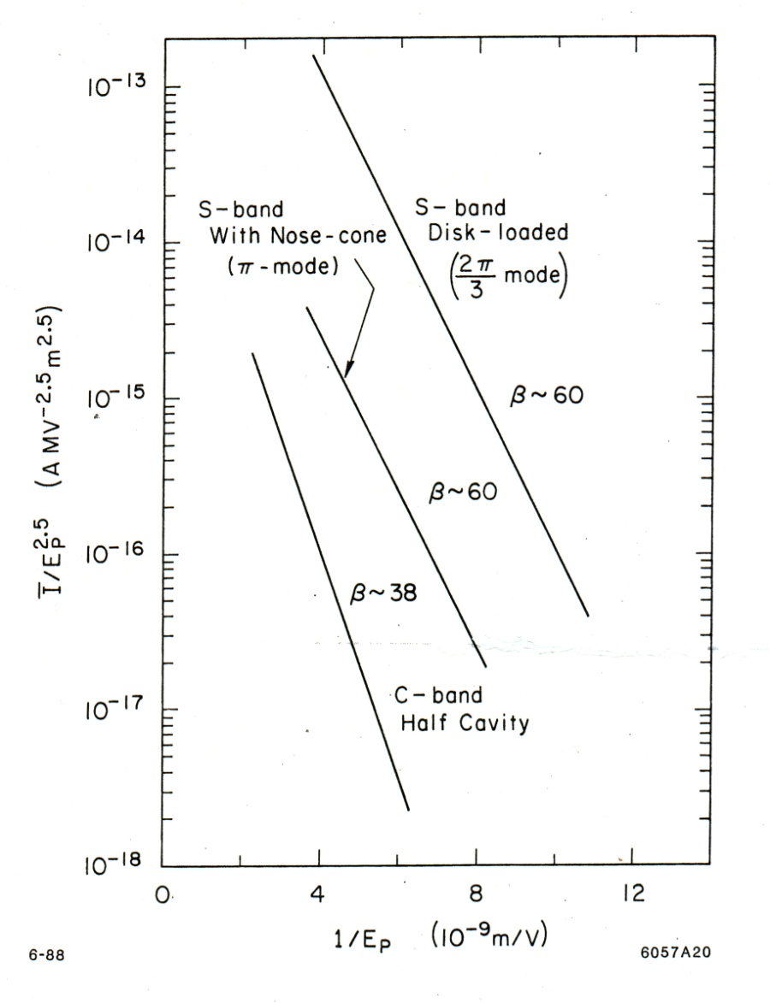
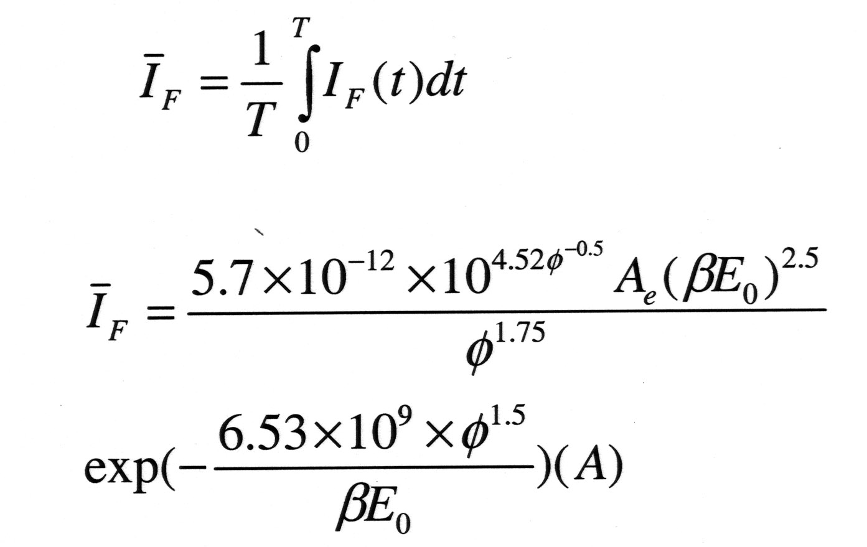
AC Field Emission and
Fowler-Nordheim Plots
A important measurement to evaluate the surface condition for enhanced field emission
Take time averaging of the
field emitted current:
The Fowler-Nordheim Plot:

Slide 10
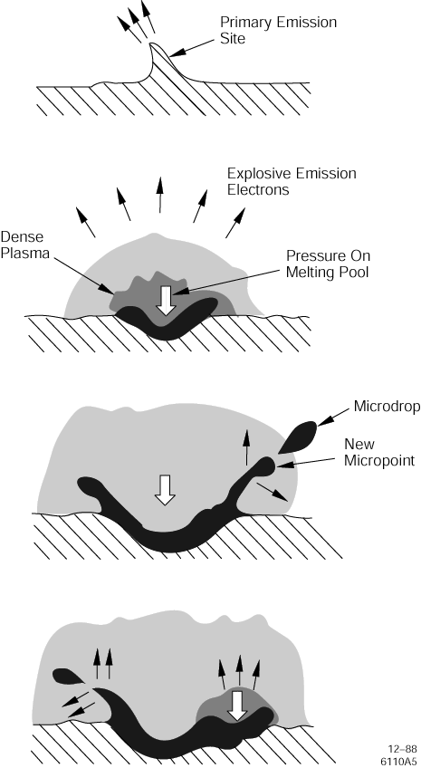
Explosive Electron Emission and plasma model for the formation of surface craters
The strong surface field at the tip of the emitter rips out a small chunk of the tip metal. As the chunk moves away from the tip, the total field emission electron current now flows across the small gap that has opened up between the chunk and the rest of the tip. This current quickly vaporizes the metal chunk. The electron current flowing through the metal vapor ionizes it, forming a plasma (plasma spot). Single spots have a diameter in the range 5–20 microns. During the lifetime of a spot, it excavates
a crater by the surface heating and melting due to an intense bombardment of plasma ions accelerated. A calculation gives a power density on the order of 1013 W/m2. The
pressure crested by the ion bombardment is on the order of a thousand Atmospheres. The height of the plasma spot is probably limited by the two‐stream instability. The electron current flowing out of a typical plasma spot is on the order of 50A.

Slide 11
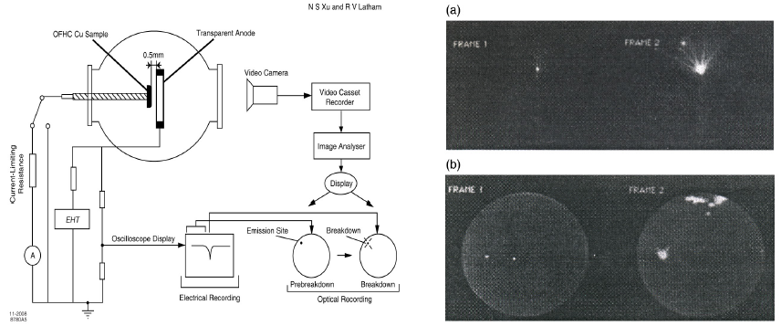
Plasma spots and associated craters
The plasma spot is the quantum unit of breakdown
The figures above from Xu and Latham (J. Physics D: Appl. Phys. 27, 2547–2555 (1994).
At the left is the experimental setup. At the right are examples of breakdown. They postulate that the pre‐breakdown currents are associated with isolated nonmetallic microstructures . These features have an average beta of 180.
P. Wilson

Slide 12
RF Breakdown due to Enhanced Electrical Fields
Explosive electron emission starting from Ohm heating at highly localized field emitting site.
Plasma formation enhances field emission.
A large fraction of RF power is absorbed inside structure.
Traveling Wave case:
  A large fraction of RF power is dissipated by electron - ion beams (up to 80%).
  Transmitted power shuts off completely in 20 – 100 ns.
  Field enhances to cause more damages in subsequent pulses.
Standing Wave case:
  RF energy reflects from structure in few ns after breakdown.
  Electromagnetic field collapses in few ns.
  Energy absorption inside structure much less than TW case.

Slide 13
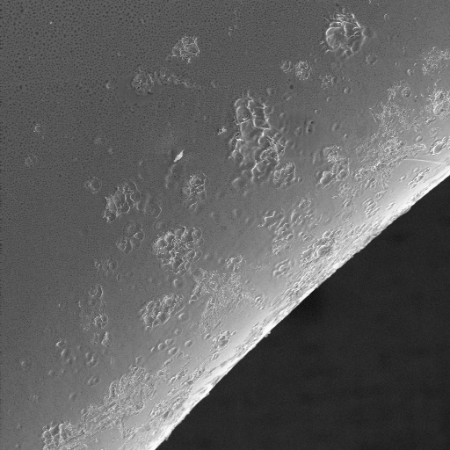
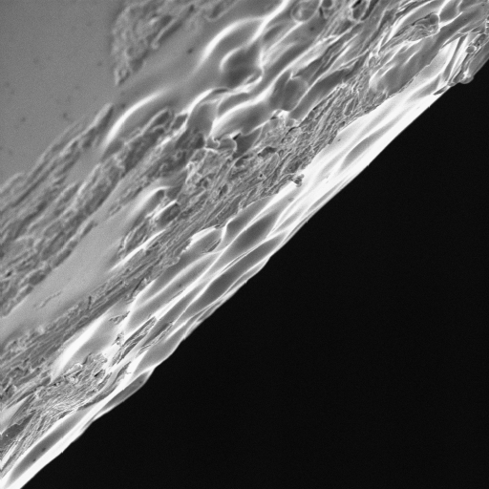
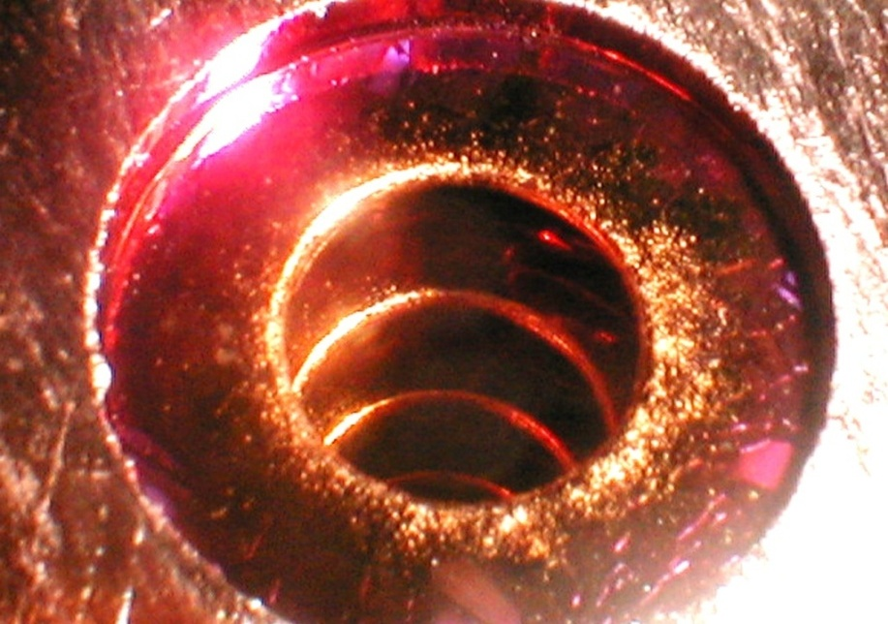
Pitting on Cell Irises of a Accelerator Structure After High Power Operation
SEM Iris Photograph
10 μm

Slide 14

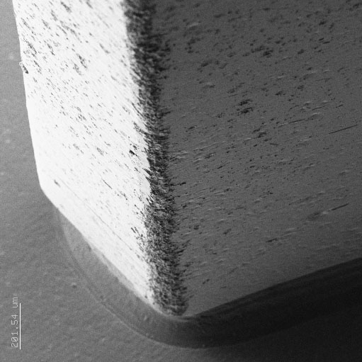
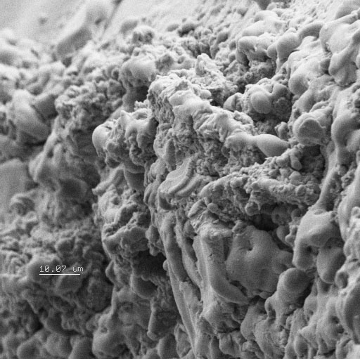
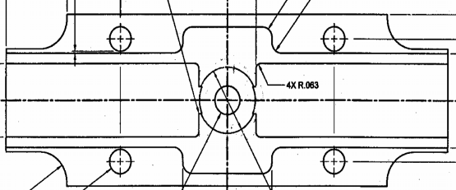
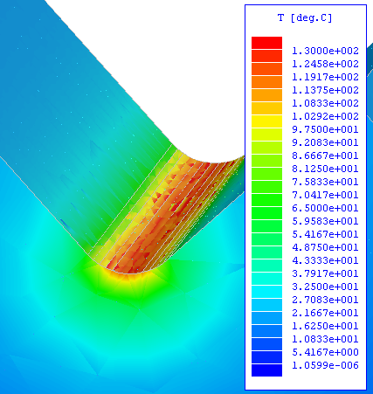
Structure Breakdown and Damage
due to RF Pulse Heating
IN the NLC era, the performances of some structures were found to be limited by RF breakdown due to pulse heating of coupler matching irises.
RF Pulse Heating causes:
Surface Roughening and Cracks
Local Surface Melting
Beam’s eye view of input coupler.
RF
RF
Temperature increase
due to RF pulse heating
SEM picture of input matching iris.
Pulse heating was in excess of 100 C°
Surface resistivity
Thermal conductivity
Magnetic field
Pulse width
Surface temperature distribution in the region of coupler iris for 400 ns pulses,48 MW. The maximum temperature increase was 127º C.
Specific heat

Slide 15
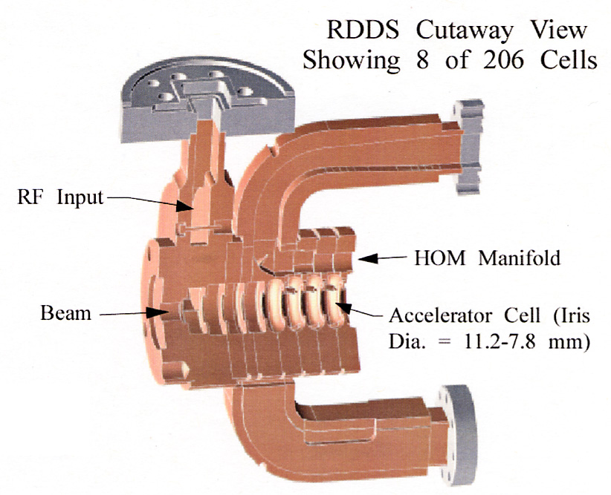
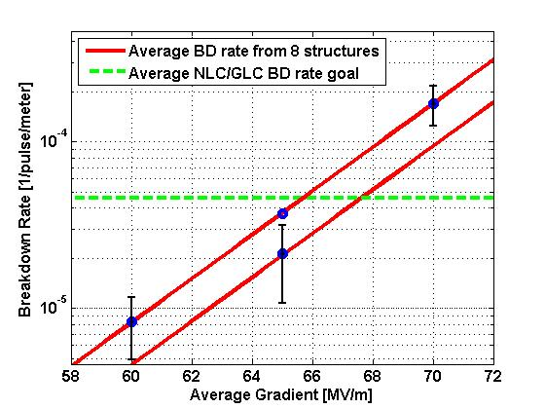
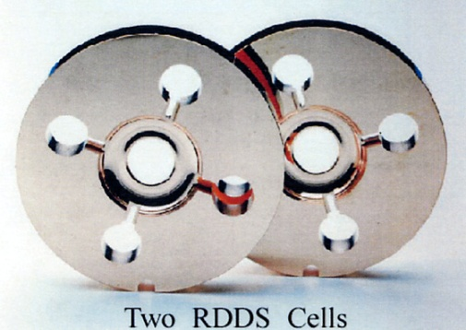
Prototype Accelerator Structures for the NLC/GLC Main Linac and High Power Performance
RDDS stands for Rounded Damped Detuned Structure. HOM stands for Higher Order Mode.

Slide 16
2. Basic Physics Research on Short/Compact Accelerator Structures

Slide 17
Basic Physics Research Short/Compact Accelerator Structures
Brazed Structures
  Geometrical Studies
    Standing wave structures have been studied extensively
    Travelling wave structures are ongoing
    Structures with wake field damping features
      Photonic band gap
      Choked structures
      Slotted structures
  Material studies
    Limited to what one can get for the brazed structure
  Low temperature normal conducting structures
Clamped Structures
  Material Studies
  Mixed material structures
  Surface coatings
Joined Structures
  Plated Joints
  Electron Beam welding
  Low Temperature brazing
Structures with View Ports for Fast Diagnostics for Breakdown Phenomenon
S. Tantawi

Slide 18
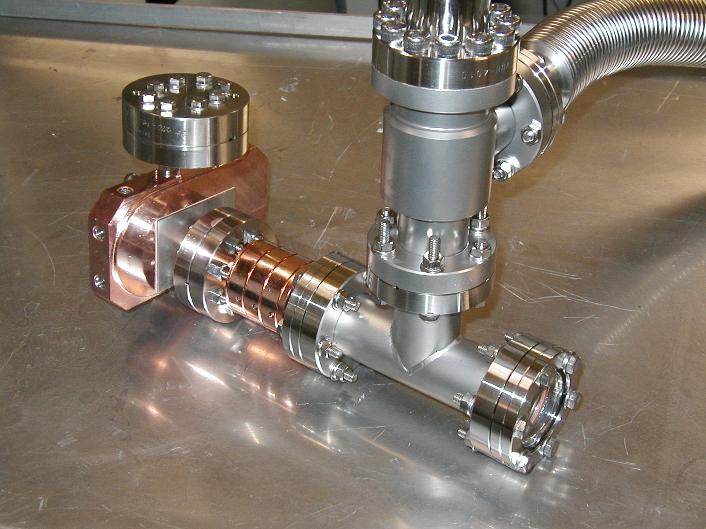
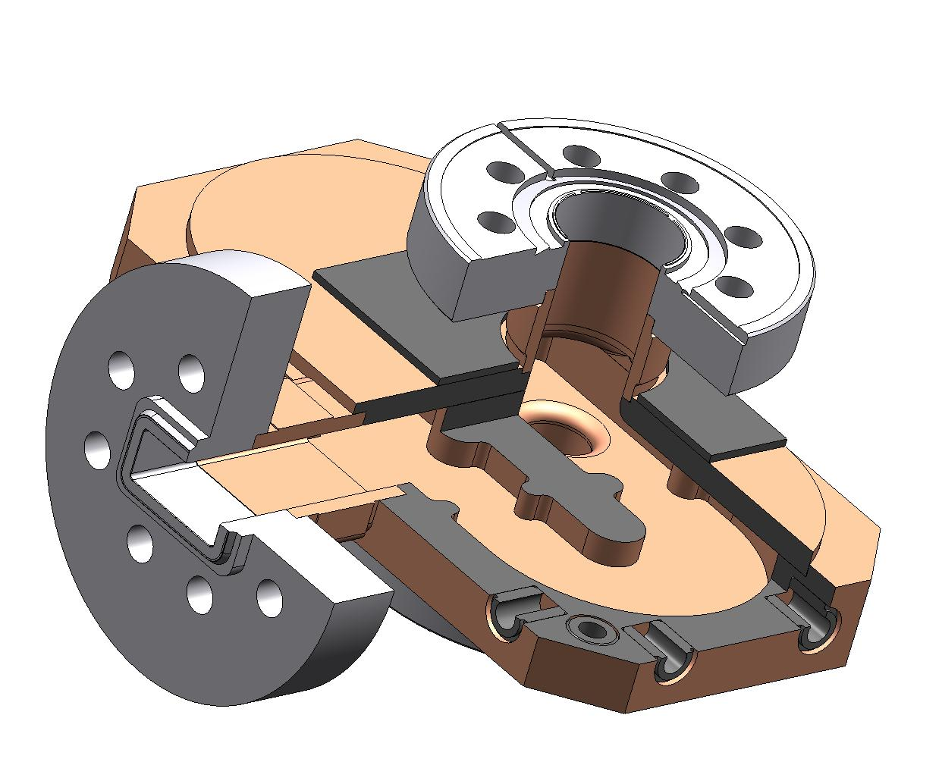
Reusable coupler: TM₀₁ Mode Launcher
RF flange
Yasuo Higashi, KEK
Cutaway view of the mode launcher. Surface electric fields in the mode launcher E_{max}= 49 MV/m for 100 MW
The mode is used for a short SW structure test
S. Tantawi, C. Nantista

Slide 19
High Power Tests of Single Cell Standing Wave Structures Tested
Low shunt impedance, a/lambda = 0.215, 1C-SW-A5.65-T4.6-Cu, 5 tested
Low shunt impedance, TiN coated, 1C-SW-A5.65-T4.6-Cu-TiN, 1 tested
Three high gradient cells, low shunt impedance, 3C-SW-A5.65-T4.6-Cu, 2 tested
High shunt impedance, elliptical iris, a/lambda = 0.143, 1C-SW-A3.75-T2.6-Cu, 1 tested
High shunt impedance, round iris, a/lambda = 0.143, 1C-SW-A3.75-T1.66-Cu, 1 tested
Low shunt impedance, choke with 1mm gap, 1C-SW-A5.65-T4.6-Choke-Cu, 2 tested
Low shunt impedance, made of CuZr, 1C-SW-A5.65-T4.6-CuZr, 1 tested
Low shunt impedance, made of CuCr, 1C-SW-A5.65-T4.6-CuCr, 1 tested
Highest shunt impedance copper structure 1C-SW-A2.75-T2.0-Cu, 1 tested
Photonic-Band Gap, low shunt impedance, 1C-SW-A5.65-T4.6-PBG-Cu, 1 tested
Low shunt impedance, made of hard copper 1C-SW-A5.65-T4.6-Clamped, 1 tested
Low shunt impedance, made of molybdenum 1C-SW-A5.65-T4.6-Mo, 1 tested
Low shunt impedance, hard copper electroformed 1C-SW-A5.65-T4.6-Electroformed-Cu, 1 tested
High shunt impedance, choke with 4mm gap, 1C-SW-A3.75-T2.6-4mm-Ch-Cu, 2 tested
High shunt impedance, elliptical iris, a/lambda = 0.143, 1C-SW-A3.75-T2.6-6NCu, 1 tested
High shunt impedance, elliptical iris, a/lambda = 0.143, 1C-SW-A3.75-T2.6-6N-HIP-Cu, 1 tested
High shunt impedance, elliptical iris, a/lambda = 0.143, 1C-SW-A3.75-T2.6-7N-Cu, 1 tested
Low shunt impedance, made of CuAg, 1C-SW-A5.65-T4.6-CuAg-SLAC-#1, 1 tested
High shunt impedance hard CuAg structure 1C-SW-A3.75-T2.6-LowTempBrazed-CuAg, 1 tested
High shunt impedance soft CuAg, 1C-SW-A3.75-T2.6-CuAg, 1 tested
High shunt impedance hard CuZr, 1C-SW-A3.75-T2.6-Clamped-CuZr, 1 tested
High shunt impedance single feed side coupled, 1C-SW-A3.75-T2.6-1WR90-Cu-SLAC-#1, 1 tested
High shunt impedance hard CuCr, 1C-SW-A3.75-T2.6-Clamped-CuCr, 1 tested
High shunt impedance double feed side coupled 3C-SW-A3.75-T2.6-2WR90-Cu-SLAC, 2 tested
Highest shunt impedance hard copper structure 1C-SW-A2.75-T2.0-Clamped-Cu, 1 tested
Low shunt impedance Photonic-Band Gap with elliptical rods 1C-SW-A5.65-T4.6-PBG2-Cu-SLAC-#1
V. Dolgashev

Slide 20
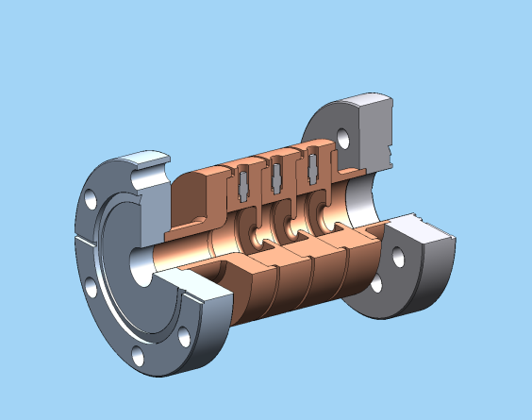
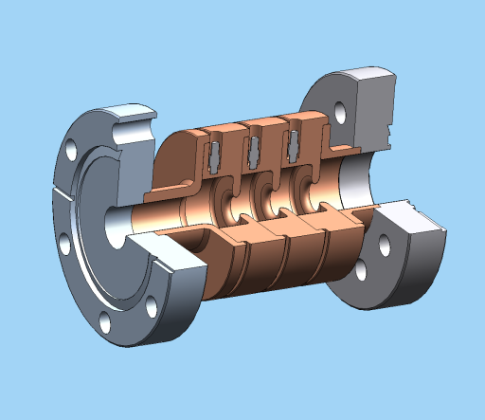
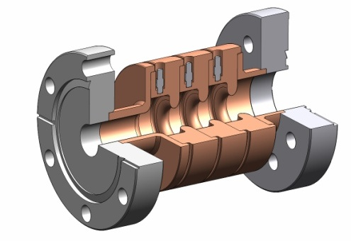
Geometrical Studies
Three Single-Cell-SW Structures of Different Geometries
1)1C-SW-A2.75-T2.0-Cu
2) 1C-SW-A3.75-T2.0-Cu
3) 1C-SW-A5.65-T4.6-Cu
3
2

Slide 21
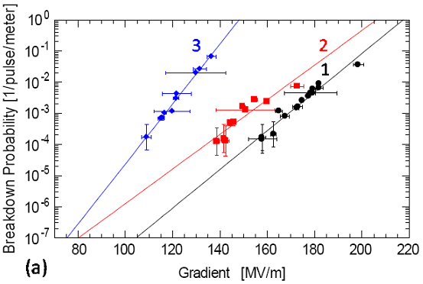
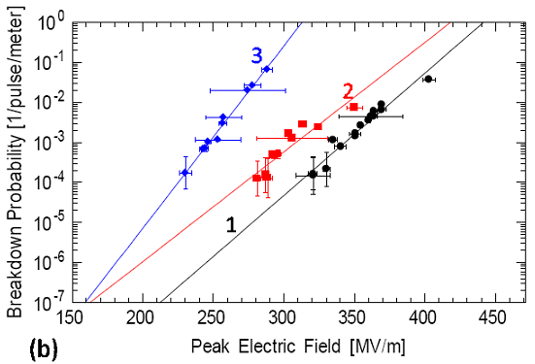
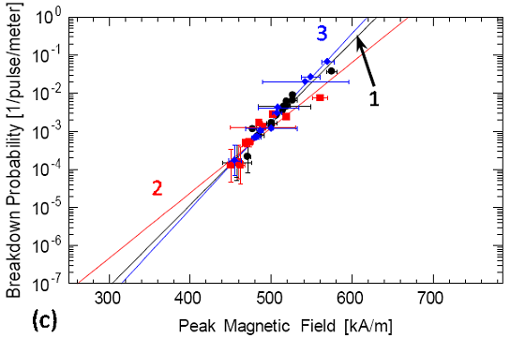
Comparison of breakdown probabilities for three different structures. Their respective a/λ values are 1) 0.105, 2) 0.143 and 3) 0.215
S. Tantawi, V. Dolgashev

Slide 22
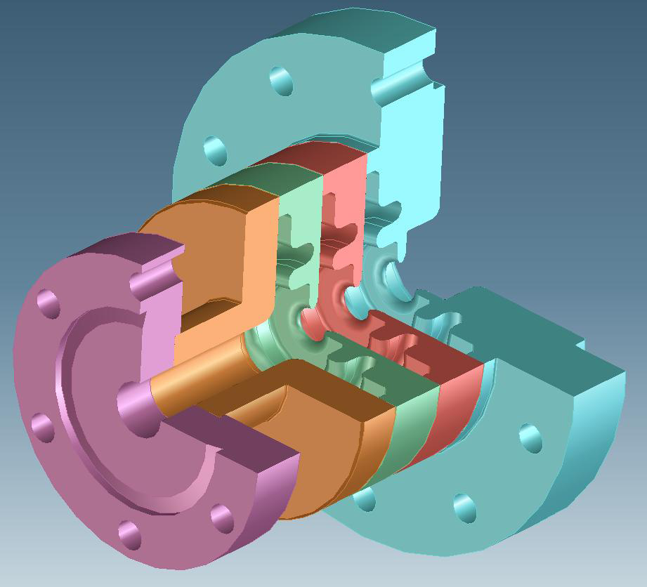
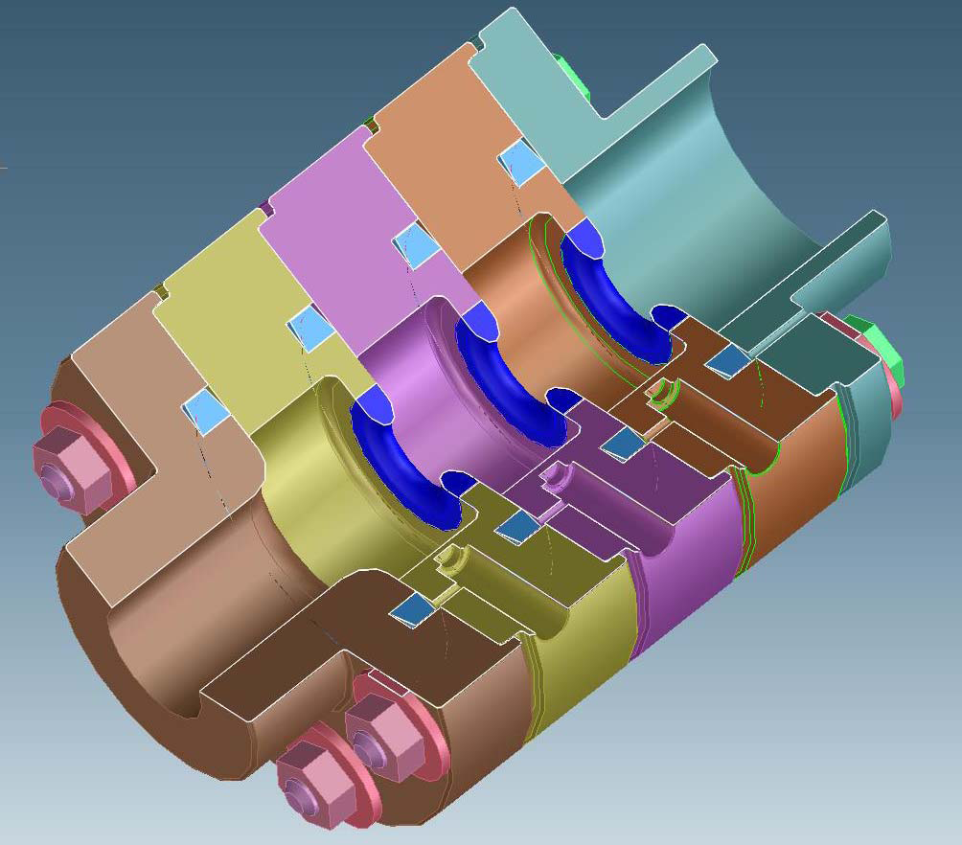
Geometry and material test
Structure joining techniques that avoid high temperature treatment
1C-SW-A3.75-T2.2-Cu,Mo-KEK,
similar configuration is under
development in INFN-Frascati
1C-SW-A3.75-T2.6-Clamped-CuAg-KEK
D. Yeremian, V. Dolgashev, S. Tantawi, Y. Higashi

Slide 23
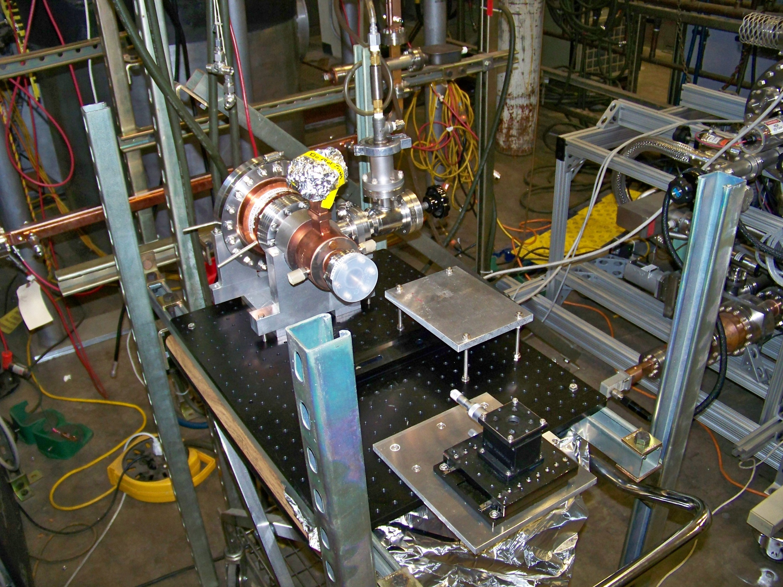
In-situ microscopic observation of surface change due to pulse heating: new pulse heating cavity with viewport and Yasuo Higashi’s optical table

Slide 24
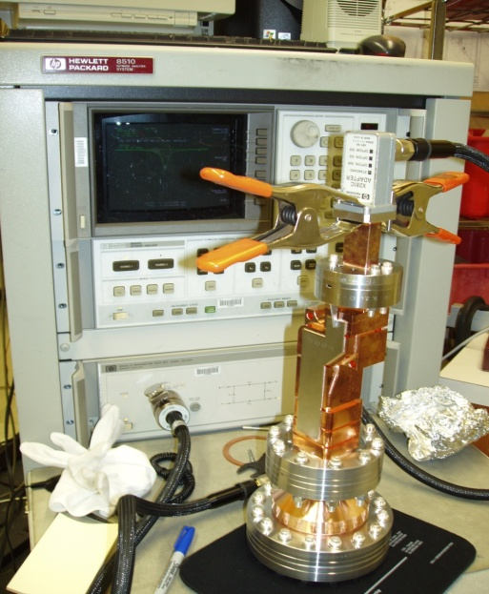
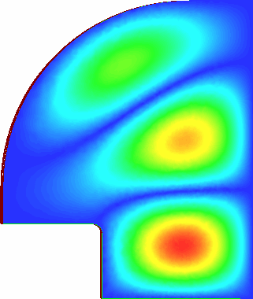
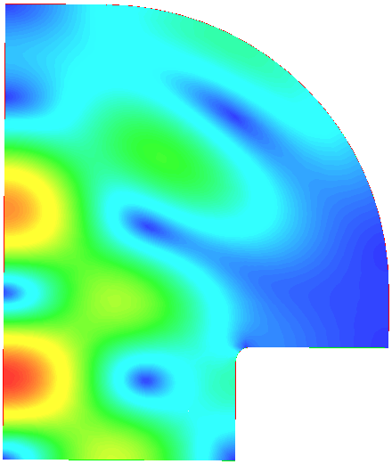
Mode Convertor
Test Cavity
|Ε|
|Η|
Q₀ = ~44,000
(Cu, room temp.)
αξισ
TE₀₁ Mode Pulse Heating Ring
material sample
r = 0.98”
Max Temp rise during pulse = 110ºC
TE013 cavity (left) and its connection to a circular to WR90 waveguide mode convertor (right).

Slide 25
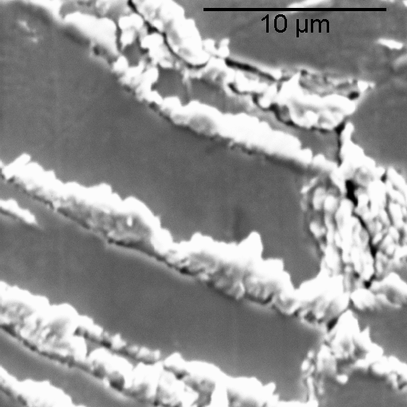
Material Testing ( Pulsed heating experiments)
SEM Images Inside Copper Pulse Heating Region
Economical material testing method
Essential in terms of cavity structures for wakefield damping
Recent theoretical work also indicate that fatigue and pulsed heating might be also the root cause of the breakdown phenomenon
Special cavity has been designed to focus the magnetic field into a flat plate that can be replaced.
Metallography: Intergranular fractures 500X
L. Laurent

Slide 26
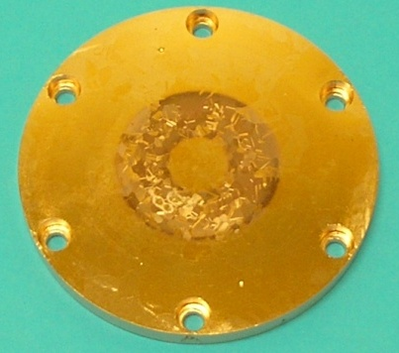
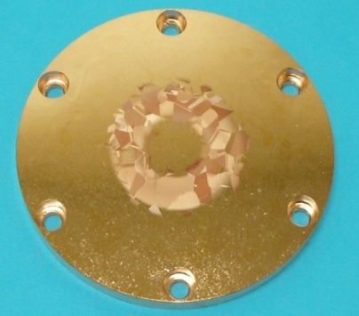
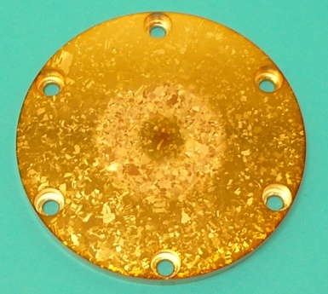
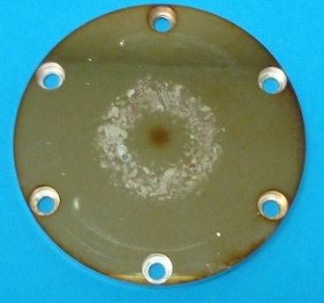
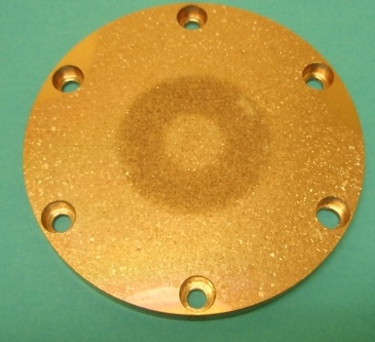
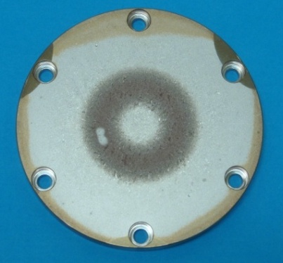
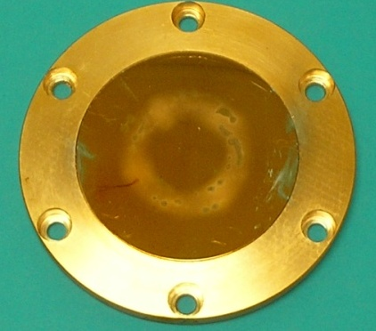
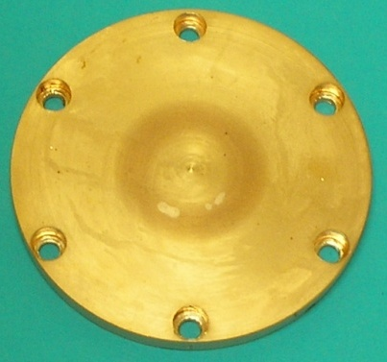
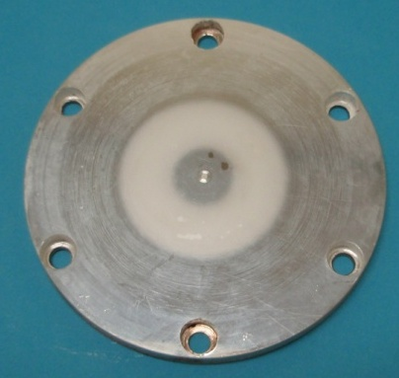
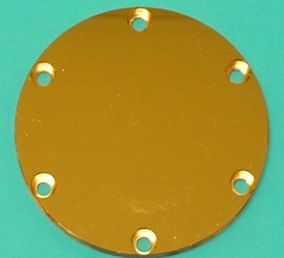
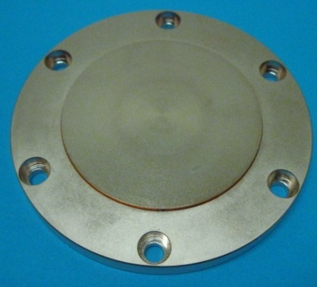
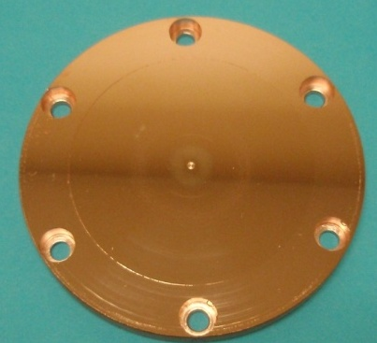
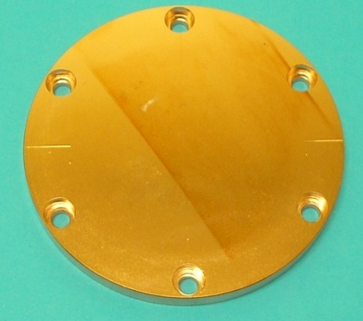
Hardness Test Value
Some of Pulse Heating Samples RF Tested
10
19
33
36
45
Cu101 (SLAC)
KEK3 (KEK)
HIP2 (KEK)
HIP1 (KEK)
CuZr2-2 (CERN)
54
??
62
64
CuCr101 (SLAC)
Single Crys Cu (KEK)
E-Dep. Cu (KEK)
AgPCu (KEK)
77
78
80
83
CuZr3-2 (CERN)
CuAg5 (SLAC)
CuAg1 (KEK)
CuCr102 (SLAC)
L. Laurent

Slide 27
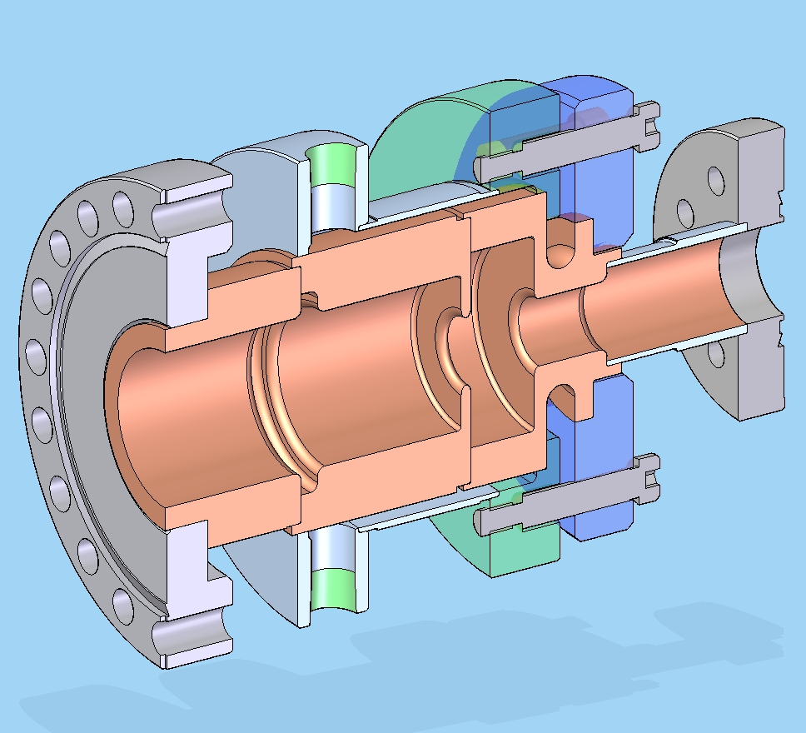
Dual mode accelerating structure to separate effect of RF magnetic and electric fields
TM01 in
TE01 in
D. Yeremian, V. Dolgashev, S. Tantawi,

Slide 28
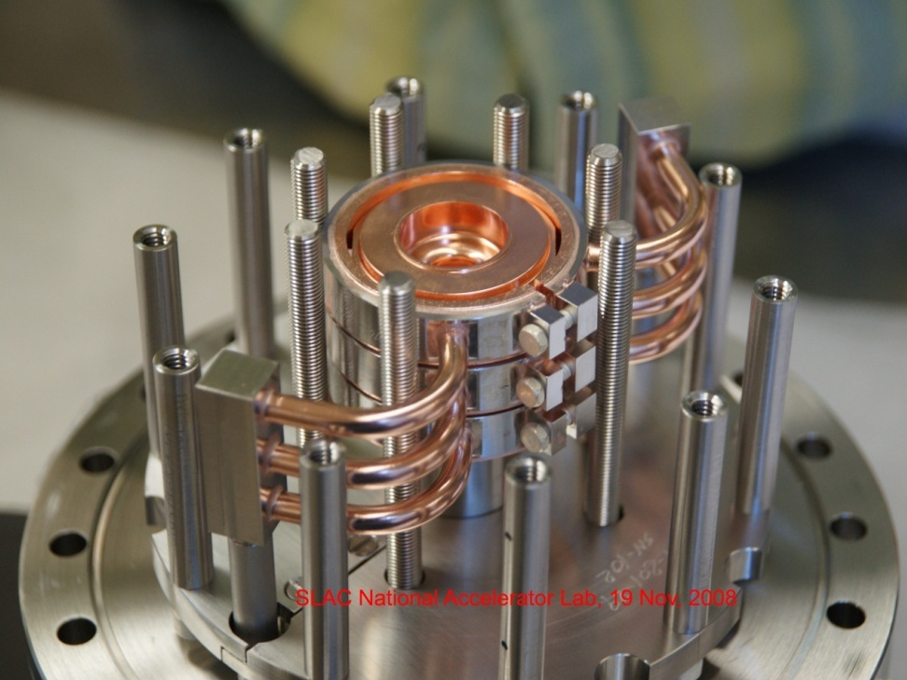
Test of Hard Copper
Clamped Structure with Hard Copper cells
Hard Copper showed an observable improvements of annealed brazed structures
V. Dolgashev

Slide 29
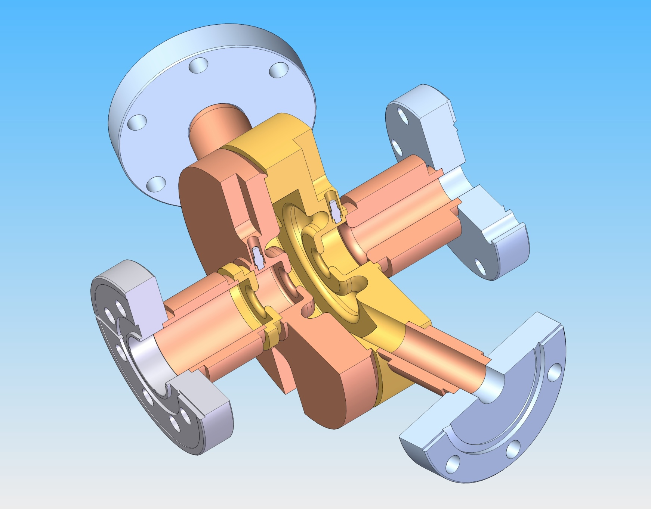
New diagnostics
In-situ microscopic observation of surface change and rf breakdowns;
Full cell choke and two view ports 1C-SW-A3.75-T2.6-Ch-View-Port-Cu-SLAC-#1,2
D. Yeremian, V. Dolgashev, S. Tantawi

Slide 30
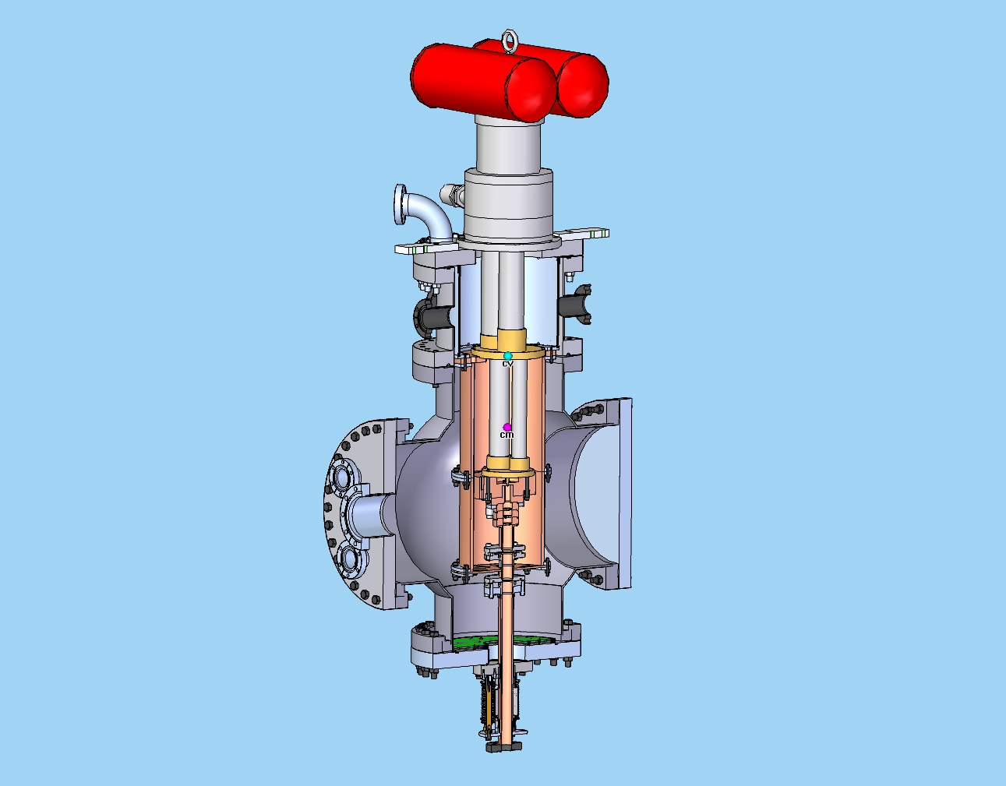
Experiments
at cryo temperatures
Refrigerator head
Accelerating structure
RF in
Solid model: David Martin, 10 January 2011

Slide 31
Some Results with Short/Compact Accelerator Structures
Test results of side coupled SW structures are opening possibility of building parallel-coupled SW structures capable of well above 100 MV/m gradients with apertures satisfactory for a linear collider, however we need to understand unusual breakdown damage pattern.
Test results of hard materials show that change in hardness for the Cu and Cu alloy changed response of the breakdown to pulse length: the breakdown rate lost correlation with Sqrt (pulse length). CuCr structure had a layer of chromium particle on surface which, likely, effected its performance. Hard Cu structure had unusual breakdown damage pattern which may be attributed to initial stage of processing with high ~200 deg. C temperature.
We have set of experiments in queue which may give us more clues about rf breakdown physics.

Slide 32
3. Basic Physics Research on Full Size Accelerator Structures

Slide 33
Basic Physics Research Full Size Accelerator Structures
Resonant Ring Structures
  Geometrical Studies
  Martial studies
CERN Structures
Dielectric Structures
New Distributed Coupling Standing Wave Accelerator Structures
Pulsed Heating Setup
  Material Studies
Mixed E&H Setup
Superconducting Material/Low Temperature Material Testing
  Novel RF materials
  Stratified materials
Basic Physics Research Others
RF Sources Research
Overmoded Magnetrons
Massively Multimoded Klystrons
Large signal codes
Novel RF sources
S. Tantawi

Slide 34
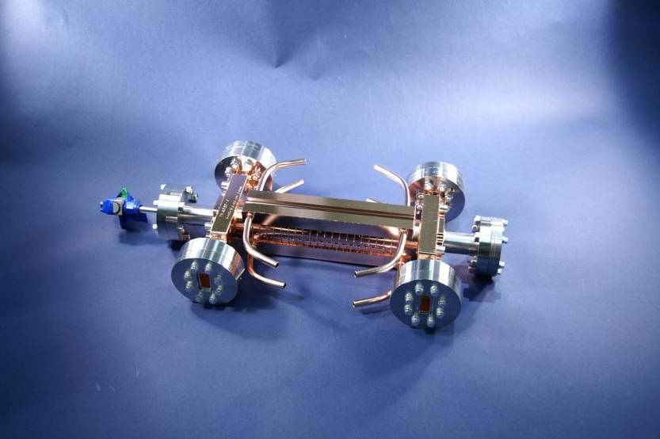
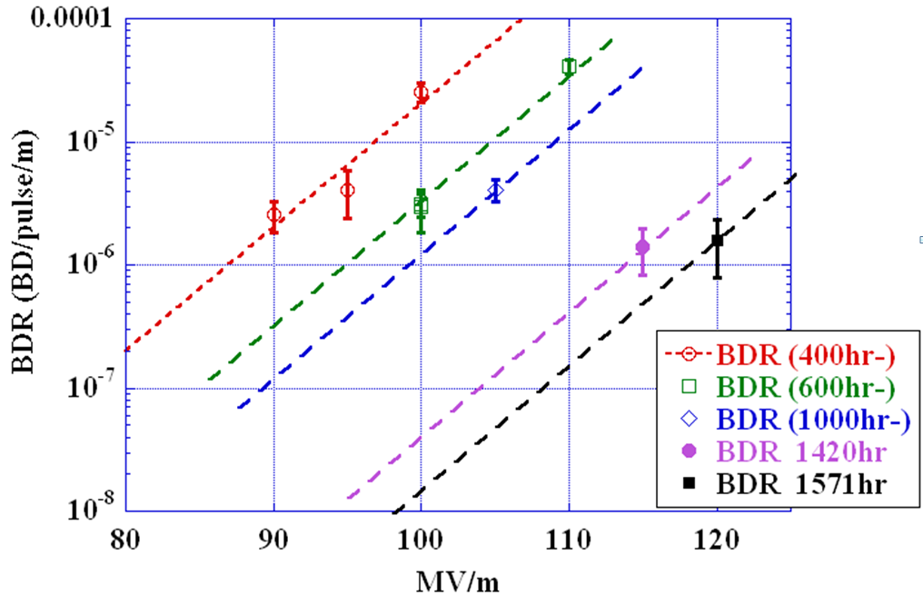

High Power Test Result for a Prototype Structure of CLIC Main Linac
Average breakdown rates for a CLIC main linac prototype structure called T24 as a function of accelerating gradient after certain hours of RF processing, the solid red line shows the design specification of 5x10⁻⁷ Breakdown/Pulse/m.
Prototype Structures of CLIC Main Linac without (top) and with HOM damping features (bottom)

Slide 35
T18_VG2.4_DISC Structures
Frequency. | 11.424GHz
Cells | 18+input+output
Attenuation Factor τ | 0.23
Filling Time | 36ns
a_{in}/a_{out} | 4.06/2.66 mm
Vg_{in}/Vg_{out} | 2.61/1.02 (%c)
S₁₁ | 0.035
S₂₁ | 0.8
Phase Advance / Cell | 120°
Pulse Heating ΔT | 2.5 /17.5 °K (55.5 MW, 200ns)
Average Unloaded Gradient | 55.5MW→100MV/m
J. Wang

Slide 36


T18_VG2.4_DISC Structure Test
Field
Amplitude
E
E
~
1
.
5
acc
_
out
acc
_
in
Cumulated
Phase Change
120°
Microwave Tuning and test
J. Wang

Slide 37

High Power Test of TW T18 in a resonant ring
One of goals of this experiment is to study circuit effect on the breakdown rate. The experiment explores circuit dependence of RF breakdowns due to external circuit which should automatically shut off breakdowns.
37
HAIMSON RESEARCH CORPORATION

Slide 38

T18 embedded in the dual resonant ring at ASTA

Slide 39
4. Design of Advanced Parallel Fed Standing Wave Accelerator Structure

Slide 40





Iris shaping for Standing-Wave π-mode structures
Shunt Impedance 83 MΩ/m
Quality Factor 8561
Peak E_{s}/E_{a} 2.33
Peak Z₀H_{s}/E_{a} 1.23
Shunt Impedance 104 MΩ/m
Quality Factor 9778
Peak E_{s}/E_{a} 2.41
Peak Z₀H_{s}/E_{a} 1.12
Shunt Impedance 102 MΩ/m
Quality Factor 8645
Peak E_{s}/E_{a} 2.3
Peak Z₀H_{s}/E_{a} 1.09
Shunt Impedance 128 MΩ/m
Quality Factor 9655
Peak E_{s}/E_{a} 2.5
Peak Z₀H_{s}/E_{a} 1.04
a/λ=0.14
a/λ=0.1
Shape optimization reduces magnetic field on the surface, and hence, we hope to improve breakdown rate with the enhanced efficiency
Magnetic Field
Distance Along the surface
S. Tantawi

Slide 41

Shaped Iris
Thick elliptical iris
Thin round iris
- Iris profile designed to maximize shunt impedance, minimize peak surface magnetic field
S. Tantawi

Slide 42
SW Cells a/λ =0.143, π Phase Shift
Field Normalized for 100MeV/m Acceleration
Parameter | T=1.66 Round Iris | T=2.6mm Elliptical Iris | T=2.2mm Shaped Iris
Stored Energy [J] | 0.189 | 0.189 | 0.186
Q-value | 8820 | 8560 | 10090
Shunt Impedance [MOhm/m] | 85.2 | 82.6 | 99.2
Max. Mag. Field [KA/m] | 314 | 325 | 294
Max. Electric Field [MV/m] | 266 | 203 | 268
Losses in one cell [MW] | 1.54 | 1.59 | 1.32
Hmax*Z0/Eacc | 1.18 | 1.22 | 1.11
Max. Im{E x H*} W/µm² | 42.8 | 44.4 | 56.5
Max. Im{E x H*}/H² | 417 | 407 | 650
S. Tantawi
Notes:
Input field (power) for shaped iris cavity ~8-10% (17-20%) lower than other cavities

Slide 43
Approach*
Potential advantages of parallel fed, π mode standing-wave (SW) structures over travelling-wave structures
  minimizes energy available during breakdown
  maximizes power distribution efficiency
  enhanced vacuum pumping conductance
  empirical evidence π mode have lower breakdown rate at given gradient vs. travelling wave structures
RF
source
Directional Coupler
Sc = (1 – i + N)^{-1/2}
Load
•
•
•
•
Accelerator
Cavity
N^{th} Accelerator
Cavity
*S. Tantawi,” RF distribution system for a set of standing-wave accelerator structures”, Phys. Rev., ST Accel. Beams,vol. 9, issue 11
Notes:
What is initial response (large reflection?)

Slide 44


RF Feed Using Biplanar Coupler
~ 7 cm
~ 3 cm
~ 24 cm

Slide 45

Design Cavity Results for 100 MV/m
Parameter
Beam Tunnel radius (mm) | 2.75
Iris thickness (mm) | 2
Stored Energy [J] | 0.153
Q-value | 8580
Shunt Impedance [MOhm/m] | 103.5
Max. Mag. Field [KA/m] | 342
Max. Electric Field [MV/m] | 253
Normalized Max. Mag. Field [290 KA/m] | 0.153
Emax/Accel gradient | 2.53
Hmax Zo/Accel gradient | 1.29
45 Degree Wedge of Cavity
Magnetic Field
J. Nelson

Slide 46


Planar Mechanical Design
~25 cm
2.7 kg
J. Nelson

Slide 47
5. Future Work and Summary

Slide 48
Future work/Open Problems
Full length accelerator structures based on standing wave cells:
  These are being theoretically designed and modeled. The structure will feature parallel coupling and would look matched like any other traveling wave structure from the outside.
  We hope to prove a structure capable of exceeding 140 MV/m gradient
Wakefield damping features are being studied theoretically and experimentally.
Accelerator structures made of copper alloys are being studied
The effect of beam-loading on gradient needs to be verified.
The development of theoretical understanding and Modeling of the RF breakdown phenomena is starting to take shape. however, this is still at its infancy.

Slide 49
Summary
The work being done is characterized by a strong national and international collaboration. The availability of SLAC facilities which was developed over the years due to healthy RF technology developments were essential and continue to be essential for these research activity.
Magnetic field plays a very important role in determining the breakdown probability in a given structure
The experimental program to date has paved the ground work for the theoretical developments for a new understanding of the gradient limits of room temperature accelerators and will allow us to break these barriers for the development of ultra-high gradient structures. .
With the understanding of geometrical effects, we have demonstrated standing and traveling wave accelerator structures that work above 100 MV/m loaded gradient.
Standing wave structures have shown the potential for gradients of 150 MV/m or higher
Further understanding of materials properties may allow even greater improvements

