Slide 1

Brief Overview of the Collider Ring Magnets Mini-Workshop
Muon Collider 2011 Physics — Detectors — Accelerators
J. Tompkins, Fermilab

Slide 2
Collider Ring Magnets
Mini-Workshop
Instigated and led by Bob Palmer
Guidance and support from Steve Geer, Harold Kirk, Giorgio Apollinari, & others…
Collider Ring Magnets Mini-Workshop, May 19-20, 2011 Fermilab
Participants…
Bob Palmer’s Summary (MAP Friday Meeting – June 3, 2011)
Muon Collider 2011 Physics — Detectors — Accelerators

Slide 3
Evolution of CR Studies
(Simplified Version)
CR/Magnet Studies ~ 2010
  Ring magnet designs were developed which met field requirements and temperature margins were acceptable
    Field quality and mechanical solutions were acceptable
    Total heat load to cryogenic system had not been addressed at this point (?…)
CR/Magnet studies ~ 2011
  Heat loads investigated in more detail – Mokhov et al
    Total heat load to LHe system much too high
    Open mid-plane magnets and/or additional shielding needed
      Thermal isolation from 4K system to keep refrigeration manageable/affordable…
Muon Collider 2011 Physics — Detectors — Accelerators

Slide 4
Some Relevant Papers
Fermilab-Conf-11-094-APC-TD
MUON COLLIDER INTERACTION REGION AND MACHINE -DETECTOR INTERFACE DESIGN
N.V. Mokhov, Y.I. Alexahin, V.V. Kashikhin, S.I. Striganov, A.V. Zlobin
Fermilab-Conf-11-095-APC-TD
RADIATION EFFECTS IN A MUON COLLIDER RING AND DIPOLE MAGNET PROTECTION
N.V. Mokhov, Y.I. Alexahin, V.V. Kashikhin, S.I. Striganov, A.V. Zlobin
Proceedings of 2011 Particle Accelerator Conference, New York, NY, USA
OPEN-MIDPLANE DIPOLES FOR A MUON COLLIDER
R. Weggel, J. Kolonko & R. Scanlan, Particle Beam Lasers, Northridge, CA
D. Cline & X. Ding, UCLA, Los Angeles, CA 90095, USA
IEEE Transactions on Applied Superconductivity, Volume 21, Issue 3, June 2011 Page(s):1825-1828
Conceptual designs of dipole magnet for muon collider storage ring,
I. Novitski, V. V. Kashikhin, N. Mokhov, A.V. Zlobin
Fermilab-Conf-10-132-APC-TD
MAGNET DESIGNS FOR MUON COLLIDER RING AND INTERACTION REGIONS
A. Zlobin, Y. I. Alexahin, V. V. Kashikhin, N. V. Mokhov
Fermilab-Conf-10-106-APC-TD
MUON COLLIDER INTERACTION REGION DESIGN
Y. I. Alexahin, E. Gianfelice-Wendt, V. V. Kashikhin, N. V. Mokhov, A. V. Zlobin
Fermilab-Conf-10-277-APC-TD
CONCEPTUAL DESIGNS OF DIPOLE MAGNET FOR MUON COLLIDER STORAGE RING
Y. I. Alexahin, E. Gianfelice-Wendt, V. V. Kashikhin, N. V. Mokhov, A. V. Zlobin
2005 Particle Accelerator Conference at Knoxville, Tennessee
OPTIMIZATION OF OPEN MIDPLANE DIPOLE DESIGN FOR LHC IR UPGRADE
R. Gupta, M. Anerella, A. Ghosh, M. Harrison, J. Schmalzle and P. Wanderer, BNL, NY, U.S.A.
N. Mokhov, FNAL, Batavia, IL, U.S.A.
Proceedings of the 2001 Particle Accelerator Conference, Chicago
DYNAMICS OF DECAY ELECTRONS AND SYNCHROTRON RADIATION IN A TEV MUON COLLIDER
P. McIntyre. and A. Sattarov, Texas A&M University, College Station, TX USA
Note: Links to these papers are found on the INDICO page for the Collider Ring Magnets Workshop: in the box labeled ‘slides’ there is a pull-down menu accessed with the arrow (rhs)
Muon Collider 2011 Physics — Detectors — Accelerators

Slide 5
Overview of the Workshop
Initiated by Bob Palmer, Harold Kirk, and Steve Geer
Cryogenic efficiency, heat loads, and wall power
  Bob Palmer reviewed cryo-system efficiencies (mostly based on CERN LHC experience) to set target for total power to 4K system
Magnetic Field Requirements were discussed by Yuri Alexahin
Heat loads in the magnets
  Mokhov & Xiaoyu Ding gave talks on tracking simulations of the energy deposition
    They will give talks in today’s session
Magnet designs to manage the heat loads
  ‘Open midplane’ designs which remove material from the path of decay products and provide space for aborbers
    Bob Palmer reminded us of earlier designs
    Zlobin, Gupta, Weggel, & McIntye presented design solutions
Muon Collider 2011 Physics — Detectors — Accelerators

Slide 6
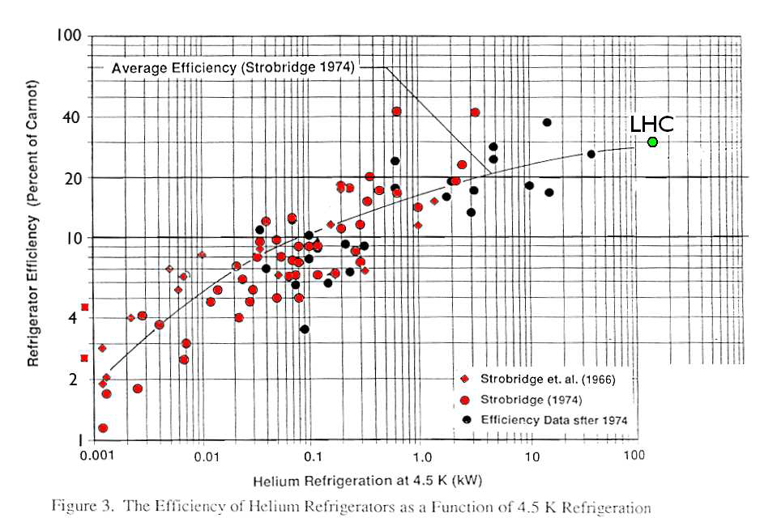
Cryogenic Efficiency and Power in Decay Electrons
(R. Palmer)
From R. Palmer (cryo eff. mostly LHC estimates)
Carnot efficiency ≈ 4K/300K = 0.0133
Refrig. Efficiency ≈ 25-30%
Distrib. Efficiency ≈ 70%
4K Eff ≈ 0.0133×0.70×0.30 ≈ 0.0028
Palmer Req.: Wall power for 4K operation <10MW => losses must be less than 28kW
Power in Decay Electrons => Attenuation Required
Beam power: 7.2 MW
Beam power dissipated as electrons: 2.5 MW (from Mokhov)
For 4K loss to be <28kW, attenuation must be = .028/2.5 = 0.011 => 99% of decay e⁻’s must be ‘removed’ from 4K region
(Bob’s note: we are assuming the same attenuation for all regions despite the dipoles only representing only 67% of the ring)
Muon Collider 2011 Physics — Detectors — Accelerators

Slide 7
4
IR Magnet Requirements
(Y. Alexahin)
Requirements adopted for this design:
Full aperture 2A = 10 sigma_max + 30 mm - more than in Oide’s design, where 2A=7.6 sigma_max
Maximum tip field in quads B_tip = 10T (G=250T/m for 2A=80 mm) - more than in Oide’s design (B_tip=6.5T)
Bending field B = 8T in large-aperture open-midplane (?) dipoles (B1 and next four)
IR quad length L_quad < 2m, dipole length L_bend < 6m
Quads Q1-Q6 are horizontally displaced by 1/10 aperture to produce a dipole component
Why 10/2 = 5 sigma beam pipe inner radius?
- we may scrape halo particles at < 3 sigma w/o any loss of luminosity !
However:
Large β_max = 50 km (~100 km for 3 TeV) → extremely high sensitivity to vibrations →
Transient orbit excursions and optics errors may force us to do scraping at larger amplitudes, ~4 sigma, + 1 sigma clearance to avoid direct hits by primary muons → 5 sigma total.
If such precautions prove to be unnecessary → reduce β* and gain in luminosity!
to accommodate beam pipe & annular helium channel
Muon Collider 2011 Physics — Detectors — Accelerators

Slide 8
7
IR Quad Issues
(Y. Alexahin)
Aperture
Are those + 30mm on top of 10 sigma enough to accommodate any absorber at the position of maximum beam size? (Luckily the maximum reached in one plane at a time)
Gradient vs Aperture
We scaled the gradient as (approximately): G = B_tip / A (A = bore inner radius)
- until what A the tip field can be held at B_tip = 10 T? It would be helpful to have a realistic G(A) curve for guidance.
Magnet Interconnects
Gaps between quads were chosen according to A.Zlobin’s formula:
Minimum coil end length: coil IR + 3cm (end parts) + 5cm (end plate)
I added 2 cm to each gap for mask holder/cooler but:
No additional space for splices! – Is this feasible?
Runaway βmax effect:
Any reduction in average gradient → increase in βmax → larger aperture → further reduction in gradient
Muon Collider 2011 Physics — Detectors — Accelerators

Slide 9

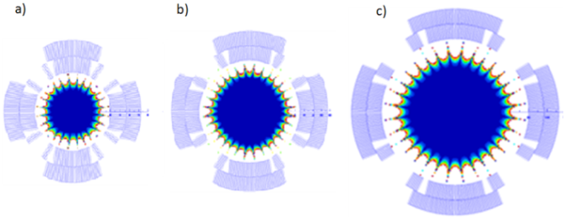
5
IR Quads
(Y. Alexahin)
a (cm)
Q1 Q2 Q3 Q4 Q5 B1 Q6
5σ_{y}
5σ_{x}
z (m)
Gradient (T/m) 250 187 -131 -131 -89 82
Quench @ 4.5°K 282 209 146 146
Quench @ 1.9°K 308 228 160 160
Margin @ 4.5°K 1.13 1.12 1.12 1.12
Margin @ 1.9°K 1.23 1.22 1.22 1.22
Coil aperture (mm) 80 110 160 160 - in Oide’s design up to 400 mm
Muon Collider 2011 Physics — Detectors — Accelerators

Slide 10
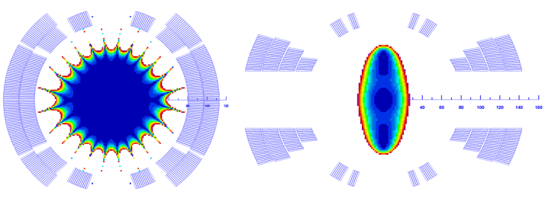
IR Dipoles
(Y. Alexahin)
8
We limited B field by 8 T due to large vertical aperture required (160mm).
Sagitta = 1.44 cm for L_bend = 6m, max. horizontal beam size σx ~ 3mm
Harmonic # | Cosθ | Open midplane
R_{ref} (mm) | 53 | 40
b₃ | 0.04 | -5.88
b₅ | 0.03 | -18.32
b₇ | 0.40 | -17.11
b₉ | 0.60 | -4.61
The gap between coils in the open-midplane dipole is 60mm (from -2.5 σy to 2.5 σy)
• Actually we need a C-magnet: almost all secondaries (electrons and synchrotron gammas) go inside, only gammas produced by electrons immediately after birth go outside, but no more than by 6cm – they stay well within the inner coil radius.
• Open-midplane or C-magnet seems better for detector backgrounds: electrons are deflected more before hitting the absorber – a factor of 2 in preliminary simulations.
• Multipole components are vertically focusing at x < 0 – will it help electrons to pass the gap?
Muon Collider 2011 Physics — Detectors — Accelerators

Slide 11
13
Summary
Y. Alexahin
♦ We need large aperture (up to 20 cm for 3 TeV) strong quadrupoles G~10T/IR
♦ For closest to IP dipoles the open-midplane C-configuration looks preferable
♦ The large nonlinearities in the open-midplane dipole do not appear prohibitive
♦ The required aperture in the arc magnets is much smaller (10σ_{y} = 7mm)
♦ We are working on a significant modification of the IR optics, hopefully the aperture requirements will be the same for 3 TeV β*=5mm
Muon Collider 2011 Physics — Detectors — Accelerators

Slide 12
Collider Ring Dipoles – Requirements/Issues
(Nikolai Mokhov)
Full aperture A = 10 σ_{max} + 2cm
Maximum tip field in quads = 10T (G=200T/m)
Dipoles: B = 10T in the arcs, open-midplane or large-aperture cos-theta with a thick liner
Tungsten masks in interconnect regions
Dipole coils used in this study are arranged in a shell-type configuration. The coil aperture is 80 mm, the coil to coil gap is 30 mm with supporting
spacers: Four 7-mm Al in March 2011, two 3-mm AlBemet in May 2011.
Magnetic length is 6 m, straight (RBEND). The nominal field is 10 T.
Muon Collider 2011 Physics — Detectors — Accelerators

Slide 13
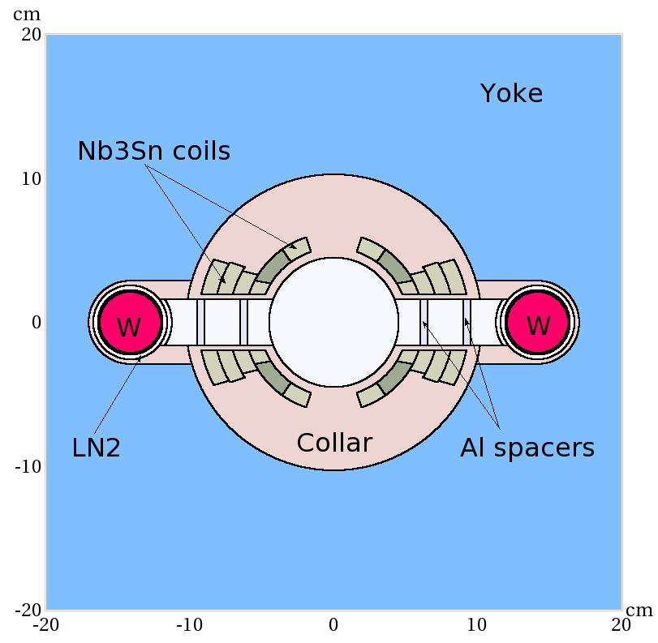
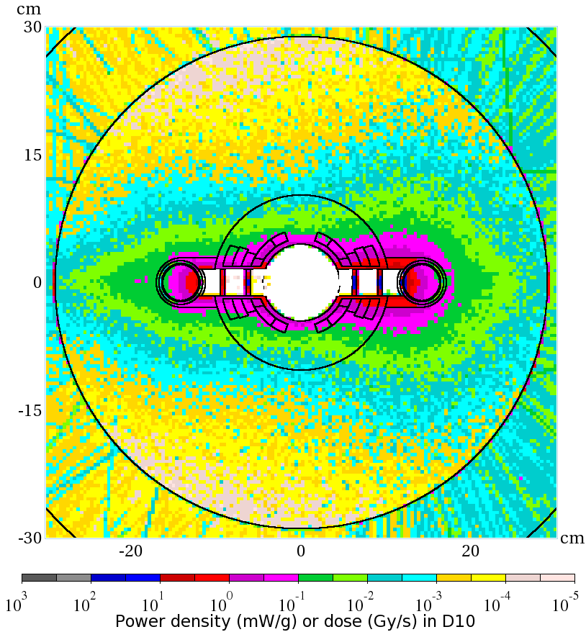
Energy Deposition in Ring Dipoles
(Nikolai Mokhov)
Dynamic heat load
W-rods: 200 W/m
1.9-K LHe: 245 W/m
The peak power density in the IR dipoles is about 2.5mW/g, safely below the quench limit for the Nb₃Sn superconductor based coils at the 1.9-K operation.
Muon Collider 2011 Physics — Detectors — Accelerators

Slide 14
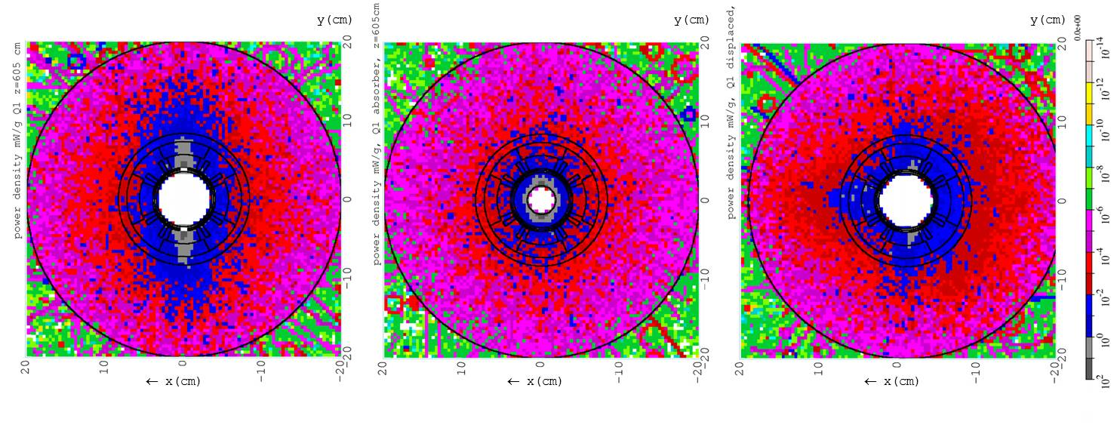
6
Heat Deposition in IR Quad
Deposited power density in Q1 (mW/g) for three cases: (i) “standard” (left), (ii) with additional 5 sigma absorbers inside (center) and (iii) w/o absorbers but with horizontal quad displacement (right).
“Standard”: 10-cm long tungsten masks with 5 σ_{x,y} elliptic openings are put in the IR magnet interconnect regions
Combination of (ii) and (iii) looks promising but has not been tried yet.
Muon Collider 2011 Physics — Detectors — Accelerators

Slide 15
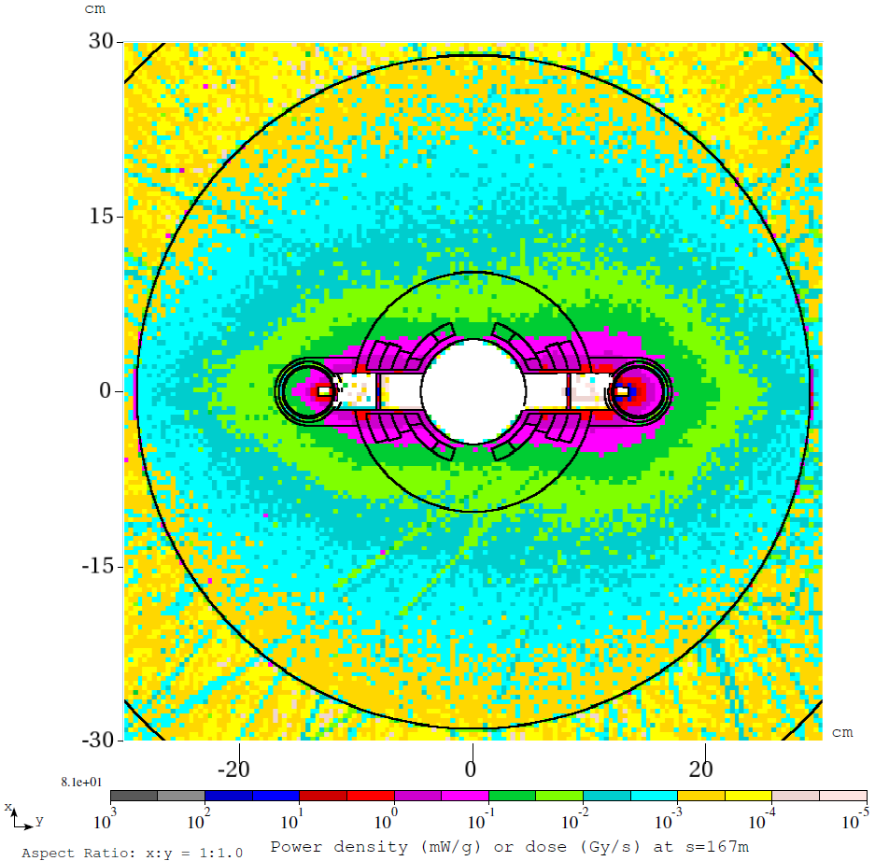
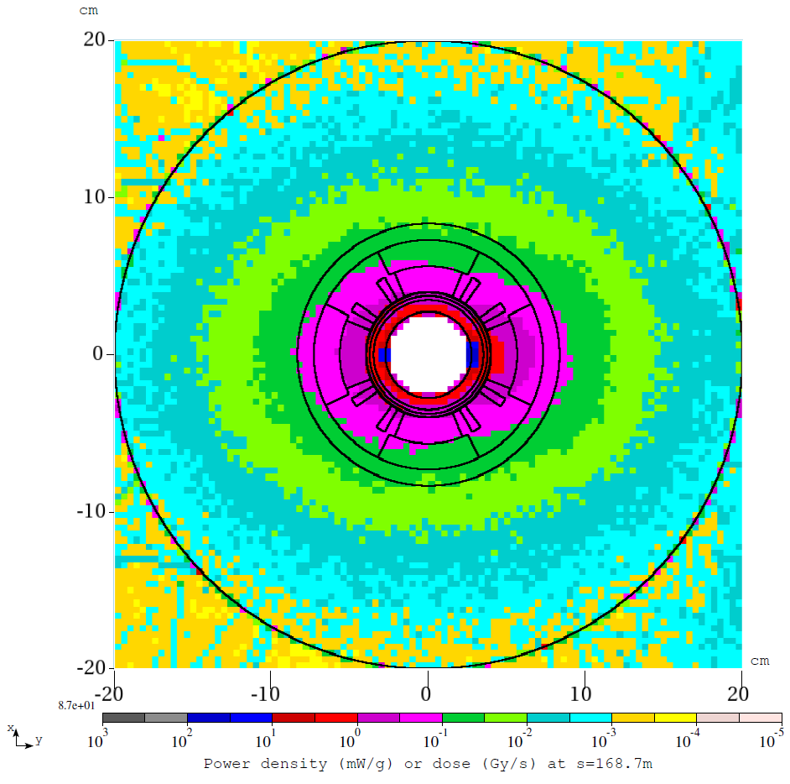
Power Density Isocontours in Ring Magnets
(Nikolai Mokhov)
Power Density Isocontours in Ring Dipole
Power Density Isocontours in Ring Quad
Peak 1mW/g - OK
Peak 1.5mW/g - OK
Muon Collider 2011 Physics — Detectors — Accelerators

Slide 16
Summary Comments
(Nikolai)
Quench stability (peak power density, heat transfer): manageable with appropriate design and protection
Dynamic heat loads: challenging with 0.5-1 kW/m
Radiation damage – Component lifetime: R&D needed
Residual dose rates - Hands-on maintenance: OK
Note: talks by Nikolai and Xiaoping Ding follow in this session
Muon Collider 2011 Physics — Detectors — Accelerator

Slide 17
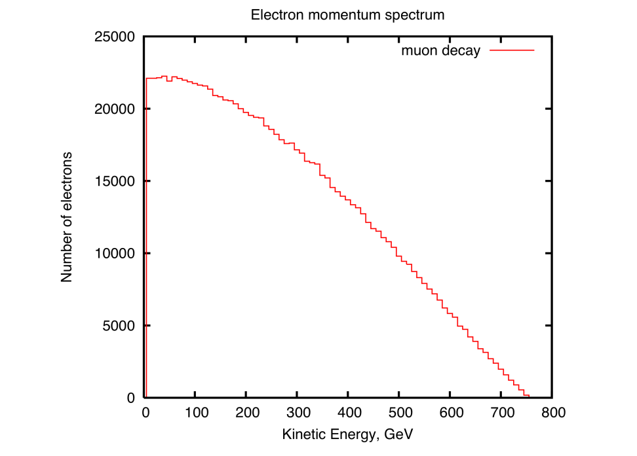
Power Density Study - Open MidPlane Dipole
(X. Deng)
The number of muons is N₀ =2×10¹² at t=0.
The muon circulating time per turn is 8.3×10⁻⁶ sec. In 1000 turns, it is 8.3×10⁻³ sec.
(Muon life time at 750GeV is 15.6×10⁻³ sec)
The decays per meter per second is 5×10⁹
15×2×10¹² ×[1-exp(8.3×10⁻³)/(15.6×10³)]/2500= 5×10⁹.
Muon Collider 2011 Physics — Detectors — Accelerators

Slide 18
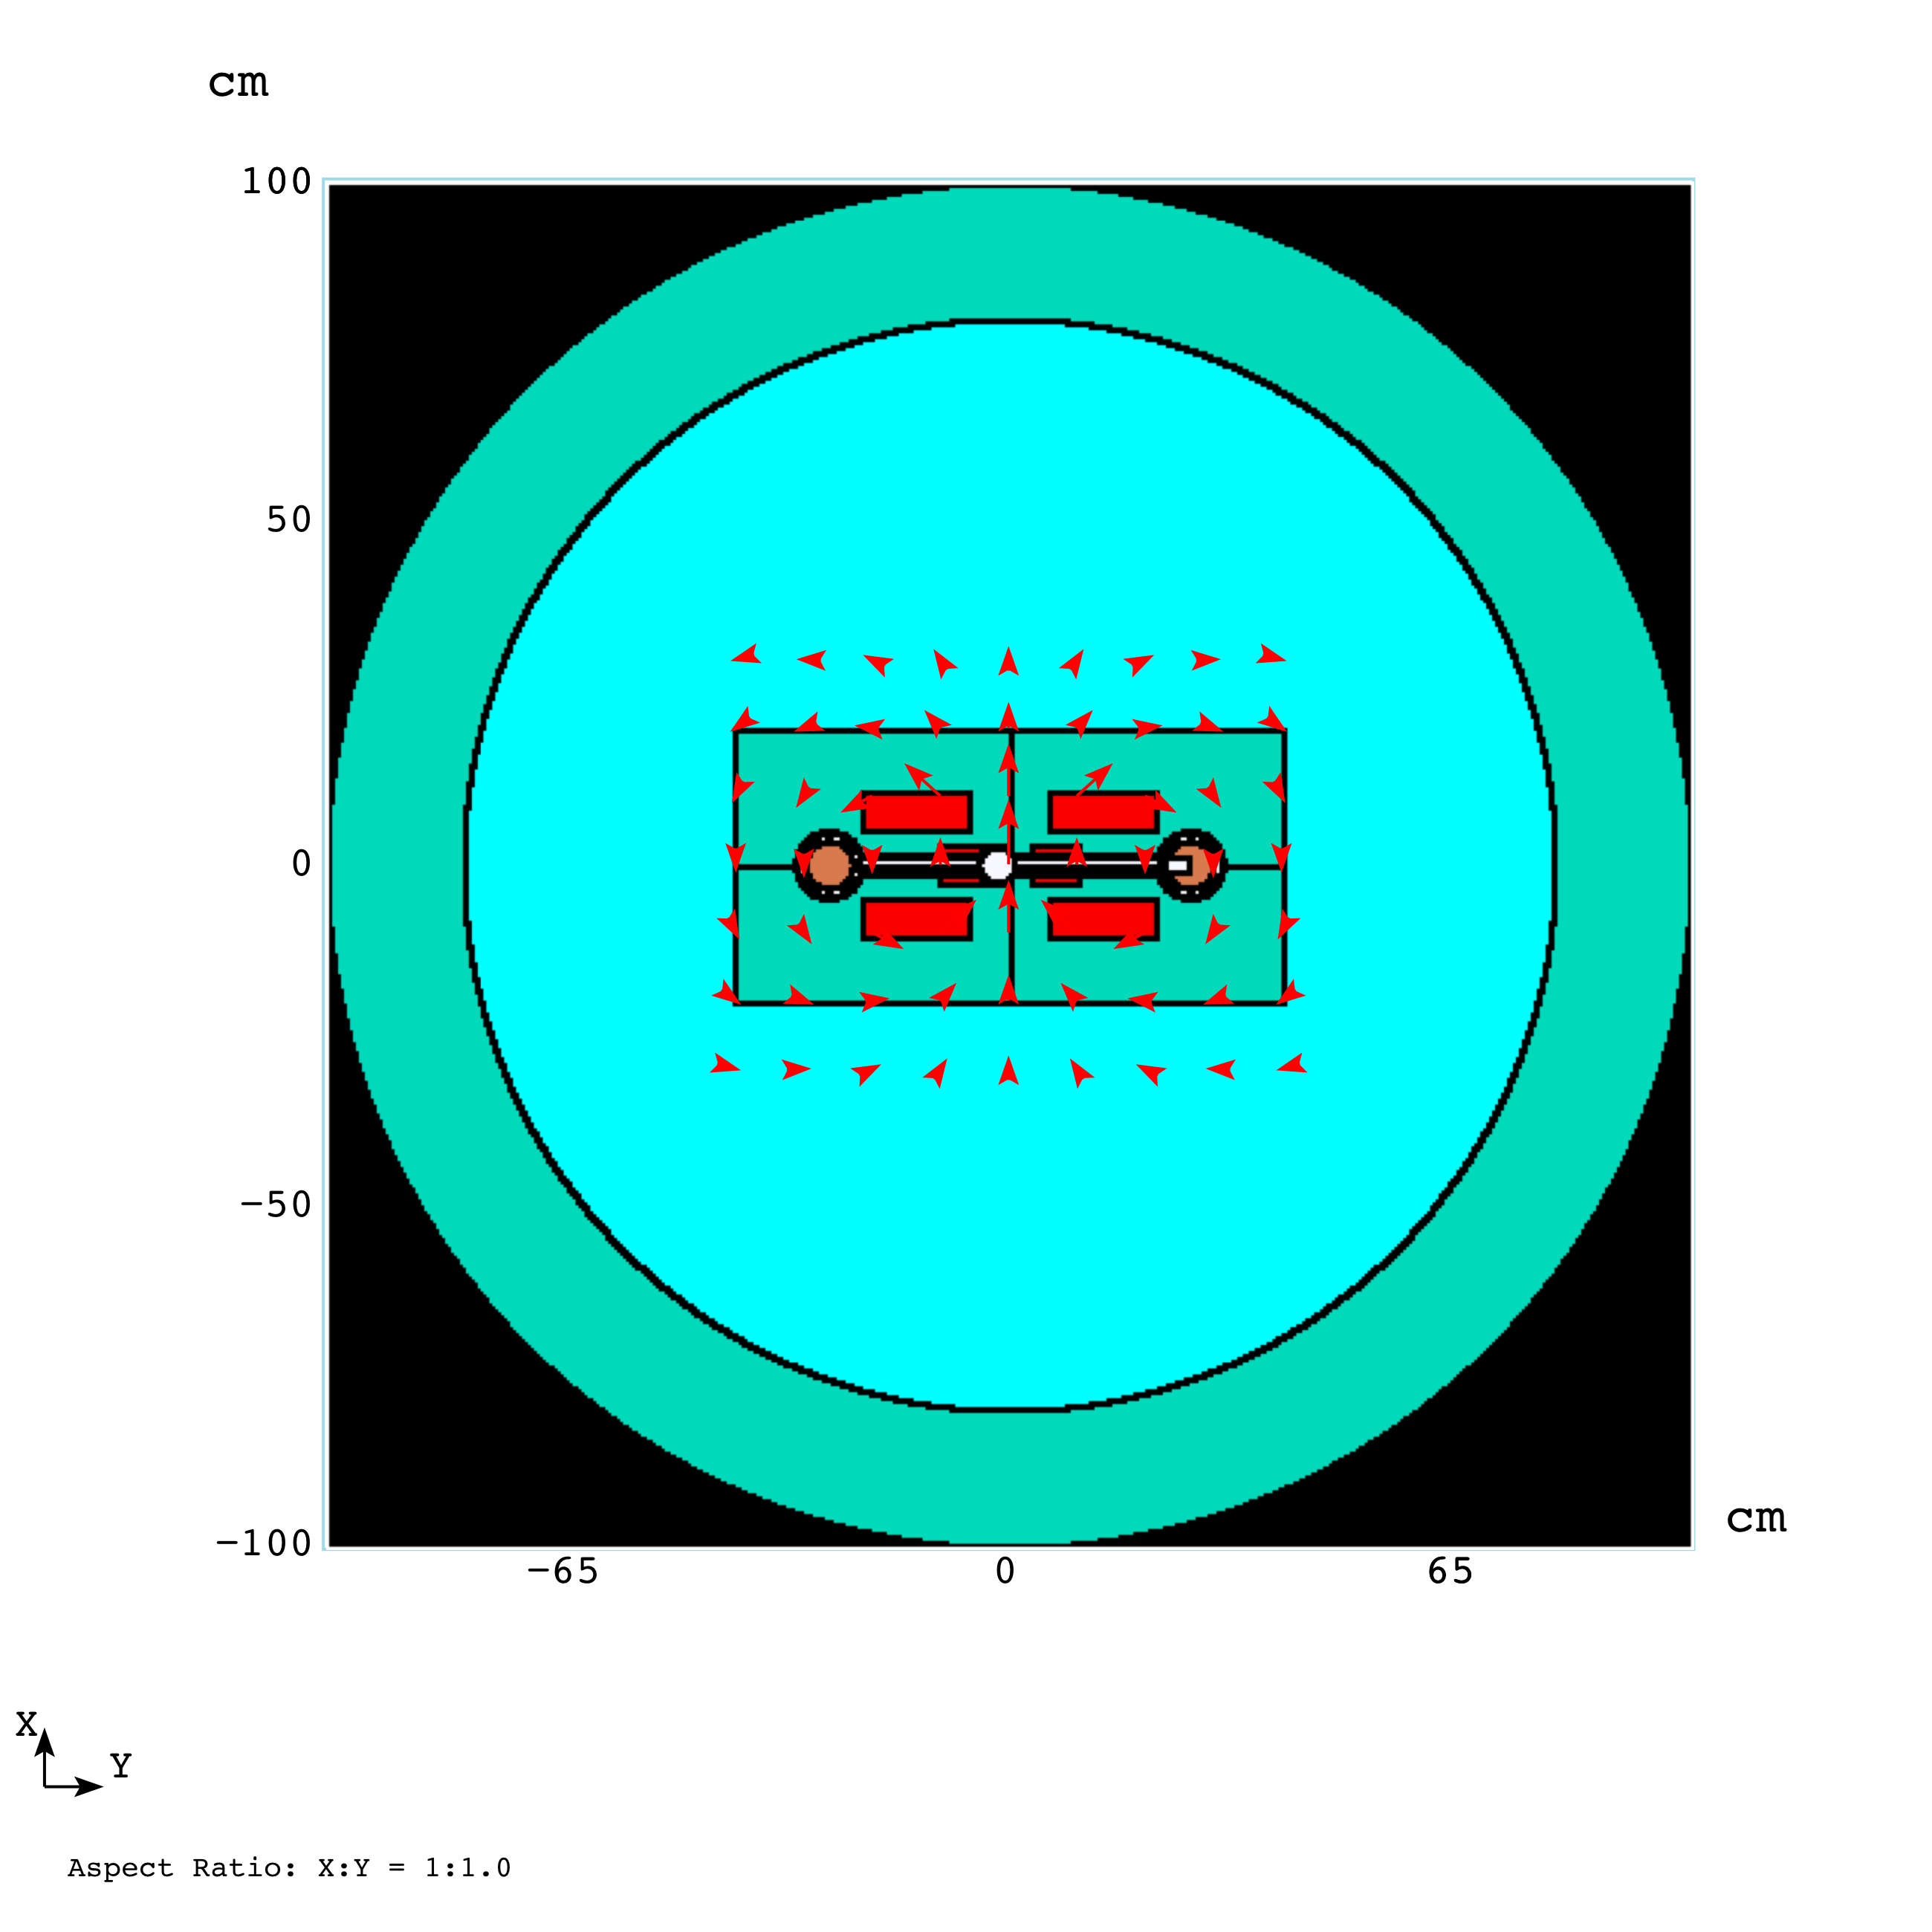
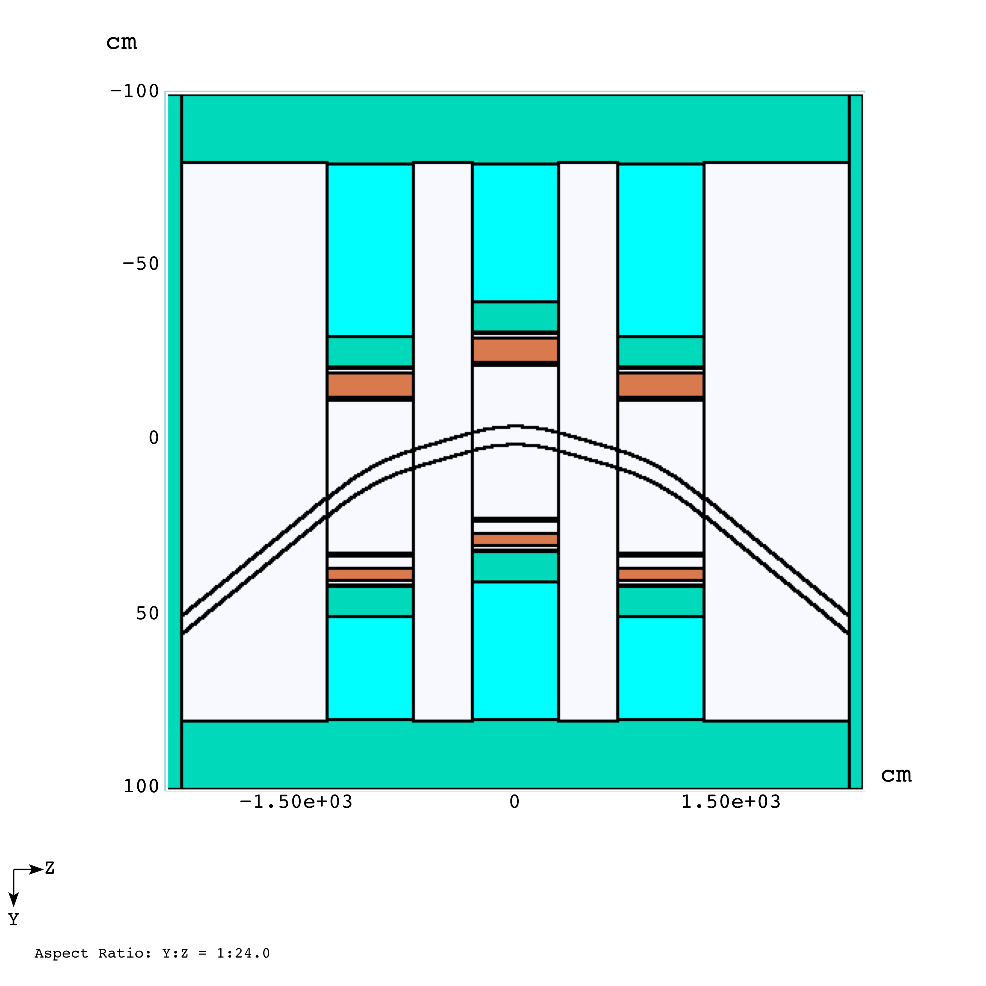
Triple Dipoles (Model II)
Middle OMD with Tungsten Rod Absorber Included
(X. Deng)
Muon Collider 2011 Physics — Detectors — Accelerator

Slide 19
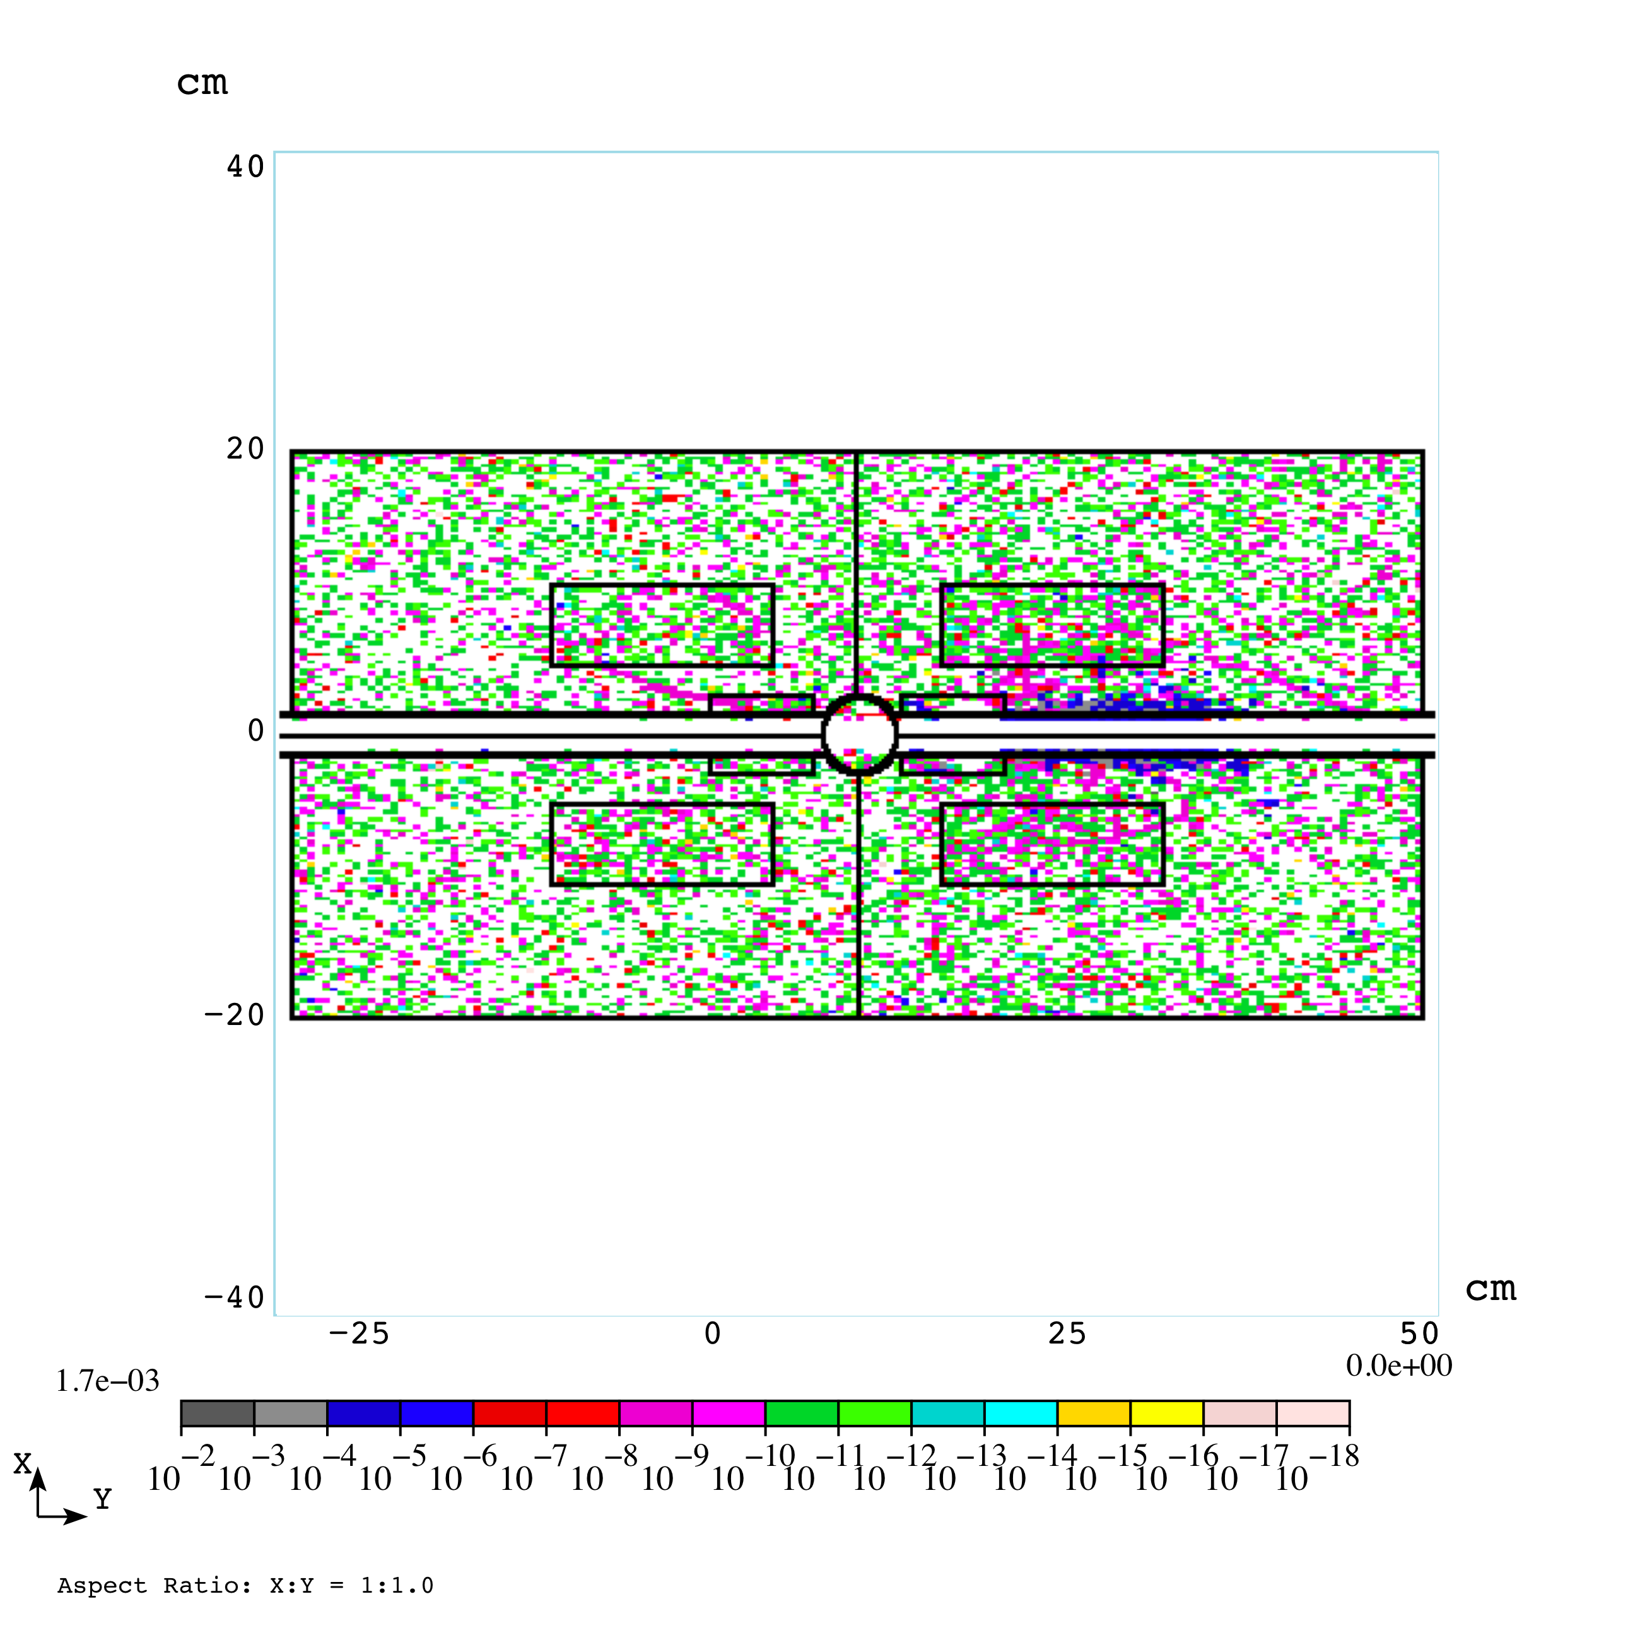
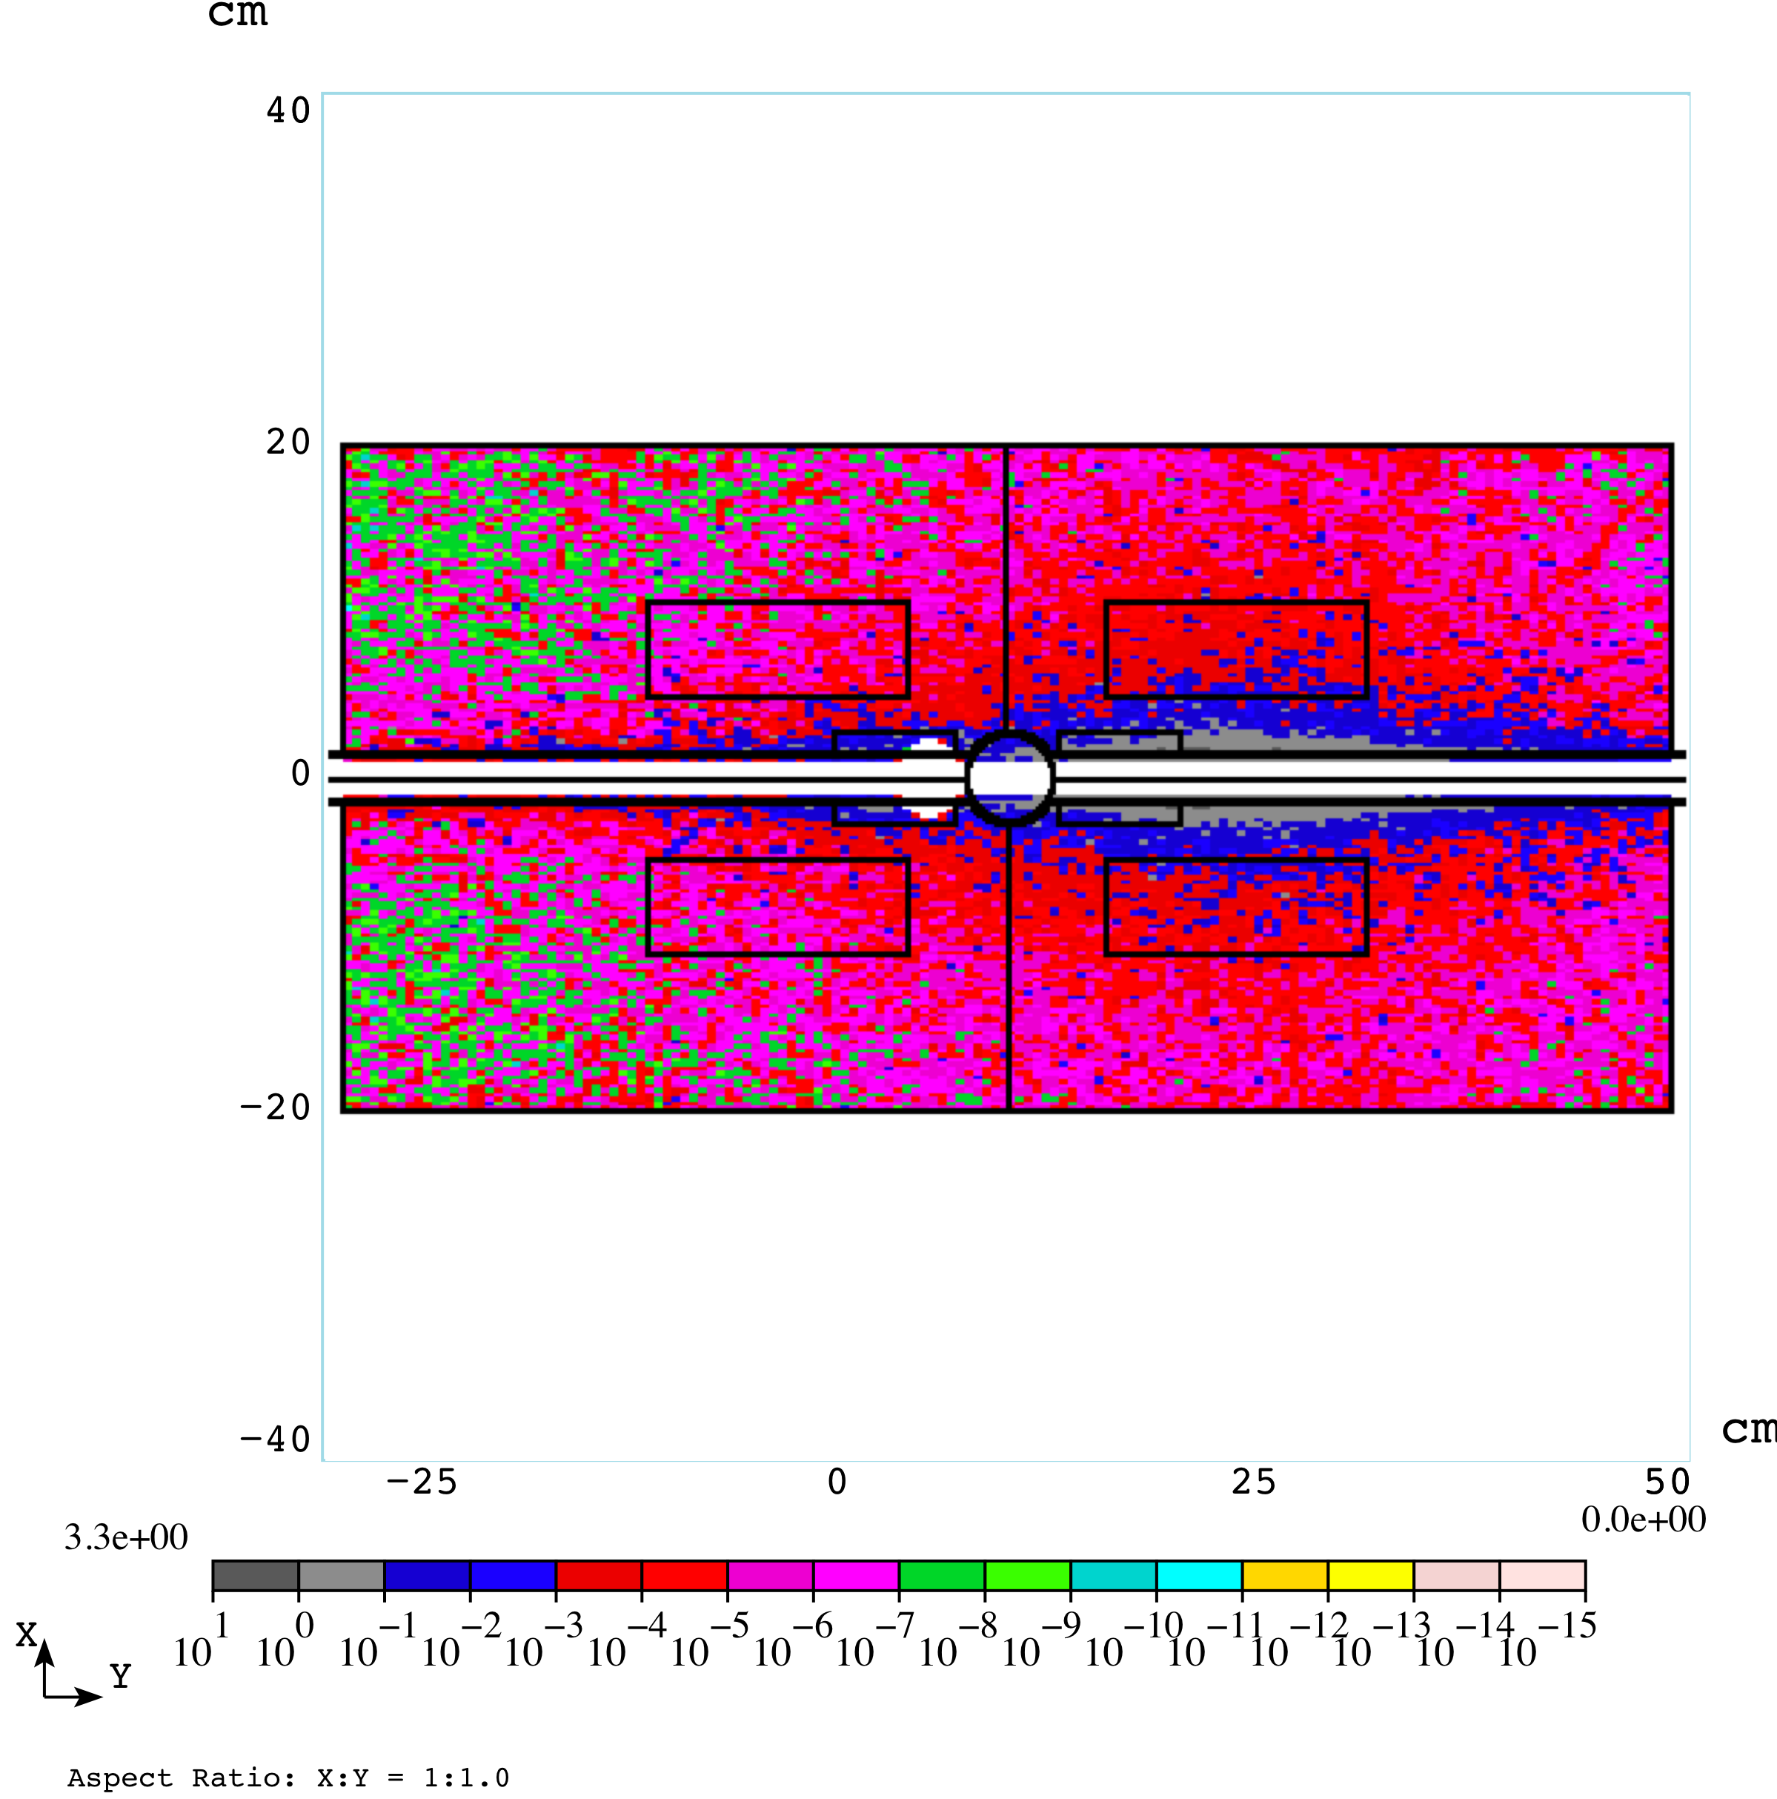
Power Density - Initial OMD/Model I
(X. Deng)
15 slabs (40cm each) in 6m dipole - Left: 1st slab; Right: last slab
Muon Collider 2011 Physics — Detectors — Accelerator

Slide 20
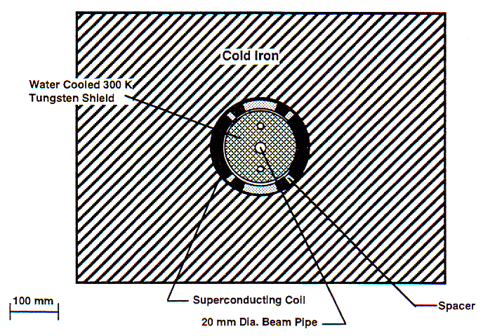
Magnet Conceptual Designs
(Beginning with a reminder from Bob)
Option # 2: Thick tungsten beam pipe - as discussed in ‘98 Feasibility Study 12
Muon Collider 2011 Physics — Detectors — Accelerator

Slide 21
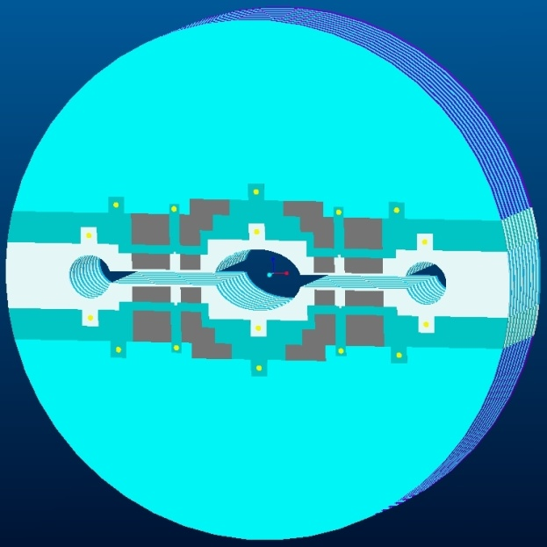
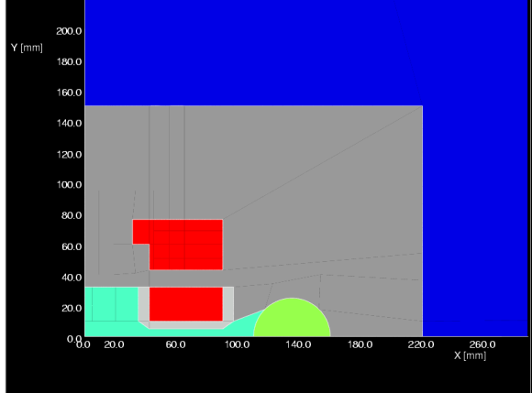
Open MidPlane Concept
(R. Gupta, BNL)
An ideal open midplane design will have no structure on the axis
Muon decay products will deposit energy in a warm absorber that is sufficiently away from the superconducting coils or support structure.
In a partial “open midplane design”, although there is “no conductor” at the midplane, there could be some “other structure” between the upper and lower halves of the coil to help deal with Lorentz forces.
Those designs, though significantly reduce energy deposited in coils from direct hit, could still face heat from secondary showers produced by the other structure. In addition, the energy deposition in that cold structure itself could be significant.
Therefore, an “ideal” or “true” open midplane dipole should be preferred, if a viable design can be proven.
Yoke (cold)
Yoke (cold)
Yoke (cold)
Lorentz
Lorentz
Lorentz
Forces:
Forces:
Forces:
Support Structure,
Support Structure,
Vertical: down
Support Structure,
Vertical: down
Vertical: down
SS (cold)
SS (cold)
Horizontal: out
SS (cold)
Horizontal: out
Horizontal: out
Lorentz
Lorentz
Lorentz
Forces:
Forces:
Forces:
Vertical: up
Vertical: up
Vertical: up
(small)
(small)
Horizontal: out
(small)
Horizontal: out
Horizontal: out
Beam
Beam
Beam
Particle Spray from IP
Particle Spray from IP
Particle Spray from IP
A large amount of particles coming from high
A large amount of particles coming from high
luminosity IP deposit energy in a warm (or 80 K)
luminosity IP deposit energy in a warm (or 80 K)
absorber, that is inside the cryostat. Heat is
absorber, that is inside the cryostat. Heat is
removed efficiently at higher temperature.
removed efficiently at higher temperature.
Muon Collider 2011 Physics — Detectors — Accelerator

Slide 22
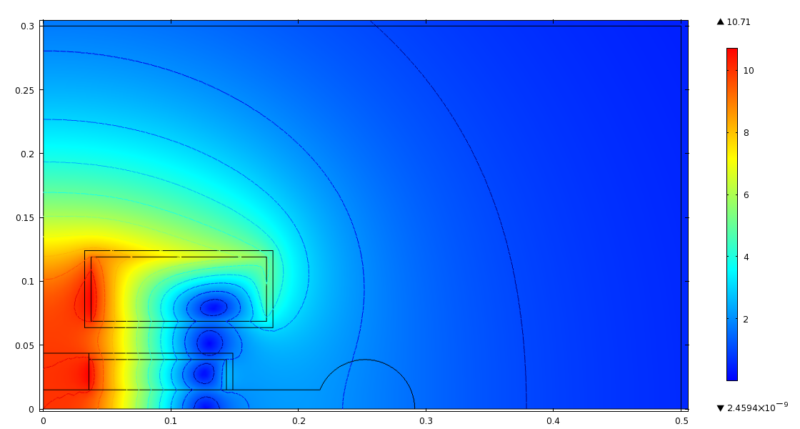
Open-Midplane Dipole Magnet Field Homogeneity
Bob Weggel, PBL
Open-Midplane Dipole Magnet Field Homogeneity
Muon Collider 2011 Physics — Detectors — Accelerator

Slide 23
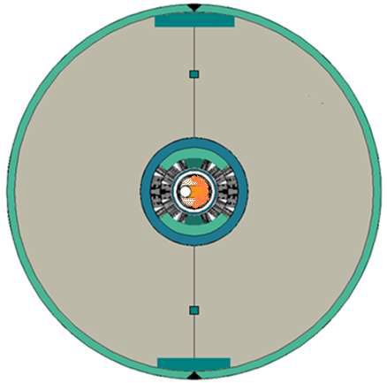
Large Aperture Dipole Mechanical Structure
(A. Zlobin)
Two double-layer cos-theta coils, vertically split iron yoke, and thick stainless steel skin with two alignment keys and two control spacers.
The coils are separated from the iron yoke by thin stainless steel collars. A similar support structure was successfully used in Fermilab’s high-field 90-mm Nb3Sn quadrupole models
Due to the asymmetrical heat deposition, the beam pipe in the proposed design was shifted within the good field quality region to reduce the coil ID
Muon Collider 2011 Physics — Detectors — Accelerator

Slide 24
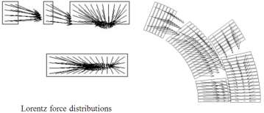
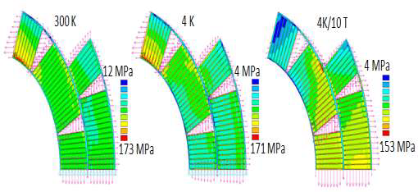
Large Aperture Dipole Stress Analysis
(A. Zlobin)
The initial coil azimuthal pre-stress and geometry control is provided by the collar blocks. The final coil pre-stress and radial support is provided by the yoke and skin.
The average inner-layer coil pre-stress at room temperature of ~120MPa keeps the coil blocks under compression and in contact with the pole blocks up to the magnet nominal operating field.
The maximum coil stress does not exceed 175 MPa. The maximum coil stress could be further reduced by optimizing the radial stress distribution on the pole turns.
The maximum coil stress in the shell-type design is lower than in the open mid-plane dipole described above, allowing operation of this magnet type at higher magnetic fields.
Muon Collider 2011 Physics — Detectors — Accelerator

Slide 25
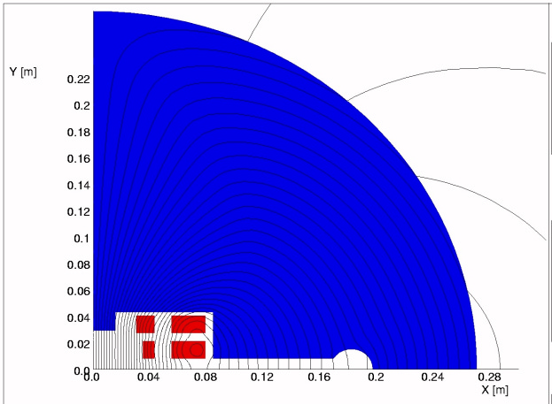
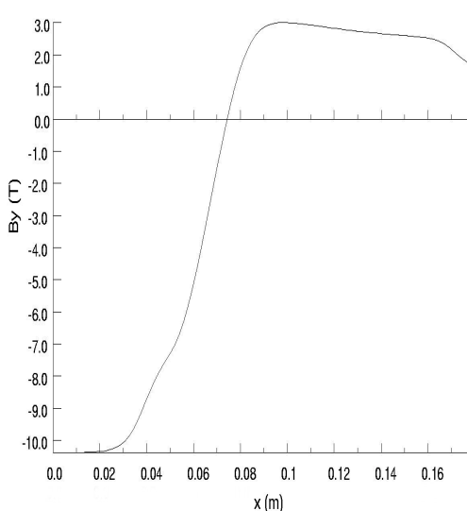
‘OMAR’
Open Midplane Active Return
(P. McIntrye, TAMU)
“REMOVE THE WALLS!
We have developed a design for the arc dipoles, in which a slot is opened between the top and bottom halves of the dipole coil and the vacuum enclosure is extended out into the midplane to a distance of ±20 cm from the beam axis. A quadrant of the dipole is shown in Figure 1. The field strength is constant within the muon beam region, then decreases and reverses as shown in Figure 2.
The motivation in this design is to permit decay electrons and synchrotron radiation to traverse the length of a dipole without striking any surface. At each end of each dipole, the electrons and photons would be absorbed at room temperature, eliminating the cryogenic heat load.
At each end of the dipole, the vacuum aperture would constrict from a 40 cm wide slot to the ~3 cm radius beam tube needed to pass the muon beams. Flanking this constriction, room-temperature absorbers would absorb decay electrons and synchrotron.”
Proceedings of the 2001 Particle Accelerator Conference, Chicago
DYNAMICS OF DECAY ELECTRONS AND SYNCHROTRON RADIATION IN A TEV MUON COLLIDER, P. McIntyre. and A. Sattarov, Texas A&M University, College Station, TX USA
B_{y} vs x (m)
Muon Collider 2011 Physics — Detectors — Accelerators

Slide 26
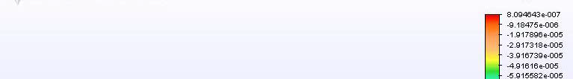

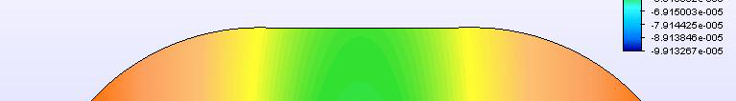
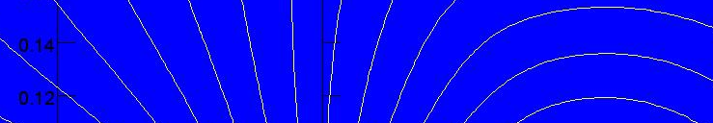

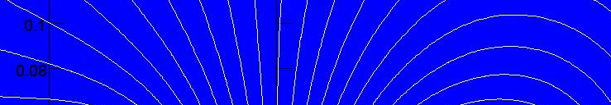
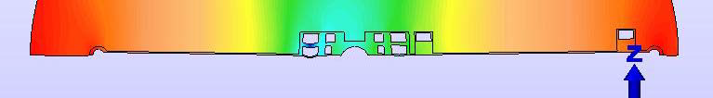
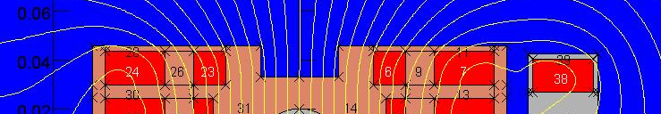
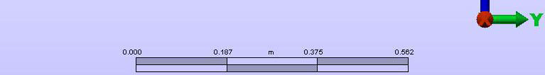

‘OMAR’, cont.
“Inner set of windings are levitated, top/bottom windings supported by skyhook”
Deflection of OMAR dipole under Lorentz forces
Coil region deflects vertically by 0.1 mm under full Lorentz load. With appropriate design, it might be possible to live with this deflection. Otherwise put more cold steel (!)
It is possible to design an open‐midplane active return (OMAR) dipole that transports ~all particles > 50 MeV out the end of the dipole without interacting (~1% of energy).
With an iris of ~±4 mm, ~all particles passing through the iris would clear the next dipole.
No detailed analysis of magnetic field quality, iris impedances, mechanical stress/strain, heat deposition distribution, etc. have been done.
If you like this concept and want it pursued, we need funding for a grad student and half postdoc. (verbatim from Peter’s talk…)
Muon Collider 2011 Physics — Detectors — Accelerator

Slide 27
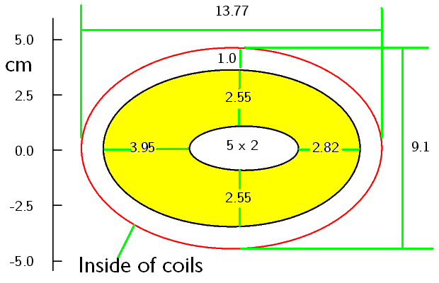
From Bob Palmer’s Summary
Open mid-plane options:
Open mid-plane designs with 3 cm gap deposit too much energy
This is NOT backscatter from absorber bars
Tracking suggests required full gap at least 4 cm
Too early to know if it will meet requirements
Tungsten beam-pipe option:
For beam pipe 5 x 2 cm and 1 cm gap, then:
Elliptical coil inside 13.8 x 9.1 cm
Can certainly meet shielding requirements, but requires large coils
• Inside pipe width = 5 cm
• Inside pipe height = 2 cm
Bob: investigate an elliptical coil geometry
Muon Collider 2011 Physics — Detectors — Accelerator

Slide 28
Summary
Workshop was productive
  Talks were well prepared, stimulating, and insightful
Challenges include:
  Heat load, heat load, heat load
  Efficient shielding/absorber
  Magnet mechanics for open midplane structures
Magnet solutions presented
  Field quality requirements achievable
  Conceptual designs look promising - further development to reduce heat load to 4K
  Mechanics/stress management details to follow…
  Elliptical coil design to be investigated
  Material properties/radiation sensitivity need continued study
Muon Collider 2011 Physics — Detectors — Accelerator

