Slide 1
Cooling
General Review and
System-Level Considerations
Tom Roberts
Muons, Inc.

Slide 2
Outline
Muon Ionization Cooling
  Everything you need to know in 30 seconds
The Devil is in the Details
  Brief Descriptions of 6-D Cooling Techniques
  Brief Descriptions of Final Cooling Techniques
  Briefer Descriptions of Other Techniques
God is in the Details
  Putting It All Together
  System-Level Considerations
The Details are in the Details
  MAP Cooling Efforts in the Next Year or So
Summary

Slide 3

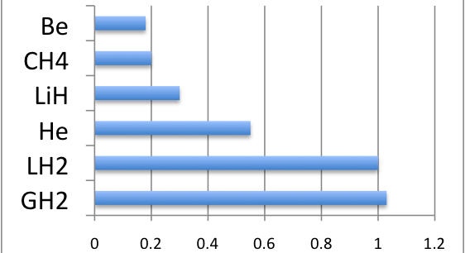
  Muon Ionization Cooling
  Everything you need to know in 30 seconds
Particle loses momentum in all directions in the
Absorber; its longitudinal momentum is restored
by the R.F. After many repetitions its transverse
momentum is greatly reduced. For a beam that
means reduced transverse emittance. Multiple
scattering gives an irreducible minimum (heating).
Liouville: reduced beam emittance ⇒ absorber electrons heated
Every cooling channel has a minimum emittance determined by its design and materials:
Smaller β⊥ ⇒ stronger focusing ⇒ lower emittance
Absorber material has a big effect
on the minimum emittance
The energy dependence of dE_{μ}/ds is
stronger than 1/β
⇒ lower energy can give lower emittance
Absorber
Beam
One
Particle
R.F.
Cooling Figure of Merit

Slide 4
Muon Ionization Cooling
Everything you need to know in 30 seconds
Rule of thumb:
Well above equilibrium, losing and re-gaining
the beam’s energy will give a 1/e reduction
in its transverse emittance in each plane.
So we need a lot of energy loss/gain to achieve
the required factor of ~1/1000 in each plane.
This is an aspect of why we work at low energies
(also: a given magnetic lens produces lower β⊥,
and most of the pions/muons are produced there).

Slide 5
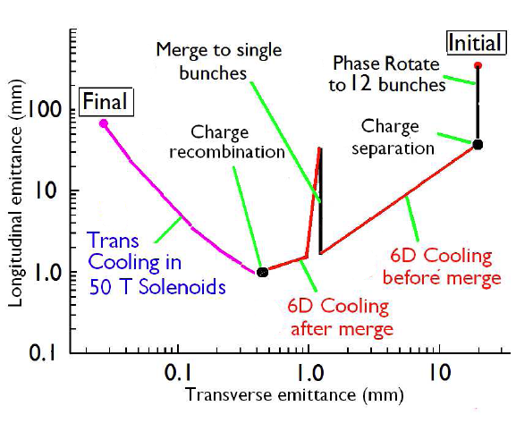
Evolution of Emittance
(Fernow-Neuffer Plot)
(Front End)
This is a generic outline which will be customized for specific cooling techniques.

Slide 6
6-D Cooling Techniques

Slide 7
6-D Cooling
Guggenheim
Basically a cooling ring stretched out vertically to simplify extraction and injection; also reduces heating power in absorbers (from multiple turns).
Liquid hydrogen wedge absorbers (pink), or LiH
Vacuum RF cavities (dark red)
Solenoid magnets, inclined to force the beam to follow the helix (yellow)
Like most channels, needs to be tapered (smaller apertures with higher fields and higher-frequency RF, as the beam cools)

Slide 8
6-D Cooling
Helical Cooling Channel
(Outer solenoid
not shown.)
Continuous high-pressure hydrogen gas absorber
Helical dipole and quadrupole fields greatly improve acceptance, and give flexibility in partitioning the cooling (transverse/longitudinal)
Short solenoids (green) in “helical solenoid” configuration give solenoid, helical dipole, and helical quadrupole fields
Integrated high-pressure RF cavities (orange)
Pressure windows only at the beginning and end

Slide 9
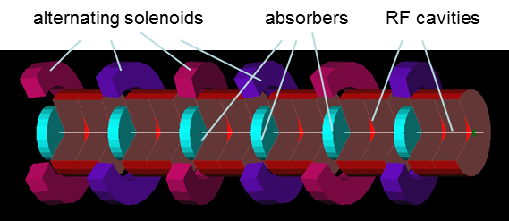
6-D Cooling
FOFO Snake
Basically a linear channel with tilted solenoids to give a shallow helix
Lumped liquid hydrogen absorbers
Vacuum RF cavities
Can cool both positives and negatives

Slide 10
6-D Cooling Summary
 | Guggenheim | HCC | FOFO Snake
Helix Ratio r : λ | > 10 : 1 almost a ring | ~ 0.2 : 1 | < 0.1 : 1 almost straight
Achievable ε_{T} (π mr-mrad) | 500 | 300 | ~10,000
Length (meters) | 690 + matching (321 + matching) | 180 | 120
Basic Simulations | Yes | Yes | Yes
Tapered Simulations | No | Yes | No
Engineering Studies | No | Yes | No
Cools both charges | No | No | Yes
The FOFO Snake will probably be used before the charge separation, as doing that at lower emittance is both easier and more efficient.

Slide 11
Final Cooling Techniques

Slide 12
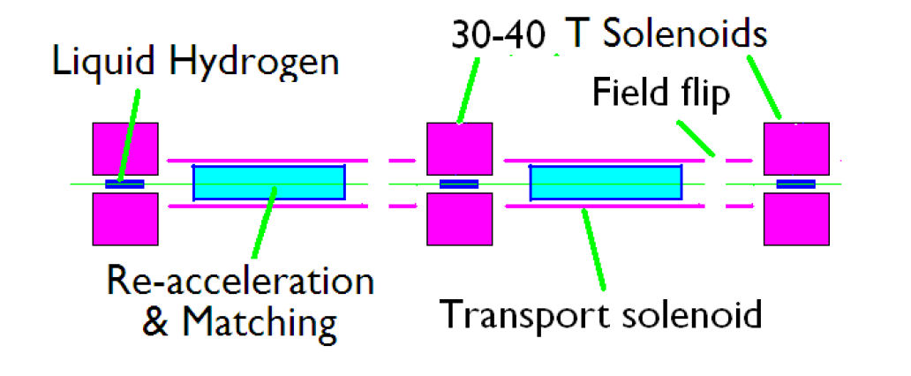
Final Cooling
High-Field Solenoids
13 Stages
30-40T HTS magnets operating @ 4K
RF cavities & Induction linacs needed
LH₂ forced-flow absorbers
  SLAC E158
Only candidate that has demonstrated ε⊥ of 25 mm-mrad

Slide 13
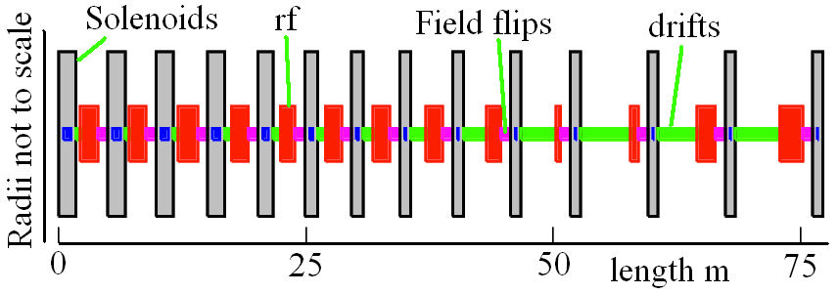
Final Cooling
High-Field Solenoids
Designed so the bunch length rises from 5 cm to 400 cm.
And the energy falls from 66 MeV to 5 MeV.
  dE/dx rises, significantly improving the LH₂ merit factor
LH₂ absorber length decreases from 77 cm to 11 cm.
Beta is reduced to 1.5 cm; RMS beam size of 0.6 mm.
For bunches larger than 0.75 m, induction linacs were assumed with gradients of 1 MV/m

Slide 14
Final Cooling
Parametric Resonance Ionization Cooling
Parametric Resonance
Lenses
Absorbers
Ordinary Parametric resonance
(Regular focusing and RF not shown.)
A half-integer resonance is induced such that normal elliptical motion in x-x’ phase space becomes hyperbolic.
The resonance can give considerably lower β⊥ without high fields.
Thin absorbers placed at the focal points will cool the beam via ionization cooling (RF required).
Aberrations and fringe field issues make lumped elements very difficult or infeasible.

Slide 15
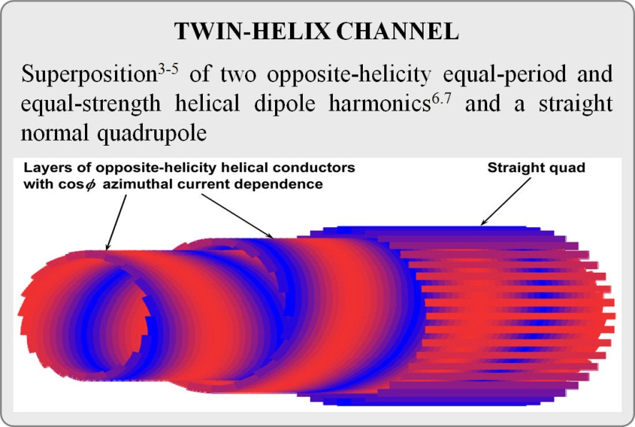
Final Cooling
Epicyclic PIC
Combine two helical dipoles
and quadrupoles with
different spatial periods, in
the ratio of small integers
See Vasiliy Morozov’s
poster
Many transverse parametric curves are possible:

Slide 16
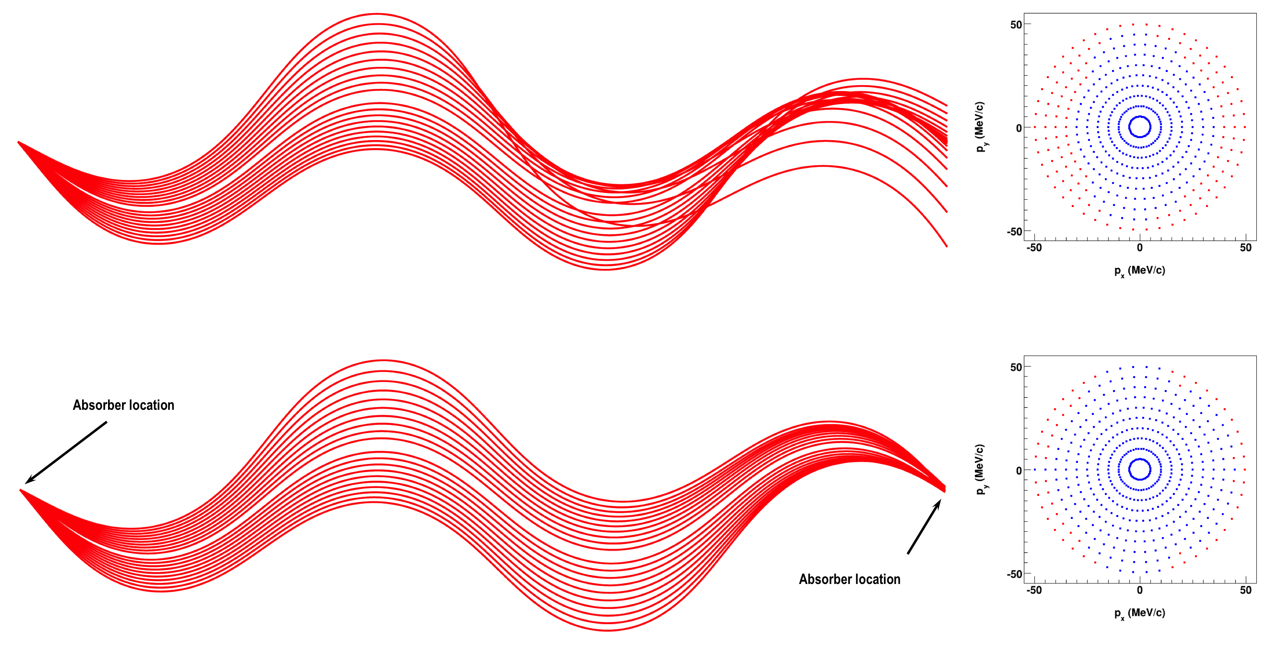

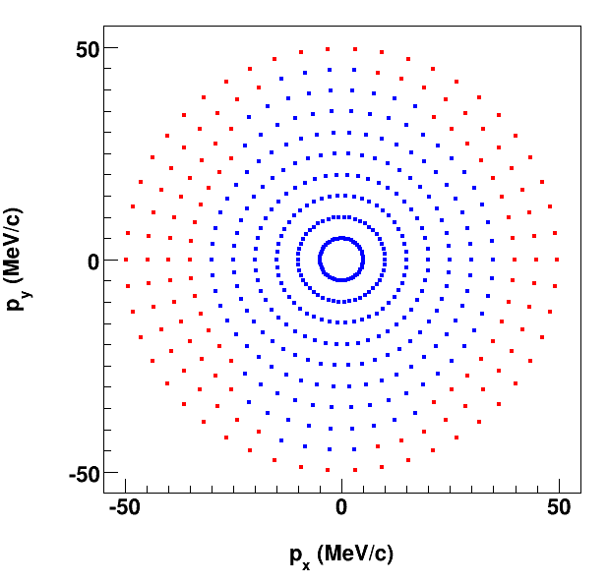

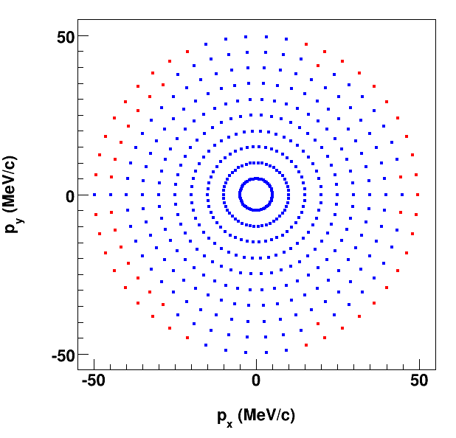
Final Cooling
Epicyclic PIC
The major challenge is identifying and correcting aberrations.
The team is now using Cosy Infinity to tune correctors.
Spherical aberrations have been corrected.
Work is in progress on chromatic aberrations.
Dynamic
Aperture
Tracks
Before compensation:
After compensation:
Absorber location
Absorber location
Absorber location
Absorber location
Absorber location
Absorber location
Absorber location
Absorber location
Absorber location
Absorber location
Absorber location
Absorber location
Absorber location
Absorber location
Absorber location
Absorber location
Absorber location
Absorber location
Absorber location
Absorber location

Slide 17
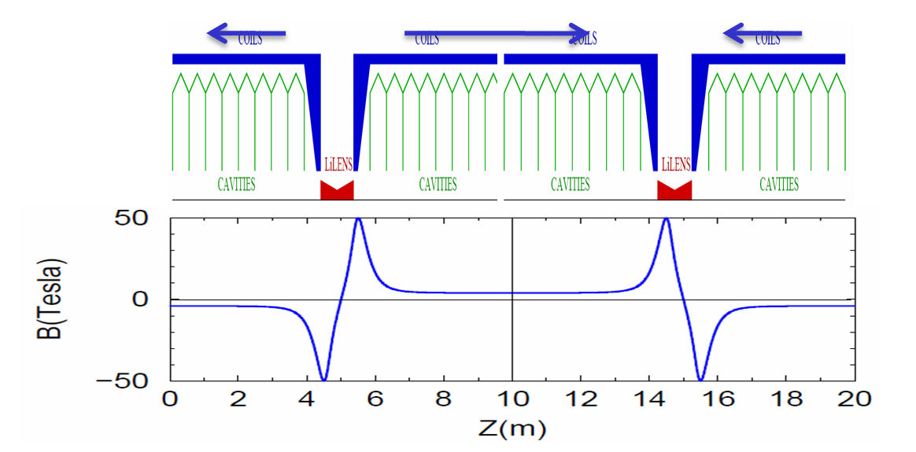
Final Cooling
Lithium Lenses
Li Lenses
Solenoids
RF Cavities
Work in progress.
See Valeri Balbekov’s poster.
Also work by K. Lee et al.

Slide 18
Final Cooling Summary
High-Field Solenoids | Epicyclic PIC | Lithium Lenses
Challenging high-field magnets Challenging bunch length Challenging low-energy output (5 MeV) | Challenging tuning Needs more work before we know it is feasible, and how well it works. | Challenging lenses Needs more work before we know it is feasible, and how well it works.
The final cooling is a major factor in determining whether a muon collider is feasible with useful luminosity. We need to get more people involved and tighten up the simulations.

Slide 19
Other Cooling Techniques

Slide 20
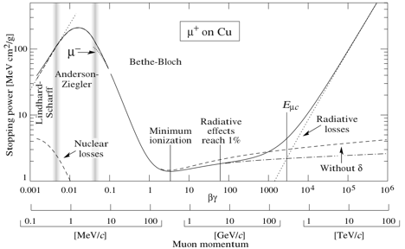
Other Cooling Techniques
Frictional Cooling
Frictional
Cooling
Ionization
Cooling
Particle Data Group
Frictional cooling operates at β ~ 0.01 in a region where the energy loss increases with β, so the channel has an equilibrium β.
This naturally cools in all 6 dimensions.
In this regime, gas will break down – use many very thin carbon or Be foils.
Major drawbacks: tiny acceptance, space charge issues;
acceleration is difficult; large delay, not clear high intensity is possible.
Experiments on frictional cooling of muons have been
performed with 10 foils (25 nm each).

Slide 21

Other Cooling Techniques
Particle Refrigerator
10 m
Solenoid
1,400 thin carbon foils (25 nm), separated by 0.5 cm and 2.4 kV.
μ⁻ climb the potential, turn around, and come back out via the frictional channel.
μ⁻ In
(3-7 MeV)
…
20
cm
μ⁻ Out
(2±0.002
MeV)
Gnd
Resistor Divider
-5.5 MV
HV Insulation
First foil is at -2 MV, so outgoing μ⁻ exit with
2 MeV kinetic energy.
Solenoid maintains transverse focusing.
Device is cylindrically symmetric (except divider); diagram is not to scale.
Remember that 1/e transverse cooling occurs by losing and
re-gaining the particle energy. That occurs every 2 or 3 foils
in the frictional channel.

Slide 22
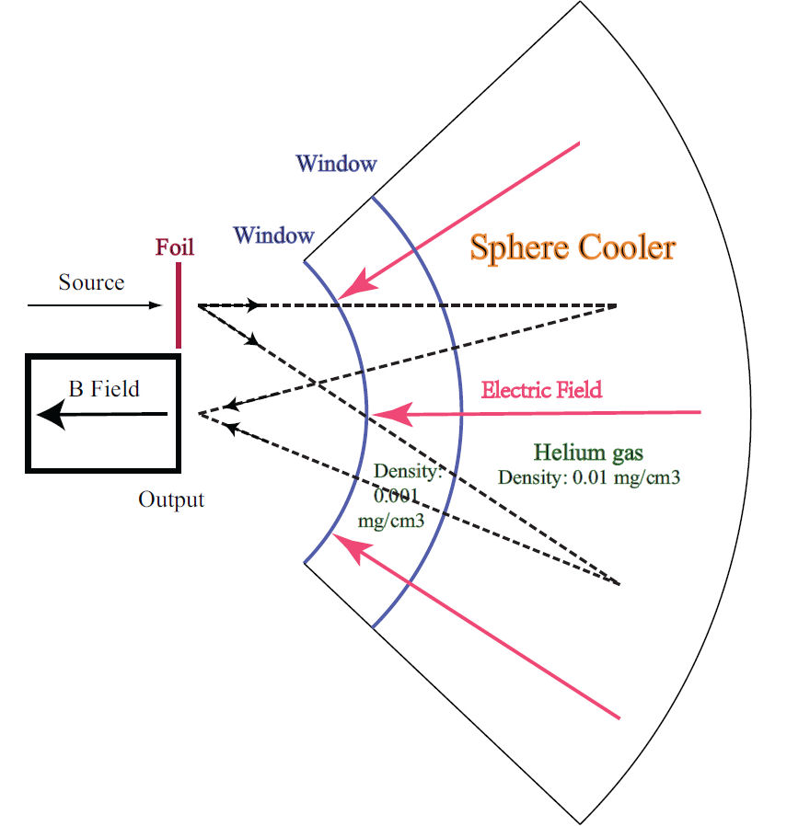
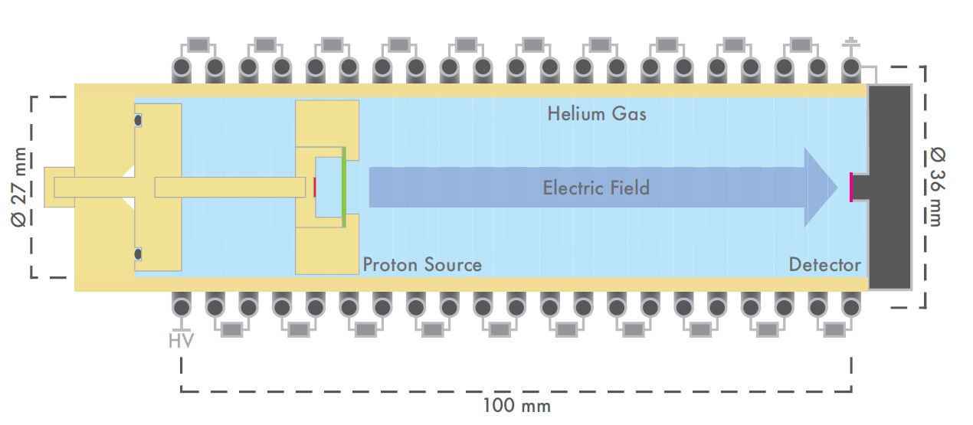
Other Cooling Techniques
Spherical Cooler
Sphere Cooler
arXiv:1012.3946v1
Caldwell & Bao
PAC 11

Slide 23
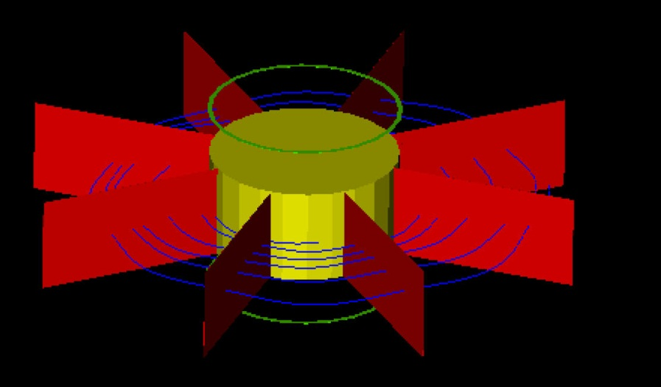
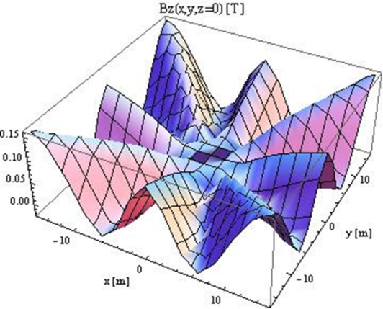
Other Cooling Techniques
Anti-Cyclotron
G4beamline model
Single turn energy loss injection
Muons spiral in and stop
- LiH wedges
- 0.1 bar helium
Extract muons from helium
  0.5 MV/m electric field along +z
Accelerate muons to 100 MeV
  1 MV/m over 100 meters through two guiding solenoids
Results: See Terry Hart’s poster
LiH wedges r=15m
He: r = 5m
Outer B Field:
  8-sector strong focus

Slide 24
Additional Aspects of Cooling

Slide 25
Cooling: Additional Aspects
Other cooling techniques not actively being studied:
  “Potato slicer” emittance exchange
  Optical stochastic cooling
Need matching between every pair of components
Need additional components:
  Charge separation
    Have example using bent solenoids
  Bunch merging
    Have example using 6-D merging
    Have another example using a helical channel
  Charge recombination
    No example at present
We need someone to look into this.

Slide 26
Putting it all Together

Slide 27
Putting It All Together
Issues Common to All
Design Issues
  Match the different sections, with acceptable emittance growth and losses.
Simulation Issues
  Evaluate space charge effects (primarily final cooling).
  Analyze, understand, and evaluate collective effects in the absorbers (primarily final cooling).
    Plasma effects (ionization electrons)
    Dielectric polarization effects
    Effect on space charge, macro-particle interactions, etc.
Engineering Issues
  High RF gradients
  High-field magnets
  High beam heat load in absorbers
  High beam loading in RF cavities
  All aspects of actually constructing the components

Slide 28
Putting It All Together
Current Best-Guess Block Diagram
Charge
Separation
6-D
A
Bunch
Merge
6-D
B
Final
Cooling
Charge
Recombination
Front
End
Accel.
6-D
A
Bunch
Merge
6-D
B
Final
Cooling
Requires charge separation at large emittance.
Requires two complete cooling channels.
Space charge problems in final cooling and charge recombination?
“Final Cooling” probably includes some initial acceleration.
Different techniques have different attributes ⇒ flexibility in block diagram.

Slide 29
Putting It All Together
Alternate Block Diagram
Charge
Separation
Bunch
Merge
6-D
B
Final
Cooling
Charge
Recombination
Front
End
FOFO
Snake
Accel.
Bunch
Merge
6-D
B
Final
Cooling
Requires two nearly complete cooling channels.
Space charge problems in final cooling and charge recombination?
“Final Cooling” probably includes some initial acceleration.

Slide 30
Putting It All Together
Alternate Block Diagram
Charge
Separation
Bunch
Merge
Charge
Recombination
Front
End
FOFO
Snake
Final
Cooling
Accel.
Bunch
Merge
Requires final cooling that can handle both signs – not obvious.
Space charge problems in bunch merge and charge recombination?
Can emittance be preserved after final cooling?
“Final Cooling” probably includes some initial acceleration.

Slide 31
Putting It All Together
Alternate Block Diagram
Front
End
FOFO
Snake
Final
Cooling
Accel.
A
Bunch
Merge
Accel.
B
Requires final cooling that can handle both signs – not obvious.
Requires bunch merging that can handle both signs– not obvious.

Slide 32
MAP Cooling Efforts
In the Next Year or So
Develop approach for comparing, assessing, and selecting cooling techniques
  Have a good start; completion awaits MAP Director
Continue explorations of 6D and Final Cooling
  Have a good start
Explore auxiliary components (charge separation, bunch merging, charge recombination)
  Have a good start on most of them
Simulation code development (ICOOL, G4beamline, ...)
  Have an excellent start, ongoing effort
Prepare for the down-selection of cooling techniques (milestone is in 2012)
  Requires tapered simulations of all techniques
Prepare for end-to-end simulations

Slide 33
Summary
We have mature conceptual designs for three 6-D cooling techniques:
Guggenheim
Helical Cooling Channel
FOFO Snake
We have a mature conceptual design for one final cooling technique, albeit with serious challenges:
High-field solenoids
We have a good start on a promising new final cooling technique:
Epicyclic PIC
We have a good start on the additional components.
We need to perform complete simulations of every component, including matching.
The details are daunting, and there is a lot of work
remaining to prepare for the cooling down-selection.

