Slide 1
Machine-Detector Interface 2 Applying G4beamline
Tom Roberts
Muons, Inc.

Slide 2
Outline
Quick Introduction to G4beamline
Why use it for MDI simulations
G4beamline Capabilities Relevant to MDI Simulations
All the major physics processes
Extensibility
Validation of G4beamline, comparison to MARS
Initial Background Studies
Neutrino-Induced Backgrounds
Neutrino-Induced Physics Opportunities
Conclusions

Slide 3
Quick Introduction to G4beamline - 1
G4beamline is a particle-tracking simulation program based on the Geant4 toolkit [http://geant4.cern.ch].
All of the Geant4 physics lists are available, modeling most of what is known about particle interactions with matter.
It is capable of very realistic simulations, but of course the effort required increases with the detail involved.
G4beamline is considerably easier to use than setting up a C++ program using the Geant4 toolkit.
The program is optimized to model and evaluate the performance of beam lines.
It has a rich repertoire of beam-line elements.
It has general-purpose geometrical solids and fields so you can construct custom elements (e.g. an electrostatic septum, multi-function magnets, complex absorbers).
It lets you easily lay out elements along the beam centerline.

Slide 4
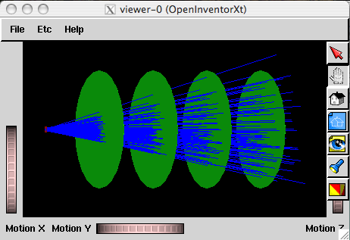
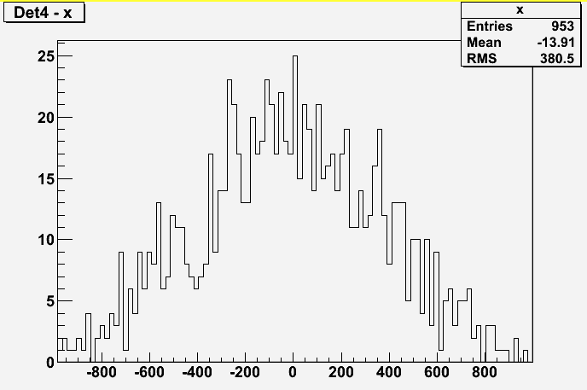
Quick Introduction to G4beamline - 2
The system is described in a simple ASCII file:
# example1.in
physics QGSP_BERT
beam gaussian particle=mu+ nEvents=1000 \
meanMomentum=200 \
sigmaX=10.0 sigmaY=10.0 \
sigmaXp=0.100 sigmaYp=0.100
# BeamVis just shows where the beam starts
box BeamVis width=100.0 height=100.0 \
length=0.1 material=Vacuum color=1,0,0
place BeamVis z=0
virtualdetector Det radius=1000.0 color=0,1,0
place Det z=1000.0 rename=Det1
place Det z=2000.0 rename=Det2
place Det z=3000.0 rename=Det3
place Det z=4000.0 rename=Det4
Visualization is included out-of-the-box
Includes a user-friendly histogram tool: HistoRoot.

Slide 5
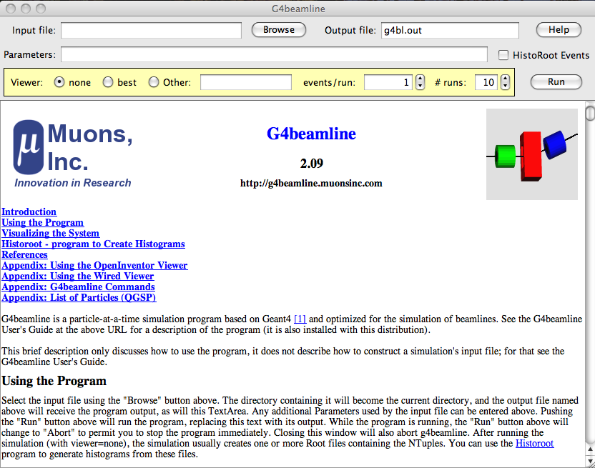
Quick Introduction to G4beamline - 3
Several tutorials and many examples are available on the website.
Extensive documentation and online help.
Its user interface is designed to be easy to use by physicists.
G4beamline is Open Source, and is distributed for Windows, Linux, and Mac.
It is currently in use by hundreds of users around the world.
http://g4beamline.muonsinc.com

Slide 6
Why Use G4beamline to Simulate Backgrounds?
It provides a new perspective independent of MARS.
Its input is flexible and straightforward, designed to make it easy to explore alternatives.
Command-line parameters make it easy to scan values
Geant4, and thus G4beamline, already has the major physics processes.
Missing are those related to the intersecting beams.
G4beamline is highly extensible:
Detailed and complete internal documentation
Internal modularity makes it easy to add new features
Register/callback structure – most new features are wholly contained in a single source file

Slide 7
Outline
Quick Introduction to G4beamline
Why use it for MDI simulations
G4beamline Capabilities Relevant to MDI Simulations
All the major physics processes
Extensibility
Validation of G4beamline, comparison to MARS
Initial Background Studies
Neutrino-Induced Backgrounds
Neutrino-Induced Physics Opportunities
Conclusions

Slide 8
Validation of G4beamline
G4beamline is based on Geant4, which has extensive validation efforts.
G4beamline Validation is documented in http://muonsinc.com/g4beamline/G4beamlineValidation.pdf
The physics processes most important to modeling backgrounds have been validated in various ways:
Particle transport Neutron transport
Hadronic interactions Electromagnetic interactions
Particle decays Synchrotron radiation
Photo-nuclear interactions Pair production
Bethe-Heitler mu pairs Neutrino interactions
Minor discrepancies remain for some physics processes.
This is an ongoing effort.

Slide 9
Comparison of G4beamline and MARS
Particle fluxes as a function of radial position.
G4BL neutron data should fall off as the Mars data does. We are looking into this.
Work in progress

Slide 10
Outline
Quick Introduction to G4beamline
Why use it for MDI simulations
G4beamline Capabilities Relevant to MDI Simulations
All the major physics processes
Extensibility
Validation of G4beamline, comparison to MARS
Initial Background Studies
Neutrino-Induced Backgrounds
Neutrino-Induced Physics Opportunities
Conclusions

Slide 11
Background Sources
Electrons from muon decays.
8.6×10⁵ muon decays per meter for each beam (750+750 GeV, 2×10¹² each).
These electrons are off momentum and will hit beam elements and shower.
Synchrotron radiation from decay electrons.
Photo-nuclear interactions.
This is the source of hadron backgrounds. This is largely neutrons.
Pair production: γA ➞ e⁺e⁻ X
Source is every surface exposed to γ from the beam.
Geometry and magnetic fields are designed to keep them out of the detector.
Incoherent pair production: µ⁺µ⁻ ➞ µ⁺µ⁻ e⁺e⁻
Source is the intersecting beams
~3×10⁴ pairs expected per beam crossing.
Detector magnetic field should trap most of these.
Beam halo.
Bethe-Heitler muon production: γA ➞ µ⁺µ⁻ X
Source is energetic photons on beam elements and shielding material.
Neutrinos from muon decays interacting in the detector and surrounding shielding.

Slide 12
Strawman Detector Concept
One quadrant is shown.

Slide 13
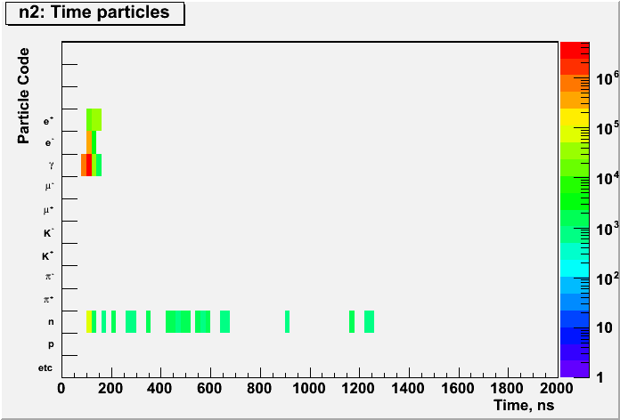
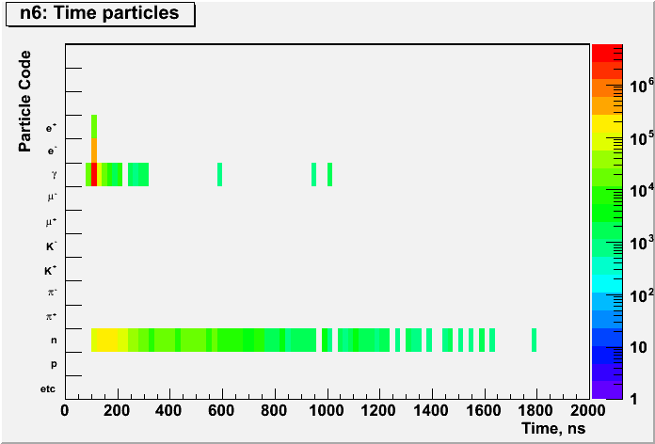
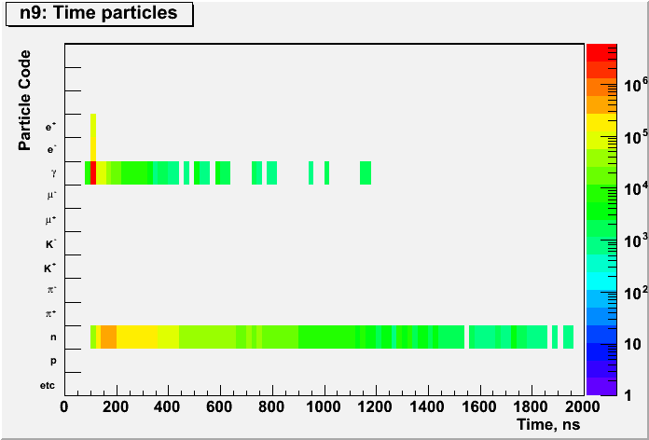
TOF Histograms at Selected Planes
(Vertical axis is particle type: e⁺, e⁻, γ, n.)
e⁺
e⁻
γ
n
TOF for particles at planes
N2 (r=5) near nose cone
N6 (r=47) in middle of tracker
N9 just inside calorimeter

Slide 14
Particle Fluxes (r=47 cm) as a Function of Cone Angle
Particle fluxes at r=47 cm
Minimum particle kinetic energy: 200 keV

Slide 15
Particle Fluxes vs. Radius for a 10° Cone

Slide 16
Synchrotron Radiation from 500 GeV Electrons
There will be ~8.6×10⁵ muon decays per meter for each beam, per crossing.
Fortunately, they are highly collimated and good design can control them.
This is a major reason for the tungsten cones in the forward directions.

Slide 17
There is LOTS more to do
This is a major, ongoing effort that is just starting.
MANY details need to be explored.
Some background sources still need to be examined.
Halo muons are particularly challenging
They penetrate anything in their path
They depend on the details of the storage-ring lattice
The fields in magnet return yokes are important
Need to consider several hundred meters around the crossing, perhaps the entire ring
Etc.

Slide 18
Outline
Quick Introduction to G4beamline
Why use it for MDI simulations
G4beamline Capabilities Relevant to MDI Simulations
All the major physics processes
Extensibility
Validation of G4beamline, comparison to MARS
Initial Background Studies
Neutrino-Induced Backgrounds
Neutrino-Induced Physics Opportunities
Conclusions

Slide 19
Neutrino-Induced Backgrounds
New physics process in G4beamline: neutrino interactions
It interfaces to the Genie Monte-Carlo generator http://genie-mc.org
It applies an artificial interaction length to specified materials, and sets the weight appropriately.
This code can also model neutrino-induced radiation, energy deposit in magnets, etc.
A 1,000 GeV ν_{μ} has a mean free path in Pb about 10 earth diameters (large, but not light years!).

Slide 20
Neutrino Interaction Rate Estimate
Simple geometry: a ring with a 10 T uniform field.
Assume a detector 5 meters in radius and 12 meters long, 50% iron (this is mostly the calorimeter).
Assume 2×10¹² muons per beam.
Muon-decay neutrinos are tracked into the iron cylinder, accounting for the ring’s path length pointing at the detector, and the weights of interactions.
Beam Energy | Ring Radius | Neutrino Interactions per Crossing
750+750 GeV | 250 m | 27%
1.5+1.5 TeV | 500 m | 38%

Slide 21
Basic Characteristics of the Neutrino Background
Interactions appear anywhere near the midplane, proportional to mass (including calorimeter, rock, supports, shielding, etc.).
They cannot be shielded.
They are in-time with the crossing to within tens of ns.
Actual timing depends on the detailed geometry.
All are early, but some can be very close to in time.
They are centered on the plane of the storage ring, with a vertical sigma of ~1.3 cm at 1.5 TeV (~1.8 cm at 750 GeV), plus the beam divergence.
The neutrinos come in from the end caps, and do not point at the crossing; they can interact anywhere, not just the end caps.
Every one I looked at has a hadronic + EM shower.

Slide 22
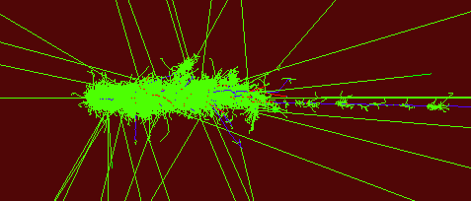
A “Typical” 1 TeV Neutrino Interaction in Fe
This is a 1.090 TeV ν_{μ} coming in from the left. Its shower is ~3 meters long, ~½ meter in diameter, and contains ½ million tracks. This is a charged-current interaction, with 56% of the energy leaving in a single muon. It has 39 delayed neutrinos from stopping π⁺ decay (green tracks). All neutrons are omitted.
612 GeV μ⁺
Tracks:
Positive
Neutral
Negative

Slide 23
Dealing with the Neutrino Background
Good timing will help a lot – a 1 ns cut will identify most of them.
Location will also identify most of them – essentially all are within a few cm of the midplane, on the outer side.
Interactions that occur in the downstream end cap with small radius will be challenging:
Very close to in time
Point reasonably close to the crossing
The only clue may be that they are near the outer midplane
Robustness of the detectors should be considered, as these multi-hundred-GeV showers could approach MHz rates, in a relatively small volume near the midplane.
Need to apply the background Monte Carlo to various detector design(s).

Slide 24
Neutrino-Induced Physics Opportunities
A muon collider is also a neutrino factory on steroids.
But it’s difficult to get significant L/E for oscillations.
A small neutrino detector near a muon collider could exceed the world’s supply of events in just a few hours.
These will be very high-energy neutrino events, in significant numbers
For a 1.5+1.5 TeV collider, 19% are above 1 TeV.
Indeed the calorimeters of the muon collider detector(s) may be all that is needed (with a neutrino trigger).

Slide 25
Conclusions
G4beamline is a useful tool for exploring backgrounds in a muon collider detector.
G4beamline (Geant4) is reasonably accurate and realistic, and getting better.
The backgrounds at a muon collider are highly challenging, and need to be well understood early enough to influence many aspects of detector design.
Neutrino interactions can be studied at very high energies with high statistics using a muon collider as a source.

