Slide 1
New (and old) Detectors for the Muon Collider
Or … random thoughts on detector technology
Detector Requirements and tools
Some basics
Tracking
Calorimetry
Conclusions
Happy to have folks in the audience comment

Slide 2
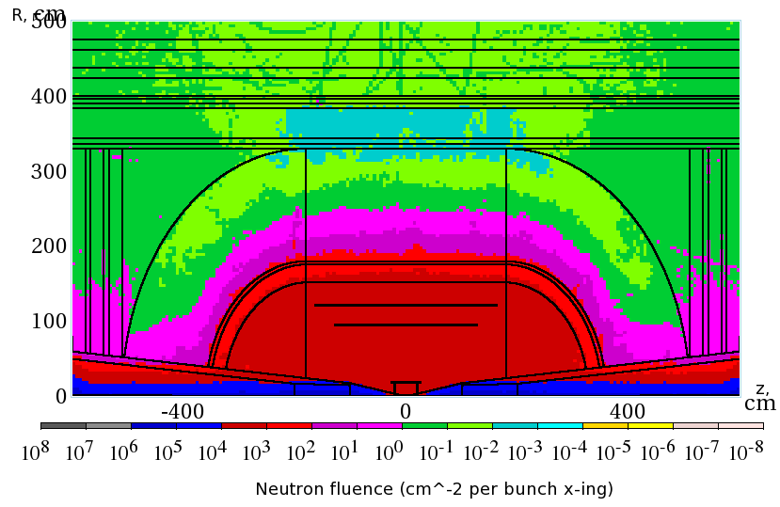
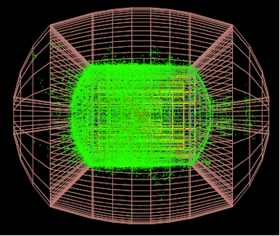
It’s About the Background
The central question is whether we can do precision physics in the huge muon collider background.
Hundreds of TeV entering the detector/crossing
4% of an event (Mazzacane)

Slide 3
Background Characteristics
Much of the background is soft.
164 TeV
5.8 TeV
92 TeV
92 TeV
172 TeV
12 TeV
(Striganov – TIPP 2011)

Slide 4
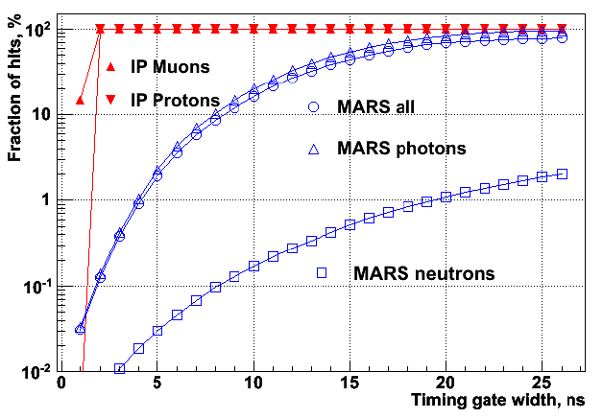
Background Characteristics
And out of time – track time with respect to photon from IP
This gives us some guidelines for detector design
(Terentev)

Slide 5
Tools
The goal is to reduce the huge background to manageable levels. Our tools include:
Timing – much of the background will be out of time with particles from the bunch crossing. This can buy a factor of 10-100
Energy – much of the energy deposit from photons and neutrons is soft, much less than a MIP – useful in reducing tracking background and EM shower discrimination
Segmentation - sufficient to limit occupancy in tracking and define shower shapes in the calorimeter
Correlations – background can be removed by requiring local correlations between tracking or calorimeter layers consistent with a high energy shower.

Slide 6
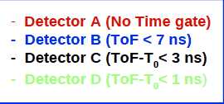
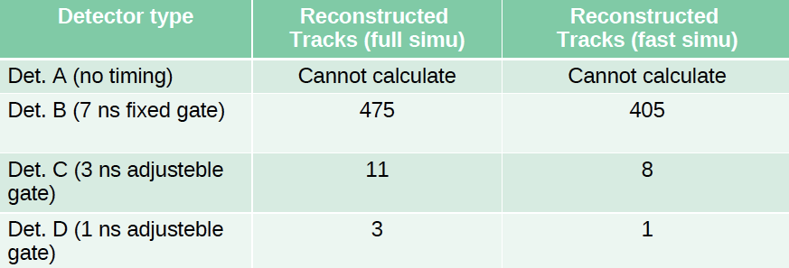
ILCROOT Track Reconstruction Study (Mazzacane)
Fresh (and encouraging) results of reconstructed tracks in full background events:

Slide 7
Time Resolution
The basic formula is:
For silicon detectors the rise time due to signal formation in the silicon is 5-10 ns (collect electrons) and will probably dominate. The mobility is voltage dependent – so we want to overbias.
The signal/noise is set by the detector capacitance, thickness, and front-end power. Typically 15-20:1
Rise time and noise depend on front-end transistor transductance (gm) ~ transistor current – the basic tradeoff
Time resolutions of 200ps – 1 ns are reasonable with proper time walk compensation and signal processing
There will be tails due to straggling, delta rays and overlaps with out of time background.
Transistor bandwidth in weak inversion ~g_{m} ~ I_{d} power

Slide 8
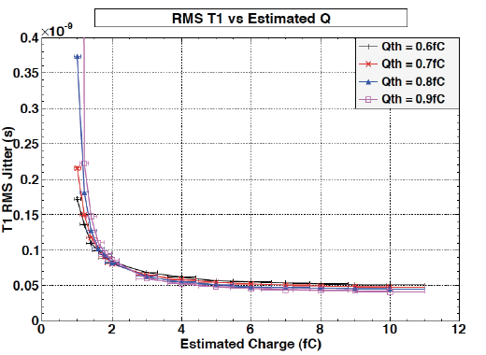
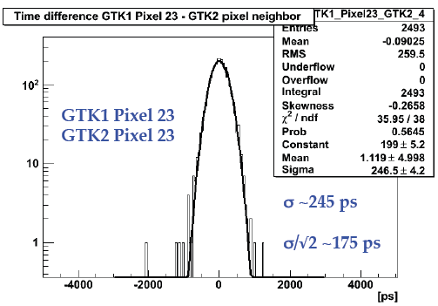
Example – NA62
“Gigatracker” aims for 100 ps resolution for K beam telescope
200 (600) micron silicon with 300 V overbias – short collection time
TDC in-chip processor
2 W/cm² –high power

Slide 9
Tracker Sensor requirements
Needs to be fully depleted – MAPS devices which collect charge by diffusion won’t work
Many technological options using commercial CMOS:
  3D
  SOI (need to improve radiation hardness)
  Hybrid
  High resistivity epitaxial (LePix)
Note that the cost of CMOS is less than silicon strip detectors
  ~$3/cm² for 8” wafer (w/o yield)
  $10/cm² for Hamamatsu SSDs (tested)
Float zone 8” SOI wafers have been produced by OKI

Slide 10
Optimal Track Fit
Naively one would expect the time resolution requirement to be set by path length variations, particle velocity differences and bunch crossing time (100 ps)
The “optimal” track fit would include time stamp information which could then be used as part of the Kalman filter
  This means that we would want the best possible time resolution with acceptable power, 100 ps or even less
  Occupancy must be small to avoid out of time background
  Hits would need a time stamp rather than a time gate – more complex electronics

Slide 11
Radiation
The overall non-ionizing flux is similar to s-LHC
  We know what is needed to operate silicon in this environment
    Low temperatures (-10 deg C) – also helps mobility
    Thin sensors – also helps collection time, but lower s/n hurts time resolution
    Single sided n-on-p preferred
Ionizing radiation causes positive charge in IC insulating layers
  Density tends to saturate
  In deep submicron technologies these charges tunnel out of the thin oxide layers – naturally radiation hard
  Future generations of electronics should be OK unless there are significant changes in the technology

Slide 12
Tracker Segmentation
The usual 50μm pitch in r-φ is probably sufficient to provide good pt resolution in the tracker.
We can consider the sea of soft background a kind of noise when we think about time resolution, so we need to keep the occupancy low enough to give us good
σ_{t}
50μm square pixels is a convenient guess, but we need to optimize this to minimize power and cost. Should be able to use existing simulations.
Smaller pixels provide lower capacitive load – lower noise and power

Slide 13
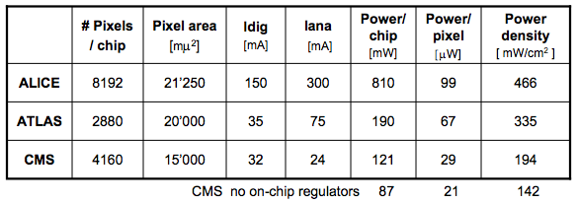
Segmentation and Power
Noise scales as C and
1/sqrt[g_{m}τ], g_{m}~ I_{d}.
For a strip or pixel detector for a given noise
  I ~ C², P ~ C²
  C ~ (width/pitch) x length (modulo edge effects)
If divided into n pixels/strip of spacing p x p (ignoring perimeter effects)
where factor depends on edge effects, overhead, and non front-end power. (Spieler)
SOI and 3D technologies can have very low node capacitance -
Cpixel < Cstrip/n even with perimeter effects
Can build high resolution low power high speed pixelated devices – if we are careful. Digital power may dominate in many applications.
Next generation ~
40 mW/cm²

Slide 14
Mass and Power
Tracker mass is usually dominated by cooling and interconnects, both are related to power dissipation
If we use silicon, the sensors must be kept cold (~-10 deg C) to minimize radiation effects.
Losses in cables can be huge –2-3x power delivered in CMS/ATLAS. Requires lots of copper (mass).
Voltage conversion using DC-DC converters (CMS) or serial powering (ATLAS) will be necessary
For ILC and CLIC power pulsing is the baseline – this can save a factor of ~ 100 for ILC. With 10 μs crossing interval this is not practical for the muon collider (cycle time ~ γτ)
In contrast to ILC liquid cooling will probably be needed – this adds mass, but not as much as LHC detectors

Slide 15
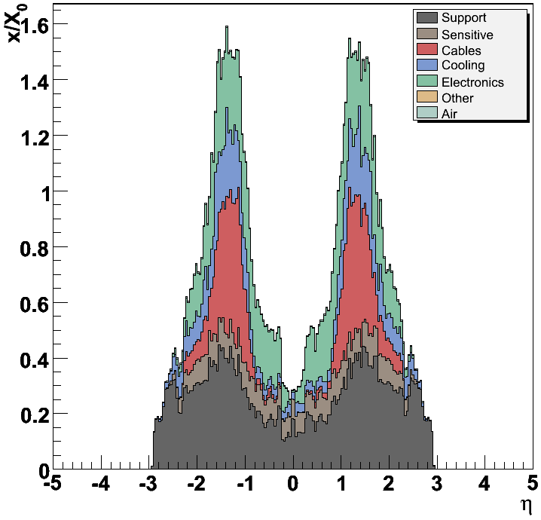
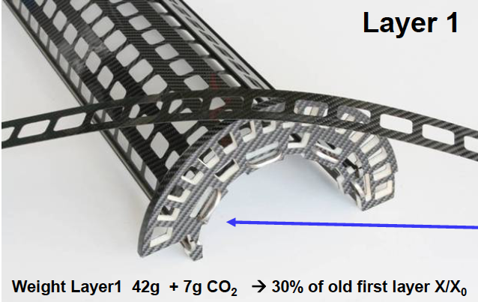
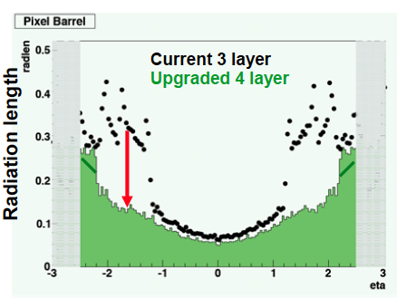

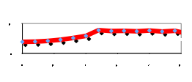
Cooling and Mass
CMS as built
Radiation length reduction in CMS
Switch to CO2 cooling
Ultra light mechanics
DC-DC conversion
Next generation cooling will cost less in mass
ILC Goal

Slide 16
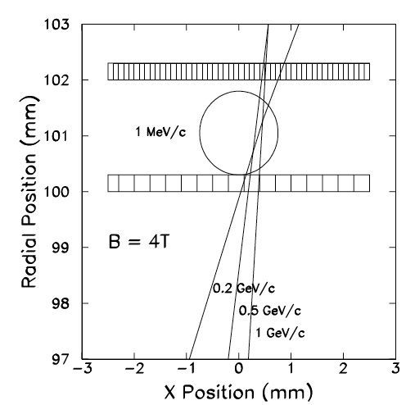
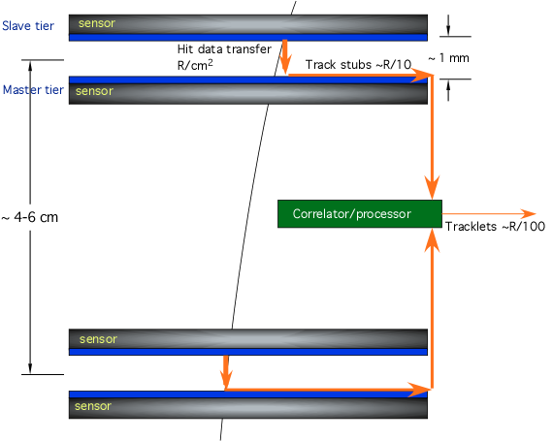
Layer Correlations
1999 μCol
Track correlation module
20th Century studies assumed 300 μm square pixels
ILC studies now assume ~ 20 μm square pixels x 225 less occupancy/pixel
S. Geer suggested a stacked layer design to reduce occupancy based on inter-layer correlations for the muon collider in 1998
This technology looks very much like what we are developing for the CMS upgrade

Slide 17
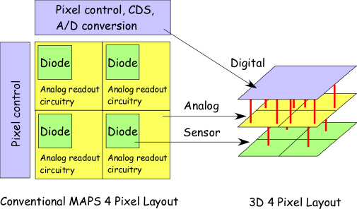
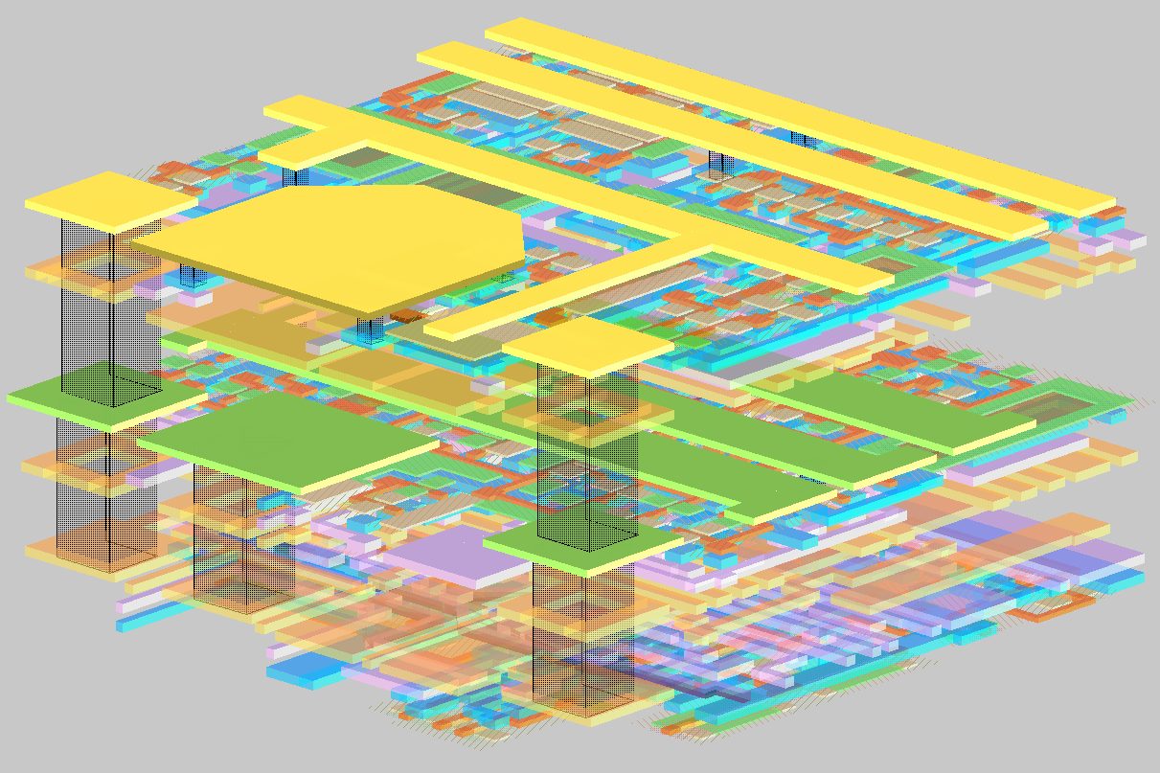

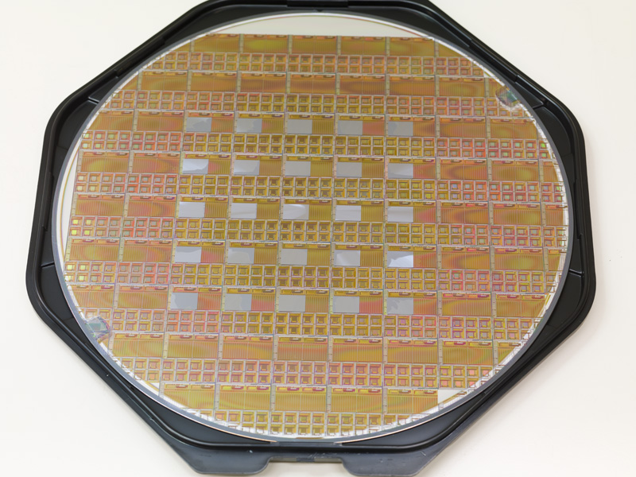
3D Integration
Technology to use wafer bonding and thinning to produce mult-layer “monolithic” devices
Chip-wafer or wafer to wafer

Slide 18
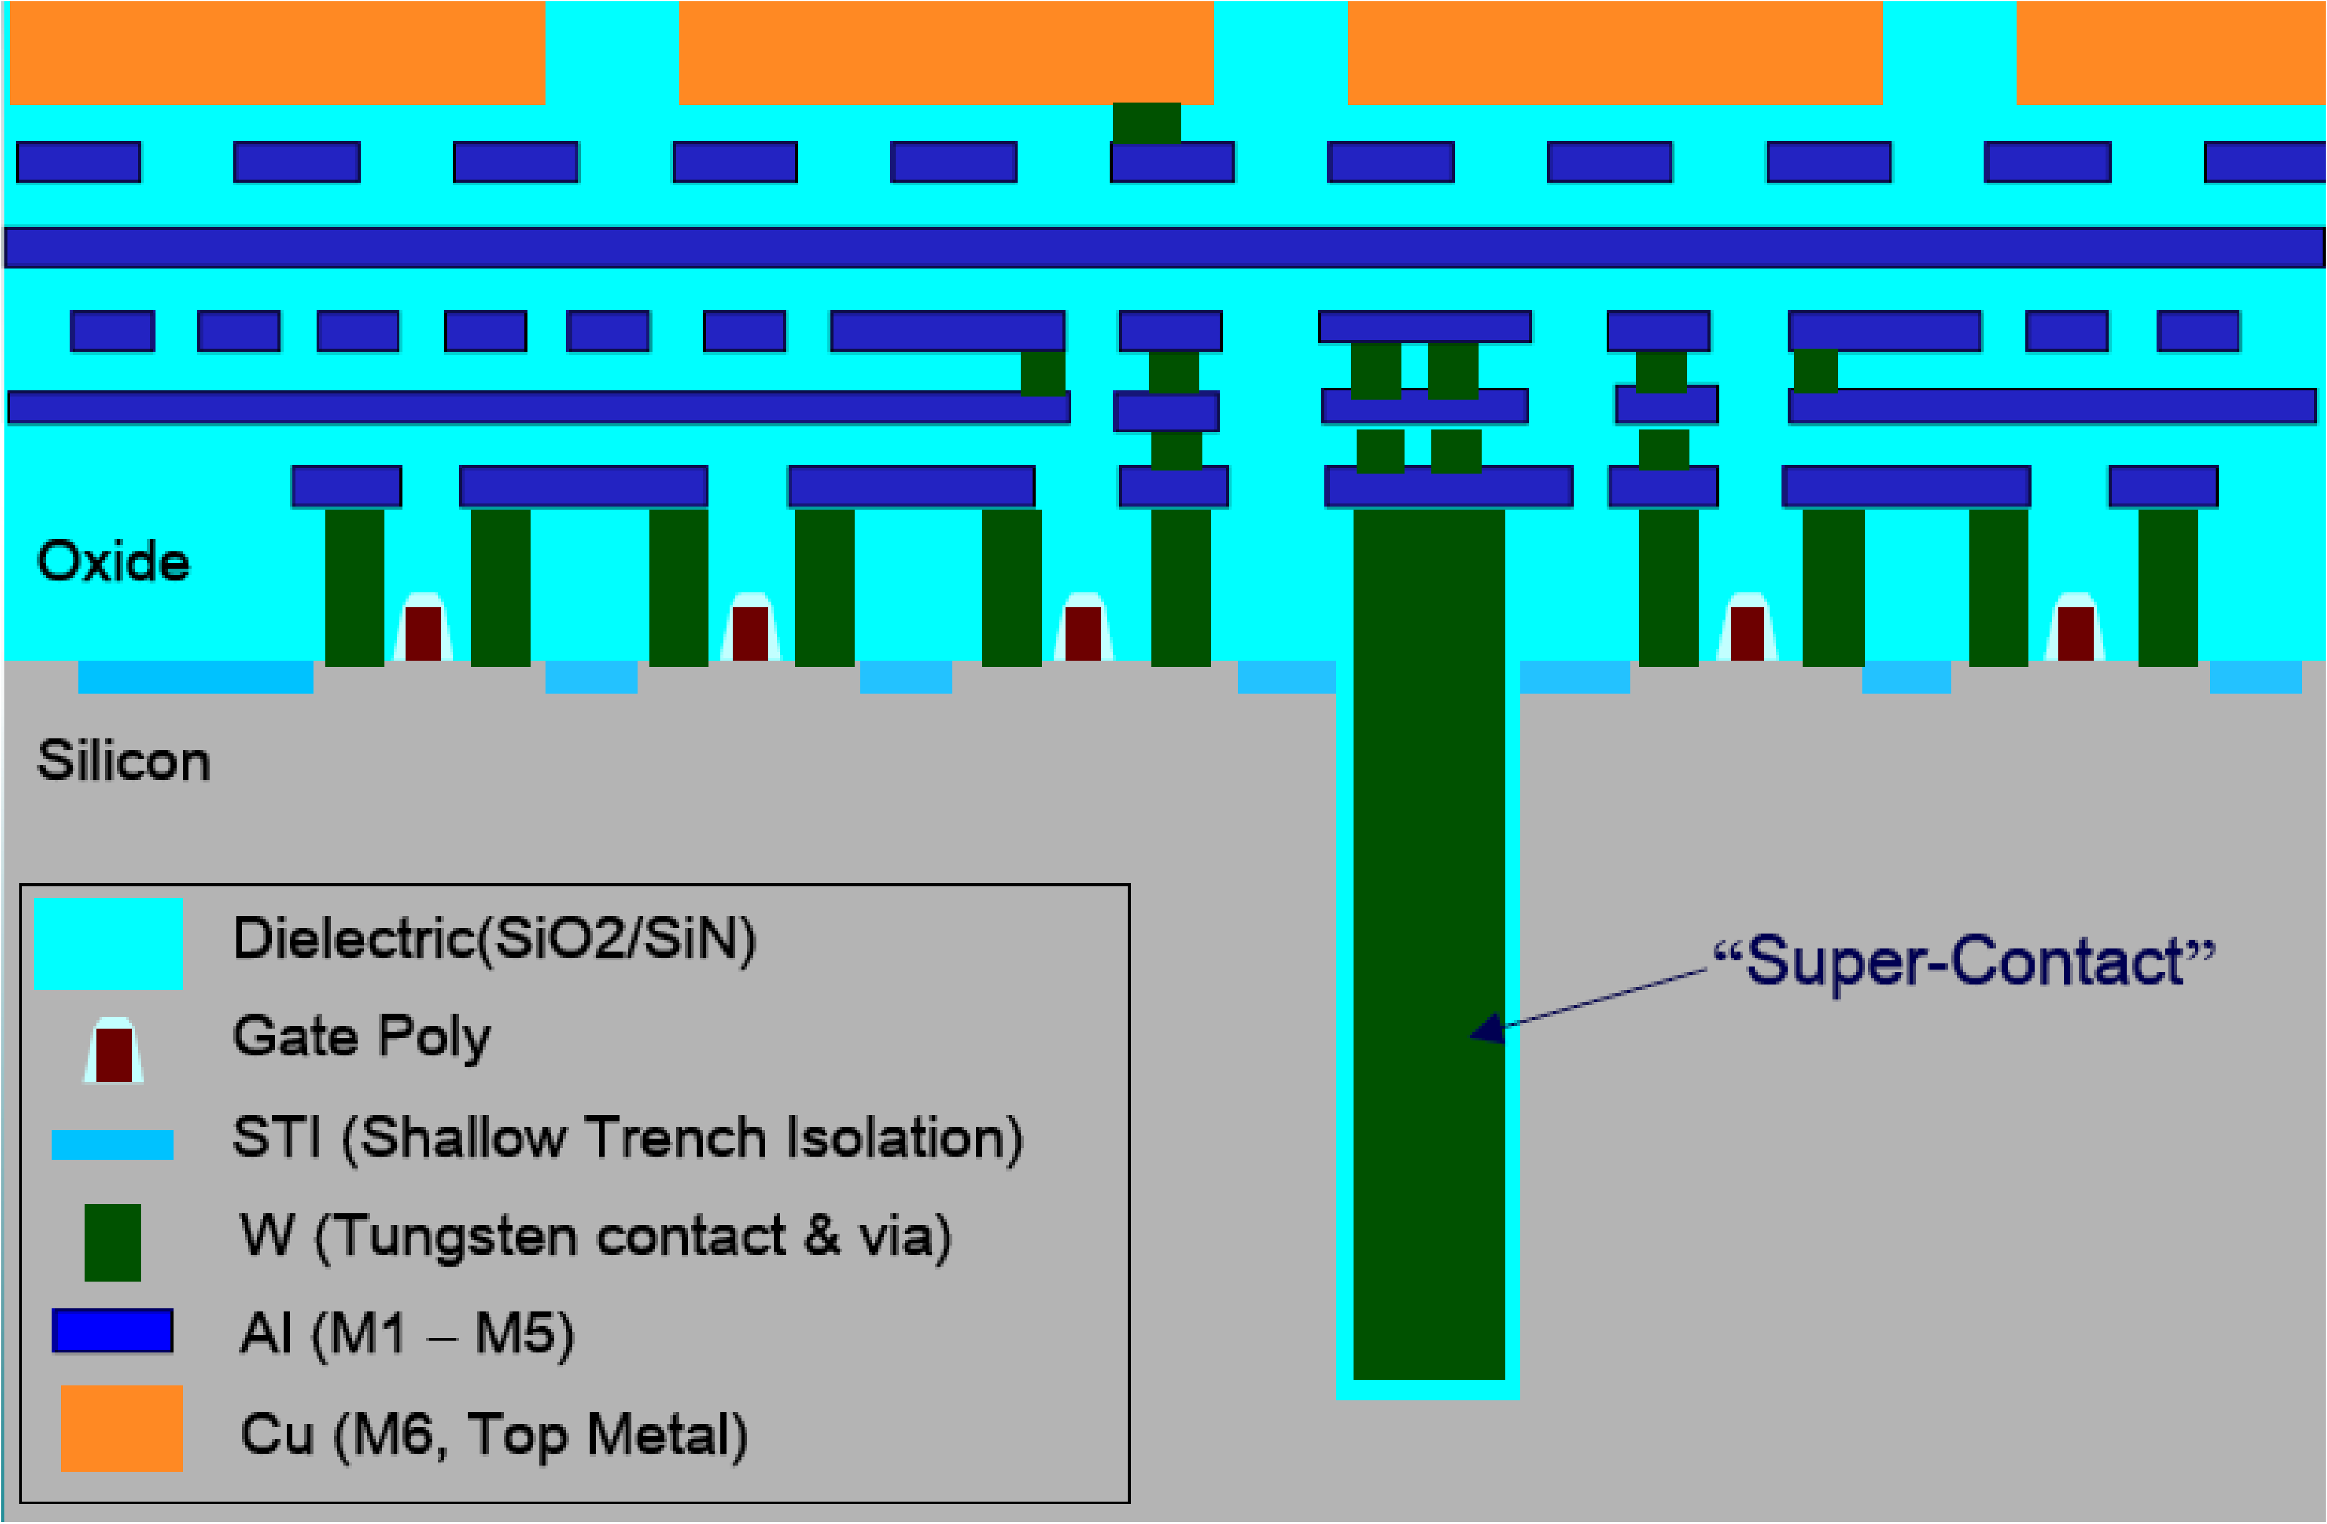

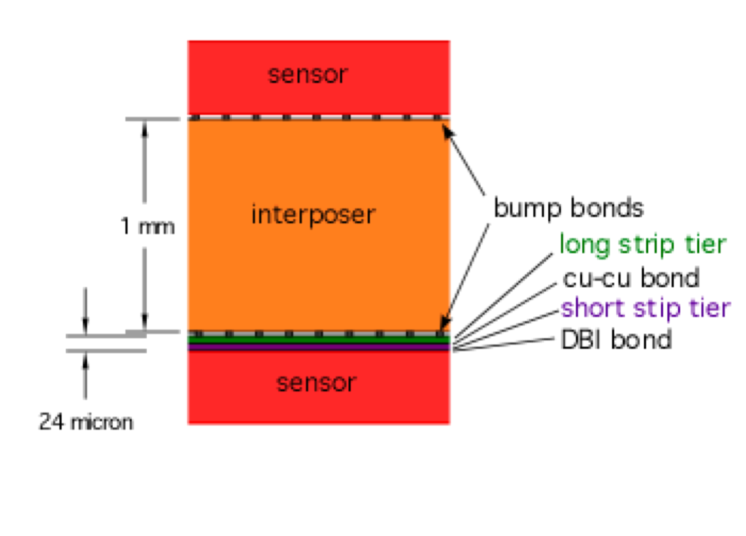
3D Track Trigger Design for CMS
Sensor
Designed for 2.5 GeV threshold
Lower threshold means less sensor separation
Uses 3D chip integration to allow ROIC to “see” top and bottom sensors
Interposer
Bump
Bond
module
Sensor

Slide 19
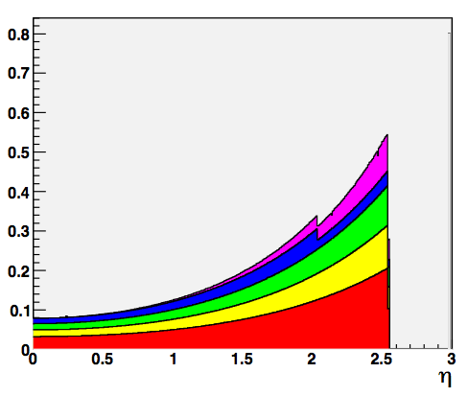
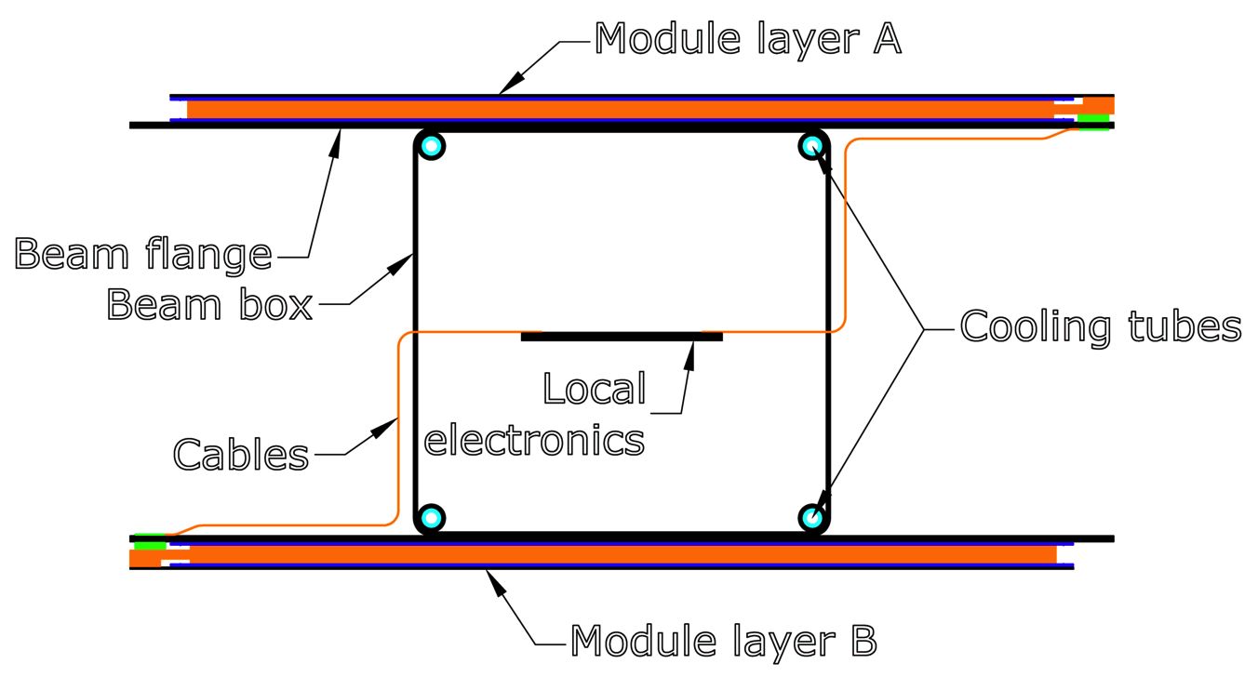
CMS Track Trigger Mass
Power locations
  Module bottom chips
    Analog power
    Digital Power
  Module -> GBT transfer
  GBT data transmission
  DC-DC conversion
Barrel only design
0.02 radiation lengths for
2 full layers (8x200μm Si) of long barrel design
Stack material excluding Si
Silicon
CF box, cooling, mesh
GBTs, DC-DC converters
LV, HV, GBT wires (Al)

Slide 20
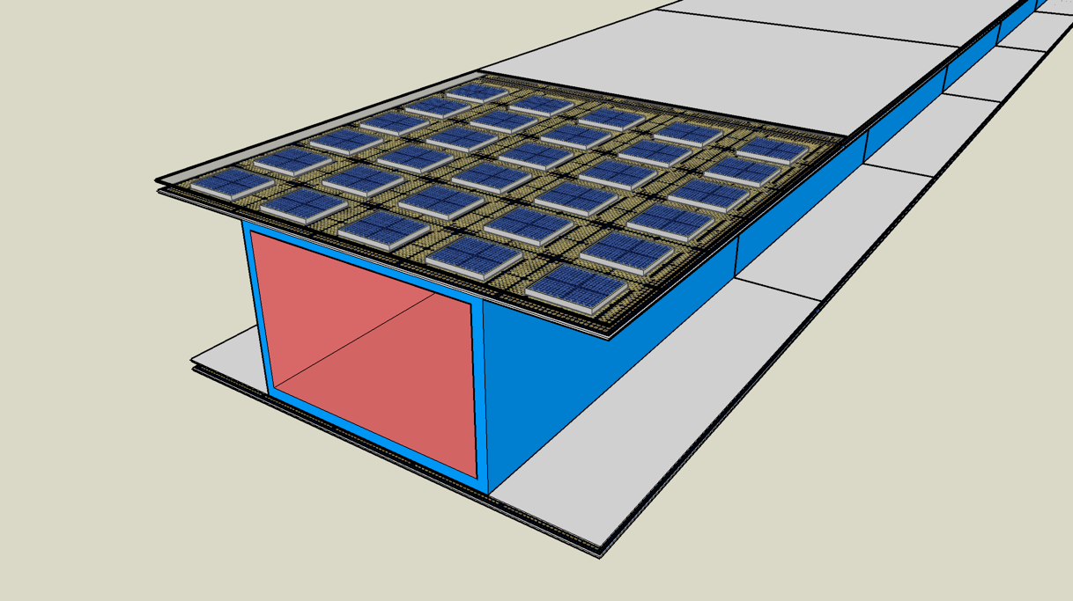
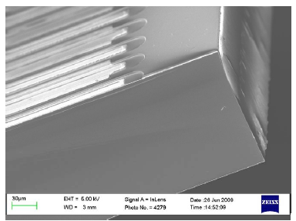
Large Area Arrays
Can we build large area, complex
pixelated systems?
Yield is (chip yield)³⁰
  Use tested die
  IC to sensor bond yield is
  crucial
  Large pitch (>500 μm) bump bond yield
  can be very high, and cost is low.
Use active edge sensor and 3D technologies to create
know good tested ROIC/sensor tiles
Technology provides only few micron
loss at edges
  Can then test integrated die/sensor
  before placement
  Large pitch bump bond yield should
  be high, parts reworkable
VTT

Slide 21
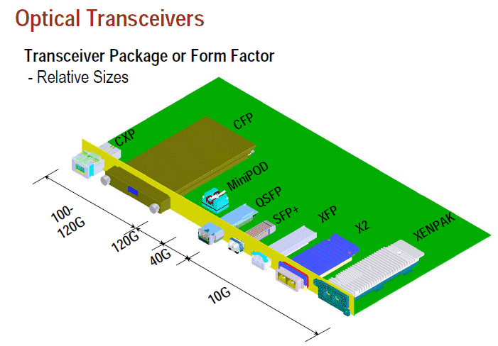
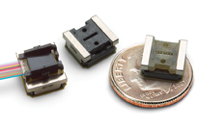
Data Flow
Readout – triggered or all events
  Is data load acceptable?
  Is power acceptable?
How do we trigger, given the large backgrounds?
Optical links – current technology
  10 pj/bit
  10 Gbit/sec per interconnect
Silicon Tracker
Data Load
50000 | hits/event
10 | cluster factor
30 | bits/hit
1.00E+05 | crossings/sec
1.50E+12 | bits/sec
Optical Readout
1.00E-11 | j/bit
1.50E+01 | Watts
1.00E+10 | bits/channel x sec
1.50E+02 | encoders

Slide 22
Power Consumption
This is strongly correlated to mass
CMS tracker total power ~ 33kW (*~2 for cable losses)
Given requirements for radiation hardness
Silicon area | 3.00E+05 | cm^2
chip power | Tracker Power (kw)
0.194 | 58 | CMS 0.25 micron vertex chip
0.035 | 11 | CMS Upgrade
2 | 600 | NA62
0.1 | 30 | GUESS

Slide 23
Calorimetery
Major thrusts for ILC
PFA-based “imaging” calorimeter
  Fine sementation
  Use tracking to measure charged component of shower
  In-calorimeter pattern recognition
Dual readout
  Separate readout of scintillation and Cerenkov light gives information on hadronic and electromagnetic parts of a shower
  Can use this to compensate for missing energy in nuclear breakup

Slide 24
Calorimetery Issues (I’m no expert)
How does shower propagation time affect background rejection?
  Segmented crystal calorimeter
  Sampling calorimeter
Can we use layer correlations?
  EM showers have well defined development – can fit to shower shape
Can we reject the soft photons in the first layers without compromising EM resolution?

Slide 25
EM Timing - LCSIM Background Study
  ECal: Tungsten, 10 x 1cm layers 1x1x1cm cells
  Background
  1ns timing cut
No timing Cut
EM cal layer
Reduction:
EM – 23% of energy survives a 1 ns timing cut
6% of that energy is beyond 1st EM cell

Slide 26
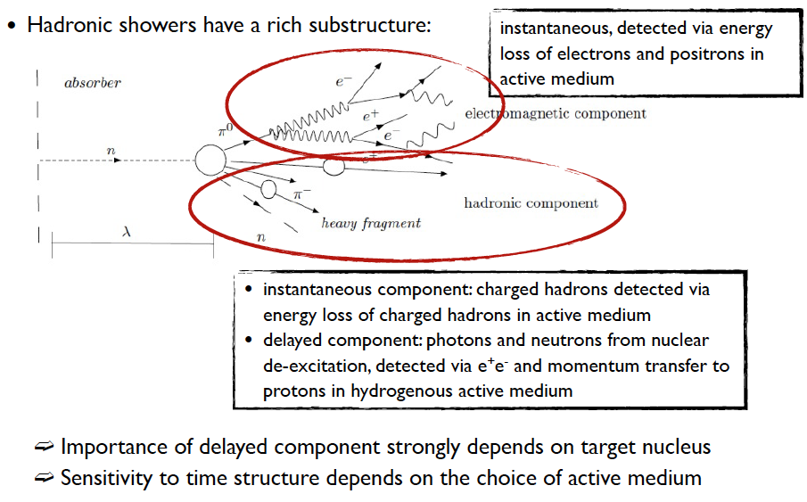
Hadron Shower Time Structure
(Frank Simon)

Slide 27
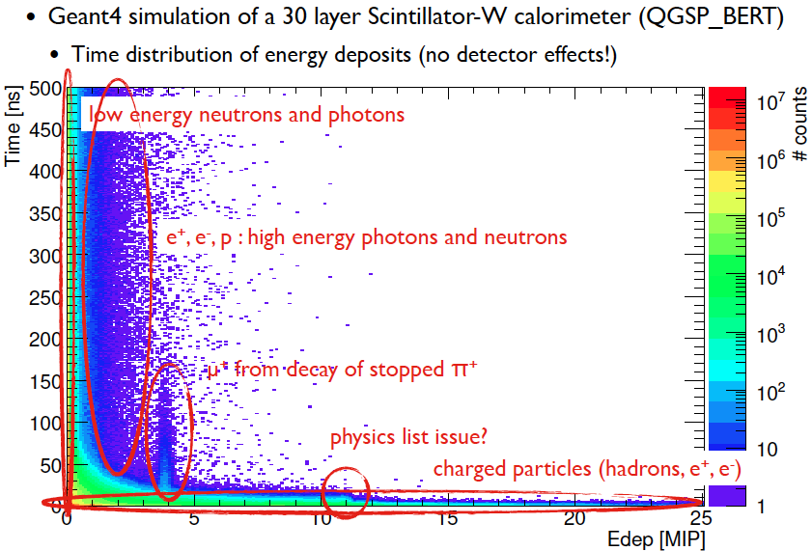
(Frank Simon)

Slide 28
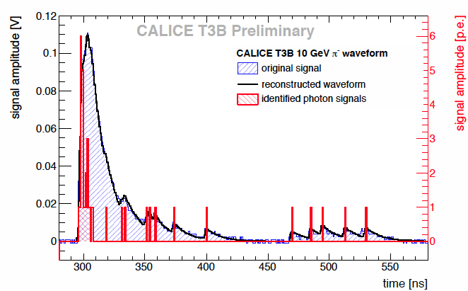
Test Beam analysis from TIPP Conference
Frank simon/CALICE

Slide 29
Fast Timing Calorimeter
Seems to me to be a subject ripe for R&D
  Absorber material to minimize slow components
  Active material with fast response
Needs to be fast and preserve resolution

Slide 30
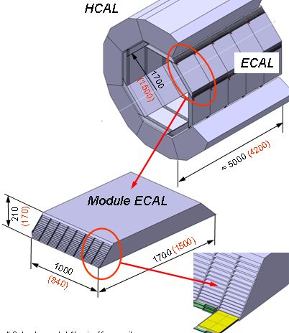
Terapixel Calorimeter -UK
Basic scale for full DECAL
a
Typical ILC SiW ECAL calorimeter
  30 layers, each a cylinder of ~ 5m×10m ~ 50m² surface area
  Total sensor surface area including endcaps ~ 2000m² needed
DECAL sensor aims to be “swap-in” for AECAL silicon
For DECAL, with pixels ~50×50μm² i.e. ~2.5×10⁻⁹m²
  Need ~10¹² pixels in total
  “Tera-pixel calorimeter”
(Paul Dauncy)

Slide 31
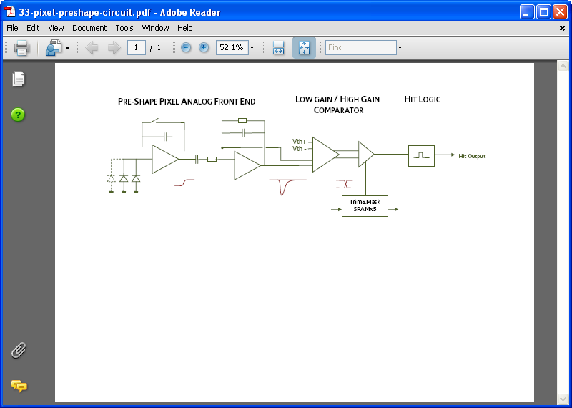
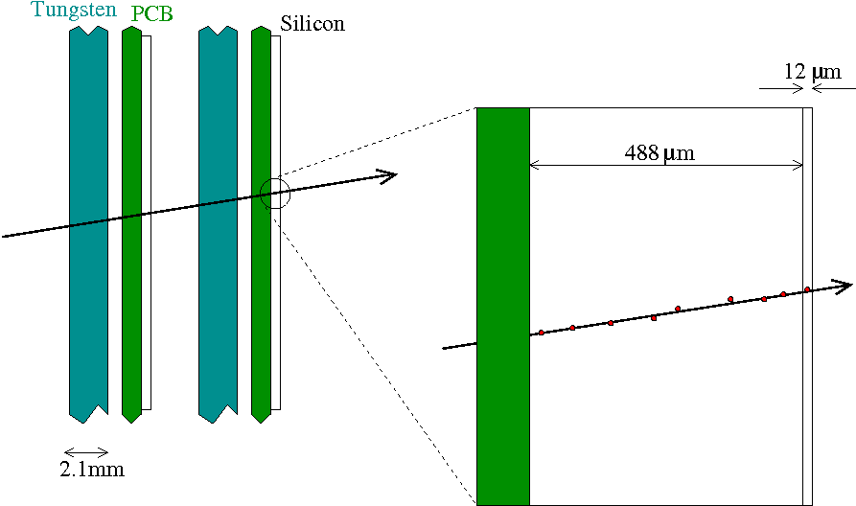
MAPS Calorimeter Design
1
Sensor has an “epitaxial layer”
  Region of silicon just below circuit
Typically is manufactured to be 5-20μm thick
  We use 12μm
Only ionised electrons within this region can be detected
(Paul Dauncey)

Slide 32
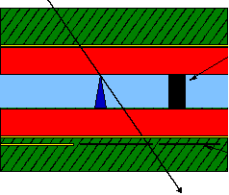
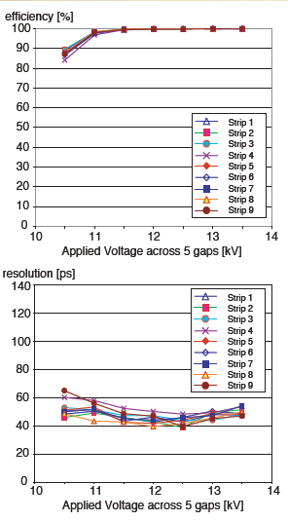
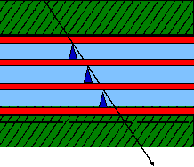
Multi-Gap RPC for ALICE Experiment
Trigger RPC: R. Cardarelli, R. Santonico
ATLAS, CMS (~ 2000 – 4000 m²)
→ timing resolution ~ 1-5 ns (MIPs)
`Renaissance of particle identification’
using Multi-Gap RPC in ALICE:
X readout strips
E ~ 50 kV
ρ ∼ 10¹⁰ Ωcm
2 mm Bakelite
2 mm gas gap
2 mm Bakelite
Y readout strips
Timing and Multi-Gap RPC → ALICE TOF
P. Fonte, V. Peskov, C. Williams (~50 ps)
Pickup electrodes
0.4 mm glass
plates
0.3 mm gas
gaps
Pickup electrodes
E ~ 100 kV

Slide 33
Limits on Timing Resolution in Gaseous Detectors
Detector Technology | Typical time resolution*
Pestov Counter (High pressure, streamer discharge mode) | 30-50 (ps)
Resistive Plate Chambers (RPC) MultiGap RPC | ~ 1-5 ns (MIPs) ~ 50 ps (MIPs)
Gas Electron Multiplier - UV photons - MIPs | ~ 1-2 ns ~ 5-10 ns
Micromesh Gaseous Structures - UV photons - MIPs | ~ 700 ps ~ 1-10 ns
(

Slide 34
Conclusions
We have had significant progress in understanding how to dea; with muon collider backgrounds
Timing is Crucial
  We need to understand how this effects hadron calorimetery – possibly a signficant R&D program
  Timing will cost power (and mass) in tracking.
  Lots of folks are interested (Fast timing project, CLIC, NA62, PET …)
There is a huge amount left to understand

Slide 35
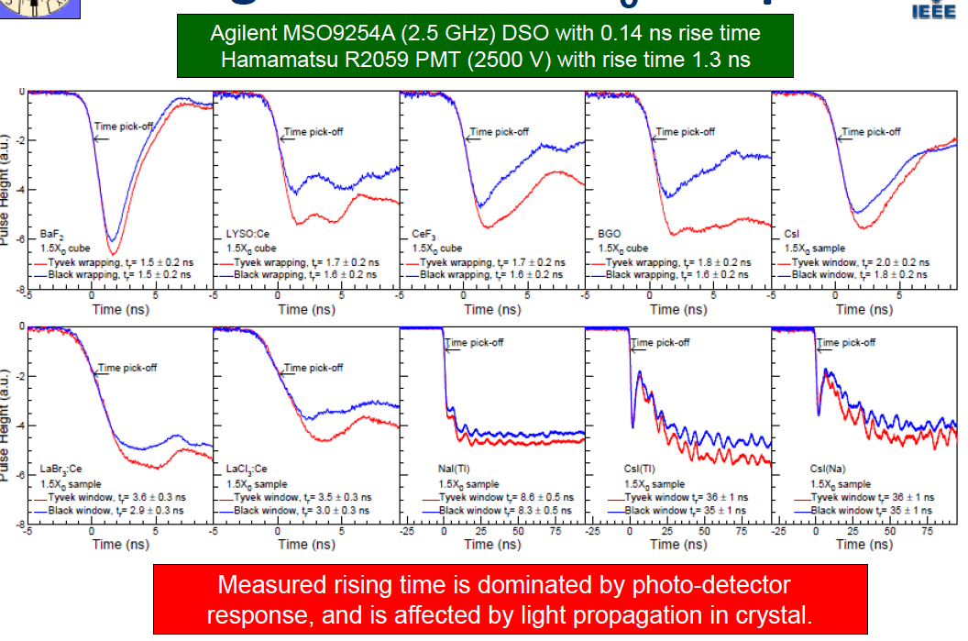
Scintillator timing
(Zhu)

Slide 36
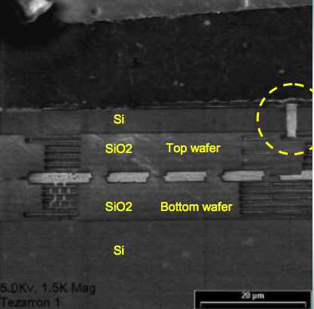
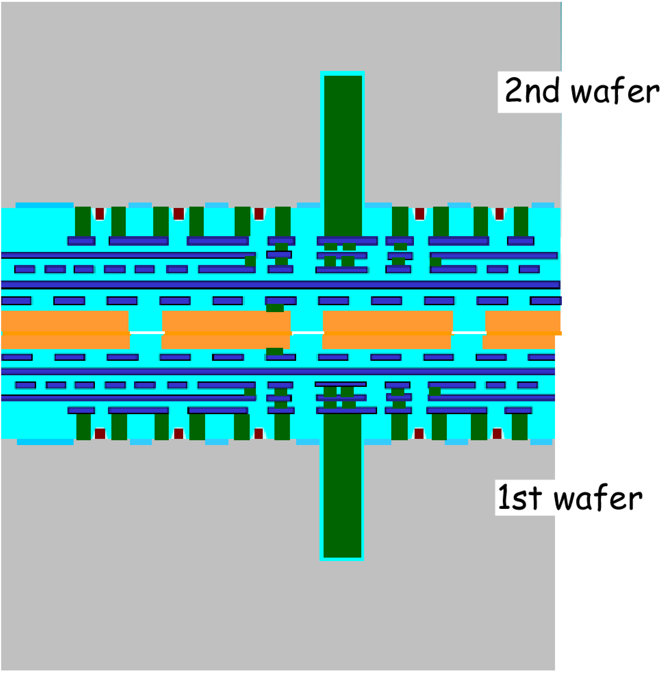
Simpler version for low momentum
Random false hits can be rejected with minimal material and modest power penalty using 3D bonded monolithic active pixel ICs
We could almost do this
now

Slide 37
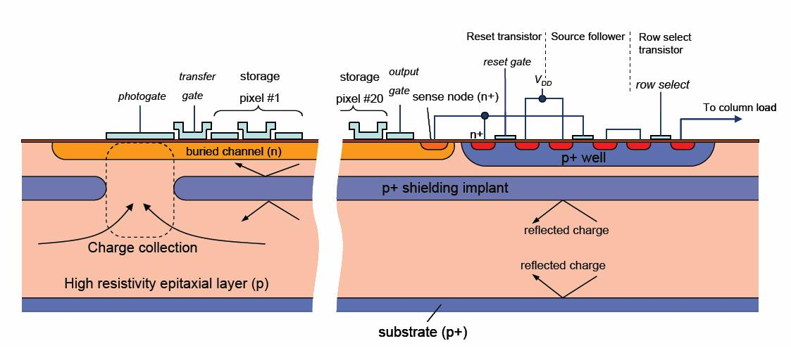
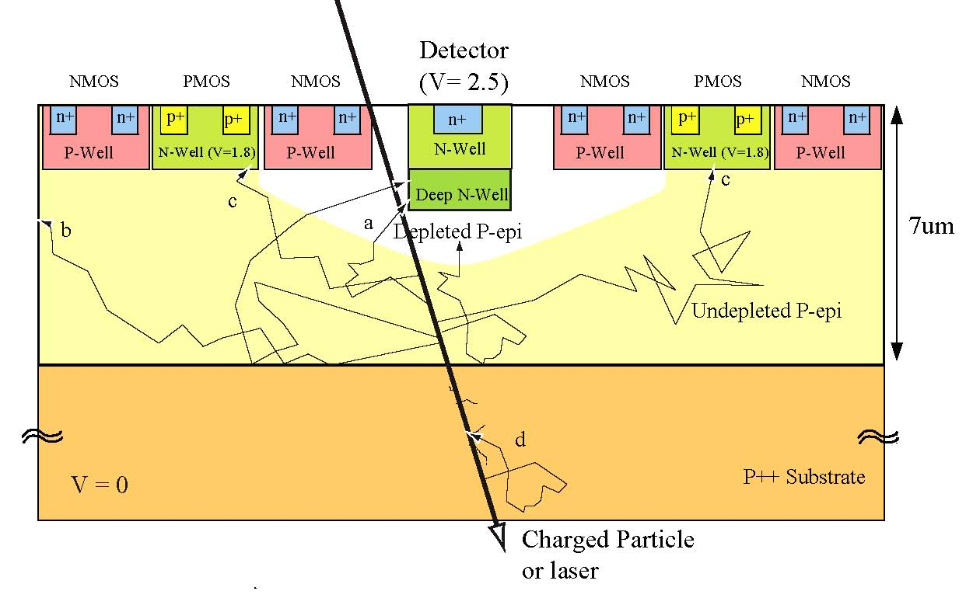
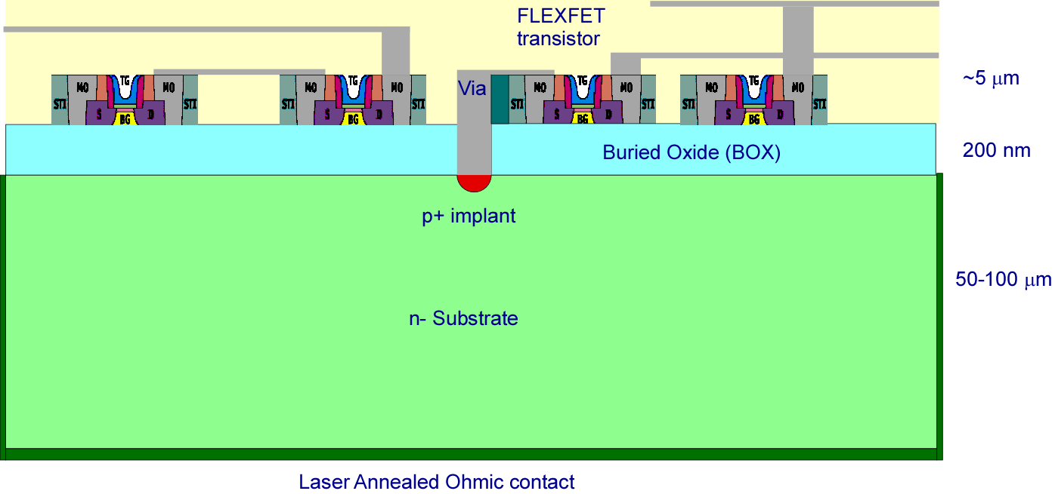
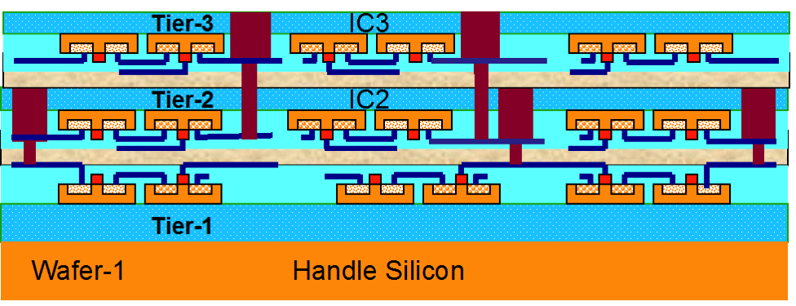
Vertex Technologies Developed for ILC
CCDs
  Readout too slow
CMOS Active Pixels
  Possible, radiation hardness?
  Speed?
  Improved with high resistivity bulk (Lepix), chronopix
SOI
  Possible, radiation hardness?
3D
  Yes
DEPFET
  Probably too slow not rad hard
CCD
?
?
CMOS Active Pixels
SOI
source
top gate
drain
clear
bulk
~1µm
p+
n+
p+
n+
n+
s
p
n
i
3D
x
internal gate
a
-
y
-
-
+
50 µm
-
r
-
t
-
e
m
DEPFET
m
+
y
-
s
-
n
-
37
37
+
+
-
p+
rear contact

Slide 38
