Slide 1

Status of the CLIC project
Muon Collider 2011
Telluride, Colorado, CO, USA
http://clic-study.org/
Erik Adli, University of Oslo, Norway and SLAC
For the CLIC/CTF3 collaboration
June 29, 2011

Slide 2
Outline
General overview and review of the CLIC project
Status of the CLIC machine studies (main beam)
Status of the CLIC rf power source studies and CTF3
Conclusions

Slide 3
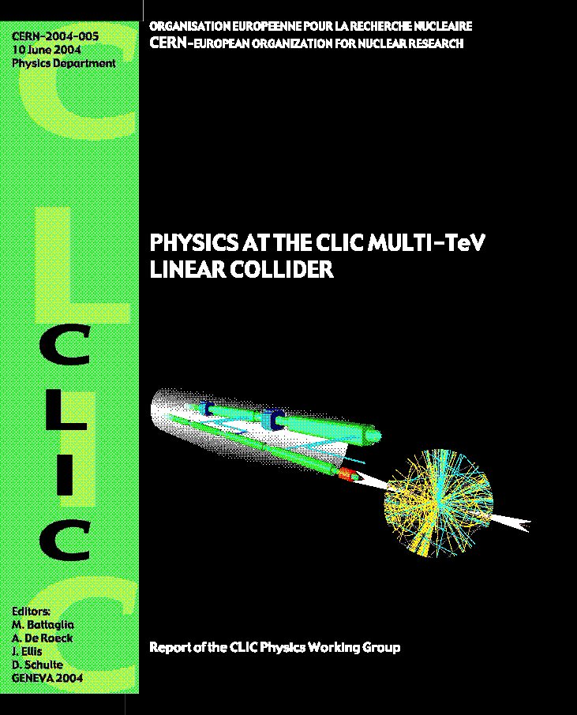
THE COMPACT LINEAR
COLLIDER STUDY (CLIC)
Objective: explore possible extension of e⁺/e⁻ linear colliders into the Multi-TeV colliding beam energy range by developing most appropriate technology :
  E_{CM} energy range complementary to LHC =>E_{CM} = 0.5- 3 TeV
  L > few 10³⁴ cm⁻² with acceptable background & energy spread
  Affordable cost and power consumption
Physics motivation:
  Consensus supported by ICFA of Lepton Collider
  (precision) favored facility to complement the LHC
  (discovery) in future
  "Physics at the CLIC Multi-TeV Linear Collider:
  http://clicphysics.web.cern.ch/CLICphysics/
Present status:
R&D addressing Feasibility Issues
Conceptual Design (Accelerator & Detector) with preliminary performance & cost estimations
http://clic-study.org/

Slide 4
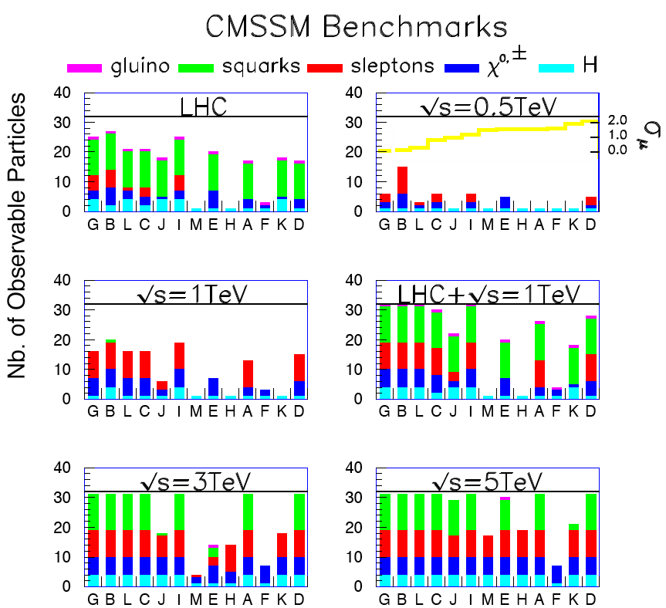
CLIC physics up to 3 TeV
LHC will indicate what physics, and at which energy scale
Potential Physics in 0.5-3 TeV range?
Higgs physics:
  Complete study of the light standard-model Higgs boson, including rare decay modes (rates factor ~5 higher at 3 TeV than at 500 GeV)
    Higgs coupling to leptons (universality)
    Study of triple Higgs coupling using double Higgs production
    Higgs spin
  Study of heavy Higgs bosons
Supersymmetry:
  Extensive reach to measure SUSY particles
In addition:
  Probe for theories of extra dimensions
  New heavy gauge bosons (e.g. Z’)
  Excited quarks or leptons
http://lcd.web.cern.ch/LCD
SUSY reach for an e+e- collider

Slide 5

























The CLIC collaboration
CLIC multi-lateral collaboration
41 Institutes from 21 countries
ACAS (Australia)
Aarhus University (Denmark)
Ankara University (Turkey)
Argonne National Laboratory (USA)
Athens University (Greece)
BINP (Russia)
CERN
CIEMAT (Spain)
Cockcroft Institute (UK)
ETHZurich (Switzerland)
FNAL (USA)
Gazi Universities (Turkey)
Helsinki Institute of Physics (Finland)
IAP (Russia)
IAP NASU (Ukraine)
IHEP (China)
INFN / LNF (Italy)
Instituto de Fisica Corpuscular (Spain)
IRFU / Saclay (France)
Jefferson Lab (USA)
John Adams Institute/Oxford (UK)
John Adams Institute/RHUL (UK)
JINR (Russia)
Karlsruhe University (Germany)
KEK (Japan)
LAL / Orsay (France)
LAPP / ESIA (France)
NIKHEF/Amsterdam (Netherland)
NCP (Pakistan)
North-West. Univ. Illinois (USA)
Patras University (Greece)
Polytech. University of Catalonia (Spain)
PSI (Switzerland)
RAL (UK)
RRCAT / Indore (India)
SLAC (USA)
Thrace University (Greece)
Tsinghua University (China)
University of Oslo (Norway)
Uppsala University (Sweden)
UCSC SCIPP (USA)
Notes:
5

Slide 6

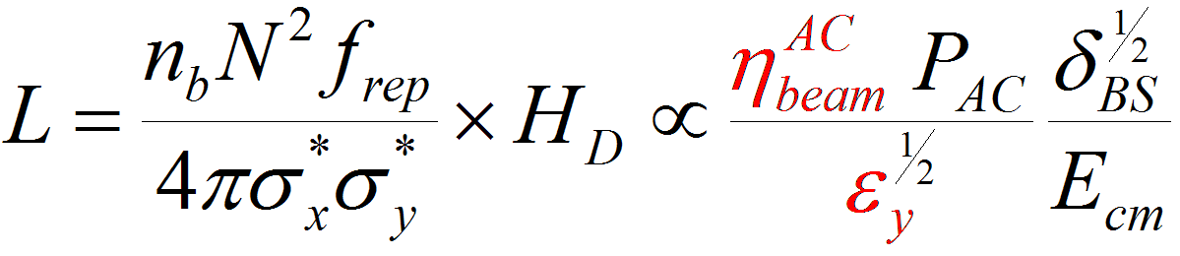
Multi-TeV Linear Colliders challenges
e+
e-
source
main linac
damping ring
beam delivery
Energy reach
Accelerating structures: large accelerating fields with low breakdown rate
RF power source: high peak power with high efficiency
Luminosity
Beam acceleration: MW of beam power with high gradient and high efficiency
Generation of ultra-low emittances: micron rad-m in H, nano rad-m in V
Preservation of low emittances in strong wake field environment
Alignment (micron range)
Stability (nano-meter range)
Small beam sizes at Interaction Point: Focusing to nm beam sizes
Stability to sub nano-meter

Slide 7
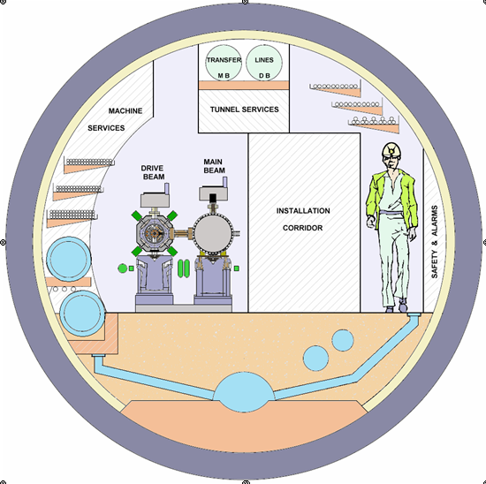
CLIC: specific features
4.5 m diameter
High acceleration gradient: > 100 MV/m
    “Compact” collider: total length < 50 km at 3 teV
  Normal conducting acceleration structures at
  high RF frequency (12 GHz)
Novel Two-Beam Acceleration Scheme
  Cost effective, reliable, efficient
Single tunnel, no active power components
Modular, staged energy upgrade
Accelerating Structures
High Frequency – High field
-> short pulses
‘few’ Klystrons
Low frequency
High efficiency
Drive beam - 100 A, 240 ns
from 2.4 GeV to 240 MeV
CLIC TUNNEL CROSS-SECTION
QUAD
QUAD
POWER EXTRACTION
STRUCTURE
Long RF Pulses
P₀ , τ₀
Electron beam manipulation :
Power compression,
Frequency multiplication
Short RF Pulses
P_{A} = P₀ × N
τ_{A} = τ₀ / N
12 GHz – 140 MW
ACCELERATING
STRUCTURES
Main beam – 1 A, 200 ns
from 9 GeV to 1.5 TeV
BPM

Slide 8
CLIC drive beam scheme
Drive Beam Accelerator
efficient acceleration in fully loaded linac
Delay Loop × 2
gap creation, pulse compression & frequency multiplication
0.5 GHz
RF Transverse Deflectors
Combiner Ring × 3
pulse compression &
frequency multiplication
Combiner Ring × 4
pulse compression &
frequency multiplication
CLIC RF POWER SOURCE LAYOUT
Drive Beam Decelerator Section (2 × 24 in total)
Power Extraction
12 GHz
Drive beam time structure - initial
Drive beam time structure - final
240 ns
240 ns
5.8 μs
140 μs train length - 24 × 24 sub-pulses
4.2 A - 2.4 GeV – 60 cm between bunches
24 pulses – 101 A – 2.5 cm between bunches

Slide 9
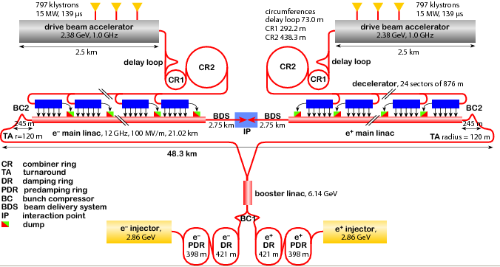
CLIC layout 3 TeV
Drive Beam Generation Complex
Main Beam Generation Complex
Main & Drive Beam generation
complexes not to scale

Slide 10
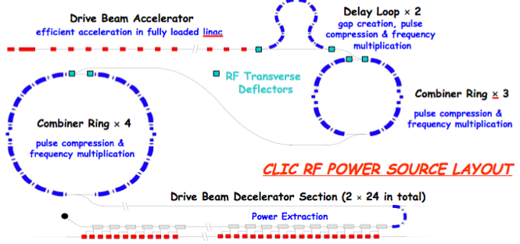
CLIC energy stages
CLIC two-beam scheme :
energy staging is straight-forward.
Lower energy machines can run most of the time during the construction of the next stage.
Physics results will determine the energies of the stages.
Linac 1
I.P.
Linac 2
0.5 TeV Stage
Injector
Complex
4 km
4 km
~14 km
The drive beam complex will stay the same for all stages.
Linac 1
I.P.
Linac 2
1 TeV Stage
Injector
Complex
7.0 km
7.0 km
~20 km
Linac 1
3 TeV Stage
I.P.
Linac 2
Injector
Complex
20.8 km
3 km
3 km
20.8 km
48.2 km

Slide 11
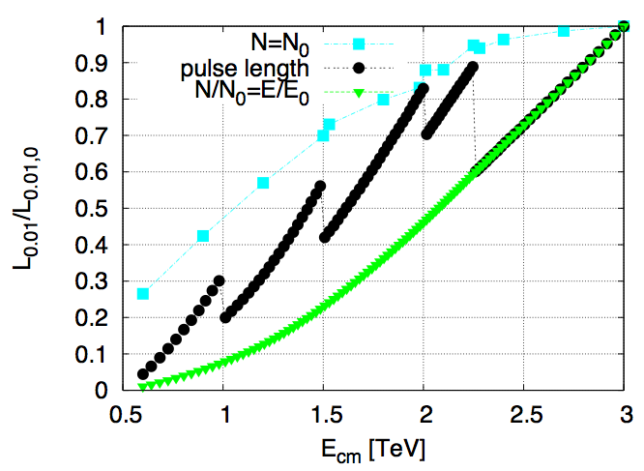
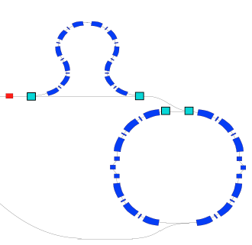
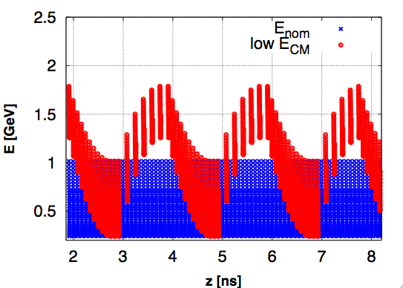
CLIC energy scans (for a single stage)
Requirement from physics : vary the c.m. energy for a given CLIC machine. Main options :
Early extraction lines : expensive, large hardware modifications needed
Reduce gradient : disadvantage: need to scale down bunch charge linearly with gradient for stability, leading to a significant luminosity loss (green)
CLIC drive beam scheme: gradient can be reduced while increasing pulse length. A large fraction of the luminosity loss is recovered (black). Modifications to drive beam generation are minimal.
Lower gradient can be achieved by switching of phase of incoming drive beam bunches :
Drive beam energy after extraction
Luminosity loss during energy scan

Slide 12
CLIC main parameters
Centre-of-mass energy | 500 GeV | 3 TeV
Total (Peak 1%) luminosity | 2.3(1.4)·10³⁴ | 5.9(2.0)·10³⁴
Total site length (km) | 13.0 | 48.3
Loaded accel. gradient (MV/m) | 80 | 100
Main linac RF frequency (GHz) | 12
Beam power/beam (MW) | 4.9 | 14
Bunch charge (10⁹ e+/-) | 6.8 | 3.72
Bunch separation (ns) | 0.5
Beam pulse duration (ns) | 177 | 156
Repetition rate (Hz) | 50
Hor./vert. norm. emitt (10⁻⁶/10⁻⁹) | 4.8/25 | 0.66/20
Hor./vert. IP beam size (nm) | 202 / 2.3 | 40 / 1
Hadronic events/crossing at IP | 0.19 | 2.7
Coherent pairs at IP | 100 | 3.8 10⁸
Wall plug to beam transfer eff | 4.1% | 5.0%
Total power consumption (MW) | 240 | 560

Slide 13
Exact numbers are under revision – chart included for illustration
Power flow 3 TeV
~560 MW
Modulator auxiliaries
260 MW AC power
Wall Plug
253 MW
η_{REL} = .93
η_{M} = .90
aux = 0.97
Main beam injection, magnets, services, infrastructure
and detector
Power supplies
klystrons
η_{K} = .70
148.0 MW 1 GHz RF power
~300 MW
Drive beam
acceleration
η_{S} = .95
η_{A} = .977
η_{plug/RF} ~ 40 %
137.4 MW Drive Beam Power
η_{D} = .84
Drive beam
power extr.
η_{RF/main} ~ 30 %
Dumps
107 MW
η_{TRS} = .98
PETS
η_{T} = .96
η_{tot} ~ 5 %
101.1 MW 12 GHz RF power
(2 x 101 kJ x 50 Hz)
Main
linac
η_{RF} = .277
28 MW
Main beam

Slide 14
10 CLIC Feasibility Issues
Two Beam Acceleration:
  Drive beam generation
  Beam Driven RF power generation
  Two Beam Module
RF Structures:
  Accelerating Structures (CAS)
  Power Production Structures (PETS)
Ultra low beam emittance and beam sizes
  Emittance preservation during generation, acceleration and focusing
  Alignment and stabilisation
Operation and Machine Protection System (MPS)
Detector
  Adaptation to short interval between bunches
  Adaptation to large background at high beam collision energy
CLIC specific
CLIC ILC Common Issues
CLIC more challenging requirements
* Feasibility issues planned to be addressed by end 2011 (CDR)
* Consolidated performance, power and cost issues adressed by 2016 (planned date for PIP)

Slide 15
Conceptual Design Report:
Towards European Strategy for HEP (mid 2012)
3 volumes: http://project-clic-cdr.web.cern.ch/project-CLIC-CDR/
  Vol 1: The CLIC accelerator and site facilities
    CLIC concept with exploration over multi-TeV energy range up to 3 TeV
    Feasibility study of CLIC parameters optimized at 3 TeV(most demanding)
    Application to 500 GeV as first stage and intermediate energy range
  Vol 2: The CLIC physics and detectors
    Exploration over multi-TeV energy range up to 3 TeV
  Vol 3: CLIC study summary
    Comprehensive summary for European Strategy
    Staging scenario compatible with LHC Physics
    Including cost & power drivers & issues (R&D mitigation in next phase)
    Proposing objectives and work plan of post-CDR phase
Schedule:
  December 2011: Drafts Vol 1 & 2 presented @ SPC for comments
  Spring 2012: Final Vol 1, 2 & 3 to European Strategy for PP

Slide 16
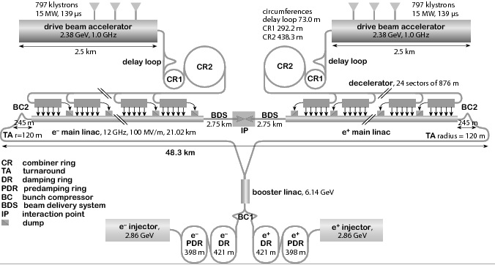
Status of CLIC machine studies
from the main beam injectors to the IP

Slide 17
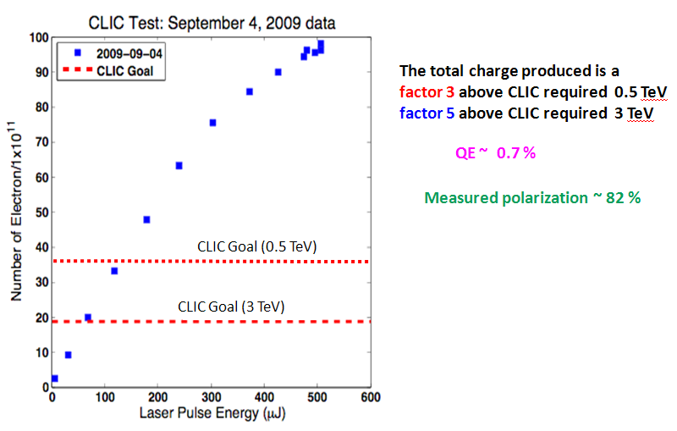
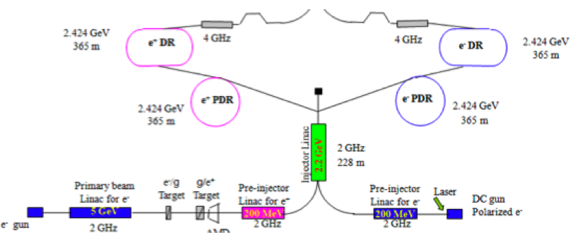
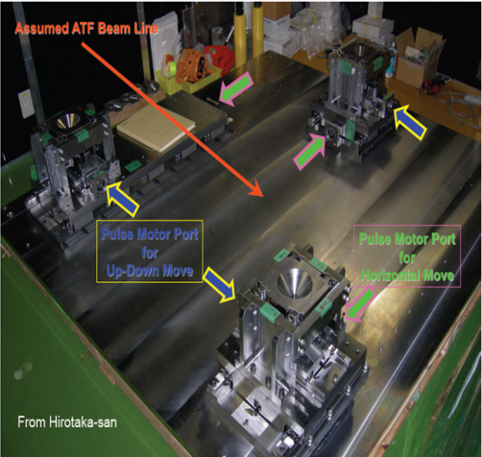
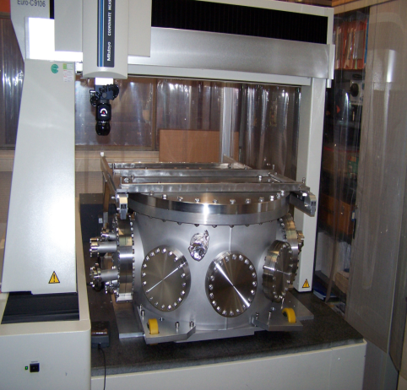
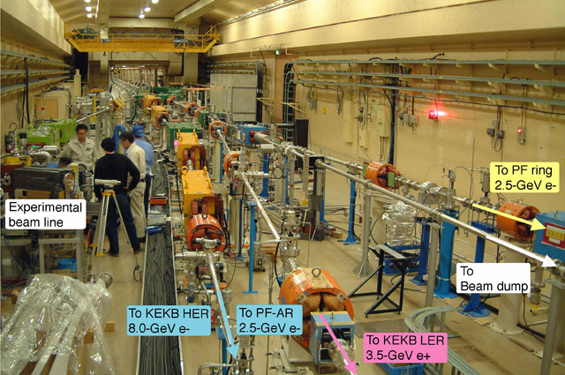
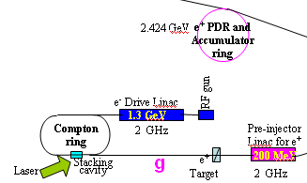
Main Beam Injector Sources
Injector charge of N = 4 x 10⁹ polarized electrons and positrons considered feasible.
3 TeV Baseline :
* Polarized e-
* Unpolarized e+
Tests @ SLAC of polarised electrons
156 ns pulse using a 120 kV DC gun, GaAs cathode
Tests @ KEK of unpolarised positrons from hybrid target
* Options for polarized e+
Tests @ KEK of Optical cavity using Compton backscattering for ILC and CLIC polarized e⁺
(Collaboration CERN/LAL/KEK)

Slide 18
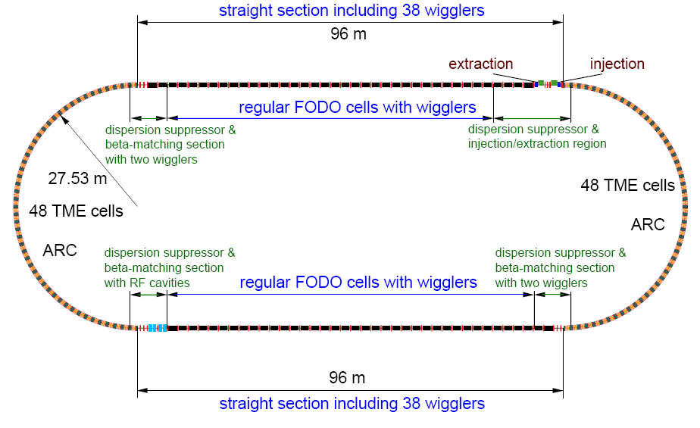
Ultra low Beam Emittance Generation
Ultra low emittance:
Key parameter to achieve high luminosity with limited beam power. CLIC damping ring design challenging.
Energy [GeV] | 2.86
Circumference [m] | 493.05
Number of arc cells | 100
Number of wigglers | 76
RF voltage [MV] | 6.5
Damping time x / s [ms] | 1.87 / 0.94
IBS growth factor | 2.0
Hor. Norm. Emittance [nm.rad] | 480
Ver. Norm. Emittance [nm.rad] | 4.7
Bunch length [mm] | 1.4
Longitudinal emittance [eVm] | 3700
CLIC 3 TeV damping ring parameters

Slide 19
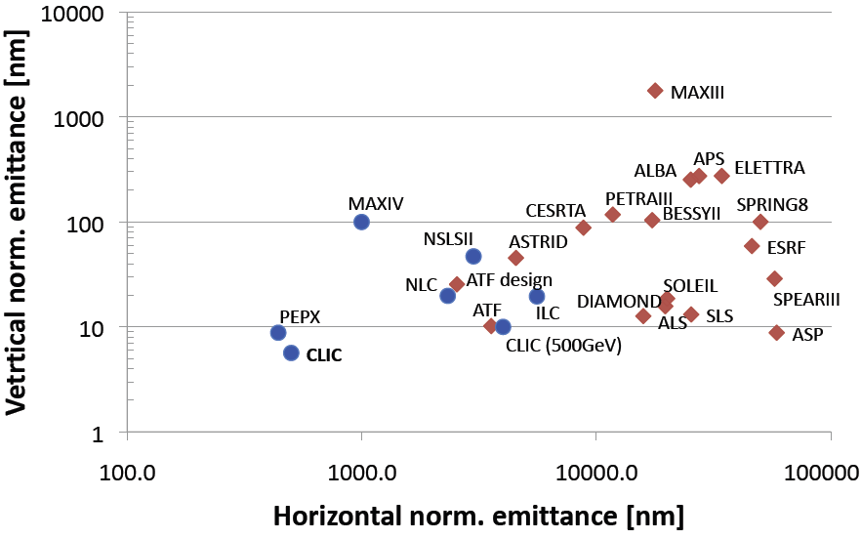
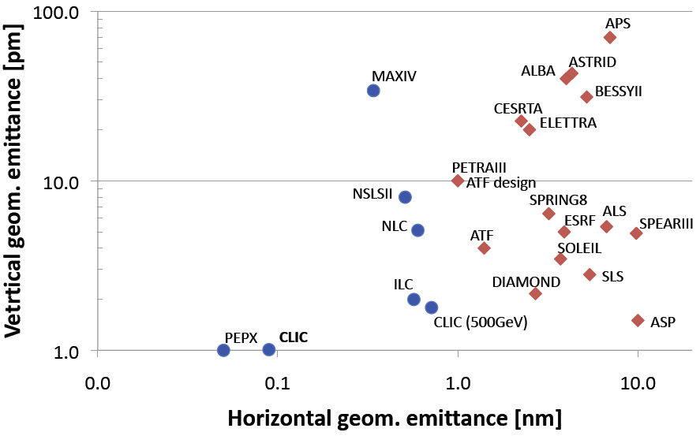
DR: comparison to other projects
CLIC requirements close to new generation synchrotron light sources (Operation- Projects)
CLIC 500 GeV similar as ILC and demonstrated in ATF/KEK (normalized emittance)
CLIC 3 TeV similar as PEPX/SLAC project.
Close collaboration with ATF/KEK (small emittances) and CESRTA/Cornell (electron clouds)

Slide 20
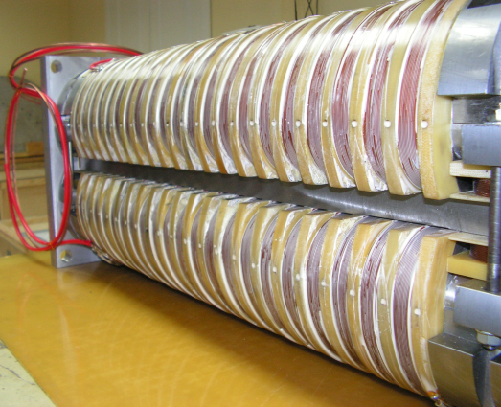
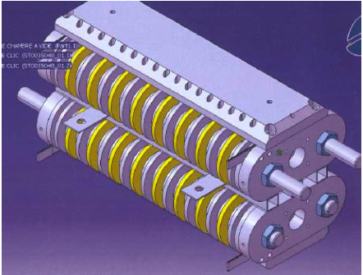
DR technology and experimental program
Parameters | BINP | CERN/Karlsruhe
B_{peak} [T] | 2.5 | 2.8
λ_{W} [mm] | 50 | 40
Beam aperture full gap [mm] | 13 | 13
Conductor type | NbTi | NbSn₃
Operating temperature [K] | 4.2 | 4.2
Super-conducting wigglers
  Demanding magnet technology combined with cryogenics and high heat load from synchrotron radiation (absorption)
High frequency RF system
  1 GHz RF system respecting power
  and transient beam
Coatings, chamber design and ultra-low vacuum
Electron cloud mitigation, low-impedance, fast-ion instability
Kicker technology
  Extracted beam stability
Diagnostics for low emittance
Experimental program set-up for measurements in storage rings and test facilities:
    ALBA (Spain), ANKA (Germany),
    ATF (Japan), CESRTA (USA),
    Synchrotron (Australia),
    SOLEIL (France)..

Slide 21
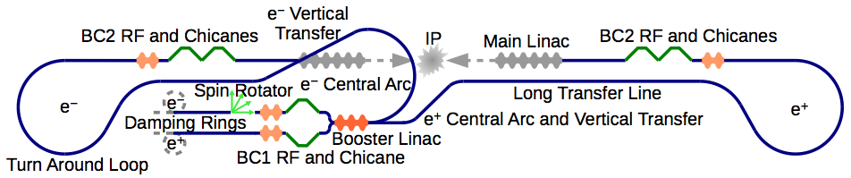
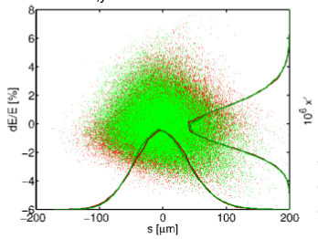
Rings to Main Linac
RTML includes:
BC1 stage: bunch length from 5 mm to 1.5 mm at 2.4 GeV
Booster linac from 2.4 to 9 GeV
Transfer line and turnaround loops
BC2 stage: from 1.5 mm to 44 um
=> max 5 nm vertical emittance growth is allowed
RTML final phase space simulated with ISR, CSR and wake fields effects included
Beam dynamics studies : full start to end simulations including ISR, CSR and wakefields show acceptable emittance growth. Effects of imperfections still under study, but no major issues are expected.

Slide 22
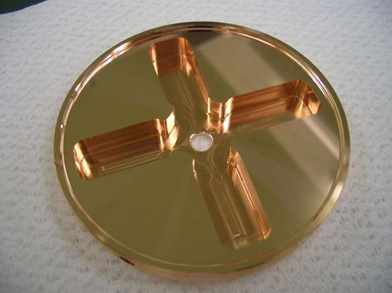
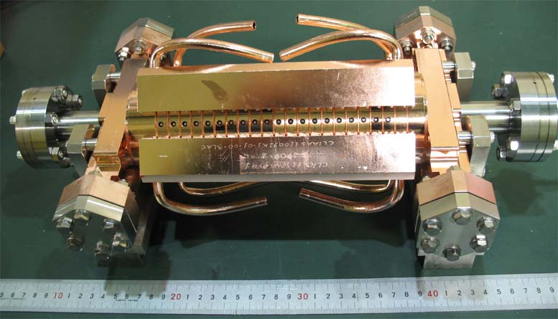
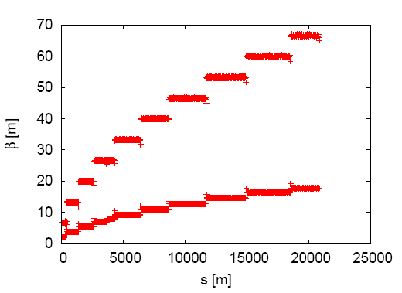
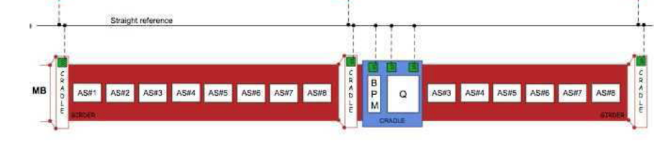

Main Linac
Main linac design and requirement is driven by structures. Requirements :
Gradient: 100 MV/m loaded
Pulse length: 156 (flat top)/240 (full) ns
Break down rate: less than 3x10⁻⁷ breakdowns/pulse/m
Single bunch and multi-bunch wakefield tolerances (< 1 V/pC/mm/m residual wake on second bunch)
Current design : NC Cu, tapered wave-guide damped structures. Constructed in disks, bonded together.
Balances wakes and dispersion :
One 2 m module (girder) has up to 8 acc. structures
Beta function along the main linac

Slide 23
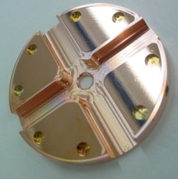
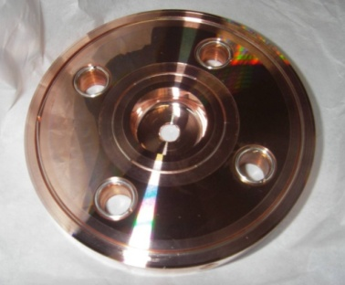
Accelerating structures:
Achieved < nominal Break down
Scaled @ 100 MV/m (unloaded ) Accelerating Gradient and 180 ns pulse length)
New
TD24
T24 – Higher efficiency
T18 – strong tapering
T24 – Higher efficiency
TD18 – waveguide damping
T18 – strong tapering
T18 – strong tapering
TD18 – waveguide damping
T18 (CERN) – strong tapering
log(BDR/m)
in CTF3
CLIC BDR specification
Interrupted by earthquake in Japan – last estimate available

Slide 24
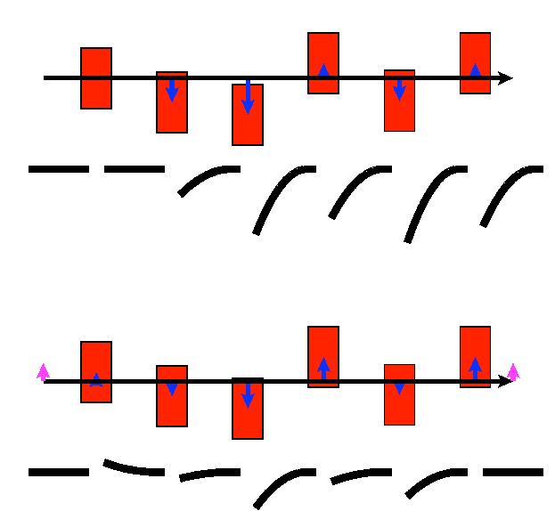
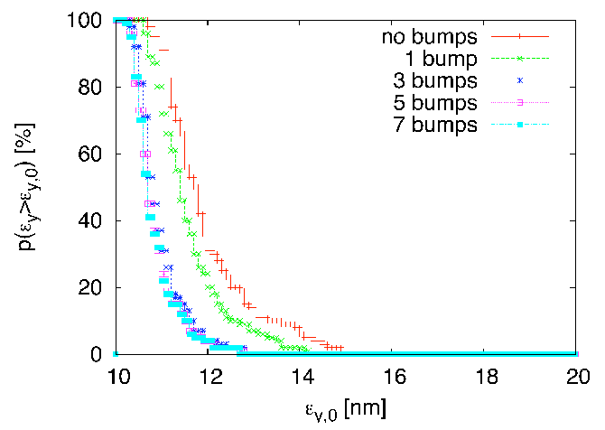
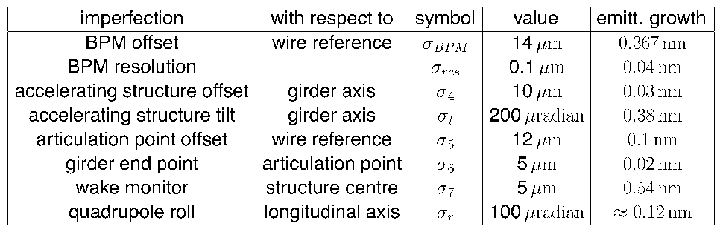
Main linac emittance preservation
Challenge: emittance preservation over 21 km of linac Δε_{y,Ν} <= 10 nm
Tuning strategy :
Beam-based alignment (dispersion-free steering, ballistic algnment)
Wake field compensation using dedicated wake monitors
Luminosity tuning bumps (global corrections)
Structure misalignment before and after wake tuning using wake monitors and girder
Effect on luminosity tuning bumps
Effects on emitt. growth due to misalignment
CLIC main linac design fulfills emittance requirements. Tight, but feasible component specification.

Slide 25
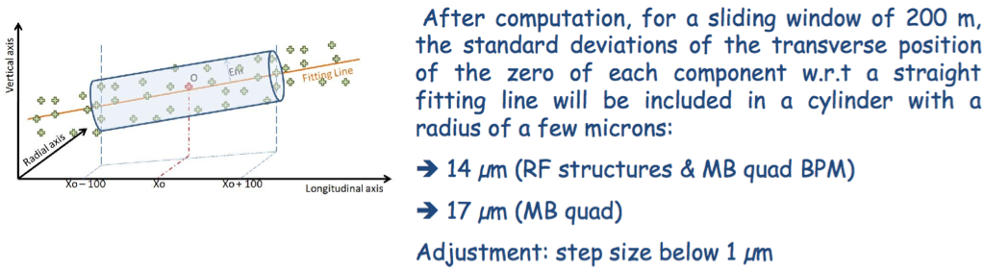
Pre-alignment and stabilisation
Pre-alignment of beam line components :
Rf structures, quadrupoles (main and drive beam)
Wire Positioning System, then independent pre-alignment by movers with respect to wires
Beam stability by quadrupole stabilisation:0.2nm beam-beam stability@IP
  quadrupole passive and active stabilisation
  beam feedback (pulse to pulse) and Intrabeam feedback
Quadrupole Magnets | Horizontal | Vertical
Linac (2600 quads) | 14nm | 1.5 nm
Final Focus (2quads) | 4 nm | 0.5 nm

Slide 26
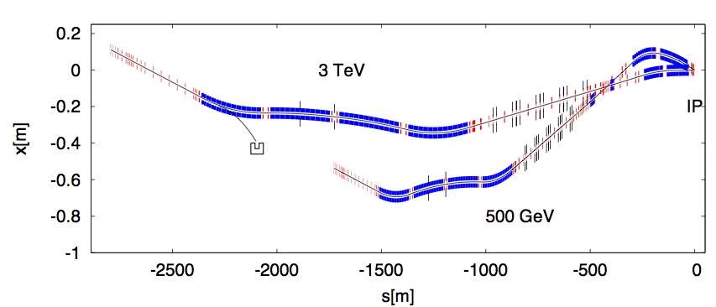
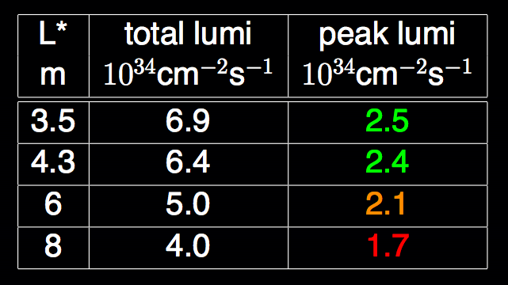
Beam Delivery System
CLIC BDS: focus to a beam spot of σ_{x}=45 nm (β_{x}=10 mm), σ_{y}=1 nm (β_{y}=0.1 mm). Design uses local chromatic correction (proposed by A. Seryi). BDS length depends on E_{cm.}
BDS layout for E_{cm} = 3 TeV and E_{cm} = 0.5 TeV
Nominal L* = 3.5 (QD0 inside detector)
Nominal crossing angle is 20 mrad (crab cavities required )
CLIC BDS study is well advanced. No remaining feasibility issues identified.
Alignment and tuning are considered the biggest challenges

Slide 27
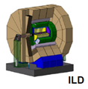
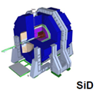
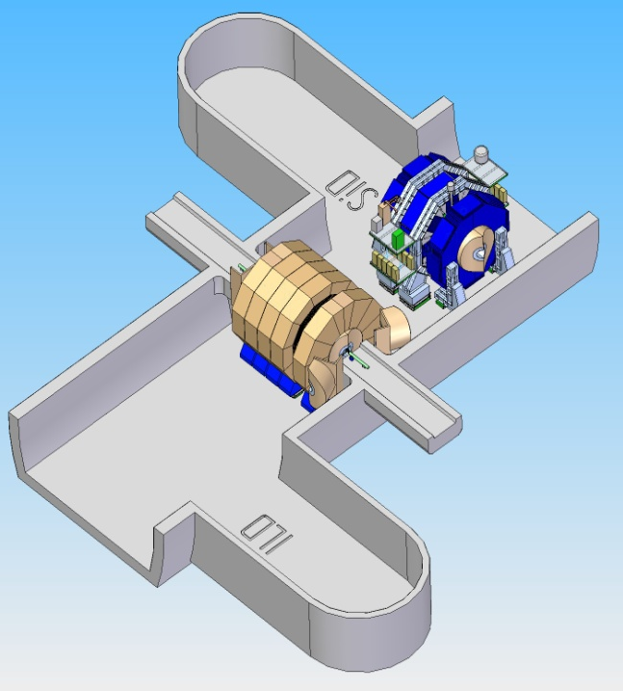
Detectors : derived from ILC
http://www.cern.ch/lcd
Close collaboration with ILC :
CLIC detector concepts based
on validated ILC detectors
Push-pull concept from ILC
Modified to address specific CLIC issues: ILC vs CLIC
  interval between bunches 369 ns vs 0.5 ns
    Time stamping bunch length: 30 mm vs 40 µm
  Multi-TeV operation (beam-beam background)
27

Slide 28
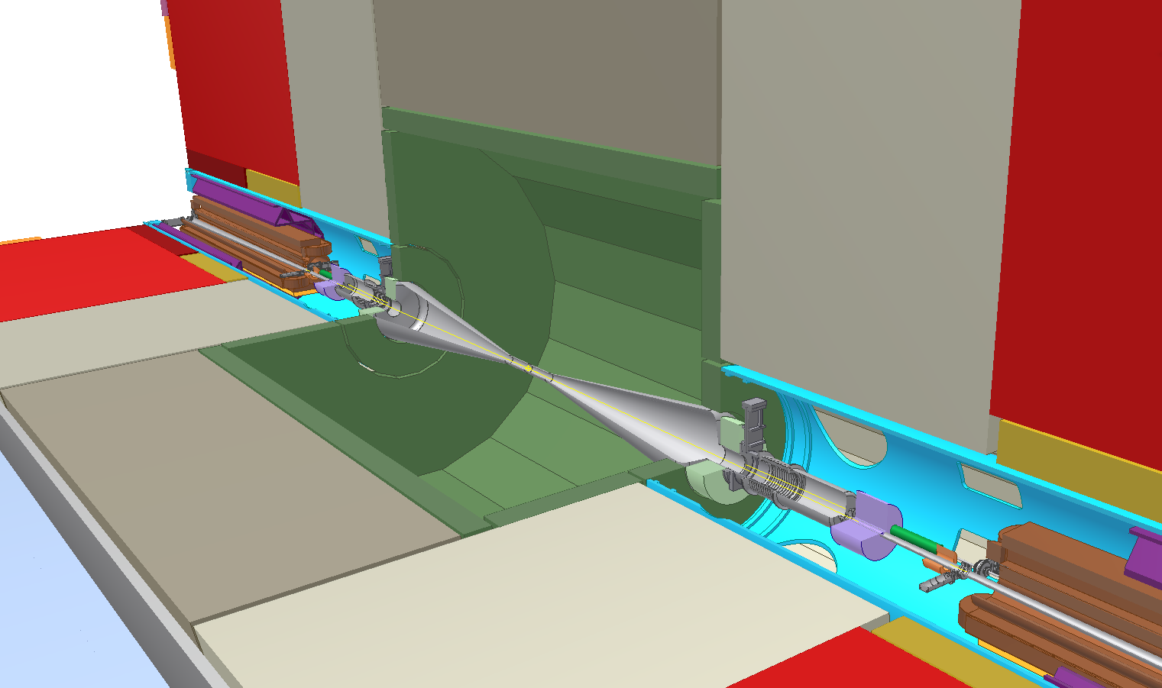
Machine Detector Interface
FD sub-nm jitter tolerance
Intra-train feedback within 150 ns train
Active mechanical stabilization of FD
Anti-solenoid
Lumical
BPM
Spent beam
Beamcal
Integration of QD0 magnets
and IP Feedback systems in IR
Kicker
QD0

Slide 29
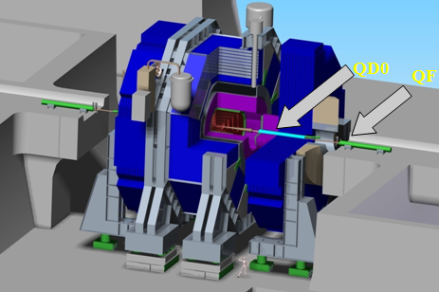
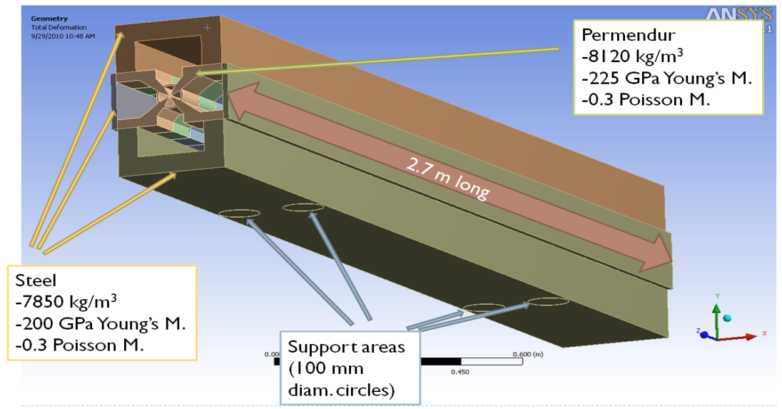
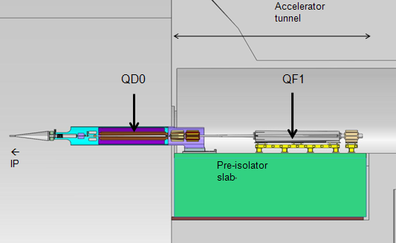
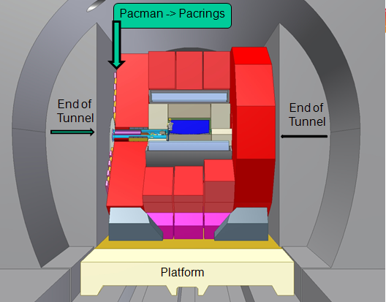
Final doublet integration
QD0 Hybride Permanent
Magnet for high stability
QD0 inside detector
Final doublet on 80 tons isolator
reducing vibrations by factor 30
Supported by cantilever from
tunnel with minimum length

Slide 30
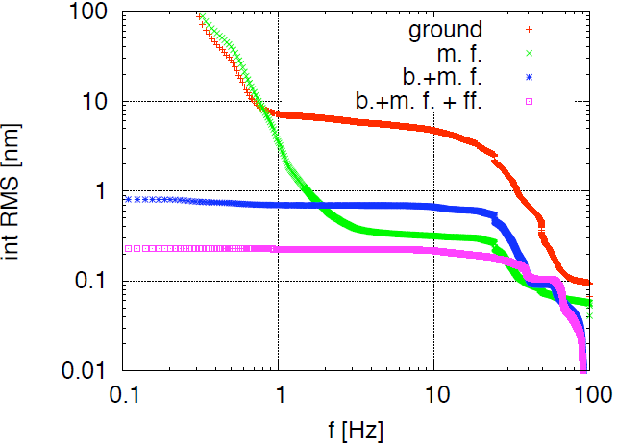
Final doublet stabilisation
Beam
feedback
Mechanical
feedback
Feed forward
CLIC
target

Slide 31
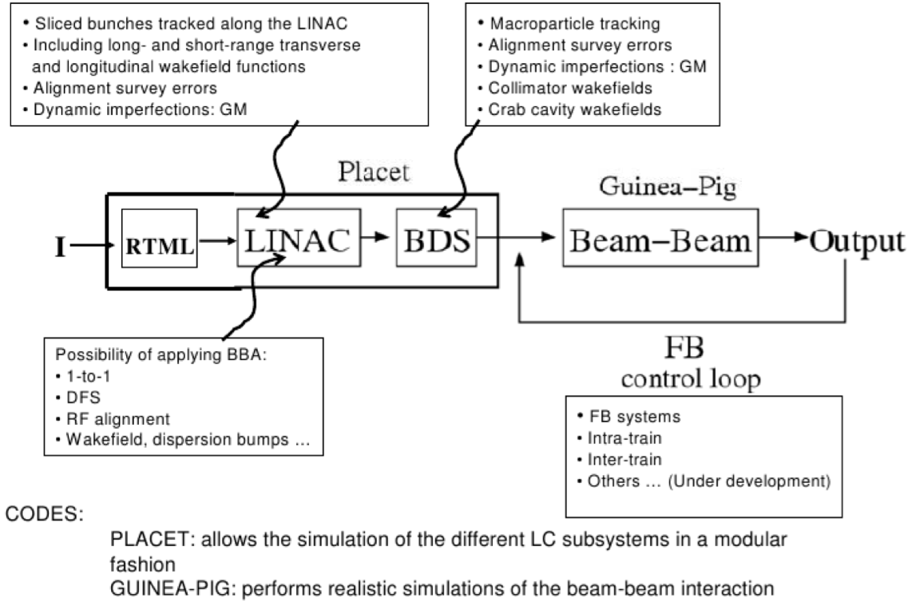
CLIC integrated simulations

Slide 32
Status of CLIC rf power source
Feasibility studies including the CLIC Test Facility

Slide 33
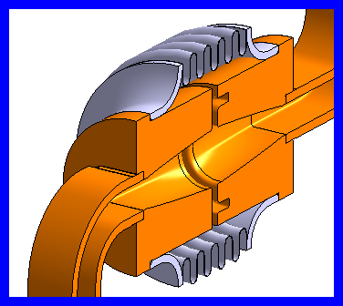
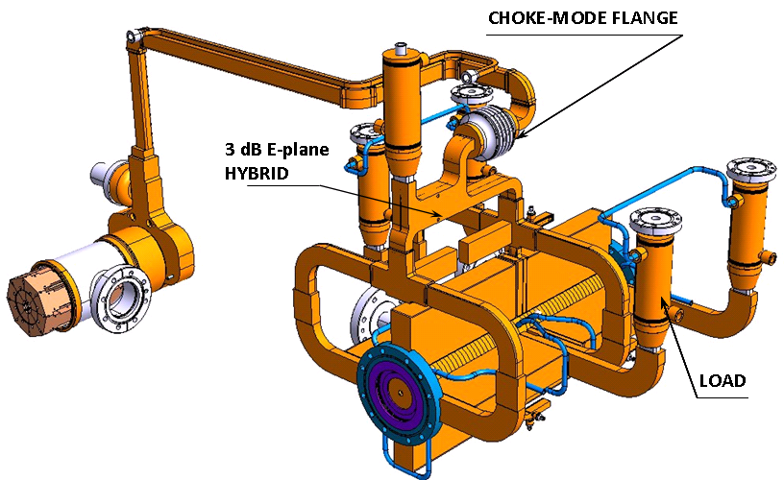
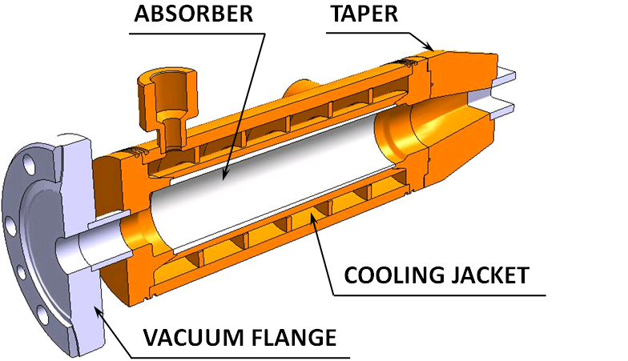
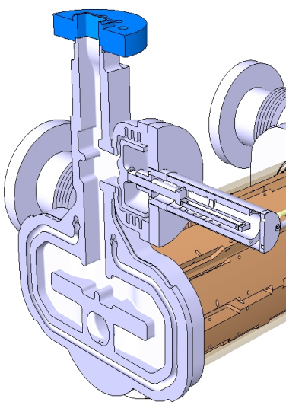
CLIC two-beam acceleration rf network
Waveguide network
high power
precise phase length
PETS
high-power
as short as possible
low longitudinal and transverse impedance
Choke mode flange
independent alignment of main and drive beam
ON/OFF mechanism
On/ramp/off
necessary (?) to react to breakdown and/or failure
Accelerating structure
high-gradient
as long as possible
micron precision
transverse wakefield suppression

Slide 34
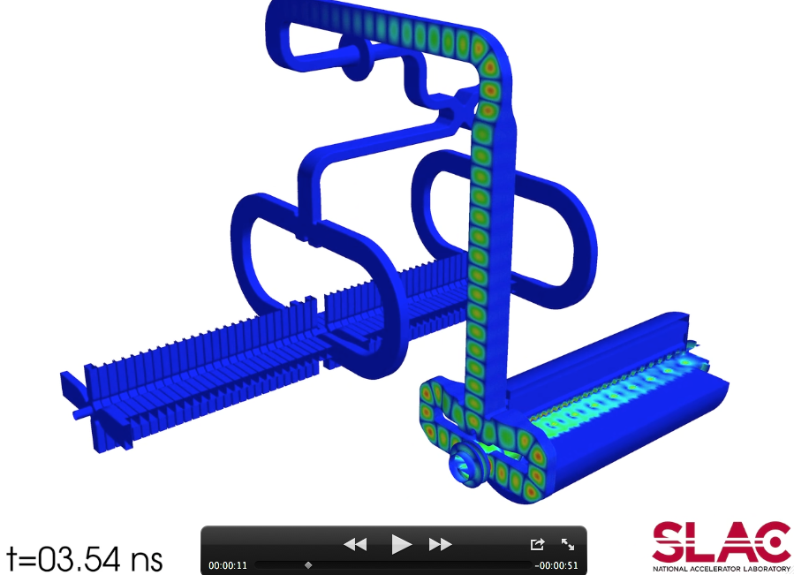
Simulation status: full 3D e.m. simulations
Full 3D FEM simulations of entire drive beam-rf power-main beam chain with SLAC/ACD ACE3P codes (Courtesy of A. Candel, SLAC). Allows for detailed studies of power production efficiency and potential HOM coupling drive beam to main beam.

Slide 35
CLIC versus CLIC Test Facility 3
Drive Beam Accelerator
efficient acceleration in fully loaded linac
Delay Loop × 2
gap creation, pulse compression & frequency multiplication
RF Transverse Deflectors
Combiner Ring × 3
pulse compression &
frequency multiplication
Combiner Ring × 4
pulse compression &
frequency multiplication
CLIC RF POWER SOURCE LAYOUT
Drive Beam Decelerator Section (2 × 24 in total)
Power Extraction
CTF3
Drive beam time structure - initial
Drive beam time structure - final
240 ns
240 ns
5.8 μs
140 μs train length - 24 × 24 sub-pulses
4.2 A - 2.4 GeV – 60 cm between bunches
24 pulses – 101 A – 2.5 cm between bunches

Slide 36

CLIC Test Facility 3 (CTF3) at CERN
CTF3 – Layout
Total length: 140 m
DELAY
LOOP
4 A – 1.2 μs
150 Mev
COMBINER
RING
DRIVE BEAM
LINAC
28 A – 140 ns
150 Mev
CLEX
CLIC Experimental Area
10 m
Two-Beam Test Stand
CLIC Test Facility 3 : designed to test key concept of the two-beam scheme. Main parts :
Drive Beam generation: acceleration in a fully loaded linac with 95 % efficiency and bunch frequency multiplication by a factor x 2 x 4 (from 1.5 GHz to 12 GHz)
Two-Beam Acceleration experiment – reach nominal CLIC gradient and pulse length
Deceleration experiment – heavy deceleration of intense electron beam (>50 %)
Instrumentation tests

Slide 37




CTF3 milestones : drive beam generation
Fully loaded acceleration RF to beam transfer: 95.3 % measured.
No issues found with transverse wakes in structures. Operation is routinely with full loading
Drive beam current stability at the end of the fully loaded linac : better than CLIC specification: 0.75 10⁻³
1.2 us drive beam pulse
Full commissioning of x 4 combiner ring

Slide 38

CLIC Experimental Area - CLEX
* Two Beam Test Stand : all aspect of two beam acceleration
* Test beam line (TBL) : study RF power production and decelerator dynamics, stability & losses
Test Beam Line TBL
Two Beam Test Stand
Probe Beam
Installation completed (2010)
except for all PETS in TBL
Drive and probe beams
in CLEX from June 2008

Slide 39



Two Beam Test Stand
(TBTS) in CTF3
Spectrometers and beam dumps
All hardware installed
Beam in both lines up to end
Commissioning with beam:
PETS 2009,
Two Beam Acceleration 2010->
Experimental area
CTF3 drive-beam
CALIFES probe-beam
Notes:
39

Slide 40



2010 two-beam acceleration : 106 MV/m
December 14, 2010:
Probe beam accelerated by
23 MV in a TD24 accelerating structure, corresponding to a gradient of 106 MV/m, in a reproducible way.
PETS power input to structure ~ 80 MW (~200 MW in the resonant loop)
Drive beam: 12.5 A, 113 MV, 12 GHz in CLEX (1.5 GHz beam combined factor 8), 140 ns pulse length
Probe beam: 0.08 A, 173 MV, 1.5 GHz, 8 ns pulse length

Slide 41




Two-beam Test Stand results 2011
2011 : CTF3 TBTS running for full after winter shut-down. Gradients of 110 – 120 MV/m are routinely reached (20% above CLIC target).
Rf power in PETS routinely reaches 300 MW (two times the CLIC target)

Slide 42




The CLIC decelerator
Decelerator: Transports the 101A, 2.4 GeV CLIC Drive Beam,extracting more than 80% of the energy
1 km
The drive beam is decelerated to 10% energy. The high energy transient must be equally well transported to the end of each 1 km decelerator.

Slide 43





Decelerator Test Beam Line
Test Beam Line: Transport of the 28A, 150 MeV CTF3 Drive Beam, while extracting more than 50% of the energy using 16 PETS, each producing CLIC level rf power, with small loss level.
Current status: 4 out of max. 16 PETS (> 50% deceleration) are currently installed. End of year: 8 PETS.
Beamline/optics almost fully commissioned
PETS power production as expected.
Energy before TBL / after TBL
2011 deceleration measurements: 7 MeV deceleration (stable beam transport)

Slide 44
Part IV) Summary and conclusions

Slide 45
CLIC Tentative Schedule
Final CLIC CDR & prop.
Project Preparation Phase
(PPP) @ European Strategy
European Strategy
for Particle Physics
@ CERN Council
Draft Conceptual
Design Report(CDR)
(Acc.&Det.) to SPC
Project Implementation
Plan (PIP) & proposal
for next phase

Slide 46
Conclusions
Conceptual Design Report (End 2011):
  CDR study well advanced for all parts of the CLIC machine. All identified feasibility issues will be adressed.
  Vol1&2 describing machine technical design optimized at 3 TeV (most demanding) and corresponding Physics scaled down at intermediate energies
  Vol3 for information to European Strategy for PP (mid 2012) indicating by Spring 2012 the CLIC cost in an energy band including 500 GeV up to an intermediate energy (1 to 2 TeV?) consistent with Physics needs deduced from LHC results as known at the time.
Anticipating CLIC CDR conclusions @ end 2011
  CLIC novel technology although challenging demonstrated to be feasible up to 3 TeV and therefore allows to extend LC into Multi-TeV energy range
  Realistic extension in energy and luminosity will certainly be limited by practical considerations like power consumption or cost
Next CLIC phase: 2012-2016
  Reviewed for adaptation to Physics needs deduced from LHC results
  R&D focused on Performance optimisation with Cost and Power consumption mitigation, Transfer to Industry & Industrialisation
  Preparation of a Project Implementation Plan (PIP)

Slide 47
We are seeking collaboration with you!
CLIC already has very fruitful collaboration with ILC
First joint CLIC & ILC workshop (October 18-22/2010 @ CERN) > 500 participants (acc. + detec.)
Next Linear Collider Workshop (LCWS11):September 26-30/2011@Granada
We are equally interested in identifying subjects of collaboration with great synergy between the CLIC and Muon Collider studies
Let us use make us of this workshop as a good occasion for this, and do not hesitate to contact the following persons for collaboration in the future :
  Roberto Corsini, CLIC/CTF3 collaboration spokesperson
  Steinar Stapnes, CERN Linear Collider Study Leader
  Ken Peach, CLIC/CTF3 board chairman
http://clic-study.org/

Slide 48
Spares

Slide 49
Accelerating Structure Performances
World record
RF to beam efficiency
World record
Accelerating Gradient
World record
Accelerating Gradient
Multicell Structures
(no damping yet)

Slide 50




Achieved results to prototype CLIC structure
T18 test structure
CLIC prototype
Notes:
50

Slide 51


CLIC performances (FoM) and cost (relative) as a function of the accelerating gradient
E_{cms} = 3 TeV L_{(1%)} = 2.0 10³⁴ cm⁻²s⁻¹
Figure of Merit
Performance
Cost
New
Previous
New
Optimum
Previous
Performances increasing with lower accelerating gradient (mainly due to higher efficiency)
Flat cost variation in 100 to 130 MV/m with a minimum around 120 MV/m

Slide 52


CLIC performances (FoM) and cost optimisation as function of RF frequency
E_{cms} = 3 TeV L_{(1%)} = 2.0 10³⁴ cm⁻²s⁻¹
Performance
Cost
New
Optimum
Previous
New
Optimum
Previous
Maximum Performance around 14 GHz
Flat cost variation in 12 to 16 GHz frequency range with a minimum around 14 GHz

Slide 53
LC 500 GeV Main parameters
Centre-of-mass energy | NLC 500 GeV | ILC 500 GeV | CLIC 500 G Relaxed |  | CLIC 500 G Nominal
Total (Peak 1%) luminosity | 2.0(1.3)·10³⁴ | 2.0(1.5)·10³⁴ | 0.9(0.6)·10³⁴ |  | 2.3(1.4)·10³⁴
Repetition rate (Hz) | 120 | 5 | 50
Loaded accel. gradient MV/m | 50 | 33.5 | 80
Main linac RF frequency GHz | 11.4 | 1.3 (SC) | 12
Bunch charge10⁹ | 7.5 | 20 | 6.8
Bunch separation ns | 1.4 | 176 | 0.5
Beam pulse duration (ns) | 400 | 1000 | 177
Beam power/linac (MWatts) | 6.9 | 10.2 | 4.9
Hor./vert. norm. emitt (10⁻⁶/10⁻⁹) | 3.6/40 | 10/40 | 7.5 / 40 | 4.8 / 25
Hor/Vert FF focusing (mm) | 8/0.11 | 20/0.4 | 4/0.4 | 4/0.1
Bunch length (microns) | 100 | 300 | 100 | 72
Hor./vert. IP beam size (nm) | 243/3 | 640/5.7 | 248 / 5.7 | 202/ 2.3
Soft Hadronic event at IP | 0.10 | 0.12 | 0.07 | 0.19
Coherent pairs/crossing at IP | 10? | 10? | 10 | 100
BDS length (km) | 3.5 (1 TeV) | 2.23 (1 TeV) | 1.87
Total site length (km) | 18 | 31 | 13.0
Wall plug to beam transfer eff. | 7.1% | 9.4% | 4.1%
Total power consumption MW | 195 | 216 | 240

Slide 54


Operation & Machine Protection System
Issues: Main beam: 2*14 MW @ 1.5 TeV (50Hz)
        Drive Beams: 2*70 MW @ 2.4 GeV (50Hz)
Protection strategy: Static protection by construction (2 ms)
  Next cycle permit system (from LHC)
  Post cycle analysis
Taking advantage of LHC experience !
Great synergy with ILC main beam (11MW @ 500GeV)
Common reflection on reliability & availability

Slide 55


Slide 56





MBQ Stabilisation Feasibility
Stabilisation two degrees of freedom with MBQ type 1 mass (100kg): “quadriped”
Specification:
1.5 nm@ 1 Hz
Achieved (in lab):
Vertical 0.9 nm @ 1 Hz
2.5 kg
Main linac Quad.
specification
Simultaneous
vertical and lateral
stabilisation

Slide 57



Nanometer Stabilisation
CLIC small quadrupole stabilized
to nanometer level by active
damping of natural floor vibration
Vibration test stand

Slide 58








PETS ON/OFF CONCEPT WITH EXTERNAL COMMUTATION & INTERNAL RECIRCULATION
PETS coupler design with integrated RF reflector
Reflection=0 dB
ON
ON
Power attenuation vs. piston position
(full reflection in OFF position)
OFF
-1 dB
Stroke 7.7 mm
-3 dB
-6dB
OFF, full
Components under construction
High power tests of components & concept validation (slow movement, external reflector at input coupler)
from summer 2011 in the TBTS PETS
Stroke 7.7 mm
ON
PETS output (steady state)
0.26
Structure input
OFF, full

Slide 59

Accelerating structures:
Achieved >100 MV/m Accelerating Gradient
( Fruitful collaboration CERN-KEK-SLAC
conditioning
time [hr]
T18 – strong tapering
1400
T18 – strong tapering
3900
T18 – strong tapering (now with recirculation)
280
T18 – strong tapering (CERN built)
550
TD18 – waveguide damping
1300
TD18 – waveguide damping
3200
T24 – high efficiency
600
T24 – high efficiency
Interrupted by earthquake in Japan
1570
Unloaded gradient (MV/m) scaled at 4*10⁻⁷ BDR and 180 ns pulse length

Slide 60
Why 100 MV/m at 12 GHz?

Slide 61





Prototype accelerating structure test areas
Nextef at KEK
NLCTA at SLAC
ASTA at SLAC
Two-beam test stand at CERN
New klystron at CERN

Slide 62




Two Beam Module tests in CTF3/CLEX
A. Samoshkin
Integration of test modules for tests with beam in CLEX
2012-132
Integration of all technical systems for tests without beam in laboratory: 2010-11
Test module representing all module types & integrating all various components: RF structures, quadrupoles, instrumentation, alignment, stabilization, vacuum, etc
G. Riddone
62

Slide 63






Standard tunnel
with modules
Tunnel integration &
Conventional Facilities
5.6m tunnel diameter
‘standard’ metro diameter in Europe
Space for power converters & other services
CV pipes now isolated via compressible filler
Transversal ventilation adopted for CDR
DB turn-around
DB dump
UTRA
cavern
63

Slide 64


Tunnel implementation
(laser straight)
Central Injector complex
Central MDI & Interaction Region

Slide 65
Relative cost of Linear Colliders
Additional CLIC offset
due to drive beam injectors
Reduced CLIC cost/GeV due to
- reduced tunnel length (by 4)
- reduced equipment per meter of tunnel

Slide 66

CLIC crossing angle
10 mrad half crossing angle

Slide 67
Req. Beam dynamics:
5.8 mm diameter minimum average aperture (short range transverse wake)
< 1 V/pC/mm/m long-range transverse wakefield at second bunch (approximately x50 suppression).
Req. Rf
E_{max,surf} < ~ 250 MV/m
Pulsed surface heating: ΔT < ~30 K
global power flow
local complex power flow

Slide 68

Planned kick and break down measurements
Andrea Palaia et al. Uppsala University

Slide 69


CTF3+ : first update plans (2012)
First upgrade of CTF3 two-beam acceleration test: adding one full CLIC-type module, in addition to TBTS.
Realistic beam tests of a module with all relevant components in CLEX.
Next step after this: 3 CLIC modules chained together
Then: N CLIC modules

Slide 70

CTF3+ : future plans
Second upgrade of CTF3 two-beam acceleration tests: adding two more CLIC-type modules
Clear goal: realistic beam tests of different modules (type 0 and type 1) + interconnections.
Optics: aperture limitations now start to become more challenging
Power: drive beam limitations, (25/100)^2 ~ 1/16 is still a challenge

Slide 71
HEP Electron/Positron Colliders
CLIC/SLC energy = 20
CLIC/SLC luminosity = 10⁴

Slide 72
Conclusion
Conceptual Design Report (End 2011):
  Vol1&2 describing machine technical design optimized at 3 TeV (most demanding) and corresponding Physics scaled down at intermediate energies
  Vol3 for information to European Strategy for PP (mid 2012) indicating by Spring 2012 the CLIC cost in an energy band including 500 GeV up to an intermediate energy (1 to 2 TeV?) consistent with Physics needs deduced from LHC results as known at the time.
Anticipating CLIC CDR conclusions @ end 2011
  CLIC novel technology although challenging demonstrated to be feasible up to 3 TeV and therefore allows to extend LC into Multi-TeV energy range
  Realistic extension in energy and luminosity will certainly be limited by practical considerations like power consumption or cost
Next CLIC phase: 2012-2016
  Reviewed for adaptation to Physics needs deduced from LHC results
  R&D focused on Performance optimisation with Cost and Power consumption mitigation, Transfer to Industry & Industrialisation
  Preparation of a Project Implementation Plan (PIP)

Slide 73
Tentative CLIC Post-CDR phase(s)
2011-2016 – Project Preparation phase
Goal: preparation of a (staged) Project Implementation Plan (PIP) at reviewed energy and luminosity (taking into account results of CDR and based on Physics requests as soon as available…) :
  - technical developments & test of critical component prototypes in upgraded facilities
  - Machine/Detector interface and Detector developments -
  - Site studies , Organisation and Governance
After 2016 – Project Implementation phase
Goal: Lay the grounds for full approval and preparation of the technical documentation needed for moving into (staged) construction following Physics requests (should be known by the time….)
    - Industrialisation & pre-series production of large series components with validation facilities
  - Detector&physics studies with emphasis on technical coordination issues&integ.
    - Project Implementation Plan (PIP) update, following staging strategy and detailed resource discussion with all partners

Slide 74

CLIC critical parameters

Slide 75
CLIC Feasibility status

