Slide 1
OFFICE OF SCIENCE
Report from DOE
June 2, 2011
Glen Crawford
Director, Research and Technology R&D
Office of High Energy Physics
Office of Science, U.S. Department of Energy

Slide 2
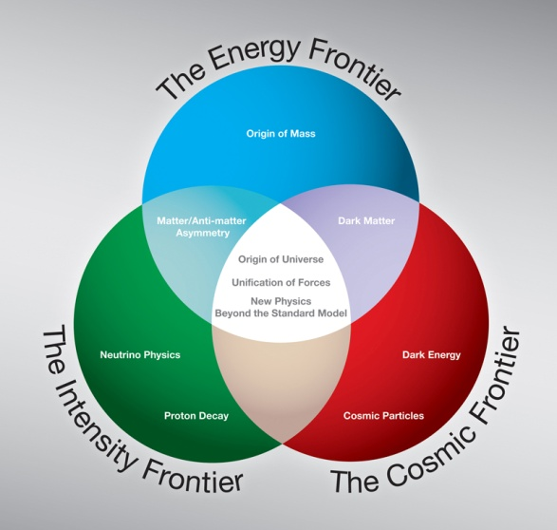
HEP Strategic Plan
Plan is based on High Energy Physics Advisory Panel “P5” report
This is still the plan.
Implementation at the Energy and Cosmic Frontiers is clear
LHC (+upgrades)
Dark Matter + Dark Energy
Implementation at the Intensity Frontier has been more challenging.
Funding levels at lower end of P5 Scenarios
CR uncertainties + “no new starts”
DUSEL difficulties

Slide 3
BudgetS

Slide 4
History of the Energy and Water Development Appropriation
FY 2011 – a new record!
The budget uncertainty associated a significant delay in the appropriation creates havoc with agency planning.

Slide 5
FY 2011 Funding Status
($M) | FY 2010 Actual | FY 2011 Request | FY 2011 CR | FY 2011 Approp. | FY2012 Request
HEP | 810 | 829 | 800 | (tbd) | 797
SC | 4,789 | 5,130 | 4,826 | 4,884* | 5,418
We were operating under a CR for over 6 full months .
We were below the FY 2010 level, since the CFO held back the funds for engineering design for Mu2e and LBNE. They are considered new starts.
Final distribution of FY2011 funding for Office of Science not yet determined
Expect final FY11 HEP budget to be very close to FY11 CR level
“No new starts” held in FY11 Appropriation
*Does not include reductions for 0.2% rescission, $16M contractor pay freeze, and unobligated Prior Year funds

Slide 6
Working under the CR
HEP formulated a plan for the $799,500,000.
We made a financial plan for the laboratories much like a normal year.
Attempted to avoid any dire impacts until the FY11 Appropriation was known
HEP is holding minimal reserves at this point.
Very limited ability to respond to problems or supplemental requests
Several Intensity Frontier projects (MicroBooNE, Mu2e, and LBNE) are considered new starts and are not receiving any equipment funding, including engineering design
Mu2e was instructed by HEP to slow work to avoid a gap in funding.
LBNE has been slowed down due to dealing with the DUSEL situation (more on this later)
We are working to try to mitigate impacts of the extended CR but these projects will inevitably experience some delays.
These delays will be exacerbated if there is another CR in FY2012.
Now pushing to get remaining FY11 funding out as soon as possible.

Slide 7
The High Energy Physics Budget Request
Description | FY 2010 | FY 2011 Request | FY 2011 March | FY 2012 Request | FY12 vs FY10
Proton Accelerator-Based Physics | 438,369 | 439,262 | 439,462 | 412,707 | -25,662
Electron Accelerator-Based Physics | 30,212 | 24,707 | 20,805 | 22,319 | -7,893
Non-Accelerator Physics | 97,469 | 88,539 | 88,539 | 81,852 | -15,617
Theoretical Physics | 68,414 | 69,524 | 68,024 | 68,914 | 500
Advanced Technology R&D | 156,347 | 189,968 | 173,346 | 171,908 | 15,561
Construction | 0 | 17,000 | 0 | 39,500 | 39,500
Total, High Energy Physics | 790,811 | 829,000 | 794,078 | 797,200 | 6,389
FY 2010 appropriation including SBIR/STTR was $810 million, so the FY 2012 request is a reduction of $13 million from FY 2010.

Slide 8
Funding Trends
HEP is now between the HEPAP/P5 “A” and “B” scenarios.
Funding FY 2009-2011: Program workforce and scope largely preserved – implementation slow
Funding FY 2012 Target: Workforce will be downsized and the program de-scoped; cannot maintain leadership program at all 3 frontiers
Scenario B (FY07 + COL)
Scenario A (FY08 + COL)

Slide 9
The Difficulties of Forecasting
General, bipartisan support for Science
Administration has also made this a priority
However, Administration priorities within Science are elsewhere:
Clean energy
Renewables
Advanced IT
Budget climate not conducive to increases in any discretionary spending area.

Slide 10
SC and HEP Funding Trends

Slide 11
HEP Major Changes in 2012
The Tevatron will not run in FY 2012. The proton accelerator complex will run for 6 months to support the neutrino program.
Funding goes from $126 million in FY 2010 to $103 million in FY 2012.
The complex will then shutdown to install the accelerator upgrade components of NOvA.
Beam power will go from 400kW to 700kW.
The NOvA Project is now in the ramp down portion of its profile.
From $59 M in FY 10 to $41 M in FY 12.
First detector modules will be installed in FY 2012. Completion is expected in 2013.
Future Complex R&D is increased to support the development of new ideas to improve the complex.
The accelerator complex is over 40 years old and the portion of the complex that accelerates protons to 8 GeV is mostly the original equipment.
From $6.6M in FY 10 to $15M in FY 12 for R&D on a superconducting proton linac.
LHC support is decreased by $6.8 M as the LHC Accelerator Upgrade project is completed.
There is $10 M in the other facilities category to support the Homestake mine, while decisions are made on whether DOE can use the mine for the SC program.

Slide 12
SELECT PROGRAM HIGHLIGHTS

Slide 13
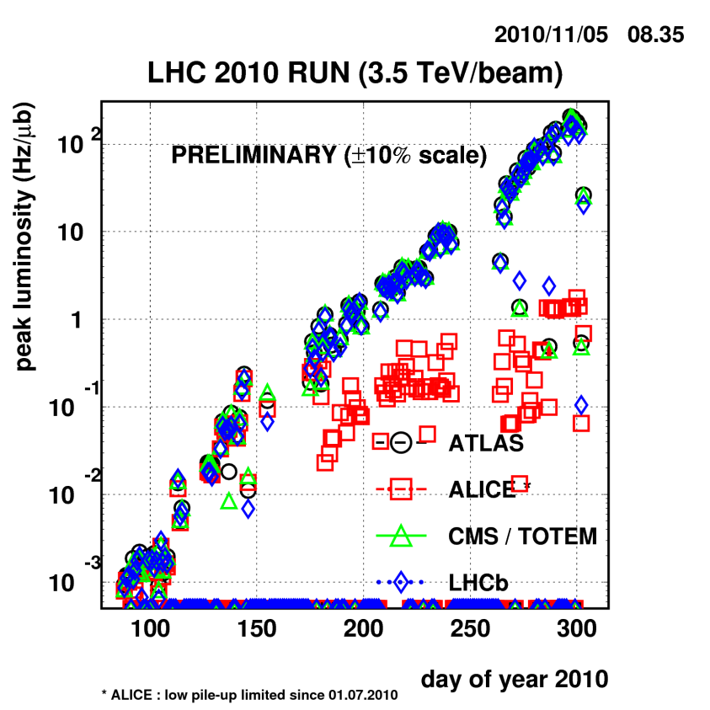
Energy Frontier: Transitioning
Tevatron Program
The machine is running the best that it ever has.
FY 2012 Request supports completion of the analyses
with the full data sets.
Computing operations at Fermilab and universities.
Support of researchers
LHC Program
Performance in 2010 improved dramatically.
5 orders of magnitude improvement;
First SUSY limits already better than the Tevatron limits.
The LHC will run through 2012, then 18 month shutdown
Expect another factor of 10 improvement in luminosity.
At the threshold of discovery (?)
Already 3σ+ evidence for new physics … will it hold up?

Slide 14
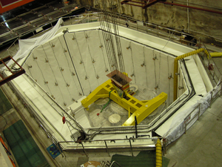
Intensity Frontier Status (non-Fermi version)
The Daya Bay Reactor Neutrino Experiment is second only to the LHC as a major US HEP offshore investment.
The scientific result is critical to the future of the Intensity Frontier program
First antineutrino detectors completed (above left) and being installed now
China contributes about 50% of detectors and all of civil construction
Initial commissioning in 2011 and full operations in 2012

Slide 15
Intensity Frontier: Homestake Mine
The Office of Science has an interest in three experiments that had been planned for DUSEL.
Long Baseline Neutrino Experiment
Dark Matter
Neutrinoless Double Beta Decay
The Office of Science has started a review process to determine if any of these can be carried out in a cost effective manner at the Homestake Mine.
Stakeholders were informed of the review process at the end of February.
Review committee met at SLAC in April and visited Homestake
Co-chairs briefed B. Brinkman on findings June 1
Final Report due June 15
The FY 2012 request includes $15 million to keep the Homestake Mine viable while decisions are made. (HEP $10 M, NP $5 M)
Review process will inform the FY 2013 request.

Slide 16
Cosmic Frontier Status
The Dark Energy Survey Project is nearing completion and will begin operations in FY 2012.
The Particle Astrophysics Scientific Assessment Group, HEPAP subpanel, made several recommendations.
Fund the High Altitude Cerenkov Array (HAWC) in all funding scenarios.
Will be done in partnership with NSF.
FY 2012 request includes an MIE start of $1.5 million of a total $3 million.
Pursue R&D on at least two technologies to search for dark matter.
Dark matter searches are very sensitive to backgrounds.
Need to demonstrate excellent background rejection before choosing a technology.
FY 2012 request includes $3 million for R&D on the technologies.
Ground-based Dark Energy: Mission Need Statement signed by the Director of the Office of Science for a “Stage IV” experiment.
Working to coordinate LSST project planning with NSF.
Space-based dark energy : JDEM R&D will be closed out this year.
NASA has the lead on WFIRST. We continue to talk with them.

Slide 17
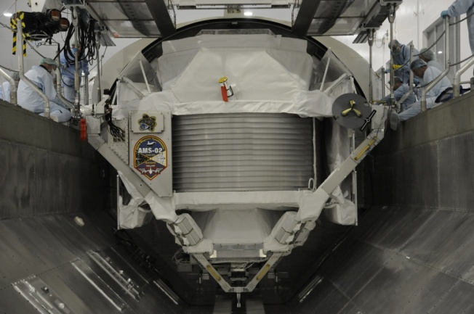
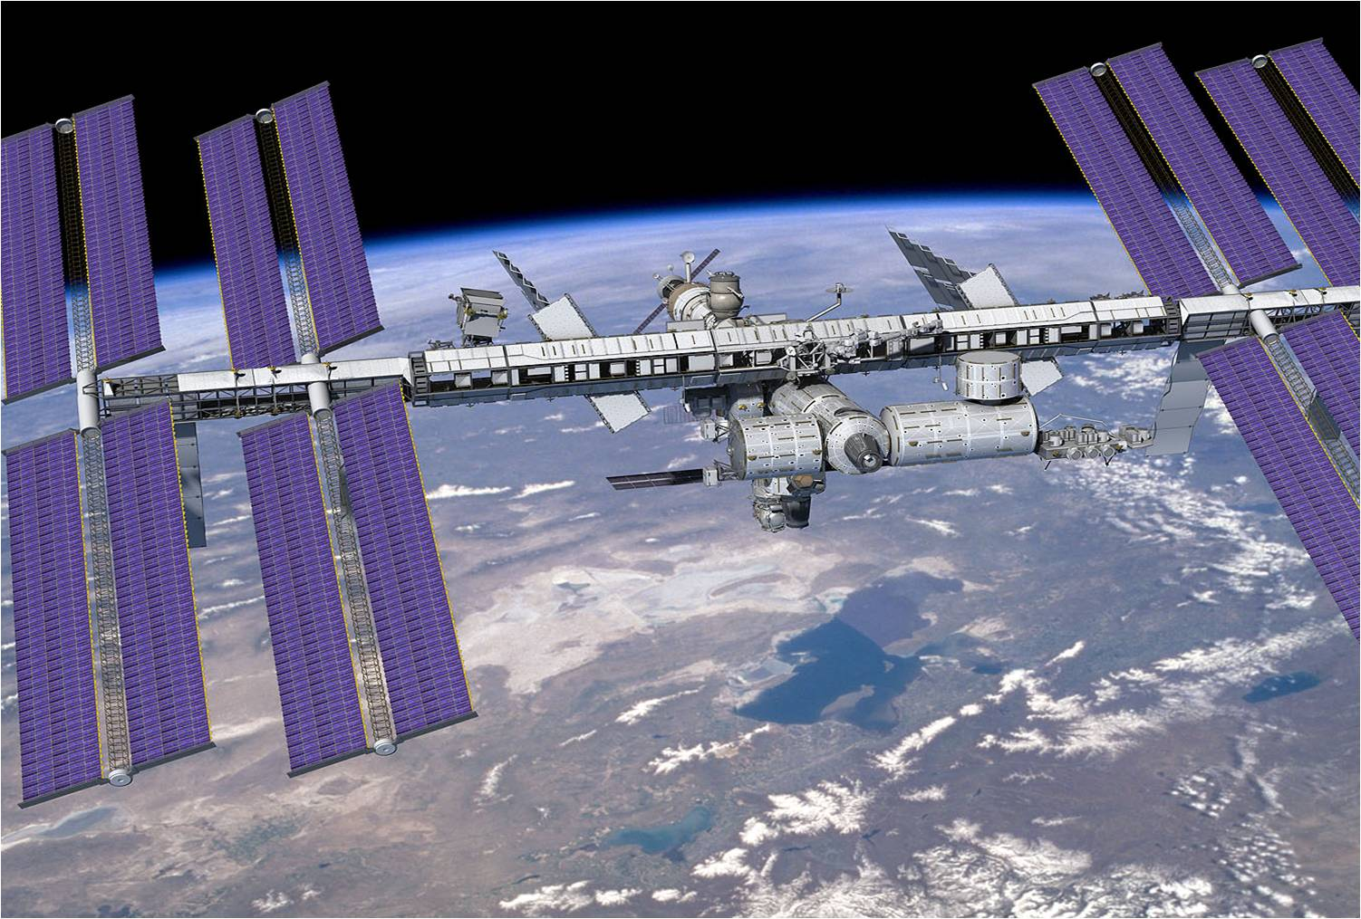
New Frontiers?
Latest $B international science project: AMS-02
Large and bold ideas are still achievable
Need a clear vision and tenacity
We hope for discoveries at LHC/Tevatron that will point to next steps at the Energy Frontier
Similarly, neutrino experiments currently underway will inform future directions at the Intensity Frontier

Slide 18
Office News

Slide 19
Personnel Changes
Dennis Kovar retired at the end of year.
Mike Procario been acting as Associate Director for HEP since January.
A search for a new AD is in progress.
Positions filled:
New program managers in Computational HEP, Theory, LHC Operations (2 Feds, 1 IPA)
We have also hired a new financial analyst.
Moving paperwork for an additional IPA
Departures:
Experienced managers in Computational HEP, Theory, LHC Operations (1 IPA, 1 detailee)
We were unable to fill a federal position for a program manager in accelerator science. We have re-advertised, closes June 3.
We are still seeking another IPA or detailee to work in accelerator science and on the accelerator R&D strategic plan.
HEP Committee of Visitors (2010) reiterated the need for additional program staff

Slide 20
Search for a New Associate Director
The search is being headed by Patricia Dehmer, Deputy Director for Programs, Office of Science.
Nominations were solicited from the field.
Those nominated have been contacted by Dr. Dehmer and asked to apply.
The posting for the position opened March 10th and closed May 10th.
A panel of three SES members from inside and outside the Office of Science will review all of the applications, and this panel will put forward the top candidates. Typically 4 to 8 candidates are put forward.
There will be interviews with a team from HEP and Feds from outside HEP. The interview process may also include a presentation by each candidate to the HEP (as well as others in SC) staff.
Dr. Brinkman will approve the selection.
According to the rules set down by the Office of Personnel Management, a decision must be made within 90 days of the close of the posting – or about Aug 9th.
Still needs several levels of approval after SC decision

Slide 21
BACKUP

Slide 22
Cross cuts
By function
By program

Slide 23
Intensity Frontier: Construction Status
Description | FY 2010 | FY 2011 Request | FY 2011 Feb | FY 2012 | FY12 vs FY10
Construction | 0 | 17,000 | 0 | 39,000 | 22,000
Mu2e (PED) | 0 | 5,000 | 0 | 22,500 | 17,500
MU2e (OPC) | 4,777 | 5,000 | 6,467 | 7,500 | 4,777
Long Baseline Neutrino Experiment (PED) | 0 | 12,000 | 0 | 17,000 | 5,000
Long Baseline Neutrino Experiment (OPC) | 14,178 | 0 | 2,750 | 7,000 | -7,178
Both projects had their first request for PED funds in FY 2011. No funds have been approved in FY 2011.
Work on both projects has been slowed to prevent a gap in funding.
Experience in FY 2008 when the NOvA project lost funding has shown that it takes 6 to 9 months to rebuild a project team after dispersing them.
It is better to slow work and keep a core team together.
The FY 2012 request includes OPC funding for both projects to prevent a funding gap in case there is a CR at the beginning of FY 2012.

Slide 24
Proton Accelerator Based Research
Description | FY 2010 | FY 2011 Request | FY 2011 Feb | FY 2012 | FY12 vs FY10
Proton Accelerator Based Physics | 438,369 | 439,262 | 441,823 | 412,707 | -25,662
Research | 125,743 | 130,299 | 130,419 | 127,696 | 1,953
Facilities | 312,626 | 308,963 | 311,404 | 285,011 | -27,615
Proton Accelerator Complex Operations | 125,945 | 123,215 | 135,830 | 103,374 | -22,571
Proton Accelerator Complex Support | 13,001 | 16,617 | 11,760 | 12,462 | -539
Proton Accelerator Facility Projects | 86,591 | 74,463 | 73,137 | 76,740 | -9,851
Current Facility Projects | 79,998 | 59,220 | 63,437 | 61,740 | -18,258
NOvA | 59,000 | 46,220 | 46,220 | 41,240 | -17,760
MicroBooNE | 2,043 | 8,000 | 8,000 | 6,000 | 3,957
Mu2e | 4,777 | 5,000 | 6,467 | 7,500 | 2,723
LBNE | 14,178 | 0 | 2,750 | 7,000 | -7,178
Future Facility R&D | 6,593 | 15,243 | 9,700 | 15,000 | 8,407
Large Hadron Collider Support | 79,511 | 84,033 | 78,818 | 72,761 | -6,750
Other Facilities | 7,578 | 10,635 | 11,859 | 19,674 | 12,096

Slide 25
Electron Accelerator-based Physics
 | FY 2010 | FY 2011 Request | FY 2011 February | FY 2012 | FY 2012 – FY 2010
Electron Accelerator-Based Physics | 30,212 | 24,707 | 24,707 | 22,319 | -7,893
Research | 15,263 | 14,927 | 14,927 | 13,069 | -2,194
Grants Research | 5,959 | 6,337 | 6,692 | 5,192 | -767
National Laboratory Research | 9,278 | 8,565 | 8,235 | 7,877 | -1,401
University Service Accounts | 26 | 25 | 0 | 0 | -26
Facilities | 14,949 | 9,780 | 9,780 | 9,250 | -5,699
Electron Accelerator Complex Operations | 12,019 | 8,880 | 8,880 | 8,350 | -3,669
Electron Accelerator Complex Support | 2,930 | 900 | 900 | 900 | -2,030
The SLAC B-factory shutdown in 2008.
Funding for support for researchers and computing continues to ramp down.
Funding is provided to disassemble the Babar detector and PEP-II accelerator.
HEP is investigating giving accelerator components to Italy for their use.
This would be less expensive than disposing of them.

Slide 26
Non-accelerator Physics
 | FY 2010 | FY 2011 Request | FY 2011 Feb | FY 2012 Request | FY 12 – FY 10
Non-Accelerator Physics | 97,469 | 88,539 | 88,539 | 81,852 | -15,617
Research | 97,469 | 88,539 | 88,539 | 81,852 | -15,617
Grants Research | 21,708 | 22,556 | 19,853 | 21,417 | -291
National Laboratory Research | 44,933 | 43,923 | 47,826 | 46,435 | 1,502
Projects | 30,828 | 22,060 | 20,860 | 14,000 | -16,828
Current Projects | 21,110 | 6,060 | 6,060 | 2,000 | -19,110
DES | 8,610 | 4,000 | 4,000 | 0 | -8,610
SuperCDMS | 1,500 | 0 | 0 | 0 | -1,500
Daya Bay | 11,000 | 2,060 | 2,060 | 500 | -10,500
HAWC | 0 | 0 | 0 | 1,500 | 1,500
Future Projects R&D | 9,718 | 16,000 | 14,800 | 12,000 | 2,282
There is a $17 million decrease in projects as Daya Bay, DES, and SuperCDMS
complete.
LSST and dark matter experiments are in an R&D phase before starting MIEs.

Slide 27
Theoretical Physics Research
Description | FY 2010 | FY 2011 Request | FY 2011 Feb | FY 2012 | FY12 vs FY10
Theoretical Physics | 68,414 | 69,524 | 68,024 | 68,914 | 500
Research | 68,414 | 69,524 | 68,024 | 68,914 | 500
Grants Research | 27,415 | 27,555 | 28,055 | 27,415 | 0
National Laboratory Research | 25,838 | 26,290 | 25,303 | 26,074 | 236
Computational HEP | 11,476 | 10,400 | 10,400 | 11,076 | -400
SciDAC | 6,000 | 5,600 | 5,600 | 5,600 | -400
Computational QCD and Network Support | 5,476 | 4,800 | 4,800 | 5,476 | 0
Other | 3,685 | 5,279 | 4,266 | 4,349 | 664
Other is dominated by the Particle Data Group.

Slide 28
Advanced Technology R&D*
Description | FY 2010 | FY 2011 Request | FY 2011 Feb | FY 2012 | FY12 vs FY10
Advanced Technology R&D | 156,347 | 169,941 | 161,941 | 152,744 | -3,604
Accelerator Science | 36,933 | 48,580 | 41,444 | 45,167 | 8,234
Grants Research | 8,146 | 9,080 | 9,880 | 10,150 | 2,004
National Laboratory Research | 28,787 | 39,500 | 31,564 | 35,017 | 6,230
Accelerator Development | 94,206 | 95,166 | 94,302 | 82,096 | -12,110
General Accelerator Development | 31,721 | 34,171 | 28,021 | 33,146 | 1,425
Superconducting RF R&D | 22,000 | 19,240 | 22,390 | 17,500 | -4,500
Electron Beam Welder | 0 | 3,200 | 3,200 | 0 | 0
Muon Accelerator Program | 5,494 | 3,555 | 10,691 | 8,950 | 3,456
International Linear Collider R&D | 34,991 | 35,000 | 30,000 | 22,500 | -12,491
Other Technology R&D | 25,208 | 46,222 | 46,222 | 44,645 | 19,437
Detector Development, Grants Research | 3,679 | 3,688 | 2,906 | 3,952 | 273
Detector Development, National Laboratory | 21,529 | 22,507 | 23,289 | 21,529 | 0
*excluding SBIR/STTR

