Slide 1

Top Quark Physics at Tevatron
Mousumi Datta
Fermi National Accelerator Laboratory
for the CDF and DO Collaborations
44th Annual Fermilab Users' Meeting
June 2, 2011

Slide 2
Outline
Introduction
Exploring top properties
  Top quark production
  Top quark mass
  Other top properties
  Search for beyond the Standard Model (SM) physics
Summary and prospects

Slide 3

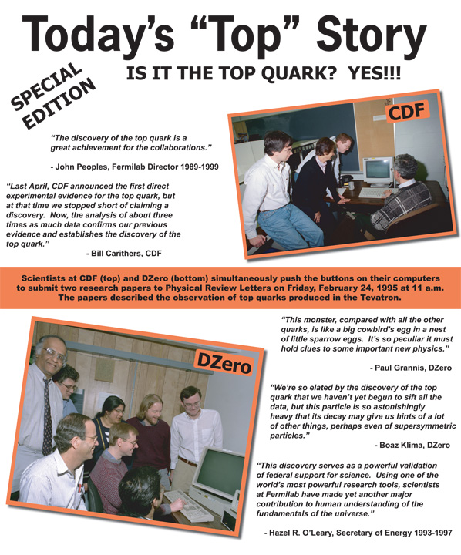
The Top Quark
Existence required by the SM
  Spin 1/2, charge +2/3, weak-isospin partner of the bottom quark
Discovered in 1995 at Tevatron
Mass ~173.3 GeV/c²
  Only SM fermion with mass at the EW scale
Top decays before hadronization: Γ~1.4 GeV >>Λ_{QCD}
  Provide an unique opportunity to study a "bare" quark

Slide 4

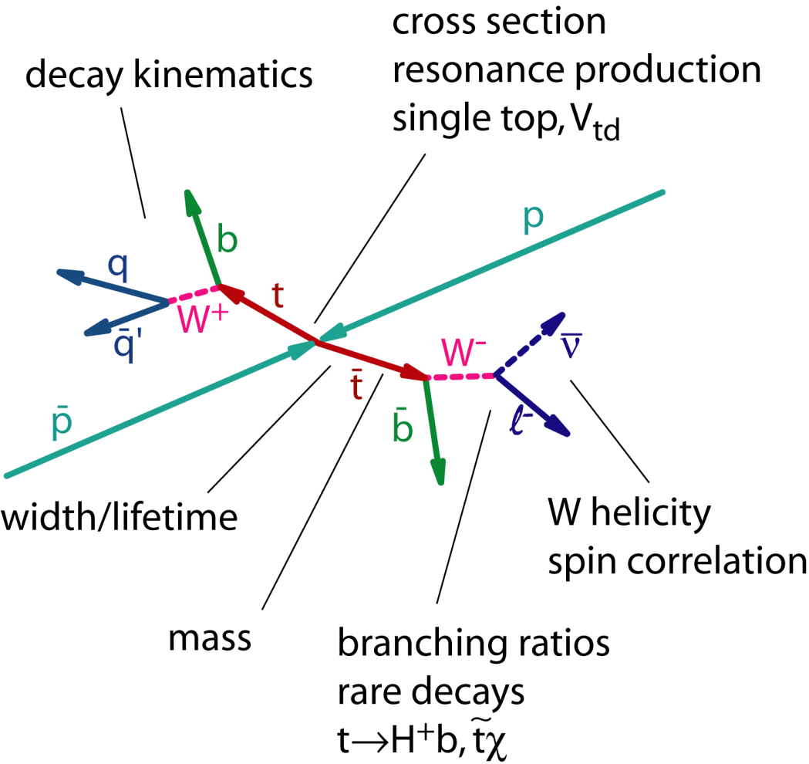
Why Study Top Quarks?
Try to address some of the questions:
Why is top so heavy ?
Is top related to the EWSB mechanism?
Is it the SM top?
Search for beyond SM physics
  Does top decay into new particles?
  Couple via new interactions?

Slide 5
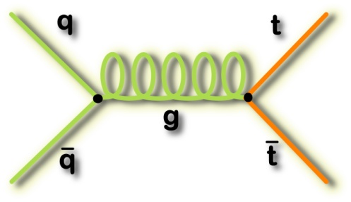
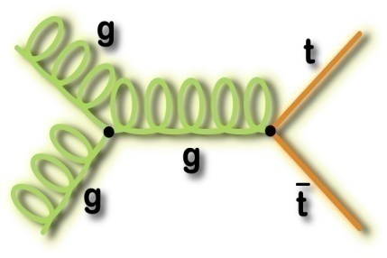
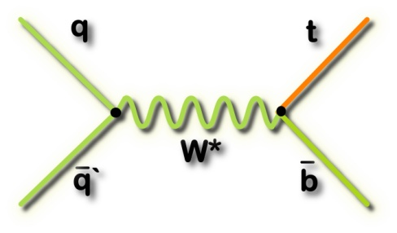
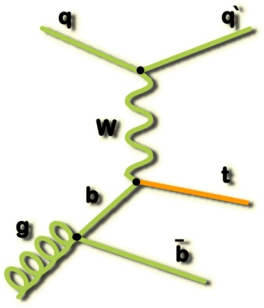
Top Quark Production at Tevatron
Predominantly pair produced via strong interaction
  σ_{tt} =7.45^{+0.72}_{-0.63} pb
  for m_{top}=172.5 GeV/c²
  (Nucl. Phys. Proc. Suppl. 183, 75 (2008))
EW single top production
  σ_{s-channel} =0.88 ± 0.11 pb
  σ_{t-channel} =1.98 ± 0.25 pb
  for m_{top} = 175 GeV/c²
  (PRD 70, 114012 (2004))
~85% from qq→ttbar
~15% from gg→ttbar
Top Quark Pair Production
s-channel
  t-channel
EW Single Top Production
Rare at Tevatron: One top pair (ttbar) per 10 billion inelastic collisions

Slide 6
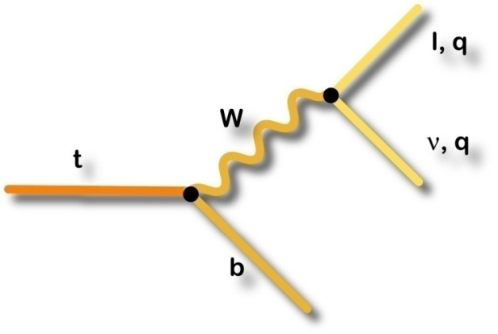
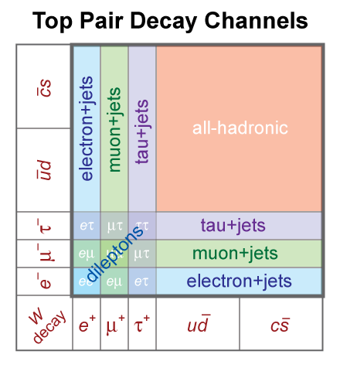
Top Quark Decay
In the SM Br(t →Wb) ~ 100%
Top pair decay channels
  Dilepton : lνlνbb
  Lepton+jets : lνqqbb
  All-hadronic: qqqqbb
Single top decay channels
  s-channel: lνbb
  t-channel: lνbq(b)
  (overwhelming background in hadronic W decays for single top)

Slide 7
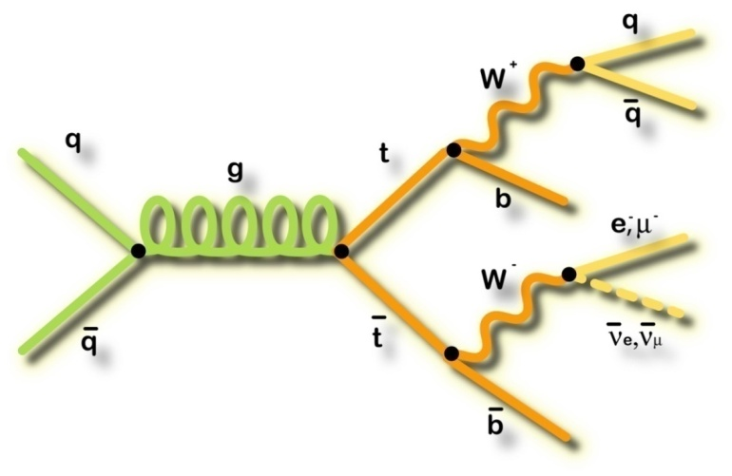
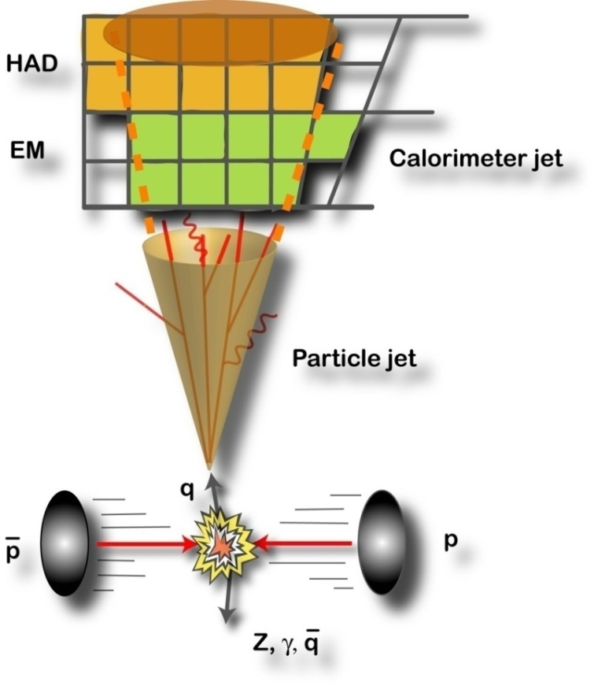
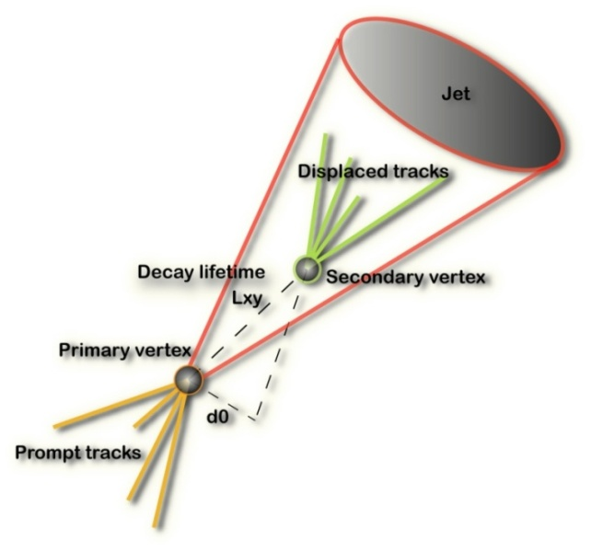
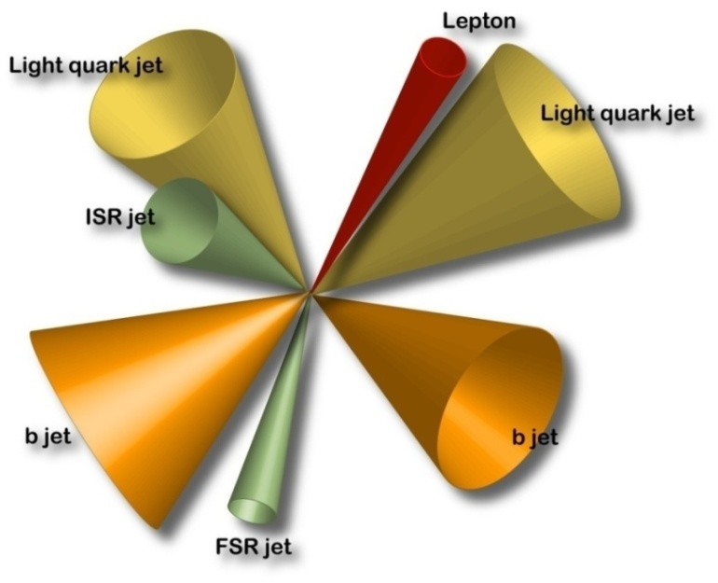
Experimental Essentials
Final State from LO Diagram
Jet Energy Scale
b-tagging
And more: background and signal modeling, background estimation, jet-parton assignment, combinatorics etc.
What we measure

Slide 8
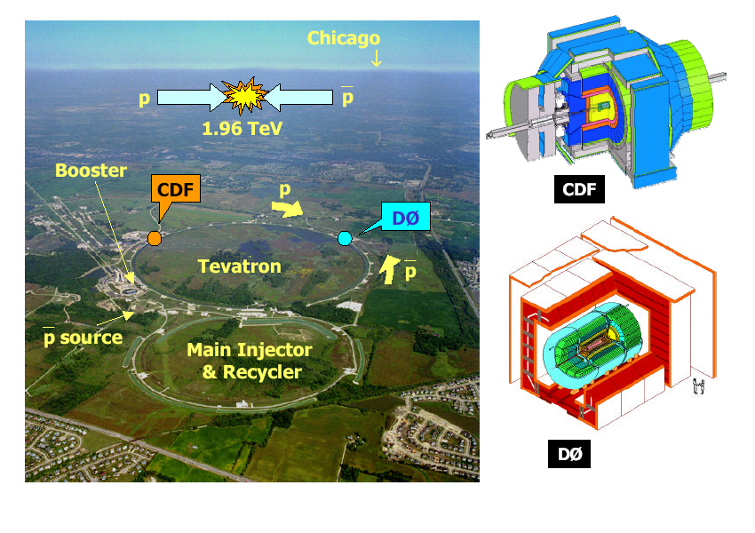
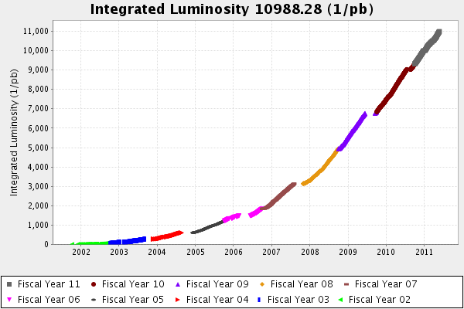
Data Sample
Tevatron Run II (2001-2011) : √s = 1.96 TeV
Total integrated luminosity delivered ~11 fb⁻¹
  ~9 fb⁻¹ recorded per experiment
Results presented with ≤6 fb⁻¹
Estimated ttbar signal events (S) and signal-to-background (S/B) events in 6 fb⁻¹ data
Lepton+Jets : e/μ+≥4 jets, ≥1 b-tag S ~1600, S/B ~ 3:1
Dilepton : 2 e/μ + ≥2 jets, ≥0 b-tag S ~280, S/B ~ 2:1
All hadronic : 6-8 jets , ≥1 b-tag, NN selection, S~1800, S/B ~ 1:4

Slide 9

Top Physics at Tevatron
Robust program of top quark measurements
Many measurements in all the different channels → consistency
Different methods of extraction with different sensitivity → confidence
Combine all channels and all methods → precision

Slide 10
Top Pair Production Cross-Section
Tests QCD in very high Q² regime.
Compare measured cross sections among various ttbar final states
  Anomalies in the tt rate would indicate the presence of non-QCD production channels: for example resonant state X→ ttbar
Provides important sample composition for all other top property measurements.

Slide 11
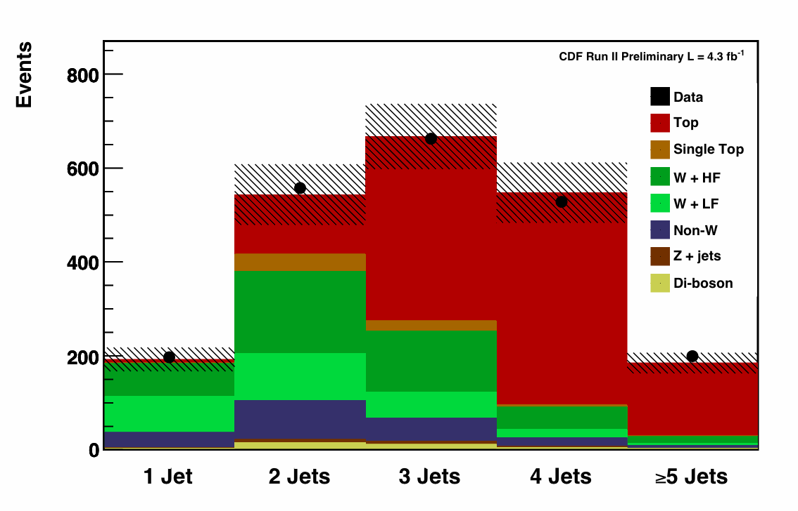
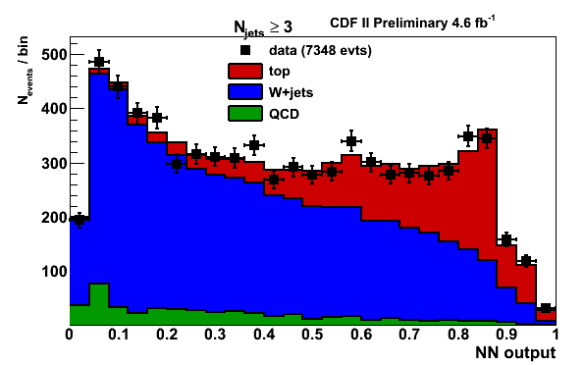
ttbar Cross Section : Lepton+Jets
PRL 105, 012001 (2010), L = 4.3-4.6 fb⁻¹
Signal region
Control region
Most Precise
Δσ/σ = 6.7%
Two complimentary methods
  Requiring ≥1 b-tag
  A topological method using pre-tag (≥0 b-tag)
Normalizing with respect to Z/γ* cross section
  Reduce uncertainty from luminosity determination
  σ_{ttbar} = 7.70 ± 0.52 pb, for m_{top}= 172.5 GeV/c²
Tom Schwarz’s talk on June 1

Slide 12
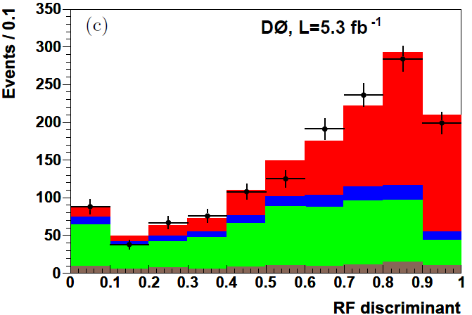
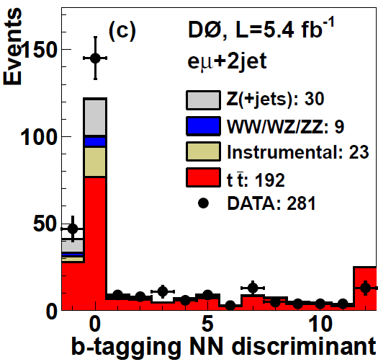
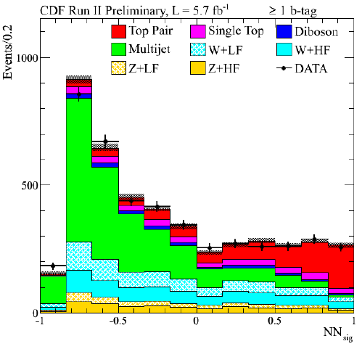
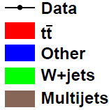
Recent Results : σ_{ttbar}
D0, leptpn+jets: based on kinematics of ttbar and b-tagging.
σ_{ttbar} = 7.78 ^{+0.77}_{–0.64} pb, Δσ/σ = 9%
D0, dilepton: Fit the b-tagging NN output, most precise in dilepton channel
σ_{ttbar} = 7.36 ^{+0.90} _{–0.79} pb, Δσ/σ = 11-12%
CDF, MET+jets: Use MET and jets to select event, veto lepton. Background to Higgs searches in the low mass region
σ_{ttbar} = 7.12 ^{+1.20} _{– 1.12} (stat + syst) pb

Slide 13
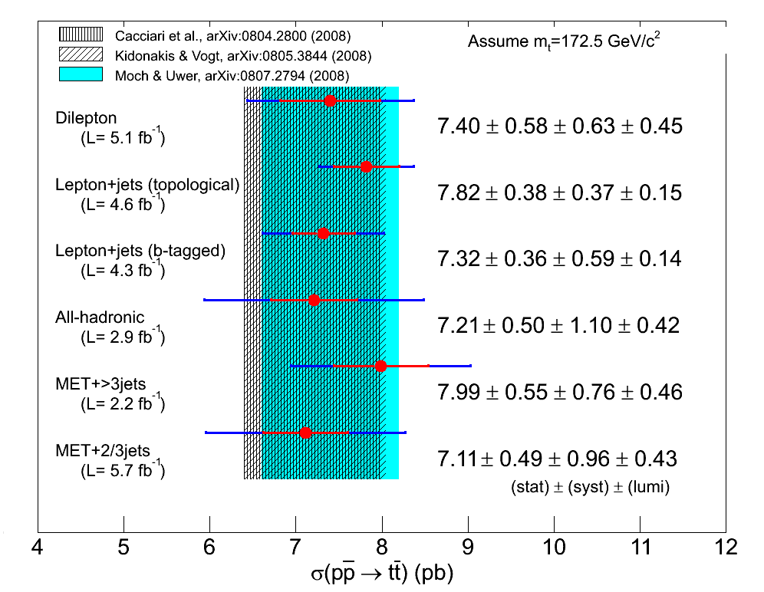
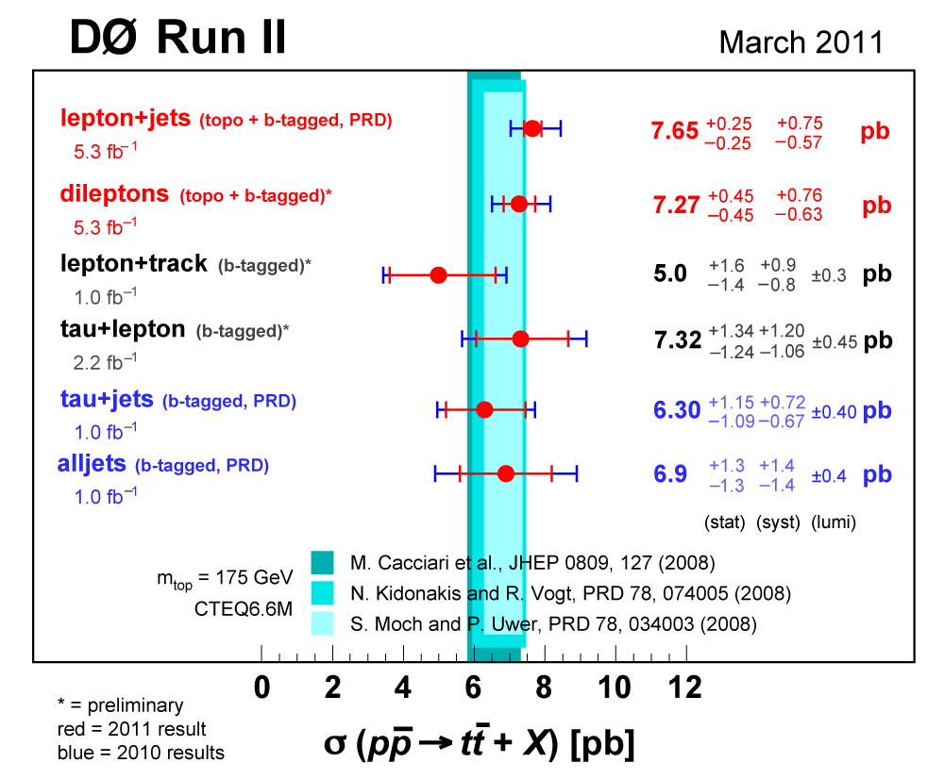
ttbar Cross Section Results
Consistent among channels, methods and experiments
Uncertainties comparable to the theoretical uncertainty
Most sensitive measurements limited by systematic uncertainties

Slide 14
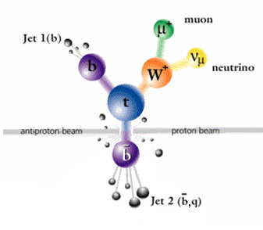
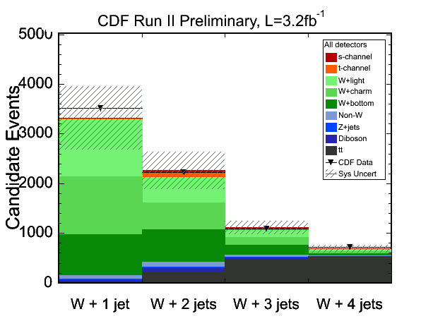
EW Single Top Production
Direct measurement of V_{tb}
Produced ~100% polarized top
  Can be used to test the V-A structure of the top EW interaction
Sensitive to beyond SM physics
  t-channel: 4th family, FCNC
  s-channel: W’, H⁺
Experimental signatures:
  One high P_{T} isolated e or μ
  Large missing transverse energy
  ≥ 2 jets (≥ 1 b-tag)
Suffers from large amount of W+jets backgrounds
  No single variable provide significant signal-background separation

Slide 15
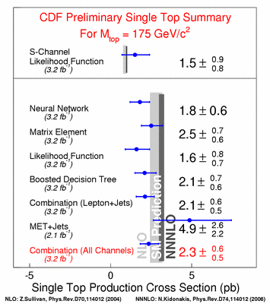
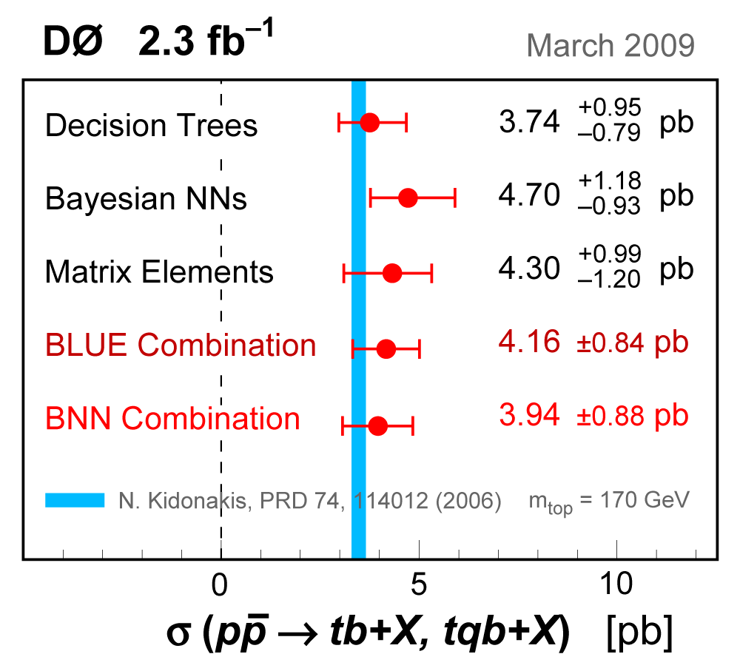
Observation of Single Top Production
First observation by CDF and D0 in March 2009 (PRL 103, 092002 (2009), PRL 103 092001 (2009) )
Tevatron combination: σ_{s+t} = 2.76^{+0.58}_{−0.47} pb
|V_{tb}| = 0.88 ± 0.07, |V_{tb}| > 0.77 at 95% CL

Slide 16
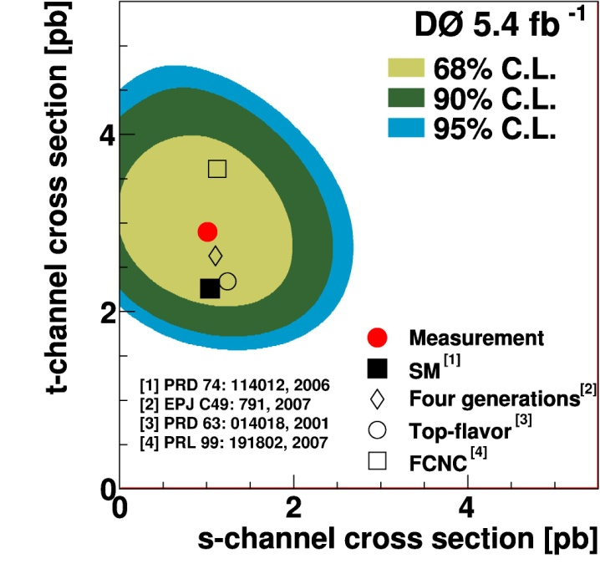
Single Top Production
NEW
D0 measurement uses:
  Boosted decision trees
  Bayesian NNs and
  Neuroevolution of augmented topologies ⇒ new method
Measurement of s-channel and t-channel cross-sections from 2D fit
D0 Result (5.4 fb⁻¹):
σ_{t} = 2.90 ± 0.59 pb
(5.5σ significance)
σ_{s} = 0.98 ± 0.63 pb
J. Joshi’s talk at New Perspective 2011

Slide 17
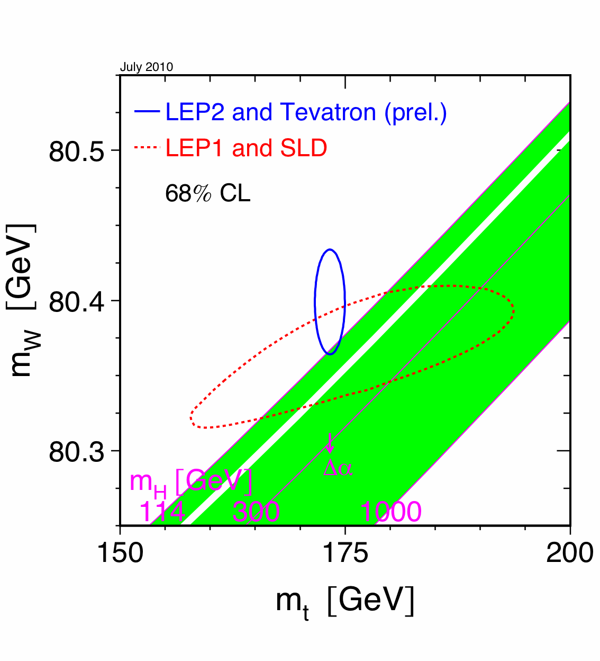
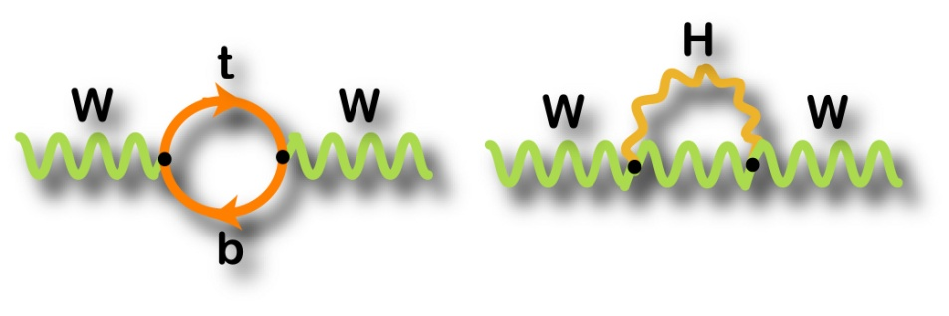
Top Quark Mass
Related to SM observables and parameters through loop diagrams
Consistency checks of SM parameters
Precision measurements of the m_{t} (and m_{W}) allow prediction of the m_{H}
Constraint on Higgs mass can point to physics beyond the standard model

Slide 18
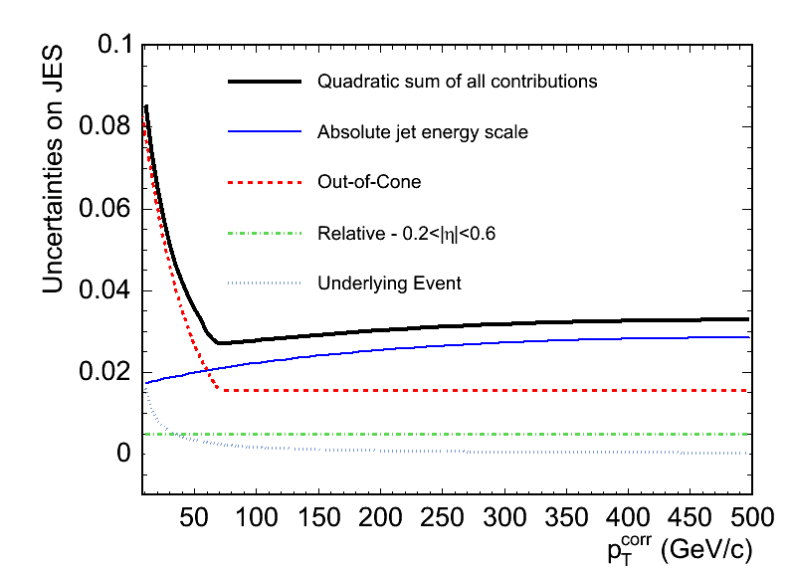

Jet Energy Scale Uncertainty
M_{jj}
NIM A, 566, 375 (2006)
Uncertainty on JES ⇒ About 3% systematic uncertainty on m_{t} measurement when convoluted with ttbar p_{T} spectrum
In-situ JES measurement for lepton+jets and all-hadronic channels
  Constrain the invariant mass (M_{jj}) of the non-b-tagged jets to be 80.4 GeV/c²

Slide 19
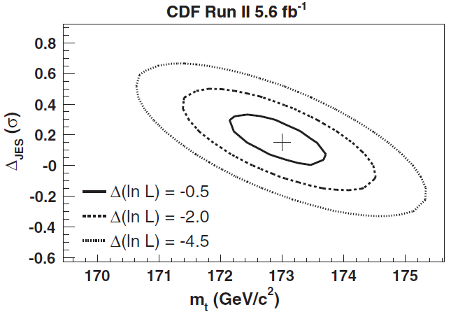
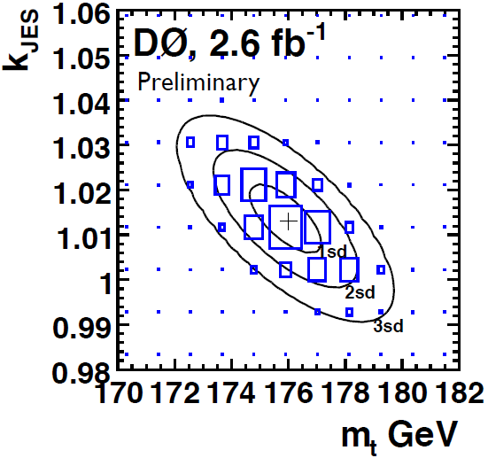
Top Mass : Lepton+Jets Channel
Use event-by-event likelihood based on leading order ttbar differential cross section.
  Most precise top mass measurements from single channels
PRL 105, 252001 (2010)
m_{top} = 173.0 ± 0.7 (stat) ± 0.6 (JES) ±0.9 (syst) GeV/c²
Δm_{top}=1.2 GeV/c²
m_{top} with 3.6 fb⁻¹ D0 data: 174.9 ± 0.8(stat) ±1.3(syst+JES) GeV/c²

Slide 20
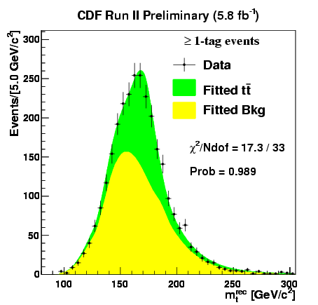
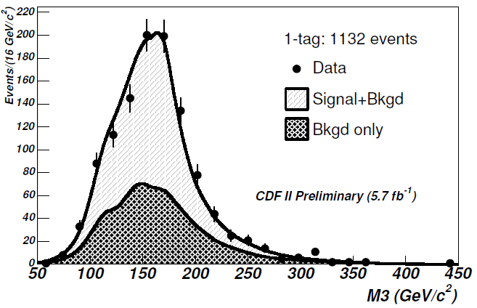
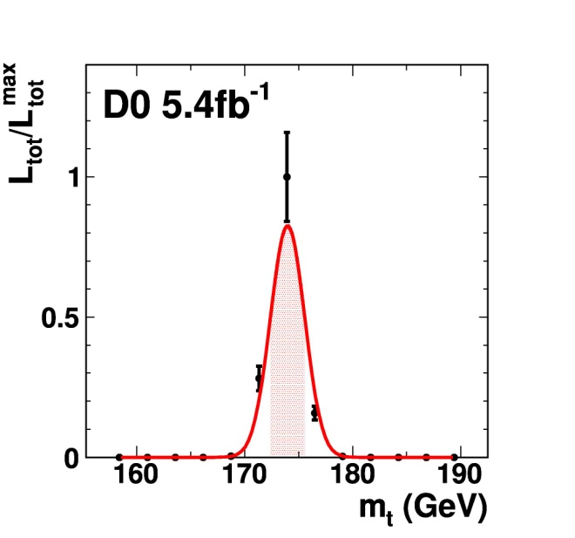
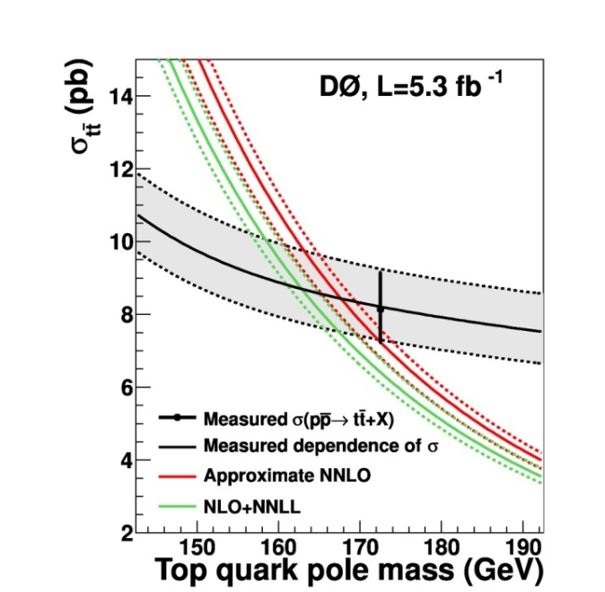
Resent Results : Top Mass
MET+Jets
All-hadronic
Dilepton
Constraint from x-sec

Slide 21
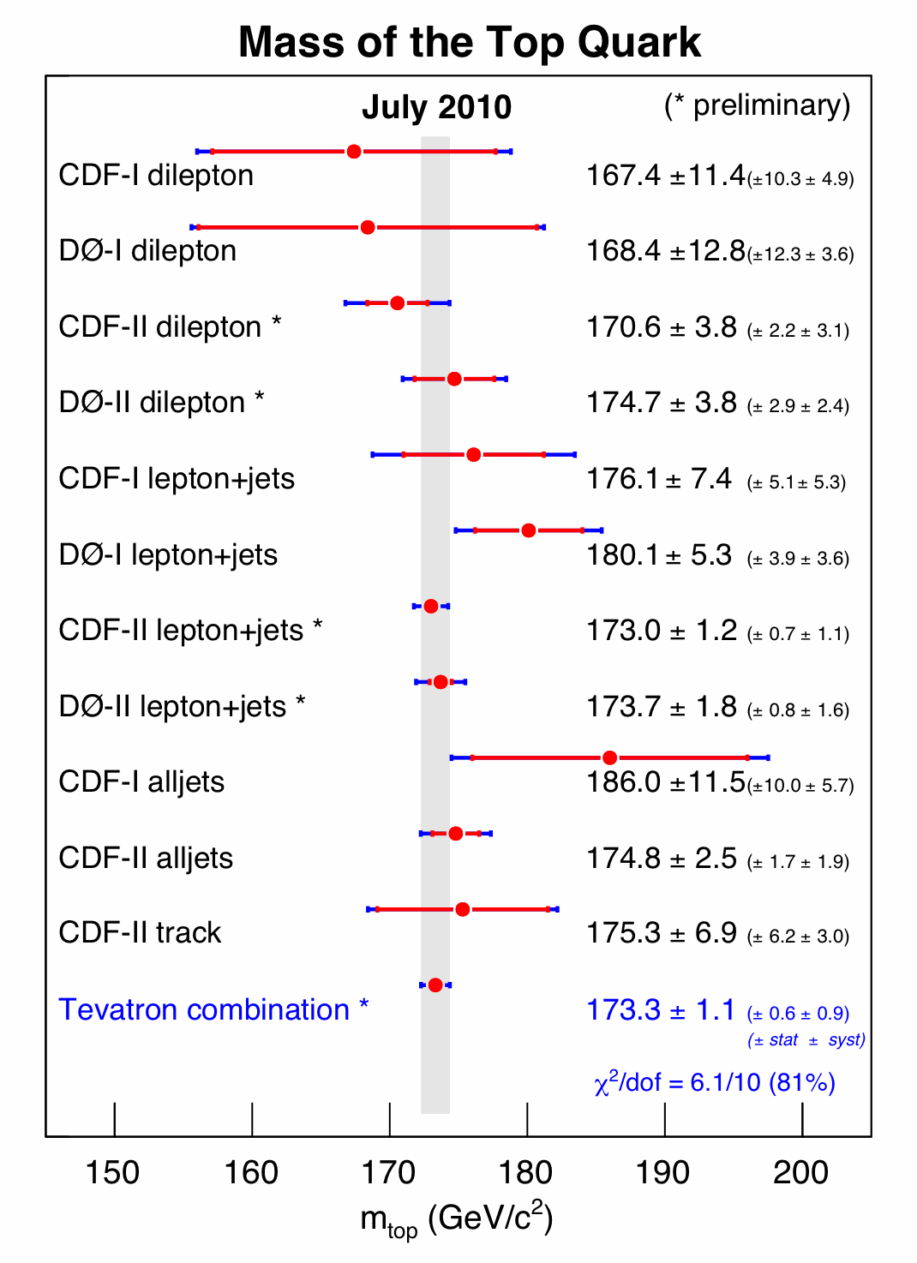
Top Mass : Combination
Combine Run I measurements with most recent Run II measurements
  Take into account the statistical and systematic uncertainties and their correlations (NIM A270 (1988) 110, NIM A500 (2003) 391)
Combined top mass
173.3±1.1 GeV/c²
  χ2/ndof 6.1/10 ⇒ 81% prob
  Good agreement among all input measurements
Top mass known with relative precision of 0.61%

Slide 22
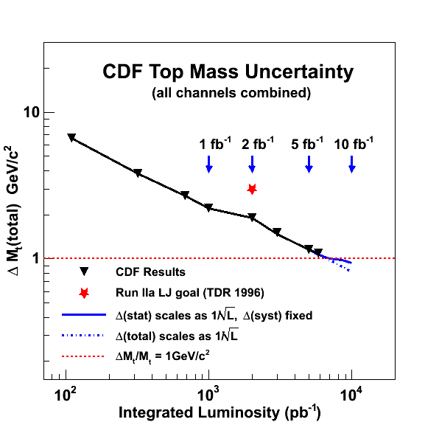
Uncertainties on Measured Top Mass
Source
jet energy scale:
ttbar modeling:
background:
lepton energy scale:
miscellaneous:
Systematic:
Statistical:
ΔM_{t} (GeV/c²)
0.61
0.59
0.23
0.10
0.14
0.89
0.56
*
Several sources of uncertainties should continue scale with the statistics of the sample
  Example: stat component of uncertainty from JES ±0.46 GeV/c²
With full Run II data set could reach Δm_{t} below ~1 GeV/c²

Slide 23
Top quark Properties

Slide 24
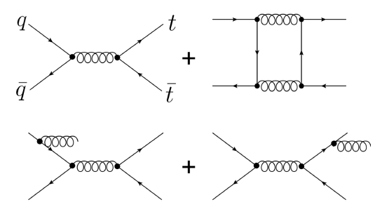

Forward Backward Asymmetry in Top Pair Production
Asymmetry caused by interference of ME amplitudes for same final state
Significantly enhanced in BSM models: Z’-like states with parity violating coupling , theories with chiral color
The SM prediction (QCD at NLO) :
A^{ttbar} = 0.058 ± 0.009
Look at A^{ttbar} dependence on the invariant mass of ttbar
  Sensitive to new physics effect
Tom Schwarz’s talk on June 1

Slide 25
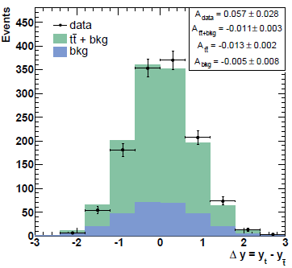
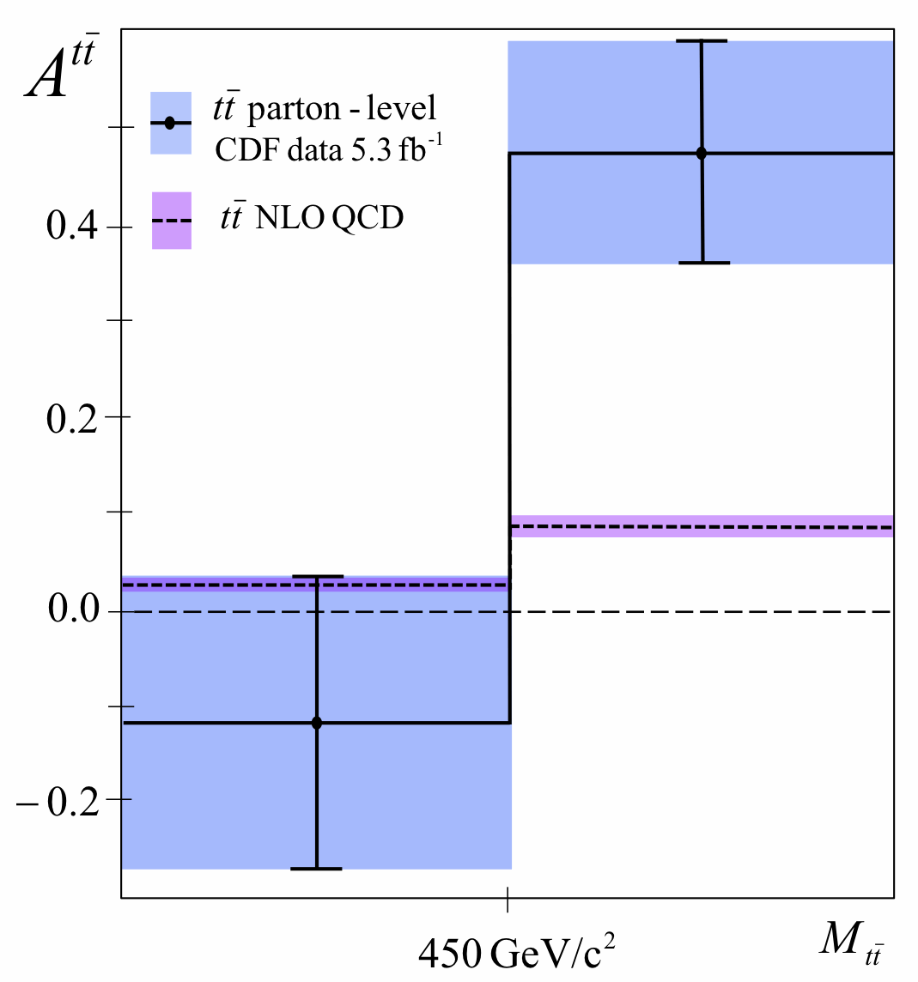
A^{ttbar} (cont’)
CDF analyses corrects for acceptance and smearing effects
CDF Lepton+Jets (5.3 fb⁻¹)
A^{ttbar} = 0.158 ± 0.075 (stat +syst)
A^{ttbar} (M^{ttbar} > 450 GeV/c²) = 0.475 ± 0.114
3.4σ above the SM prediction in high M^{ttbar} region
CDF Dilepton (5.1 fb⁻¹)
A^{ttbar} = 0.42 ± 0.15 (stat) ± 0.05 (syst)
2.3 σ from the SM prediction
D0 lepton+jets uncorrected (4.3 fb⁻¹)
  A^{ttbar} = (8 ± 4 (stat) ±1 (syst))%
  1% expected from NLO MC before correction

Slide 26

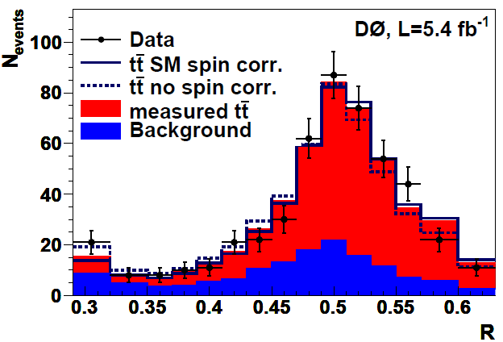
ttbar Spin Correlations
Top production has a characteristic spin correlation. New production mechanisms (Z’, KK) can modify it
D0 analysis: dilepton channel using a matrix-element approach
  Distinguish “H = c” (hypothesis of SM-like correlated top spins) from “H = u” (hypothesis of uncorrelated top spins)
Fraction of events with “H=c”
f_{meas} = 0.74^{+0.40}_{−0.41} (stat+syst)
Exclude “H=u” at 97.7% C.L.
Correlation coefficient
C_{meas} = 0.57 ± 0.31
  (SM Prediction: C=0.78)
See T. Head’s talk at New Perspective 2011

Slide 27
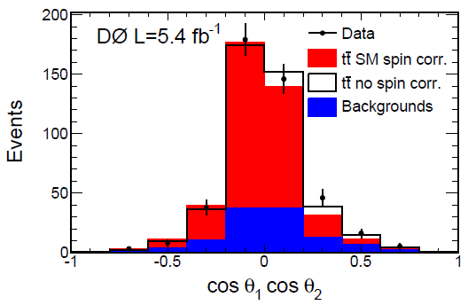
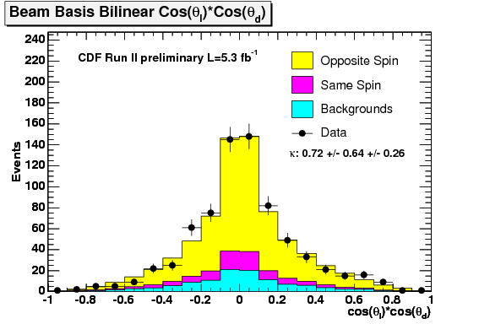
ttbar Spin Correlations (Cont’)
D0 measurement (dilepton )
  Decay products (l⁺,l⁻) angular correlation coefficient C
  C = 0.10 ± 0.45 (stat+syst)
  SM Prediction: C=0.78
CDF measurement (lepton+jets)
  Use both helicity and beam-line basis
κ_{helicity} = 0.48 ± 0.48_{stat} ± 0.22 _{syst}
κ_{beam} = 0.72 ± 0.64_{stat} ± 0.26 _{syst}
SM prediction: κ_{helicity} = 0.35 and κ_{beam} = 0.77

Slide 28
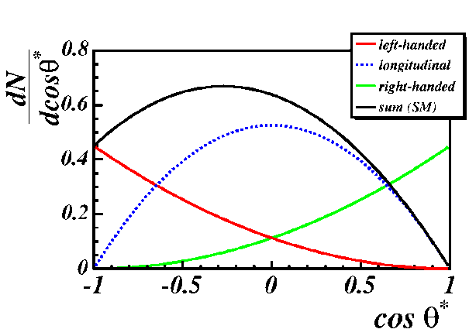
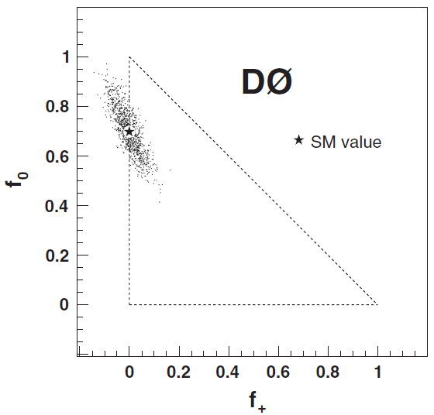
Polarization of W from Top Decay
V-A coupling in the SM
  longitudinal fraction f₀ ~70%
  left-handed fraction f₋ ~30%
  right-handed fraction f₊ ~0%
  Sensitive to non-SM tWb coupling
  Use θ*: Angle between lepton (down-type quark) in W rest frame and the momentum of the W in the top rest frame
PRD 83, 032009 (2011)
Simultaneous measurement of f₀ and f₊
D0 (lepton+jets and dilepton, 5.4 fb⁻¹):
f₀ = 0.669 ± 0.078 (stat) ± 0.065 (syst)
f₊ = 0.023 ± 0.041 (stat) ± 0.034 (syst)
CDF (dilepton, 5.1 fb⁻¹)
f₀ = 0.722 ± 0.179 (stat) ± 0.065 (syst)
f₊ = −0.088 ± 0.088 (stat)± 0.032 (syst)

Slide 29
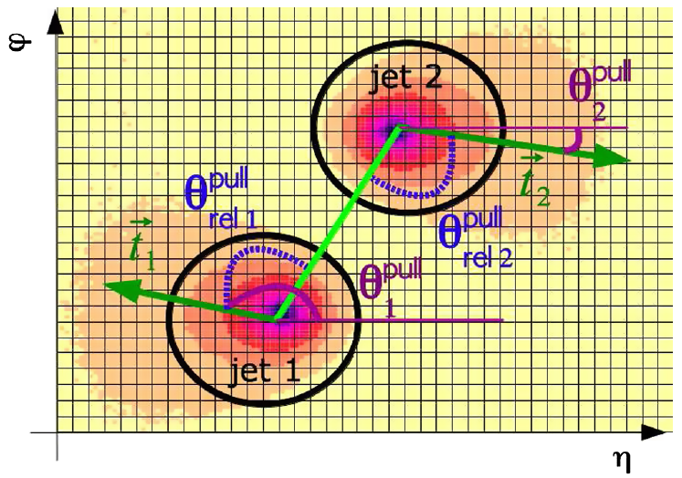
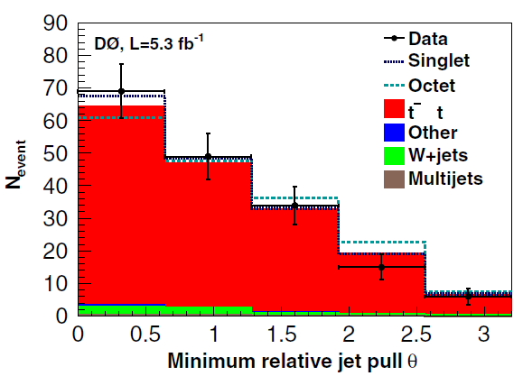
Color Flow In Top Decays
PRD 83, 092002 (2011)
Using color connections between jets to separate different processes. Example:
  H→bb : two b quarks color connected to each other ⇒ color singlet
  g→bb: b quarks color connected to beam remnants ⇒ color octet
Measure ‘‘jet pull’’: related to the jet energy pattern in the η-φ plane
Verify color-flow simulation and jet pull reconstruction using lepton+jets
  Two jets from W decay ⇒ color singlet
W(singlet)/W(all) =
f_{singlet} = 0.56 ± 0.42 (stat + syst)
(SM ratio for ttbar = 1)

Slide 30
Search for New Physics

Slide 31
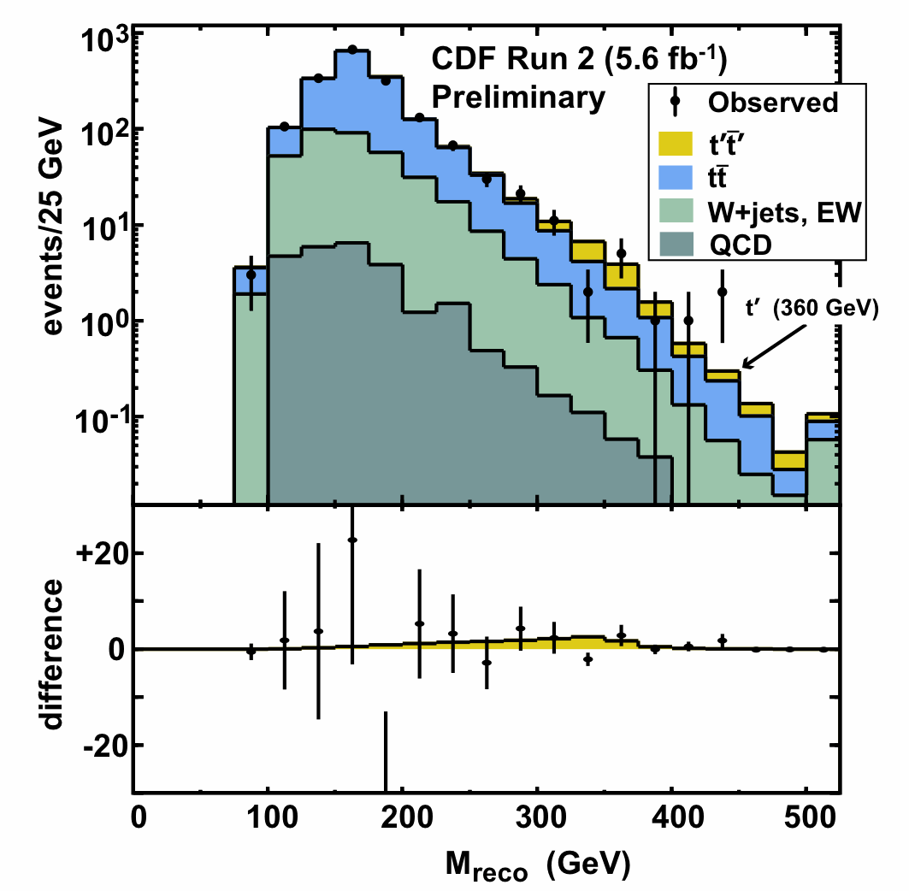
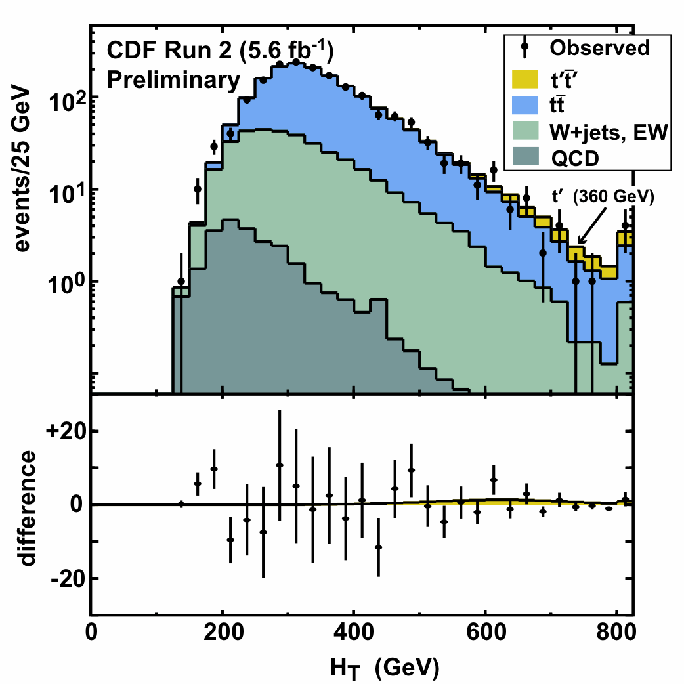

t’ search
Motivated in various BSM: Little Higgs model with t-parity, “Beautiful Mirrors” model
EWK precision data don’t exclude fourth generation
Two-variable search using e/μ+ ≥4 jets events:
  Reconstructed top mass
  H_{T} (total transverse energy)
CDF searches for t’→Wb
  Exclude M_{t’}< 358 GeV at 95% CL
(D. Cox’s talk at New Perspective 2011)
D0 searches for t’→Wq
  Exclude M_{t′} < 285 GeV at 95% CL

Slide 32


Search for Boosted Top Quarks
Probe NLO QCD
  Search for possible new physics
Require two massive jets or one massive jet with large missing E_{T}
58 candidate events
  Exp. bkg. of 44±8 (stat) ±13 (syst)
Boosted SM ttbat cross section < 40 fb⁻¹ @ 95% CL
  (for ≥ 1 jet with pT>400 GeV/c)
Cross section for a pair of massive objects with masses near the top mass < 20 fb⁻¹ @ 95% CL
  (for ≥1 jet with pT > 400 GeV/c)

Slide 33
Summary
Top quark properties are currently being studied at Tevatron
  Most precise ttbar cross-section and top mass measurements are already systematically limited
  Study other properties of top quark, search for new physics
    Almost all the measurements are statistically limited
Almost twice the data sample already available
  Stay tuned for the updates and new results
LHC will have a much larger top sample in future
  Understanding of systematic uncertainties would be crucial
Tevatron’s top physics program and understanding of systematic effects will continue to play a significant role for years to come

Slide 34
More Top Physics Results From Tevatron
Apologies for my many omissions.
For a full listing of results go to:
http://www-cdf.fnal.gov/physics/new/top/top.html
http://www-d0.fnal.gov/Run2Physics/WWW/results/top.htm

Slide 35
BACKUP

Slide 36


The CDF and D0 Detectors
Silicon tracking
Outer fiber tracker (r=0.5m)
2.0 T solenoid
Hermetic calorimetry (|η| < 4)
Muon chambers (|η| < 2.0)
New trigger and more silicon in Summer 2006 (Run2b)
Silicon tracking
Large radius drift chamber (r=1.4m)
1.4 T solenoid
Projective calorimetry (|η| < 3.5)
Muon chambers (|η| < 1.0)
All crucial for top physics!

Slide 37
Experimental Essentials
Sample composition : Signal to background ratio (S/B)
  Lepton+Jets : Golden channel for most top-properties measurements
Jet-parton assignment : Combinatorial background
  Dilepton: 2 combinations
  Lepton+Jets: 12 (0 b-tag), 6 (1 b-tag), and 2 (2 b-tags) combinations
  All hadronic: 90 combinations (0 b-tag), 30 (1 b-tag), 6 (2 b-tags)
S/B | Dilepton (≥2 jets) | Lepton+Jets (≥4 jets) | All-hadronic (6-8 jets, after NN Selection)
0 b-tag | 2:1 | ~1:4 | ~1:20
1 b-tag | 20:1 | 3:1 | 1:4
2 b-tags |  | 20:1 | 1:1

Slide 38



ttbar Spin Correlations : Dilepton
D0 measures decay products (l⁺,l⁻) angular correlation coefficient C
θ₁ (θ₂): angle between the flight direction of 1⁺ (l⁻) and direction of flight of one of the colliding hadrons in the ttbar rest frame
D0 result:
SM Prediction at NLO:
Bound on C: [−0.66, 0.81] at 95% CL

Slide 39

ttbar Spin Correlations : Lepton+Jets
Use the decay angles of the lepton (θ_{l}), the d-quark (θ_{d}), and the b-quark which comes from the hadronically decaying top (θ_{b})
Decay angles defined in two basis
  Helicity (Beam-line) basis: the angle between the decay product momentum in the top rest frame and the top quark momentum (the direction of the beamline) in the ttbar rest frame
Obtain spin correlation coefficient κ from fit to 2D distributions
κ_{helicity} = 0.48 ± 0.48_{stat} ± 0.22 _{sys}
κ_{beam} = 0.72 ± 0.64_{stat} ± 0.26 _{syst}
SM prediction at NLO:
κ_{helicity} = 0.35 and κ_{beam} = 0.77

Slide 40
Kinematical Reconstruction of Lepton+Jets
Minimize a χ² describing the over constrained kinematics of Lepton+Jets channel
Constraints on measured Lepton and Jet momenta
Constraints on un-clustered Energy
W Mass Constraints
Top mass Constraints
Select one permutation based on χ²:
  Require consistency with identified b-jet assignments

Slide 41









Extracting Single Top Signal
No single variable provide significant signal-background separation
Perform multivariate analysis ⇒ take advantage of small signal background separation in many variables

