Slide 1
Revival of the cern ps neutrino beam
Rende Steerenberg,
CERN Switzerland
Short-Baseline Neutrino Workshop
12 - 14 May 2011, Fermilab – Batavia, IL - USA

Slide 2
Acknowledgements:
Thanks to:
Jan Borburgh, Marco Calviani, Tobias Dobers, Ilias Efthymiopoulos, Alfredo Ferrari, Massimo Giovannozzi, Edda Gschwendtner, Alberto Guglielmi, Dominique Missiaen, David Nisbet, Ans Pardons, Francesco Pietropaolo, Youri Robert, Paola Sala, Bernard Vandorpe, Heinz Vincke, Samuel Zeler,
for fruitful discussions and work done so far.
REVIVAL OF THE CERN PS NEUTRINO BEAM

Slide 3
Contents
Why Another Neutrino Facility
PS Proton Beam Production Scheme
The Infrastructure
Target System and Decay Tube
Present status
Concluding Remarks
REVIVAL OF THE CERN PS NEUTRINO BEAM

Slide 4
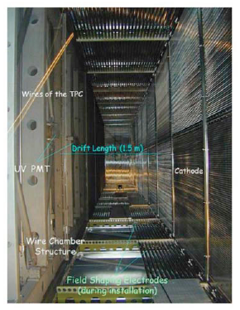
Contents
Why Another Neutrino Facility
PS Proton Beam Production Scheme
The Infrastructure
Target System and Decay Tube
Present status
Concluding Remarks
REVIVAL OF THE CERN PS NEUTRINO BEAM

Slide 5
Why a New Neutrino Facility ?
The idea for reviving the CERN PS neutrino beam line was triggered by a letter of intent from an experimental collaboration led by C. Rubbia for the search of sterile neutrinos
A more concrete experimental proposal is being considered
See talk of F. Pietropaolo Saturday morning 8:00
However, the facility can also be used for other experiments/studies:
Neutrino cross section measurements at very low energies (on and/or off-axis)
Target R&D
Detector studies, etc......
REVIVAL OF THE CERN PS NEUTRINO BEAM

Slide 6
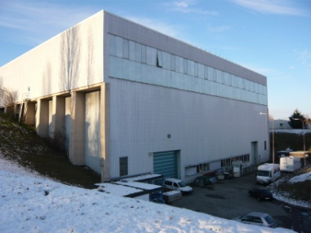
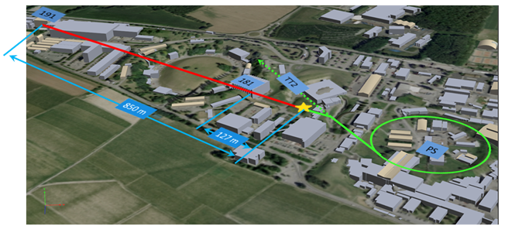
The Proposed Lay-out
Near detector
REVIVAL OF THE CERN PS NEUTRINO BEAM
Far detector
Re-use the old TT7 tunnel and cavern to house primary beam line and target station
Proton beam to be provide by CERN PS
T600
ICARUS
detectors
150t liquid argon TPC near detector in building 181
600t liquid argon TPC far detector in building 191

Slide 7
Experimental Requirements
Request: 2.5x10²⁰ protons over 2 years
Based on neutrino production yield of 1980’s
Proton beam momentum ~ 20 GeV/c
Secondary ν_{μ} and ν_{μ} beam with Eν ≤ 2 GeV
The challenge lies in:
producing this extra amount of protons from the CERN PS
designing the optimum and reliable target and focussing system
Respect radiation limits for this surface facility
REVIVAL OF THE CERN PS NEUTRINO BEAM

Slide 8
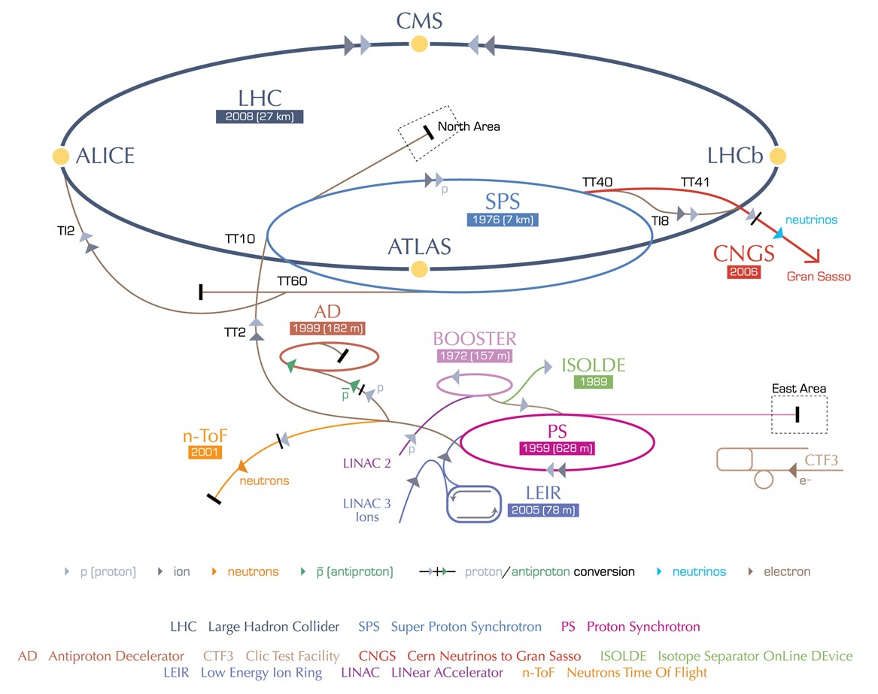
Contents
Why Another Neutrino Facility
PS Proton Beam Production Scheme
The Infrastructure
Target System and Decay Tube
Present status
Concluding Remarks
REVIVAL OF THE CERN PS NEUTRINO BEAM

Slide 9
The actual CERN Accelerator Complex
REVIVAL OF THE CERN PS NEUTRINO BEAM

Slide 10
The Accelerator Complex with PSNF
Beam delivery by partial time sharing
REVIVAL OF THE CERN PS NEUTRINO BEAM
PSNF

Slide 11
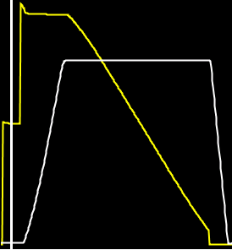
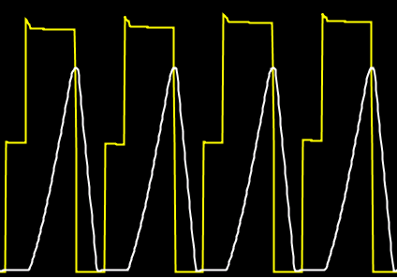
Beam Scheduling
Super Cycle outside LHC filling periods (39.6 sec):
SPS provides beam to Fixed target physics, CNGS and LHC
PS provides beam to the SPS, East Area, AD, nTOF
PSB provides beam to PS and ISOLDE
CNGS
CNGS
CNGS
CNGS
SPS
Fixed target
physics
REVIVAL OF THE CERN PS NEUTRINO BEAM
DIRAC
DIRAC
DIRAC
DIRAC
DIRAC
EA
EA
EA
EA
PS
nTOF
nTOF
Leaving 12 pulses out of 33 possible (36% duty cycle) for the ISOLDE experiment behind the PS booster. They request actually~ 50%
No place for more cycles in the super cycle left to produce the required extra protons

Slide 12
How to Produce the Extra Protons
PS produces beam for other users while SPS is accelerating and extracting
No direct competition for protons from PS and SPS
The DIRAC experiment in the East Experimental Area has mentioned plans to move to the SPS, freeing 5 cycles
However, the nTOF facility requests extra cycles, leaving again little possibilities
Only possibility left :
Make even more efficient use of the PS
REVIVAL OF THE CERN PS NEUTRINO BEAM

Slide 13
Beam Sharing
On the nTOF cycle only 1 bunch is produced, while 8 can be produced.
The nTOF cycle can routinely produce 3x10¹³ protons in 8 bunches:
7 bunches for the PSNF (2.6x10¹³)
1 bunch for the nTOF facility (3.8x10¹²)
Putting in total 7 of these cycles in the super cycle:
PS can produce ~ 6.7x10¹⁹ protons per typical run of 180 days
PS would need 3 to 4 runs (years) to accumulate 2.5x10²⁰ protons, instead of the requested 2 years.
Run time can be shortened by extending the years PS run with dedicated PSNF running
More efficient use of the CERN PS and no loss of integrated protons for nTOF (slight increase)
REVIVAL OF THE CERN PS NEUTRINO BEAM

Slide 14
PS to TT7 Transfer Line
About 150 m of transfer line to be build
No real design made yet
Magnet needs for beam transfer line:
~ 16 Main Dipoles
~ 14 Quadrupoles
~ 6 Corrector Dipoles
Fast switching magnet (~ 200 ms) for sharing
Beam instrumentation:
Beam current transformer
Beam positioning monitors
Beam profile measurement
Beam loss monitors
Primary beam collimator
REVIVAL OF THE CERN PS NEUTRINO BEAM

Slide 15
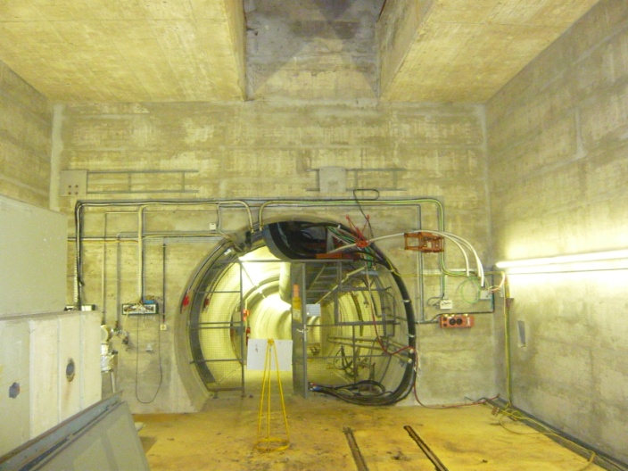
Contents
Why Another Neutrino Facility
PS Proton Beam Production Scheme
The Infrastructure
Target System and Decay Tube
Present status
Concluding Remarks
REVIVAL OF THE CERN PS NEUTRINO BEAM

Slide 16
Re-use existing infrastructure
In the 80’s the PS also provided protons beam to a target for neutrino physics:
CDHS
CHARM
BEBC experiment
The infra-structure is presently not use and could after thorough consolidation be re-used to house:
Primary proton transfer line
Target and focusing
Decay channel
REVIVAL OF THE CERN PS NEUTRINO BEAM

Slide 17
The TT7 Tunnel
The TT7 tunnel:
Jura
REVIVAL OF THE CERN PS NEUTRINO BEAM
Geneva
Geneva
Jura

Slide 18
The TT7 tunnel towards the target
REVIVAL OF THE CERN PS NEUTRINO BEAM

Slide 19
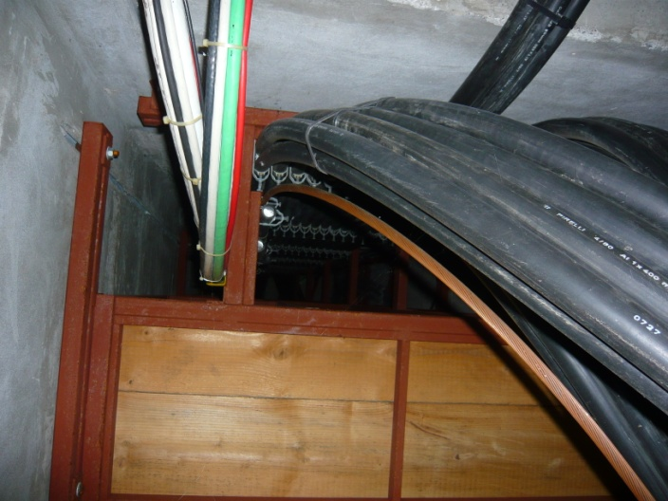
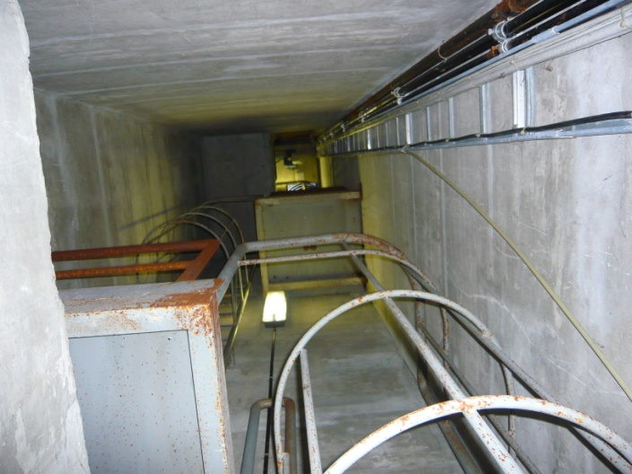
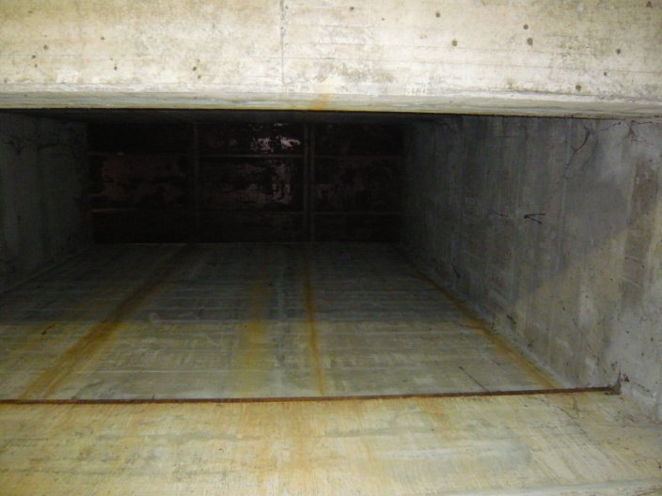
The TT7 Target Cavern
TT7 emergency exit
TT7 cable & ventilation
shaft
REVIVAL OF THE CERN PS NEUTRINO BEAM
TT7 cavern
TT7 cavern
TT7 cavern shaft

Slide 20
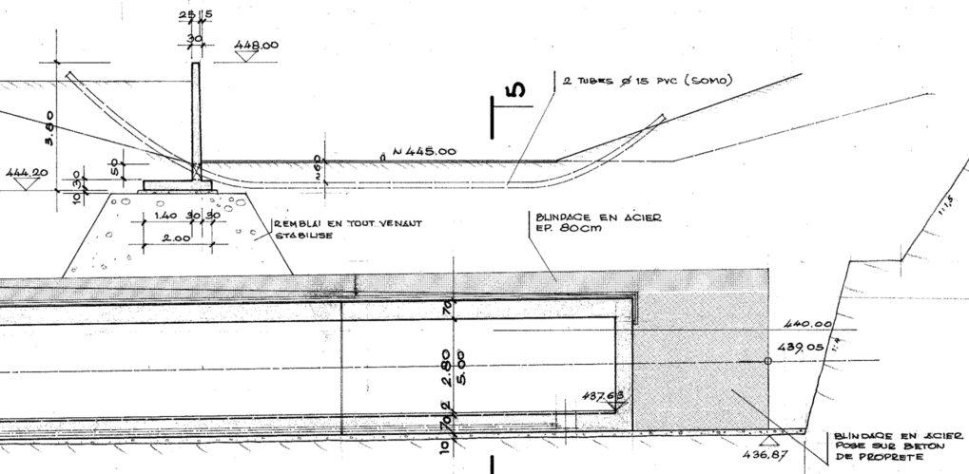
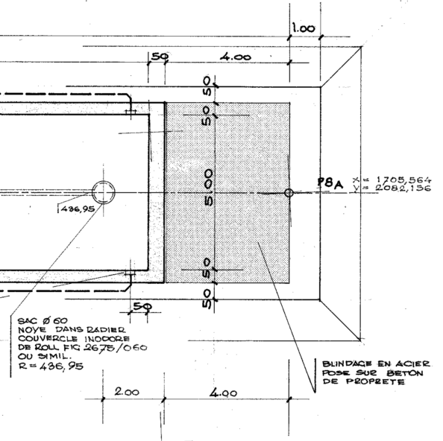
Beam Dump / Hadron Absorber
4 meter thick beam dump (none sealed iron blocks)
~ 65 meter of earth
No cooling
REVIVAL OF THE CERN PS NEUTRINO BEAM
To be reviewed !

Slide 21
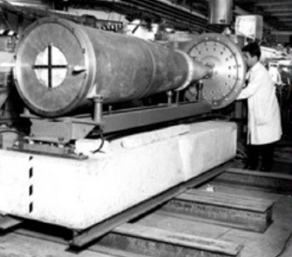
Contents
Why Another Neutrino Facility
PS Proton Beam Production Scheme
The Infrastructure
Target System and Decay Tube/Tunnel
Present status
Concluding Remarks
REVIVAL OF THE CERN PS NEUTRINO BEAM

Slide 22
Preliminary Target & Focusing Ideas
The design has not started, but some ideas are being discussed.
Target (partly) inside single horn (Eν ≤ 2 GeV)
Beam synchronous pulsed horn
Type of target material to be used
Graphite target rod of <6 mm radius is being considered
Interaction length is ~ 40 cm therefore an ~80 cm long target would be needed
For a 20 GeV/c beam with 4x10¹³ ppp at a 1.2 second repetition rate ~ 1.3 kW is deposited in target
Simulations have started
REVIVAL OF THE CERN PS NEUTRINO BEAM

Slide 23
Primary Beam Parameters
 | Old neutrino facility |  | New neutrino facility
 | PS dedicated Feb-Mar 1983 | PS parallel 1983 - 1984 | PS dedicated | PS parasitic | PS ultimate^{[1]}
Proton Momentum | 19.2 GeV/c | 19.2 GeV/c | 20 GeV/c | 20 GeV/c | 26 GeV/c
Protons/pulse | 1.25x10¹³ | 1.2x10¹³ | 3x10¹³ | 2.6x10¹³ | 4x10¹³
Max. rep. rate | 1.2 s | 14.4 s | 1.2 s | 1.2 s | 1.2 s
Beam energy | 38 kJ | 38 kJ | 96 kJ | 84 kJ | 166 kJ
Average beam power | 32 kW | 2.5 kW | 80 kW | 70 kW | 140 kW
REVIVAL OF THE CERN PS NEUTRINO BEAM
^{[1]} The PS ultimate beam is presently not possible, but could perhaps be in reach after the completions of the LHC Injector Upgrade (LIU) project.
Running with 7 cycles in the previously mentioned super cycle with PS parasitic beam
Corresponds to 21% duty cycle and 15 kW beam power
To complete experiment dedicated running during short periods at 80% - 100% duty cycle (80 kW) is needed

Slide 24
Decay Tunnel
The available decay tunnel is 50 meters long
Cross section:
3.5 x 2.8 m2 for the 1st 25 m
5.0 x 2.8 m2 for the remainder
REVIVAL OF THE CERN PS NEUTRINO BEAM
No vacuum or helium filled decay tube available →to be considered
Consider also muon detectors for beam steering and target/horn alignment

Slide 25
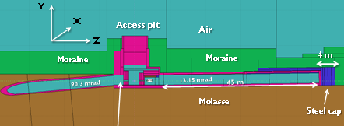
Contents
Why Another Neutrino Facility
PS Proton Beam Production Scheme
The Infrastructure
Target System and Decay Tube/Tunnel
Present status
Concluding Remarks
REVIVAL OF THE CERN PS NEUTRINO BEAM

Slide 26
Present Status
A partial feasibility study, addressing the most critical issues, was made and result have been reported to the CERN management
A memorandum with the experimental proposal, prepared by C. Rubbia et al, was discussed in the CERN SPSC in April
CERN is now considering some form of a conceptual design study
The existing very rough cost estimate is not representative and should not be used
A realistic cost estimate and project planning should be made instead
A decision is expected after the Research Board of June 8th
REVIVAL OF THE CERN PS NEUTRINO BEAM

Slide 27
Contents
Why Another Neutrino Facility
PS Proton Beam Production Scheme
The Infrastructure
Target System and Decay Tube/Tunnel
Present status
Concluding Remarks
REVIVAL OF THE CERN PS NEUTRINO BEAM

Slide 28
Concluding Remarks
A very exciting physics experiment is proposed for the more than 50 years old CERN PS
More news awaited after the CERN Research Board meeting of 8 June
TT7 and nTOF beam sharing makes efficient use of the CERN PS:
The proposed experiment could be completed in 3 to 4 runs without forming any competition for protons with other experiments
Shortening possible by dedicated running
nTOF would gain also on the number of integrated protons
No direct competition for protons between PS and SPS neutrino facilities
Large part of the required infrastructure is available, but needs to be consolidated
Everything else needs to be designed and constructed
The facility can also be (re-)used for other low energy neutrino physics, target R&D, Detector R&D, etc...
REVIVAL OF THE CERN PS NEUTRINO BEAM

