Slide 1
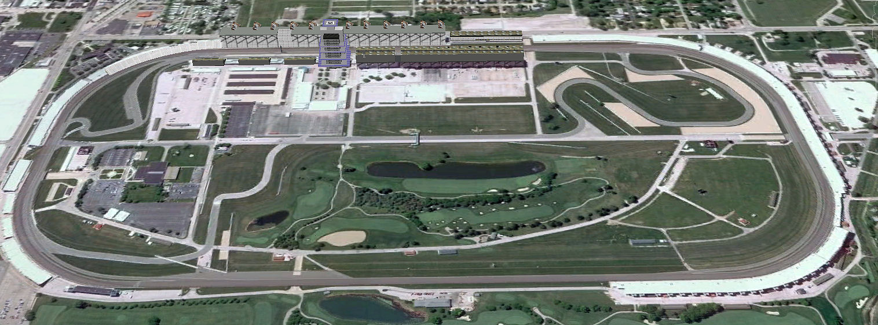
μ Storage Rings
Neutrino Physics opportunities with Neutrinos from μ decay
Alan Bross
SBNW11

Slide 2
Introduction
For well over 30 years physicists have been talking about doing ν experiments with νs from μ decay
Flavor content fully known
“Near Absolute” Flux Determination is possible in a storage ring
Beam current, polarization, beam divergence monitor
Tremendous control of systematic uncertainties with a well designed system

Slide 3
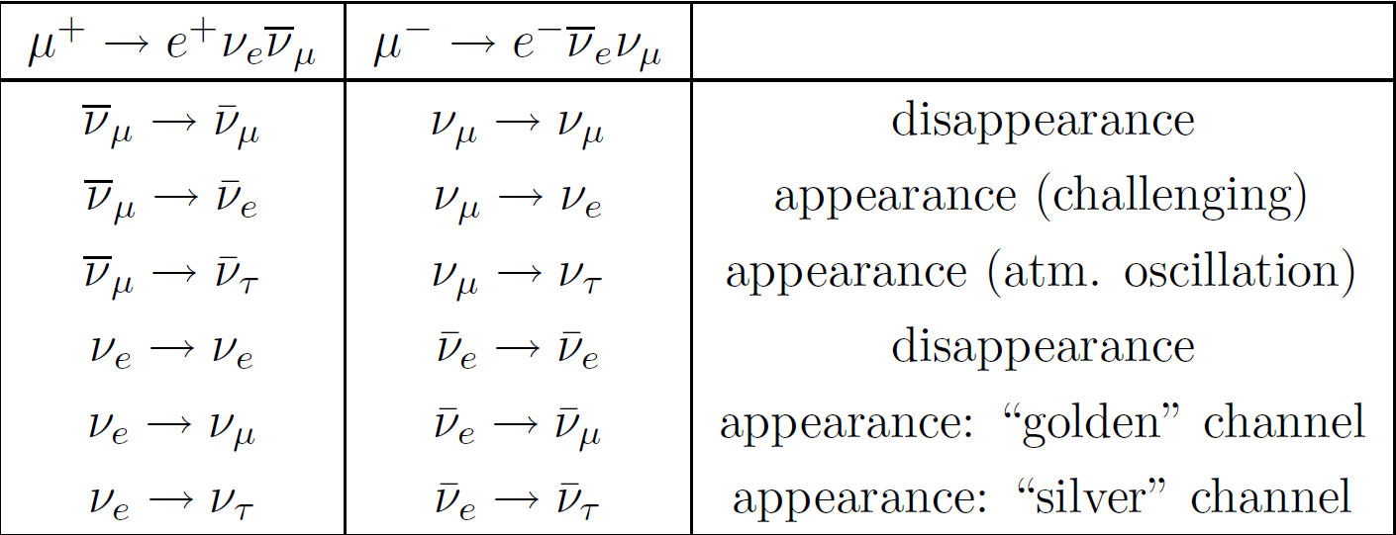
ν Oscillation Physics – μ Storage Rings
12 channels accessible
if E_{ν} is above the τ threshold

Slide 4
But First

Slide 5
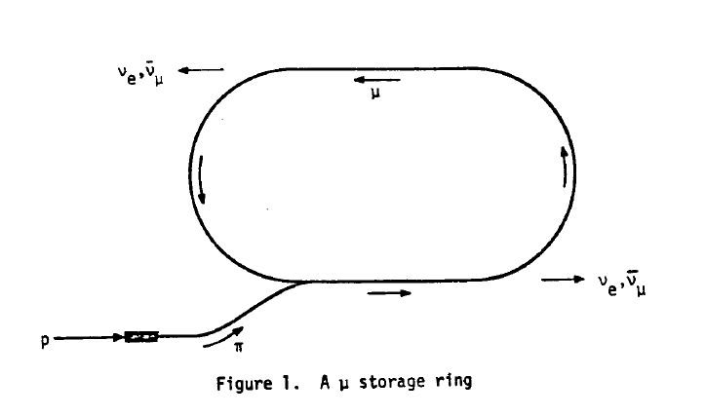
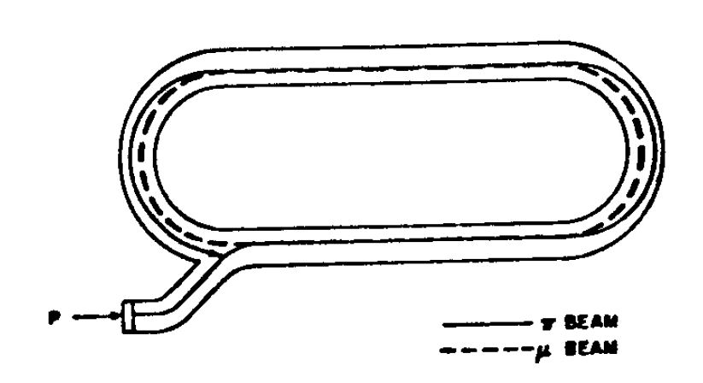
ν Mass Mini-conference 1980 Telemark, Wisconsin Barger And Cline eds.
At this conference David Neuffer proposed μ storage rings for ν oscillation physics (first mentioned at¹)
“Precisely knowable flux”
“It is found that a low energy ( ≈ 1GeV) ring matched to a high energy proton source (8 GeV Booster) is most practical and can provide ν beams suitable for accurate tests of ν oscillations”
¹Cline and Neuffer, proc. of the XX International
Conf. on High Energy Physics. Madison, WI (1980)

Slide 6
Telemark, WI 1980
David calculated that with an 8 GeV proton driver and for a 1.5 GeV μ energy, that
could be obtained (with 1980’s technology) from a μ storage ring
Remember this for Later!
In his summary, David stated
The decaying muons can be monitored so that the neutrino intensities can be precisely known
There are no impurities from π decay or K decay or stray charged particles
And, he concluded saying:
“Both oscillations of the “first kind” (ν_{e} → ν_{μ}, ν_{τ}) and of the “second kind”
(ν_{e} → M, where M is a “Moron”, a non-interacting particle) are observable”

Slide 7
Telemark, WI 1980
At that same meeting Eugene Colton proposed that the Fermilab anti-proton “Pre-Cooler” could function as a μ storage ring
The pions produced simultaneously with antiprotons are utilized to provide a circulating beam of decay muons that can serve as a source of νs. The considered design indicates a primary produced flux of 1.5 X 10⁹ decay muons per incident proton pulse of 1.8 X 10¹³.
Remember this also

Slide 8
Fast Forward 10 Years

Slide 9
P-860 (1990)
A Search for Neutrino Oscillations Using the Fermilab Debuncher
Slide from
1991 PAC
Presentation

Slide 10
Fermilab Debuncher aka Pre-Cooler, aka μ Storage Ring

Slide 11
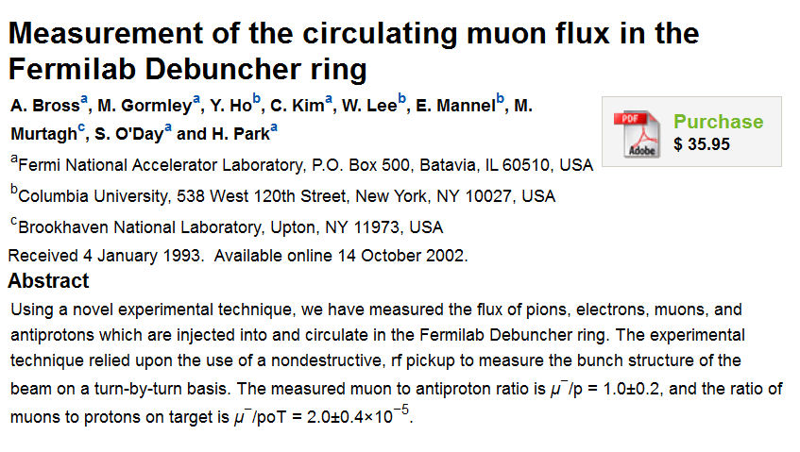
Muons in the Debuncher?
Eugene didn’t do too Badly!

Slide 12
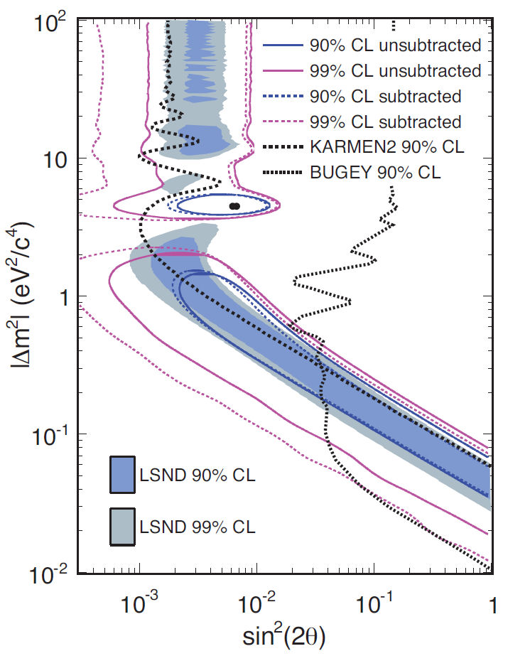
P860 Limits
MiniBooNE
Running
Phys. Rev. Lett. 105 181801 (2010)

Slide 13
Fast Forward 10 (ish) More Years

Slide 14
The Birth of the Neutrino Factory
TopCite 500+ “Renowned Paper”

Slide 15
Which Begat

Slide 16
Neutrino Factory Studies
Study 1 (US-Fermilab) [2000]
Study 2 (US-BNL) [2001]
NuFact-J study [2001]
CERN NF study [2002]
Study 2a (APS Multidivisional Neutrino Study) [2004]
ISS (first international study; ISS group) [2006]
One on-going
International Design Study for a NF
Just published its Interim Design Report

Slide 17
IDS-NF IDR (2011)
4MW Proton Driver
1 X 10²¹ useful n per year (0.5 X 10²¹ each sign)
Two 25 GeV m storage rings
Two detectors
2500-5000 km (100kT)
7000-8000 km (50kT)
But this is, of course, really
does takes us

Slide 18
Back to the Present
BUT
Neutrino Physics with a neutrino beam from muons.
The case for a μ Storage Ring

Slide 19
ν beams from a μ storage ring The Physics Case
One focus of this meeting is the physics of Beyond Three Family Neutrino Oscillations
An experiment that uses a ν_{e} beam from a muon storage ring
Can go a long way in confirming or ruling out sterile νs
Goal:
ν_{e} disappearance experiment with 1% precision
In addition, the beam opens up opportunities for
Detailed study of ν_{μ} interactions
Known ν beam flux and flavor composition
Oscillation Physics
What can be done with the MiniBooNE infrastructure?

Slide 20
Using the MiniBooNE Detector
With 10% of the MiniBooNE flux, we could expect about 10,000 events (each of ν_{e}-bar and ν_{μ} for the same proton exposure as for MiniBooNE ν running
1% measurement of ν_{e} disappearance
Study of ν oscillations (non-magnetized detector)?
Kinematically ν and ν-bar events are different
Muon lifetime due to μ⁻ capture
cosθ distribution
ν-bar produce more forward lepton
Effect largest around 1 GeV
Outgoing nucleon is either a proton or a neutron (QE)
Neutron tagging via Gadolinium doping and n absorption
8 MeV γ - Tag ν-bar events
In this context, MiniBooNE presents an interesting experimental opportunity with this type of beam

Slide 21
Comment on ν Flux & Exposure
Useful ν/proton
MiniBooNE obtains: 5 X 10⁻⁴
Number of neutrinos that hit detector/POT
We said that an interesting Experiment needs
10% of MiniBooNE flux ⇒ 5 X 10⁻⁵ useful (hit the detector) ν/POT (Assuming same p exposure)
Remember Dave’s number?

Slide 22
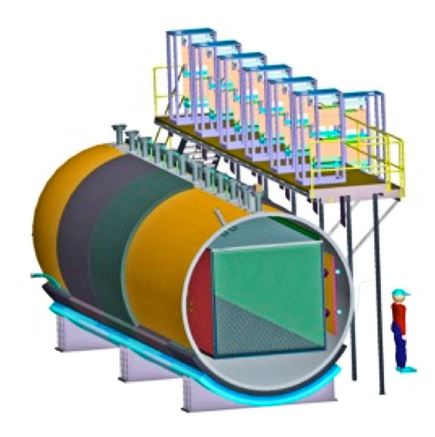
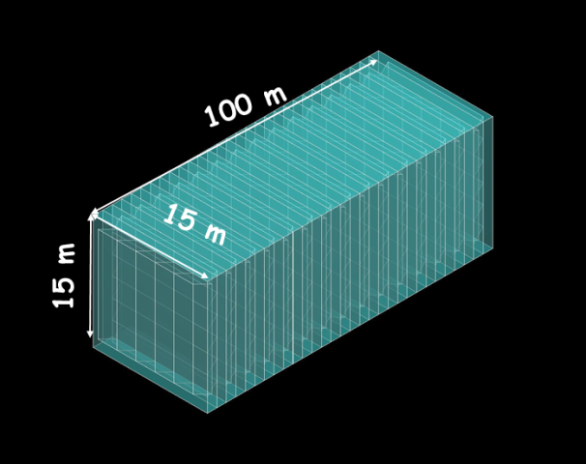
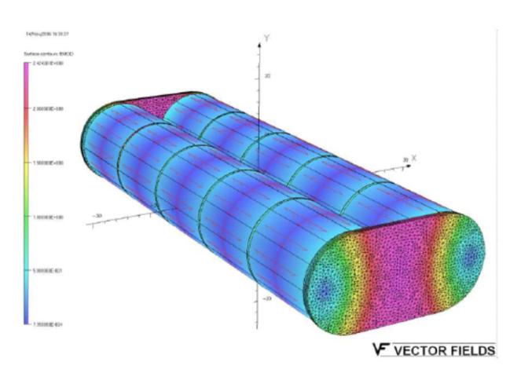
The Next Detector & Beyond
μBooNE would present an excellent opportunity
Particularly if it can be magnetized for oscillation physics
A roughly 1 kT totally active scintillator detector (magnetized) would also be an interesting possibility

Slide 23
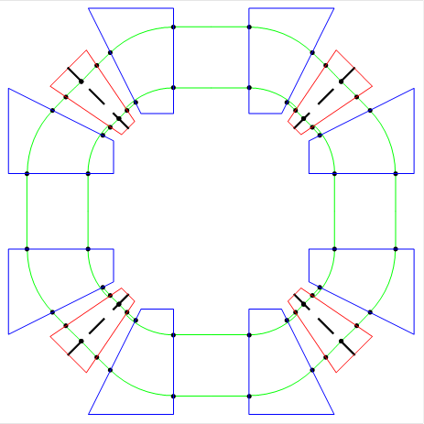
μ Storage Ring Schematic
Simple ring
Small # turns
No need for UHV
No RF
How can we do it?
MiniBooNE decay region = 50 m
Decay ring with 50 m straight
FFAG ARCs

Slide 24
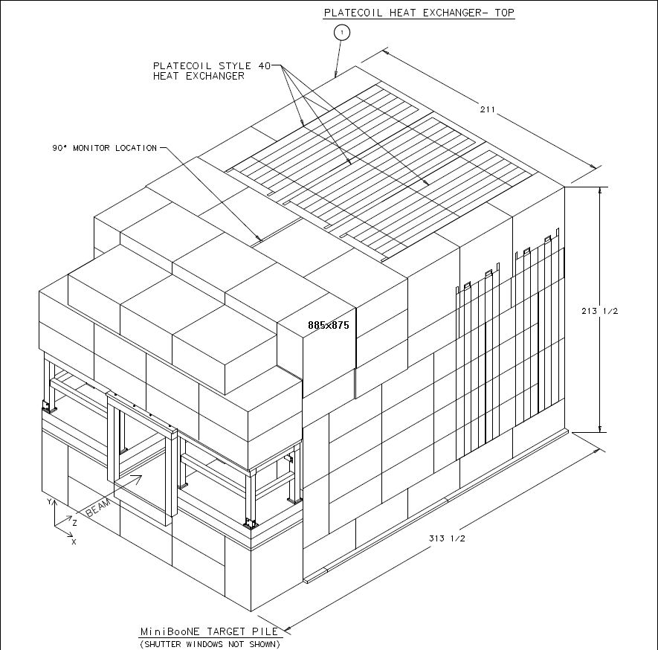
Targeting
Two options
External Target (a few 10s kW)
As Dave envisioned in his Telemark paper
Issue is injection
Internal Target
No transfer line, injection
Potentially higher collection efficiency, but
Issue – Target pile

Slide 25
Target Hall Options

Slide 26
Use AP0 Target New transfer line & μ Storage Ring Hall
~650m
~60m

Slide 27
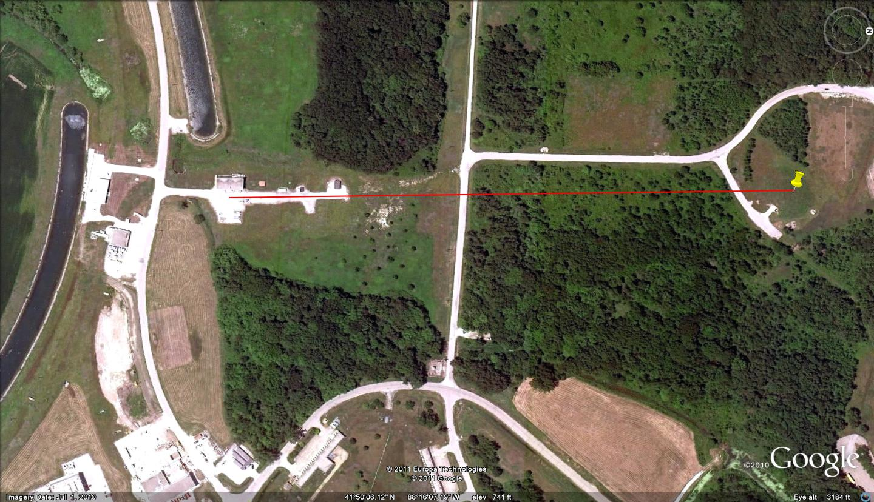
New MiniBooNE Target Hall
~60m
~450m

Slide 28
MiniBooNE Target Hall & p Beam line
Siting?

Slide 29
Very Preliminary Costing
New Target Hall: $18M (escalated by 30% from MiniBooNE 2005 numbers)
Beam line
Target
Horn
Civil
μ Storage Ring (not burdened)
Dipoles: $1M
Quads: $2M
Power Supplies: $1M
μSR instrumentation $2M

Slide 30
Conclusions
ν beams produced from the decay of μ in a storage ring present exciting possibilities to study topical ν physics (complementary to conventional ν beam experiments)
Sterile ν study via ν_{e} disappearance experiment
Oscillation physics (some reach even without B)
ν_{μ} interaction studies
Excellent flux normalization
Flavor content known
All of the above can be done (some better than others) with the MiniBooNE detector
New detectors present extended possibilities
Magnetized μBooNE
Mini-TASD (also magnetized) at some future time

Slide 31
Conclusions II
Some R&D needs to be done, of course
Detailed study of external vs. internal targeting for the μ Storage Ring
Optimized design of μ Storage Ring
Beam diagnostics
Realistic capability of Beam Current Transformers for this application
Measuring decay electrons
Radiation damage issues for storage ring components
How to site the new Target Hall
Accurate Costing
A <$50M estimate at this time seems Credible (including some detector work)
However, this concept does not represent Future Technology
It is today’s technology with some extensions
The physics is timely and can, in principle, be done in the short-term
A detector exists and a 2nd is on the way

Slide 32
Finally, Back to the Future (again)
This very-low energy μ storage ring represents a first, small step to facilities that need ultra-intense μ sources that are, or may become, the future of this Laboratory
cLFV experiments (μ2e)
Cooled μ beam (muon ionization cooling) as upgrade path
Neutrino Factory
Best opportunity to exploit ν oscillation physics if θ₁₃ is small
Muon Collider to explore the energy frontier

Slide 33
Acknowledgements
David “Nostradamus” Neuffer (Neufferdamus?)
Chuck Ankenbrandt, Carol Johnston, Milorad Popovic, Sergei Striganov
Bill Louis, Zarko Pavlovic, Bob Zwaska
André de Gouvêa, Joachim Kopp, Patrick Huber

Slide 34
END
Thank You
Or Just The Beginning?

