Slide 1
NuComp News (and FY11 budget analysis)
Lee Lueking
March 16, 2011

Slide 2
Outline
New stuff and planned stuff
Maintenance day stuff
Miscellaneous
Usage Eval and FY11 Requests review
BlueArc Disk
GPCF VM & Batch
FermiGrid, sp. GP Cluster

Slide 3
IF web area
BlueArc disk area is being served by FNAL web server
Disk: /nusoft/app/web/htdocs/<group>
Admin: owner:group =nusoft:nusoft
GrpAdmin (proposed): owner:group=<group>web:<group>
url:http://nusoft.fnal.gov/<group> (ex. nova, lbne)
This is intended for automated/monitoring information. It is not a replacement for experiment’s afs web area.

Slide 4
Group /home areas for if/gpcf
Group areas have used “local” /home/<group> area with .k5login
This is awkward; there are lots of group accounts now.
Inventory and plan: https://cdcvs.fnal.gov/redmine/attachments/1770/gpcf-home-accounts20110211.pdf
move to /<exp>/app/home/<group>
REX will set up areas, and move obvious stuff (.k5login).
Exp’s/groups need to help/double check.
FEF will change to new homes
Should be transparent, will coordinate with each exp.
Existing /home areas will remain for a while.

Slide 5
Maintenance Day: Tomorrow 3/17
Reboot GPCF/IF/MINOS/MB nodes for kernel updates
https://fefweb.fnal.gov/mediawiki/index.php/EAG,_GP_Grid,_IF_Experiments_-_17_Mar_2011
Upgrade GlideinWMS on GPSN01, batch unavailable.
IFORA PRD Oracle v10 to v11 upgrades: MINOS, MINERvA, NOvA
Nova & Argoneut BlueArc volume migrations to new back-end arrays:
blue3:/nova/app blue3:/nova/data
blue3:/argoneut/data blue3:/argoneut/app
MINOS specific work
Bluearc /minos/data remount globally to eliminate data1,data2 paths
Removal of /minos/scratch compatibility link
FermiGrid
rebooting the head nodes of the GP Grid cluster to do kernel updates., also
changing automount maps to account for the bluearc changes.

Slide 6
Security Audit Next Week
Next week the security auditors will be onsite.
Please be extra vigilant!
Do not have un/pw on display
Use password locked screen savers,
Lock you office
Don't let people tailgate into secure areas.
Ask to see badge ID when it doubt
Use common sense
Spread the word

Slide 7
Next NuComp
April 13 or 20, 2011 (?)

Slide 8
Usage Stats and Evaluation of FY11Budget
Where are we?
How should we modify requests if budget:
Cut by 10%?
Cut by 30%?
Disk and GP Cluster CPU were purchased near the end of FY10 to get a leg up on FY11.
FY requests and FY budgets are offset in time.
Cost of equipment might be different (hopefully lower) than estimated.

Slide 9
Central Disk (BlueArc)
 | 2009 | 2010 | 2011 (replace) | 2012 request
MiniBooNE | P80 | 30 | P15+P10 (+13) | 0
MINOS | P90 | P30 | P30 (P30+30) | 30
MINERvA | P10 | P20 | P20+P15 | 30
Argoneut | P20 | 0 | 0 | 0
NOvA | P4 | P26 | P30 | 100
MicroBooNE | P2 | 0 | P5 | 30
LBNE (all) | 0 | P2 | P20 | 0
Mu2e | 0 | P2 | P2 | 0
g minus 2 | 0 | 0 | ?20 | 0
Psatisfied
Pin hand

Slide 10
BlueArc Data Areas

Slide 11
BlueArc App Areas

Slide 12
BlueArc Disk usage vs. FY11 Request
X
X = best guess or no information

Slide 13
GPCF Status
 | Int. Login status | Comments | Local Batch
ArgoNeuT | 1 VMP |  | Jobs submitted through gpsn01 Currently 84 job slots: 7 worker nodes with 12 slots on each (limited by memory, plan to purchase). Four additional nodes to be added soon: FKA gpcf026,30,31,32.
LBNE | 2 VMsP | Gpcf026 to gpwn pool
MicroBooNE | 1 VMP
MINERvA | If01-if04 2 VM’sP | If05 to be returned soon. (slf5?)
MiniBooNE | (not assigned)
MINOS | Minos50-54P 1VM (for testing)
Mu2e | 1 VMP+ 1 VM (for testing)
NOvA | 5 VM’sP+ 2 x gpcf nodes temporarily | Gpcf028+29 until VM I/O issues resolved

Slide 14
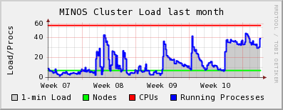
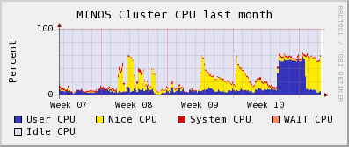
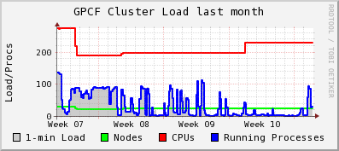
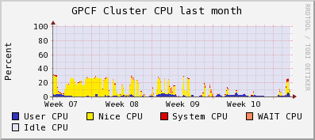
Ganglia Stats
Linked from https://cdcvs.fnal.gov/redmine/projects/ifront/wiki/Monitoring_Stats

Slide 15
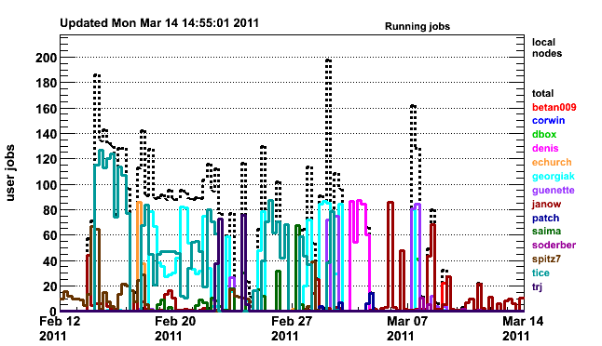
Batch Jobs gpsn01 Cluster
http://gpsn01.fnal.gov/condor_monitor/index_month_grid.html

Slide 16
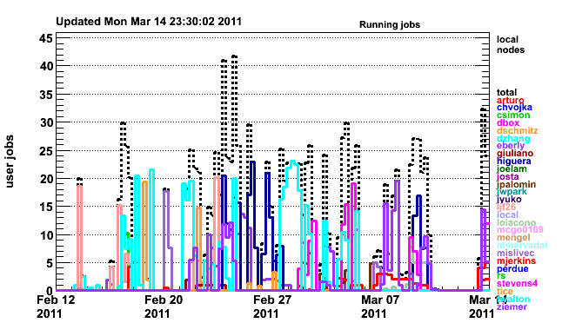
Batch Jobs on if01 Cluster
http://if01.fnal.gov:8080/condor_monitoring/index_month_local.html
24 total slots

Slide 17
GPCF/IF/MINOS usage vs. FY11 Request
Includes rough estimates of gpsn01 batch usage

Slide 18
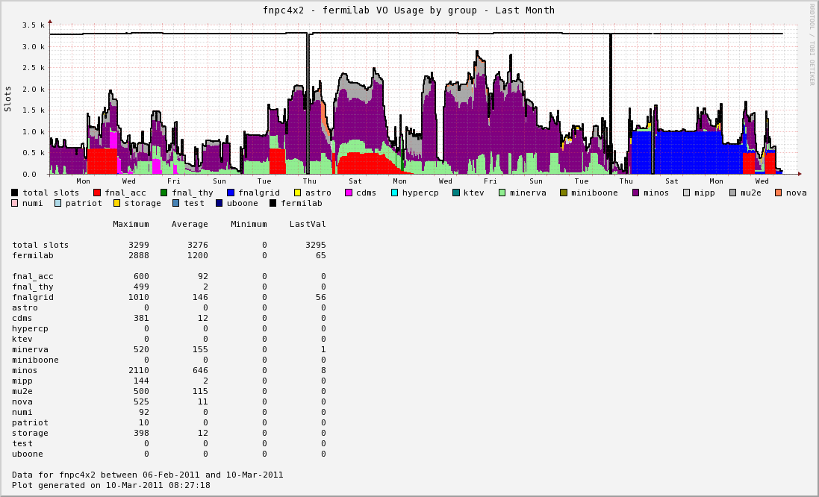
FermiGrid GP Cluster Last Month

Slide 19
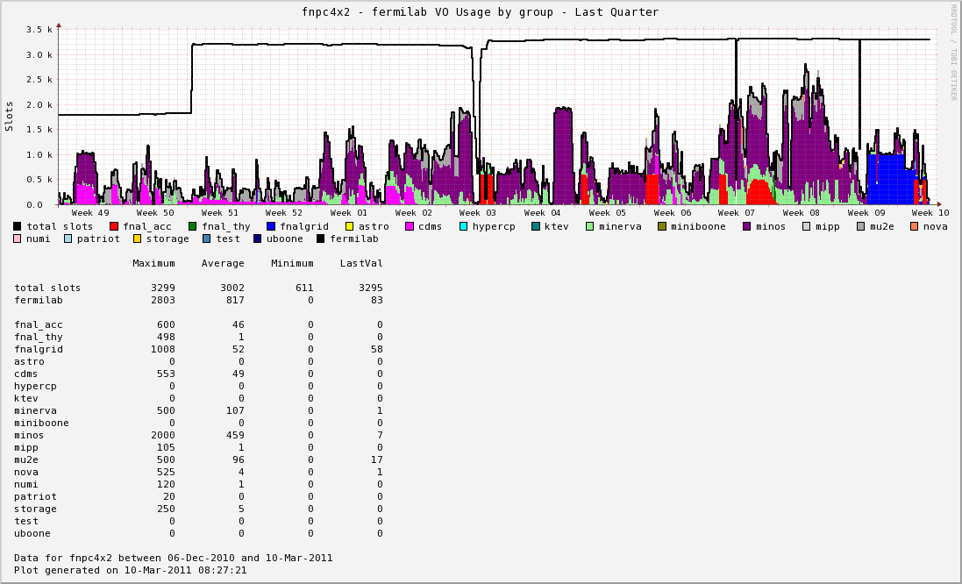
FermiGrid GP Cluster Last Quarter

Slide 20
GP Cluster Usage vs. FY11 Request
Used last month’s accounting for “Actual”

Slide 21
FY12 Requests (very uncertain)

Slide 22
Other Thoughts and Conclusions
Replacement hardware for EOL is also in budget.
10% cut scenario
Reduce grid replacements
Reduce BlueArc some
30% cut scenario, 10% cuts plus
Reduce added grid nodes by 25%
Reduce BlueArc by 20% (might be done with cheaper alternative).

Slide 23
finish

