Slide 1
DC Trip Overview Fermilab Users Executive Committee Meeting
March 11, 2011

Slide 2
General Timeline (Part 2)
Should be done: send Marj your list of congressional contacts
Today: deadline to book hotel room at Best Western Georgetown
Now: fill out Travel Authorization spreadsheet with cost estimates including airfare
Soon: you will receive a list of members of Congress for whom you are the primary contact
fax/email a letter requesting an appointment
follow-up a few days later with a phone call
GET AN APPOINTMENT
fill out the spreadsheet to report your appointments
In the meantime, familiarize yourself with
the materials that we will be taking
the Congress members that you will be visiting (background, voting record, etc)
the science that effects their district/state

Slide 3
General Timeline (Part 1)
Shortly before the trip you will receive a list of appointments where you are the secondary (and the list of your secondaries for your appointments)
Apr. 12-15: Washington trip
After the trip: fill out the visit form for all appointments
After the trip: fill out your Travel Voucher spreadsheet and provide Barb with your receipts

Slide 4
Timeline In Washington (Part 1)
Tues Apr. 12
arrive mid-afternoon if possible
check into your hotel
group dinner (around 6:30 or 7pm)
meet your partners for appointments

Slide 5
Timeline In Washington (Part 2)
Weds Apr. 13
meet at URA Headquarters early (8am?)
short briefing session + continental breakfast
pick up your folders
head to Capitol Hill for appointments
generally should start after 10am
first timers should avoid scheduling an appointment before noon so they can be a secondary before being a primary
appointments 10am-5pm
group dinner (again probably around 6:30 or 7pm)

Slide 6
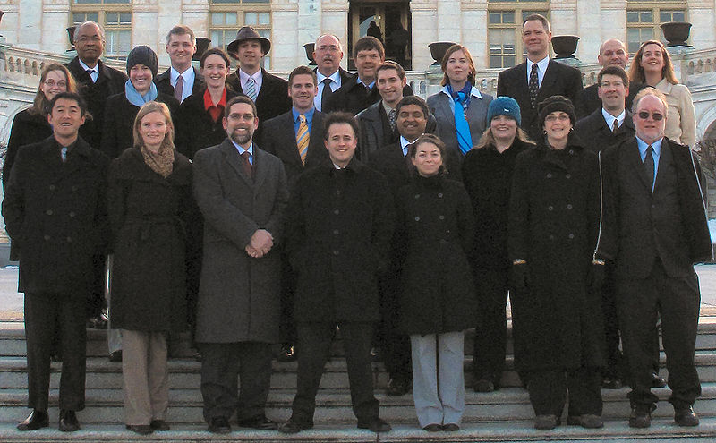
Timeline In Washington (Part 3)
Thurs Apr. 14
meet on steps of Capitol building for group photo (early)
Head to appointments
generally should start after 9am
most folks will head home late afternoon or early evening

