Slide 1
Indian Institutions and Fermilab Collaboration on High Intensity Proton Accelerator (Project-X)
Shekhar Mishra
Project-X, Fermilab
International Collaboration Coordinator
Talk Given at BARC/DAE March 23rd, 2011

Slide 2
650 MHz Cryomodules
650 MHz cryomodule design collaboration
Fermilab, RRCAT
650 MHz cryomodule team leaders
Tom Peterson (650 MHz cryomodule subproject manager)
Camille Ginsburg (650 MHz cavity subproject manager)
Yuriy Orlov (Fermilab 650 MHz cryomodule point of contact)
Prashant Khare (Indian Institutions 650 MHz cryomodule point of contact)

Slide 3
CM Functional Requirements
Among the important 650 MHz cryomodule functional requirements (but not an all-inclusive list) are the following:
Provide the required insulating and beam vacuum reliably
Minimize cavity vibration and coupling of external sources to cavities
CW operation and RF power tightly constrain cavity tune and microphonics
Provide good cavity alignment (<0.5 mm)
Allow removal of up to 250 W at 2 K per cryomodule
Requires revising TESLA/ILC pipe sizes and configurations
Intercept significant heat loads at intermediate temperatures above 2.0 K to the extent possible in full CW operation
Provide high reliability in all aspects of the cryomodule (vacuum, alignment stability, mechanics, instrumentation) including after thermal cycles
Provide excellent magnetic shielding for high Q0
Minimize cost (construction and operational)

Slide 4
Design Status
Various cryomodule designs from laboratories around the world have been reviewed by Fermilab and RRCAT to understand “the state of the art” and to supplement our design concepts
Designs differ due to various kinds of requirements
Generally means adapting but not copying design concepts for Project X
Overall mechanical and thermal design based on a closed-ended TESLA-style cryomodule has been selected as an initial baseline
Design incorporates unique features for high dynamic heat loads at 2 K (~25 W/cavity)
CW operation and RF power tightly constrain cavity tune and microphonics

Slide 5
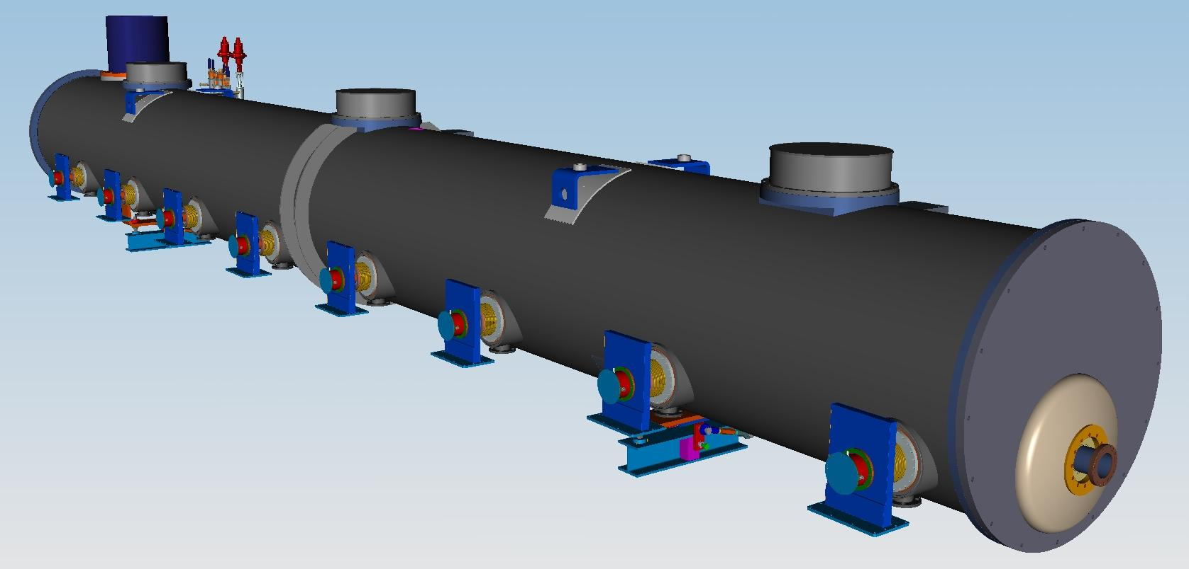
650 MHz Cryomodule (Tesla Style-Stand Alone Concept Fermilab)
Vacuum vessel
Cold mass supports (2+1)
Power MC (8)
Beam
End Plate

Slide 6
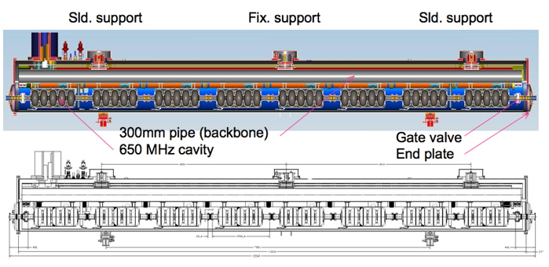
650 MHz Cryomodule (Tesla Style Concept Cross-section Fermilab)

Slide 7
RRCAT

Slide 8
Glimpses of 650 MHz CM 3-D Model (more from RRCAT contd…)
SCRF Cavity supported on HGR pipe
The model incorporates a modified Cavity support system.
2K helium supply line includes a bellow in vertical configuration
Notes:
8

Slide 9
650 MHz CM Conclusions
Many very good ideas and much work have already gone into SRF cryomodule design by various laboratories around the world
DESY, Jlab, Cornell, INFN, Saclay, HZB (Berlin) and others
Fermilab and RRCAT are building upon the experience from these various other laboratories as well as continuing our own analysis and design work in developing a cryomodule design for the unique requirements of the 650 MHz, CW section of the Project X linac

