Slide 1
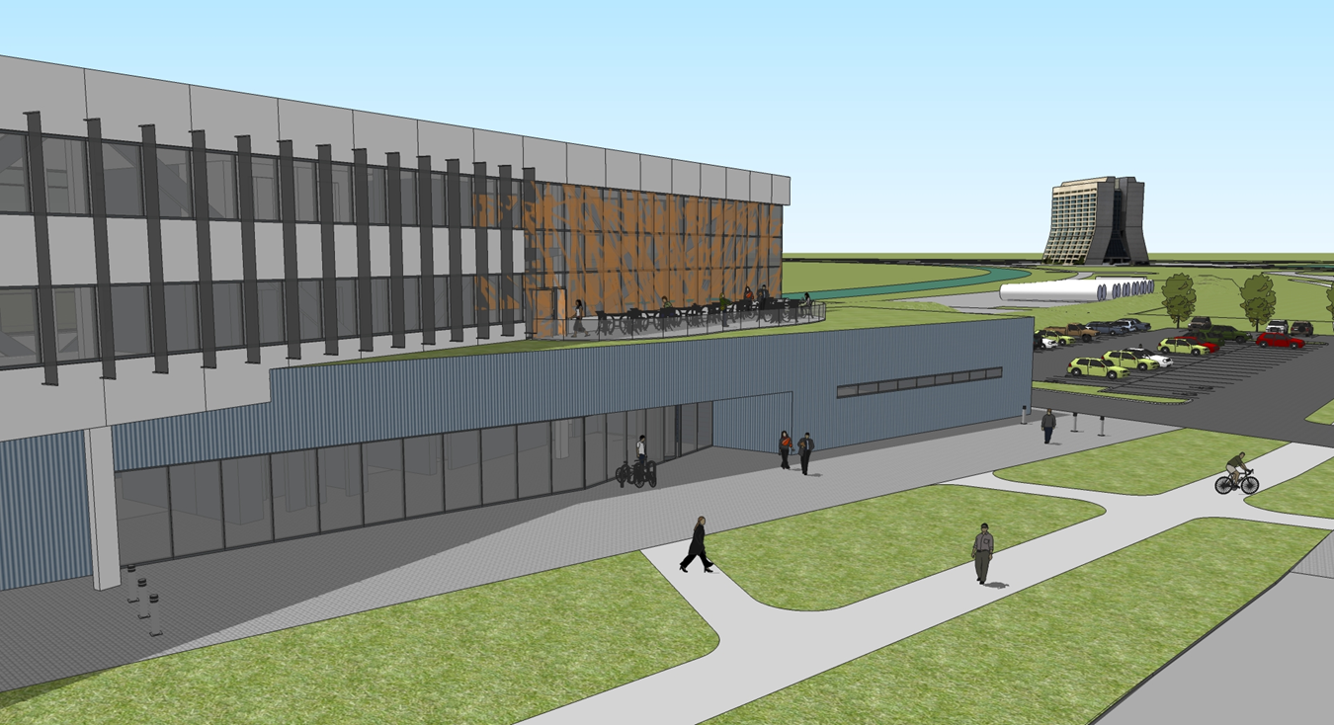
OTE Building PMG Report 03/17/2011
Rhonda Merchut

Slide 2
Overall Project Summary Status:
OTE bi-weekly design meetings on-going. Includes HOK, RBA, FESS-Eng, Ops, Services, CDF, AD, CD
OTE Building Preliminary Design on-going.
Building systems design directions
Cost evaluations
LEED evaluations
HOK PD submittal due 3/24/11

Slide 3
Overall Project Summary Status:
OTE Education/Conference Area concept evaluation underway.
Concept direction: 175-person + 30/30 executive
HOK PO for add’l services in progress
Coordination of related projects on-going.
IASU & FCC San Sewer projects bids due 3/25/11.
Lift station Circuit breaker installed in CDF 3/7/11
Meeting with Tev museum consultants 3/7/11

Slide 4
Table of Recommendations – Corrective Action Plan (no changes this month)
Open Items:
Identification of add’l scope items (if bids are favorable) to be determined based on preliminary design
Integrated design schedule and time frames: on-going
Design remains on track to meet Final Design Director’s review 7/21/11

Slide 5
C A P
# | Recommendations | Assigned to | Status/Corrective Action | Due Date | Closed
2.0 | Project Preparedness
2.1 | Cost and Scope
1. | The use of the DOE escalation rate for FY12 is not a recognized best practice. Facility and construction escalation costs have historically been significantly higher than DOE rates. It is recommended more appropriate escalation rates be used for the cost estimate. | Merchut | Comment withdrawn by J. Budd per email 10/14/10. 5.4% Escalation indicated in PP adequate. |  | 10/14/10
2. | Additional scope items need to be identified, estimated, and prioritized so in the event favorable bids are received during the construction RFP a clear plan is in place for allocating the additional funds. | Merchut | Additional Scope items identification & design included as part of HOK scope of work. Postponed until prelim design complete | Prelim: 5/1/11 Final: 7/14/11
3. | Project currently plans include continuation of RBA as LEED project manager to insure the project obtains Gold certification. Project should consider assigning responsibility for LEEDs Gold certification as part of the HOK design contract. In the same manner that “design to cost” is a contract requirement, “design to LEEDs Gold” could also be a delivery requirement. | R. Merchut | LEED Manager responsibility to provide final design documents to achieve LEED Gold, with all supporting documentation, tracking, shop drawing verification, & final systems verification included in HOK scope of services. RBA project coordination RFP is to provide review & oversight of HOK LEED work. |  | 11/18/10

Slide 6
# | Recommendations | Assigned to | Status/Corrective Action | Due Date | Closed
2.0 | Project Preparedness
2.2 | Schedule
4. | Create an integrated overall IARC schedule which includes accelerator operation decision points, scheduled shutdowns, the utility upgrade project, and the OTE design and construction schedules. | R. Merchut B. Aprile AD CDF | Baseline integrated schedule for utility upgrade project and OTE created and will be updated and expanded on-going during final design & construction. Start of construction scheduled after Tev close 9/30/11 | 6/2/11 | 11/10/10
5. | Review the OTE project schedule to assure that adequate time is included for performing reviews, addressing recommendations and obtaining signoff/approval of final procurement documents. | R. Kephart R. Merchut | The additional Director’s Review at the end of final design is incorporated into the schedule. Add’l time DOE approvals to be determined and added. | 5/6/11 | 11/10/10
6. | The impact of vibration due to construction on accelerator operations has not been clearly understood. The committee recommends pre-drilling a prototype casing foundation to measure the impact on operations. | R. Merchut CDF AD | Prototype caisson will NOT be pursued. Caissons work to be after 9/30/11. | Spring 2011 | 1/19/11

Slide 7
# | Recommendations | Assigned to | Status/Corrective Action | Due Date | Closed
2.0 | Project Preparedness
2.3 | Management & Oversight
7. | There should be CDF and AD people on the IPT. | R. Merchut P. Czarapata | Dervin Allen has been added for CDF. AD representative to be identified. Duane Newhart added as AD representative. | 12/15/10 | 12/15/10
8. | Retain the Project Managers control over change to a reasonable level, and make the PMG function as the change control board for larger changes. This eliminates the separate change control board and removes the need to check with the PMG for changes that require broader consideration. | R. Kephart R. Merchut | The Project Plan has been revised to eliminate the separate Change Control Board. The PMG is now identified as the Change Control Board. |  | 10/29/10
9. | Project management should convene a working group or mini-review where operations experts can work with the FESS to ensure the proposed building construction steps fit the schedule and minimally impact operations, e.g. CDF, TD, Road D, fire response, etc. | R. Merchut | To be conducted during Concept validation. Additional reviews will take place as the design develops | 12/30/10 7/14/11 | 12/30/10
10. | There should be a review prior to submitting an RFP for the construction contract to ensure that the cost, schedule and interface conditions are well understood. | R. Merchut | A Director’s Review at the conclusion of Final Design has been added to the schedule. | 7/21/11

Slide 8
Fiscal – EDI Professional Services
Anticipate add’l conference room A/E services at $55K
Geothermal test bore: $15K
Perc tests if permeable pavers will be used: $4-$5K
Site Survey: ??

Slide 9
Schedule Resource loaded schedule in progress
Tracking Milestone | Definition | Target Date | Date Accomplished
OTE Building
CDR Complete | RBA delivers CDR document | 6-Oct-10 | 6-Oct-10
Director’s Review | Review by FNAL mgmt of Proj Plan | 13-Oct-10 | 13-Oct-10
Engineering Start | Proj Plan approved, directorate sign-off | 18-Nov-10 | 16-NOV-10
A/E start | Proposal negotiations complete, PO issued | 18-Nov-10 | 3-DEC-10
Concept Validation |  | 30-Dec-10 | 7-Feb-11
30% Final Design OTE building |  | 30-March-11
Pre-Final Design OTE Building |  | 8-June-11
CC Review Building Final Design |  | 29-June-11
Eng Drawings complete | CCR comments incorporated | 15-Jul-11
Director’s Review | Review by FNAL management for cost, schedule, & interface conditions per 10/13/10 Director's Review | 21-Jul-11

Slide 10
External Milestones
IASU & FCC San Sewer projects bid together to allow 1 contractor coordination of both projects. Bids due 3/25/11. Anticipate award o/a 4/29/11 (subject to required approvals of successful bidder).
A1-CDF Road paving postponed until Fall ‘11
Accelerator Shutdown:
Final Close 9/30/11: Start Building construction after all systems shut down.
Identification and status of various vents, controls, etc. on north elevation of CDF underway to determine impact on scope, cost & schedule of OTE construction

Slide 11
Risk Management External Risk Status
NEPA categorical exclusion (CX) received 3/8/11 for revised IASU parking lot.
Jurisdictional Determination: Per Kathy Chernich, Regulatory Branch, COE Chicago District, COE will not visit site until Spring 2011, however indicated “if the hydrologic connection from the wetland to a waterway is through underground pumping methods then we probably would not regulate it…[and] If the wetland is used for cooling purposes only then we probably would not have jurisdiction.” (2/8/11 email)

Slide 12
Risk Management External Risk Status
IASU/FCC San Sewer construction award – may take 5-6 weeks after bid opening for contractor to submit corporate safety policy (approval by ES&H), HA plan, bonds, small business sub contracting plan if large business. At this time, schedule can accommodate.

Slide 13
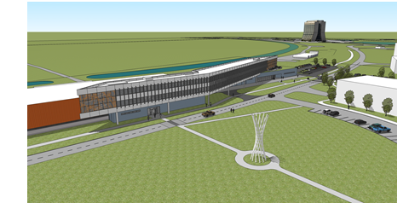
Risk Management External Risk Status
TEV museum may impact scope, cost, schedule.
Bus drop-off in front of Ground Floor East (accessible access to CDF): impact on geothermal wells, additional road work – consider pavers to match Ground Floor West. Study interior relationships.
Consultant report due April ‘11. Continue working with Katie Yurkewicz, Kurt Reisselmann.

Slide 14
Risk Management Internal Risk Status
DCEO Bond funding court ruling: Stay issued by Illinois Supreme Court. J. Eisenmenger will continue to monitor
Safeguards and Securities lab costs impact: C. Conger will continue to monitor

Slide 15
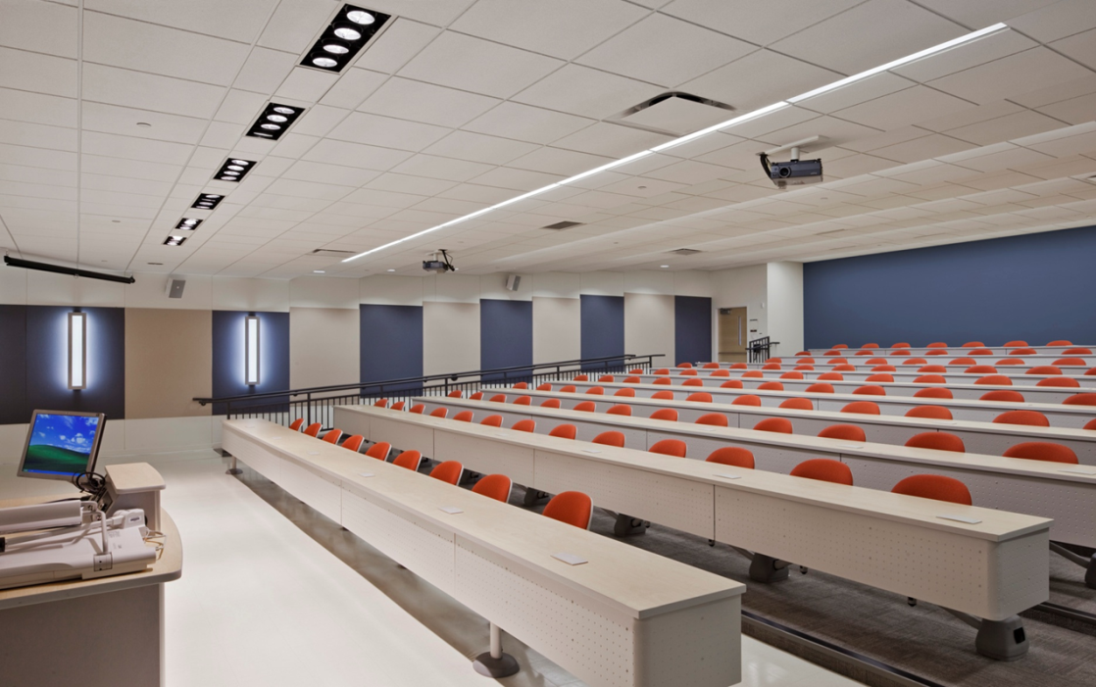
Risk Management Internal Risk Status
Conference Area Change approval: Updated cost estimate based on Prelim Design (4/07) to be basis for understanding additional scope/cost impact. Rapid turn-around for change control will be required.

Slide 16
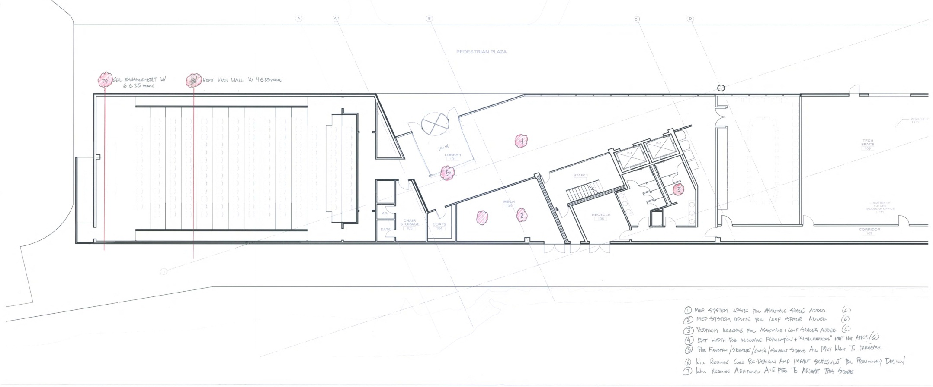

Slide 17
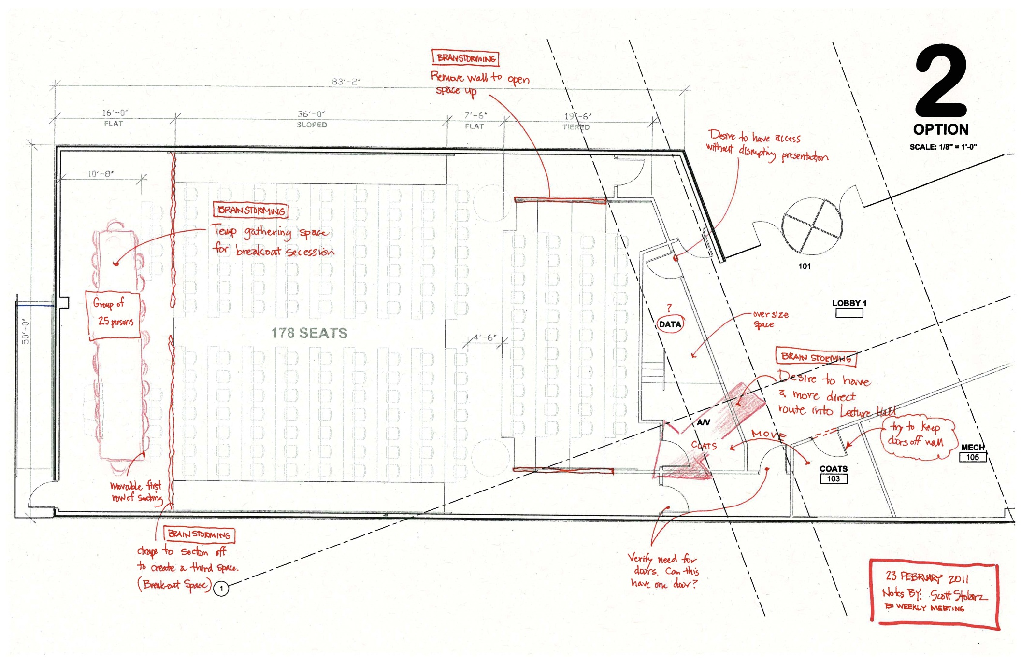

Slide 18
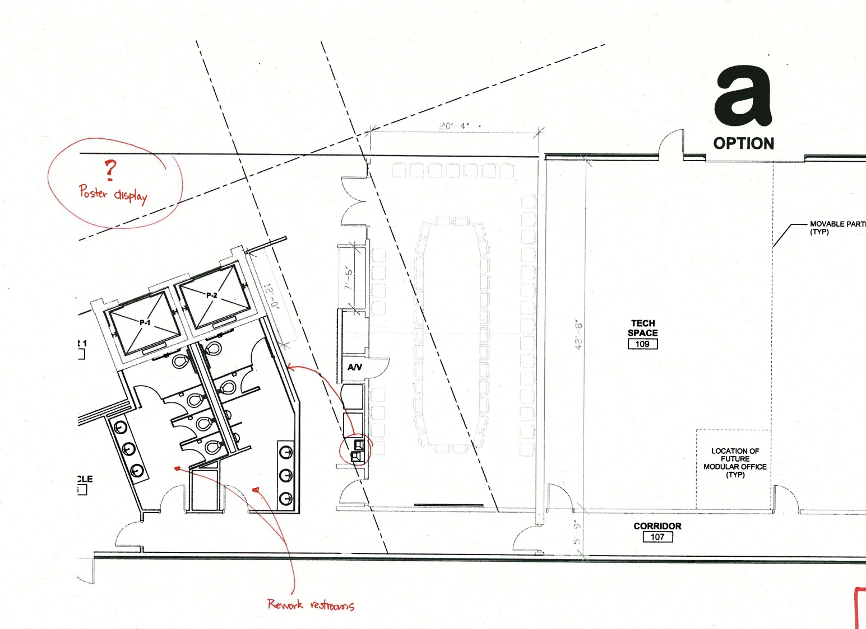

Slide 19
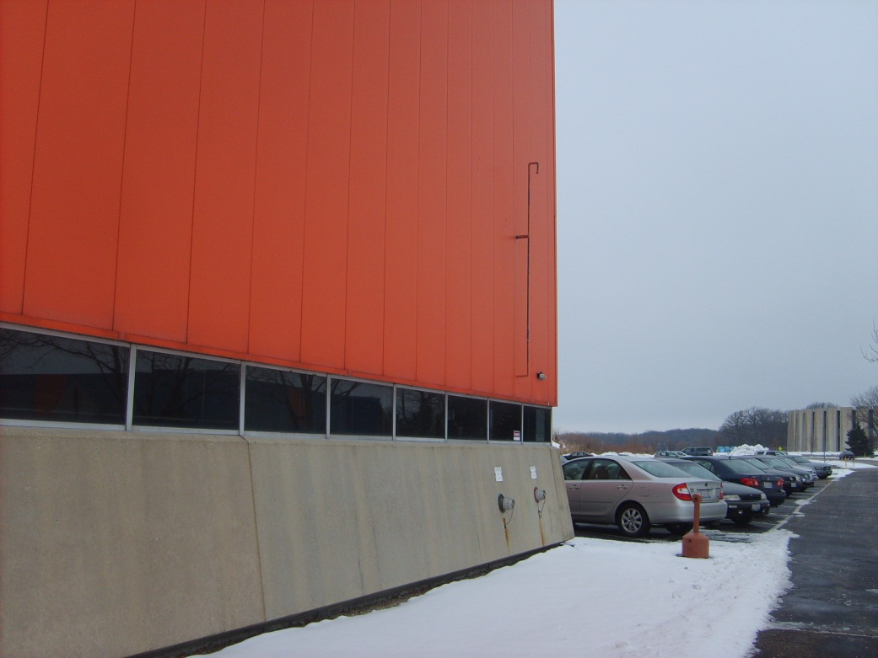
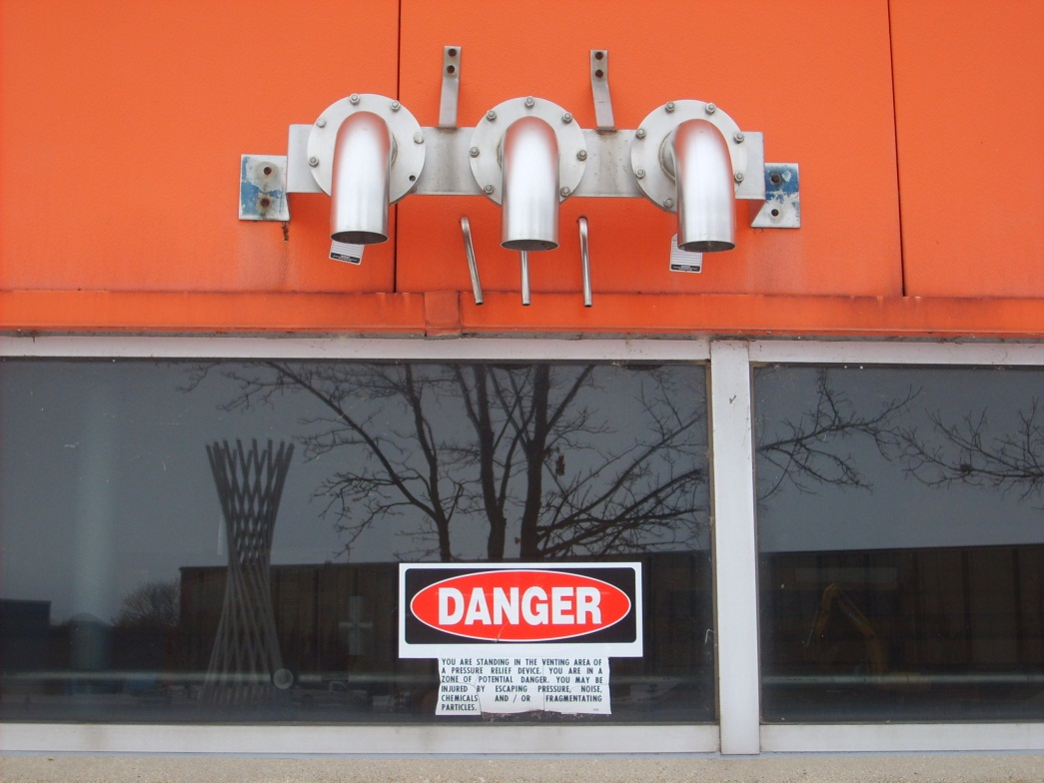
Risk Management Internal Risk Status
Impact of existing CDF equipment on north elevation: Owner equipment to be removed prior to construction start. Dervin Allen, Jonathan Lewis are identifying, advising.

Slide 20
Procurements
Conference area design change REQ in progress
RFP for Thermal Conductivity Testing for Ground-Loop Heat Exchanger in progress (geothermal test well).
External:
RFP for IASU/FCC San Sewer construction contracts in progress. Award o/a 4/29/11
Air switch PO issued. Promised by 5/10/11

Slide 21
Labor Resources

Slide 22
Change Request
No active change requests
Future change request:
New Conference Center based on previously presented concept:
Tiered Conference/Lecture Center for 175 people to replace current 4-25 person class rooms.
30/30 Executive Conference Room in lieu of 1 Tech Space
Ground Floor East Entrance enhancements/drop-off area

Slide 23
Issues
Conference Room expansion scope finalization.
Wetlands impact from revised parking layout Resolved – no impact per CX 3/8/11
Radiation – Main ring bypass. Resolved per P. Czarapata 3/2/11
Structural understanding of CDF snow loading, fire separation protection of roof – additional steel for snow loading required. Investigating constructability in CDF.

Slide 24
Issues
DOE Directive for $2M – will this be a “new start”?
Zinc cladding: understand Buy American implications
Toilet Fixture count: evaluate “surge factor” for conference areas.
CDF bridge: evaluate internal vs external solution
Permeable Pavers: requires special snow removal (no sand). If limited to pedestrian areas, can building owner do snow removal?

Slide 25
Issues
New Gas Meter location: consider west wall of CDF, north of loading dock.
Fire Department Hook-up location: re-route through OTE Ground floor east. Approval by Fire Department required.
NOVA FHEP Table: need schedule of transporting out & in of CDF. Must be coordinated with construction schedule.

Slide 26
Look Ahead
Continue working on Integrated Project Schedule.
Complete Preliminary Design.
Evaluate cost estimate
Evaluate LEED Gold
Exterior materials selection.
Refine Conference Center design, initiate change control.
State Report quarterly report due 3/30/11.

