Slide 1
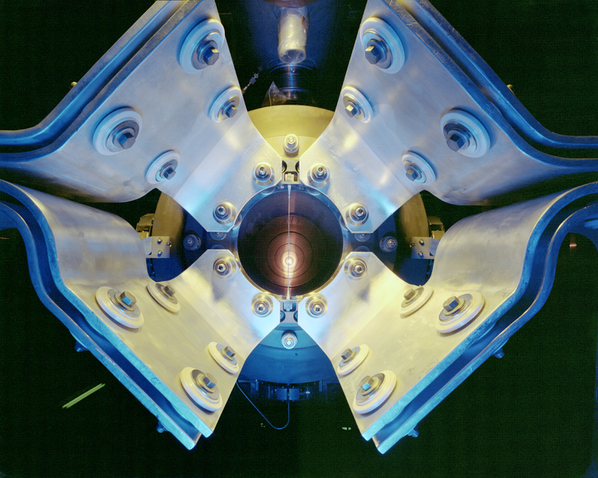
Fermilab in Transition
DOE Institutional Review, June 6th, 2011

Slide 2
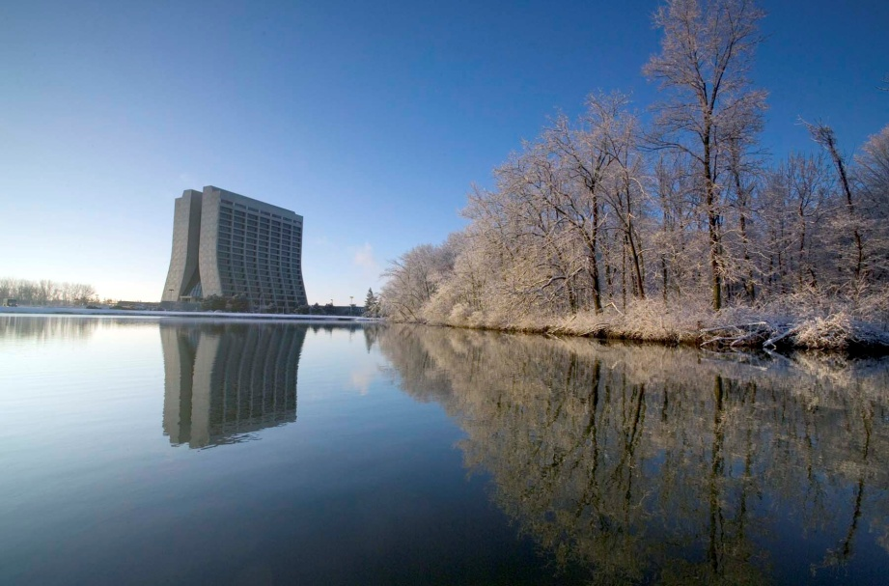

Fermilab characteristics (FY2010)
Highest intensity neutrino beams (low and high energy)
A world class astrophysics, particle theory and computation programs
Advanced detector and accelerator technology
1925 employees; $ 399M
2300 users and visiting scientists
6800 acres, park-like site
Tevatron: the only p-p collider through FY 2011

Slide 3
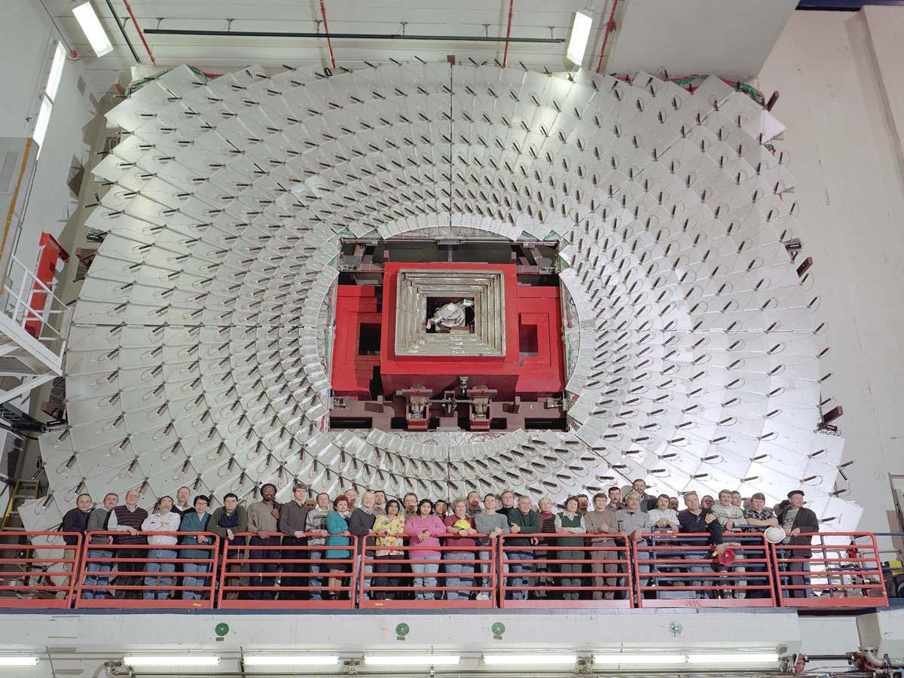
Mission: the national particle physics lab
Enable the US community to tackle the most fundamental physics questions of our era
Interdependence: integrate the universities and other laboratories fully into national and international programs

Slide 4
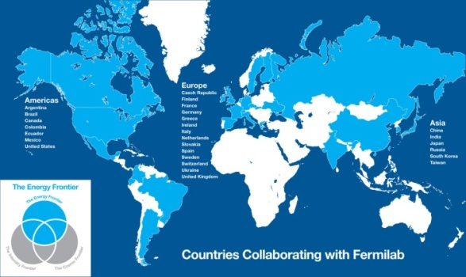
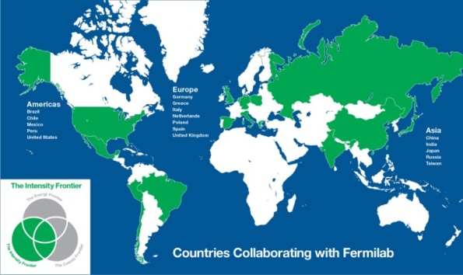
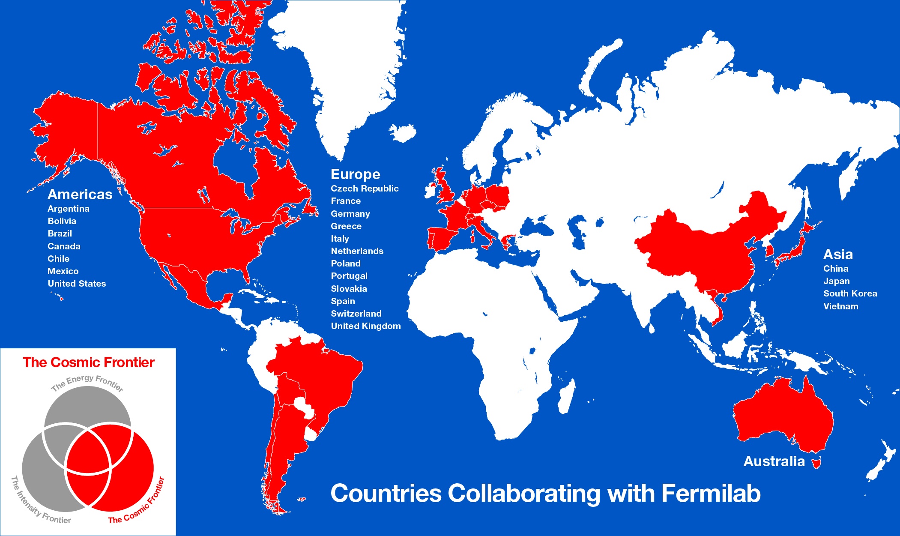
Collaborative Efforts
27 countries
International collaborations
for our programs
Collaboration among DOE laboratories
  Project X, ILC/SRF, Muon collider, neutrino factory, LHC Accelerator, many particle experiments, …
Work for other DOE laboratories
Argonne-UChicago-Fermilab Collaboration
17 countries
24 countries

Slide 5
Program drivers: science
The sense of mystery has never been more acute and evident
  Where does mass come from?
  Are there extra dimensions of space?
  Why only three families of quarks and lepton?
  Why is matter dominant?
  What are the neutrino masses and what do they say?
  Where are the heavy neutrino partners?
  Does nature use supersymmetry?
  Do the forces unify?
  What is dark matter?
  What is dark energy?

Slide 6
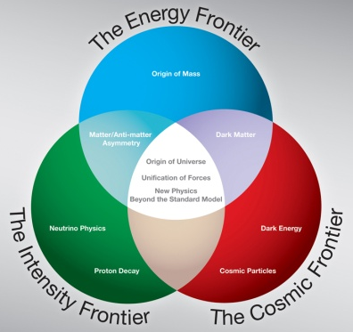
Program drivers: science
These questions fire the imagination of the public and the press
As the national laboratory for particle physics, we place the US in a leadership position in the world
Most elements are in place: exciting opportunities and national strategic plan at each of the three frontiers of particle physics: energy, intensity and cosmic frontiers
Historically many applications in society through development of accelerator, detector and computational technology

Slide 7
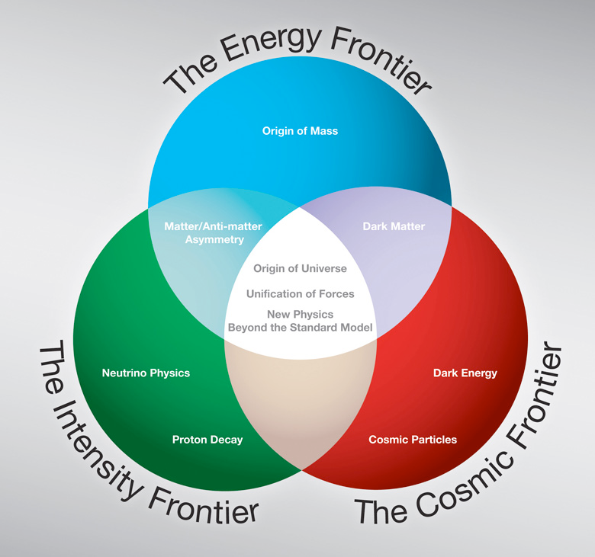
Future program: at the three frontiers

Slide 8
Gaps and roles: energy frontier
Next two decades: dominated by LHC. Upgrades to machine and detectors
Biggest gap: what follows the LHC? Depends on results and at what energy results occur
Fermilab strategy: completion of the Tevatron program and physics exploitation and upgrades of LHC. R&D on future machines: ILC if at “low” energy; muon collider if at high energy; new high field magnets for extension of LHC or future proton colliders at ultra-LHC energies

Slide 9
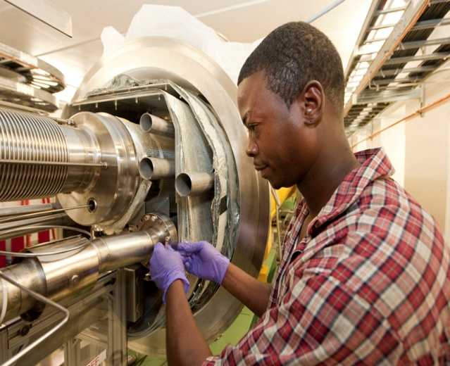
Roles: energy frontier
Tevatron
LHC
LHC
LHC Upgrades
ILC??
LHC
ILC, CLIC or
Muon Collider
Now
2013
2016
2019
2022

Slide 10
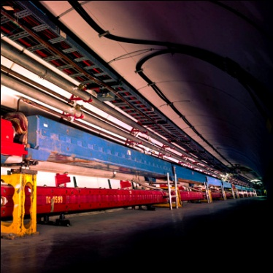
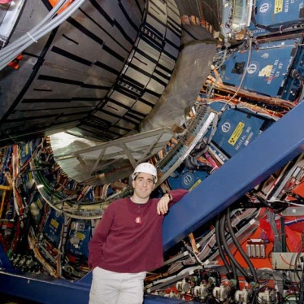
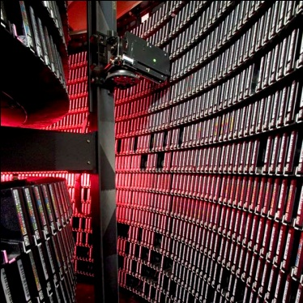
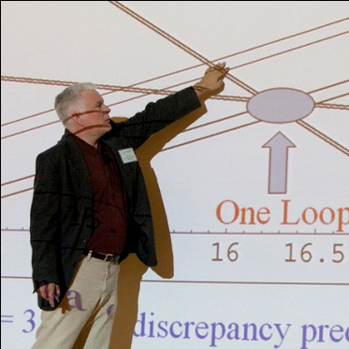
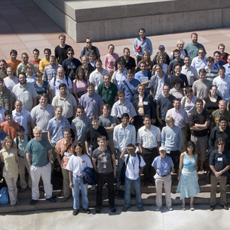
Energy frontier: the legendary Tevatron
Accelerator Innovations
  First major SC synchrotron
  Industrial production of SC cable (MRI)
  Electron cooling
  New RF manipulation techniques
Detector innovations
  Silicon vertex detectors in hadron environment
  LAr-U238 hadron calorimetry
  Advanced triggering
Analysis Innovations
  Data mining from Petabytes of data
  Use of neural networks, boosted decision trees
  Major impact on LHC planning and developing
  GRID pioneers
Major discoveries
  Top quark
  B_{s} mixing
  Precision W and Top mass → Higgs mass prediction
  Direct Higgs searches
  Ruled out many exotica
The next generation
  Fantastic training ground for next generation
  More than 500 Ph.D.s
  Produced critical personnel for the next steps, especially LHC

Slide 11
Gaps and roles: cosmic frontier
The principal connection to particle physics today: the nature of dark matter and dark energy
Gap in the direct search for dark matter: get to “zero—background” technology. Gap in understanding dark energy is establishment of time evolution of the acceleration: new major telescopes (ground and space)
Fermilab strategy: establish scalable “zero-background” technology for dark matter. Commission and exploit DES. Participate in future ground and space telescopes (the principal agencies are NSF and NASA, not DOE)

Slide 12
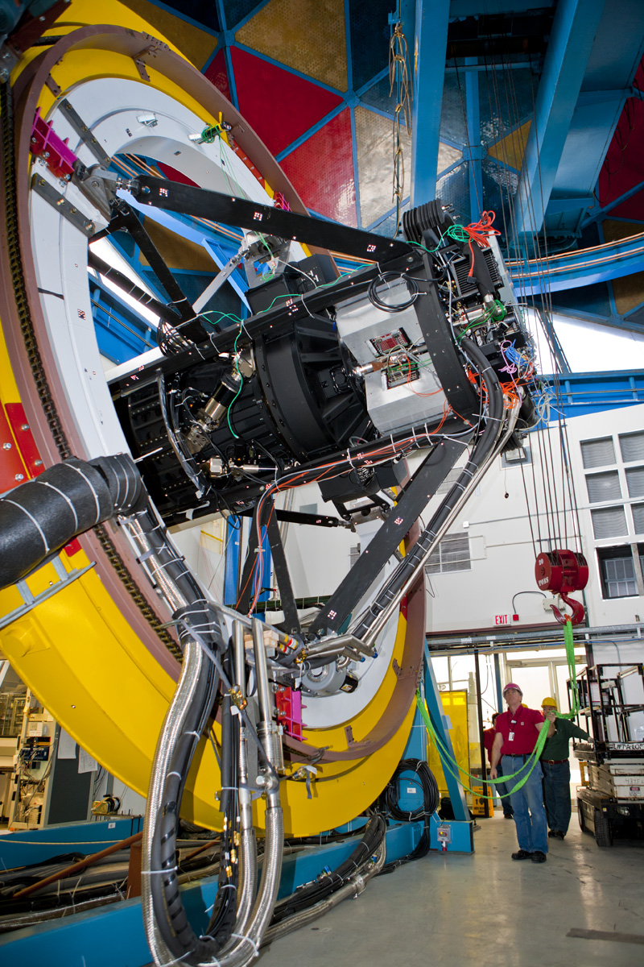
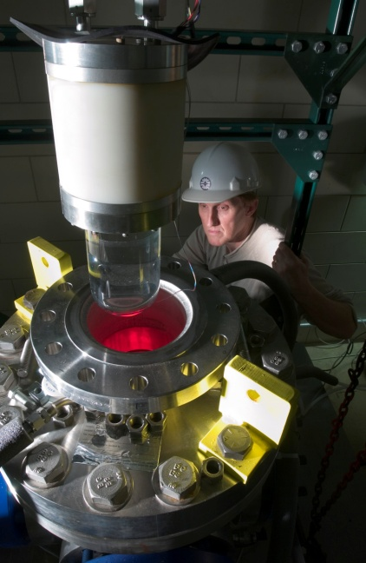
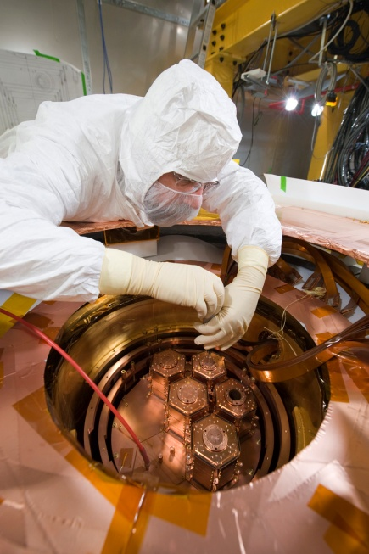
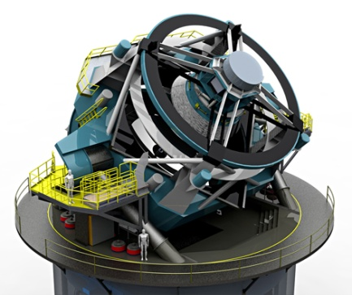
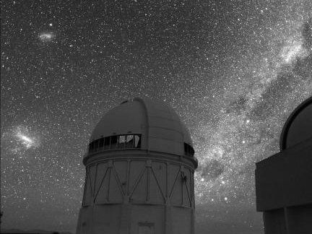
Roles: cosmic frontier
DM: ~1 ton
DE: LSST
WFIRST??
BigBOSS??
DM: ~10 kg
DE: SDSS
P. Auger
DM: ~100 kg
DE: DES
P. Auger
Holometer?
DE: LSST
WFIRST??
Now
2013
2016
2019
2022

Slide 13
Gaps and roles: intensity frontier
Two principal approaches: 1) proton super-beams to study neutrinos and rare decays and 2) quark factories: in e⁺e⁻ and LHCb
Principal gap is the understanding of neutrinos and the observation of rare decays coupled to new physics processes
Fermilab strategy: develop the most powerful set of facilities in the world for the study of neutrinos and rare processes, well beyond the present state of the art. Complementary to LHC and with discovery potential beyond LHC. DOE has the central role. Will define the role of US facilities in the world’s program.

Slide 14
Interplay: LHC Intensity Frontier
nothing
Only handle on the
next energy scale
Intensity
Frontier
LHC
Determine/verify
structure of new
physics. Anything
beyond?
Lots

Slide 15
Program this decade
In the intermediate term, a series of world-class experiments exploiting the present complex:
  NOvA: ν vs. ν, next step in oscillation parameters
  MicroBooNE: follow MiniBooNE anomaly; LAr TPC
  MINERvA: ν nuclear cross sections/nuclear structure
  MINOS+ (proposed): ν vs. ν; anomalous interactions
  LBNE (700 kW): neutrino oscillations, neutrino mass spectrum, matter-antimatter symmetry, proton decay, SN burst
  g-2: anomalous magnetic moment of the muon
  Mu2e: direct muon to electron conversion
  SeaQuest: nuclear physics Drell-Yan process

Slide 16
Program next decade
LBNE (2+ MW): the long-base line experiment
  Neutrino mass spectrum (mass hierarchy)
  Matter-antimatter symmetry
  Neutrino/antineutrino differences
  Anomalous interactions
Project X: a broad program with megawatts of continuous beam, ideal to lead at the intensity frontier
  Neutrino, long/short base-lines, more than 2 MW to LBNE
  Kaons where the Standard Model backgrounds are minimal and we are sensitive to many models including supersymmetry
  Rare muon decay with sensitivity to masses 1000 TeV
  Symmetry violations through electric dipole moments in nuclei
  Applications to transmutation, spallation targets, ADS

Slide 17
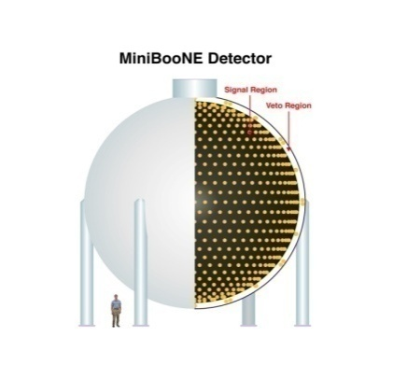
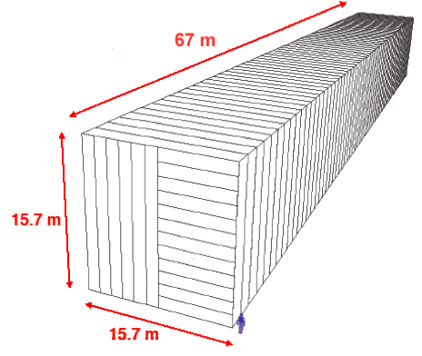
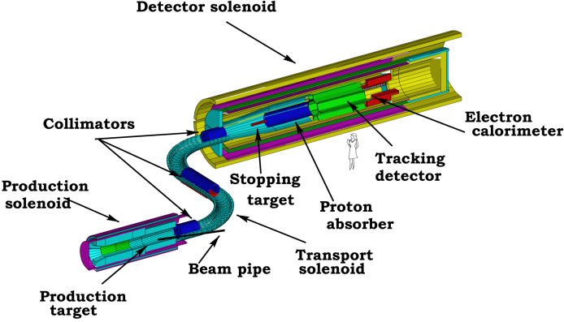
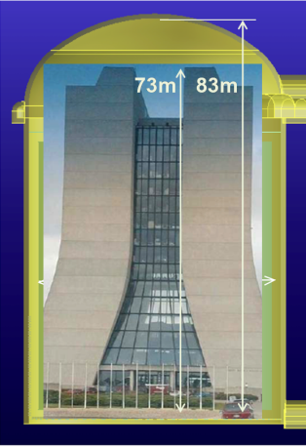
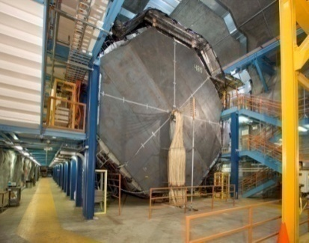
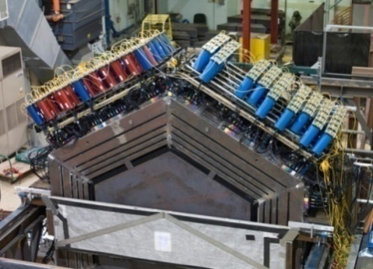
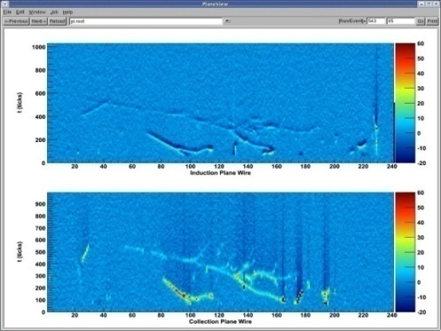
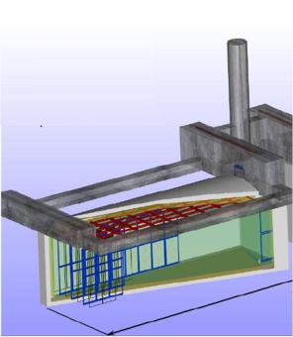
Roles: intensity frontier
NOvA
MicroBooNE
g-2
MINERvA
MINOS
SeaQuest
MINOS
MiniBooNE
MINERvA
SeaQuest
NOvA
g-2
LBNE
Mu2e
Project X+LBNE
μ, K, nuclear, …
ν Factory ??
Now
2013
2016
2019
2022

Slide 18
Intensity Frontier Today at Fermilab
Take Home Message: we have a set of world-class experiments
over the next decade BEFORE Project starts operating
EXPERIMENT | INSTITUTIONS | NATIONAL LABORATORIES | COLLABORATORS | FOREIGN COUNTRIES
MINOS | 29 | 3 | 148 | U.K, Brazil, Poland, Greece
MiniBooNE | 18 | 2 | 84
MINERvA | 27 | 2 | 127 | Peru, Greece, Brazil, Chile, Mexico, Russia
SeaQuest (NP) | 18 | 4 | 65 | Japan, China
NOVA | 28 | 2 | 180 | Greece U.K, Russia, Germany, Brazil
MicroBooNE | 13 | 3 | 70
g-2 | 20 | 2 | 67 | Russia, U.K, Italy, Germany, Japan
Mu2e | 22 | 3 | 105 | Italy, Russia
LBNE | 58 | 6 | 306 | U.K, Japan, Italy, India
More than 1000 additional users in CMS (ROC,LPC,TIER 1), Particle Astro and Accelerator R&D; Intensity Frontier experiments will double in the next fewyears.

Slide 19
Implementing the vision: LBNE
LBNE is a key experiment in the neutrino area and already engages a very broad collaboration
It can start with the 700kW beam developed for NOvA (facilities have to be built towards the DUSEL direction)
It would ultimately use over >2000kW in the Project X era

Slide 20

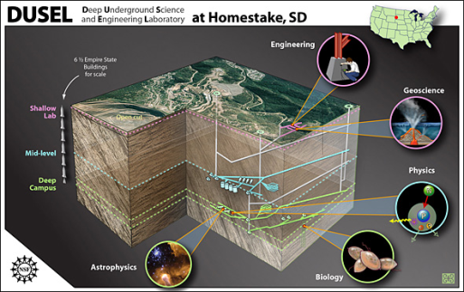
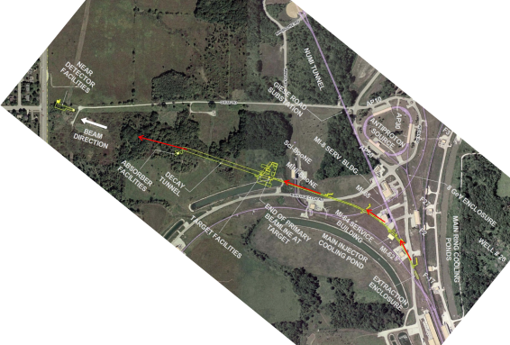
Long Baseline Neutrino Experiment
CD 0: January 2010
1300 km
Collaboration: 306 members
58 institutions (6 US labs) and 5 countries (India, Italy, Japan, UK, US)
Continue to grow!

Slide 21
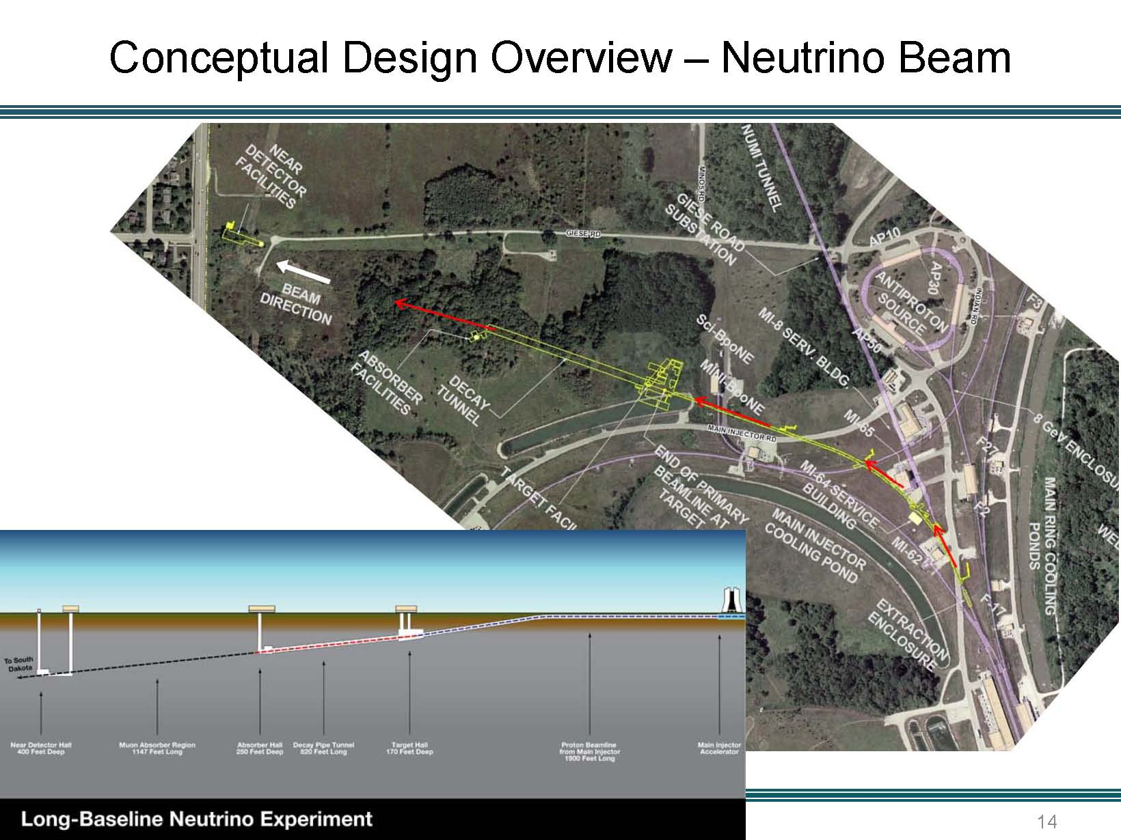

Slide 22
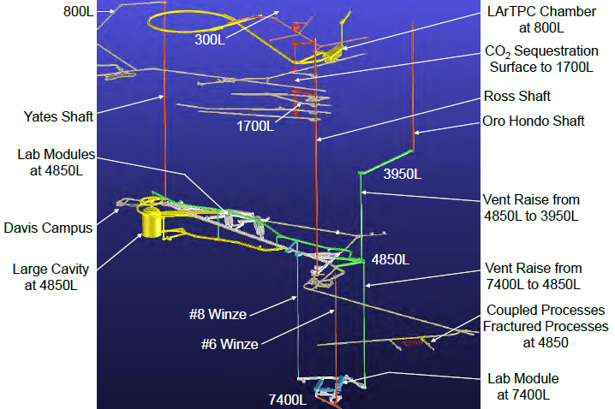
DUSEL Lab Layout

Slide 23
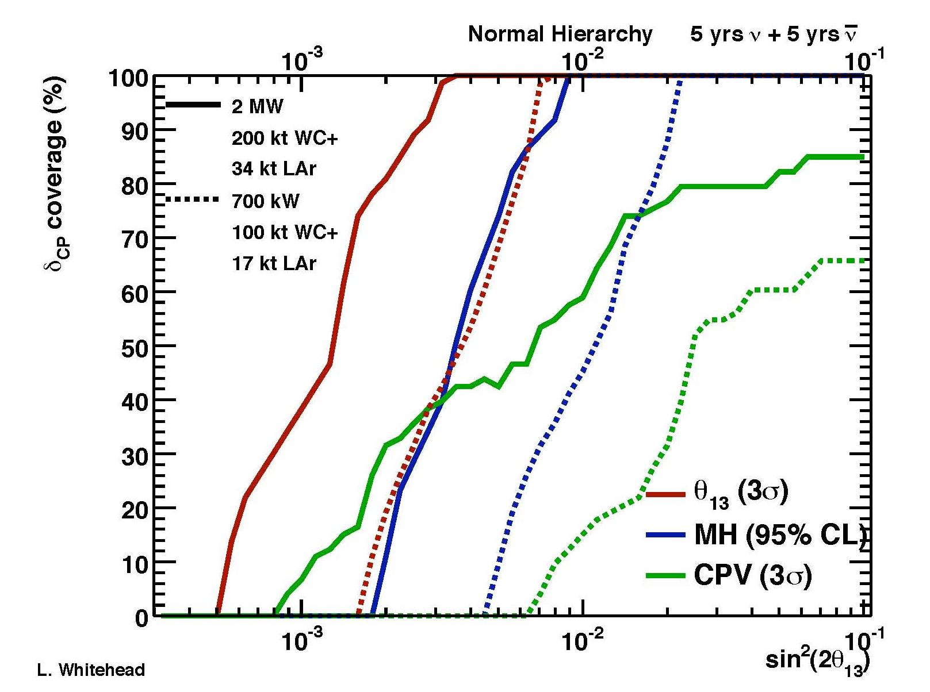
Neutrino physics sensitivities
LBNE ← NOvA ← MINOS
(>2MW ← 0.7MW) (0.7MW) (0.3MW)
With Project X

Slide 24
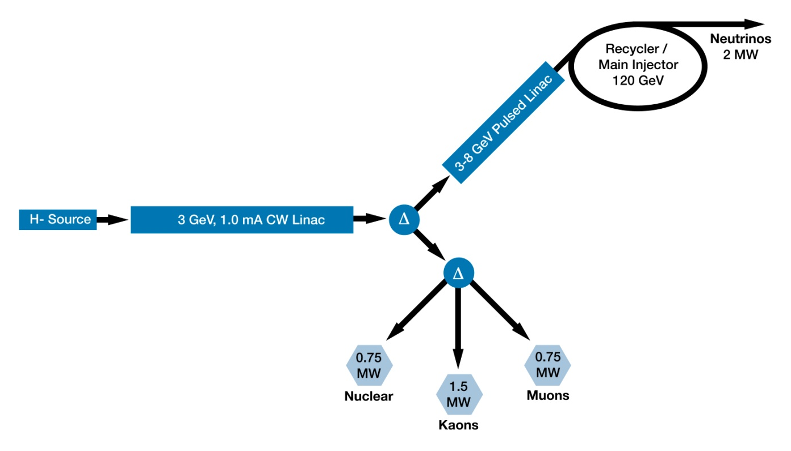
Project X Reference Design

Slide 25
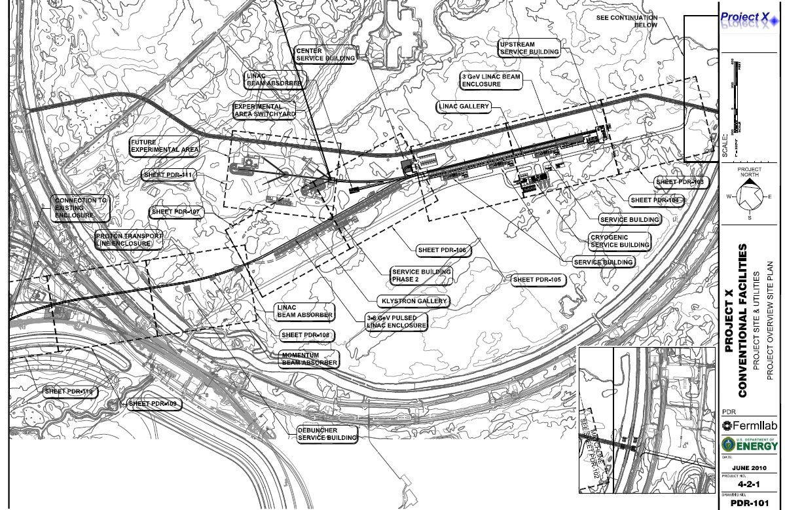
Project X Siting

Slide 26
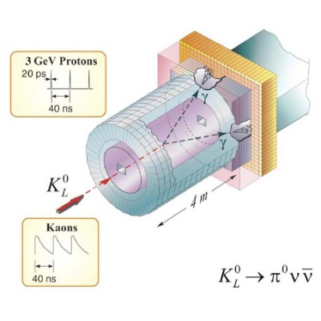
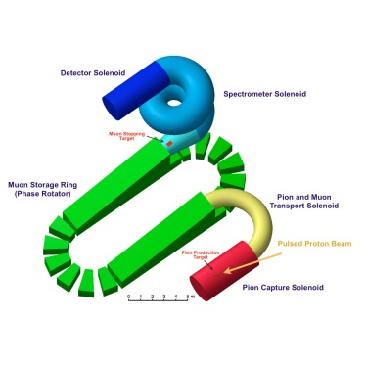
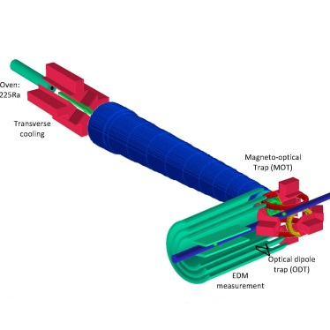
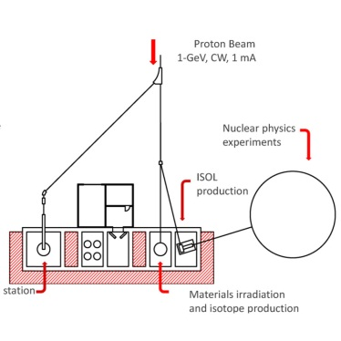
Project X: new experiments
Neutrinos
  Matter-antimatter asymmetry
  Neutrino mass spectrum
  Neutrino- antineutrino differences
  Anomalous interactions
  Proton decay
  SuperNova bursts
Kaons
  Physics beyond the Standard Model
  Minimally flavor violating supersymmetry
  Elucidation of LHC discoveries
  Two to three orders of magnitude increase in sensitivity
Muons
  Oscillation in charged leptons
  Physics beyond the Standard Model
  Elucidation of LHC physics
  Sensitive to energy/mass scales three orders of magnitude beyond LHC
Nuclei
  New generation of symmetry-test experiments
  Electric Dipole Moments
  Three or more orders of magnitude increase in Francium, Radium, Actinium isotopes
Energy Applications
  Transmutation experiments with nuclear waste
  Spallation target configurations
  Materials test under high irradiation
  Neutron fluxes under various configurations relevant to ADS

Slide 27
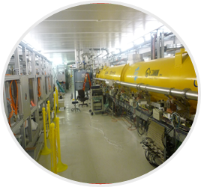
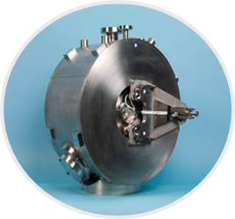
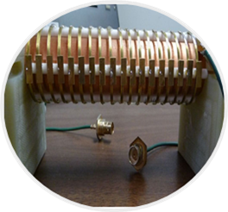
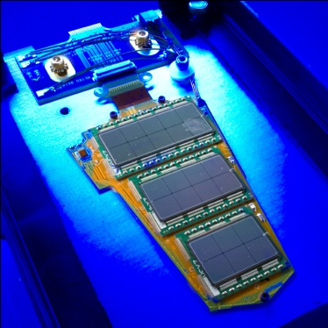
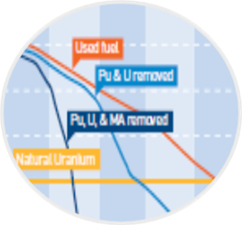
Project X: technology innovation
CW Linac Design
  Multi-MW/high duty factor (continuous wave) proton linac
  First of a kind, all superconductingRF design
  Low beam loss/high reliability
SRF Accelerating Modules
  State-of-the-art performance
  High Q₀/high gradient
  Low-β spoke resonators
  Medium-β elliptical resonators
  U.S. industrial development
Fast Chopper
  Revolutionary concept
  Programmable bunch patterns at 162 MHz
  Applications beyond HEP
Detector Development
  High speed electronics & triggering
  Rad hard detectors
  Large Liquid Argon Time Projection Chambers
  Cryo-electronics
  High power targeting
Transmutation
  MW-class CW beams at 1 GeV
  Technology demonstration
  Benchmarking experiments to validate concepts

Slide 28

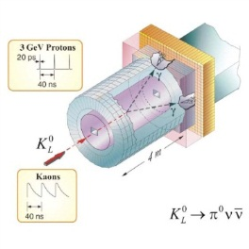

Project X and the big questions
Where does mass come from?
Why is matter dominant?
What are the neutrino masses and what do they say?
  Where are the heavy neutrino partners?
  Why are there three families of quarks and leptons?
  Do the forces unify?
  Does nature use supersymmetry or other new symmetries?
  Are there extra dimensions of space?
  What is dark matter?
  What is dark energy?
neutrinos
muons
kaons
Nuclei
(EDMs..)

Slide 29
