Slide 1
Computing Strategy
Victoria White, Associate Lab Director for Computing and CIO
Fermilab Institutional Review
June 6-9, 2011

Slide 2
Outline
Introduction
Experiment Computing
Sharing strategies
Computing for Theory and Simulation Science
Conclusion

Slide 3
Introduction

Slide 4
Scientific Computing strategy
Provide computing, software tools and expertise to all parts of the Fermilab scientific program including theory simulations (Lattice QCD and Cosmology), and accelerator modeling
Work closely with each scientific program – as collaborators (where a scientist from computing is involved) and as valued customers.
Create a coherent Scientific Computing program from the many parts and many funding sources – encouraging sharing of facilities, common approaches and re-use of software wherever possible

Slide 5
Core Computing – a strong base
Scientific Computing relies on Core Computing services and Computing Facility infrastructure
  Core Networking and network services
  Computer rooms, power and cooling
  Email, videoconferencing, web servers
  Document databases, Indico, calendering
  Service desk
  Monitoring and alerts
  Logistics
  Desktop support (Windows and Mac)
  Printer support
  Computer Security
  ….. and more
All of the above is provided through overheads

Slide 6
Scientific Computing Review
Multi-lab review of all scientific computing (except DAQ and online) was held on February 8th, 2011
In-depth review of how scientific computing works and how it is funded at each lab
https://indico.fnal.gov/conferenceDisplay.py?confId=3973
  Password available on request
This review will not cover computing in depth

Slide 7
Experiment computing strategies

Slide 8
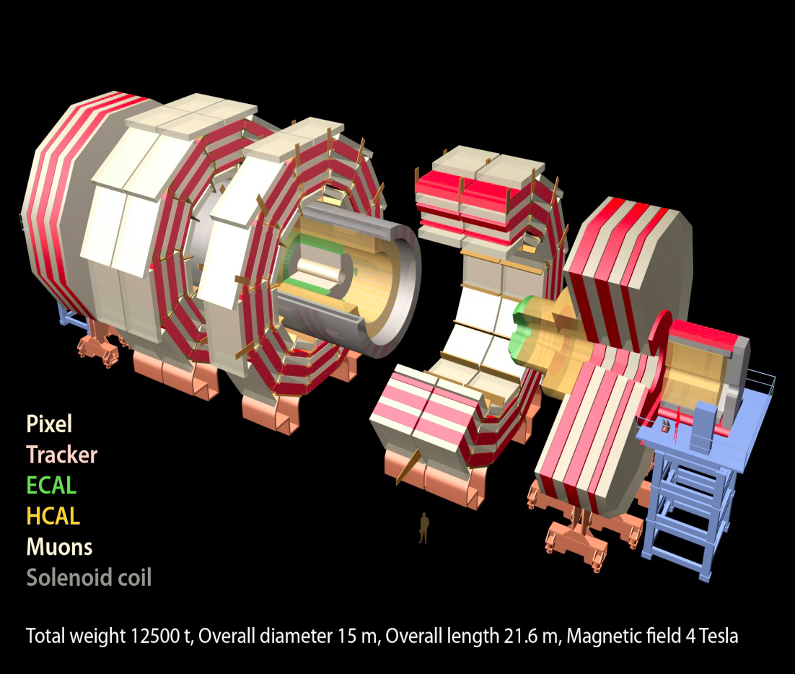
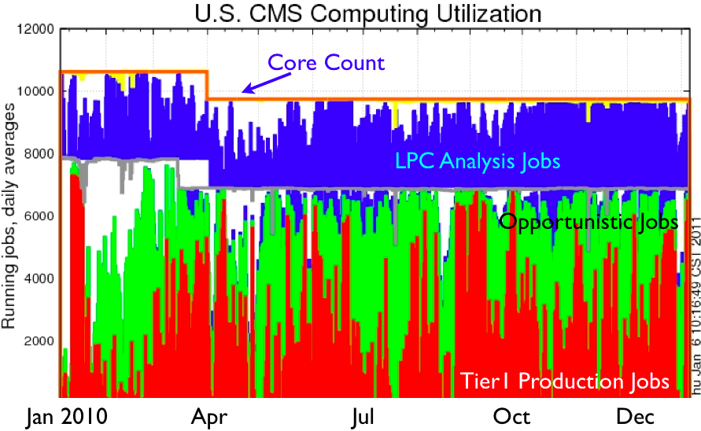
CMS Tier 1 at Fermilab
The CMS Tier-1 facility at Fermilab and the experienced team who operate it enable CMS to reprocess data quickly and to distribute the data reliably to the user community around the world.
Fermilab also operates:
LHC Physics Center (LPC)
Remote Operations Center
U.S. CMS Analysis Facility
Notes:
2010 Data Taking was successful. Scientific Results published within weeks of data being acquired.
Computing system has had flexibility to handle
trigger rates at 300 Hz and much higher in peaks, T0 kept up
more reprocessing passes than expected (19)
full 2010 pp dataset reprocessed in 10 days plus one week debugging/postmorterm
large transfer rates, full-mesh transfer topology
5 PB from T0 and other T1’s to T1
Most T2’s can get data from any T1 or T2
3.1 billion events simulated
with underlying experimental conditions changing throughout!
Workflows were performed at expected locations from Day 1
2011 will have quick startup, with peak luminosity for the year reached as soon as May -- 16 interactions/event!
RECO/AOD event sizes double from 2010 values to 0.8/0.2 MB/event

Slide 9
CMS Offline and Computing
Fermilab is a hub for CMS Offline and Computing
  Ian Fisk is the CMS Computing Coordinator
  Liz Sexton-Kennedy is Deputy Offline Coordinator
  Patricia McBride is Deputy Computing Coordinator
  Leadership roles in many areas in CMS Offline and Computing: Frameworks, Simulations, Data Quality Monitoring, Workload Management and Data Management, Data Operations, Integration and User Support.
Fermilab Remote Operations Center allows US physicists to participate in monitoring shifts for CMS.

Slide 10
Computing Strategy for CMS
Continue to evolve the CMS Tier 1 center at Fermilab - to meet US obligations to CMS and provide the highest level of availability and functionality for the $
Continue to ensure that the LHC Physics Center and the US CMS physics community is well supported by the Tier 3 (LPC CAF) at Fermilab
Plan for evolution of the computing, software and data access models as the experiment matures – requires R&D and development
  Ever higher bandwidth networks
  Data on demand
  Frameworks for multi-core

Slide 11
Run II Computing Strategy
Production processing and Monte-Carlo production capability after the end of data taking
  Reprocessing efforts in 2011/2012 aimed at the Higgs
  Monte Carlo production at the current rate through mid-2013
Analysis computing capability for at least 5 years, but diminishing after end of 2012
  Push for 2012 conferences for many results –no large drop in computing requirements through this period
Continued support for up to 5 years for
  Code management and science software infrastructure
  Data handling for production (+MC) and Analysis Operations
Curation of the data: > 10 years with possibly some support for continuing analyses

Slide 12
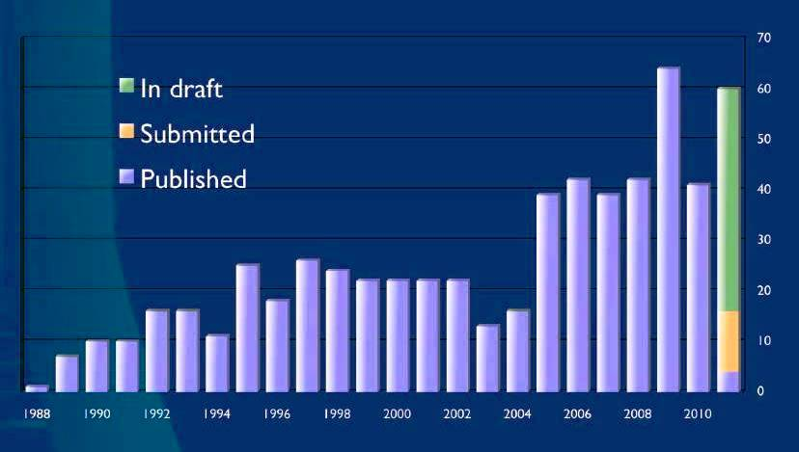
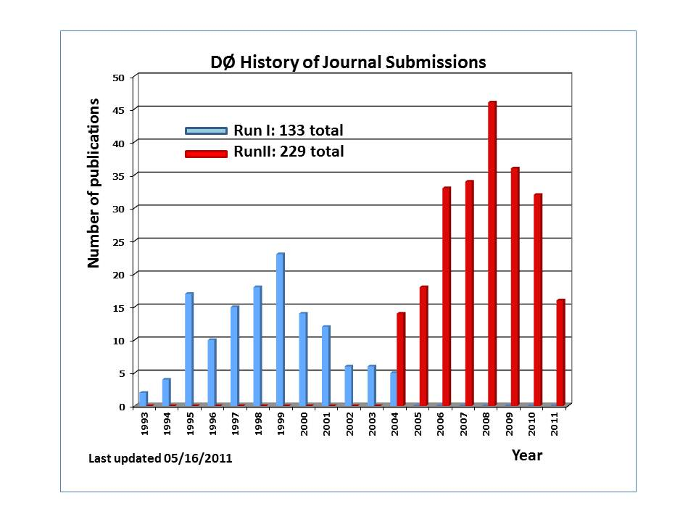
Tevatron – looking ahead
CDF and D0 expect the publication rate to remain stable for several years.
Analysis activity:
  Expect > 100 (students+ postdocs) actively doing analysis in each experiment through 2012.
  Expect this number to be much smaller in 2015 though data analysis will still be on-going.
CDF Publications each year
D0 Publications each year

Slide 13
“Data Preservation” for Tevatron data
Data will be stored and migrated to new tape technologies for ~ 10 years
  Eventually 16 PB of data will seem modest
If we want to maintain the ability to reprocess and do analysis on the data there is a lot of work to be done to keep the entire environment viable
  Code, access to databases, libraries, I/O routines, Operating Systems, documentation…..
If there is a goal to provide “open data” that scientists outside of CDF and Dzero could use there is even more work to do.
4th Data Preservation Workshop was held at Fermilab in May
Not just a Tevatron issue

Slide 14
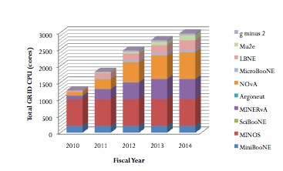
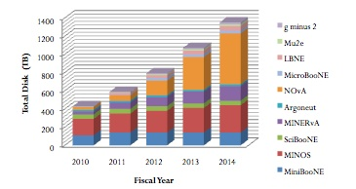
Intensity Frontier program needs
Many experiments in many different phases of development/operations.
  MINOS
  MiniBooNE
  SciBooNE
  MINERvA
  NOvA
  MicroBooNE
  ArgoNeuT
  Mu2e
  g-2
  LBNE
  Project X era expts
CPU (cores)
Disk (TB)
1 PB

Slide 15
Intensity Frontier strategies
NuComp forum to encourage planning and common approaches where possible
A shared analysis facility where we can quickly and flexibly allocate computing to experiments
Continue to work to “grid enable” the simulation and processing software
  Good success with MINOS, MINERvA and Mu2e
All experiments use shared storage services – for data and local disk – so we can allocate resources when needed
Hired two associate scientists in the past year and reassigned another scientist.

Slide 16
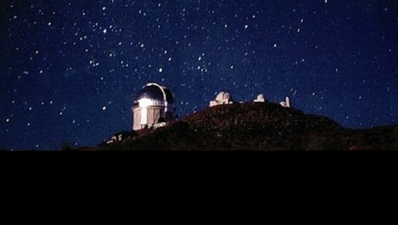
Cosmic Frontier experiments
Continue to curate data for SDSS
Support data and processing for Auger, CDMS and COUPP
Will maintain an archive copy of the DES data and provide modest analysis facilities for Fermilab DES scientists.
  Data management is an NCSA (NSF) responsibility
  We have the capability to provide computing should this become necessary
DES use Open Science Grid resources opportunistically
Future initiatives still in the planning stages
SDSS
DES

Slide 17
Sharing Strategies

Slide 18

Sharing via the Grid – FermiGrid
User Login
& Job
Submission
Open Science
Grid
TeraGrid WLCG NDGF
FermiGrid
Authentication/Authorization
Services
FermiGrid
Site
Gateway
FermiGrid
Infrastructure
Services
FermiGrid
Monitoring/Accounting
Services
GRIDFarm
3284 slots
D0
6916 slots
CDF
5600 slots
CMS
7485 slots

Slide 19

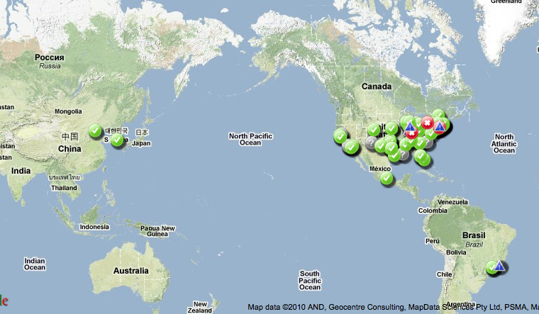
Open Science Grid (OSG)
The Open Science Grid (OSG) advances science through open distributed computing. The OSG is a multi-disciplinary partnership to federate local, regional, community and national cyberinfrastructures to meet the needs of research and academic communities at all scales.
Total of 95 sites; ½ million jobs a day, 1 million CPU hours/day; 1 million files transferred/day.
It is cost effective, it promotes collaboration, it is working!
The US contribution and partnership with the LHC Computing Grid is provided through OSG for CMS and ATLAS

Slide 20
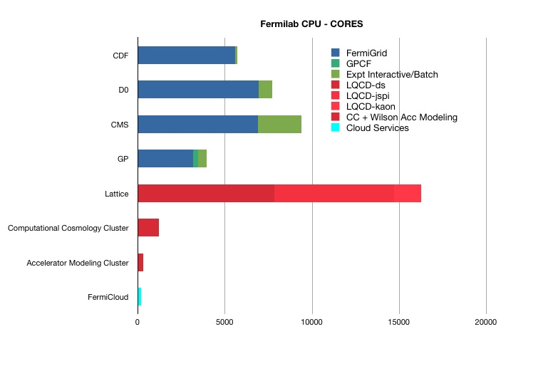
FNAL CPU – core count for science

Slide 21
Data Storage at Fermilab - Tape

Slide 22
COMPUTING FOR THEORY AND SIMULATION SCIENCE

Slide 23
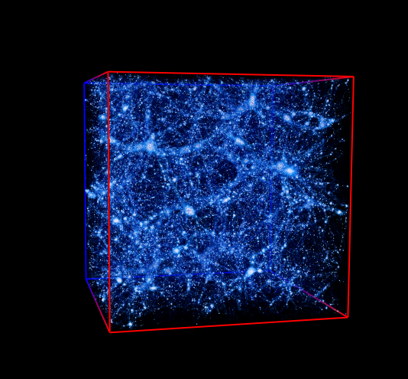
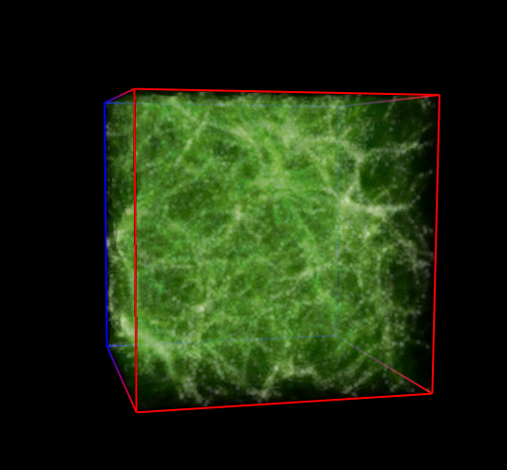
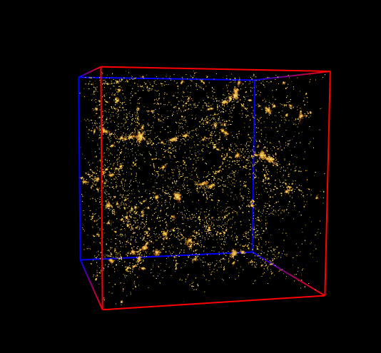
High Performance (parallel) Computing is needed for
Lattice Gauge Theory calculations (LQCD)
Accelerator modeling tools and simulations
Computational Cosmology:
Dark energy, matter
Cosmic gas
Galaxies
Simulations connect fundamentals with observables

Slide 24
Computing for the Scientific Program
 | Applications | Type of Computing | Computing Facilities
EXPERIMENT | Detector simulation Event simulation Event processing Data analysis. DAQ software triggers | High Throughput and Small Scale Parallel (<= number of cores on a CPU) | Fermilab campus grid (FermiGrid) Open Science Grid (OSG) World Wide LHC Computing Grid (WLCG) Dedicated clusters FermiCloud
COMP SCI | Accelerator modeling Lattice Quantum ChromoDynamics (LQCD) Cosmological simulation | Large Scale Parallel High Performance Computing | Local “mid-range” HPC clusters Leadership class machines: NERSC, ANL, ORNL, NCSA etc.
 | Data acquisition and event triggers | Custom computing | Custom, programmable logic, DSPs, embedded processors.

Slide 25
Strategies for Simulation Science Computing
Lattice QCD is the poster child
  Coherent inclusive US QCD collaboration
    Paul MacKenzie, Fermilab leads. This allocates HPC resources.
  LQCD Computing Project (HEP and NP funding)
    Bill Boroski, Fermilab is the Project Manager
  SciDAC II project to develop the software infrastructure
Accelerator modeling
  Multi-institutional tools project COMPASS – Panagiotis Spentzouris, Fermilab is the PI
  Also accelerator project specific modeling efforts
Computational Cosmology
  Computational Cosmology Collaboration (C³) for mid-range computing for astrophysics and cosmology
  Taskforce – Fermilab, ANL, U of Chicago - to develop strategy

Slide 26
Software – collaborative efforts
ComPASS – Accelerator Modeling Tools project
Lattice QCD project and USQCD Collaboration
Open Science Grid – many aspects and some sub-projects such as Grid security, workload management
Grid and Data Management tools
Advanced Wide Area Network projects
Dcache collaboration
Enstore collaboration
Scientific Linux (with CERN)
GEANT core development /validation (with GEANT4 collaboration)
ROOT development & support (with CERN)
Cosmological Computing
Data Preservation initiative (global HEP)

Slide 27
Experiment/Project Lifecycle and funding
Expt or
Project
specific
Shared
services
Project specific
Shared services
Shared
services
Shared services
Early Period
R&D, Simulations
LOI,
Proposals
Mature phase
Construction, Operations, Analysis
Final data-taking
and beyond
Final analysis,
Data preservation
and access

Slide 28
Budget/resource allocation for 2012 +
There is always upward pressure for computing
  more disk and more cpu leads to faster results and greater flexibility
  more help with software & operations is always requested
Within a fixed budget each experiment can usually optimize between tape drives, tapes, disk, cpu, servers
  assuming basic shared services are provided.
With so many experiments in so many different stages we intend to convene a “Scientific Computing Portfolio Management Team” to examine the needs/computing models of the different Fermilab based experiments and help in allocating the finite dollars to optimize scientific output.

Slide 29
Conclusion
We have a coherent and evolving scientific computing program that emphasizes sharing of resources, re-use of code and tools, and requirements planning.
Embedded scientists with deep involvement are also a key strategy for success.
Fermilab takes on leadership roles in computing in many areas.
We support projects and experiments at all stages of their lifecycle – but if we want to truly preserve access to Tevatron data long term much more work is needed.

Slide 30
Extra SlIDES

Slide 31
CMS Tier 1 at Fermilab
The CMS Tier-1 facility at Fermilab and the experienced team who operate it enable CMS to reprocess data quickly and to distribute the data reliably to the user community around the world.

Slide 32

CMS Computing Model
T1 centers play prominent role as they share the custodial storage of raw & reconstructed data
Jobs follow data access location
US T1 at Fermilab is the largest of CMS, the only T1 in the Americas
T3 centers come into the picture
Network capabilities of the whole computing system very important
USA
share raw & reconstructed data (FEVT) for custodial storage
each site has full AOD data
perform Data Reprocessing
Analysis Tasks (Skimming)
Data Serving to Tier-2 centers for analysis
Archive Simulation From Tier-2
UK
Italy
Monte Carlo Production
Primary Analysis Facilities
CERN
France
Germany
Data recording
Primary reconstruction
Partial Reprocessing
First archive copy of the raw data (cold)
Spain
Taiwan
1 Tier 0
7 Tier 1
25-50 Tier 2
Ken Bloom/UNL
DOE/NSF Review of LHC Operations
March 8, 2011

Slide 33
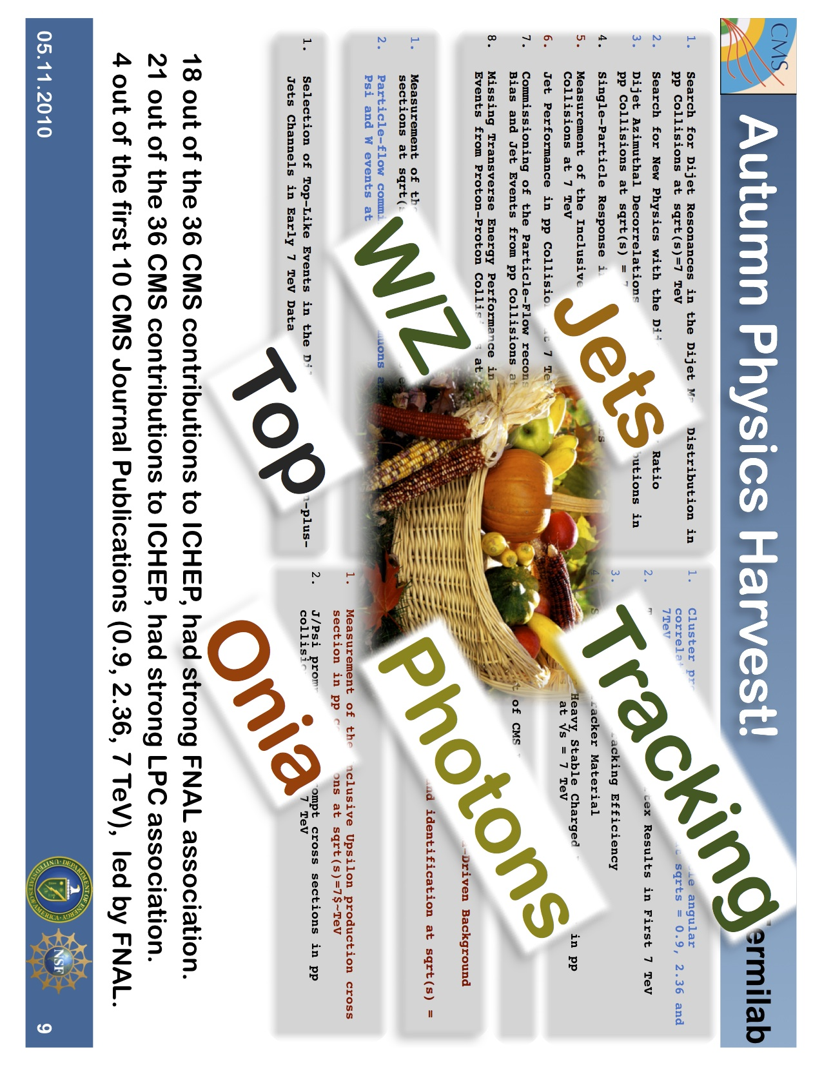
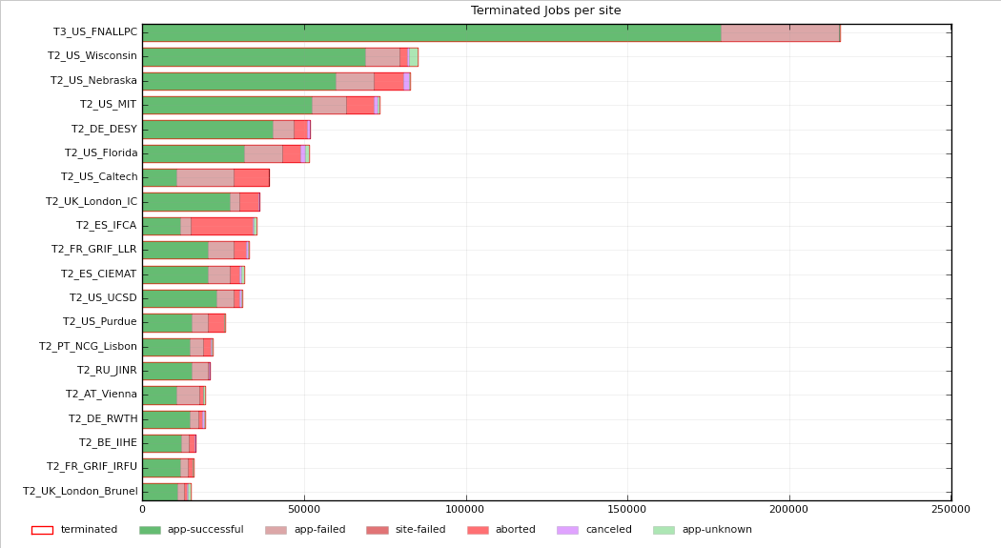
CMS Physics Analysis at Fermilab
Analysis Jobs at CMS T2/T3 sites
in a week
200000
U.S.CMS analysis facility at Fermilab has the highest number of CMS analysis jobs: ~200k/week.
Fermilab is an excellent place to work on CMS physics analysis.

Slide 34
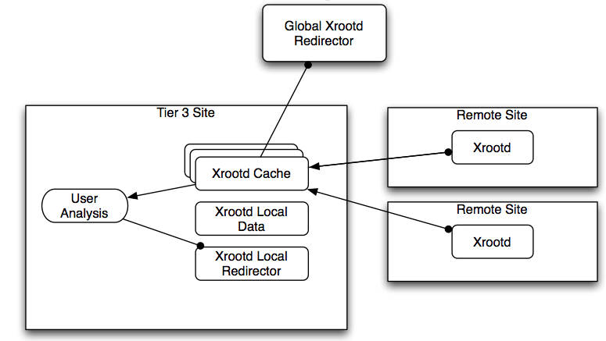
Any Data, Anywhere, Any time: Early Demonstrator
Root I/O and Xrootd demonstrator to support the CMS Tier-3s and interactive use
  Nebraska, Fermilab, UCSD working together

Slide 35
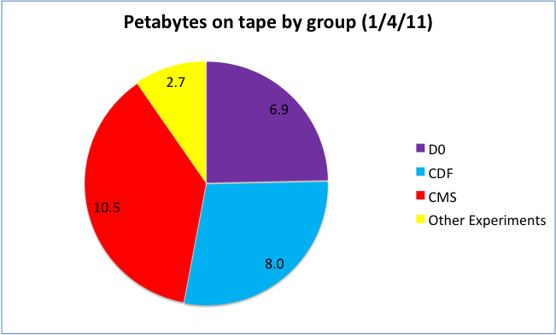
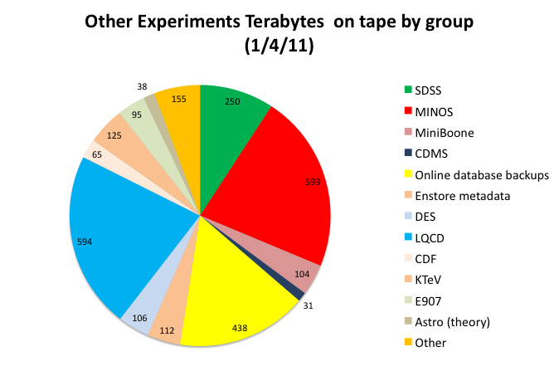
Data on tape - total
Other Experiments
35

Slide 36
Data lives a long time (and is migrated to new media many times)
L- legacy tape
$ -contributes funding

Slide 37
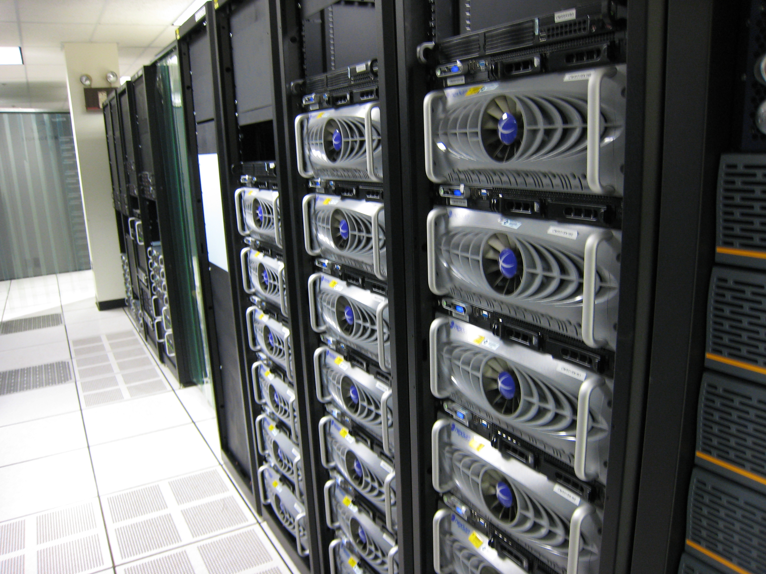
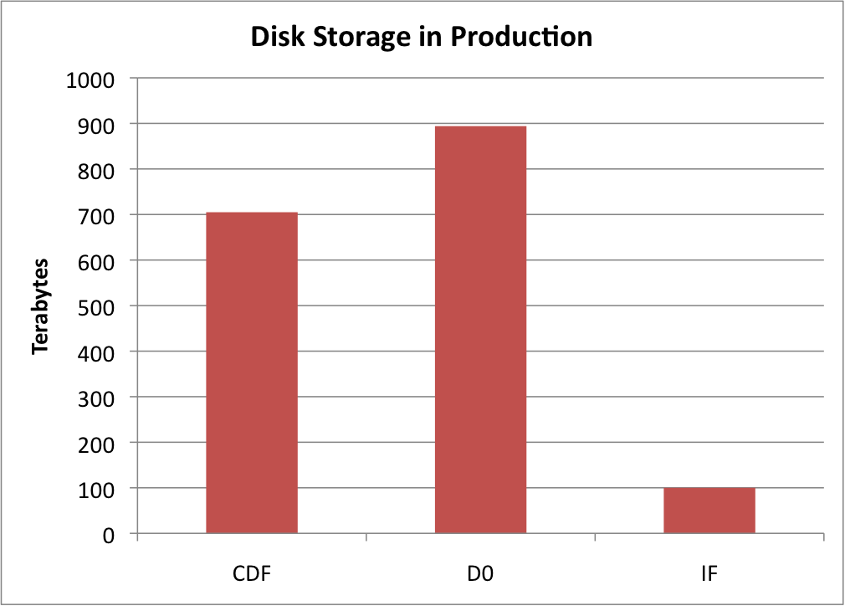
Disk Storage Services
Large cache storage for D0, CDF, CMS (1, 1, 7 PB)
BlueArc storage area network (1.3 PB)
Lustre (distributed parallel I/O used on Lattice QCD and Cosmology clusters and CMS in test)
AFS – legacy system

Slide 38
FermiCloud: Virtualization likely a key component for long term analysis
The FermiCloud project is a private cloud facility built to provide a testbed and a production facility for cloud services
A private cloud—on-site access only for registered Fermilab users
  Can be evolved into a hybrid cloud with connections to Magellan, Amazon or other cloud provider in the future.
Unique use case for cloud - on public production network, integrated with the rest of the infrastructure.

Slide 39
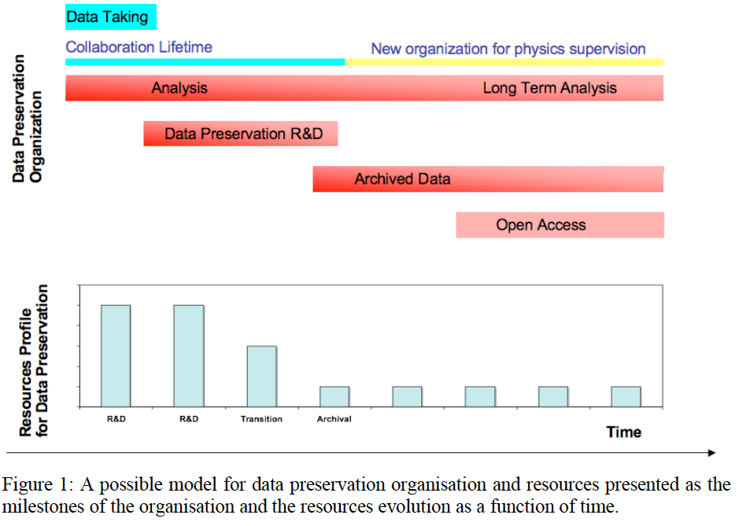
Data Preservation and long-term analysis: general considerations
Physics Case
Models
Governance
Technologies

Slide 40
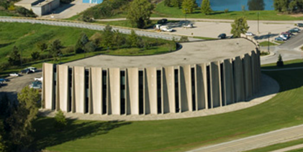
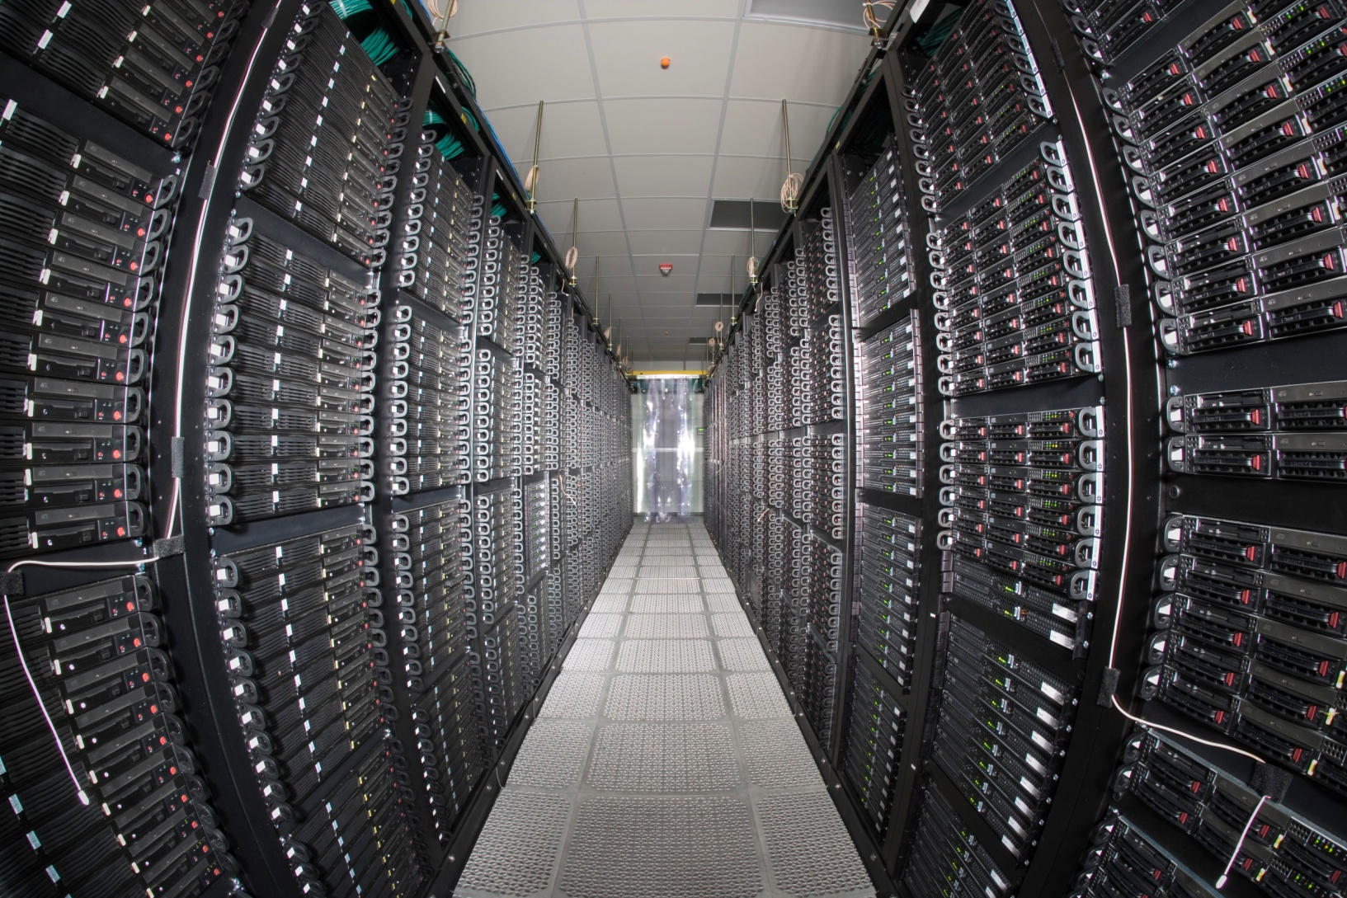
Fermilab Computing Facilities
Feynman Computing Center (FCC)
  High availability services – e.g. core network, email, etc.
  Tape Robotic Storage (3 10000 slot libraries)
  UPS & Standby Power Generation
  ARRA project: upgrade cooling and add HA computing room - completed
Grid Computing Center (GCC)
  High Density Computational Computing
  CMS, RUNII, Grid Farm batch worker nodes
  Lattice HPC nodes
  Tape Robotic Storage (4 10000 slot libraries)
  UPS & taps for portable generators
EPA Energy Star award 2010
Lattice Computing Center (LCC)
  High Performance Computing (HPC)
  Accelerator Simulation, Cosmology nodes
  No UPS

Slide 41
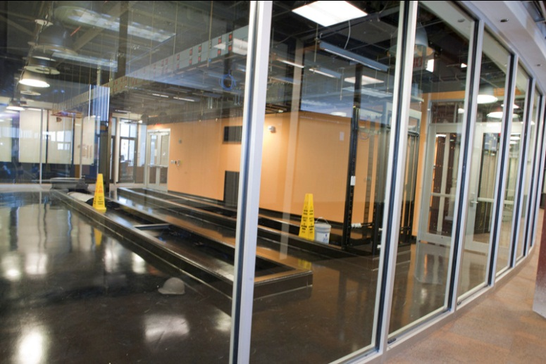
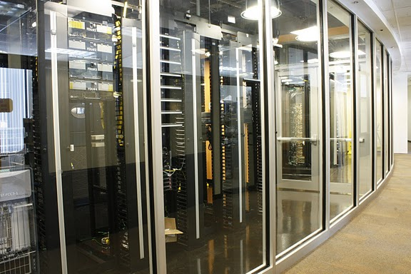
Facilities: more than just space power and cooling – continuous planning
ARRA funded new high availability computer room in Feynman Computing Center

Slide 42
Reliable high speed networking is key

Slide 43
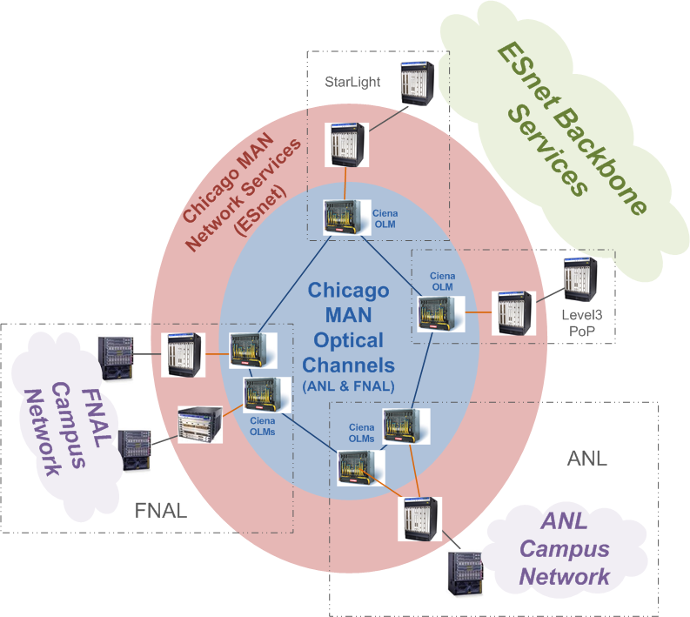
Chicago Metropolitan Area Network

Slide 44
Lattice Gauge Theory: significant HPC computing at Fermilab
Fermilab is a leading participant in the US lattice gauge theory computational program funded by Dept of Energy (OHEP, ONP, and OASCR).
Program is overseen by the USQCD Collaboration (almost all lattice gauge theorists in the US)
  USQCD’s PI is Paul Mackenzie of Fermilab.
Purpose is to develop software and hardware infrastructure in the US for lattice gauge theory calculations.
  Software grant through the DOE SciDAC program of ~ $2.3 M/year.
  Hardware and operations funded by the LQCD Computing Project of ~$3.6M/year.
http://www.usqcd.org/

Slide 45
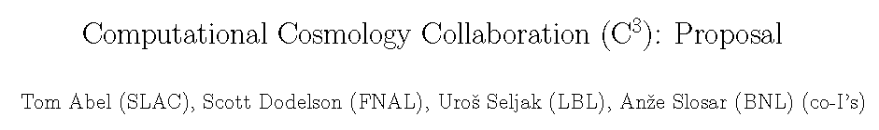


Computational Cosmology
Fermilab scientists N. Gnedin and collaborators are experts in the area of computational cosmology.
Fermilab hosts a small cluster (1224 cores) that is in use by the astrophysics community at Fermilab and at KICP University of Chicago.
Fermilab is part of the Computational Cosmology Collaboration (C³) for mid-range computing for astrophysics and cosmology.
  Cosmological surveys require many medium-sized simulations
  Medium scale clusters are used for code development
  Medium scale machines are used for analysis of simulations performed at leadership class facilities
A Computational Cosmology Task Force with Argonne, Fermilab and University of Chicago was started recently.

Slide 46
DES Analysis Computing at Fermilab
Fermilab plans to host a copy of the DES Science Archive. This consists of two pieces
  A copy of the Science database
  A copy of the relevant image data on disk and tape
This copy serves a number of different roles
  Acts as a backup for the primary NCSA archive, enabling collaboration access to the data when the primary is unavailable
  Handles queries by the collaboration, thus supplementing the resources at NCSA
  Enables the Fermilab scientists to effectively exploit the DES data for science analysis
To support the science analysis of the Fermilab Scientists, DES will need a modest amount of computing (of order 24 nodes). This is similar to what was supported for the SDSS project.

Slide 47
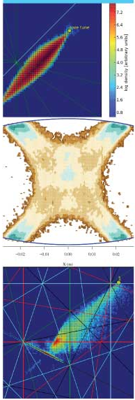
Accelerator modeling tools at Fermilab
Fermilab is leading the ComPASS Project:
  Community Petascale Project for Accelerator Science and Simulation — a multi-institutional collaboration of computational accelerator physicists
  Panagiotis Spentzouris from Fermilab is PI for ComPASS
  ComPASS goals are to develop High Performance Computing (HPC) accelerator modeling tools
    Multi-physics, multi-scale for beam dynamics; “virtual accelerator”
    Thermal, mechanical, and electromagnetic; “virtual prototyping”
Development and support of CHEF
  general framework for single particle dynamics developed at Fermilab

