Slide 1
MicroBooNE
Regina Rameika
Fermilab Institutional Review
June 6-9, 2011

Slide 2
Outline
Introduction
  Mission Need
  Project Scope
  Key Performance Parameters
The Project Plan
Project Organization
Progress on the Plan
  Infrastructure
  Detector Systems
Cost & Schedule Summary
  Resources
Conclusion

Slide 3
Introduction
The MicroBooNE detector will be a liquid argon time projection chamber (LAr TPC) containing 170 tons of liquid argon, and located on the Booster Neutrino Beamline.
The experiment’s goal is to begin operation in 2013; availability of funding may constrain the schedule
This device represents a major advance in neutrino detector technology.

Slide 4
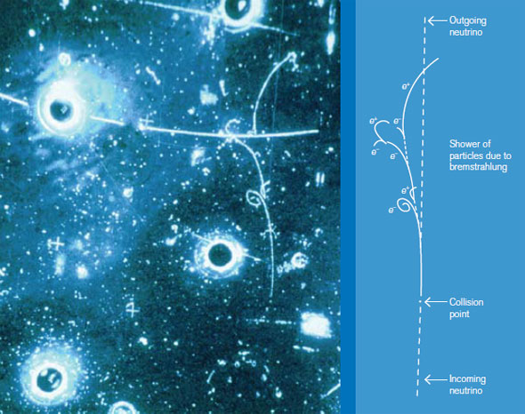
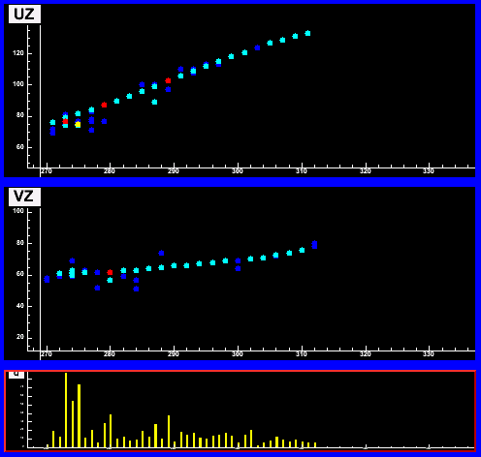
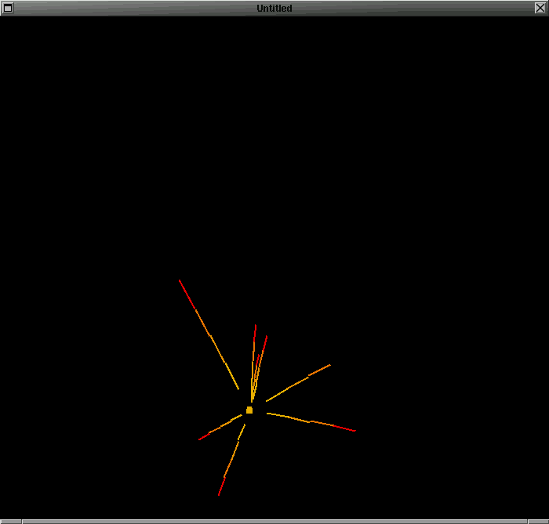
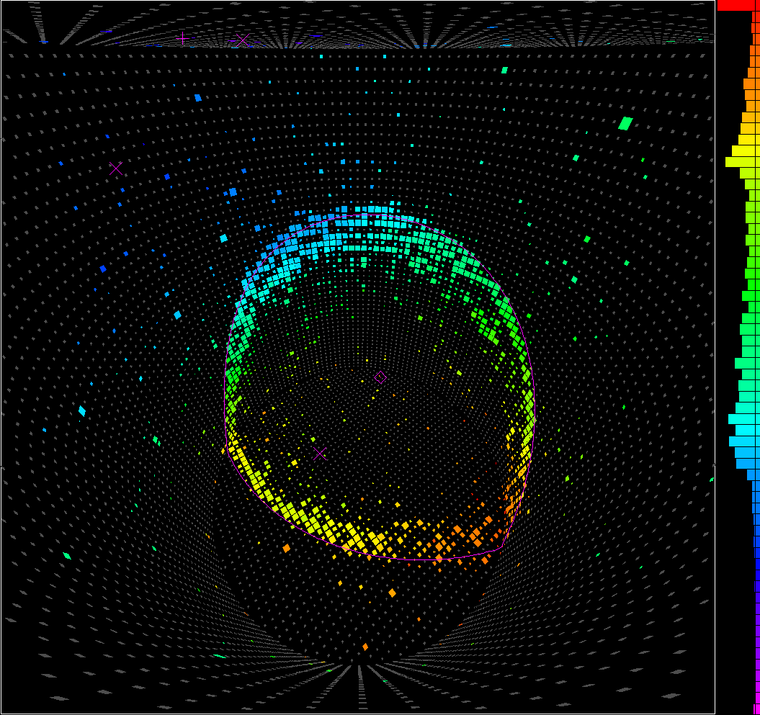

Evolution of Neutrino Detectors
Bubble Chambers
Tracking
Calorimeters
Emulsion
Cherenkov
Liquid Argon

Slide 5
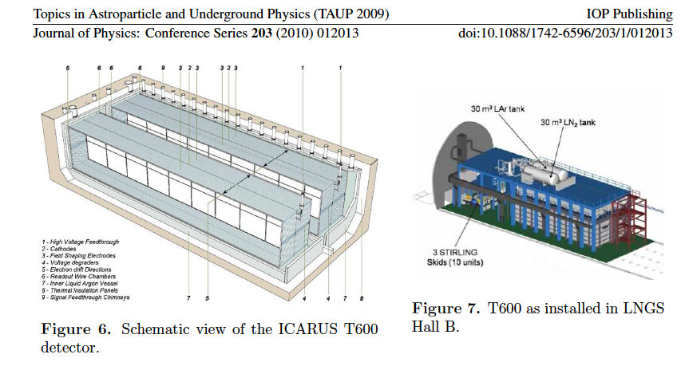
T-600 at Gran Sasso : 1st generation of large LAr
Evacuated cryostats; 1.5 m drift; warm (exterior) electronics

Slide 6
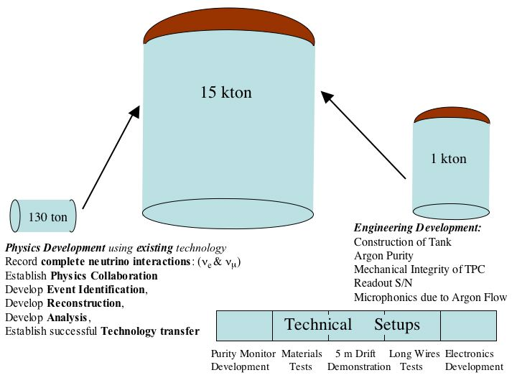
From NuSAG 2006 report : develop a plan to go to the 10’s of kTon scale

Slide 7
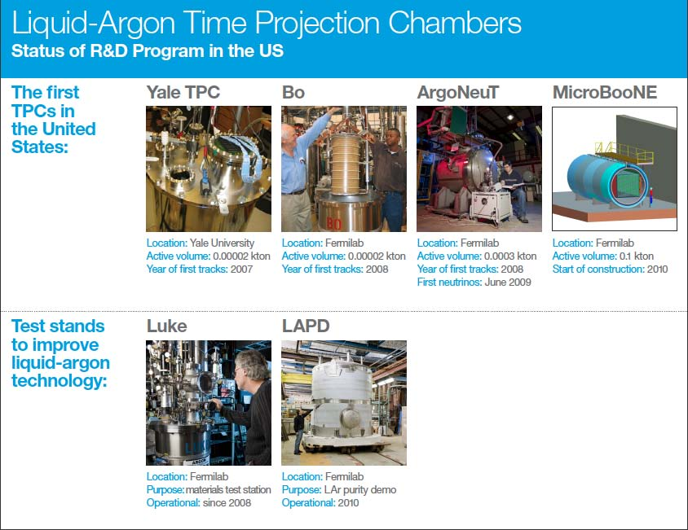
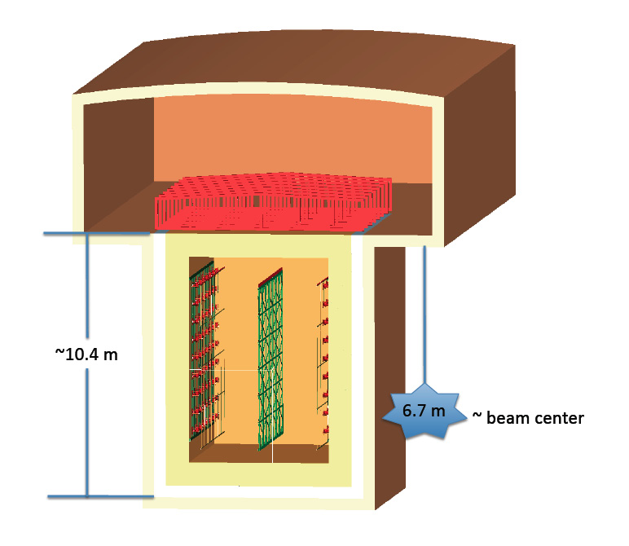
LAr1:
Engineering
prototype

Slide 8
MicroBooNE will :
Fully test the LAr TPC technology at a scope and scale that will help inform the design and operation of very large LAr TPC detectors for next-generation neutrino oscillation experiments.
  Purity without evacuation; cold electronics; 2.5 m drift
Investigate the source of the excess of low energy electron-type neutrinos observed by the MiniBooNE experiment using the unique electron-photon discrimination power offered by a LAr TPC.
Produce the first high-statistics measurements of neutrino interactions in argon. Currently, such measurements do not exist; they will provide the first constraints for future LAr-based neutrino oscillation experiments.
Physics

Slide 9
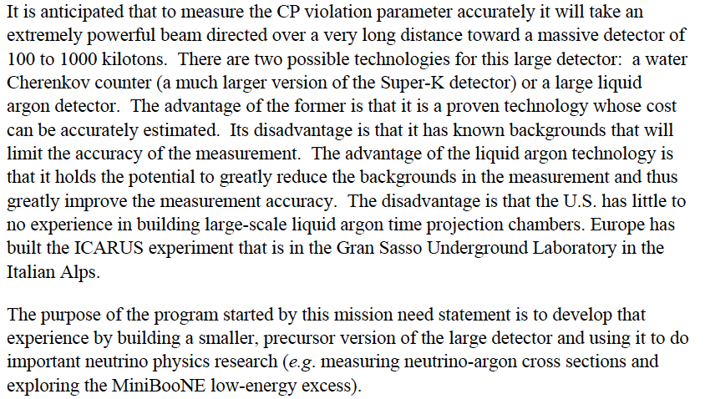
Mission Need for a Large Liquid Argon Detector for Neutrino Physics – September 2009

Slide 10
Project Plan
CD-0 Mission Need : September 2009
CD-1 Alternative Selection and Cost Range : June 2010
CD-2/3a : Performance Baseline
  Director’s review – End of June
  DOE Review – End of July
CD-3 Begin Construction : before end of CY2011
CD-4 Begin Operations :
  Working date – mid-2013 (~2 years from now)
  DOE milestone – mid 2014

Slide 11
Project Scope – DOE + NSF funding
Cryostat to contain 170 tons of LAr
Cryogenic system for purging, filling and purification
Time Projection Chamber and PMTs
  $900K + $180K
Front end electronics and digitization
Readout ($700K)
DAQ, monitoring and slow control
Building and Infrastructure
Project Management
DOE Project funding ~$20M

Slide 12
Key Performance Parameter (KPP) and CD-4 Definition
The Key Performance Parameter for the project is : Liquid Argon Time Projection Chamber Detector positioned in the Booster Neutrino Beam with a total capacity for at least 100 tons of liquid argon after filling
The KPP is achieved by demonstrating the following items that enable readiness for initial filling with liquid argon :
  Experiment infrastructure complete and operational
  Safety systems operational
  Detector installation complete
  Detector subsystem checkouts complete
  Cryo-plant tests complete
  Operational readiness clearance granted by the Laboratory

Slide 13
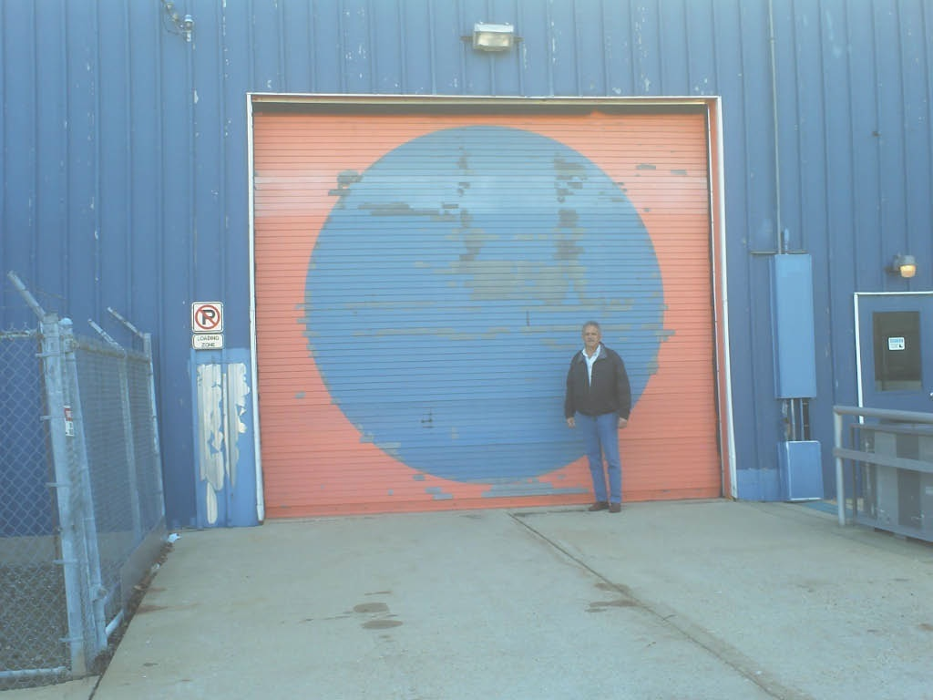
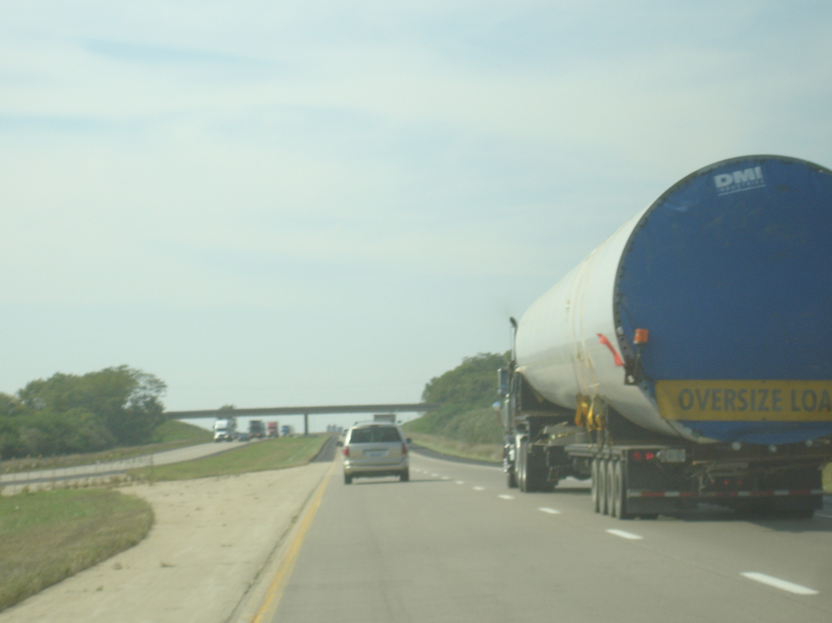
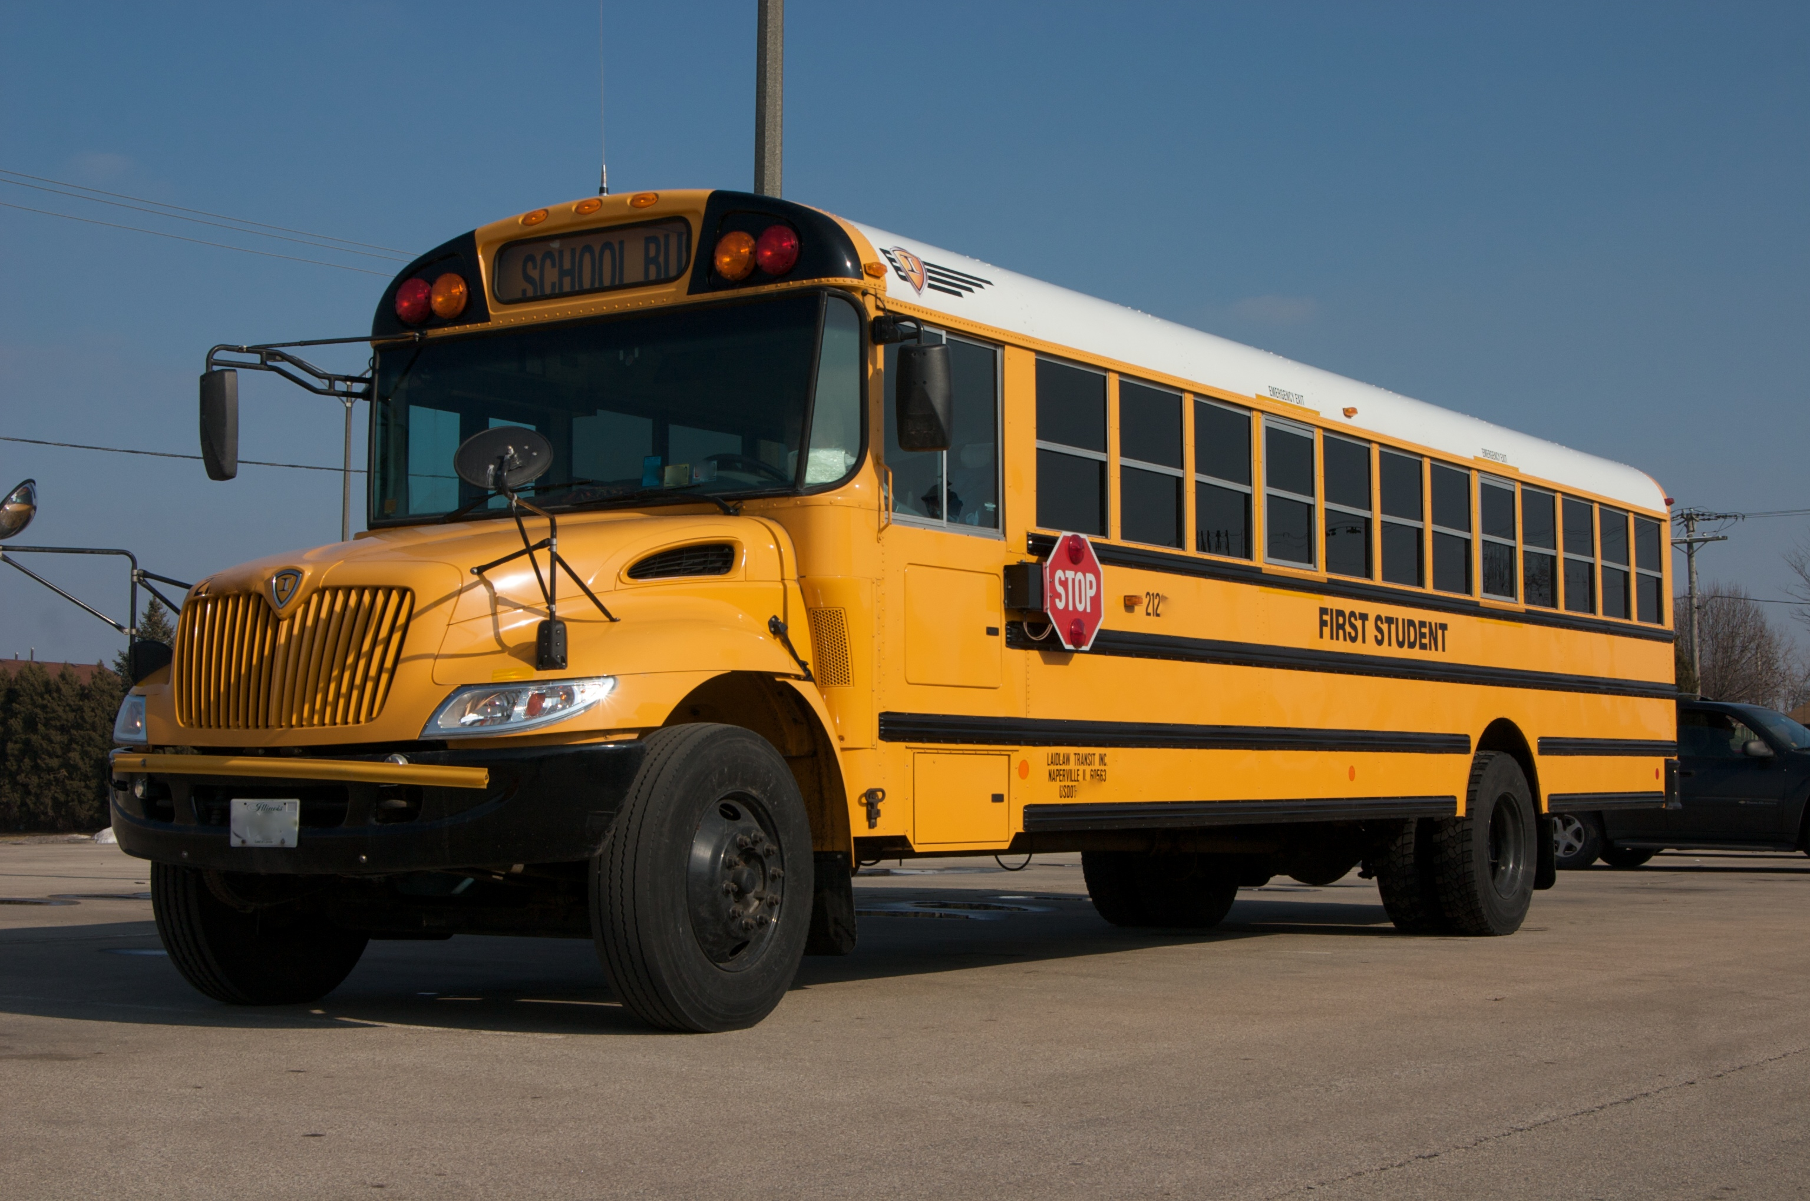
Project Scale
Cryostat
TPC

Slide 14
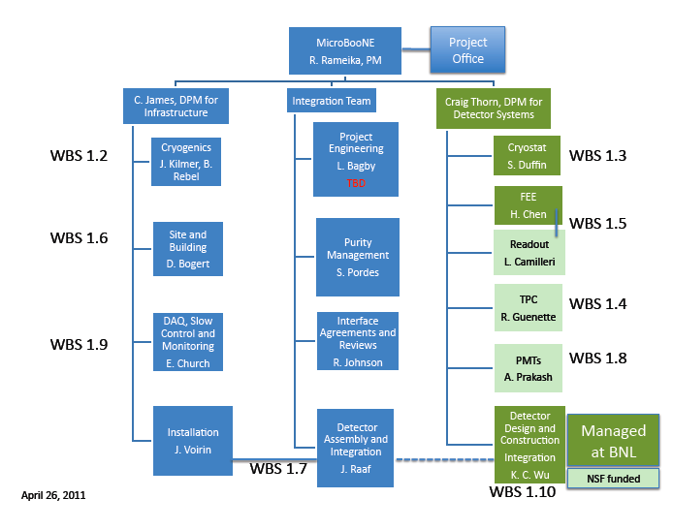
Work Breakdown Structure and Organization

Slide 15
Progress on the Plan
Detector Systems
  Cryostat design
  TPC design
  Electronics and readout prototypes
  PMTs
  Integration
Infrastructure
  Cryo system design
  Building design
  Assembly and Installation planning

Slide 16
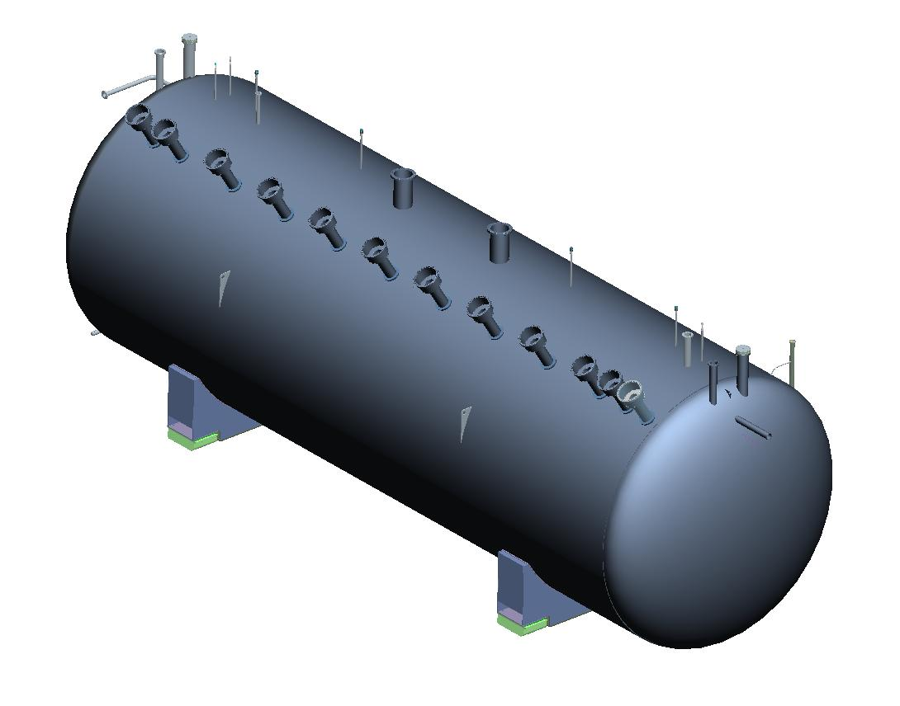
Cryostat design
Market Survey – Feb 2011
Design nearly complete
Removable end

Slide 17
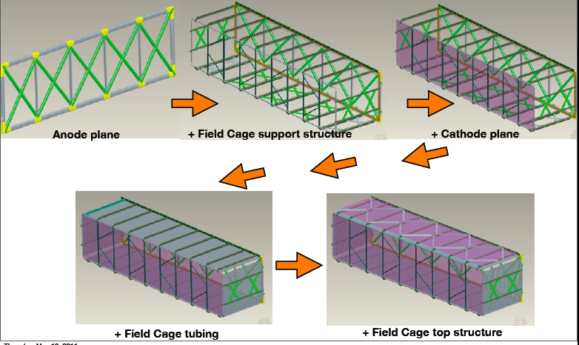
TPC Components and assembly sequence
Technical Design Review – June 14
3 mm wire pitch
8,256 wires (150 micron)
U,V,Y
2.5 m drift

Slide 18
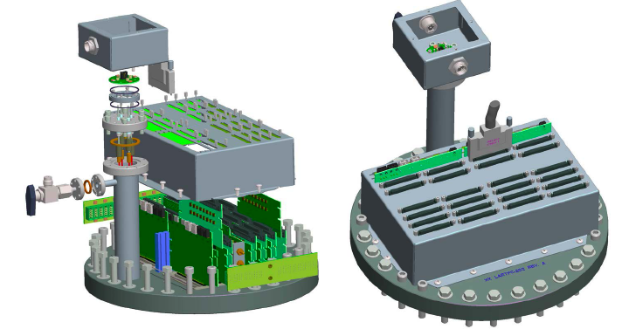
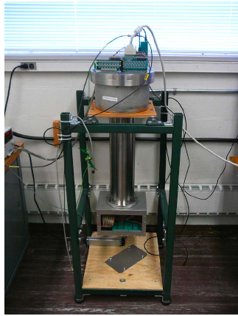
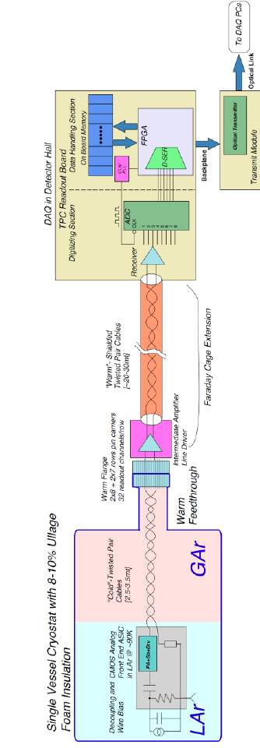
Front end electronics (cold + warm)

Slide 19
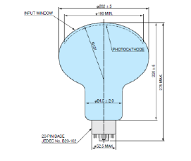
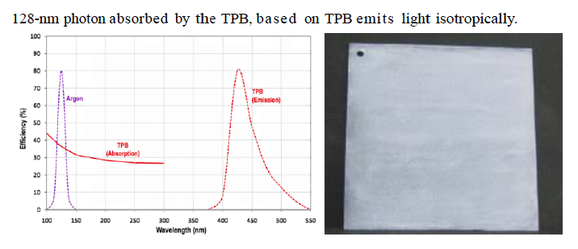
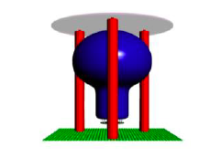
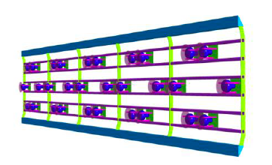
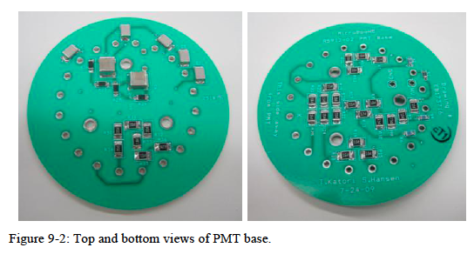
PMT System

Slide 20
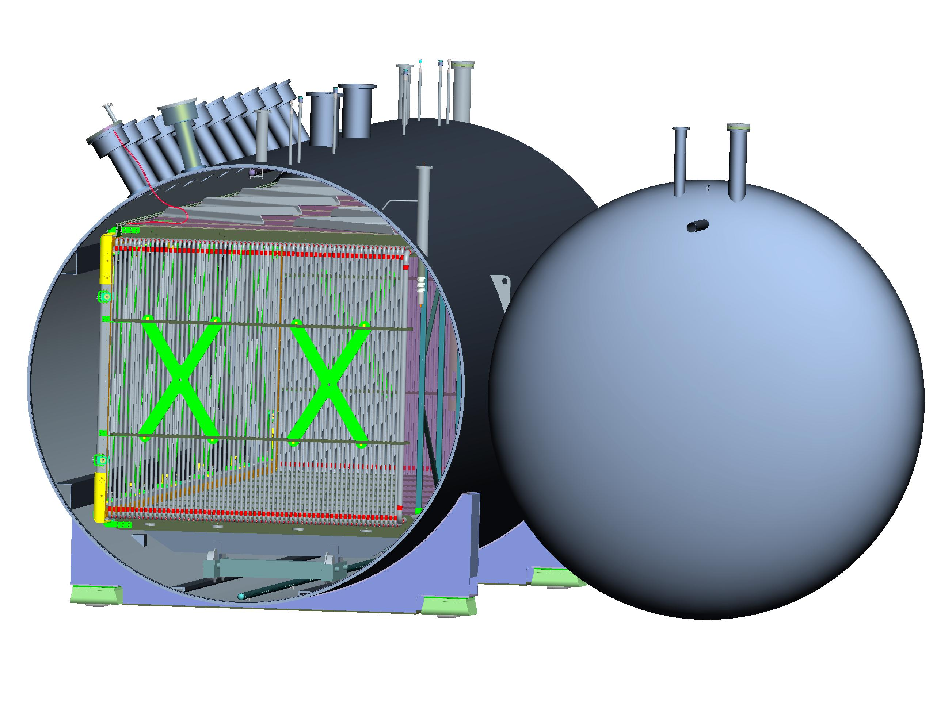
Integration of components

Slide 21
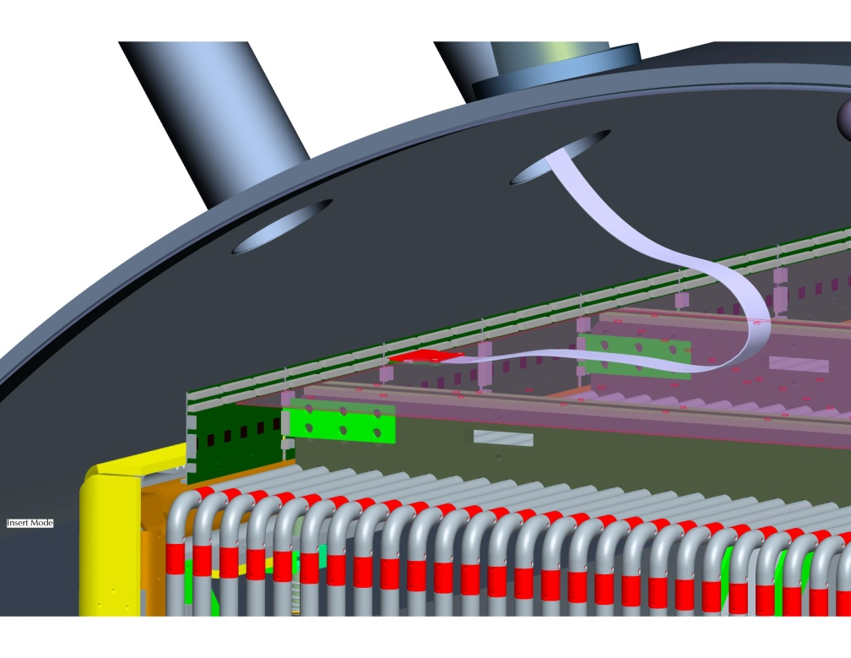
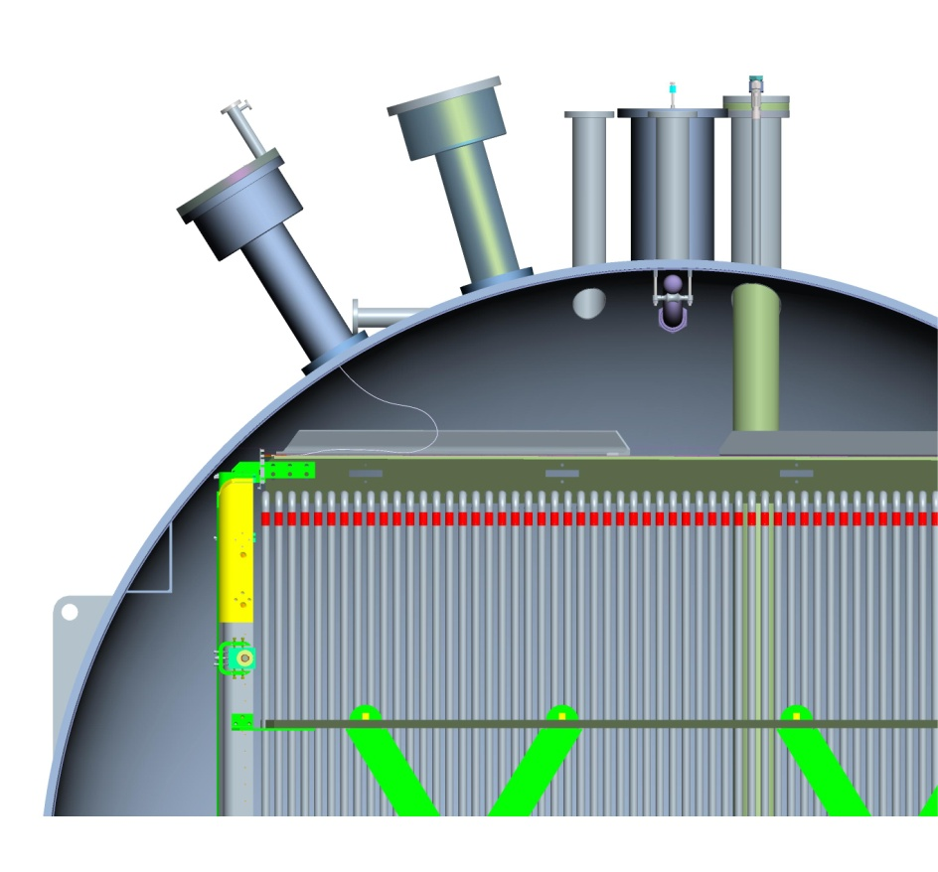

Slide 22
Cryogenic System Process Flow

Slide 23
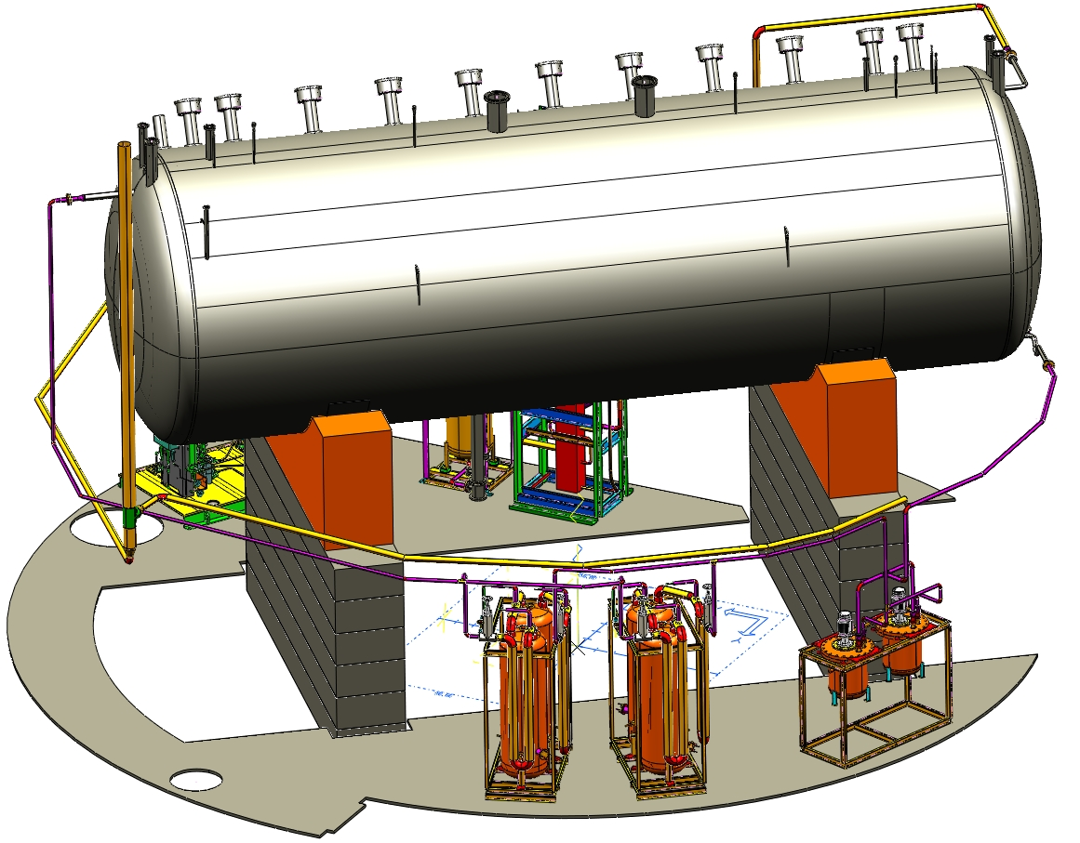
Cryogenic equipment and piping
Pumps
Filters

Slide 24
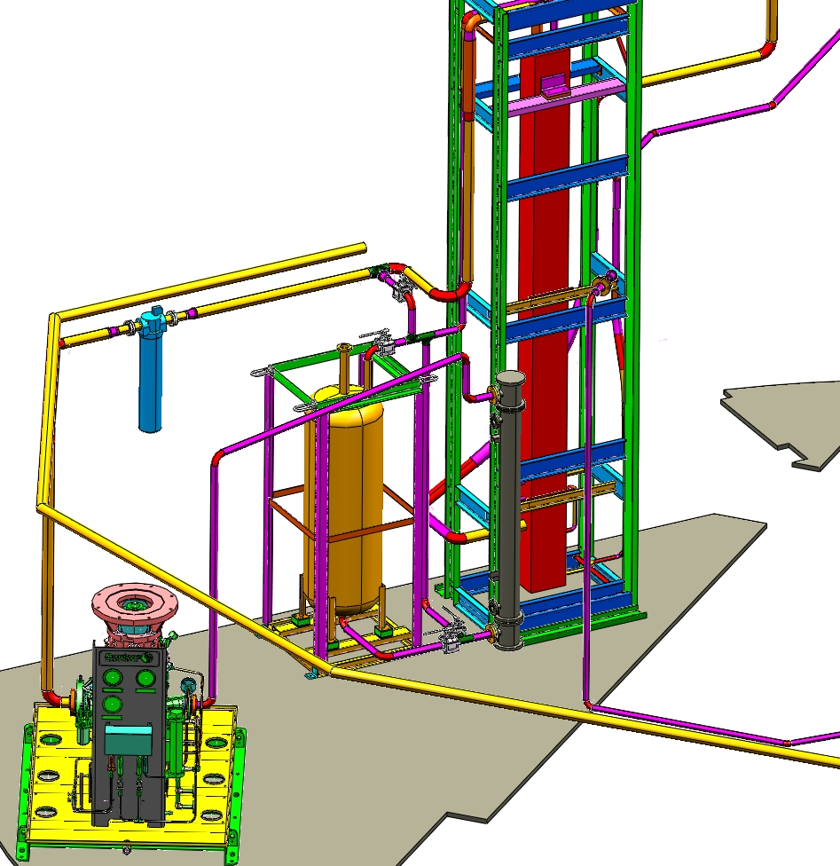
Cooldown system
Heat exchanger
Molecular Sieve filter
compressor

Slide 25
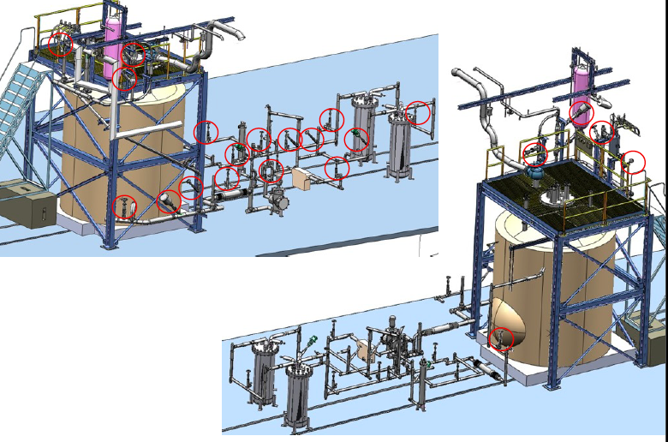
An actual setup – LAPD* at PC4
30 ton tank
*Liquid Argon Purity Demonstration

Slide 26
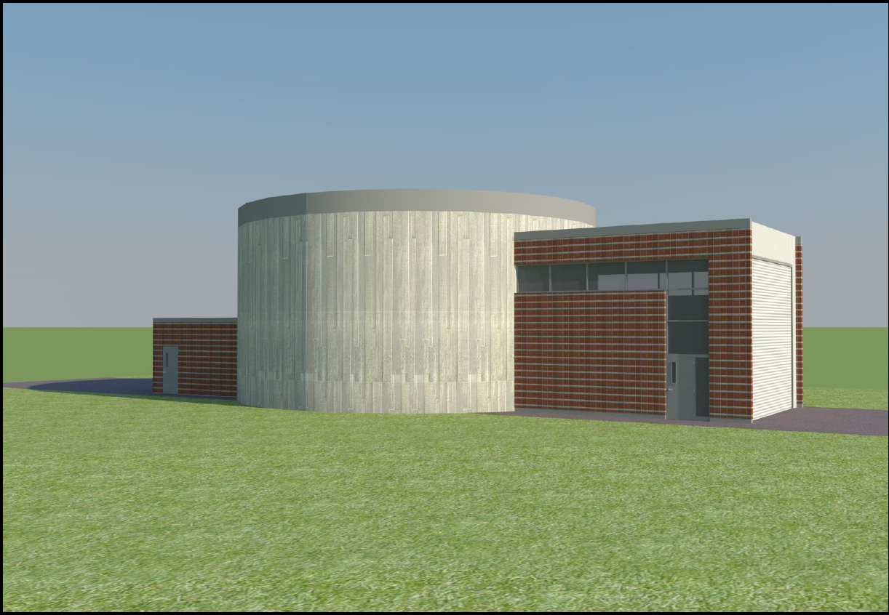
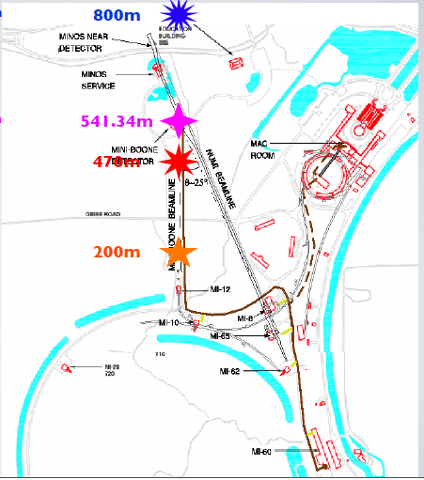
Building just upstream of MiniBooNE on BNB
Delivery area
Controls
room
Could hold a larger membrane
cryostat design in future
Locations for detectors in
a future SBL neutrino program

Slide 27
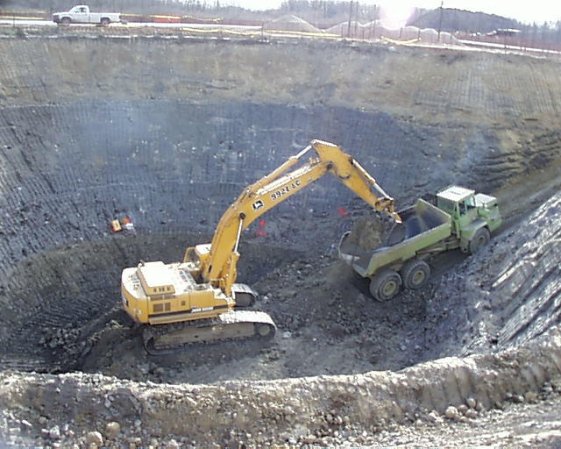
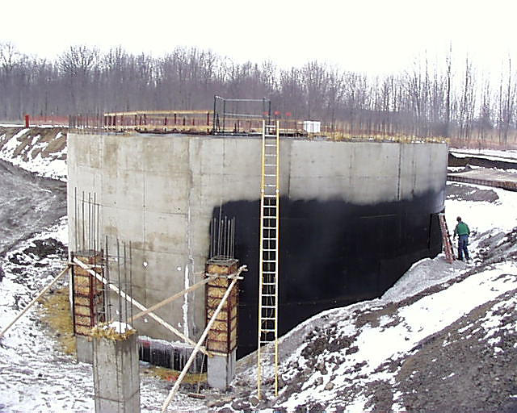
Construction similar to MiniBooNE
54 week construction time

Slide 28
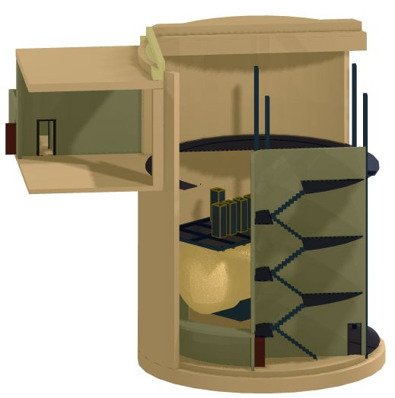
MicroBooNE detector
will be located on
BNB centerline

Slide 29
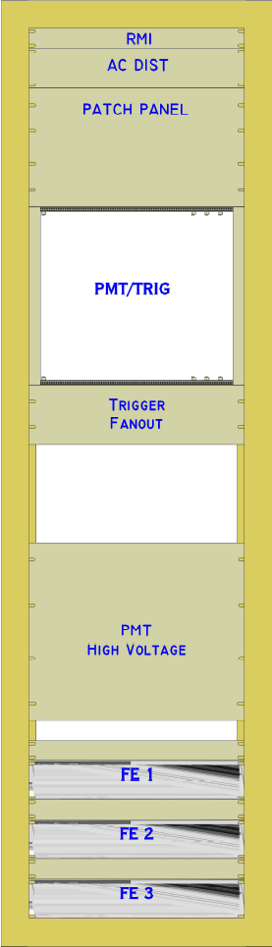
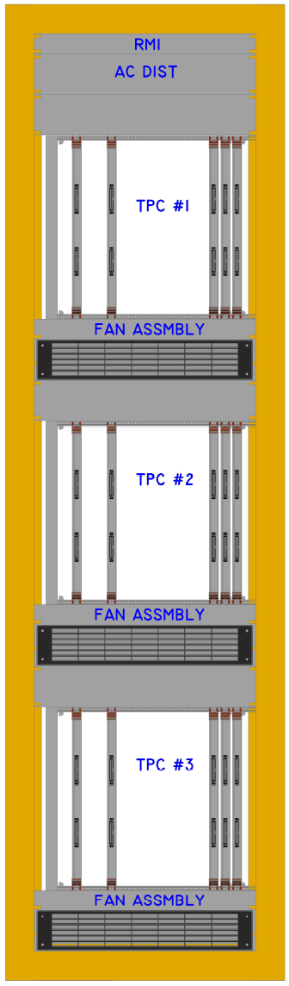
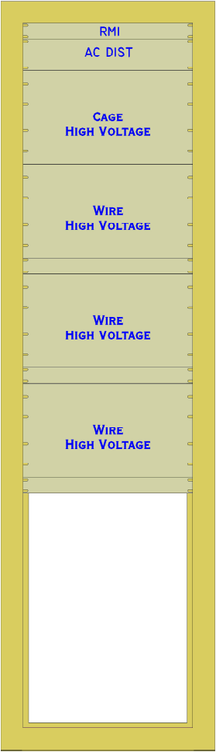
Electronics and readout racks

Slide 30
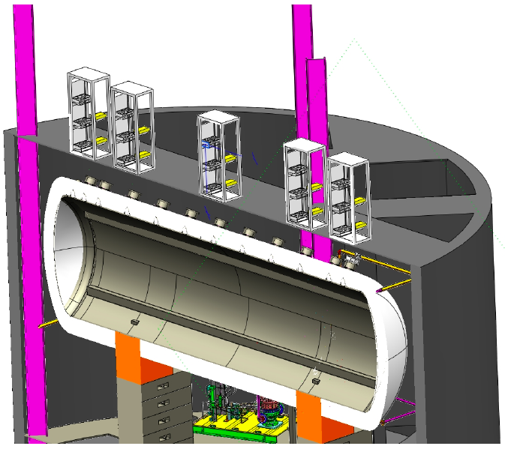
Rack locations in detector hall

Slide 31
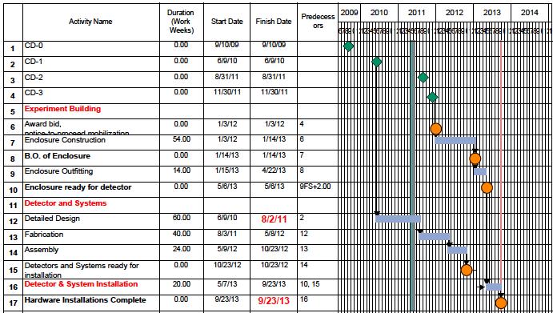
Schedule Overview

Slide 32
Detector Assembly Plan
Use D0 Assembly Area
Vessel will be delivered there and placed on temporary support structure
Detector components fabricated at Yale, BNL, MIT, FNAL
Detector components will be delivered to DAB
Clean assembly area will be constructed
TPC will be assembled in clean “tents”
TPC, FEE and PMTs will be inserted into cryostat
Cryostat will be sealed (flange or/and weld)
Electronics racks will be pre-assembled at D0
DAQ systems will be tested prior to installation

Slide 33
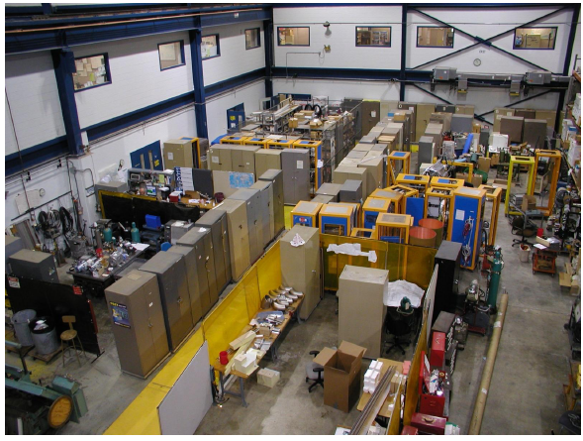
D0 Assembly Hall to be cleaned out
Racks for MicroBooNE

Slide 34
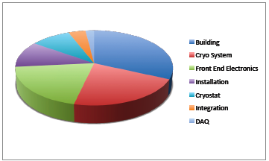
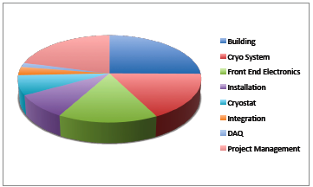
Project Cost Estimate being developed for CD-2 baseline
Base Cost
  $19M
Includes costs since CD-0
  $2M
Contingency
  30% on remaining work = $5M
TPC ~ $24M
Before Contingency ~$15M
Including PM ~$19M

Slide 35
Fermilab Manpower Resources
On-project
  FY11 : 7-8 FTE
  FY12 : 11-12 FTE
  FY13 : 12 FTE
Scientific Staff in addition to PM (Rameika, James)
  Baller, Jostlein, Kirby, Pordes, Raaf, Rebel, Zeller

Slide 36
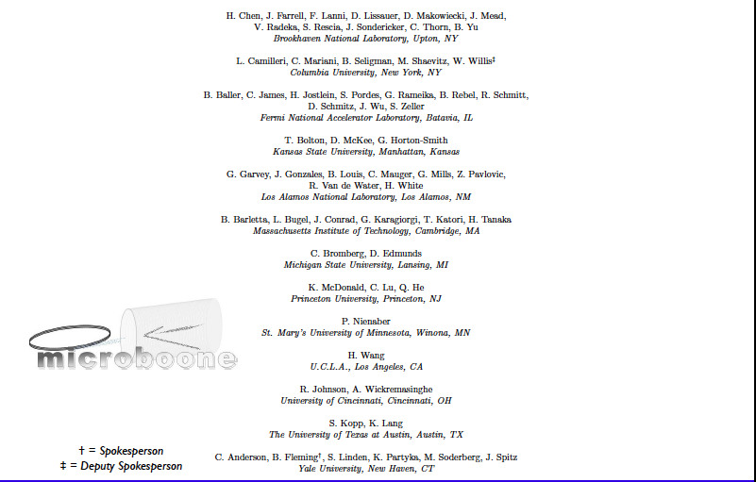
MicroBooNE Collaboration
13 institutions
~60 collaborators

Slide 37
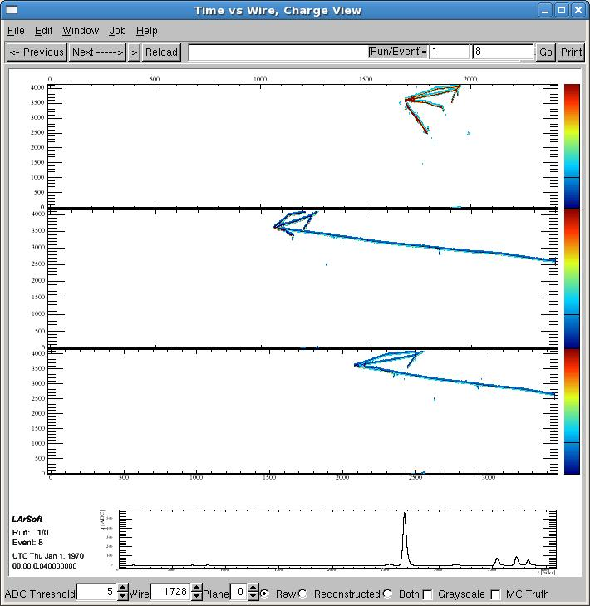
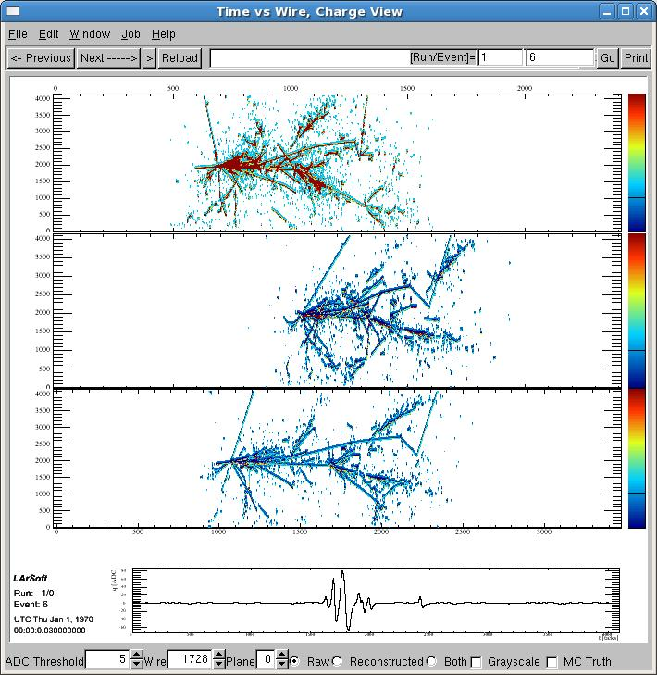
Off-project activities
Argon procurement
Filling and purification
Booster Neutrino Beam preparation
Off-line software

Slide 38
Summary and Conclusions
Project design is nearing completion
Project team is in the process of optimizing the schedule to determine the earliest technically driven completion date ; aiming for completion in 2013
CD-2 review is planned for end of July
Procurement of key elements (building, cryostat and cryogenic equipment) could begin in October if funding is available

