Slide 1
Current Neutrino Experiments
Jennifer Raaf
Fermilab Institutional Review
June 6-9, 2011
with help from:
D. Harris, R. Hatcher, A. Kreymer, L. Lueking,
K. McFarland, T. Nakaya, R. Plunkett, C. Polly,
M. Soderberg, M. Wascko, R. Van de Water, S. Zeller

Slide 2
Introduction
Recently completed and on-going experiments in the Fermilab neutrino program have provided a wealth of neutrino interaction measurements, both for oscillation and neutrino cross sections.
  Booster Neutrino Beamline
    SciBooNE, MiniBooNE,NOνA
  NuMI beamline
    MINERνA, MINOS, ArgoNeuT, NOνA
The entirety of the future neutrino program builds upon knowledge gained through operation of these experiments.

Slide 3
Computing Resources
Intensity Frontier Grid CPUs
Computing usage by Intensity Frontier experiments steadily increasing
None of the physics results shown today would have been possible without these resources

Slide 4
Booster Neutrino Beamline
NOνA prototype
(2010 – present)
MiniBooNE (2002 – present)
SciBooNE (2007 – 2008)

Slide 5
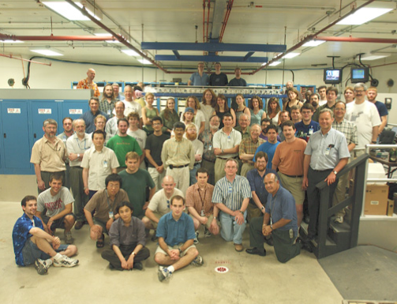
MiniBooNE
54 collaborators (anti-ν run)
15 institutions, 2 countries
11 FNAL personnel – ~3 FTEs
- S. Brice (co-spokesperson ν run)
- C. Polly (analysis co-coordinator)
- S. Zeller (analysis co-coordinator)
- R. Stefanski (timing analysis, retired)
- T. Kobilarcik (operations meeting coordinator, BNB expert)
- D. Perevalov (RA, AEM presentations)
- B. Brown, R. Ford, F. Garcia, B. Marsh, C. Moore (shifts)

Slide 6
MiniBooNE Physics Goals and Recent Publications
20 publications (8 in 2010-2011)
ν_{e} and ν_{e} appearance
  “Event Excess in the MiniBooNE Search for ν_{μ} ν_{e} Oscillations,” Phys. Rev. Lett. 105,181801 (2010)
ν_{μ} and ν_{μ} disappearance
ν_{μ} and ν_{μ} cross section measurements
  “Measurement of neutrino-induced charged-current charged pion production cross sections on mineral oil at E_{ν} ~1 GeV,” Phys. Rev. D83, 052007 (2011)
  “Measurement of ν_{μ}-induced charged-current neutral pion production cross sections on mineral oil at E_{ν} from 0.5-2.0 GeV,” Phys. Rev. D83, 052009 (2011)
  “Measurement of the neutrino neutral-current elastic differential cross section,” Phys. Rev. D82, 092005 (2010)
  “First measurement of the muon neutrino charged current quasielastic double differential cross section,” Phys. Rev. D81, 092005 (2010)
  “Measurement of ν_{μ} and ν_{μ}-induced neutral current single π⁰ production cross sections on mineral oil at Eν ~1 GeV,” Phys. Rev. D81, 013005 (2010)

Slide 7
MiniBooNE Physics Goals and Recent Publications
Additional measurements:
Neutrino flux
  “Measurement of the neutrino component of an anti-neutrino beam observed by a non-magnetized detector,” arXiv:1102.1964, submitted to Phys. Rev. D
Supernova search
  “Search for core-collapse supernovae using the MiniBooNE neutrino detector,” Phys. Rev. D81, 032001 (2010)

Slide 8
SciBooNE
63 collaborators
18 institutions, 5 countries
9 FNAL personnel – <1 FTE
- S. Brice
- B. Brown
- D. Finley
- T. Kobilarcik
- A. Russell
- R. Stefanski (retired)
- R. Tesarek (project manager)
- H. White
- S. Zeller

Slide 9
SciBooNE’s World Tour
Originally part of the K2K experiment at KEK in Japan (SciBar & EC)
SciBar & EC shipped to Fermilab for SciBooNE project
  MRD parts recycled from E-605, NuTeV, KTeV
  Collaboration was awarded DOE Pollution Prevention Star (P2 Star) award for reusing existing materials
  Fermilab was awarded DOE Pollution Prevention Environmental Stewardship Accomplishment award
Now on its way to Mexico to become part of the Global Muon Detector Network at Sierra Negra!

Slide 10
SciBooNE Physics Goals and Recent Publications
5 publications (3 in 2010-2011)
ν_{μ} and ν_{μ} cross section measurements
  “Measurement of K⁺ production cross section by 8 GeV protons using high energy neutrino interactions in the SciBooNE detector,” arXiv:1105.2871, submitted to Phys. Rev. D (2011)
  “Measurement of inclusive charged current interactions on carbon in a few-GeV neutrino beam,” Phys. Rev. D83, 012005 (2011)
  “Improved measurement of neutral current coherent π⁰ production on carbon in a few-GeV neutrino beam,” Phys. Rev. D81, 111102(R) (2010)
Measure background processes for oscillation experiments (T2K)
Act as MiniBooNE near detector

Slide 11
BNB Oscillation Summary
 | SciBooNE | MiniBooNE
ν mode | 0.99 x 10²⁰ POT | 6.5 x 10²⁰ POT
ν mode | 1.53 x 10²⁰ POT | 8.7 x 10²⁰ POT
Low energy excess (below 475 MeV)
  MB: 3σ ν_{e}-like excess in neutrino mode (128 ± 43 events)
  Does not fit simple 2ν oscillation hypothesis
  MB: Negligible excess in anti-neutrino mode (18 ± 14 events)
    Rules out some explanations of neutrino-mode excess
LSND-like signal (above 475 MeV)
  MB: No evidence of ν_{e} excess in neutrino mode
  MB: 2.7σ excess in anti-neutrino mode
    Null hypothesis 0.5% probable, 2ν fit prefers LSND-like signal at 99.4% CL
ν_{μ} and ν_{μ} disappearance
  MB: No evidence in neutrino or anti-neutrino mode
  MB + SB: No evidence in neutrino mode
    More precise anti-neutrino joint analysis underway

Slide 12
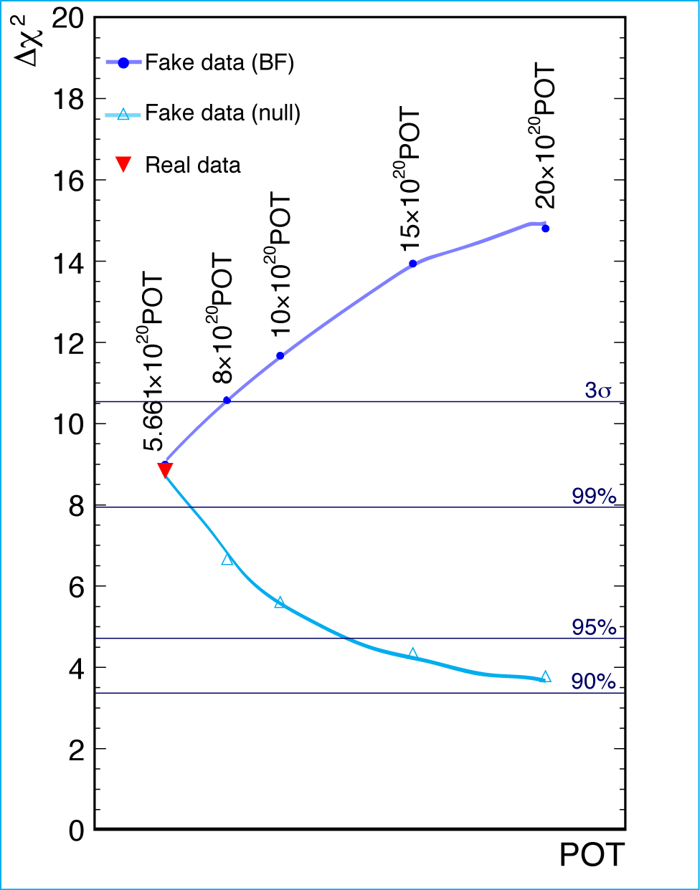
MiniBooNE: Expected sensitivity with additional ν data
With 15 x 10²⁰ POT ν significance could grow to 3.7σ, or fall back to include null at 95% CL.
Analysis of 8.5 x 10²⁰ POT will be released this summer.

Slide 13
Flux constraints
Comment from 2010 DOE S&T Review closeout report:

Slide 14
Flux constraints
Comment from 2010 DOE S&T Review closeout report:
SciBooNE measurement of ν from K⁺ component of ν beam
arXiv:1105.2871, submitted to Phys. Rev. D
Measure higher energy ν’s (> 2 GeV) from “wrong-sign” parent:
  Prediction of ν from K⁺ in ν beam over-estimated
Directly applicable to MiniBooNE
Identical beam simulation
Greatly reduces K⁺ flux systematic errors
  40% → 14%

Slide 15
Flux constraints
Comment from 2010 DOE S&T Review closeout report:
ν (right sign)
Preliminary
Preliminary
ν (wrong sign)
Wrong sign ~30% background in
MRD-stopped
sample
ν (wrong sign)
In progress:
  Measuring wrong-sign component for lower energy neutrinos
1-track w/o activity
2-track QE-like
~90% ν purity
~90% ν purity

Slide 16
Flux constraints
Comment from 2010 DOE S&T Review closeout report:
MiniBooNE
Measure the ν component of the ν beam in MiniBooNE
arXiv:1102.1964, submitted to Phys. Rev. D
Two independent methods agree:
Prediction of ν flux component of predominately ν beam is over-estimated.
Constrains ν flux for region of angular acceptance HARP can’t measure
Novel technique for non-magnetized detectors

Slide 17
SciBooNE-MiniBooNE joint analysis
Comment from 2010 DOE S&T Review closeout report:
MiniBooNE-only results are limited by neutrino flux and neutrino interaction uncertainties
Use CC ν_{μ} rate measured at SciBooNE to constrain MiniBooNE ν_{μ} rate and test for disappearance
Two methods
  Simultaneous oscillation fit of MB and SB data
  Correct MB energy spectrum to measured SB spectrum, then do oscillation fit to MB data only

Slide 18
Joint MiniBooNE-SciBooNE ν_{μ} disappearance
Both methods agree:
No disappearance at 90% CL
Spectrum fit
Simultaneous fit
Truly collaborative effort!
In progress:
  Paper in approval process
  Joint ν_{μ} disapp. analysis

Slide 19
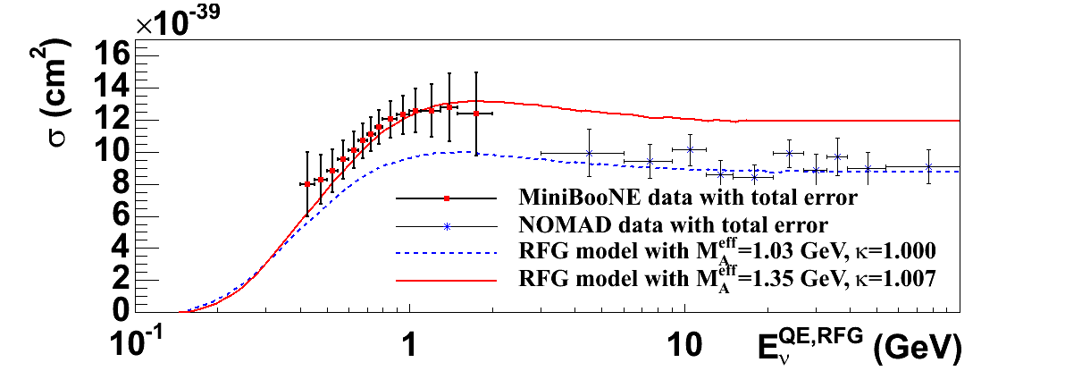
MiniBooNE Cross Sections
Neutrino cross sections are not well-known below ~2 GeV
MiniBooNE CC quasi-elastic cross section ~30% higher than “standard” QE prediction
Possible explanation:
  Extra contributions from multi-nucleon correlations in the nucleus.
Well-established effect in electron scattering… somehow forgotten when transferring knowledge to neutrino scattering.

Slide 20
MiniBooNE Cross Sections
Neutrino cross sections are not well-known below ~2 GeV
MiniBooNE CC quasi-elastic cross section ~30% higher than “standard” QE prediction
MINERνA, MINOS, ArgoNeuT
If discrepancy is due to extra nucleons, MINERνA, MINOS, and ArgoNeuT are all capable of detecting them, and they cover the gap between MiniBooNE and NOMAD data!

Slide 21
MiniBooNE/SciBooNE: What’s Next…
MiniBooNE
Analyzing 50% more ν now, updated osc. results this summer
ν cross sections: QE, NC elastic (prelim. shown in March)
Published cross sections for 90% of ν data
Published 100% of oscillation data in ν mode
Focus now is really on ν
SciBooNE
ν cross sections: QE, CC π⁰ underway
ν cross sections: Coherent π⁻ underway
MiniBooNE + SciBooNE
Joint ν_{μ} disappearance analysis underway

Slide 22
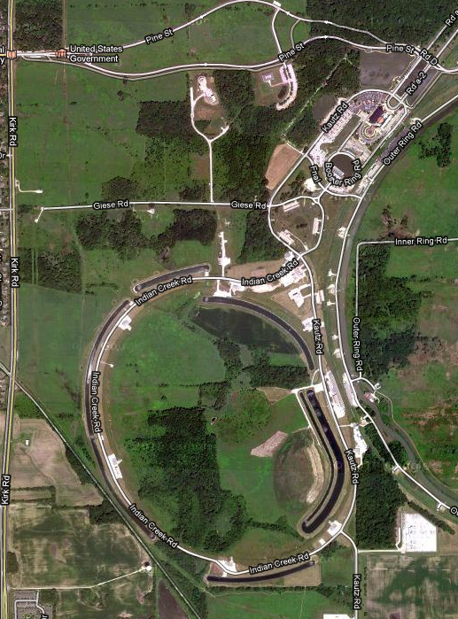
NuMI Beamline
To Soudan Mine
(MINOS far detector)
MINOS (2005 – present) near detector
ArgoNeuT (2009 – 2010)
MINERνA (2010 – present)
NOνA prototype
(2010 – present)

Slide 23
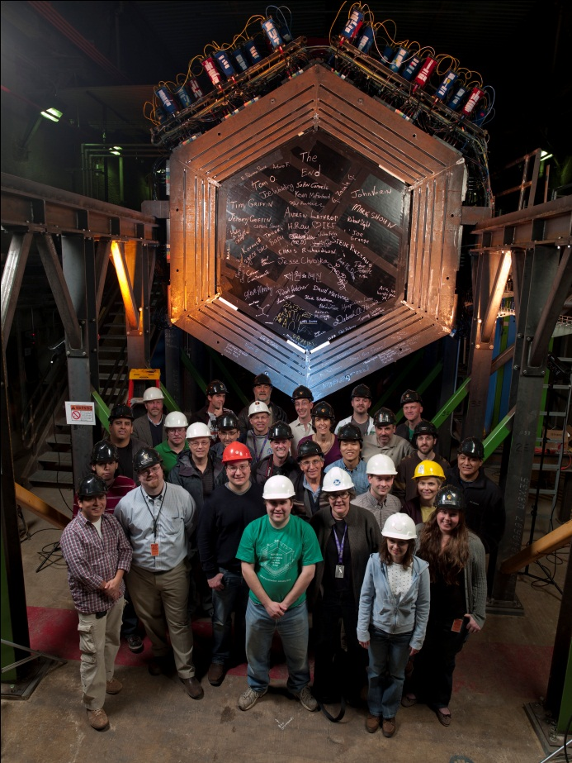
MINERνA
80 collaborators
23 institutions, 7 countries
5 FNAL physicists – ~4.5 FTEs
- D. Harris (co-spokesperson, project manager)
- J. Morfín (former co-spokesperson)
- D. Schmitz (Lederman fellow, deputy analysis coordinator)
- J. Osta (RA, testbeam, calorimetry reconstruction)
- R. Snider (computing liaison)
Important technical contributors:
- D. Hahn (shift and safety coordinator)
- L. Bagby, R. DeMaat, J. Kilmer, A. Pla-Dalmau,
P. Rubinov (active during project and installation, now “on call” experts)
D. Boehnlein, R. Stefanski (former shift coordinators, left last year)

Slide 24
MINERνA Physics Goals
Precision ν–A cross section measurements at moderate energies, wide range of Q²
Exclusive final state and differential cross sections
Form factors and structure functions
Nuclear effects in a variety of targets
  - polystyrene (CH), C, Fe, Pb, He
Provide measurements that will enable greater precision in oscillation experiments by minimizing systematic uncertainties

Slide 25
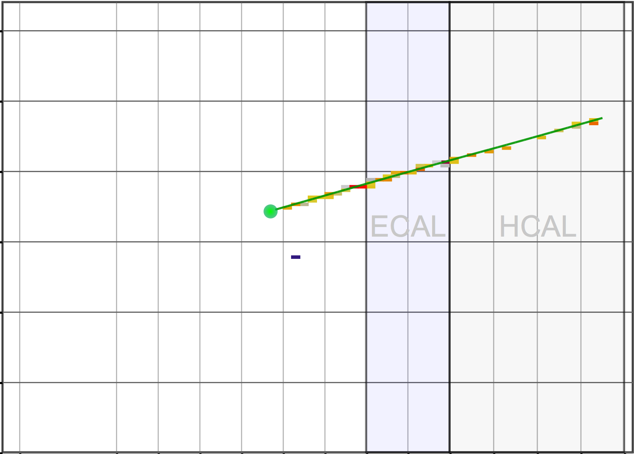
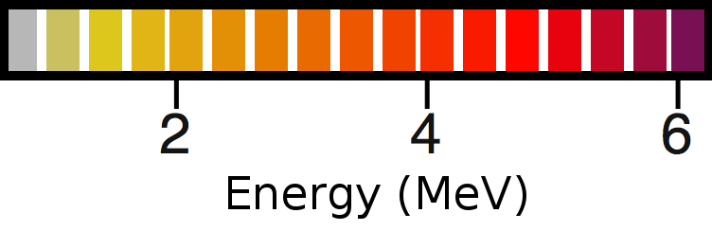
MINERνA: Quasi-Elastic Event Selection
ν_{μ} beam, partial detector: 0.4 x 10²⁰ POT
Beam direction
If elastic kinematics,
E_{ν}=2.5 GeV, Q²=0.3GeV²
μ⁺ must originate in MINERνA; analyze momentum in MINOS
Neutron may or may not appear in detector
  Two event samples:
  Inclusive μ⁺
  candidates
30 MeV deposited in
single bar. Neutron interaction candidate.
View of detector from above
This is a first pass at the analysis.
Other methods for selecting a clean event sample are in development (Michel veto, rejection of events with extra tracks, etc.)

Slide 26
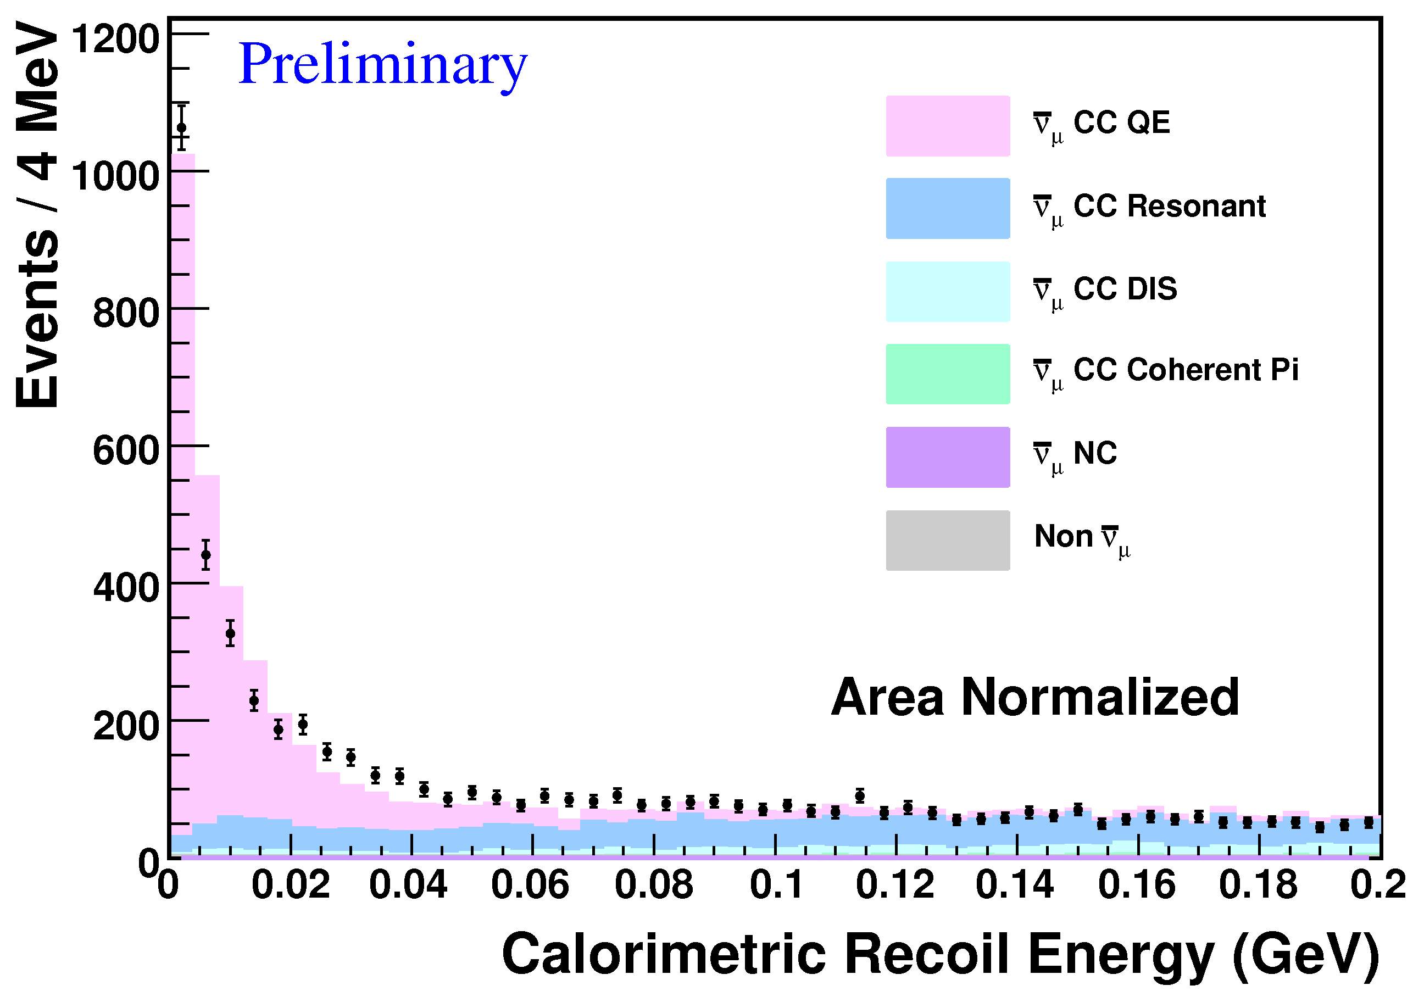
MINERνA: Quasi-Elastic Recoil Selection
ν_{μ} beam, partial detector: 0.4 x 10²⁰ POT
Beam direction
If elastic kinematics,
E_{ν}=2.5 GeV, Q²=0.3GeV²
View of detector from above
Sum calorimetric energy in detector, ignoring region within 5 cm of μ⁺ track (to reduce contribution from δ-rays)
QE events dominate at low recoil energy

Slide 27
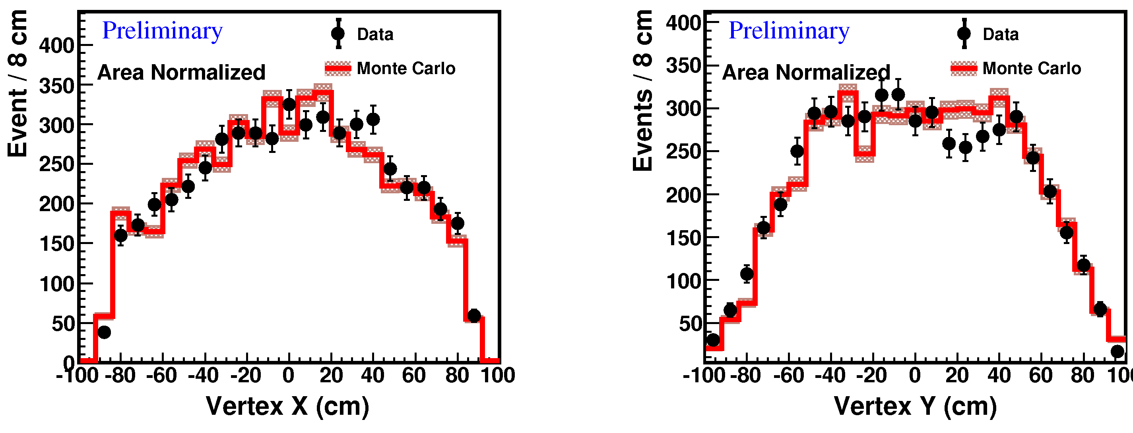
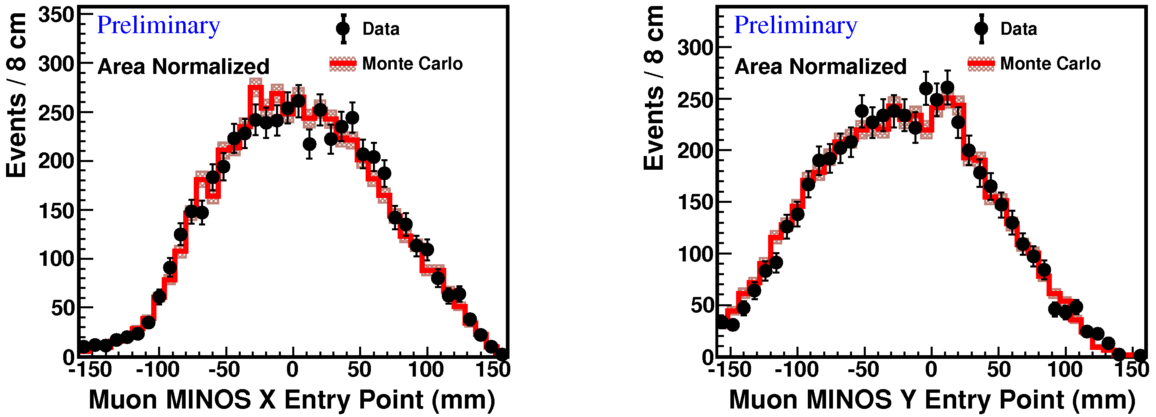
MINERνA Comparisons to Simulation
ν_{μ} beam, partial detector: 0.4 x 10²⁰ POT
Event vertex in MINERνA
Muon entry in MINOS
Good agreement in spatial distributions across detectors

Slide 28
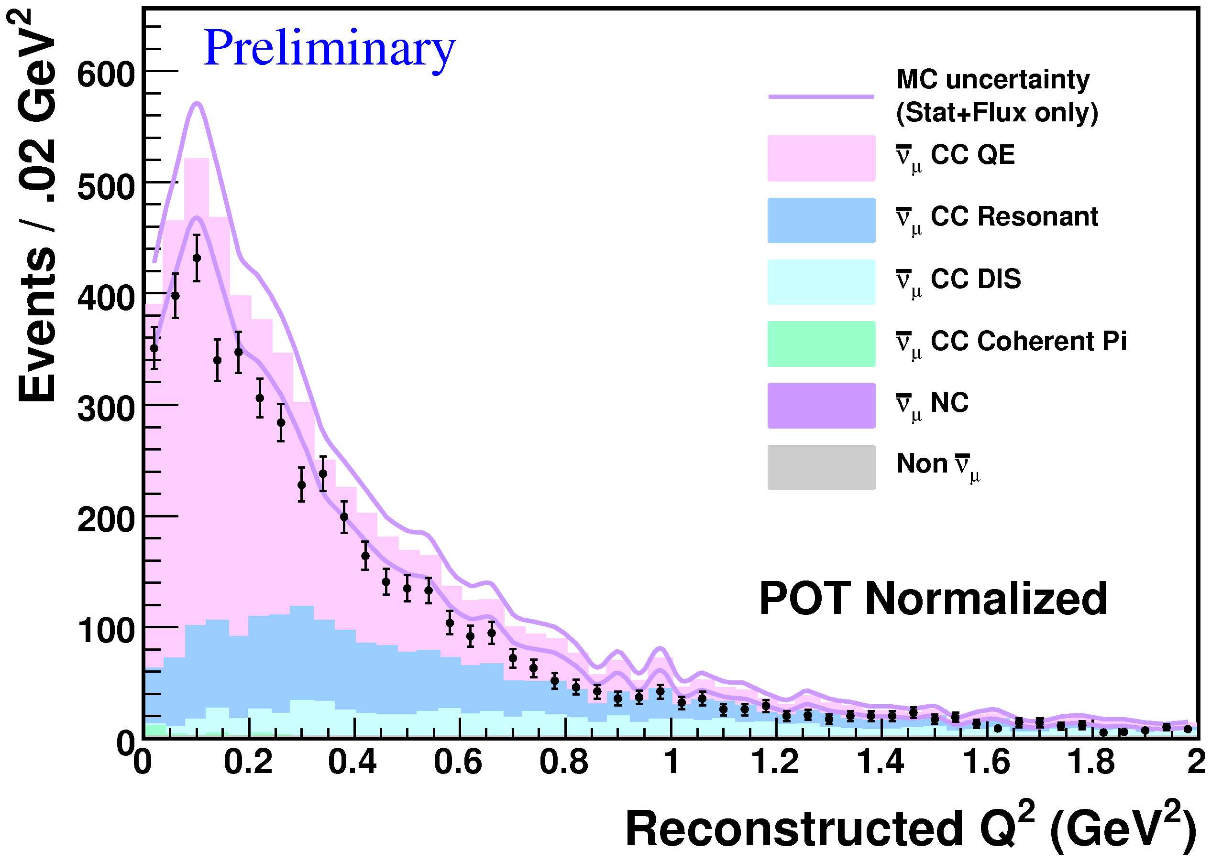
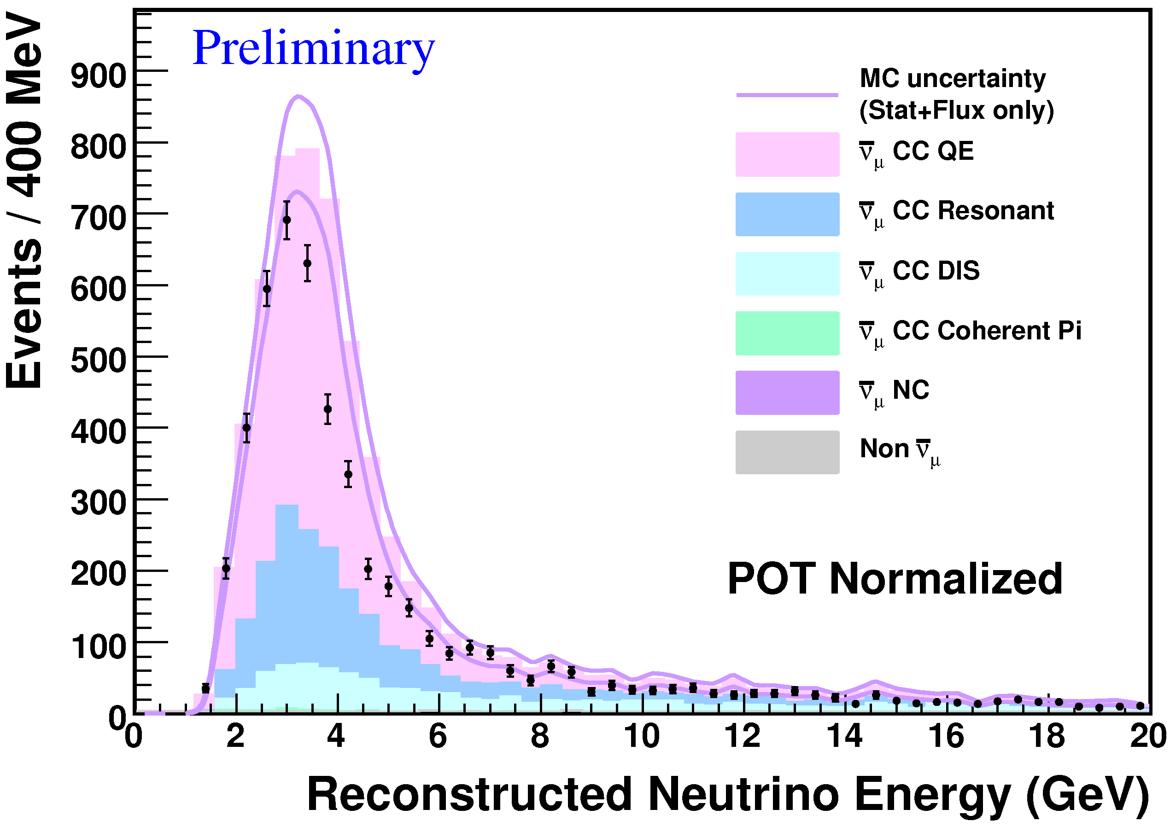
MINERνA: Event Kinematics
Event deficit flat in Q², not flat in neutrino energy.
First look at QE physics from MINERνA!
Absolute normalization predictions include:
Flux simulation
GENIE 2.6.2
MINERνA detector simulation

Slide 29
MINERνA: What’s Next…
Many other analyses currently underway
  Inclusive CC events on nuclear targets
  QE events in neutrino mode: nuclear targets and plastic
  Flux tuning methodology
  …many more! (These are the 3 most active areas now.)
All of these analyses require different techniques that are being developed
  pion (kinked) and proton (short) tracking
  EM shower reconstruction
  particle ID by dE/dx
  stopping muons in MINERvA
  Michel tagging
  vertex reconstruction in passive targets

Slide 30
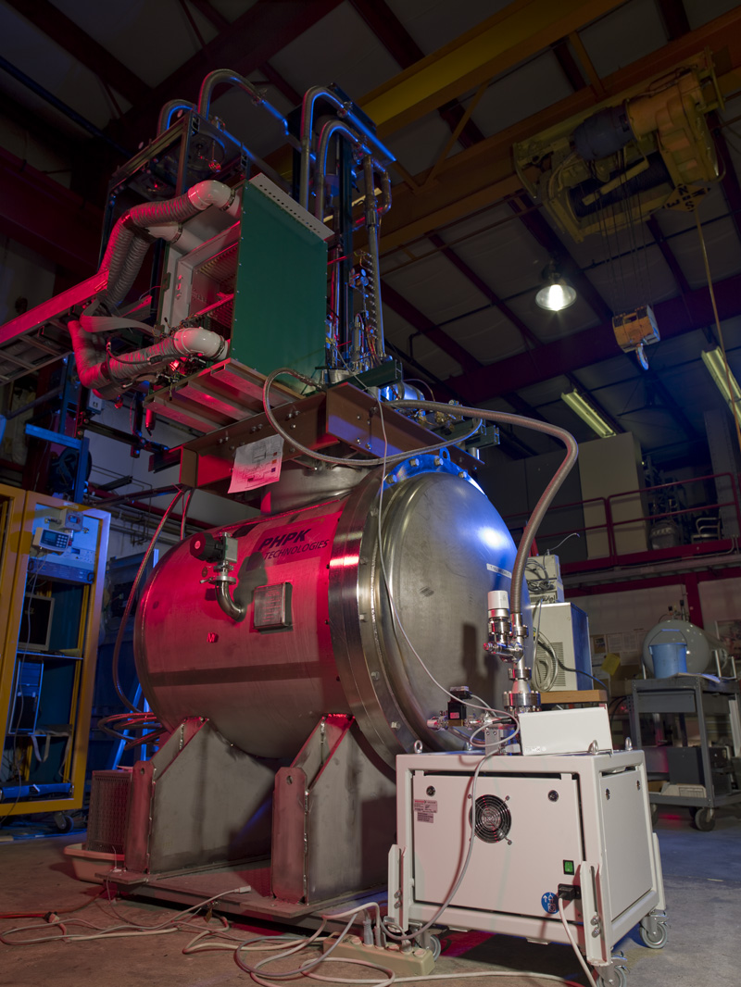
ArgoNeuT
30 collaborators
9 institutions, 3 countries
6 FNAL personnel – ~1 FTEs
- M. Soderberg (spokesperson)
- B. Baller
- C. James
- R. Rameika
- B. Rebel (Wilson Fellow, software coordinator)
- S. Zeller

Slide 31
ArgoNeuT in the NuMI Beamline
Cryocooler failure
(otherwise, uptime ~99%)
175 liter liquid argon TPC
Physics run: Sept. 2009 – Feb. 2010
Data collected: ~1.35 x 10²⁰ P.O.T.
0.1 x 10²⁰ ν-mode, 1.25 x 10²⁰ ν-mode
ArgoNeuT in the MINOS hall

Slide 32
ArgoNeuT Goals
Experience building and running liquid argon TPCs
  Development focused on scaling LArTPCs to sizes necessary for long baseline experiments
Measure cross sections in the range 1 to 5 GeV
  ν and ν events accumulated
Develop generalized simulation and reconstruction tools for LArTPCs

Slide 33
ArgoNeuT: LArTPC Reconstruction
Preliminary
dE/dx, neutrino-induced muons
Vertical angle of muons
(NuMI beam is -3°)
ArgoNeuT data invaluable to development of full generalized reconstruction/simulation chain
Useful for current and future LArTPC projects

Slide 34
ArgoNeuT: Shower Reconstruction
ν_{e} CCQE candidate
Length along shower direction (cm)
Development of 3D shower reconstruction tools in progress
Very important step for determining true signal & background capabilities of LArTPCs

Slide 35
Coming this summer…

Slide 36
What’s Next…
Cross sections for CC QE-like ν and ν from 1-5 GeV
  Low statistics (but ICARUS 50-liter meas. with ~80 events)
Initial focus: analyze ~2 weeks of ν-mode data
  Study inclusive CC sample
  Data/MC comparisons
Start to look at ν data this fall…

Slide 37
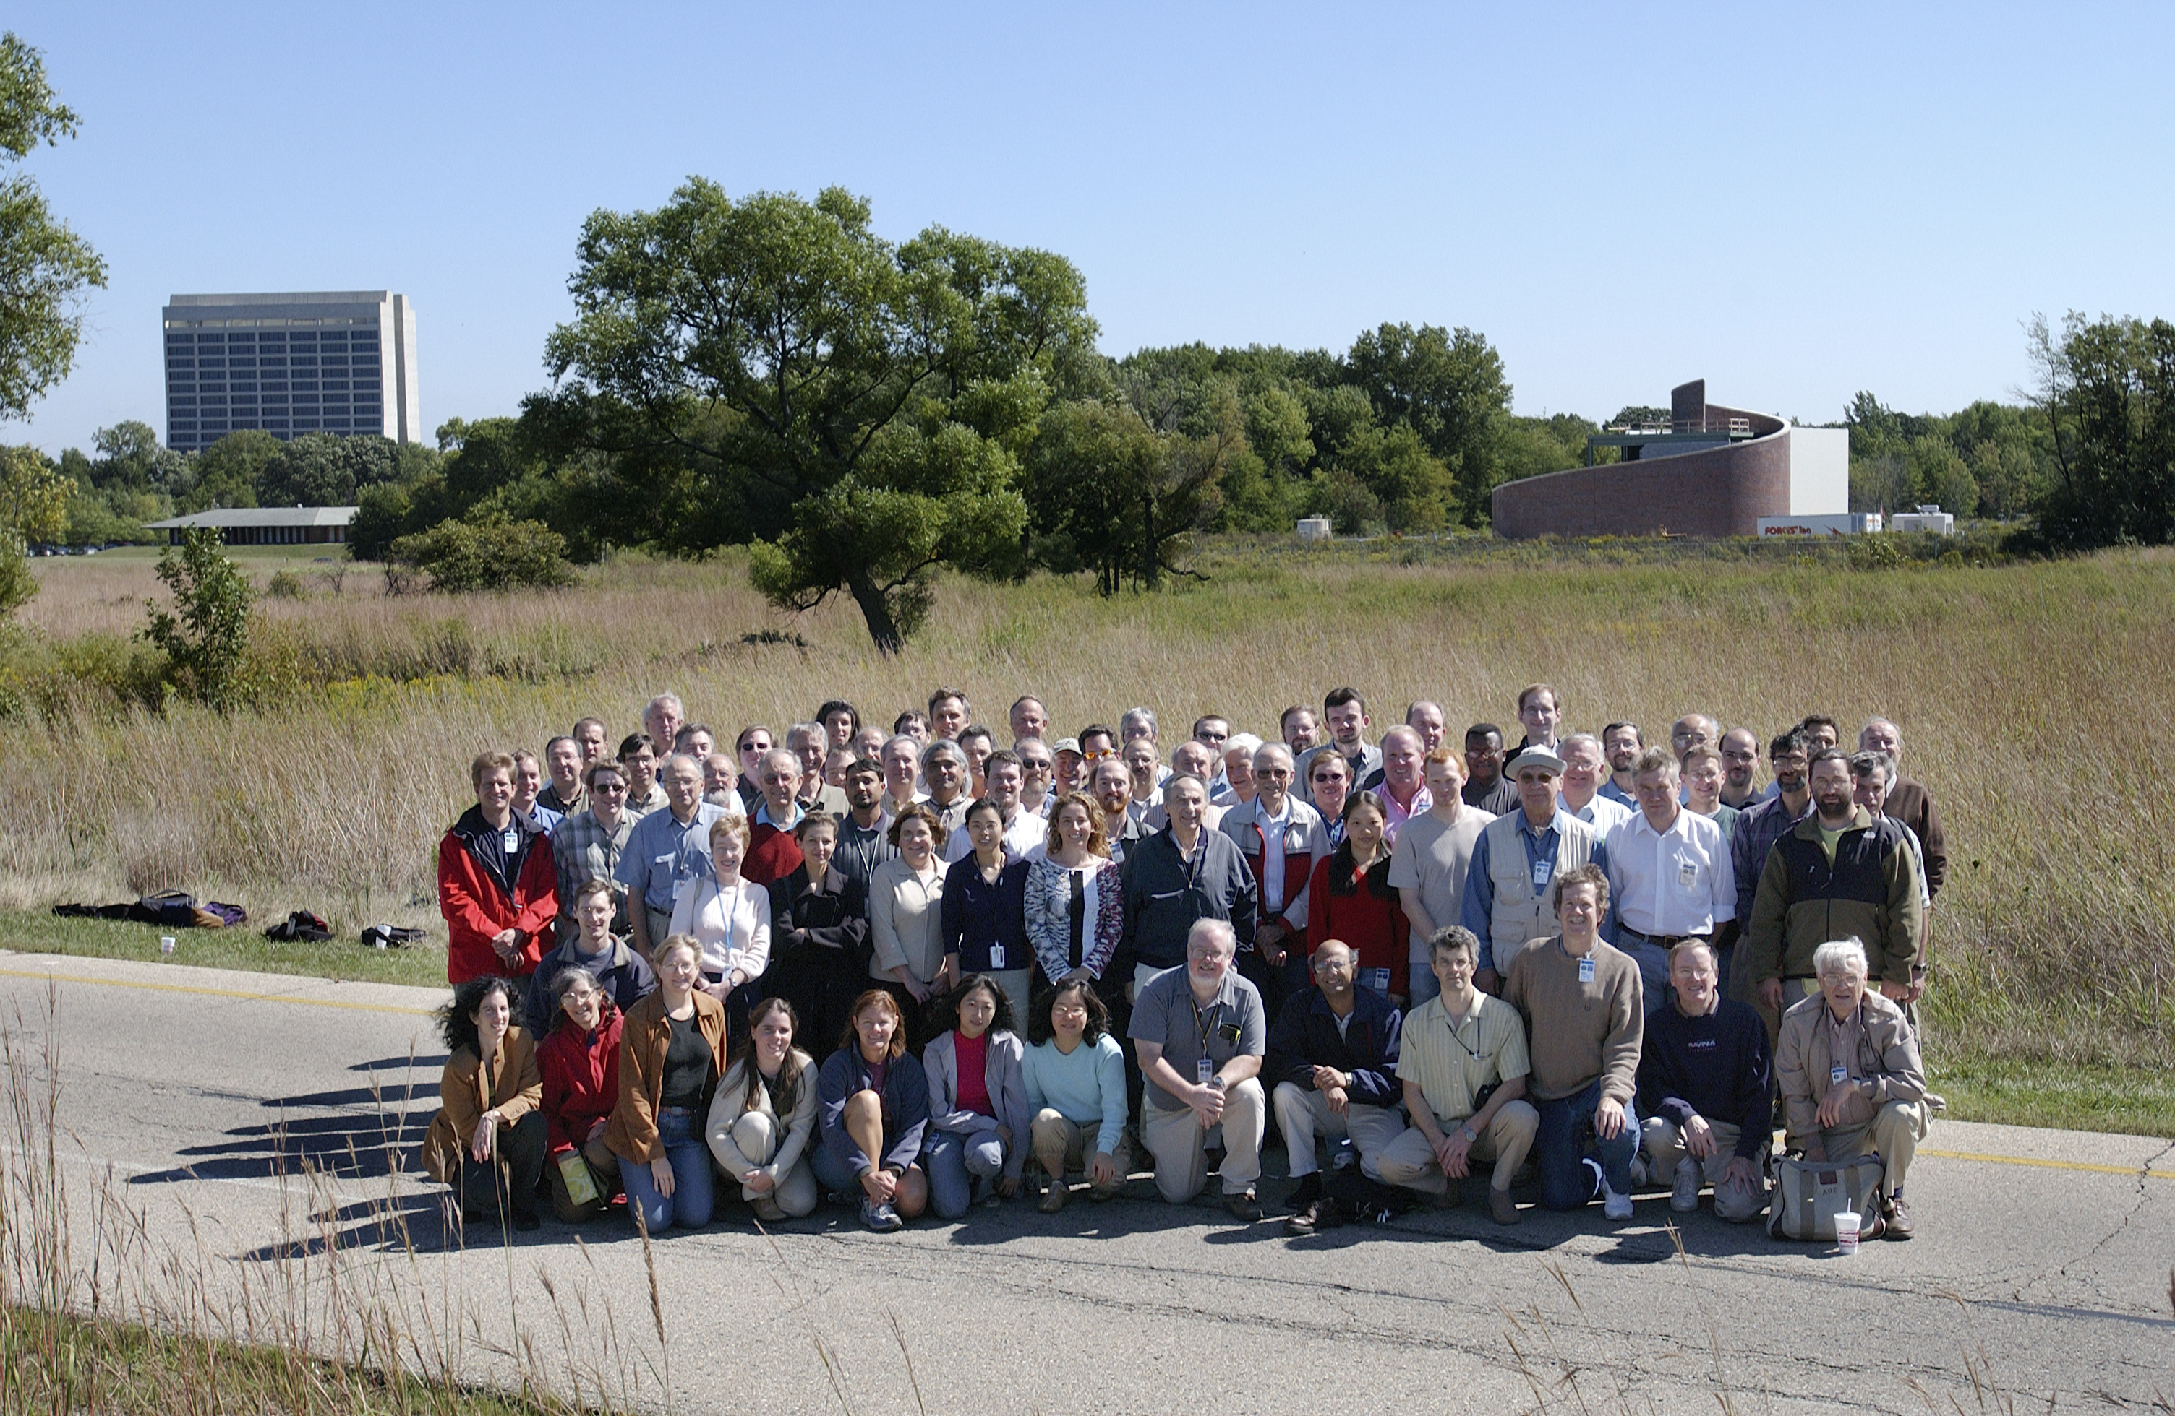
MINOS
126 collaborators
29 institutions, 5 countries
18 FNAL personnel – ~7 FTEs
- R. Plunkett (co-spokesperson)
- B. Rebel (Wilson fellow, publications committee)
- B. Pahlka (RA)
- A. Kreymer, R. Hatcher (CD)
- D. Torretta (DAQ)
- R. Sharma (graduate student)
- P. Adamson, S. Childress, J. Hylen, G. Koizumi, P. Lucas,
C. Moore, B. Zwaska (beam)
- G. Bock, D. Boehnlein, D. Bogert, C. James, D. Jensen (shifts)

Slide 38
MINOS Physics Goals and Recent Publications
24 publications (9 in 2010-2011)
ν_{μ} disappearance
  "Measurement of the neutrino mass splitting and flavor mixing by MINOS,” Phys. Rev. Lett. 106, 181801 (2011)
ν_{μ} disappearance
  “First direct observation of muon antineutrino disappearance” arXiv:1104.0344, accepted for publication in Phys. Rev. Lett.
ν_{e} appearance
  "New constraints on muon-neutrino to electron-neutrino transitions in MINOS,” Phys. Rev. (Rapid Comm.) D82, 051102 (2010)
Sterile neutrino search
  “Active to sterile neutrino mixing limits from neutral-current interactions in MINOS,” arXiV:1104.3922, submitted to Phys. Rev. Lett.
  "Search for sterile neutrino mixing in the MINOS long-baseline experiment,” Phys. Rev. D 81,052004 (2010)

Slide 39
MINOS Physics Goals and Recent Publications
Additional measurements:
Cross sections
  "Neutrino and antineutrino inclusive charged-current cross section measurements with the MINOS near detector,” Phys. Rev. D 81,072002 (2010)
Tests of Exotic Scenarios
  "A search for Lorentz invariance and CPT violation with the MINOS far detector,” Phys. Rev. Lett. 105, 151601 (2010)
Cosmic Ray Studies
  "Measurement of the underground atmospheric muon charge ratio using the MINOS near detector,” Phys. Rev. D83, 032011 (2011)
  "Measurement of the underground atmospheric muon charge ratio using the MINOS near detector,” Phys. Rev. D 83, 032011 (2011)
  "Observation in the MINOS far detector of the shadowing of cosmic rays by the sun and moon,” Astropart. Phys. 34, 457-466 (2011)
  "The atmospheric charged kaon/pion ratio using seasonal variation methods,” Astropart. Phys. 33, 140-145 (2010)

Slide 40
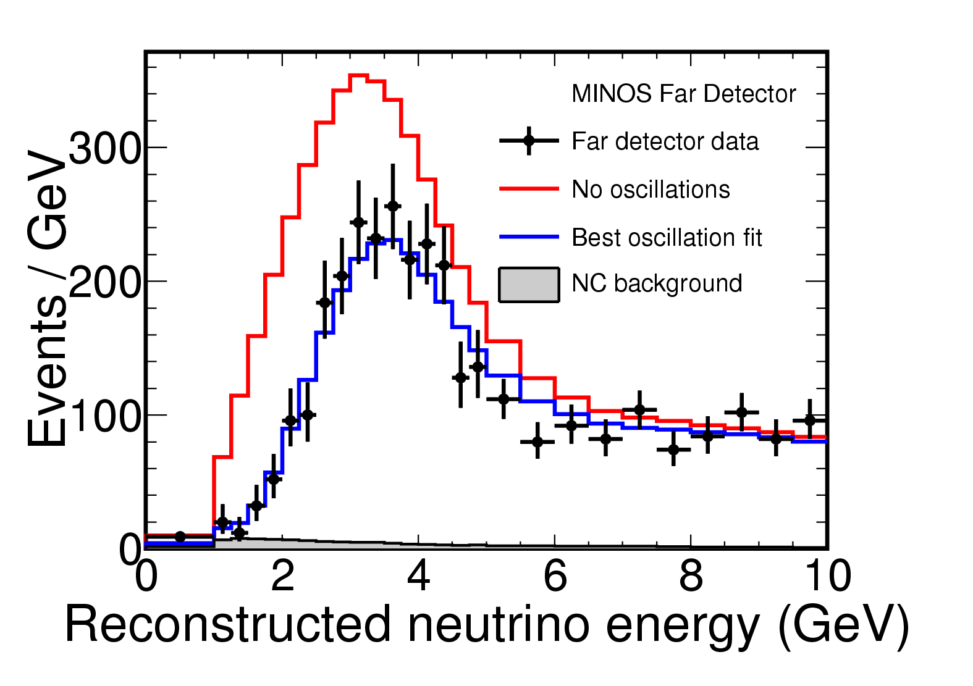
MINOS ν_{μ} disappearance
Phys. Rev. Lett. 106, 181801 (2011)
ν_{μ} dataset: 7.25 x 10²⁰ POT
Fully reconstructed
Partially reconstructed
 | Fully reconstructed | Partially reconstructed
Predicted (no osc.) | 2451 | 2206
Observed at Far Detector | 1986 | 2017

Slide 41
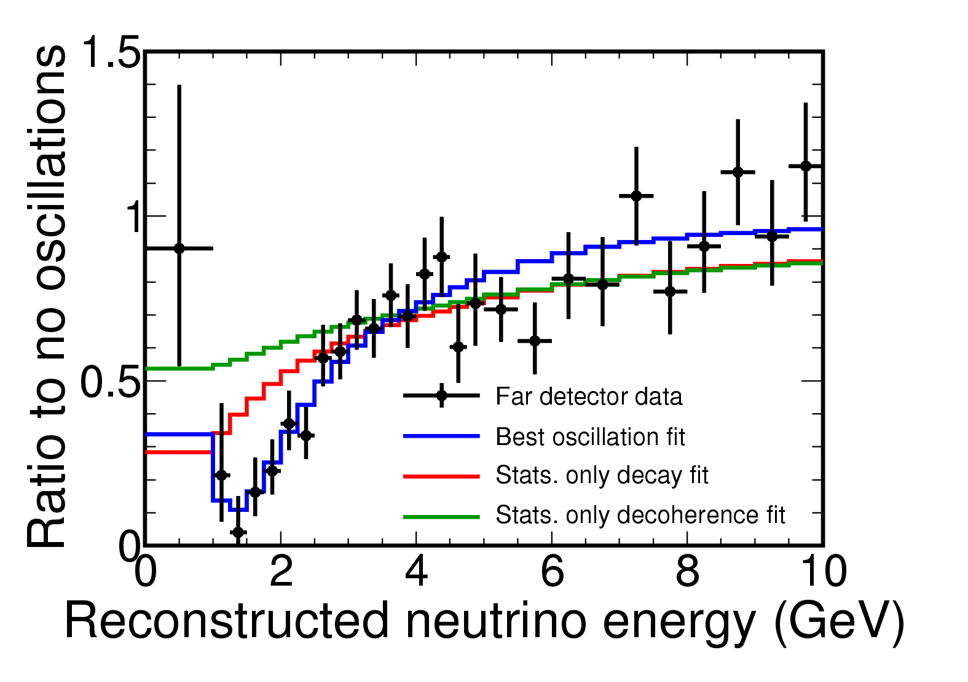
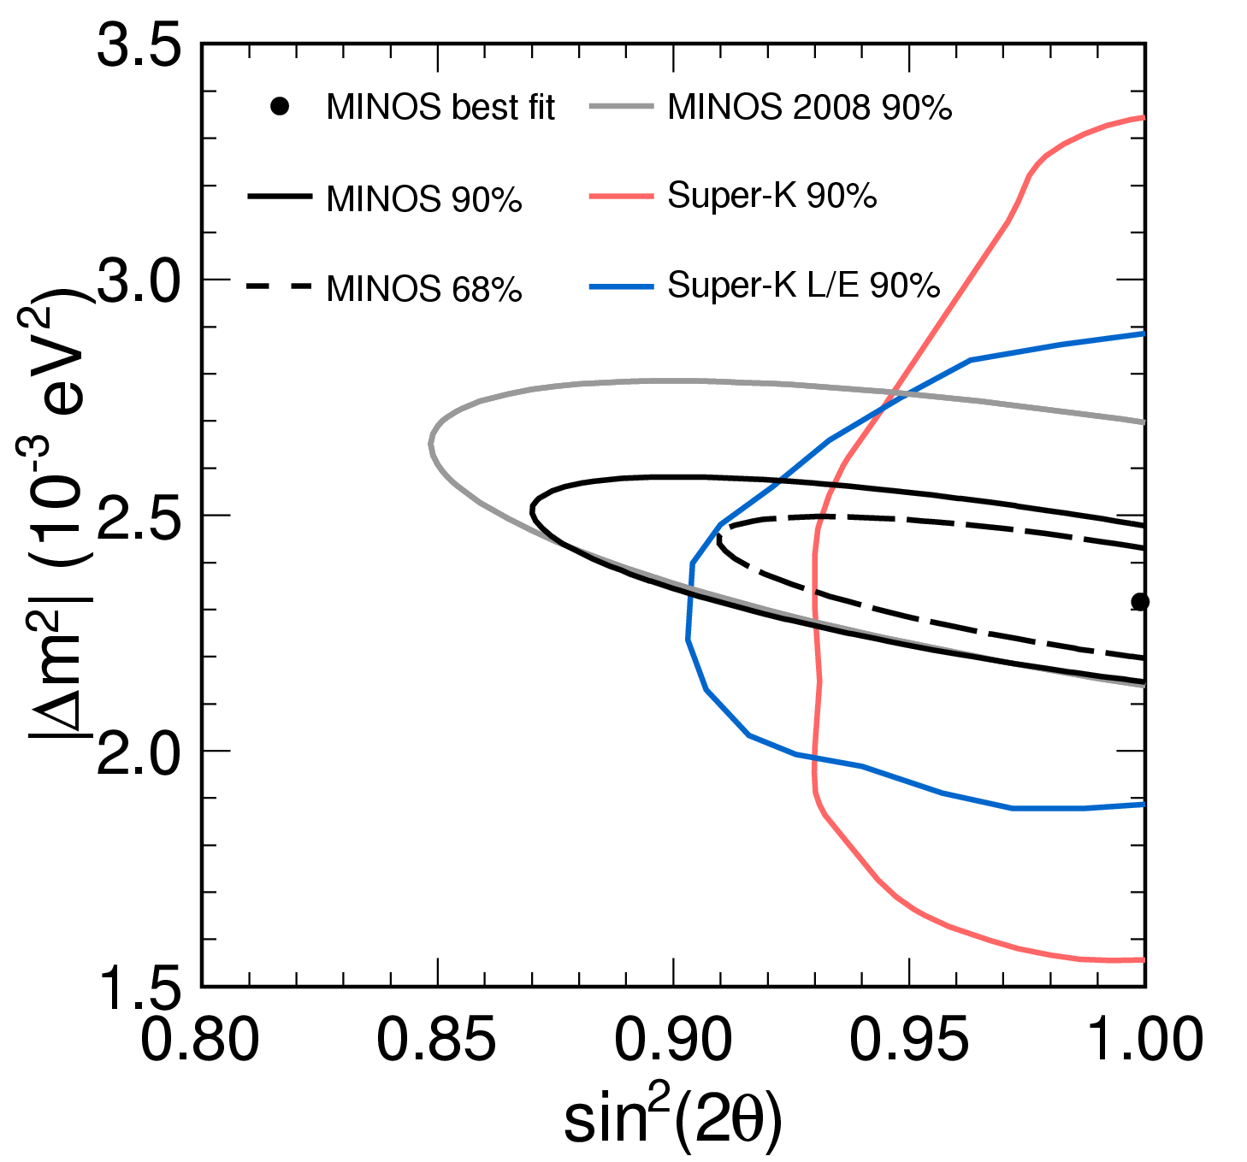
MINOS ν_{μ} disappearance
Pure decoherence disfavored at 9σ
Pure decay disfavored at 7σ
Best oscillation fit:
Dataset doubled from previous analysis:
3.4 x 10²⁰ 7.25 x 10²⁰ POT
Improved analysis method
Most precise mass splitting measurement so far!

Slide 42
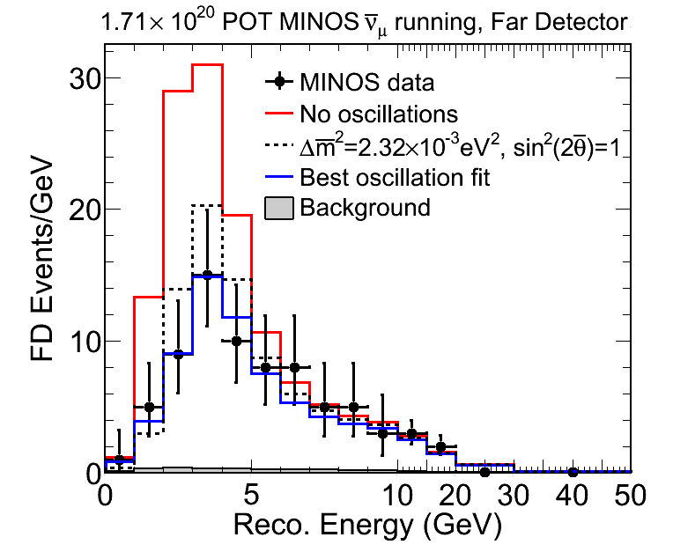
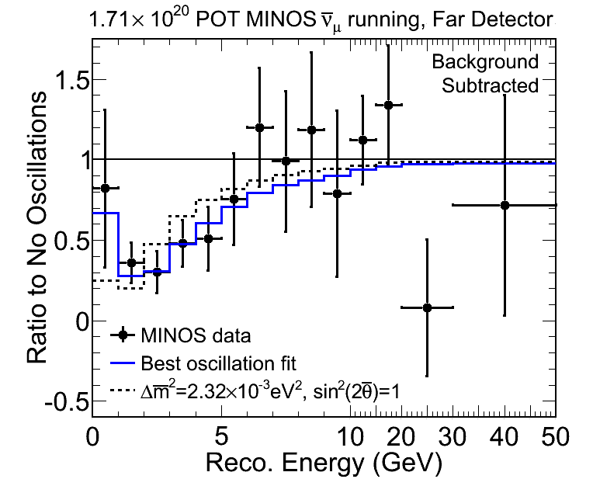
arXiv:1104.0344 [hep-ex], accepted by PRL
ν_{μ} dataset: 1.71 x 10²⁰ POT
MINOS ν_{μ} disappearance
No oscillation disfavored at 6.3σ
Best oscillation fit:
Predicted (no osc.) | 156
Observed at Far Detector | 97
First direct observation of muon antineutrino disappearance.

Slide 43
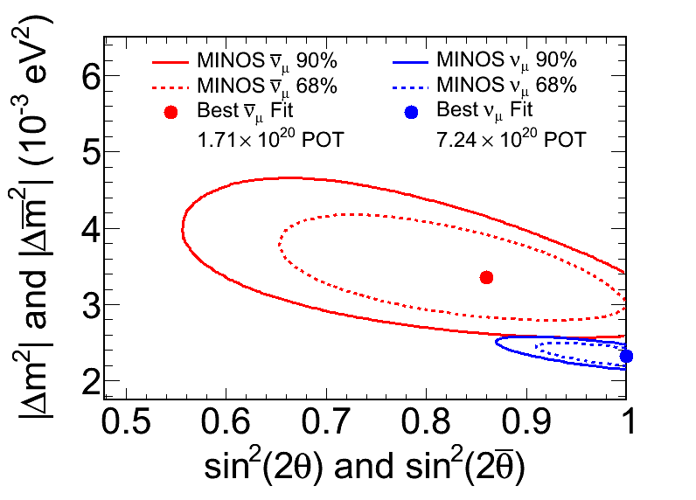
MINOS: Neutrinos vs. Antineutrinos
Best oscillation fit (ν_{μ}):
Best oscillation fit (ν_{μ}):
Nearly independent measurements:
- Less than 3% contamination of ν_{μ} in ν_{μ} sample (and of ν_{μ} in ν_{μ} sample)
~2% probability of common parameters

Slide 44
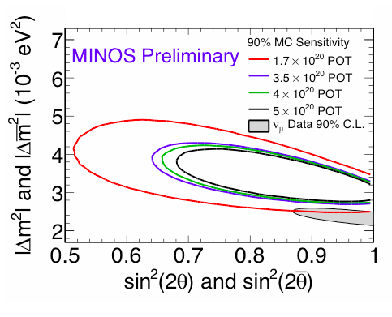
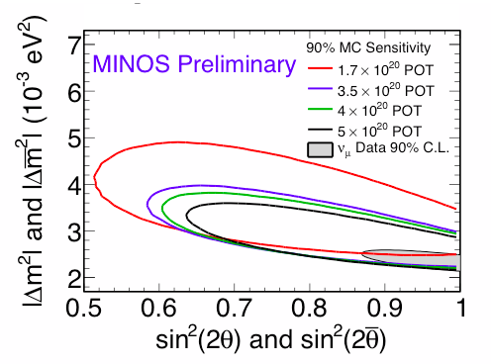
MINOS Future Sensitivity
Comment from 2010 DOE S&T Review closeout report:
Assuming additional data have same ν_{μ} parameters
Assuming additional data have CC ν_{μ} parameters

Slide 45
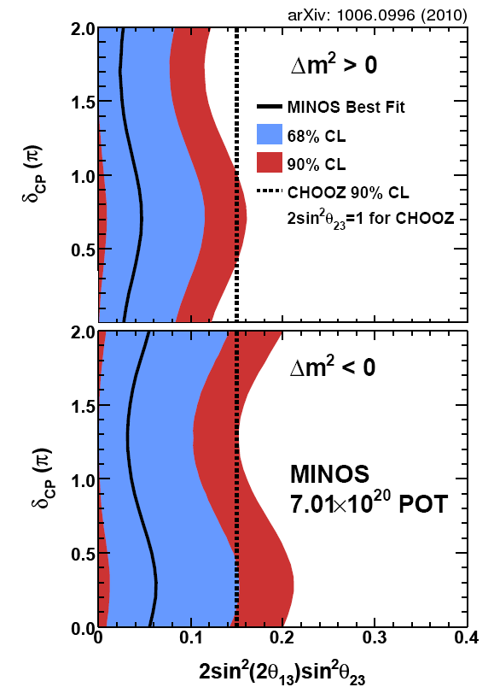
MINOS ν_{e} appearance
Phys. Rev. (Rapid Comm.) D82, 051102 (2010)
Strongest limit for all but a small portion of δ_{CP} in the case of normal hierarchy.
Analysis with new ν_{e} event selection and improved analysis techniques underway for 8.2 x 10²⁰ POT.

Slide 46
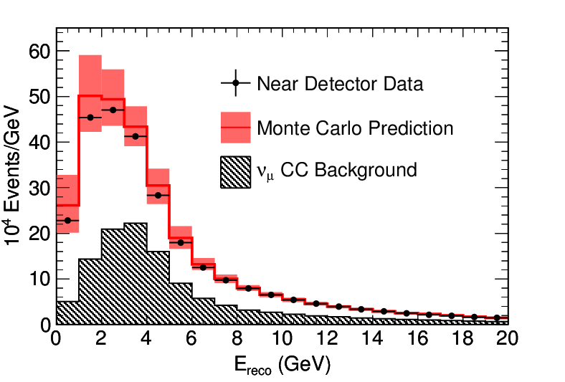
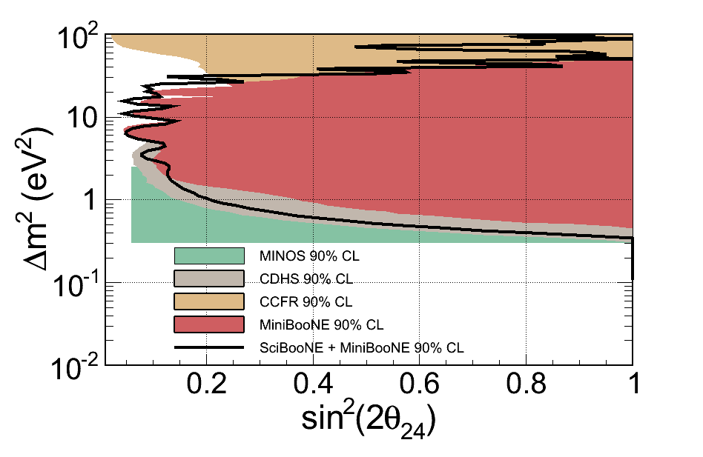
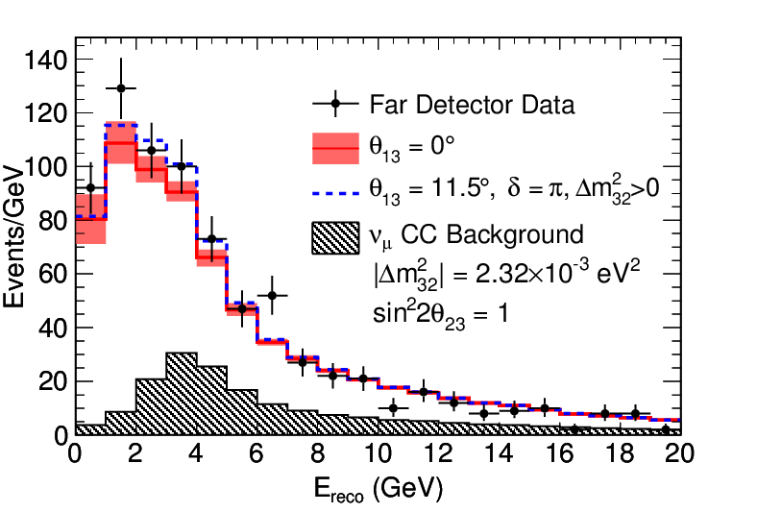
MINOS: Sterile ν mixing limits from NC events
arXiv:1104.3922 [hep-ex], accepted by PRL
ν_{μ} dataset: 7.1 x 10²⁰ POT
Predicted (for std. 3 flavor osc.) | 757
Observed at Far Detector | 802
World’s most stringent limit on sterile neutrino fraction.

Slide 47
MINOS: What’s Next…
Updated ν_{μ} results soon
ν_{e} appearance
  Improved analysis technique, new event selection
  Analysis of 8.2 x 10²⁰ POT available in ~1 month
Additional cross section measurements
Updated atmospheric neutrino results
Further symmetry tests and exotic model exclusions
MINOS+
  Discussed in next talk (M. Soderberg)

Slide 48
Conclusions
Many new results from the Fermilab neutrino program this year
Renewed interest in nuclear effects and neutrino cross sections by theorists, resulting directly from MiniBooNE “QE” measurement
  SciBooNE, MINERνA, ArgoNeuT can help!
Differences in ν and ν not yet clear
  MINOS summer update (ν_{μ} vs. ν_{μ} disappearance)
  MiniBooNE summer update (ν_{e} appearance)
MINERνA and ArgoNeuT
  Great advances in reconstruction software and analysis tools
  Preliminary QE analysis from MINERνA, many others in progress
Many new puzzles in neutrino physics!
Fermilab experiments will continue to play a strong role in the global neutrino program.

Slide 49
Extra

Slide 50
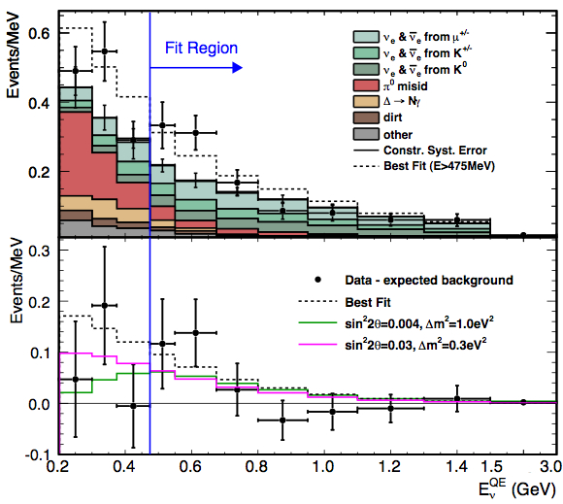
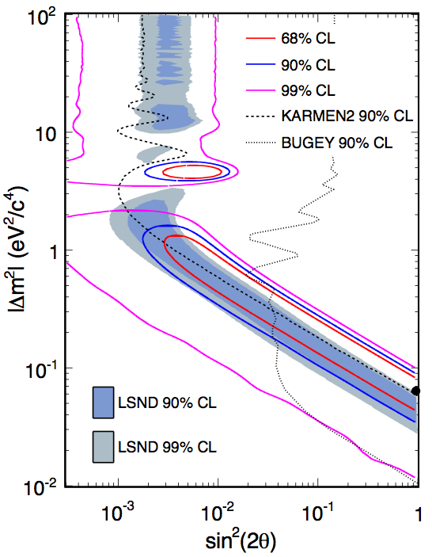
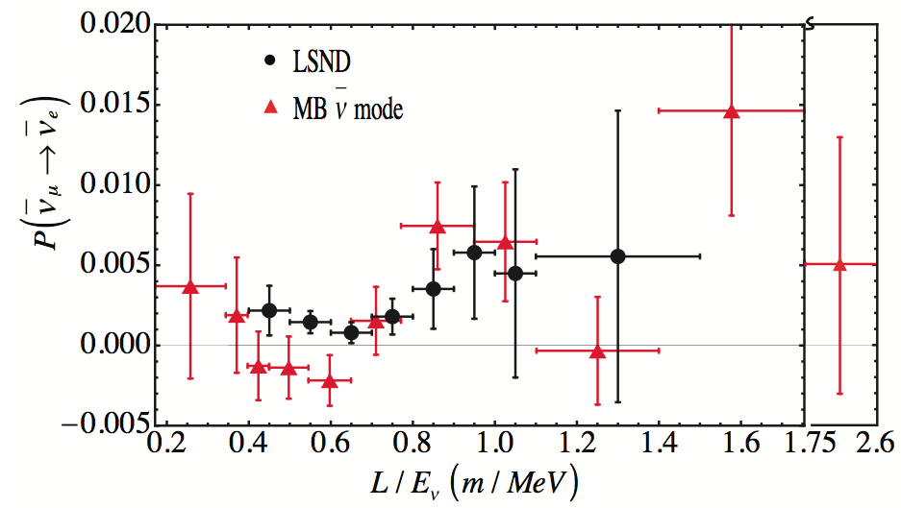
MiniBooNE Anti-neutrino Results

Slide 51
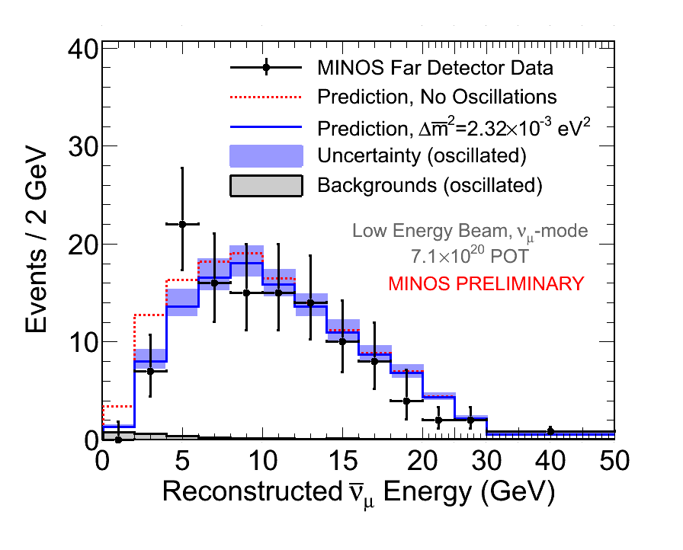
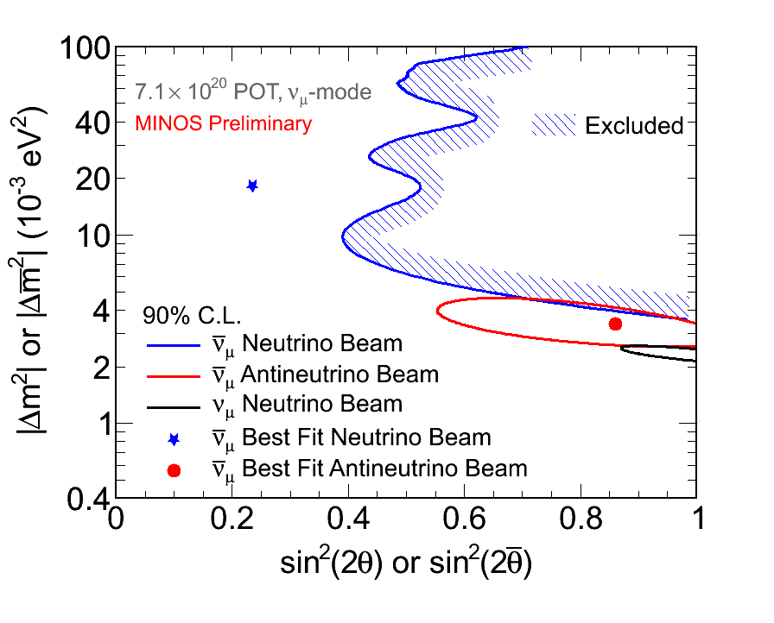
MINOS: Another handle on ν_{μ} oscillations
dataset: 7.1 x 10²⁰ POT
Anti-ν_{μ} selected from ν_{μ} beam
Predicted (no osc.) | 150
Observed at Far Detector | 130

Slide 52
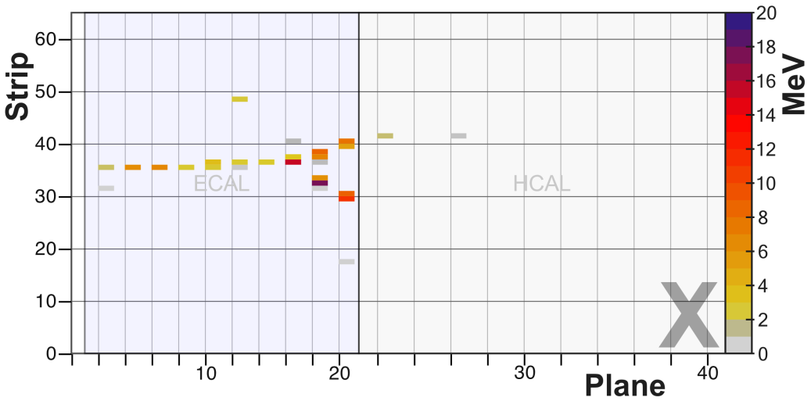
MINERνA Testbeam Activities
FNAL M-Test beam:
  p, π, K, μ (0.4-1.2 GeV) sent to 40-plane MINERνA replica
  June/July, 2010
Two configurations to study tracker, ECAL, HCAL performance
Beam data,107k accepted events
π⁻ candidate
p = 709 MeV/c

Slide 53
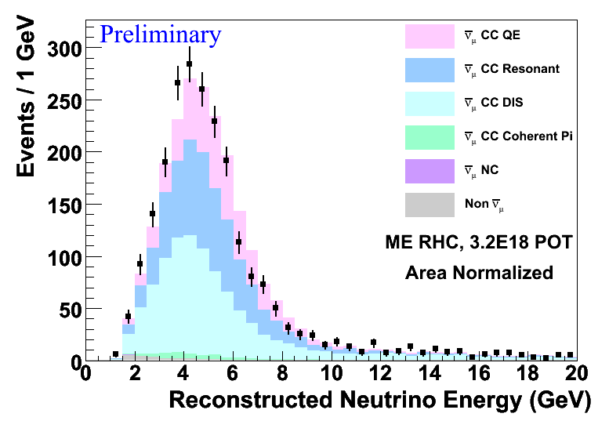
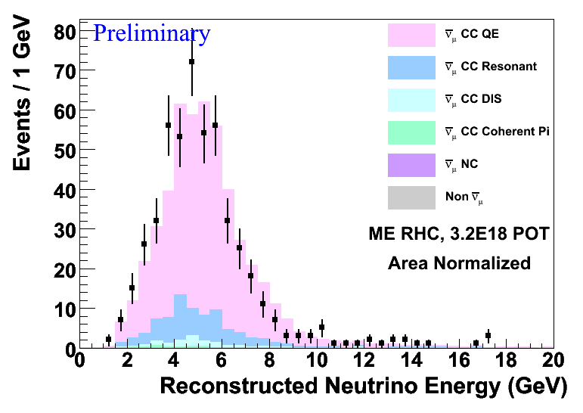
MINERνA CCQE in Special Runs
CC candidates
(before recoil cut)
CCQE candidates
(after recoil cut)

Slide 54
ArgoNeuT: Calorimetry
Muon hypothesis MC
Pion hypothesis MC
Kaon hypothesis MC
Proton hypothesis MC
Data
Track length = 25 cm
Kinetic energy = 194 MeV

Slide 55
ArgoNeuT Neutrino Data
Combination of software and eye-scan to identify neutrino candidates
Identify 3D tracks and match to corresponding MINOS information, allowing full muon reconstruction (available soon)
Vertex position, neutrino candidates
Beam view Top view

Slide 56
Computing Resources
None of the physics results shown today would have been possible without the efforts of CD:
  Framework for reconstruction and analysis code
  Database implementation/migration
  GRID submissions for simulations
  Many others…

