Slide 1
Proton Improvement Plan William Pellico Fermilab Institutional Review June 6-9, 2011

Slide 2
Outline
Introduction
Proton Source Review
Proton Source Improvement Plan
Current Proton Source Projects and Effort
Conclusion

Slide 3
Introduction
The Fermilab Proton Source (PS) consists of:
The Pre-Acc, Linac, and 8 GeV Booster accelerators
Three transport lines
Three beam absorbers
Two low energy beam facilities
The Neutron Therapy Facility
The Muon Test Area
Designed and built over 40 years ago, the Proton Source remains largely unchanged. The ability to deliver 8 GeV protons has been essential for successes of the Run II, neutrino, and test-beam programs. These machines are expected to deliver ever higher performance to support the laboratory’s experimental High Energy Physics objectives for the next decade or longer.
Notes:
MAJOR CHANGES

Slide 4
Proton Source Review
Pre-Acc/Linac
Booster
A 400 MeV negative hydrogen ion accelerator comprising:
25 keV H-minus magnetron ion source
Two 750 keV electrostatic Cockcroft Walton accelerators
116 MeV, 201.25 MHz drift-tube (Alvarez) linac
805 MHz side-coupled cavity linac to 400 MeV
8 GeV, 15 Hz synchrotron with a 474 meter circumference .
Using multi-turn injection and a stripping foil, 400 Mev Beam is injected into the Booster from the Linac via the 400 MeV transport line.
Booster accelerates the beam from 400 MeV to 8 GeV in about 35 milliseconds.
Booster 8 GeV proton beam is extracted down the MI-8 line for the Main Injector or the 8 GeV neutrino experiments
Notes:
CHANGES

Slide 5
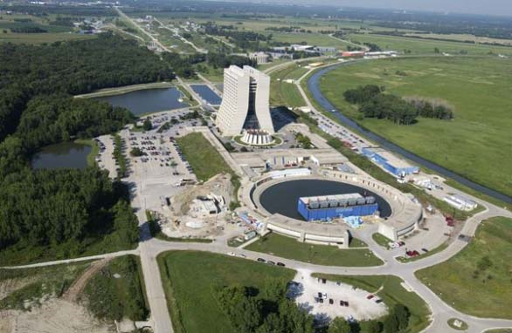
Pre-Accelerator Linac Booster
Proton Source Review – PS Layout
NTF
MTA

Slide 6
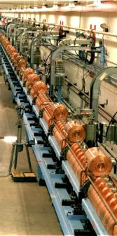
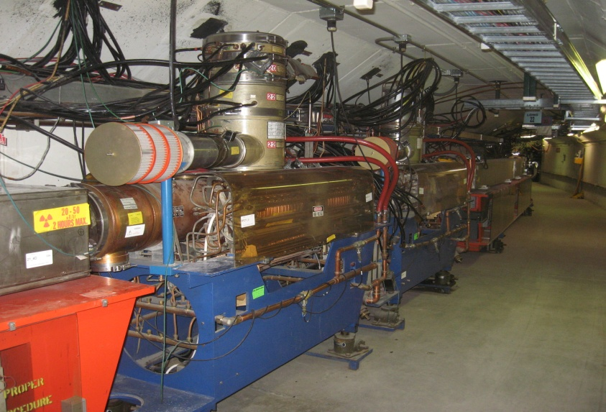
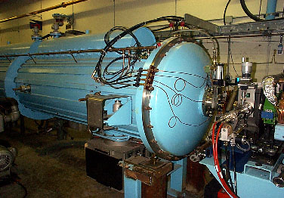
Proton Source Review – Basic Hardware
Cockcroft-Walton
H-
800 MHz Klystron
High Energy Linac
Booster Gradient Magnet
Booster
RF
Cavity
200 MHz Alvarez LE
Accelerating Cavity

Slide 7
Proton Source Improvement Plan (PIP)
A recognition that, until the Project-X linear accelerator is operational, the entire domestic accelerator-based high-energy physics program is powered by the 40+ year old Proton Source.
Despite age-related issues of reliability and availability of spare components, demands on the Proton Source continue to increase.
Experiments that have received Fermilab PAC approval or are in the DOE CD-process expect a factor of two increase of the current proton delivery rate within the coming decade.
Notes:
CHANGES

Slide 8
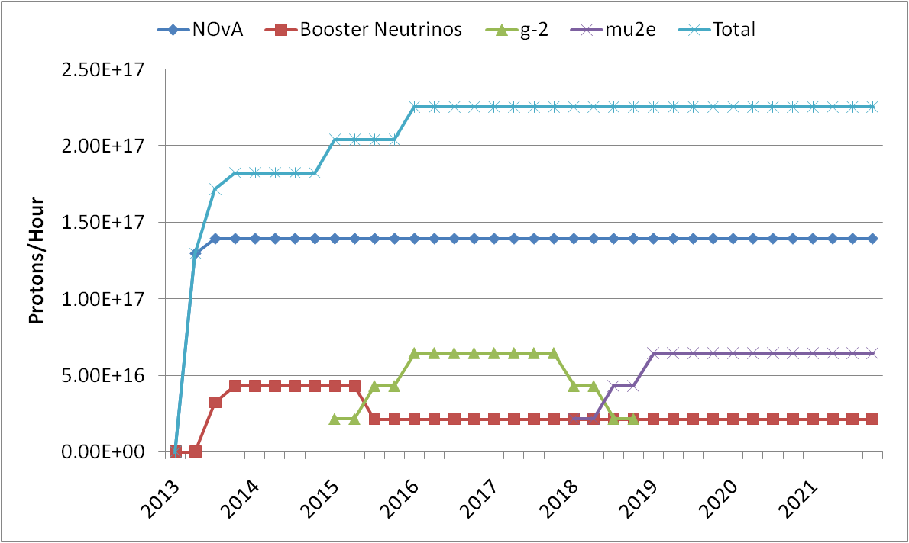
Proton Source Improvement Plan (PIP)
Present Proton Flux
Proton source throughput goals for the next decade.

Slide 9
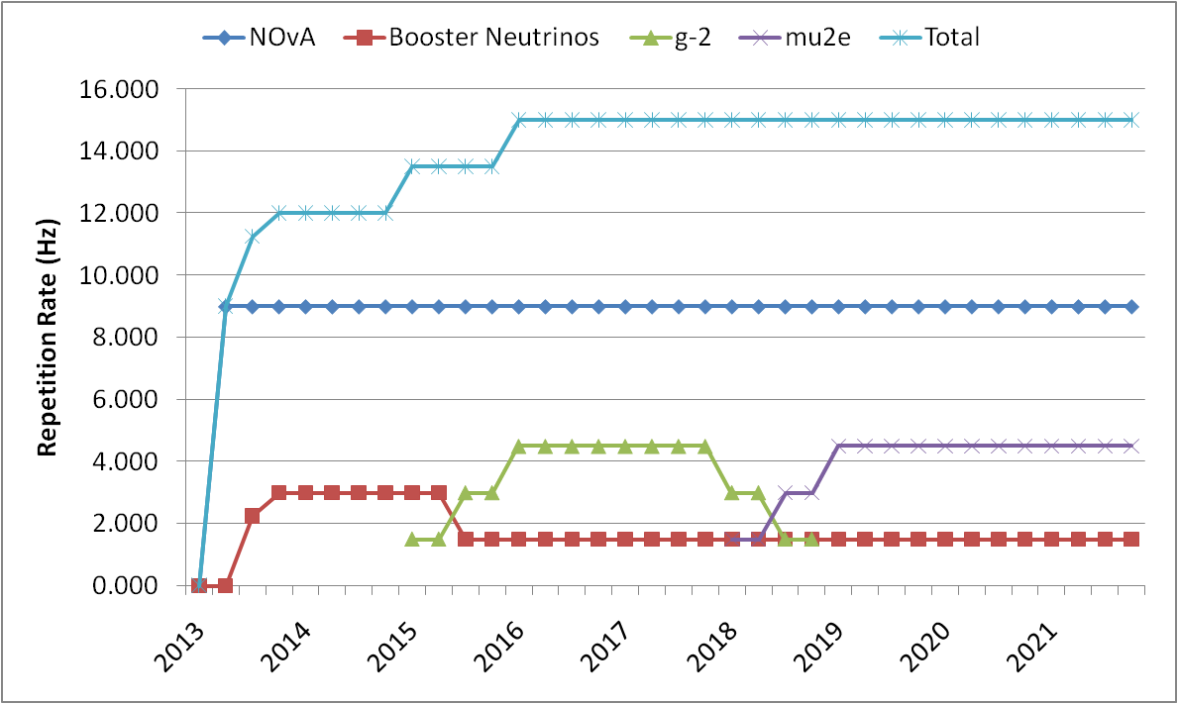
Proton Source Improvement Plan (PIP)
Present Beam Cycle Rate
Beam repetition rate goals through the next decade

Slide 10
Proton Source Improvement Plan Goals
The goals of the Proton Improvement Plan are to:
Increase the beam repetition rate from the present ~7 Hz to 15 Hz
Eliminate major reliability vulnerabilities and maintain reliability at present levels (>85%) at the full repetition rate
Eliminate major obsolescence issues
Increase the proton source throughput, with a goal of > 2E17 protons/hour
Ensure a useful operating life of the proton source through at least 2025
Notes:
CHANGES

Slide 11
Proton Source Improvement Plan Scope
The scope of the Proton Improvement Plan includes:
Upgrading or replacing components required to reach the Booster 15 Hz repetition rate
Replacing components that risk poor reliability
Replacing obsolete or soon to be obsolete components
Doubling the 8 GeV Beam Flux
Studying beam dynamics to diagnose performance limitations and develop mitigation strategies
Implementing operational changes to reduce beam loss
Beam flux will be increased by cycle rate not by increased cycle intensity
Notes:
CHANGES

Slide 12
Proton Source Improvement Plan Scope – Major Items/Categories
The Cockcroft-Walton system
Drift Tube Linac RF Power Systems
Booster RF Solid State Program
Booster RF Cavities, Tuners, Anode Supplies, and Bias Supplies
Beam Instrumentation and Controls
Linac and Booster Conventional Systems
Vacuum system upgrades
Booster Gradient Magnet Spares

Slide 13
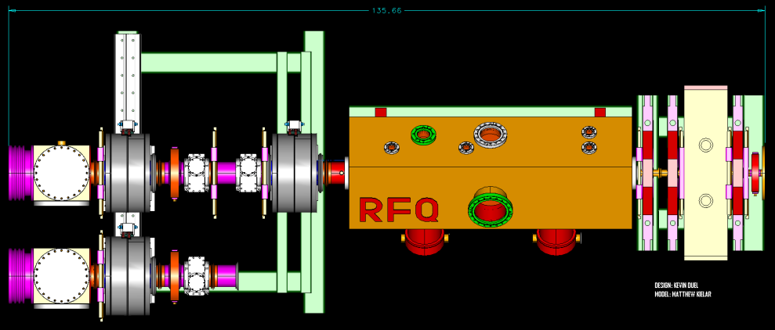
Current Proton Source PIP Work Underway
Pre-Acc and Linac
Booster
Cockcroft Walton Replacement
Started FY09 using operating funds
Completion set date June FY12
Linac Dump Repair
Linac Optics
High Power RF 201.25 MHz Drive System
Buildup of 7835 Power Tube Inventory
Solid State RF Power Drivers
First solid state system installed FY04
Solid state project tasks started FY06
4 of 19 solid state stations now installed
Collimator System Review
Cogging System Upgrade
Booster Orbit/Aperture Work
Fast Kicker (Built – Testing)
Booster Gradient Magnet
Build Spare Inventory
Prepare Required Hardware
Notes:
CHANGES

Slide 14
Proton Source Improvement Plan Timeline Constraints
The timeline for the implementing PIP depends upon:
Funding
M&S funding profile
Capturing engineering design effort to match the M&S profile
Manpower
Identifying qualified personnel
Committing key personnel to the effort for several years
Project Development
Reaching sound technical solutions to challenging and expensive problems that are now just in a pre-conceptual stage
Operational Beam Constraints
Integrating necessary machine studies and shutdowns with ongoing operational commitments
Notes:
CHANGES

Slide 15
Proton Source Improvement Plan Initial M&S Cost Estimates (Millions of $)
Project Management --
DTL High Power RF System 13
Pre-Acc RFQ Completion .750
New Booster RF Cavities 18
Booster Tuner System Upgrade 2
Doubling beam throughput (Physics) --
Collimator system 1.5
Instrumentation and Control 1.5
BRF Anode and Bias supplies & test stand 1.7
Booster Solid state systems 3.7
Conventional Systems Upgrades 2.3
Vacuum System Upgrades .4
TOTAL 44.85
Best-effort cost estimates based on experience and recent similar procurements. Estimates for the larger cost elements should be considered as appropriate at the conceptual level
Notes:
CHANGES

Slide 16
Proton Source Improvement Plan FY Funding Profile Guidance
Year M&S Funding (Millions)
FY12 6.2
FY13 6.2
FY14 13.3
FY15 12.3
FY16 6.4
These numbers were provided as guidance for PIP planning. Some items in the plan are ready to be procured even in FY11. Areas that require additional design/engineering work must be allocated labor resources consistent with the out-year M&S profile.
Notes:
CHANGES

Slide 17
Proton Source Improvement Plan Labor Estimate
Labor estimates were developed by the responsible support departments and based upon current work. As with the cost estimates, labor estimates for the large projects are just in the initial planning stages and should be considered as a first pass estimates.
Project Management 9
DTL High Power RF System Phase 50
Pre-Acc RFQ Completion 10
New Booster RF Cavities 39
Booster Tuner System Upgrade 6
Doubling beam throughput (Physics) 8
Collimator system 7
Instrumentation and Control 15
BRF Anode and Bias supplies & test stand 6
Booster Solid state systems 9
Conventional Systems Upgrades 5
Vacuum System Upgrades 6
TOTAL (Units FTE years) 170
Notes:
CHANGES

Slide 18
Proton Improvement Plan
Bill Pellico
Bob Webber, Deputy
Bob Zwaska, Deputy
Booster RF
John Reid
Power Distribution
Steve Hayes
Proton Source Utilities
Todd Sullivan
Linac RF
Ralph Pasquinelli
Instrumentation & Controls
Craig Drennan
Beam Physics
Valeri Lebedev
Solid State
Tom Kubicki
Anode PS
Rene Padilla
Cavities
Joe Dey
Tuners
Bias Supplies
Spare Cavity
Mike May
Cavity Test Stand
200 MHz HLRF
Ralph Pasquinelli
Linac Modulators
Fernanda Garcia
Booster Cogging
Kiyomi Seiya
Booster Collimation
Nikolai Mokhov
Booster Instabilities & Feedback
Linac Lattice and Collimation
Dave McGinniss
Linac Front End and Emittance Control
C. Y. Tan
400 MeV
Linac Vacuum Systems
PreAccelerator
C. Y. Tan
Linac Controls
Craig Drennan
Booster Vacuum Systems
Booster Controls
Craig Drennan
Linac and Booster Power Distribution Equipment
Steve Hayes
Booster Power Distribution Duct
Steve Hayes
95LCW System
Maurice Ball
Booster Sumps
Todd Sullivan
Other Utilities / FESS
Todd Sullivan
Linac Notch Creation
Jim Lackey
Linac
Booster
Optics Matching
Fernanda Garcia
400 MeV Collimation
Valeri Lebedev
Booster Notcher
Jim Lackey
Booster Orbit and Alignment
Kiyomi Seiya
Booster Optics
Injection Painting
Radiation Shielding
Peter Kasper
PIP Management
Fully Specified
Waiting on Funding
Work Progressing
Operational Funding
Laboratory Management is in the process of allocating labor resources – post Collider. The time critical areas have been identified and there has been a concentrated effort to allocate labor to those sections of the PIP.

Slide 19
Upgrade Success - Historical Performance
Record Year
FY10
Proton Improvement Examples:
Booster Collimators FY04
Booster Low Level/Damping FY04
New Booster Injection Line FY FY06
Removal of L13 Extraction Region FY07
Linac Quad PS FY07
Linac Low Energy Low Level FY08
New Ramped Correctors FY09
Notes:
Time and/or performance level correlation of improvements is implied but unclear in this slide…..The plot is good, but how the text correlates is confusing at best.

Slide 20
Proton Source Improvement Plan Summary
The Proton Source has faithfully served the needs of the Fermilab program for more than 40 years.
Demands for doubling the proton throughput with continued highly reliable operation necessitate a dedicated program of improvements to secure the viable operation of the Proton Source for the next 15+ years.
A plan at the level of 45M$ M&S over the next five fiscal years has been developed.
Staffing at the level of ~34 FTEs per year is required to carry out the plan.
Improvement Plan funds must be in addition to the current annual operating funding for the plan to be successful.
References
[1] A Plan for Delivery of 8-GeV Protons through 2025, Beams-doc-3781, http://beamdocs.fnal.gov/ADpublic/DocDB/ShowDocument?docid=3781
[2] Proton Source Task Force Report, Beams-doc-3660, http://beamdocs.fnal.gov/ADpublic/DocDB/ShowDocument?docid=3660
[3] Proton Source December 2010 Workshop,
http://beamdocs.fnal.gov/ADpublic/DocDB/DisplayMeeting?conferenceid=114
Notes:
CHANGES

Slide 21
X-tra X-tra

Slide 22
RFQ Injector Test Area

Slide 23
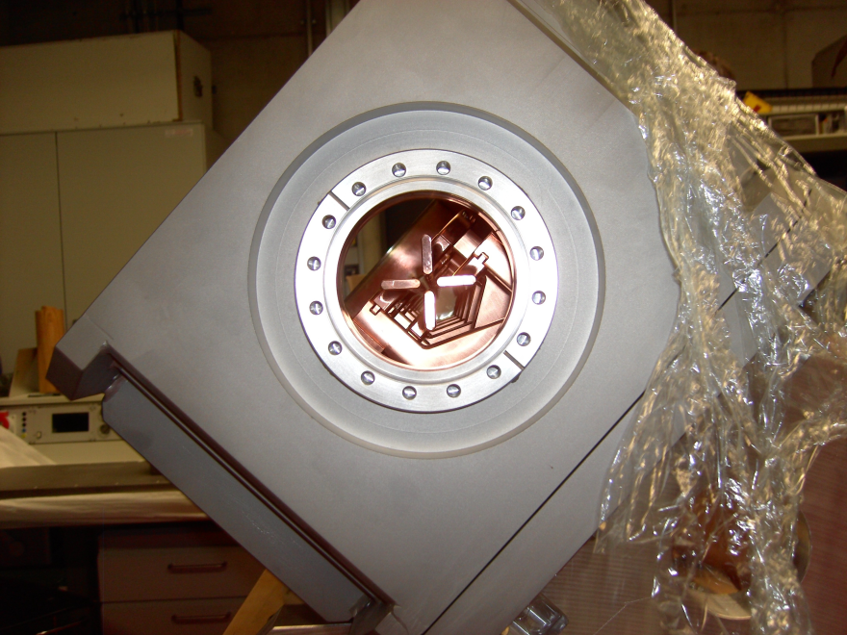
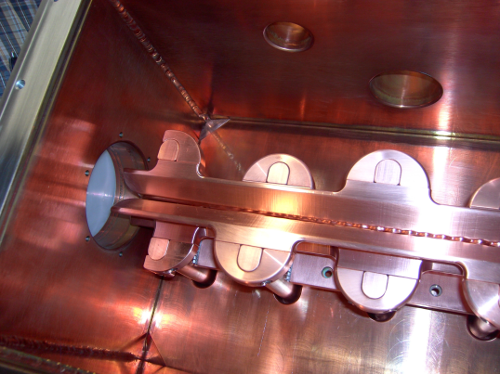
RFQ PICS

Slide 24
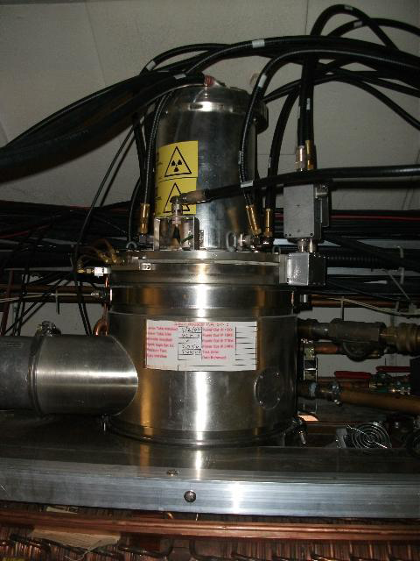
Solid State Cavity
Power Tube Amplifier
Solid State Amplifier

