Slide 1
Superconducting RF Program
Bob Kephart
Fermilab
DOE S&T Review
June 6-9, 2011

Slide 2
Outline
Goals, Approach, and Context of FNAL SRF Program
Accomplishments that demonstrate:
  Merit, effectiveness, and impact of the program
  Leadership and creativity of the FNAL SRF staff
  Productivity of SRF facilities at FNAL
Integrated management & planning
  Prioritize and optimize the program
ES&H
Summary

Slide 3
Goals of the Fermilab SRF Program
Support the strategic goals of the U.S. HEP program
  Intensity frontier: Project X
  Energy frontier: International Linear Collider (& Muon Collider)
Develop low-beta SRF cavities and cryomodules for the acceleration of high intensity Proton beams
  Subharmonics of 1.3 GHz
  SRF starting from very low beam energy of 2.5 MeV (New!)
Develop β=1 SRF cavities and cryomodules for ILC and/or the Project X pulsed linac (3-8 GeV)
Develop related SRF infrastructure and technology that can be applied to future Office of Science projects
  Infrastructure and expertise at Fermilab and U.S. partners
  U.S. Industrialization to permit fabrication of SRF projects

Slide 4
General Approach of the R&D Effort
Build on experience
  Take full advantage of existing U.S. SRF capabilities and infrastructure (close collaboration with ANL, JLAB, and Cornell)
  International Collaborations (DESY, KEK, INFN, etc)
  Extensive network of collaborators ( 23 MOU’s in place)
  Supports recent build-up of FNAL infrastructure and capabilities
Contribute to existing programs
    Participation in international ILC R&D program
    Fabrication 3.9 GHz Cryomodule for DESY/XFEL
Enable new programs
  Project X at Fermilab (and Future Muon Collider)
Establish new collaborations
  Collaboration with India, China, and perhaps Korea
  Crab cavities for LHC (CERN) ? , NGLS (LBNL) ? , etc.

Slide 5
Context of SRF Activity at Fermilab
SRF activities are supported by three KA15 B&R’s:
  General Accelerator Development
  SRF Infrastructure
  ILC R&D Program
Plus one-time ARRA SRF funds of ~$53 M in FY09
Fermilab SRF activities are managed as an integrated program to avoid duplications and insure efficiency
Because of past emphasis on ILC R&D ➔There is substantial ongoing activity on 1.3 GHz technology
  R&D on gradient, quality factor, and manufacturing yield
  Development of US cavity vendors (ARRA procurements)
  Construction of cryomodules for RF Unit test at New Muon Lab
325/650 MHz for PX
Primarily 1.3 GHz

Slide 6
Context of SRF Activity at Fermilab
SRF development for Project X began with the HINS program
  Development of 325 MHz SSR1 spoke resonator
Adoption of a 3 GeV CW linac followed by a 3-8 GeV pulsed linac for Project X has added great capability to the Project, but presents new challenges
  Need six different families of cavities optimized for changing velocity ( β ) of Protons
  Three different frequencies (325, 650, 1300 MHz)
  Five of these cavities are completely new for Project X (vs 2 for SNS)
The development of these cavities is a major new effort

Slide 7
PX SRF Linac Technology Map
ILC
β=0.11
β=0.22
β=0.4
β=0.61
β=0.9
β=1.0
CW
Pulsed
325 MHz
2.5-160 MeV
650 MHz
0.16-3 GeV
1.3 GHz
3-8 GeV
Section | Freq | Energy (MeV) | Cav/mag/CM | Type
SSR0 (β_{G}=0.11) | 325 | 2.5-10 | 18 /18/1 | SSR, solenoid
SSR1 (β_{G}=0.22) | 325 | 10-42 | 20/20/ 2 | SSR, solenoid
SSR2 (β_{G}=0.4) | 325 | 42-160 | 40/20/4 | SSR, solenoid
LB 650 (β_{G}=0.61) | 650 | 160-460 | 36 /24/6 | 5-cell elliptical, doublet
HB 650 (β_{G}=0.9) | 650 | 460-3000 | 160/40/20 | 5-cell elliptical, doublet
ILC 1.3 (β_{G}=1.0) | 1300 | 3000-8000 | 224 /28 /28 | 9-cell elliptical, quad

Slide 8
Accomplishments
  Project X:
    325 MHz cavity & cryomodule Development
    650 MHz cavity & cryomodule Development
  ILC and Project X
    1300 MHz: Cavity gradient improvement, CM development, and industrialization
    1300 MHz: SRF infrastructure Operations
  SRF Infrastructure Construction
  RF unit test facility at New Muon lab
  CryoModule Test Facility (CMTF)

Slide 9
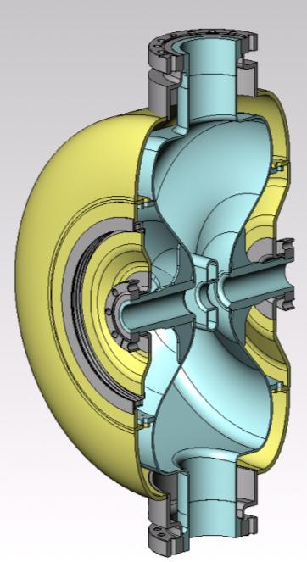
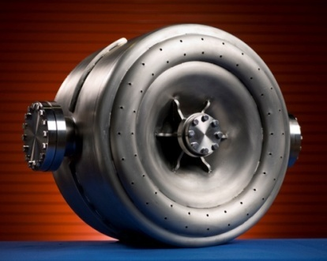
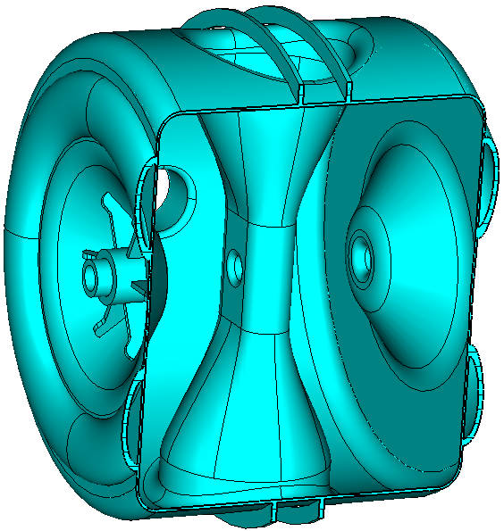
325 MHz Cavities: Single-Spoke Resonators
Three designs cover the beta range 0.07 → 0.52
SSR0 ( β = 0.11 )
  EM and Mechanical Design in Progress
  Also working with ANL to evaluate 162 MHz half wave cavities
  Optimize to achieve tight packing in PX front end
SSR1 ( β = 0.22 )
  Started under HINS program and is therefore more advanced
  Two prototypes have been fabricated by industry, processed in collaboration with ANL, and tested at Fermilab
  Two cavities in fabrication at IUAC-Delhi ( Fall 2011 )
  Ten cavities in fabrication by US industry (arriving now)
  One cavity dressed with He vessel, coupler tuner
  Tests in progress (next slides)
SSR2( β = 0.42 )
  EM design complete
  Awaiting Mechanical Design
  Possible ANL task

Slide 10
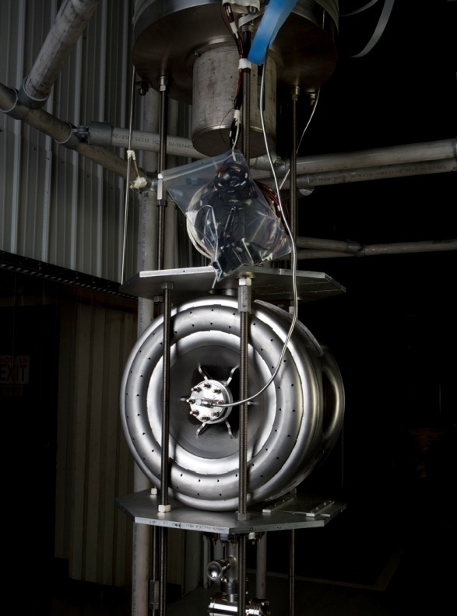
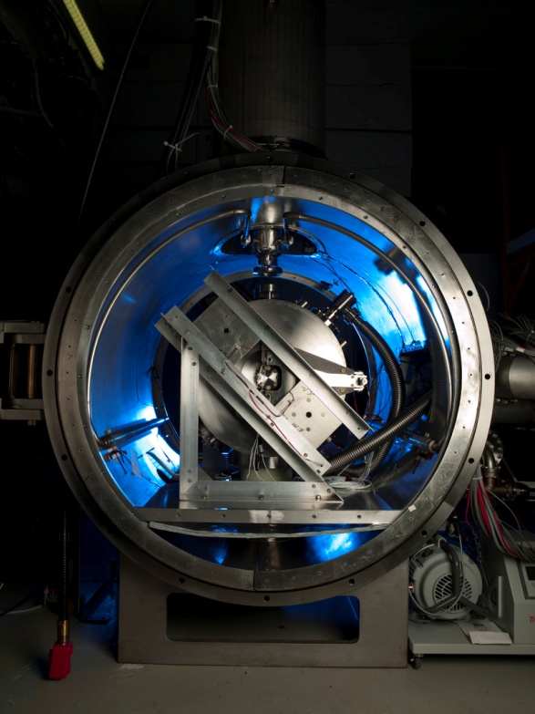
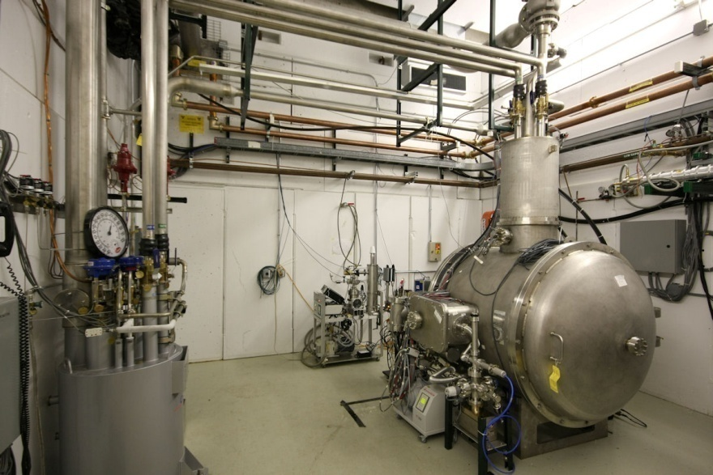
New 325 MHz Test Capabilities Developed
Bare
Dressed
SSR-1 prototypes were tested in the VTS-1 vertical dewar (normally used for 1.3 GHz cavity testing ) with the addition of new electronics and tooling.
Spoke Cavity Test Cryostat completed and commissioned.
Enables 4 K testing of “dressed” 325 MHz single-spoke resonators.
Upgrades for 1.8 K operation in process
Dressed SSR-1 prototype prepared for testing.
Includes RF couplers, tuners, and magnetic shielding

Slide 11
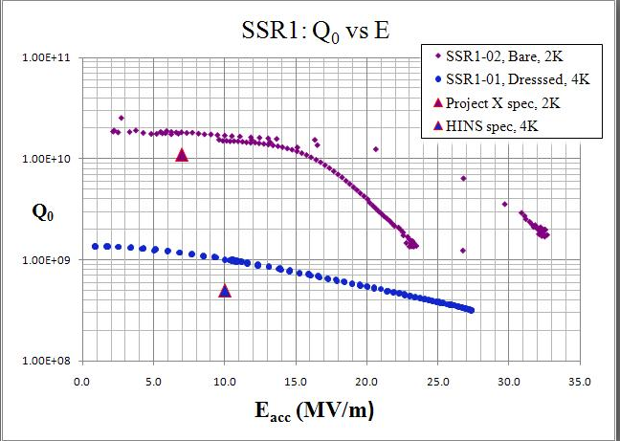
SSR1 Prototypes Exceeded Performance Specs.
Bare cavity at 2 K
Dressed cavity at 4.8K
Also tested one dressed cavity at 4.8 K. Exceeded the HINS specification
Modifications to allow CW tests of dressed spoke resonators at 2 K for Project X are in progress
Tested two SSR1 spoke resonators both performed very well in bare cavity tests
Performance at 2 K is above requirements for Project X in both Q₀ and gradient

Slide 12
  650 MHz Electromagnetic Cavity Design β = 0.6 & 0.9 Five-Cell Cavities is Complete

Slide 13
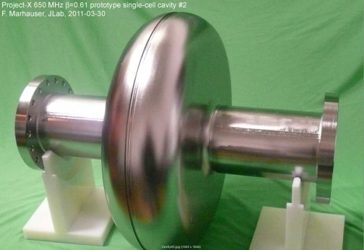
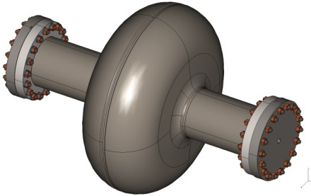
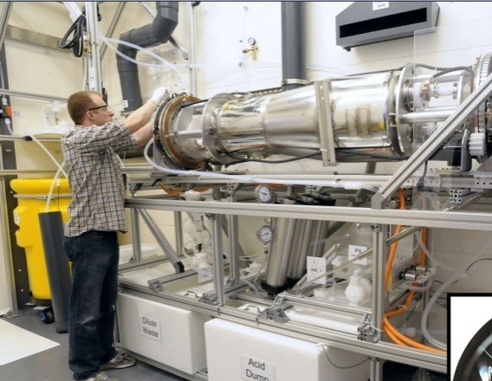
650 MHz Cavity Prototypes and Readiness for Processing & Testing
Single-cell designs complete: for β = 0.6 & 0.9 cavities
Prototypes being fabricated:
  Two single-cell β = 0.6 cavities prototyped at JLab
  Six single-cell β = 0.9 cavities ordered from industry; due Jul 11
  Prototypes at both β are also being fabricated in India
Infrastructure modifications: for 650 MHz in process
    FNAL: Vertical Test Stand: Electronics, amplifier, tooling
    FNAL: Cavity handling & HPR tooling, etc.
    FNAL: Optical inspection system modifications
    ANL: New electro-polishing tool
    Industry: EP/BCP capability in US industry
    JLAB: new cryo infrastructure (FNAL ARRA funds)

Slide 14
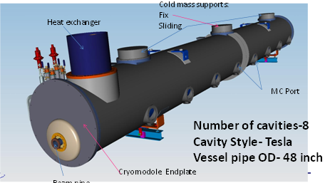
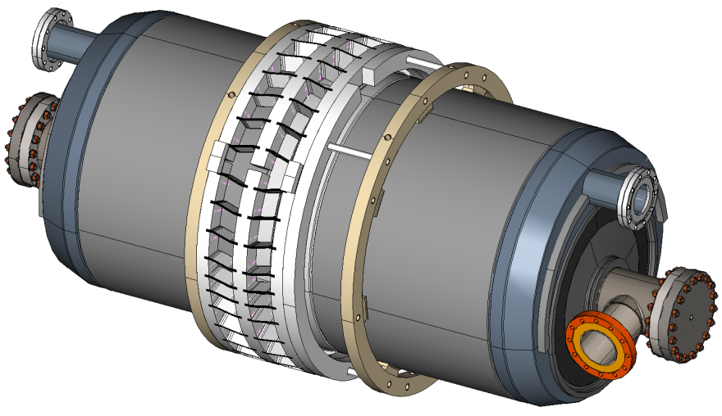
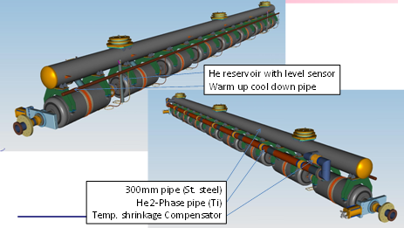
650 MHz Five-Cell Cavity and CM Design Status
Cavity drawing package and specification done
Industrial procurement of both β ’s in FY11
Cryomodule conceputal design advanced
  stand-alone 8-cavity cryomodule
  Overall length: ~12 m, 48 “ O.D.
5-cell β= 0.9
Stiffening rings located to minimize dF/dP while maintaining tunability
Concept for pass-through helium vessel utilizing blade tuner

Slide 15
1300 MHz Development for ILC and PX
Goals: ILC SRF goals remain
    S0 >35 MV/m bare cavities
    S1 31.5 MV/m dressed cavities in a ILC Cryomodule
    S2 Beam test of full ILC RF unit (CM, klystron, modulator)
    Build and test ~ 1 CM/yr
  All of this will benefit the 3-8 GeV pulsed linac for Project X
Accomplishments:
  Excellent progress on gradient improvement
  ANL/FNAL EP facility: world class throughput & yield
  18 Dressed cavities, HTS tests in progress for CM2
  Parts for 4 more 1.3 GHz cryomodules ( ARRA funds)
  Cost reduction (e.g. tumbling vs. EP, & cavity repair.)
Excellent progress on all of these
  CM1 cold and under test at NML ( 5 of 8 cavities tested)

Slide 16
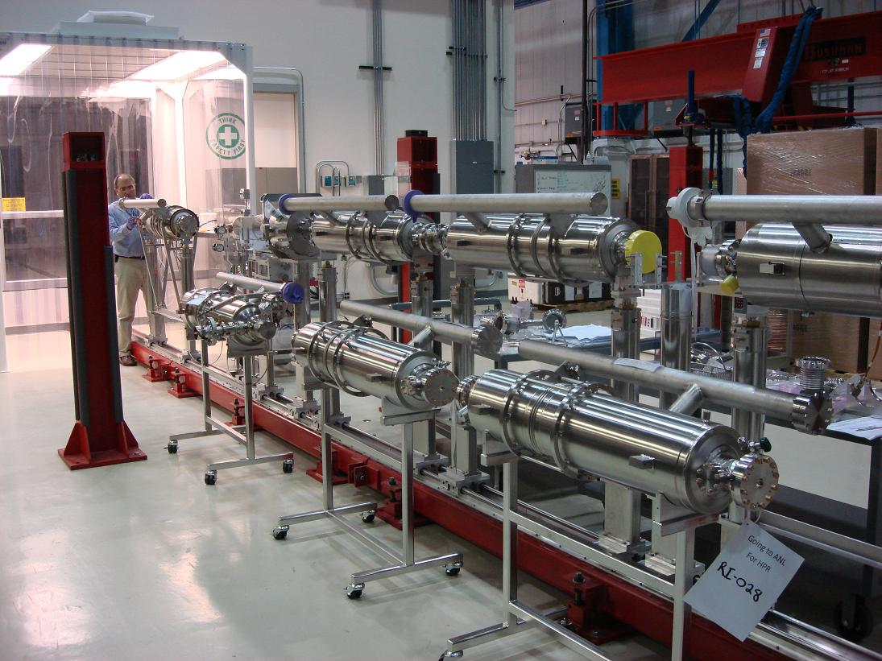
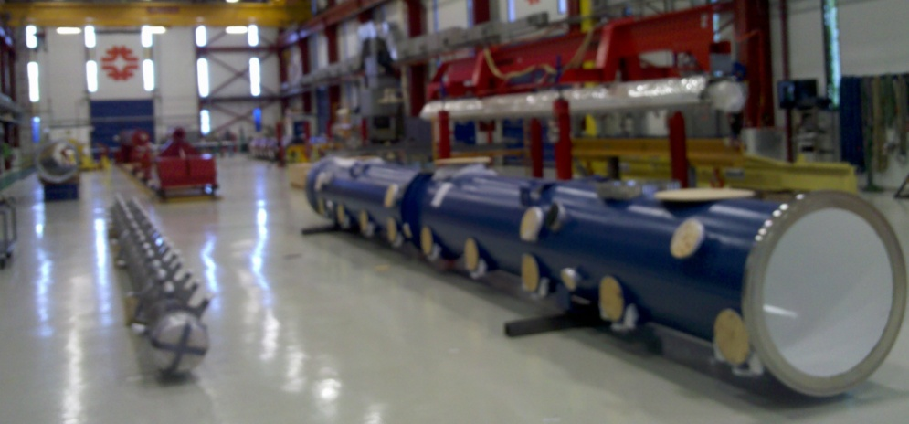
Current 1300 MHz cavity status
# ordered | 90
# received | 50
# processed | 41
# vertically tested | 38
# dressed | 18
# horizontal tests | 11
# CM2 qualified | 4
Full suite of facilities in use
New vendors being developed
Dressed cavities in CAF
Cryomodule 2: cold mass parts from Europe in hand, 4 of required 8 dressed cavities qualified in HTS
U.S. built ILC/PX Cryomodule Parts
CM 3, 4, 5, 6 for NML arriving,
funded by ARRA

Slide 17
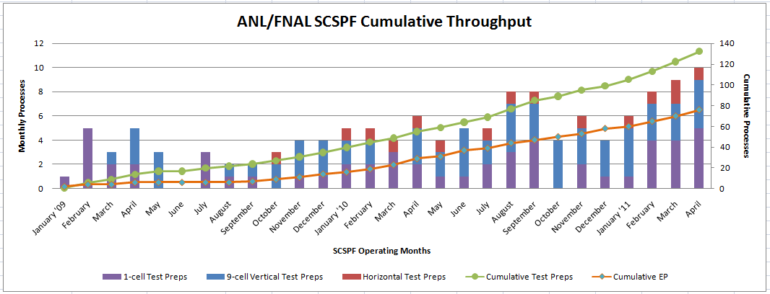
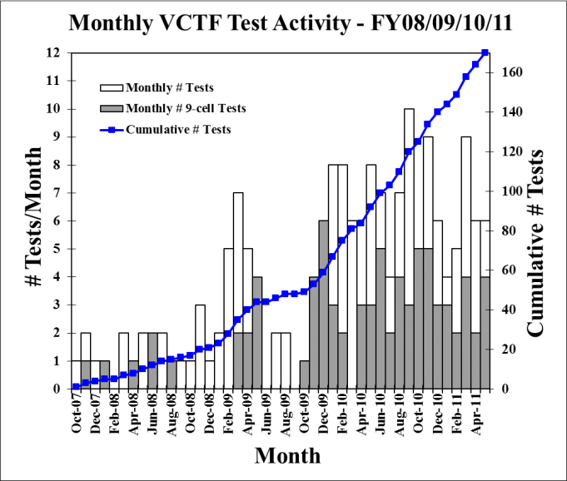
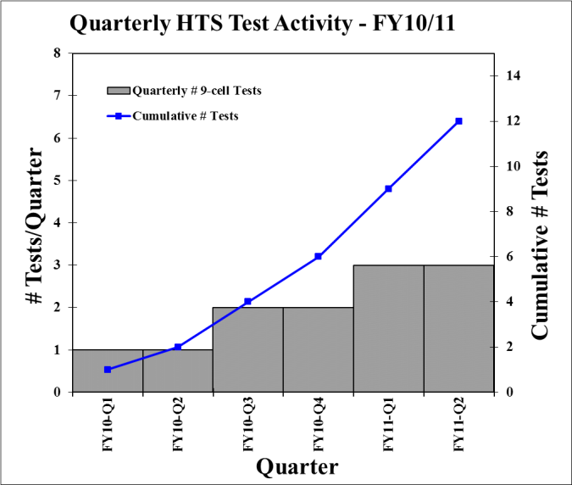
Facility Throughput
ANL/FNAL EP Processing
VTS
HTS
Steady and improving throughput from ANL/FNAL processing, VTS, and HTS

Slide 18
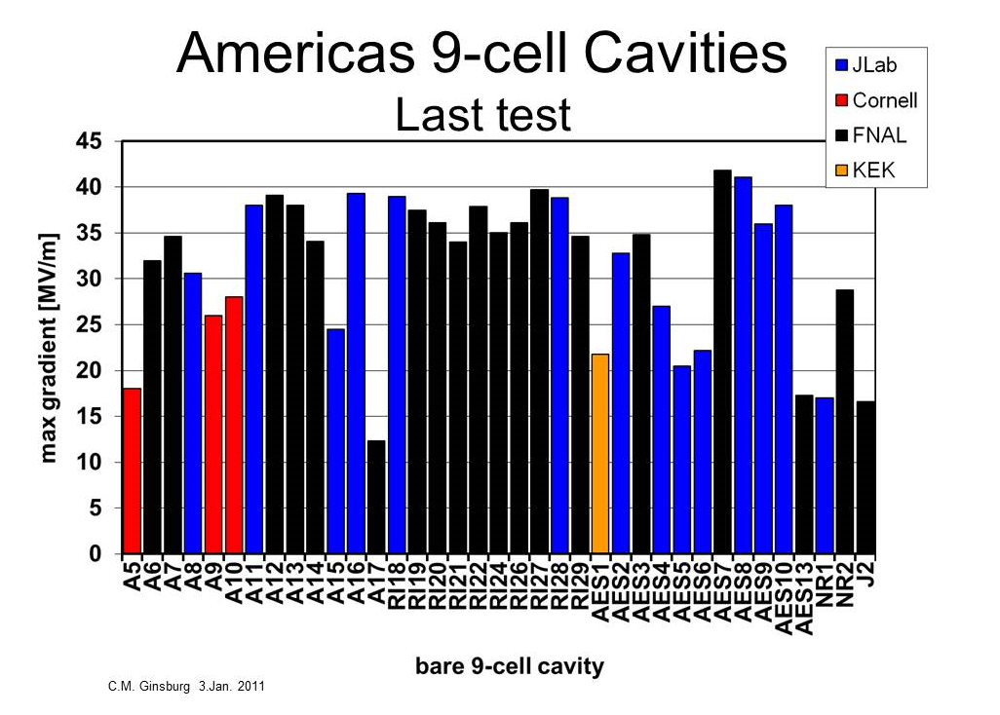
A15 Repaired by tumbling 20→34
ILC
PX
ANL/FNAL facility contributing
Heavily to ILC gradient program
Pits in EB weld HAZ
New vendor
1st BCP AES

Slide 19
FNAL SRF Infrastructure
Goals:
Build generic SRF infrastructure at FNAL
  Particularly large cryogenic & RF systems, cavity & cryomodule assembly and test facilities, etc. that are hard for industry to provide
Develop SRF capability in U.S. Industry
Accomplishments:
Vertical test stands (VTS1) fully operational, VTS 2 dewar delivered, VTS 2/3 civil work complete, VTS 3 dewar in fall
  VTS2 and Cryo upgrades operational in FY12
Horizontal Test Stand (HTS1): fully operational
  Testing dressed cavities for CM2, tuner studies, LLRF,etc
New vacuum oven installed & operational (ARRA)
Excellent progress on NML and CMTF (slides)

Slide 20
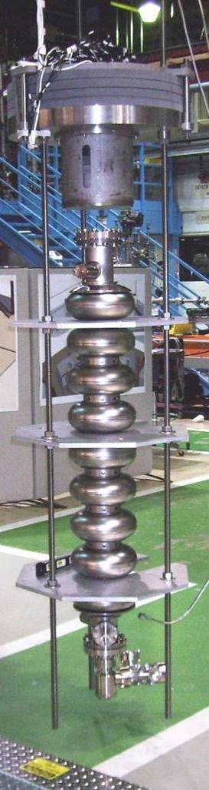
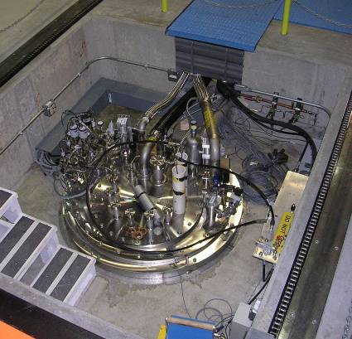
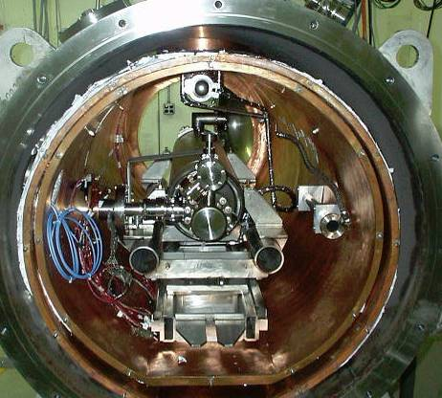
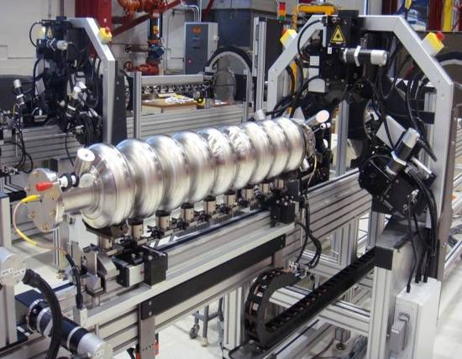
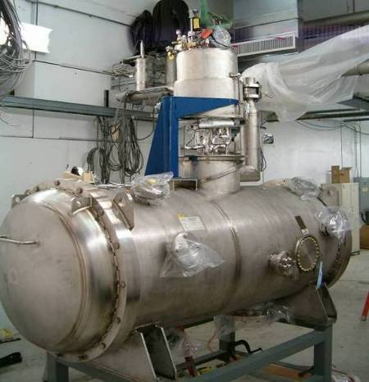
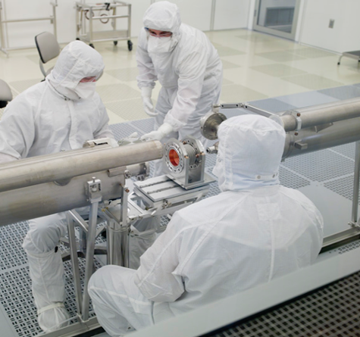
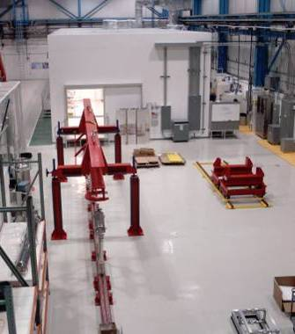
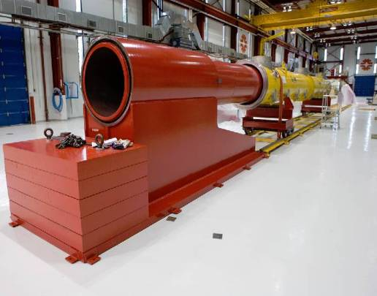
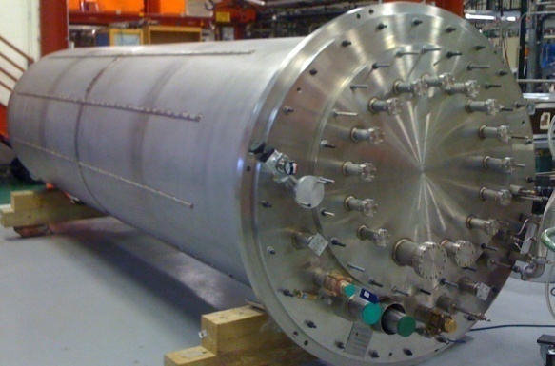
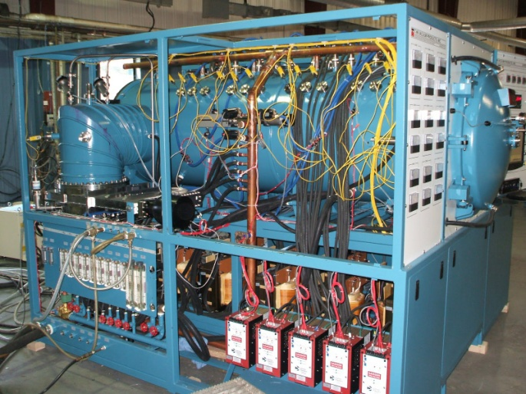
New Vacuum Oven
New FNAL SRF infrastructure
Cavity tuning machine
VTS
HTS
VTS
String Assembly
MP9 Clean Room
VTS2 Dewar
Final Assembly

Slide 21
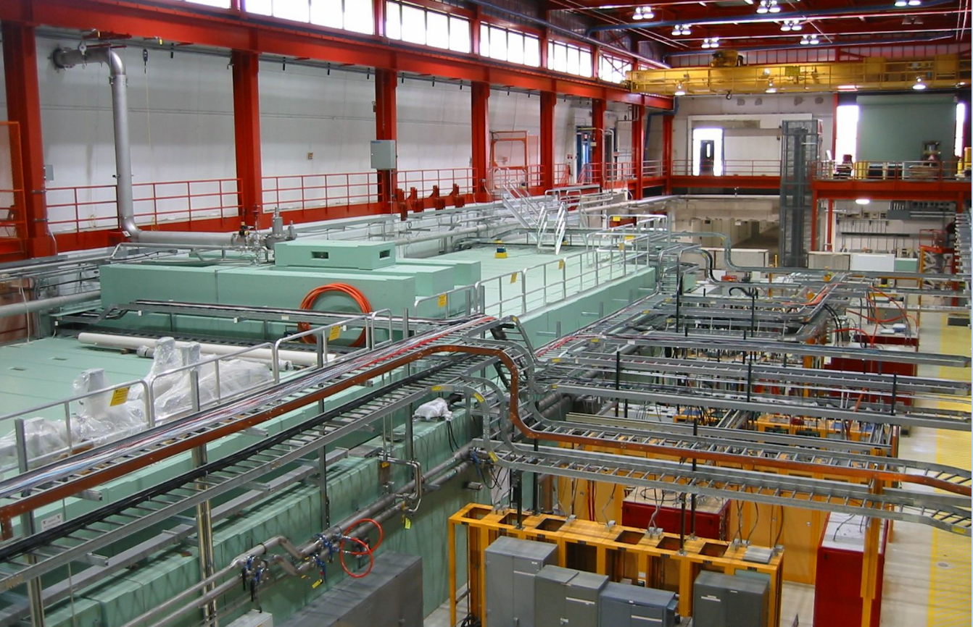
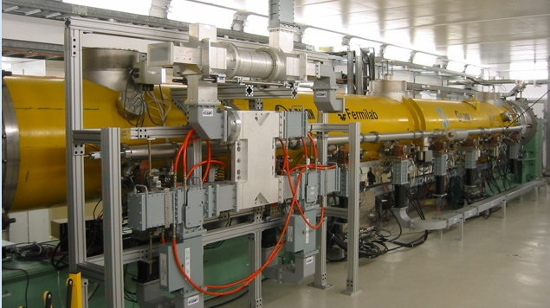
NML: RF Unit Test Facility
1st Cryomodule Cold and under test

Slide 22
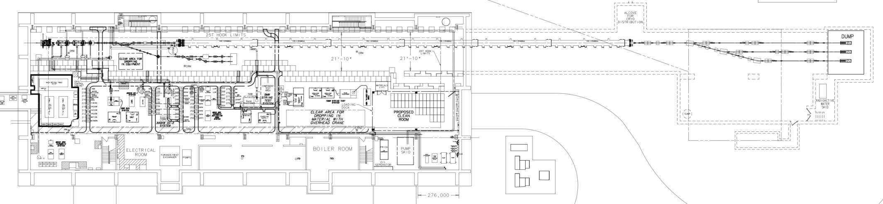
NML Status and Expansion
Capture Cavity II operational
CM1: cold and operational
New Underground Tunnel Expansion
(Space for up to 6 Cryomodules (2 RF Units), AARD Test Beam Lines)
Civil construction complete (doubles tunnel length to 160 M)
Phase 1 NML Building

Slide 23
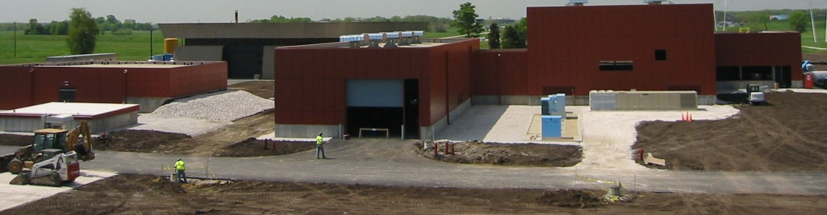
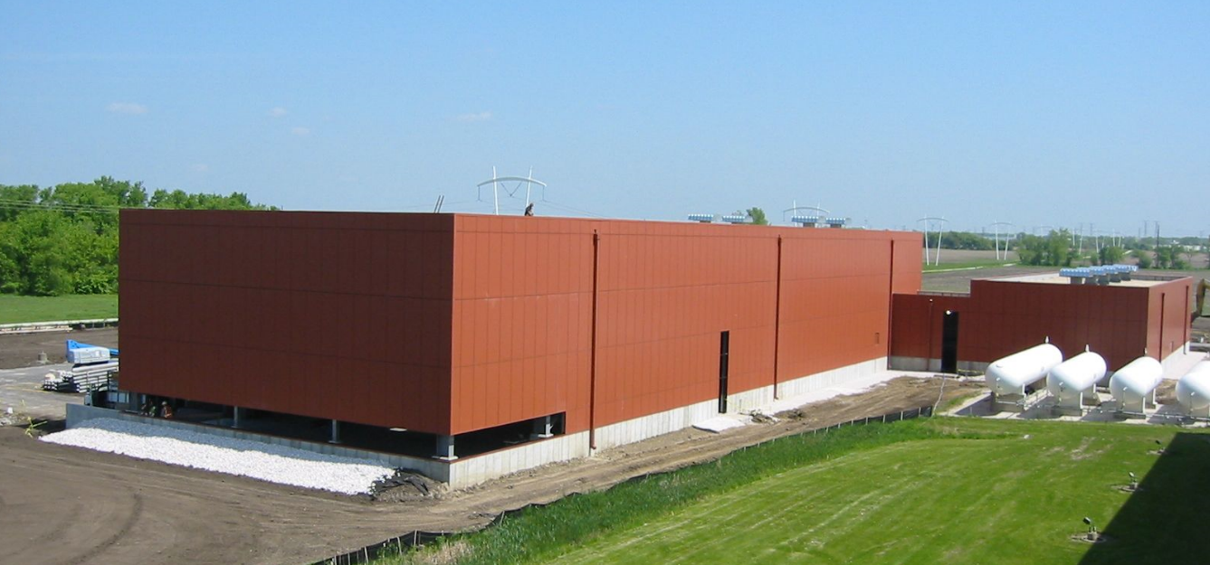
New NML Buildings (ARRA funded )
New 500 W 1.8 K refrigerator
(under fabrication in industry)
will be located in CMTF bldg
New Electronics building above tunnel extension
New Cryomodule Test Facility
Compressor building

Slide 24
R&D Plans: FY12 and beyond
Cavity development for Project X.
  Process and test 650 MHz single cells, order 1st 5 cell 650 MHz
  Process and test SSR1 cavities from industry and India
  Prototype the upstream SC cavity in Project X ( SSR0 or HW)
  Cryomodule design continues; order parts for first Prototype CM’s
Development for ILC & Project X pulsed linac
  Process and test 1300 MHz cavities to demonstrate required yield at 35 MV/M for ILC, serial assembly of CM2, 3, …
  Install CM2 at NML (1st high gradient CM) and test
  Continued work on centrifugal barrel polish (Giorgio’s talk)
  Continue tech transfer effort to U.S. Industry
Infrastructure
  Complete ARRA tasks: VTS 2/3, NML tunnel ext, CMTF, etc
  Prepare for arrival of super-fluid refrigerator at NML
  Work to provide 1st beam at NML by end of FY12

Slide 25
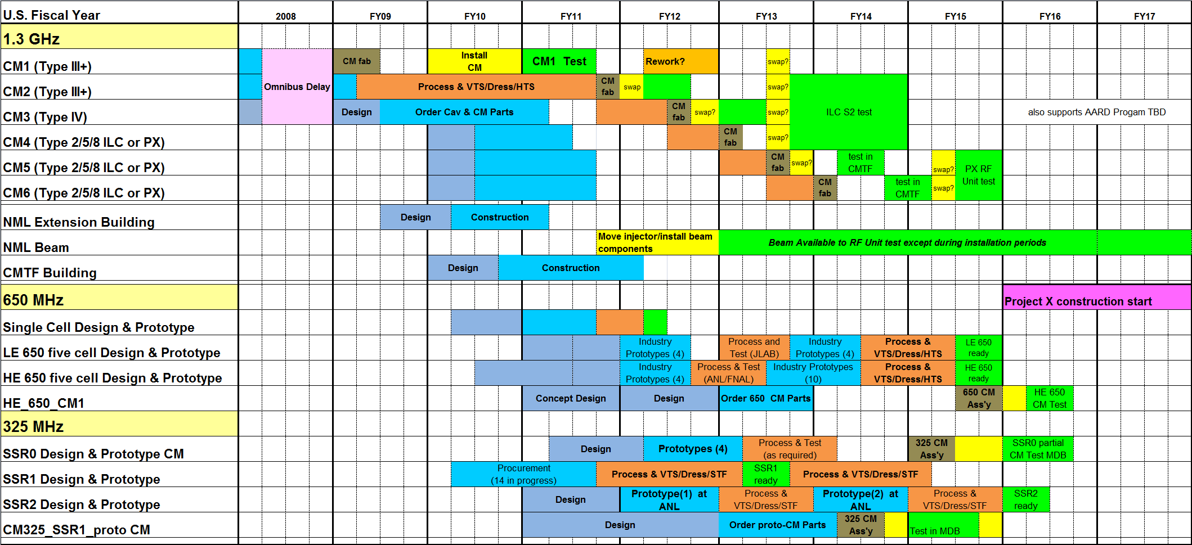
Integrated SRF Schedule - Cryomodules

Slide 26
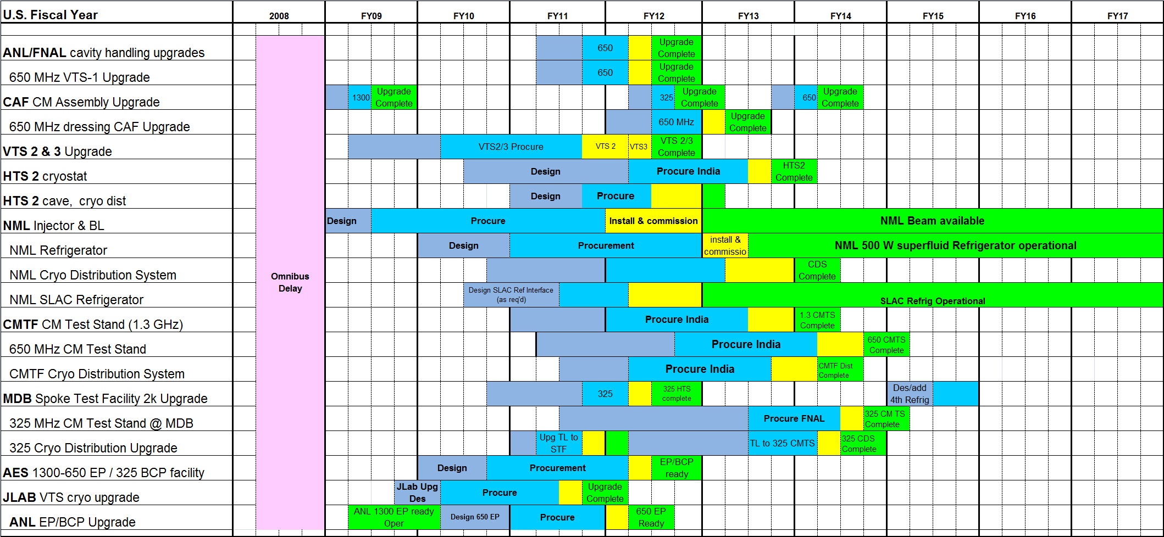
Integrated SRF Schedule - Infrastructure
Shows only remaining items, many completed items are now not shown (VTS-1, HTS, STF, CAF)

Slide 27
Recommendations from FY10 S&T Review
One of comments from last year’s S&T review was:
“The SRF infrastructure represents an excellent training ground for young researchers. A cooperative educational program in Accelerator Technology would be advantageous as the lab moves forward with the new accelerator initiatives.”
We agree. Currently 5 students in our accelerator program do work on SRF linacs/SRF Technology projects
  D.Ford (supervisor L.Cooley) - chemical and e-polishing
  A. Dzyuba (supervisor L. Cooley) – SRF theory and Exp
  S.Mironov (superviosr A.Klebaner) - cryosystem for SRF cryomodules
  S.Koshelev (supervisor R.Cagnaro) - SRF cavities testing
  A.Saini (supervisor N.Solyak) - beam dynamics in SRF linac
Plans are in progress to engage additional students from India, China, and other U.S. labs and universities in the program. We are enthusiastic about the opportunities.

Slide 28
ES&H and Quality
There are many potential hazards associated with SRF
  Cryogenics, high pressures, RF, strong acids, etc
  Extensive civil construction at NML in FY11-12
  Must assure safe design & operation of equipment/facilities
Functional Requirements Specifications
  Insure all intended functionality is clear to design team
  In use for PX components and SRF infrastructure
  Particularly important for collaborative activities
Technical Reviews (examples)
  VTS 2/3 cryostat, 650 MHz cavity design, 1300 MHz dressed cavity, NML superfluid cryoplant, CM2 instrumentation, etc
Safety Reviews
  Operational Readiness Reviews for facilities: VTS, HTS, CAF, NML,CM1, vacuum ovens, ICPA, ANL EP facility, etc
  Reviews of components: Dressed cavity, CM1 safety review,
No injuries in FY11. Doing a lot… but doing it safely
Extensive Cavity QC effort!

Slide 29
Summary
SRF R&D program at FNAL is productive & successful
Supports both ILC and Project X strategic goals
  Demonstrated world class performance of 1300 MHz cavities
  Also demonstrated outstanding performance of 1st 325 MHz spoke resonators
Developing additional 325 & 650 MHz cavity and cryomodule designs in support of Project X
Application of SRF to the low energy extreme of 2.5 MeV is a new and significant development in high intensity hadron linacs
Program leverages existing FNAL infrastructure (bldgs, cryo, etc)
  Augmented with SRF and ARRA infrastructure funds
  Lots of infrastructure is now in operation and is being used effectively
Leveraging existing SRF collaborations and building new ones
Significant effort to transfer SRF technology to U.S. Industry
Have an excellent team in place with growing SRF expertise and an already significant list of achievements

Slide 30
Backup Slides / Additional Material

Slide 31
Collaborations (~20 MOU’s)
ANL: EP development and cavity processing
Cornell: Cavity processing & test, materials R&D
DESY: 3.9 GHz, cryomodule kit, FLASH
Dubna: cavity development, bimetallic joints
KEK: Cavity R&D, ATF II
MSU: Cavity cost reduction, hydro-form, TIG
TJNL: EP cavity processing and test, PX cavities
INFN: tuners, HTS, NML gun cathodes
TRIUMF: Vendor development (PAVAC)
SLAC: RF power, klystrons, couplers
CERN, DESY, KEK, INFN, etc: Type IV CM design
BARC, RRCAT, IUAC, VECC (India) CM design, cavities, infrastructure
China: Peking U, IHEP, cavity development
UC,NW,NHMFL, UN Reno, Cornell, DESY, KEK…: Materials R&D
Notes:
31

Slide 32
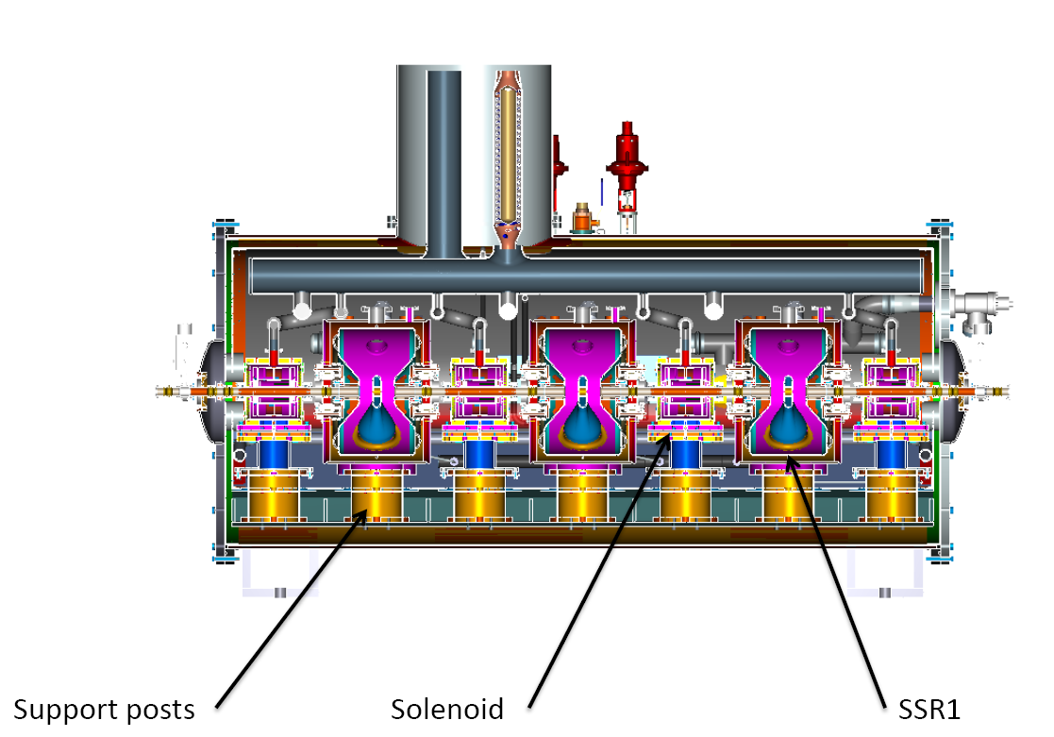
Prototype Three-Cavity SSR Cryomodule
Features 3 325 MHz cavities, 4 solenoids, and beam instrumentation
Intended to validate design concepts and alignment requirements for PX and demonstrate that tight lattice spacing is achievable

