Slide 1
Accelerator Strategy
Stuart Henderson
Associate Laboratory Director for Accelerators
Fermilab Institutional Review
June 6-9, 2011

Slide 2
Outline
Mission of the Accelerator Sector
Strategic Plan
Organization
Overview of Activities, Goals and Plans
Fermilab Institutional Review, June 6-9, 2011

Slide 3
Mission of the Accelerator Sector
Enable the U.S. scientific community to tackle the most fundamental physics questions of our era by
  Operating the accelerator complex at the highest levels of performance, efficiency and safety [Operations]
Operations
Capability
Acceler- ator Science
Technology Develop- ment
Future Facilities
  Maximizing the capabilities of the accelerator complex through upgrades and improvements [Expanding Capability]
  Designing and building the next generation accelerator facilities for particle physics [Future Facilities]
  Developing and nurturing those technologies that will enable the accelerator facilities of the future [Technology Development]
  Advancing basic understanding of beams and accelerators [Accelerator Science]

Slide 4
Fermilab Accelerator Strategy
NuMI (120 GeV):
350 kW
Booster (8GeV): 35 kW
NuMI (120 GeV)
700 kW
Booster (8GeV): 80 kW
Project-X:
>2MW @ 120 GeV
3MW @ 3 GeV
150 kW @ 8 GeV
Neutrino Factory
To build upon our existing strengths to establish a world-leading program at the Intensity Frontier, enabled by a world-class facility
…and use this program to provide a cornerstone for an Energy Frontier facility beyond LHC
LHC
Tevatron
LHC Upgrades in
luminosity and energy
Lepton Colliders
Technology Development and Fundamental Accelerator Science
…while relying on a strong program of technology development and fundamental accelerator science.

Slide 5
Fermilab Accelerator Activities Are Aligned with the Mission and Strategy
Accelerator Science
Accelerator Technology Development
Future Facilities
Advanced Accelerator R&D Program
Collimation
Ionization cooling
High field magnets
Superconduct-ing RF
Accelerator Operations
Project-X
Muon Collider
Tevatron Colliding Beams
120 GeV Neutrino Program
8 GeV Neutrino Program
Beam Instrumentation
Beam dynamics and simulation
Expanding Capability
Proton Improvement Plan
NOvA Upgrades
High-power Targetry
Mu2e and g-2
Neutrino Factory
RF Systems
Cooling tech.
LBNE
ILC

Slide 6
Accelerator Sector Organization
Accelerator Sector
Stuart Henderson
Associate Laboratory Director
Accelerator Support
Accelerator Physics Center
V. Shiltsev Head
Accelerator Division
Technical Division
R. Dixon Head
G. Apollinari Head
Fermilab Institutional Review, June 6-9, 2011

Slide 7
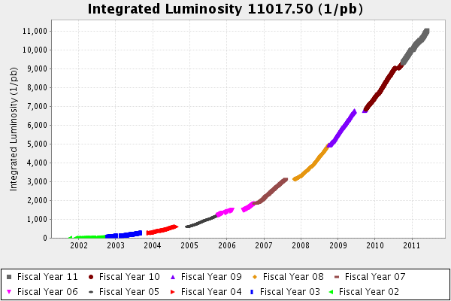
Operations
Mission: Operate the accelerator complex at the highest levels of performance, efficiency and safety
Goals:
  Deliver on operational commitments for the colliding beam program, 120 GeV and 8 GeV neutrino programs while maintaining an excellent safety record
Activities:
  Operations
  NOvA outage planning and execution
Fermilab Institutional Review, June 6-9, 2011

Slide 8
Expanding Capability
Mission: Maximize the capability of the accelerator complex through upgrades and continuous improvement to support the broadest and most effective program
Five-year Goals and Activities
  Deliver 700 kW reliably from MI for the neutrino program
    NOvA accelerator upgrades
    High-power target development efforts
  Increase proton source reliability, rep-rate and throughput to meet increased proton demands throughout this decade
    Proton Improvement Plan
  Establish a leading muon program at the existing accelerator complex
    Reconfiguration of antiproton source to support Mu2e and g-2
  Develop a high-power beamline for the Long Baseline Neutrino Experiment
Fermilab Institutional Review, June 6-9, 2011

Slide 9
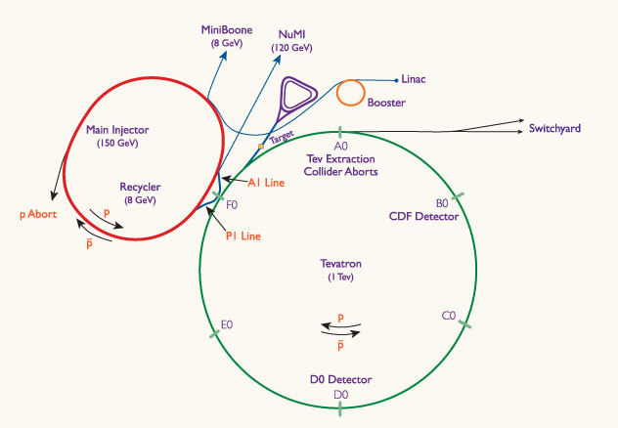
Evolution of the Accelerator Complex (through 2020)
2013-2017: Reconfigure P-bar for Mu2e/g-2
2012-2016: Proton Improvement Plan
2012: Shutdown Tevatron
2012-2013: Accelerator Upgrades for NOvA
Fermilab Institutional Review, June 6-9, 2011

Slide 10
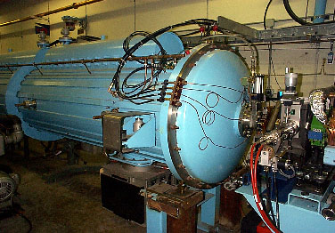
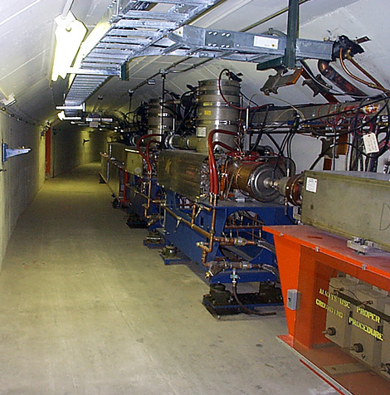
Proton Improvement Plan (more from Bill Pellico)
The 40-yr old Proton Source (Linac and Booster) powers the U.S. accelerator-based HEP program until Project X is built
The demand for protons increases by a factor of two throughout the 2010s
Many components in operation are “original equipment” that
  were not designed for the repetition-rate and throughput that is required
  are difficult to maintain, and
  for which replacement parts are difficult to find

Slide 11
Goals for the Proton Improvement Plan
The Proton Improvement Plan should enable Linac/Booster operation capable of
  delivering 2.25E17 protons/hour (at 15 Hz) in 2016
while
  maintaining Linac/Booster availability > 85%, and
  maintaining residual activation at acceptable levels
and also ensuring a useful operating life of the proton source through 2025.
The scope of the Proton Improvement Plan includes
  Upgrading (or replacing) components to increase the Booster repetition rate
  Replacing components that have (or will have) poor reliability
  Replacing components that are (or will soon become) obsolete
  Studying beam dynamics to diagnose performance limitations
  Implementing operational changes to reduce beam loss
Several important activities are well underway (e.g. RFQ replacement, Booster solid-state RF replacement)

Slide 12
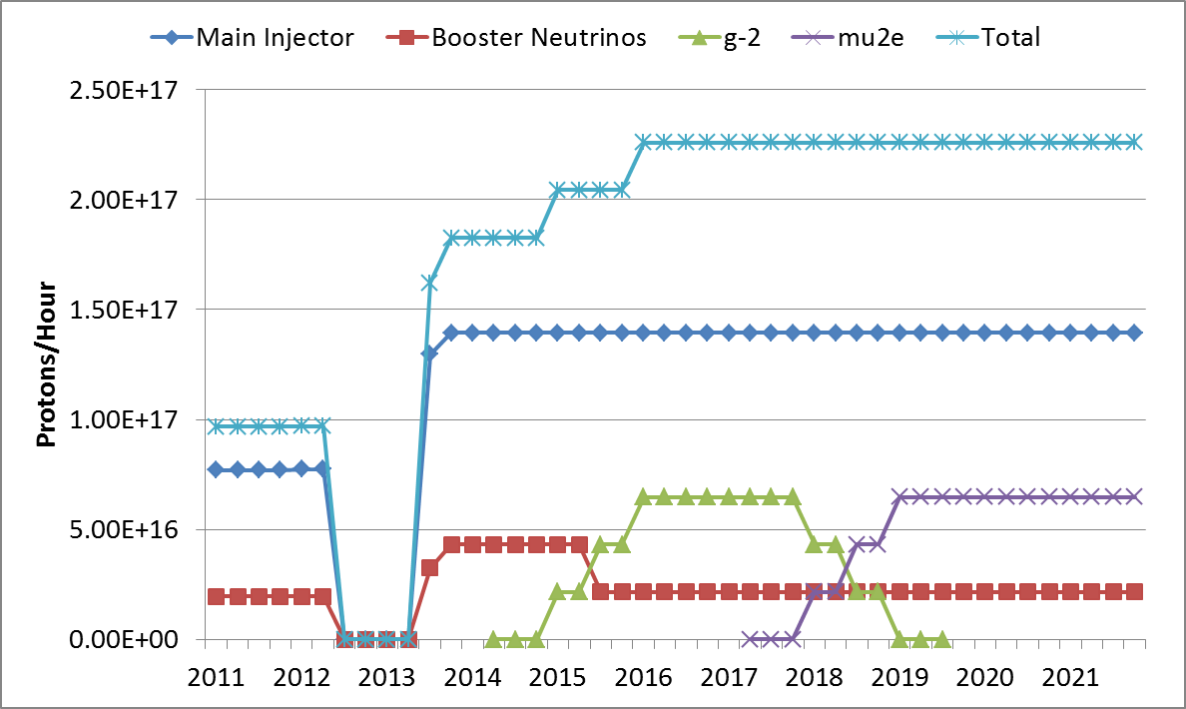
Proton Source Throughput Goals
NOvA Shutdown
120 GeV ν
LBNE
g-2
Mu2e
8 GeV ν
Fermilab Institutional Review, June 6-9, 2011

Slide 13
Future Facilities
Mission: Design and build the next-generation accelerator facilities for particle physics
Five-year Goals and Activities
  Begin constructing Project X, which will be the most powerful and flexible facility in the world for Intensity Frontier physics that will power the domestic program for the next three decades
    Project-X RD&D phase: develop a credible and cost-effective design for a multi-MW intensity frontier facility, as a national project with international participation.
  Enable community to make an informed choice on MC and NF
    Muon Accelerator Program: feasibility study for a MC by 2016, RDR for NF, MICE experiment, hardware R&D at MuCool Test Area, …
  Complete TDR for ILC and prove beam performance in a fully-integrated ILC RF-unit test
    Building SRF Test Facility at the “New Muon Lab”
Fermilab Institutional Review, June 6-9, 2011

Slide 14
Future Facilities: Project X
The central element of our Strategic Plan is the construction of Project X
Project X Mission is to establish a world-leading Intensity Frontier Facility by providing
  MW-class, multi-GeV, proton beams supporting multiple kaon, muon, and neutrino based precision experiments;
  Neutrino beam for long baseline neutrino oscillation experiments, based on a capability of targeting at least 2 MW of proton beam power at any energy between 60 – 120 GeV. Simultaneous operations of the rare processes and neutrino programs.
  Path toward a muon source for possible future Neutrino Factory and/or a Muon Collider .
  Options for implementing a program of Standard Model tests with nuclei and/or applications beyond HEP
Fermilab Institutional Review, June 6-9, 2011

Slide 15
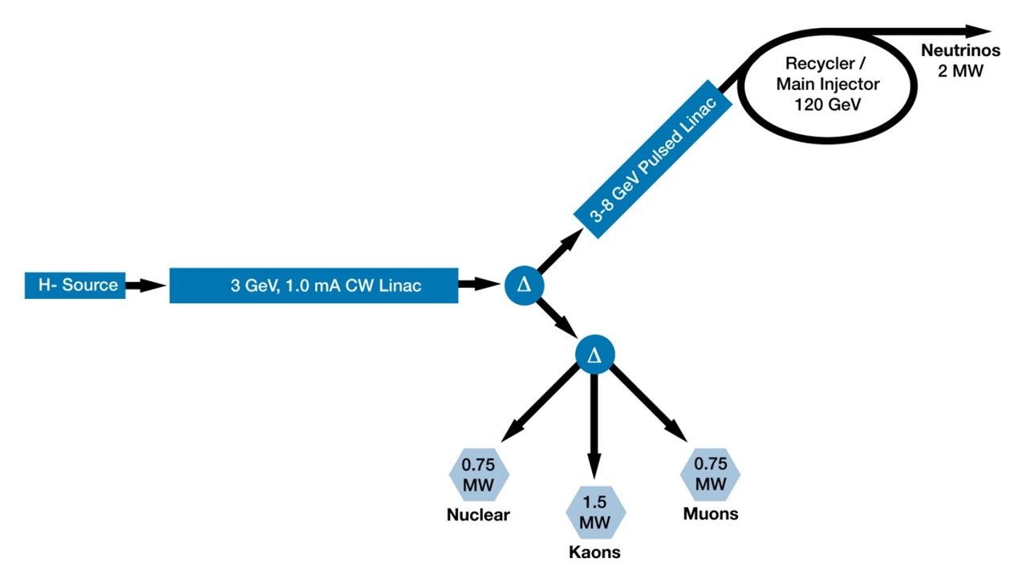
Project X Reference Design
>2MW @120 GeV
3 MW @ 3 GeV
150 kW @ 8 GeV
Unique capability to provide multi-MW beams to multiple experiments simultaneously, with variable bunch formats.
  Design concept/configuration stable for more than a year
Provides U.S. Intensity Frontier leadership for decades!
Fermilab Institutional Review, June 6-9, 2011

Slide 16
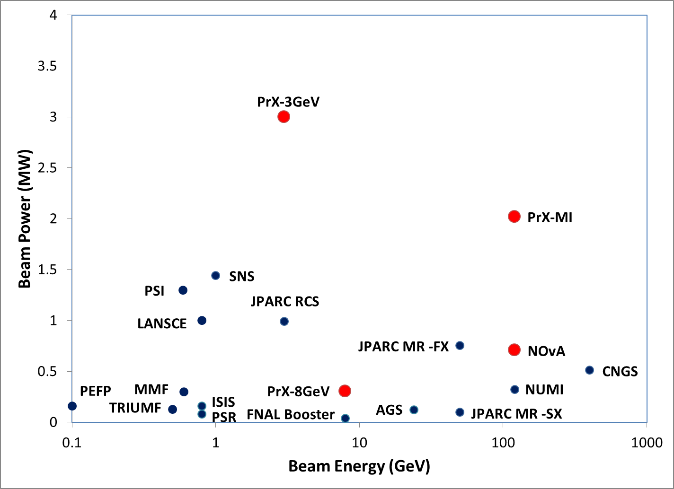
Project X and the High Power Proton Accelerator Landscape
Simultaneous

Slide 17
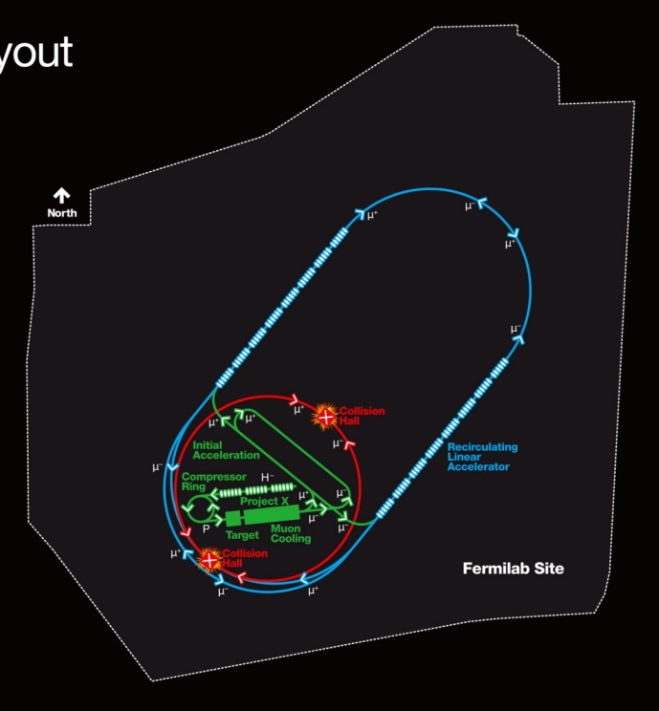
Future Facilities
Muon Collider and Neutrino Factory
  Fermilab is the host lab for the national Muon Accelerator Program (MAP) and contributes ~2/3 of MAP effort
  Deliverables:
    Muon Collider Design Feasibility Report
    Critical technology R&D: cooling, magnets,..
    Contributions to and leadership in MICE
    Contributions to International Design Study for a NF
International Linear Collider
A 4 TeV Muon Collider would
fit on the Fermilab Site
  We are constructing a fully integrated ILC RF unit consisting of 3 cryomodules powered by a single RF source with the goal of demonstrating required beam performance (S2 Goals)
  We are testing the first CM now and anticipate testing of the full unit in FY13
Fermilab Institutional Review, June 6-9, 2011

Slide 18
Technology Development
Mission: Develop and nurture those technologies that will enable the accelerator facilities of the future
Five-year Goals and Activities:
  Complete technology development to support 2016 Project X construction start
    Focused effort on SRF structure development for proton acceleration
    High Power Proton Accelerator front-end development
  Extend understanding of SC materials and performance limits
    SC materials R&D program: understand the limits of Q and gradient of SCRF cavities; develop and integrate future generation superconductor into accelerator magnet construction
  Lead in technology development for LHC luminosity and energy upgrades, and future colliders
    High-Field Magnet Program: 11T dipole development, LARP magnet development, HTS for accel. magnets, MC/NF
  Engage industry in Illinois Accelerator Research Center Program
Fermilab Institutional Review, June 6-9, 2011

Slide 19
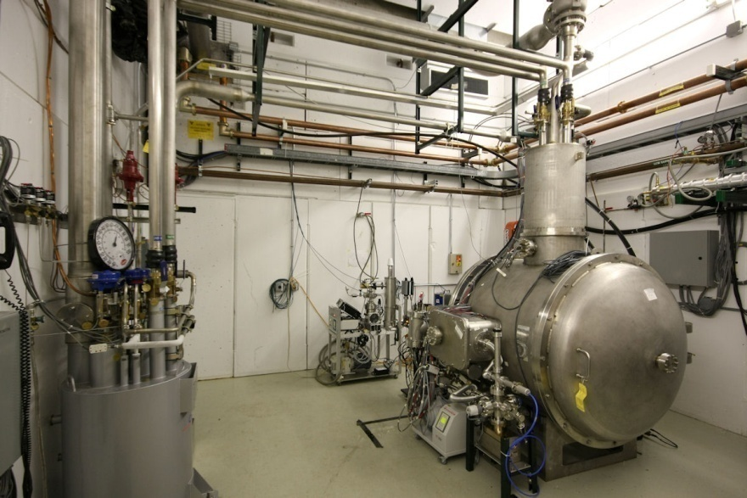
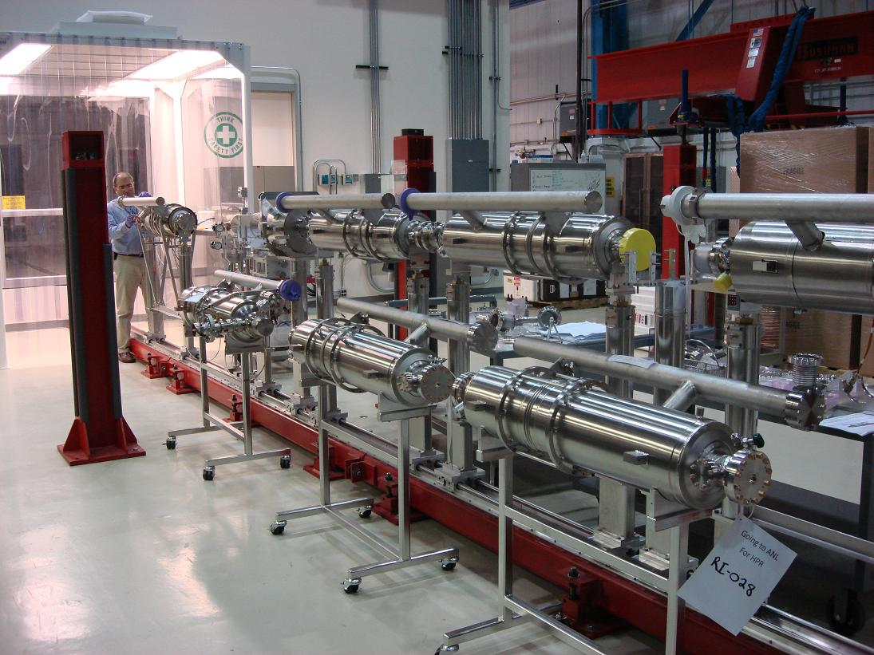
Superconducting RF Program
The Laboratory’s strategy hinges on SRF Technology
SRF R&D program is carried out in an integrated approach that supports the strategic goals of U.S. HEP: Project X and the ILC
Focus of and goals of efforts
  Building technological base for Project-X through development of complete set of SC RF structures for acceleration from 0.07 < β = 1 : 325 MHz, 650 MHz, 1300 MHz.
  Advancing state-of-the-art in SCRF performance at 325, 650 and 1300 MHz
  Understanding limits to Quality Factor and Gradient through basic SC materials R&D
  Proving capability in the SCRF Test Facility at NML
  Developing necessary SRF infrastructure to support activities
Dressed 1300 MHz cavities
β=0.22 SSR1
Spoke Cavity Test Cryostat
Fermilab Institutional Review, June 6-9, 2011

Slide 20
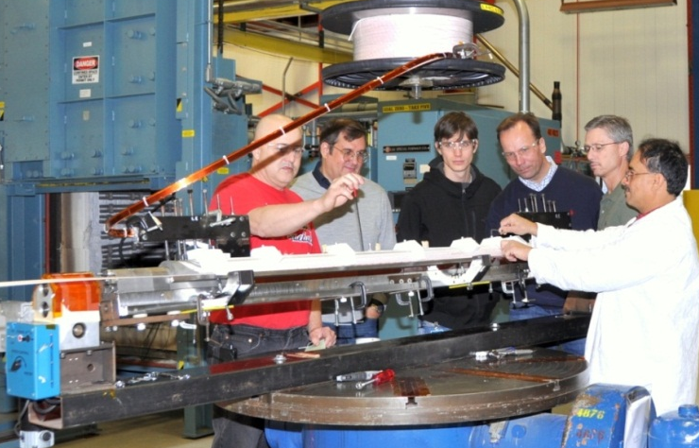
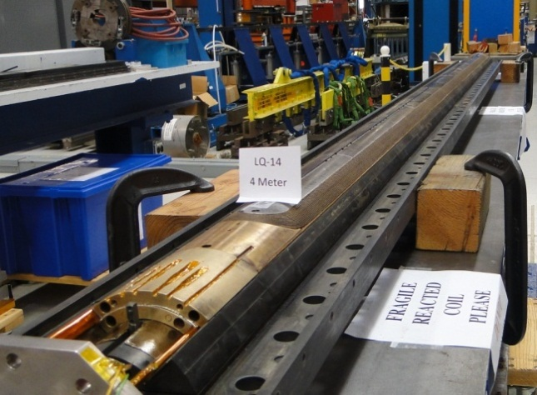
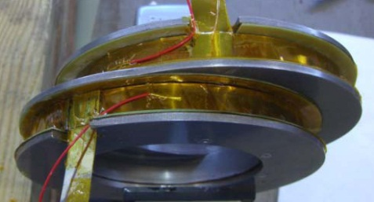
High-Field Magnets
  Goal: Develop advanced SC magnets and baseline technologies, while improving engineering aspects of SC strands/cables for present and future particle accelerators
  Focus of Efforts:
    11T Nb₃Sn twin-aperture dipole magnet development for LHC upgrade
      Higher field 11T-11m length replaces 8.3T-15m length to allow space for additional collimation systems needed for higher luminosity
      Would be first application of Nb₃Sn technology in a working accelerator
    Nb₃Sn coil fabrication technology: conductor, insulation, structural materials; LARP success: 220T/m (85% of short sample limit) in LQ
    Conceptual design studies for MC/NF magnets;
      fabrication and test of two short large-aperture helical solenoid models
      First test of HTS (YBCO tape) coil in hybrid configuration; 18.3T achieved

Slide 21
Accelerator Science
Mission: Advancing basic understanding of beams and accelerators
Five-year goals and Activities
  Develop NML into a flexible, powerful, proposal-driven user facility for Advanced Accelerator R&D
    Advanced Accelerator R&D: We are planning an AARD program at NML with ANL colleagues
  Improve performance of operating accelerators through improved beam-dynamics understanding at both FNAL and LHC
    Operations and beam studies support for Tevatron, LHC, MI, Proton Source
  Extend basic understanding of beams and accelerators
    Accelerator and Beam physics: development of modeling and simulation tools, including MARS code; theory and experiment
    Leadership in SciDAC ComPASS (Community Petascale Project for Accelerator Science and Simulation)
  Increase our focus on educating the next generation:
    Educational Program engaging 7 Ph.D. students, 15 undergraduates each year
    Anticipate expanded activities associated with IARC
Fermilab Institutional Review, June 6-9, 2011

Slide 22
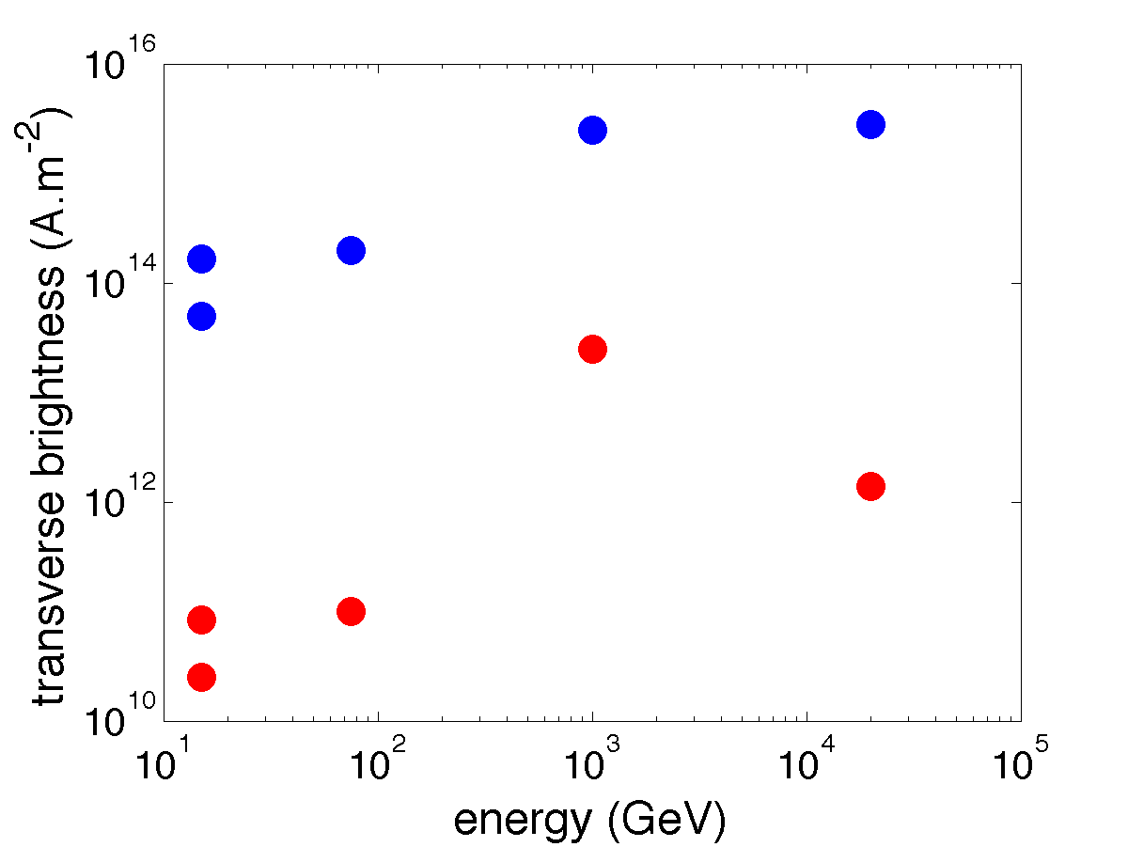
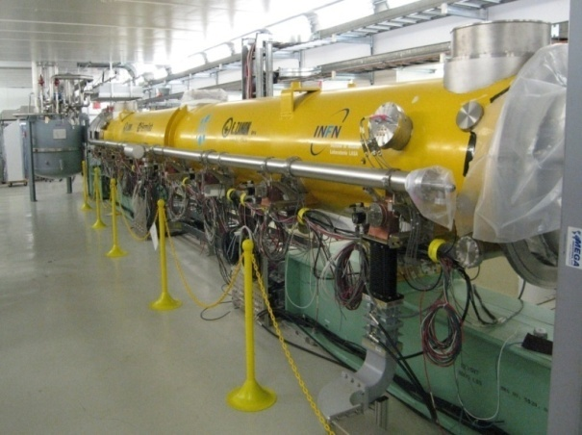
Advanced Accelerator R&D at the SCRF Test Facility
We are constructing a test accelerator using ILC technology to serve two purposes
NML
FACET
A0
ATF
  to demonstrate technology readiness of a complete ILC RF Unit
  provide a powerful and unique facility for advanced accelerator R&D
We have set up a joint FNAL-ANL working group on scientific opportunities for AARD at the Test Facility
We have identified three flagship experiments:
  longitudinal bunch-shape manipulation using double-emittance exchange,
  integrable optics test accelerator,
  crystal-based compact high-brightness x-ray source
AWA
NML
FACET
A0
ATF
Peak brightness
Average brightness
AWA
Fermilab Institutional Review, June 6-9, 2011

Slide 23
Summary
The Strategic Plan
  Builds on our existing strengths in the Intensity Frontier, and seeks to cement this position by
    getting the most from our Accelerator Complex in the near-term and
    building a world-leading program powered by a world-class facility in the mid-term: Project X
  Relies on a strong foundation of technology development and fundamental accelerator science to realize the ambitions of the field for Project X and beyond.

