Slide 1
Broaching Standoffs Cryocycling & Load Tests
Brooke Russell
ArgonCube Engineering Meeting | July 17th 2020

Slide 2
Press-fit broaching standoffs
Main support for charge and light readout assembly in SingleCube
Replaces original pixel standoffs
Same location and thread
Installed by commercial vendor
***Cryogenic and load qualification discussed here***
If successful, employed for Module 0 and 2x2

Slide 3
Broaching standoffs to support pixel tile and light readout assemblies
ArCLight w/ Pixel Tile
LCM w/ Pixel Tile
*Figures courtesy of A. Lambert

Slide 4
Two standoff types for testing
Metric – tall and thin
Imperial – short and broad

Slide 5
Cryocycling & Load Test Procedure
Hold PCB with standoffs in cold vapor just above LN₂ surface (1 minute before initial submerge; 30 seconds before subsequent submerges)
Slowly submerge entire PCB into LN₂ (20 seconds initial submerge time; 5 seconds subsequent submerge time)
PCB totally submerged in LN₂ for 30 seconds
Slowly raise PCB out of LN₂ (5 seconds removal time)
Place PCB on bench top
Attach weights on bench top
Load test at room temperature
*steps 1-4 repeated 4 times

Slide 6
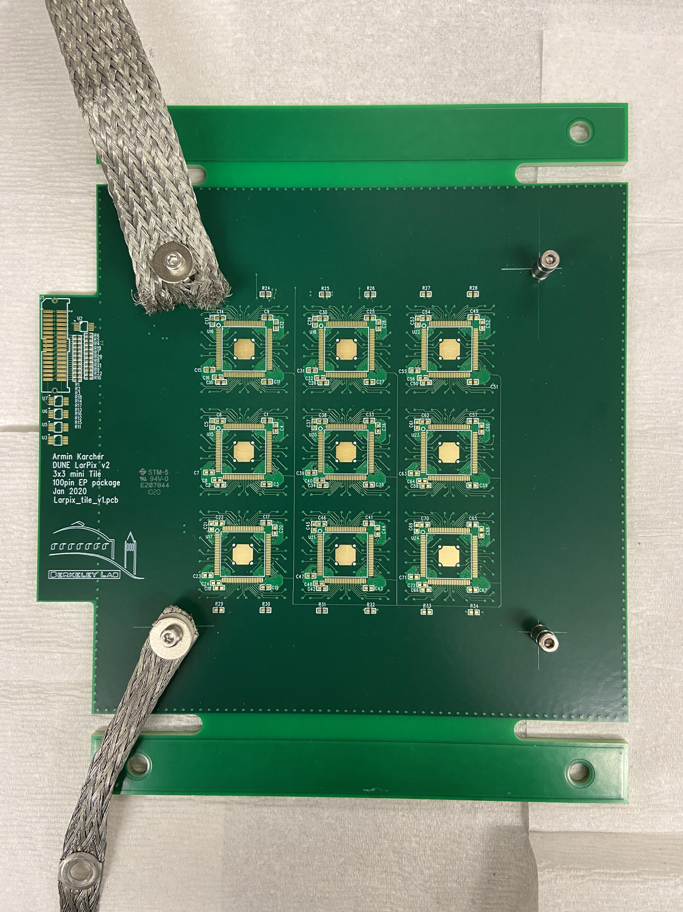
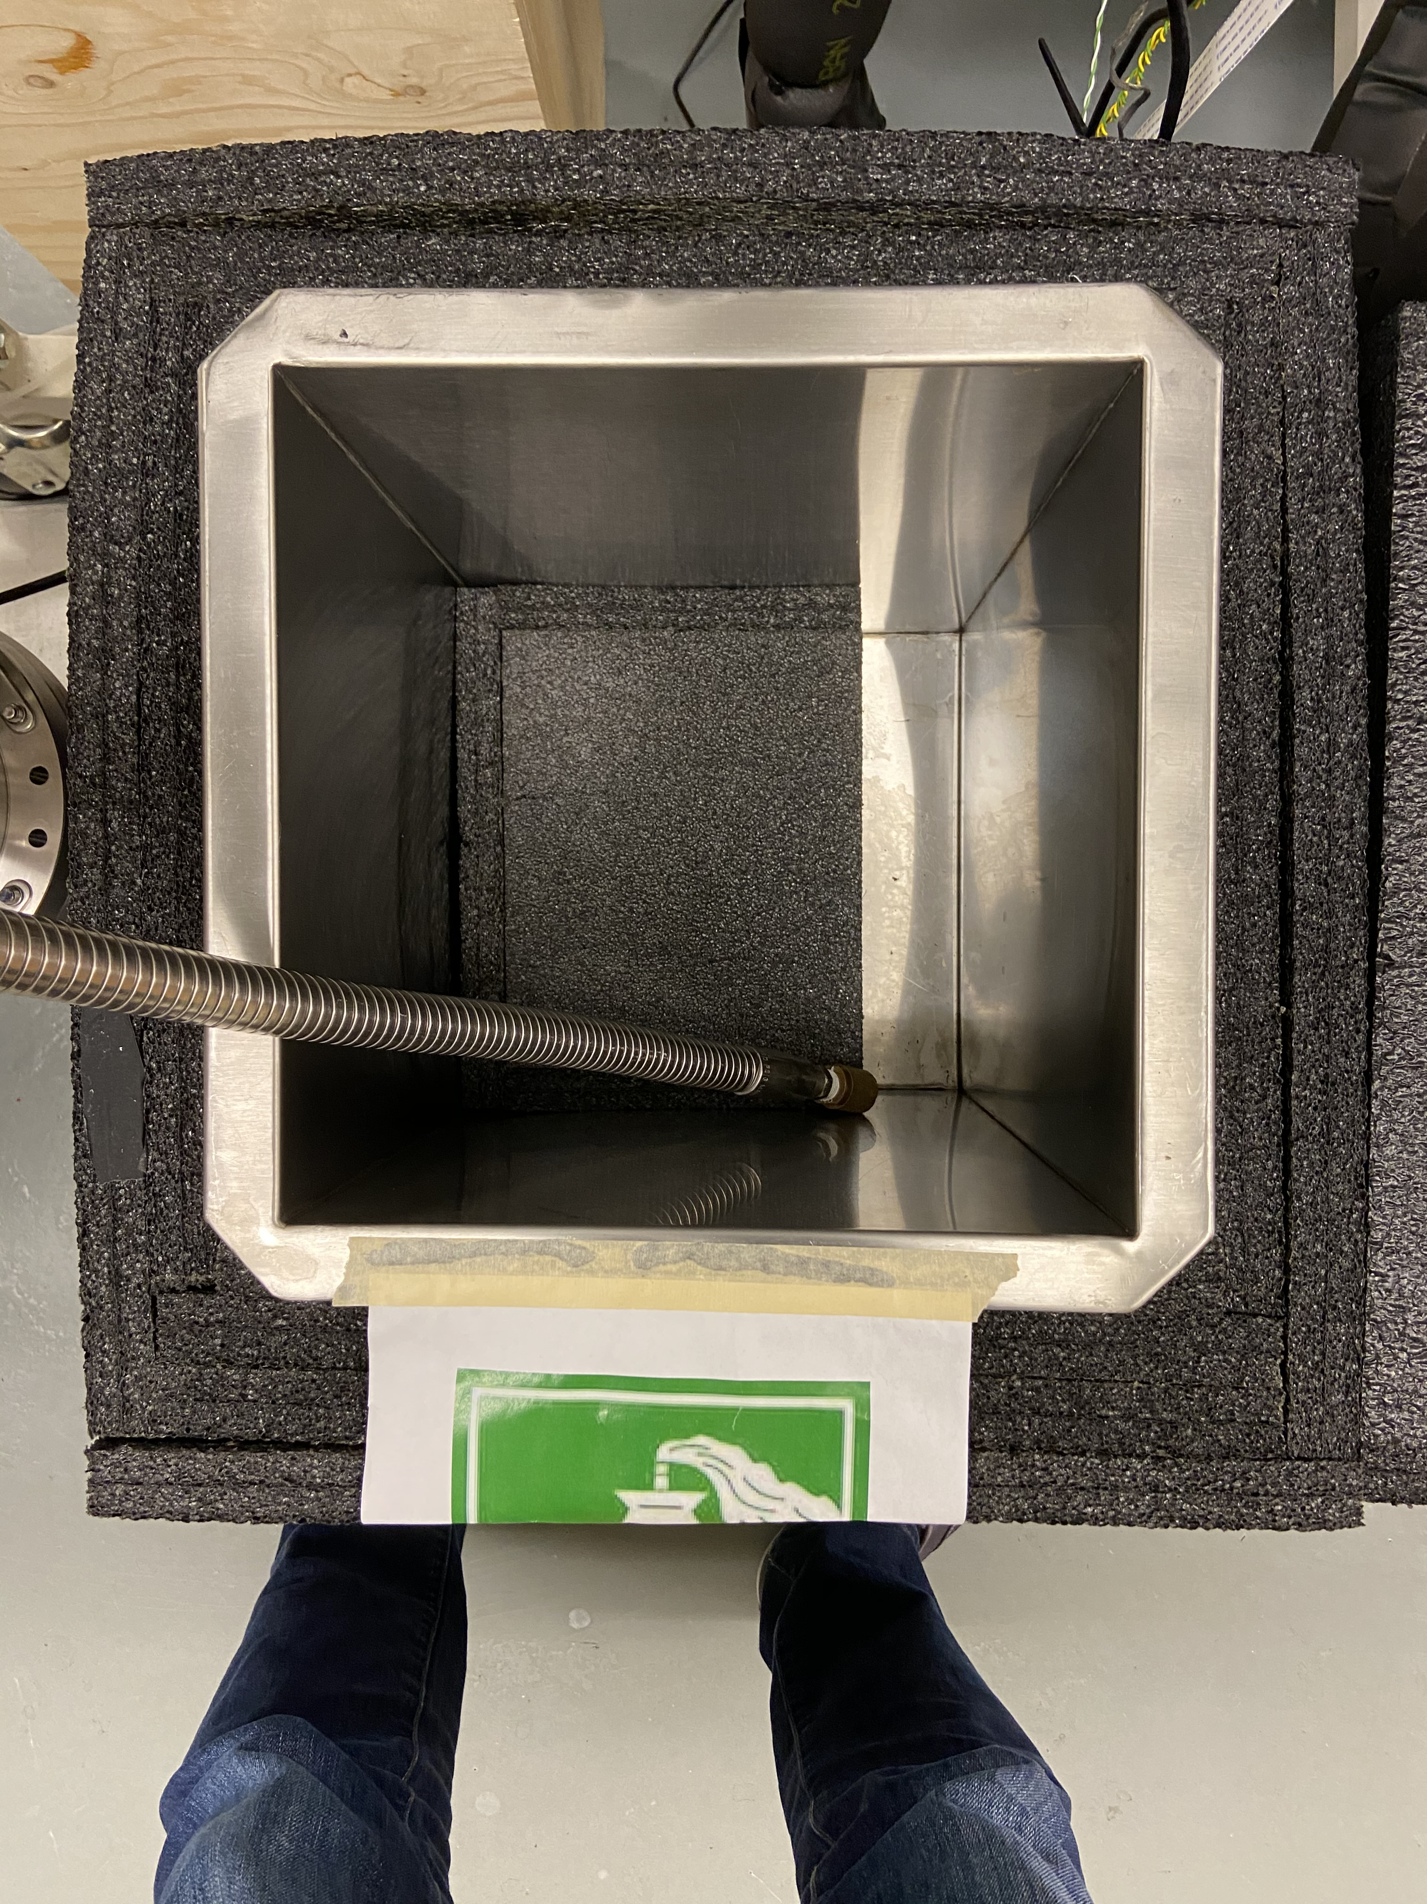
Ancillary equipment for quick testing
Tin-plated copper grounding braid:
insertion/removal from LN₂
hold point for load test
Aluminum box with foam insulation
LN₂ fill line
Tin-plated copper grounding braid for load test
First generation mini tile 3x3 pixel board (v1 rev1) – pixel pads on back-facing side
Eyelets to attach weights

Slide 7
Top right corner – metric standoffs
Before cryocycling
After cryocycling

Slide 8
Bottom right corner – metric standoffs
Before cryocycling
After cryocycling

Slide 9
Bottom left corner – metric standoffs
Before cryocycling
After cryocycling

Slide 10
Top left corner – metric standoffs
Before cryocycling
After cryocycling

Slide 11
Top right corner – imperial standoffs
Before cryocycling
After cryocycling

Slide 12
Bottom right corner – imperial standoffs
Before cryocycling
After cryocycling

Slide 13
Bottom left corner – imperial standoffs
Before cryocycling
After cryocycling

Slide 14
Top left corner – imperial standoffs
Before cryocycling
After cryocycling

Slide 15
Load test
100-chip pixel tile: ~740g
ArCLight: ~980g
Maximum load tested: 2024g
Load tested single attachment point (single standoff) for both type of broaching standoffs
Neither standoff type failed under load exceeding ArCLight plus 100-chip pixel tile mass
Test load equivalent to pixel PCB
Test load ~115% mass of ArCLight plus pixel PCB

Slide 16
Summary
Upon visual inspection, no cracking or damage to pixel tile PCB was observed after multiple cryocycles
Neither standoff type failed at cold with load exceeding 100-chip pixel tile + ArCLight mass
Either broaching standoff is suitable for SingleCube

