Slide 1
Targetry challenges for the next generation of high-intensity neutrino beams
Robert Zwaska
Neutrino 2020 Conference
29 June 2020

Slide 2
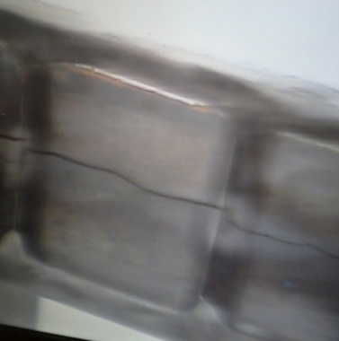
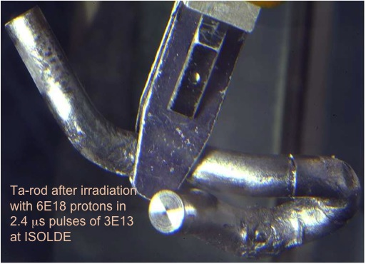
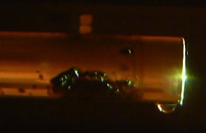
What we don’t want

Slide 3
High Power/Intensity Targetry Challenges
Target Material Behavior
  Radiation damage
  Thermal “shock” response
  Highly non-linear thermo-mechanical simulation
Targetry Technologies (System Behavior)
  Remote handling
  Target system simulation (optimize for physics & longevity)
  Rapid heat removal
  Radiation protection
  Radiation accelerated corrosion
  Manufacturing technologies
Additional Neutrino Beam Challenges:
Primary beam handling and instrumentation
Accuracy and consistency of all beam inputs, particularly alignment
Focusing elements
Beam-based alignment
Secondary beam instrumentation
Radiation transport modeling
Hadron production
The high statistics from high-power beams require an emphasis on precision

Slide 4
Nu HPT R&D Materials Exploratory Map
Uncharted Territory
Future Nu 4 MW
NuMI-MINOS Target NT-02 (damaged)
NuMI-NOvA Target TA-01 (survived)
NT-07
NT-04
LBNF-2.4 MW Tau Nu
NT-06
NT-05
NT-03
NT-01
Thermal Shock Severity (p/cm²/pulse)
LBNF-2.4 MW (Ideal)
LBNF-1.2 MW (CDR)
LBNF-2.4 MW (CDR)
T2K First Target
SNS range for 1.4 MW operation for 1 year
Radiation Damage Severity
(damage equivalent fluence, p/cm²)

Slide 5
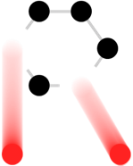











RaDIATE
Collaboration
Radiation Damage In Accelerator Target Environments
www-radiate.fnal.gov
Broad aims are threefold:
to generate new and useful materials data for application within the accelerator and fission/fusion communities
to recruit and develop new scientific and engineering experts who can cross the boundaries between these communities
to initiate and coordinate a continuing synergy between research in these communities, benefitting both proton accelerator applications in science and industry and carbon-free energy technologies

Slide 6
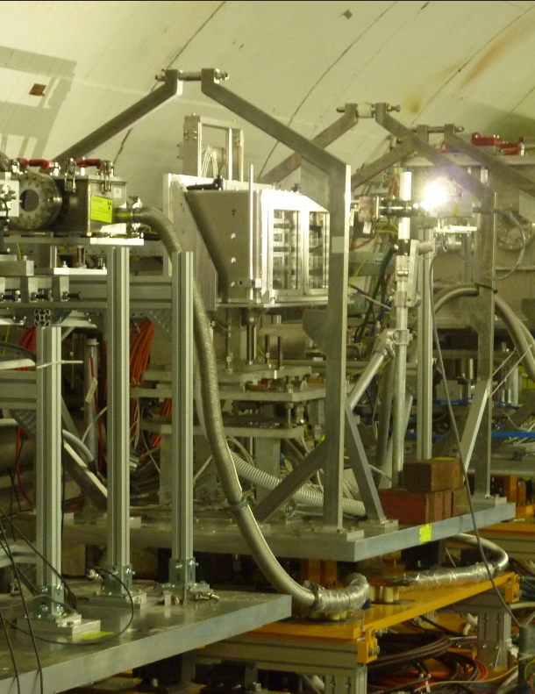
High Power Targetry: Materials R&D
Multi-MW Neutrino Targets & Beam Windows Materials:
Graphite (target core material) studies:
  Swelling/fracture studies
  Preparing for HE proton irradiation at BLIP (2020) to confirm elevated temperature annealing
Beryllium (beam window material) studies:
  Examination of BLIP irradiated Be specimens underway
  Helium implantation studies show bubble formation at irradiation temperatures above 360 ˚C
Titanium Alloys (beam window material) studies:
  Examination of BLIP irradiated specimens underway
  World first high cycle fatigue testing of
  irradiated titanium underway at FNAL
Benefits to multi-MW targets e.g. LBNF):
alloy/grade choice
cooling system design
tolerable beam intensities
expected lifetimes
In-beam thermal shock testing of BLIP irradiated Be and Ti alloys at CERN
RaDIATE

Slide 7
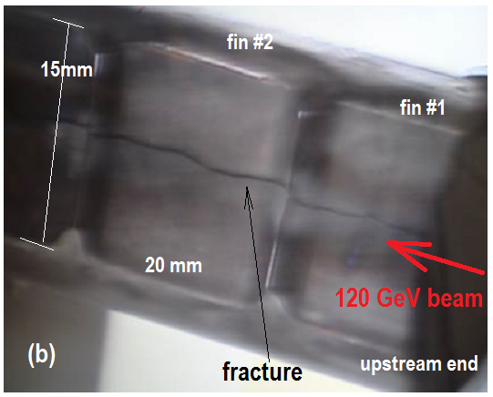
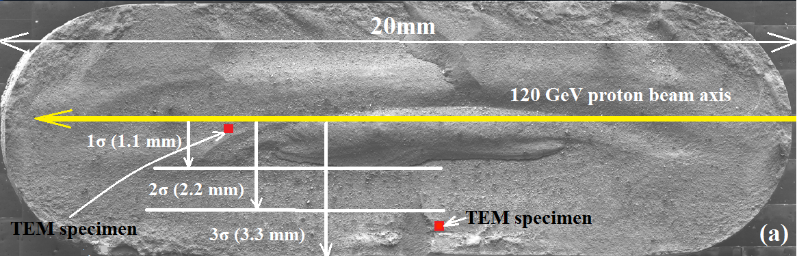
Background- Fractured NuMI target fin
Detailed PIE at PNNL
x
y
z
z
Beam Parameters:
Energy :120 GeV
Beam sigma : 1.1mm
Spill duration : 10µsec, 4x10¹³ protons/pulse
Duty cycle :1.87sec
Peak fluence : 8.6x10²¹ protons/cm²
Bulk swelling of ~2%

Slide 8
Graphite Results – X-ray diffraction of NuMI graphite fin shows lattice growth and amorphization at beam center
Irradiation temperature ~150 ˚C
Simos et al

Slide 9
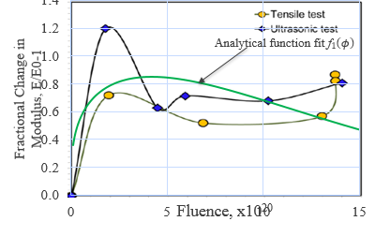
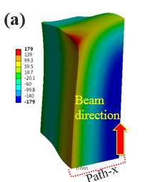
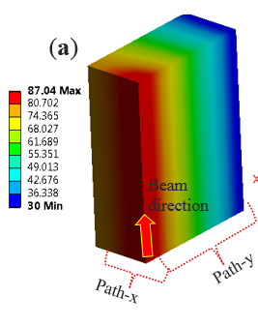
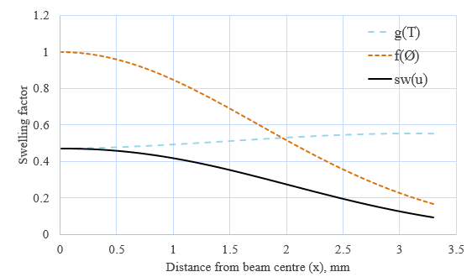
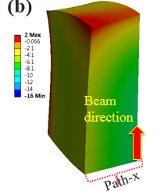
Modeling of graphite swelling predicts fracture
Sujit Bidhar (FNAL) – User defined material model in ANSYS
Elastic modulus as a function of dose and temperature
Swelling (NSLS-II) as a function of dose and temperature
Tensile strength of graphite:
79 MPa (0 DPA)
110 MPa (0.1 DPA)
179 Mpa !!
Stress
E change
Thermal Response
2 MPa
Swelling
No radiation damage effects
Stress

Slide 10
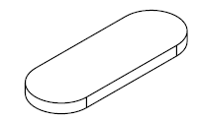

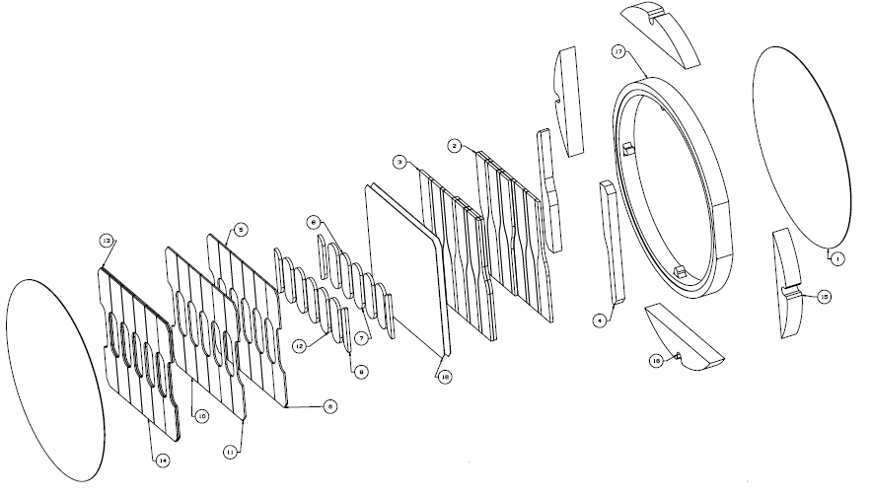
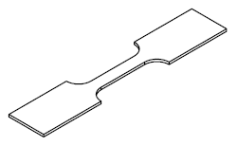
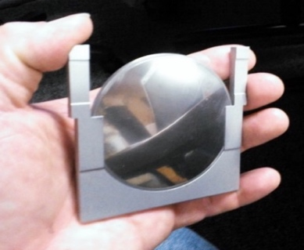
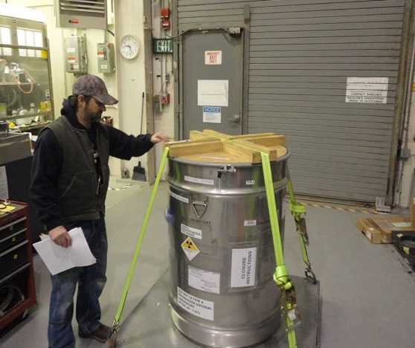
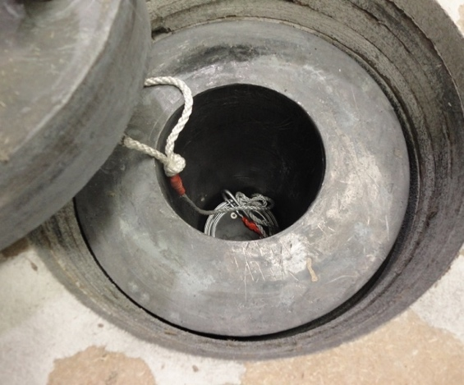
High Energy Proton Irradiation
    181 MeV p irradiation @ BNL’s BLIP facility
  Over 200 specimens from 6 RaDIATE collaborators
  Participants: BNL, PNNL, FRIB, ESS, CERN,
  J-PARC, STFC, Oxford, FNAL
Completed irradiation on March 9, 2018
  4.5E21 accumulated protons on target
  1.52 peak DPA on Ti alloy achieved
Microstructural analysis specimens
Fatigue specimens
Tensile specimens
70mm
Impact: Will benefit many facilities including LBNF, T2K, BDF at CERN, FRIB, and even LHC-HiLumi (collimators)

Slide 11
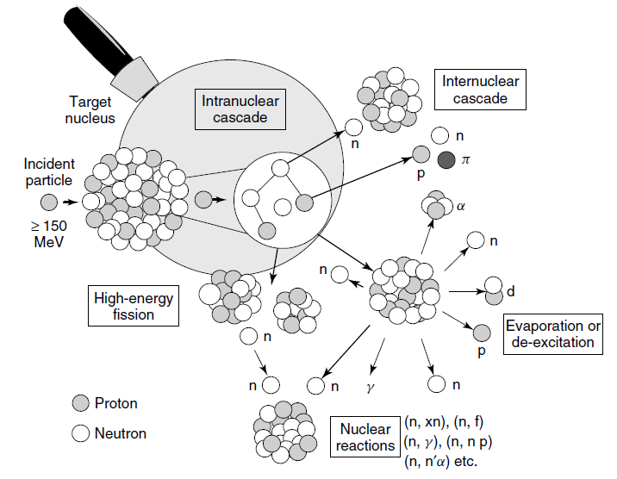
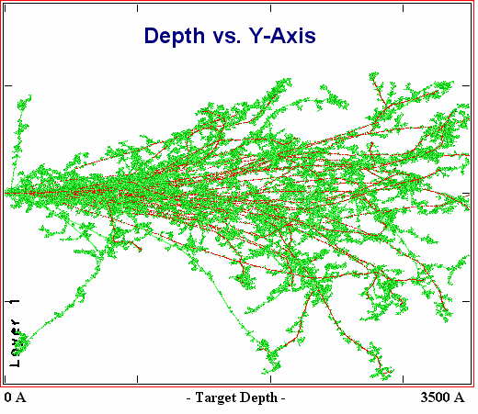
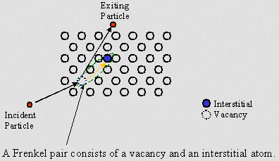
Radiation Damage Disorders Microstructure
Microstructural response:
creation of transmutation products;
atomic displacements (cascades)
  average number of stable interstitial/vacancy pairs created = DPA (Displacements Per Atom)
Gas production (hydrogen / helium)
From D. Filges, F. Goldenbaum, in:, Handb. Spallation Res., Wiley-VCH Verlag GmbH & Co. KGaA, 2010, pp. 1–61.
Slide prepared by V. Kuksenko (Oxford)

Slide 12






RaDIATE BLIP irradiation summary
Consisted of 9 capsules from 6 RaDIATE institutions with over 200 material specimens relevant to beam intercepting devices in various current/future accelerator facilities
181 MeV incoming protons used for RaDIATE irradiation
Irradiation campaign executed in 3 phases with different target box configurations
  6 capsules in target box during each irradiation phase
Total protons on target: 4.57E21 (154 µA avg)

Slide 13
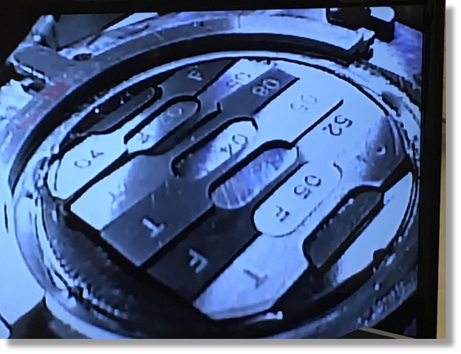
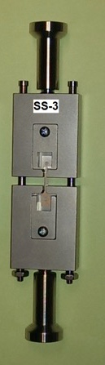
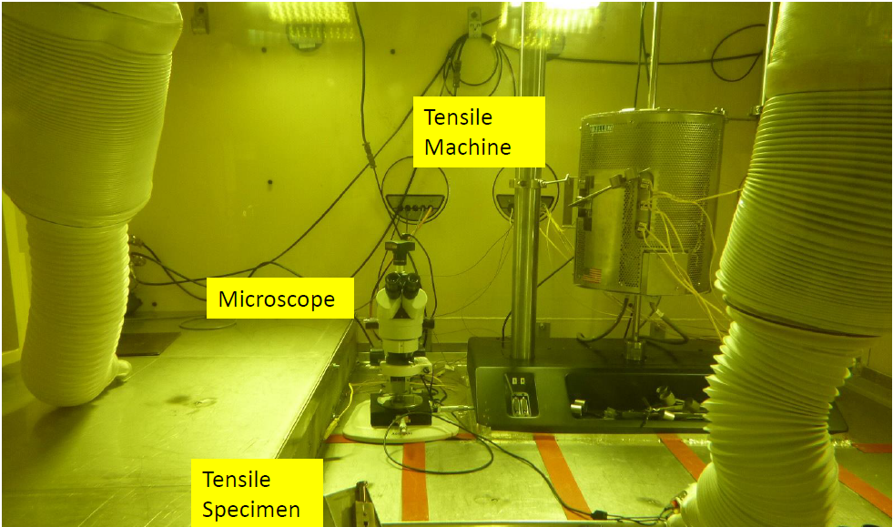
BLIP Irradiation Examinations Underway
Significant hardening at low dose in Be and Ti
  Less hardening in higher temperature specimens
First ever fatigue study on irradiated Ti alloys begun
  Indicates about 10% reduction in fatigue strength
Microstructural examinations underway
Irradiation hardening of S-65F Be
Reduction of strain to failure
Increased strength
Custom Fatigue Testing Machine for Irradiated Materials (FNAL)

Slide 14
X-ray diffraction – Swelling in BLIP irradiated graphite
Simos et al
Impact: Allows confidence to use reactor data for lattice swelling of graphite in HE proton regime for future target facilities
W. Bollmann. “Electron-microscopic observations on radiation damage in graphite” Phil. Mag., 5(54):621-624, June 1960.

Slide 15
Neutron irradiated graphite dimensional changes
B.J. Marsden, “Irradiation Damage in Graphite due to fast neutrons in fission and fusion systems,” IAEA-TECDOC-1154, 2000
Big change in c-axis growth ~250 ˚C
Impact: Correlation informs target choice of operating temperature (cooling system design)

Slide 16
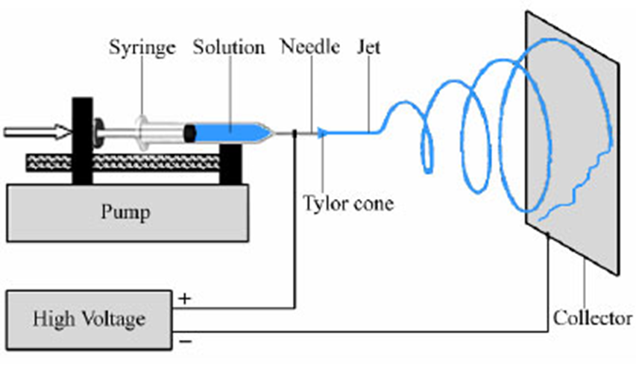
In-Beam Thermal Shock Test: BeGrid2 (HRMT43)
Beam taken on Oct. (2018)
Primary Objectives:
Compare thermal shock response between non-irradiated and previously irradiated material specimens from BNL BLIP (Be, C, Ti, Si)
  First/unique test with activated materials at HiRadMat
Explore novel materials such as metal foams (C, SiC) and electrospun fiber mats (Al₂O₃, ZrO₂) to evaluate their resistance to thermal shock and suitability as target materials
Electrospinning concept
SEM: as-spun Al₂O₃

Slide 17
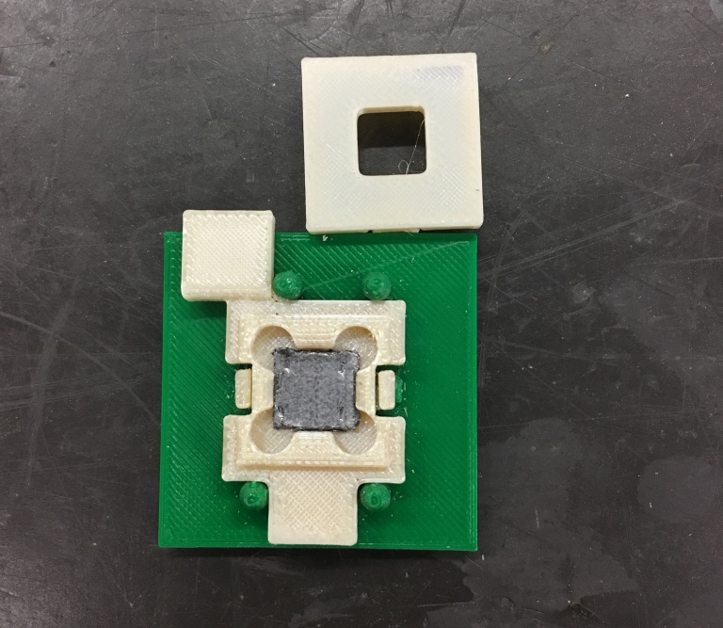
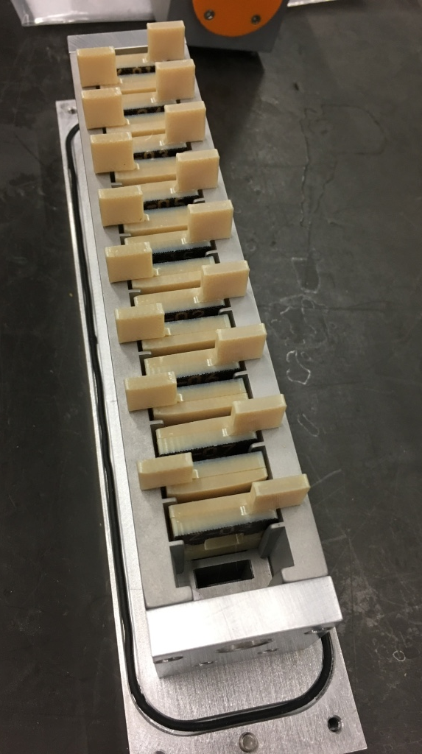
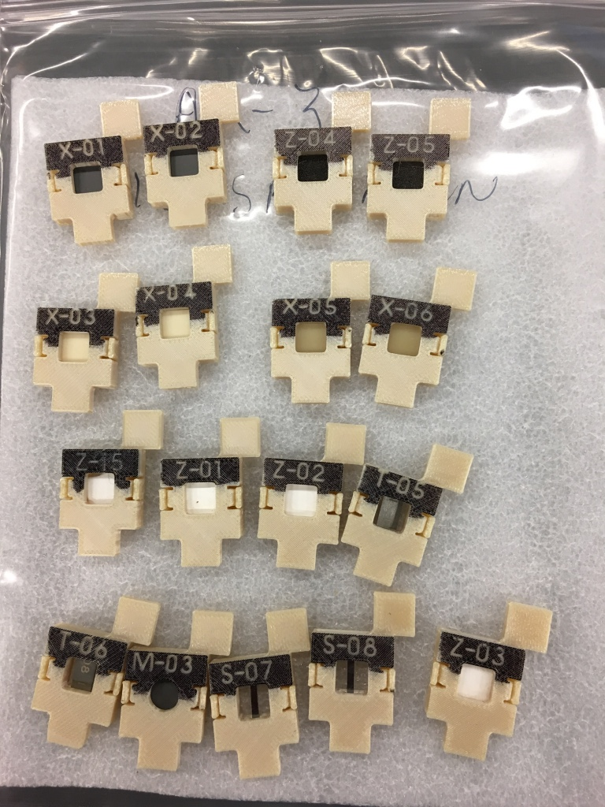
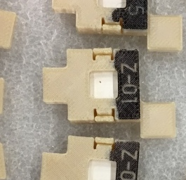
BeGrid2 (HRMT43) – 3-D printed specimen holders

Slide 18
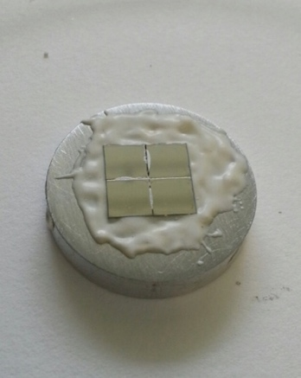
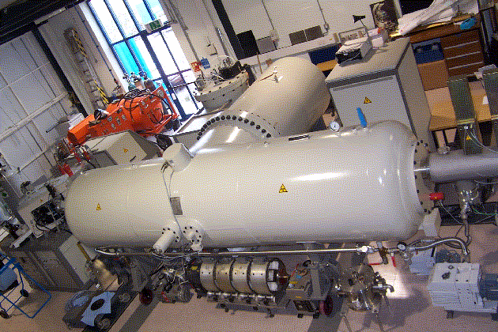
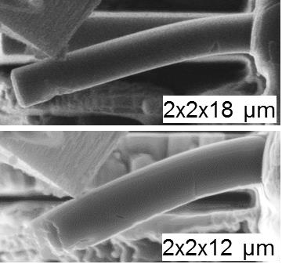
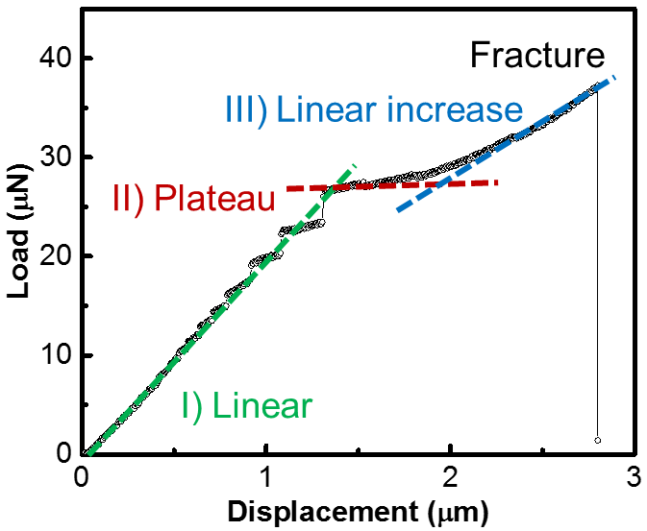
MIMiC - Methods of Irradiated Material Characterization
Replicating proton beam interaction damage with minimal residual activity
        The current routes for high-energy proton irradiations are expensive, long in duration, and lack control of testing conditions and schedule.
        Low-energy ion irradiations are attractive because they allow study of the evolution of the micro-structure during irradiation without activating the specimens, are relatively low cost, and can achieve high dose in very short durations.
        Micro-mechanics and meso-scale testing are potential enabling technologies to overcome some of the limitations of low-energy irradiations as well as to drastically reduce specimen size requirements (which also reduces activity of specimens).
        Ion irradiations and micro-mechanics have been used in the RaDIATE studies on beryllium.

Slide 19
Nu HPT R&D Materials Exploratory Map
Uncharted Territory
HiRadMat Beam Test - 2
Thermal Shock Test (planned) MIMiC
Future Nu 4 MW
HiRadMat Beam Test - 1
Graphite Fin Studies
NT-02
LBNF-2.4 MW Tau Nu
NT-04
NT-07
NT-06
NT-05
NT-03
TA-01
NT-01
LBNF-2.4 MW (CDR)
LBNF-2.4 MW IDEAL
NuMI Be Beam Window
Thermal Shock Severity (p/cm²/pulse)
T2K-1
LBNF-1.2 MW (CDR)
BLIP Irradiation - 1
BLIP Irradiation – 2
Ion Irradiation (planned) MIMiC
Radiation Damage Severity
(damage equivalent fluence, p/cm²)

Slide 20
Overview of Strategy for HPT Material R&D
        To Present (2010-2020) – Benefits ongoing neutrino program
        Measure irradiated material behavior of currently identified targetry materials
          Be, graphite, Ti alloys
          High-energy proton irradiations, thermal shock tests, autopsies
        Identify more effective Methods of Irradiated Material Characterization (MIMiC)
        Explore ab initio and molecular dynamics to model irradiated material behavior
        Mid Term* (2021-2027) – Benefits LBNF 2.4 MW design & next-gen experiments
        Continue irradiated material studies on candidate targetry materials
          Focus on reducing costs/risks of high-energy proton irradiations
        Develop MIMiC ideas into valid experimental techniques
        Far Term* (2028 and beyond) – Benefits next-gen HPT Facilities
        Utilize the developed MIMiC techniques, ab initio/MD modeling, and previous experimental results to develop and select promising candidate targetry materials
        Qualify selected candidate targetry materials for next generation HPT facilities with a combination of high-energy proton and MIMiC techniques

Slide 21
Targetry challenges for the next generation of high-intensity neutrino beams
Robert Zwaska
Neutrino 2020 Conference
29 June 2020

