Slide 1
Status of IOTA
Sergei Nagaitsev
(draft slides for the 2020 July Fermilab PAC)
30 June 2020

Slide 2
Biographical Sketch
Head of Accelerator Science Programs, Fermilab (since March 1, 2018)
Professor, Department of Physics, University of Chicago
2020 DPB Chair
Chief Accelerator Officer and Accelerator Division Head (2013-2018)
  700 kW beam to NOvA, 15 Hz Booster operation, Muon g-2 commissioned;
  Record-high beam energy in ILC cryomodule; IOTA ring construction complete
  Successful PIP-II R&D
PhD in Accelerator Physics (Indiana, 1995)
Fermilab Wilson Fellow, USPAS Prize (2007), Dieter Möhl Medal (2015)

Slide 3
Fermilab Accelerator R&D (aka GARD) org chart
Fermilab Director
Office of the CRO
Luciano Ristori, CRO
Sergei Nagaitsev, Head of Accel Science Programs (GARD Lead)
Office of the CTO
Sergey Belomestnykh, CTO
(Accel Test Fac Ops Lead)
GARD Test Facility Ops

Slide 4
Fermilab Operations and Research Priorities
(Feb 2020)
NOvA (current flagship, has multiple competitors)
CMS (upgrades and CERN partnership)
Muon g-2 (the world is watching)
Quantum science (national and DOE priority)
MicroBoone (FY20 is final year of data taking)
Accelerator science IOTA (strategic initiative)
Axion ops and R&D (Cosmic plan)
ProtoDUNE(analyze data and get ready for Run 2)
Dark Energy Survey (headline results on the way)
PIP-III R&D (for accelerator and physics program)

Slide 5
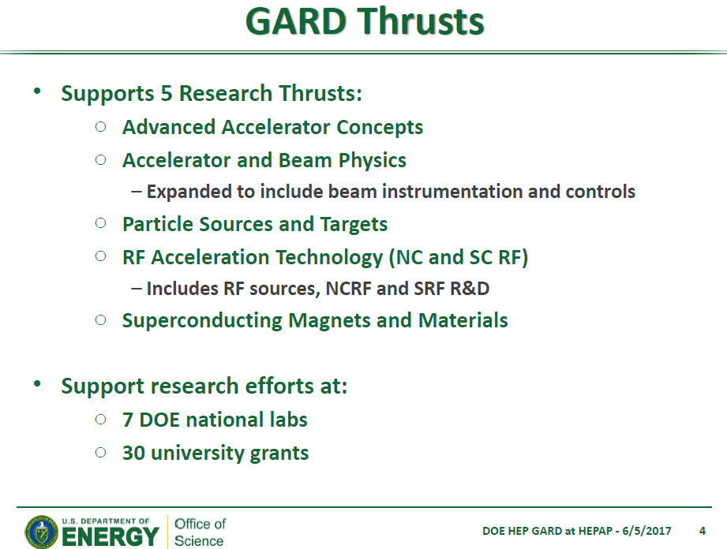
IOTA
The ABP thrust supports research efforts at 4 DOE national labs (SLAC, LBNL, Fermilab, ANL)
and ~10 university grants

Slide 6
Accelerator and Beam Physics Grand Challenges
Grand challenge #1 (beam intensity): How do we increase beam intensities by orders of magnitude?
Grand challenge #2 (beam quality): How do we increase beam phase-space density by orders of magnitude, towards quantum degeneracy limit?
Grand challenge #3 (beam control): How do we measure and control the beam distribution down to the level of individual particles?
Grand Challenge #4 (beam prediction): How do we develop predictive “virtual particle accelerators”?

Slide 7
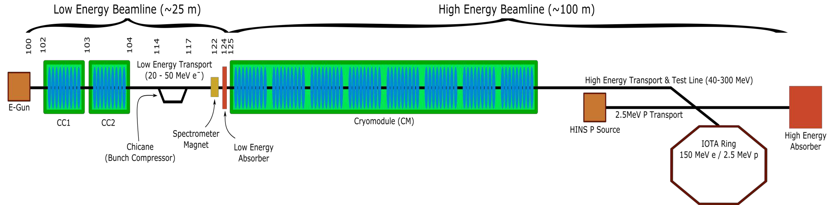
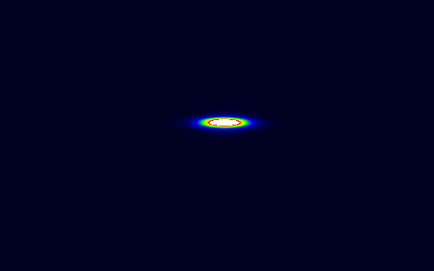

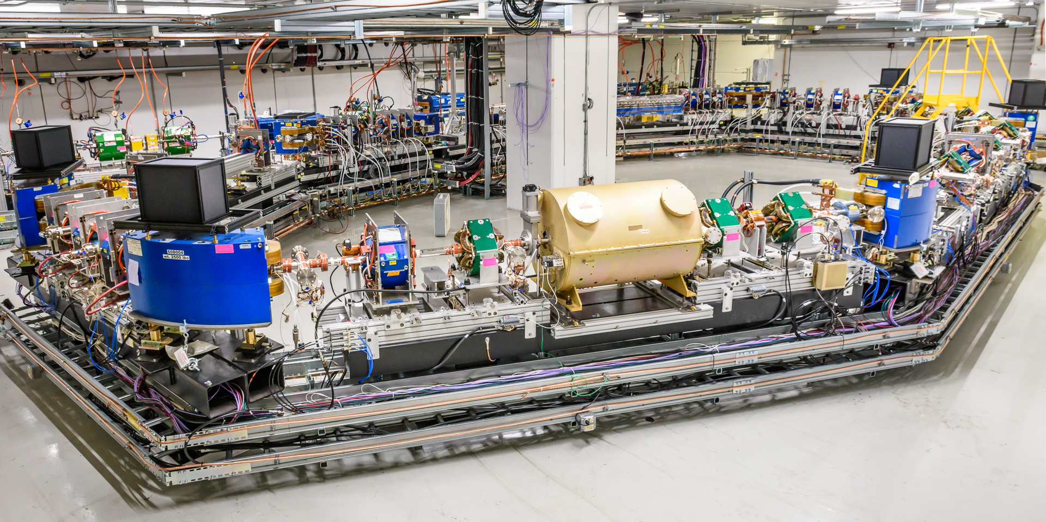
IOTA/FAST Facility: a center for Acc. and Beam Physics
IOTA/FAST establishes a capability at FNAL, unique in the world, to address frontier topics in Accelerator and Beam Physics
The only dedicated facility for intensity-frontier accelerator R&D; ranked as top facility (“Tier 1”) for acc. & beam physics thrust by recent GARD review
~30 Collaborating institutions
Nat. Lab Partnerships: ANL, BNL, LANL, LBNL, ORNL, SLAC, TJNAF
Many opportunities for R&D with cross-office benefit in DOE/SC
Sync. Rad in IOTA
Single electron in IOTA
Notes:
Read colored lines (blue and orange). Mention that IOTA is the premier facility for targeting these high-leverage areas.
It has been completed and commissioned and its primary science program has begun; added a slide in extras with more details if needed.

Slide 8
FAST
FAST – Fermilab Accelerator Science and Technology facility
  Electron linac and experimental area
  Proton injector
  IOTA ring
  Future plans: heavy-ion injector for ion crystals and quantum experiments
Research at FAST and IOTA is the biggest fraction of the ABP thrust of GARD. It is also a big portion of the Test Facility Ops budget
The facility is managed and operated by the Accelerator Division (A. Valishev – lead PI)
FAST is not a DOE User Facility, but it welcomes many collaborators to conduct experiments at the electron linac and IOTA.

Slide 9
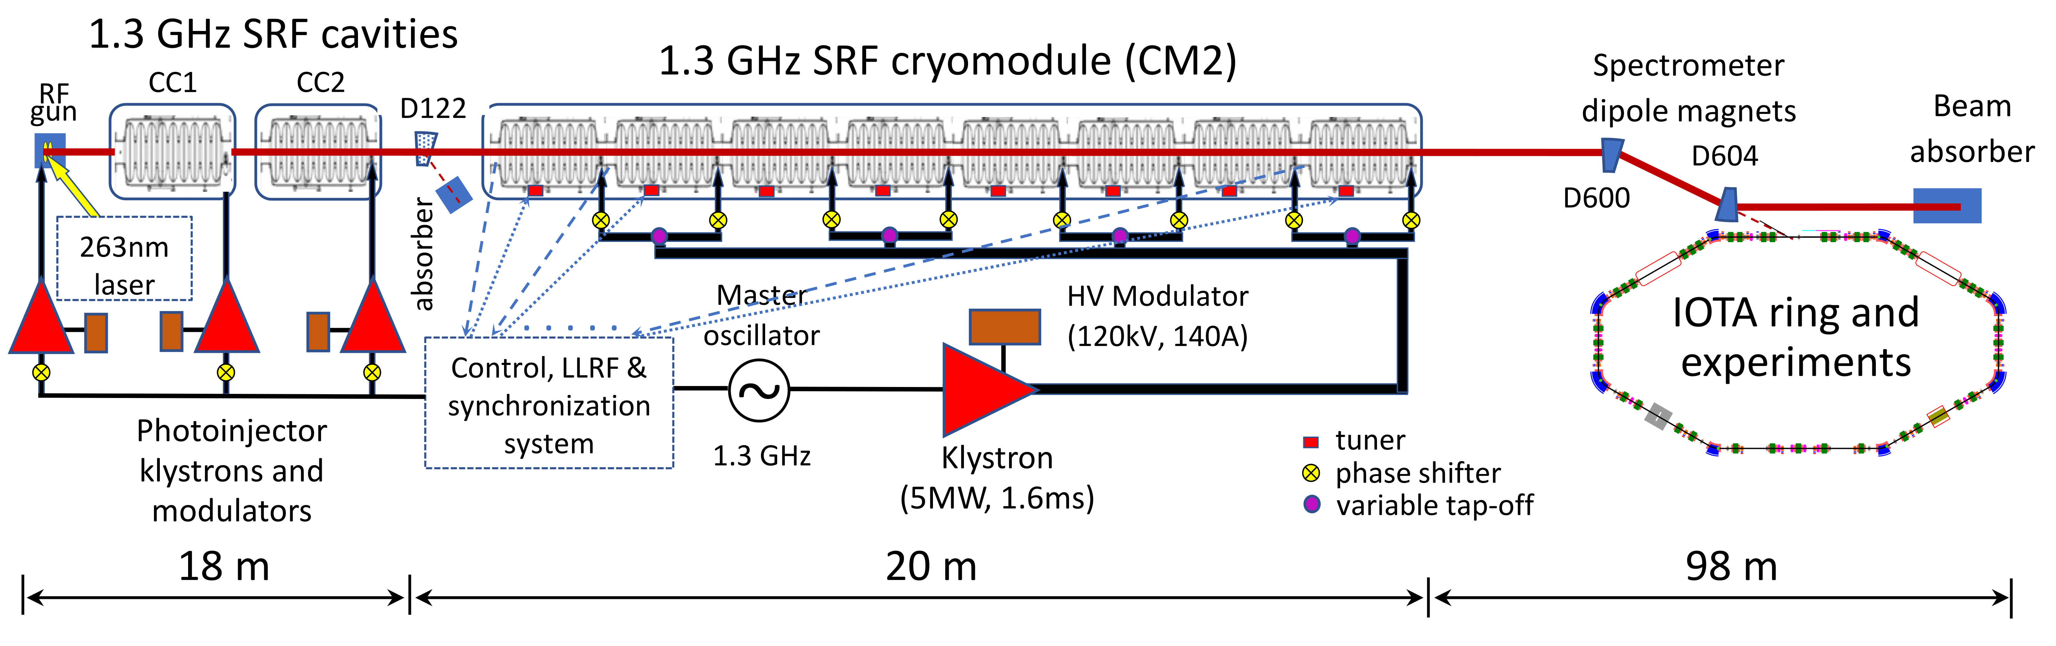
IOTA/FAST Accelerators
Electron beams are supplied to IOTA from FAST, 1.3 GHz Superconducting RF electron linear accelerator
  Beam energy to IOTA: 40-200 MeV
  Bunch charge: 1e- to 3 nC (160 pC nominal)
  Injection frequency: up to 5 Hz
  Max pulse duration: up to 1 ms (3000 bunches), ILC-like

Slide 10
Our focus: challenges of high-power and high-brightness beams
Uncontrolled beam losses
  Keep beam losses at < 1 W/m
    Fermilab Booster is presently running at the limit of losses (~400 W)
  Space-charge effects cause beam halo!
Beam instabilities (loss of entire beam, emittance degradation)
  Common resistive-wall instabilities can be mitigated by external dampers
    Dampers are already used to mitigate instabilities
  As beam space-charge increases, there are more severe types of instabilities appear, e.g. an “electron cloud” instability (observed in the Recycler) can be very fast and can not be damped by dampers
    This is the area of our research

Slide 11
Fermilab Accelerator and Beam Physics components (the core IOTA program)
Beam Instabilities and mitigation
  Focus: Multi-MW facilities, future colliders
  IOTA program: nonlinear optics, Landau damping, electron lenses
Space-charge and mitigation
  Focus: Multi-MW facilities
  IOTA program: Electron lenses, space-charge compensation
Beam cooling
  Future colliders
  IOTA program: OSC, EIC cooling R&D
Modeling tools and theory development in support of the above

Slide 12
Current priorities of IOTA research
In developing the priorities and schedules we balance present research capabilities, potential impact and available resources
IOTA research focused on beam intensity and brightness in proton rings mostly driven by the development of Fermilab’s high-energy neutrino program
  Prerequisite is the completion of the proton injector and IOTA commissioning with protons
  Research that can be done with present capabilities
High-impact science aligned with GARD mission
Collaboration-driven research seeding potentially high-impact directions

Slide 13
I. Research Focused on Beam Intensity in Rings
Key components of this research topic are
Suppression of coherent instabilities via Landau damping
  Can be studied with both electrons and protons
  Possible technologies
    Nonlinear Integrable Optics
    Electron Lenses
Mitigation of space-charge effects
  Requires proton beam in IOTA
  Possible technologies
    Nonlinear Integrable Optics
    Electron Lenses
    Electron columns

Slide 14
II. High-Impact GARD Research
Nonlinear Integrable Optics
  Can be studied with electrons
  Several options for implementation: octupole lenses, elliptic-potential magnet, electron lenses
Optical Stochastic Cooling
  Can do now with electrons
Development of novel beam instrumentation
  Large dynamic range halo monitoring
SRF acceleration: beam intensity and brightness
  Achievement of ILC beam acceleration and beam parameters

Slide 15
III. Collaboration-Driven Research & Development
Radiation generation
Electron-Ion Collider R&D
Collaboration with other beam facilities and projects
  FACET-II and other accelerator test facilities
  LCLS-II
  PIP-II
Quantum science
Education and training

Slide 16
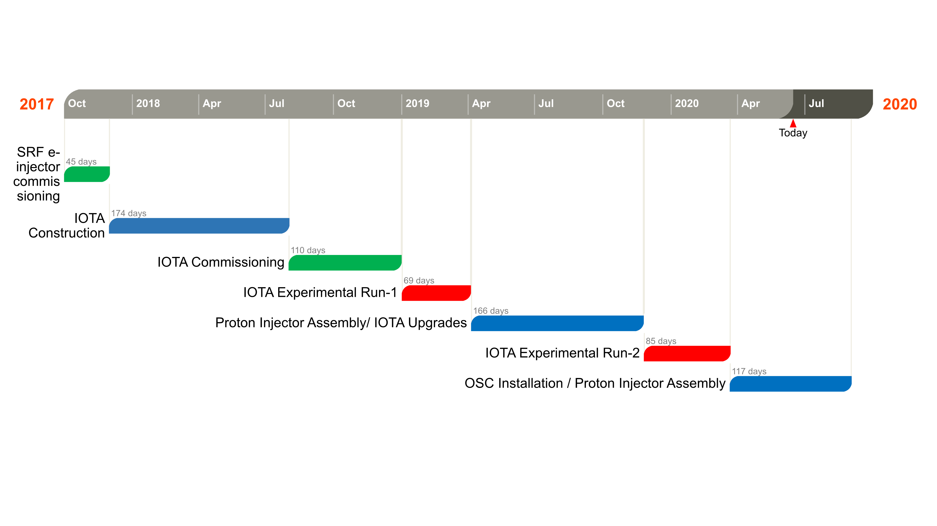
IOTA timeline
Balance priorities and resources
Interleave facility development with experimental runs
Staged approach to research

Slide 17
Research Staging
Nonlinear Integrable Optics
Phase I – research concentrates on the academic aspect of single-particle motion stability using electron beams
  Run-1 2019, Run-2 2020
Phase II – intense-beam studies with protons
  2021 and beyond
Optical Stochastic Cooling
Without optical amplifier
  Run-3 2020 fall
With optical amplifier
  2022 and beyond

Slide 18
Research in IOTA/FAST Experimental Run 2
Broad program: in all 9 experiments took data over 60 shifts and produced relevant results. Engagement of outside collaborators (CERN, SLAC, Jlab, Uchicago, NIU) and 6 graduate students.
1. Nonlinear Optics Measurements and Correction in the IOTA Ring | PI M.Hofer (R.Tomas), CERN
2. Study of Intrabeam Scattering | V.Lebedev, FNAL
3. Nonlinear Integrable Optics in Run 2 | A.Valishev, FNAL
4. Angular Measurement of Photons from Undulator Radiation in IOTA’s Single Electron Mode | E.Angelico (H. Frisch/S. Nagaisev), UChicago
5. Measurement of Spontaneous Undulator Radiation Statistics Generated by a Single Electron | S.Nagaitsev, I. Lobach, FNAL/UChicago
6. Fluctuations in undulator radiation | I.Lobach (S. Nagaitsev/G. Stancari), UChicago
7. Instability thresholds and integrable optics | N.Eddy, FNAL
8. Investigations of Long-range and Short-range Wakefield Effects on Beam Dynamics in TESLA-type Superconducting Cavities | A.Lumpkin, FNAL
9. Generation, Transport and Diagnostics of High-charge Magnetized Beams | P.Piot, NIU/ANL

Slide 19
IOTA science program highlights

Slide 20
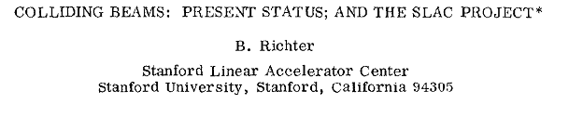
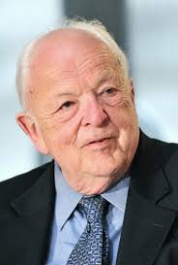
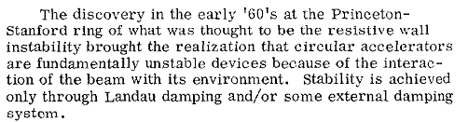
How does one stabilize the beam?
Landau damping – the beam’s “immune system”. It is related to the spread of betatron oscillation frequencies. The larger the spread, the more stable the beam is against collective instabilities.
  The spread can be achieved by adding special magnets
External damping (feed-back) system – presently the most commonly used mechanism to keep the beam stable.

Slide 21
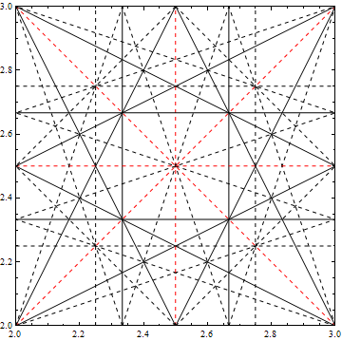
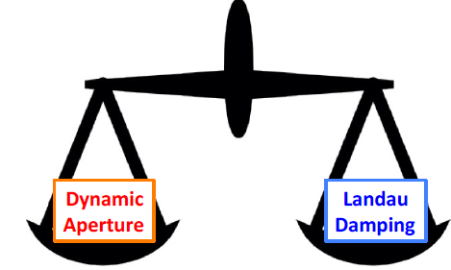
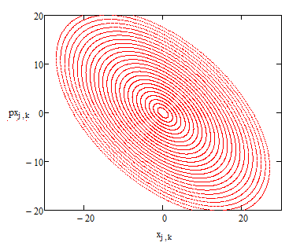
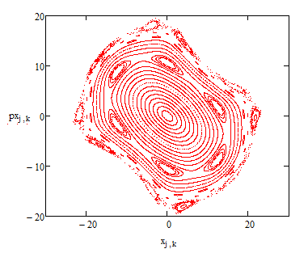
Octupoles introduce tune spread
  Figure of merit is the max betatron “tune spread”: the spread in oscillation freq. for beam particles with beam loss

Slide 22
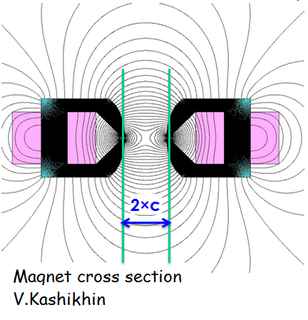
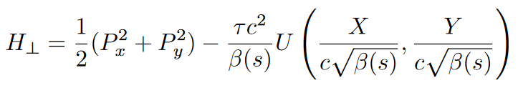
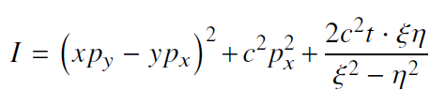


Are there “magic” nonlinearities with zero resonance strength?
Yes, we call them “integrable”
Chaotic motion
Integrable motion
Nonlinear beam dynamics:
A new concept for nonlinear
focusing in rings
Two integrals of motion :
$$×$$
We found several examples suitable for accelerators

Slide 23
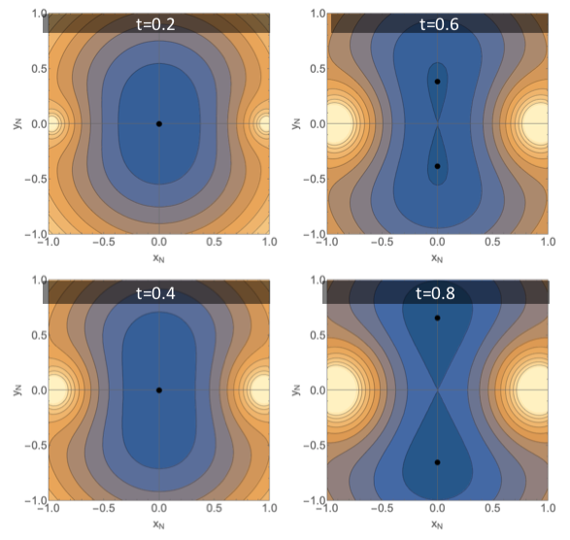
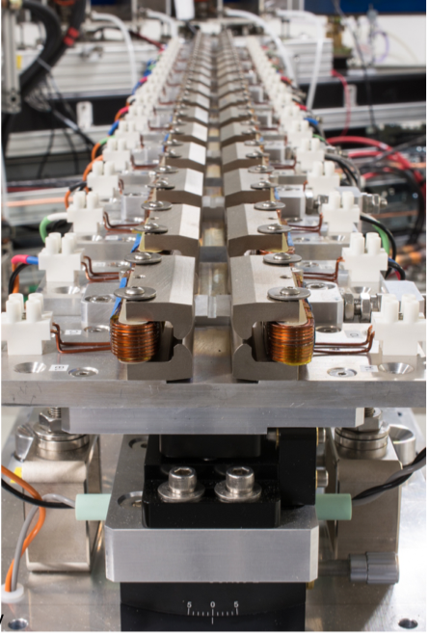
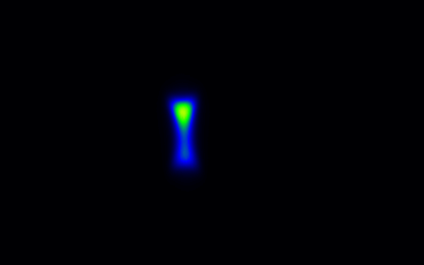
Run 2: experiments with special nonlinear magnet
Real-time video of IOTA beam
On an integer resonance

Slide 24
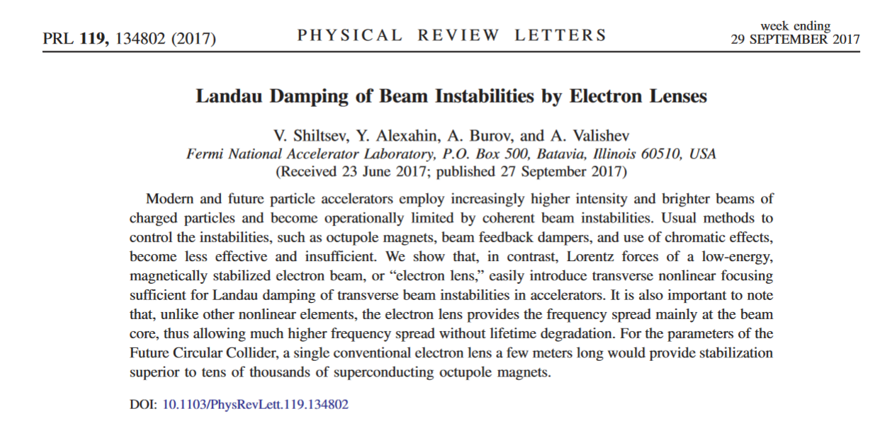
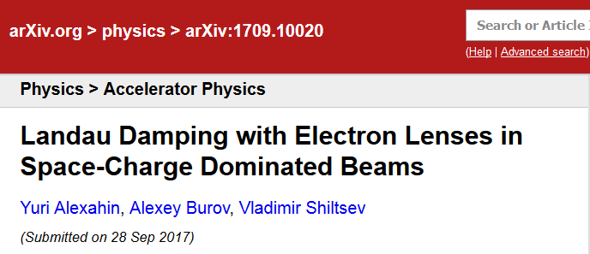
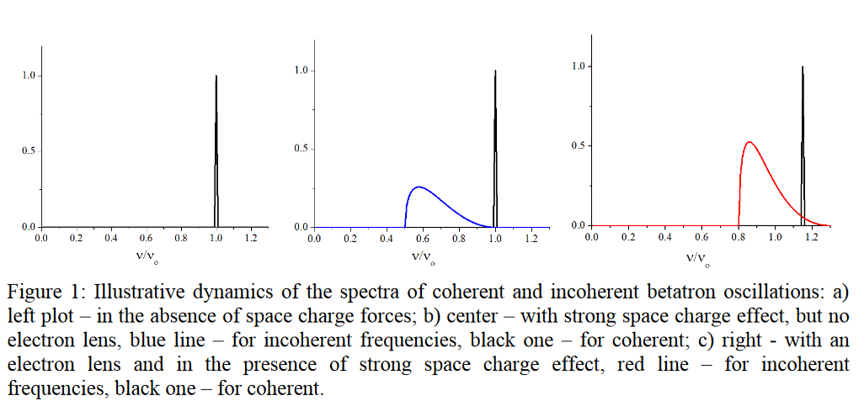
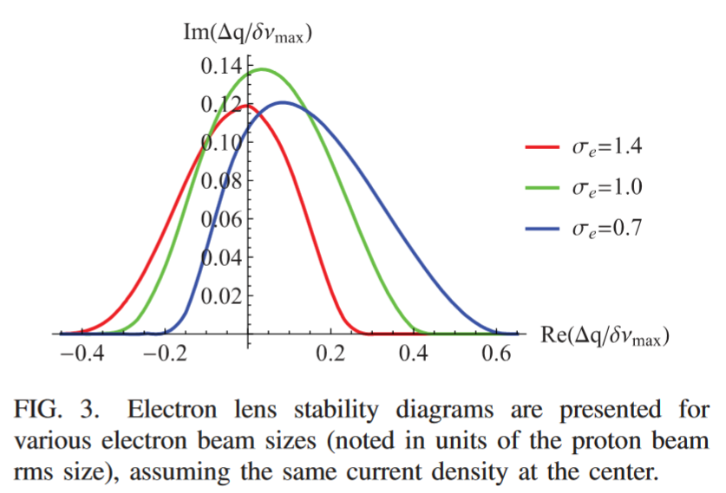
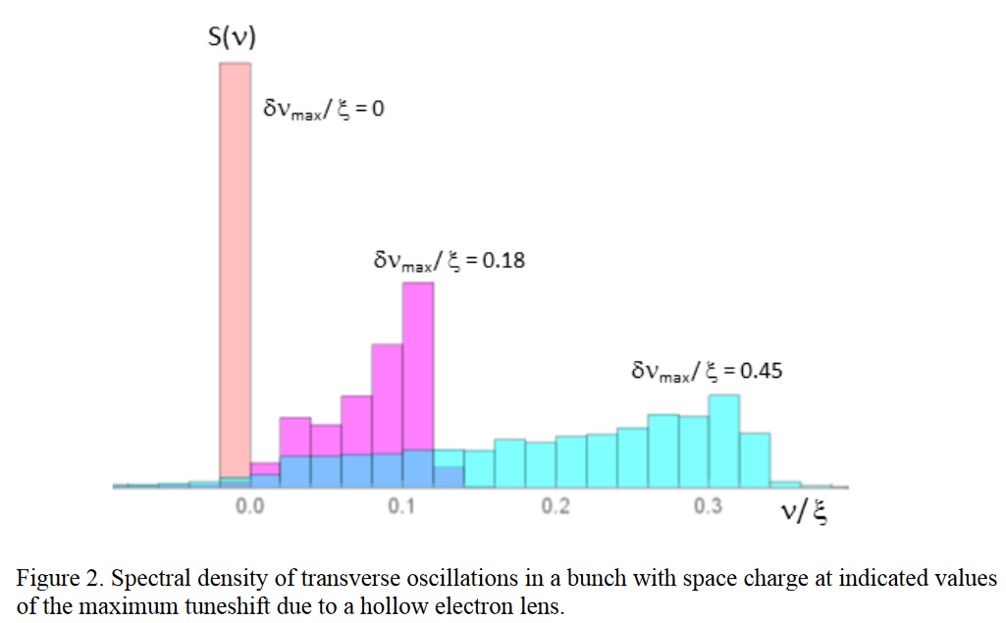
Landau Damping with Electron lenses
A.Burov, Y. Alexahin, V.Shiltsev, A.Valishev
“…For the parameters of the Future Circular Collider, a single conventional electron lens a few meters long would provide stabilization superior to tens of thousands of superconducting octupole magnets.”

Slide 25
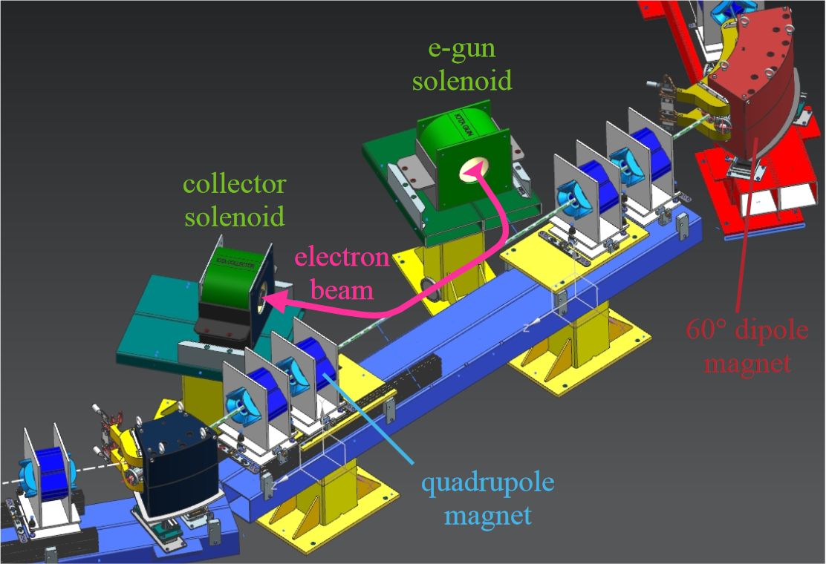
Electron lens experiment in IOTA (concept)

Slide 26
Beam-cooling
Fermilab is a world-recognized leader in beam cooling:
  Both stochastic and electron cooling systems in the past
  World’s highest energy electron cooler in operation, 2005-2011
  IOTA: optical stochastic cooling experiments
Two EIC R&D projects (FY18-19),
supported by DOE/NP
PRL 96, 044801, 2006

Slide 27
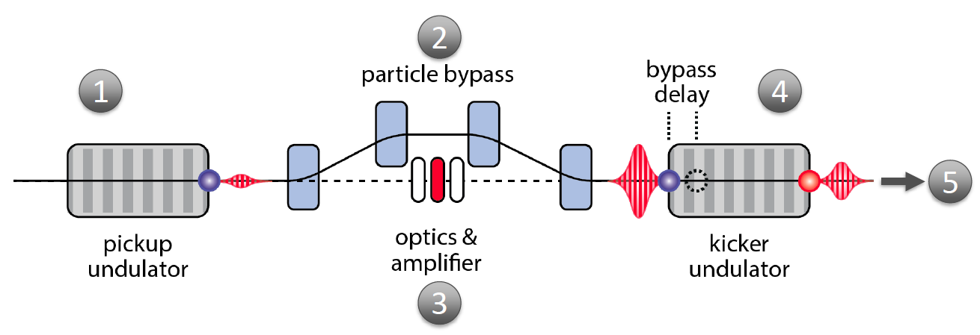
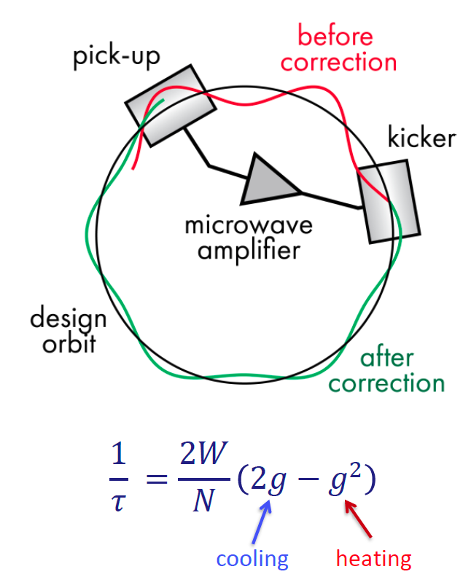
Optical Stochastic Cooling from ~10 cm to 1 um wavelength
Simon van der Meer,
1984 Nobel Prize
Each particle generates EM wavepacket in pickup undulator
Particle’s coordinates are “encoded” by transit through a bypass
EM wavepacket is amplified (or not) and focused into kicker undularor
Induced delay relative to wavepacket results in corrective kick
Coherent contribution (cooling) accumulates over many turns
OSC promises a new cooling scheme of relevance to high-energy, high brightness proton storage rings and colliders
The IOTA ring is designed to accommodate an OSC insert and a proof-of-principle experiment with electrons

Slide 28
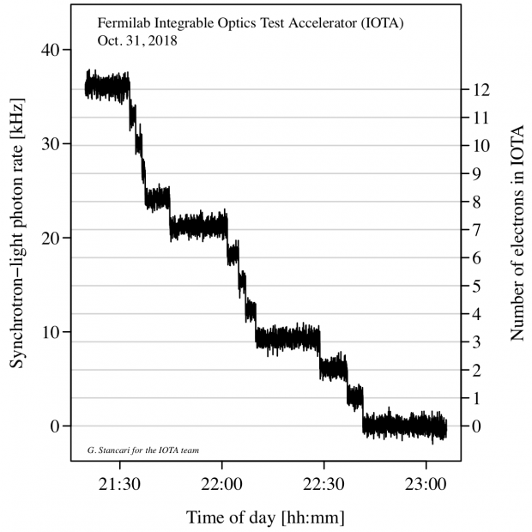
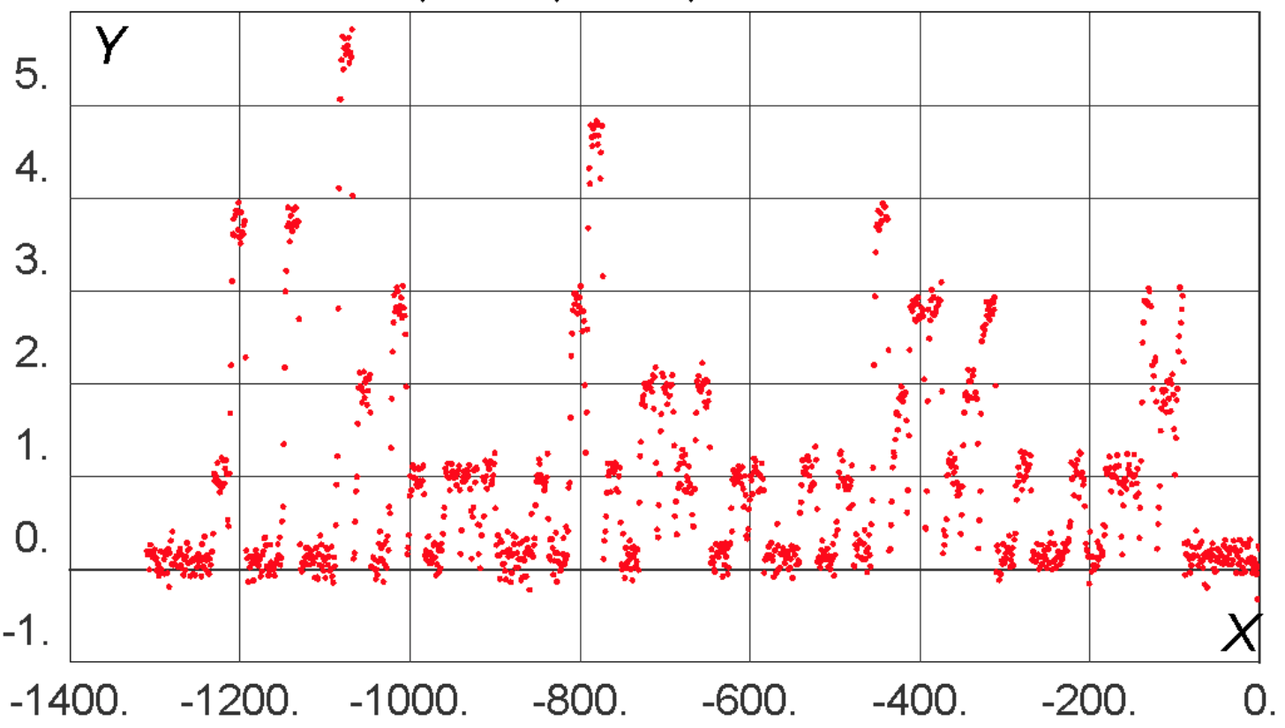
IOTA presents unique opportunities in QS
IOTA demonstrated storage of a single relativistic electron for long periods of time (~30 minutes).
High particle energy (100 MeV) enables observation of SR emission
This opens the way to a wide variety of quantum experiments
Recent Workshop on Single-Electron experiments in IOTA – 30 participants from U.Chicago, LANL, SLAC, ANL, Princeton, RadiaBeam, BNL, UC Berkeley, Fermilab
single e- beam
injection every 20 s
Time (s)

Slide 29
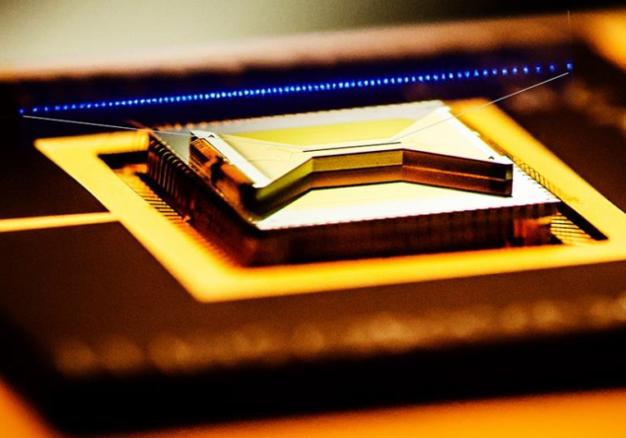
Exploring the scalability of ion QC architectures
State of the art: ~Tens of ¹⁷¹Yb+ ions (qubits) in a stationary linear ion trap (https://ionq.com/)
PALLAS ring (LMU, Germany) in 2001 achieved a 1-D and 2-D Coulomb crystals in ring with Mg⁺ ions
by using Doppler laser cooling. Ion temperature was 1 mK, which is still too “hot” for QC applications.
T. Schätz, U. Schramm and D. Habs, “Crystalline Ion Beams”, 2001 Nature 412 717.
We propose to use unique IOTA infrastructure and our expertise in beams and storage rings to create a 1-D crystal of ~one-million ions (~10 m with 10-μm separation) as a pathfinder for scalability in ion QC
Aim to develop the full suite of capabilities and techniques to create these crystals, achieve ion temperatures of <50 μK and prepare and readout quantum states using external lasers

Slide 30
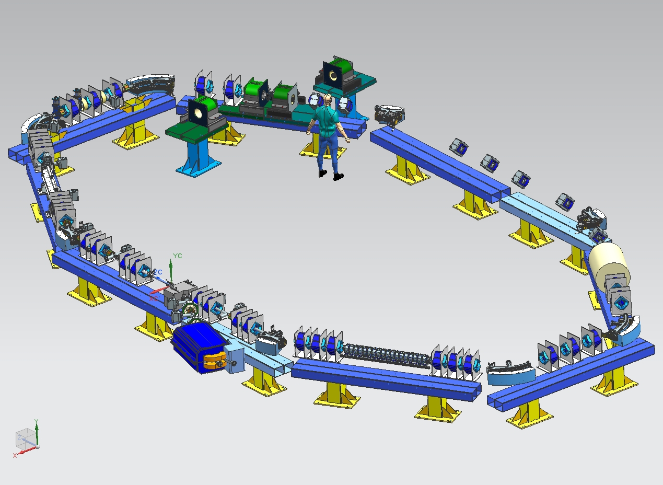
Fermilab IOTA ring (40-m circumference,
50 – 150 MeV/c momentum range)
Rev. freq.: ~6 kHz
50 keV ¹⁷¹Yb+ ions
Present status: operating with relativistic electrons (~100 MeV)
  Present (quantum-related) experiments are focused on single electron/photon experiments.
Opportunity: add a 50-keV (120-MeV/c momentum) ¹⁷¹Yb+ ion source, install counter-propagating lasers for Doppler laser cooling and extra ion diagnostics.
We envision a 5-year program to demonstrate that we could reliably manipulate quantum information of a single ion in IOTA at the same level of state of the art ion traps

Slide 31
DOE Early Career Awards (related to IOTA)
2016: Chad Mitchell (LBNL) -- IOTA
2020: Rob Ainsworth (Fermilab) – IOTA/Recycler
2020: Jonathan Jarvis (Fermilab) – IOTA
2020: Brendan O’Shea (SLAC) – FACET-II/IOTA

Slide 32
Summary: Accelerator science at FAST
Fermilab is mostly interested in the IOTA-based science
  IOTA is capable of circulating both protons and electrons
    Heavy ions in the future
  Research focused on high-intensity proton rings: space-charge effects, instability mitigation, beam loss control, beam cooling, QS
However, there are excellent science opportunities with the FAST electron linac:
  ML/AI
  Radiation generation
  High average current experiments with many bunches
  Complementary to FACET-II and AWA
  Suitable for LCLS-II commissioning studies, MARIE and EIC R&D

