Slide 1
IOTA run 2 NIO implementation and first results
Nikita Kuklev and IOTA NL team
IOTA collaboration meeting
June 15, 2020

Slide 2
Outline
Previous results and run 2 goals
Run 2 configuration
Run 2 commissioning
Data collection
Simulations
Analysis

Slide 3
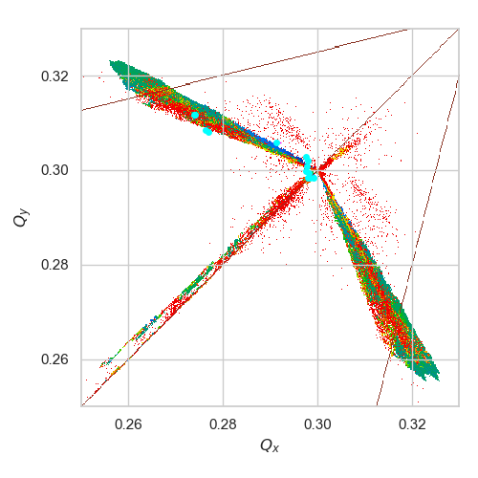
Run 1 – partial success
Reminder: QI =
In run 1, measured significant tune spread, ~0.6x of simulated performance
Did not get invariants to sufficient accuracy
Limitations:
Insufficient BPM resolution
Bent pipe aperture restriction
Only V-kicker control
Run 1 FMA

Slide 4
Run 2 plans
Improve and fix HW/SW
3 experimental phases
Stage 1
Commission, measure nominal configuration
Demonstrate predicted performance
Stage 2
Perturbed systems (tune/dispersion/field errors/etc.)
Demonstrate resiliency to errors
Stage 3
Different working points, close to resonances, etc.
Explore exotic conditions
Uses same base, nominal lattice
Needs new lattice design/tuning

Slide 5
Outline
Previous results and run 2 goals
Run 2 configuration
Run 2 commissioning
Data collection
Simulations
Analysis

Slide 6
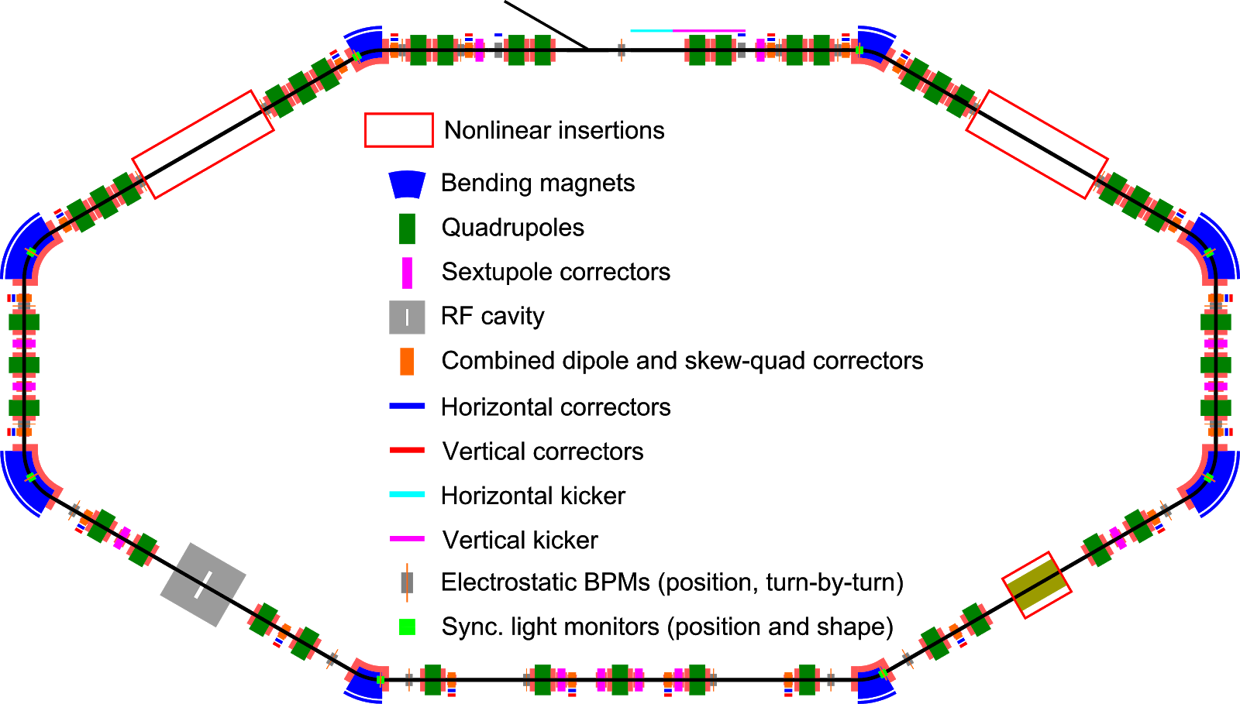
Main upgrades
Added flux compensators to change dipole edge field
Improved path length discrepancy
Added 4 sextupoles (2 families)
Added tunable H-kicker
BPM hardware improvements
SW/timing improvements

Slide 7
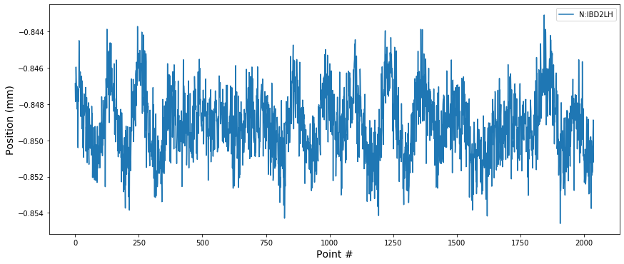
Remaining issues
Significant optics breathing
Operational issues – drifts, trips, etc. (minor)

Slide 8
Remaining issues
Significant optics breathing
Operational issues – drifts, trips, etc. (minor)

Slide 9
Outline
Previous results and run 2 goals
Run 2 configuration
Run 2 commissioning
Data collection
Simulations
Analysis

Slide 10
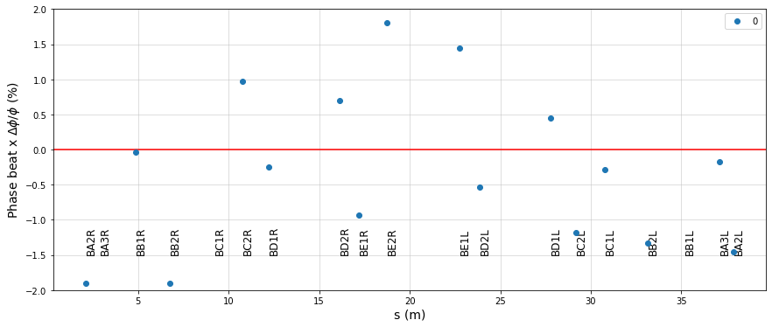
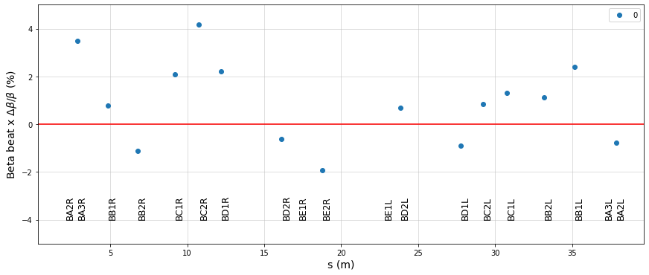
Commissioning
4 main categories:
Lattice
Knobs/kickers/etc.
BPMs
Insert
Lattice: LOCO provided best precision
β within a few %, but drift + hysteresis problematic
Verified with TBT data from each sequence
Kickers: analyzed repeated triggers
Jitter - <5% rms
Linearity within 5-8%

Slide 11
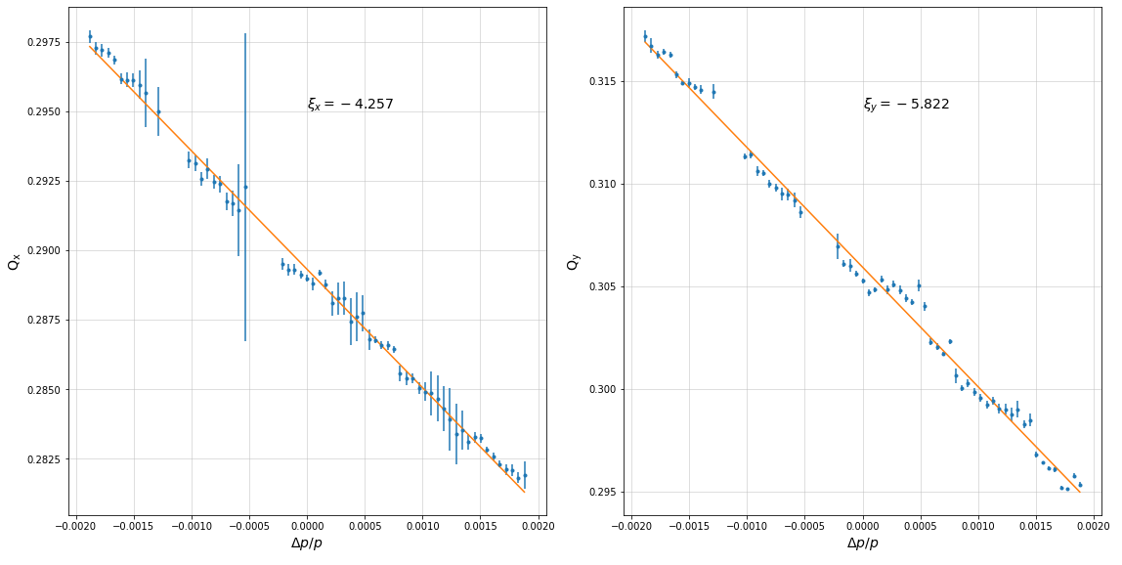
Commissioning
Lattice: Unknown reduction in x chromaticity
Suspect due to dipole effects
Means sextupole strength required for (x,y)=(0,0) < model
Too low
Good

Slide 12
Commissioning – BPMs
Orbit linearity and noise:
<1% linear within 4 mm of center
~1um @ 0.3mA
TBT noise:
100um @ 0.8mA
Meets specs!
Overall, improved significantly from run 1
A few issues remained:
Dynamic saturation
Timing/ADC desync
Errors/timeouts
Kick amplitude vs current
Position rms vs current (and RF=bunch length)

Slide 13
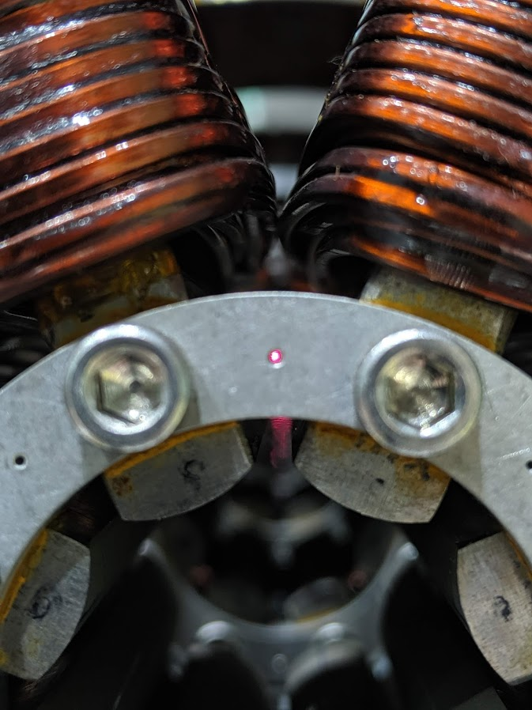
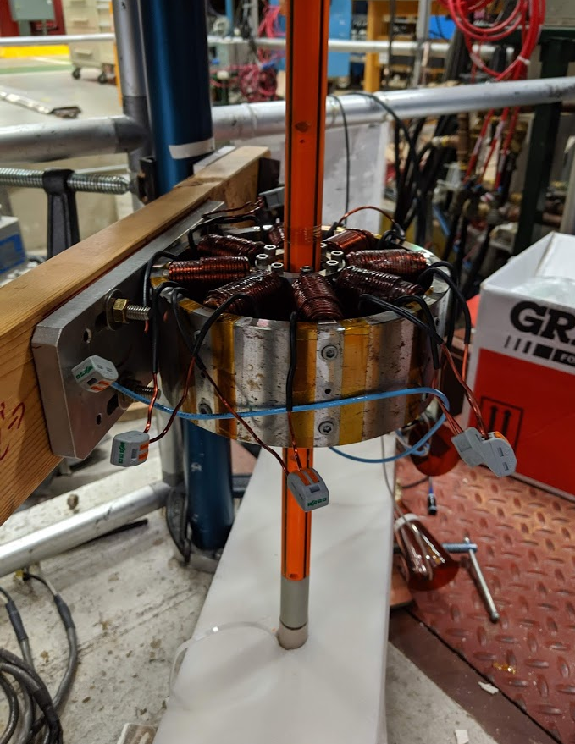
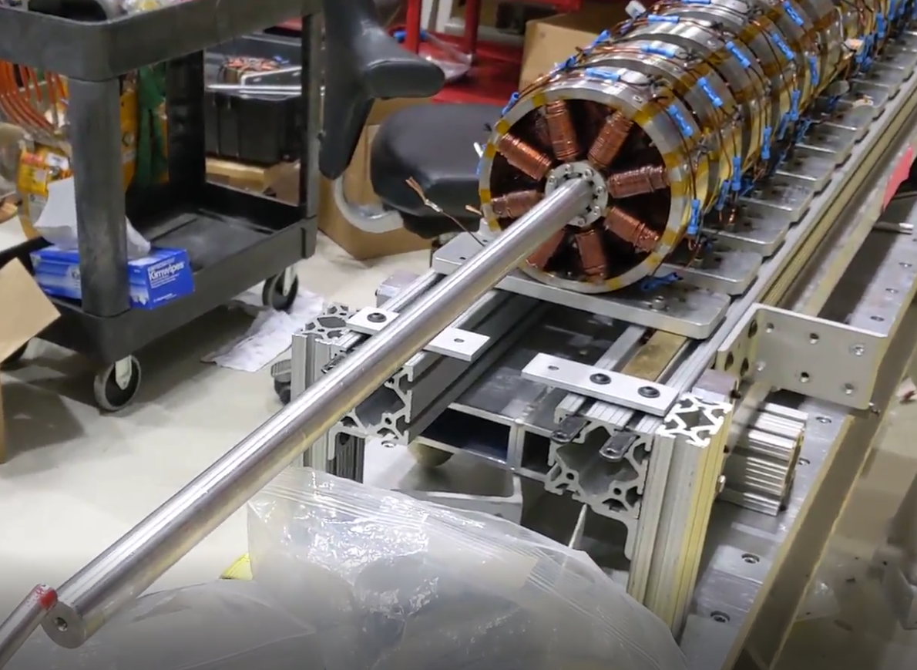
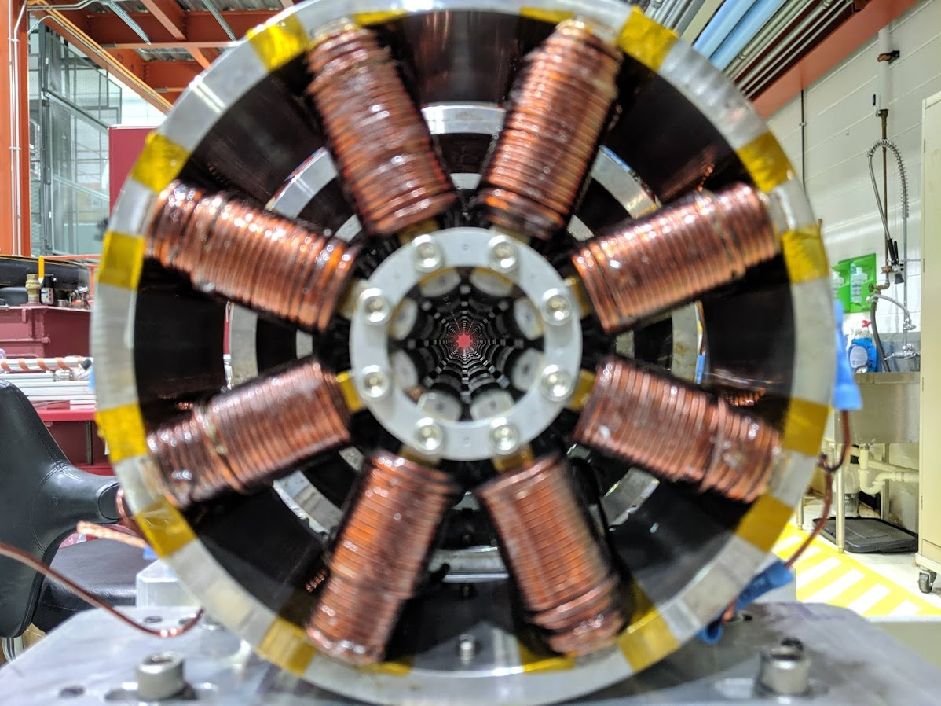
Commissioning – QI
Insert was taken apart and each magnet tested at TD (rotating coil)
Rebuilt with best ones in the middle
Alignment done with precision mechanical rod and laser
Both indicated < 150um mechanical
Testing @ TD VTS
Precision soviet stick alignment
Final assembly

Slide 14
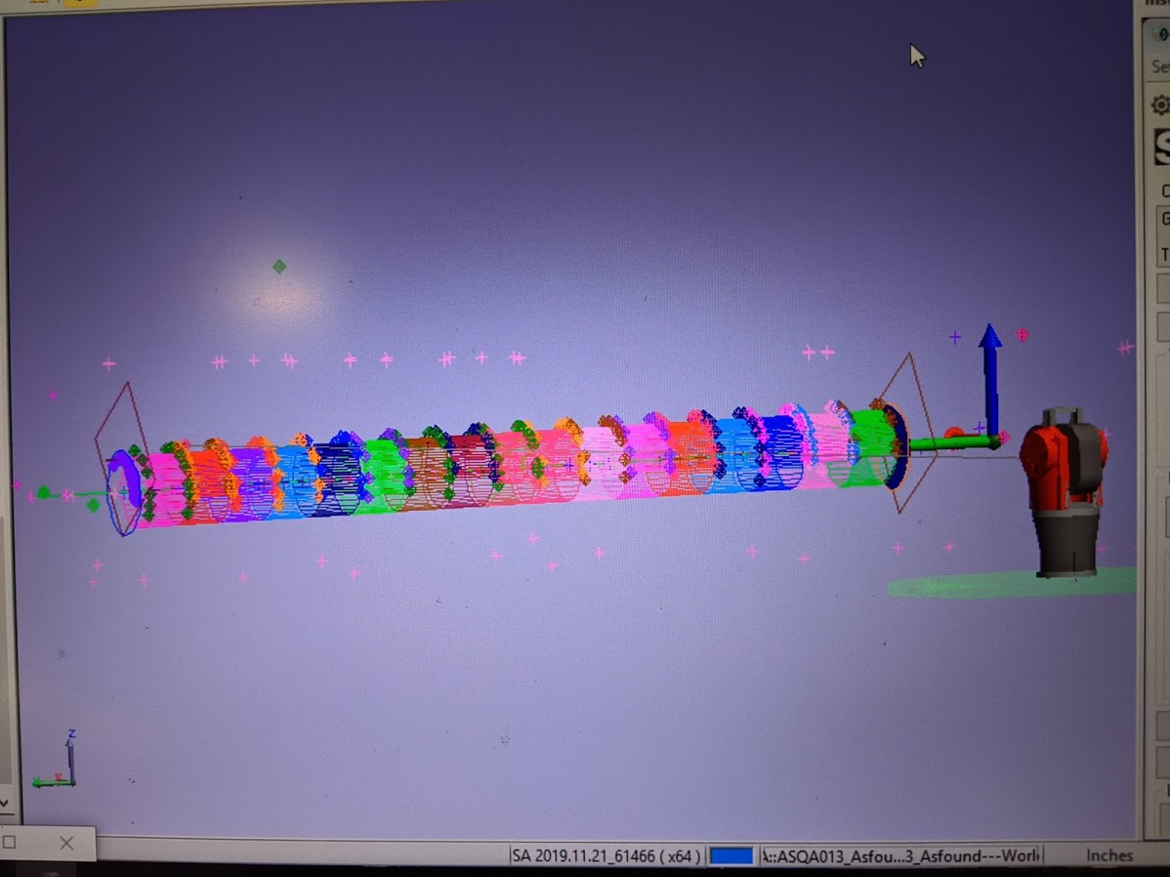
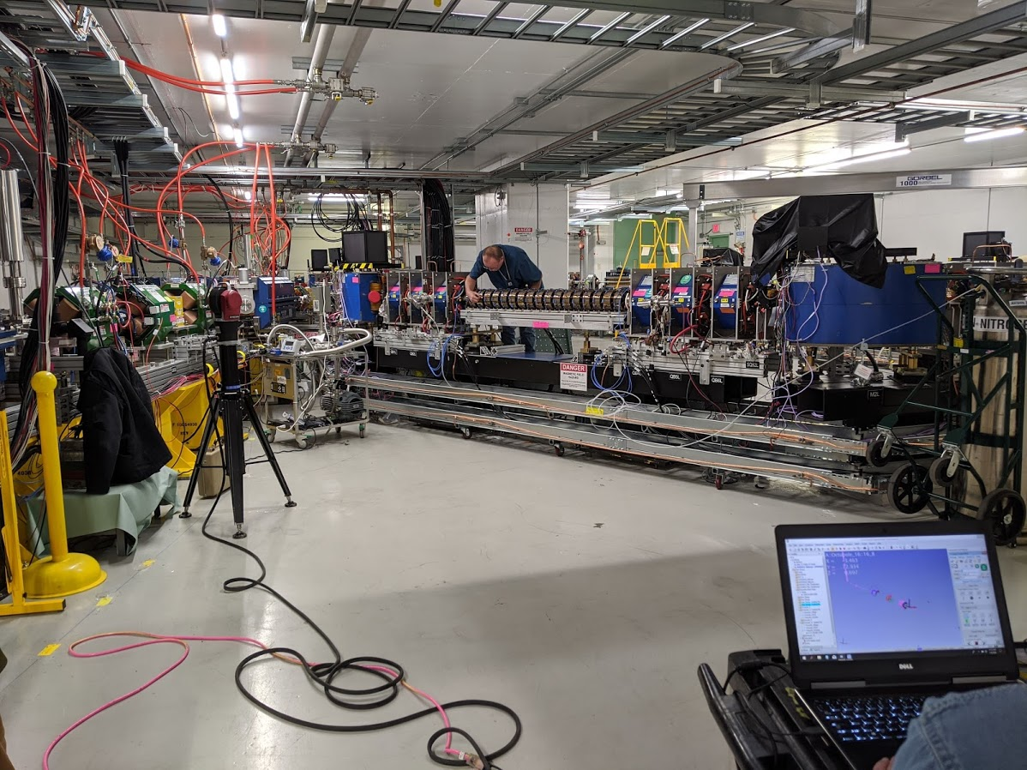
Commissioning – QI
Laser tracker aligned into the ring
Measured tracker model
Manual edge checks

Slide 15
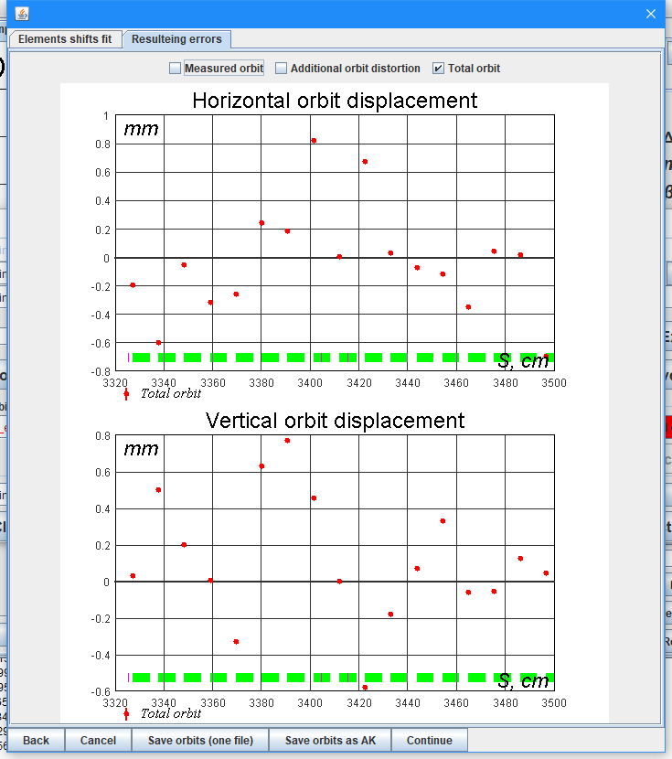
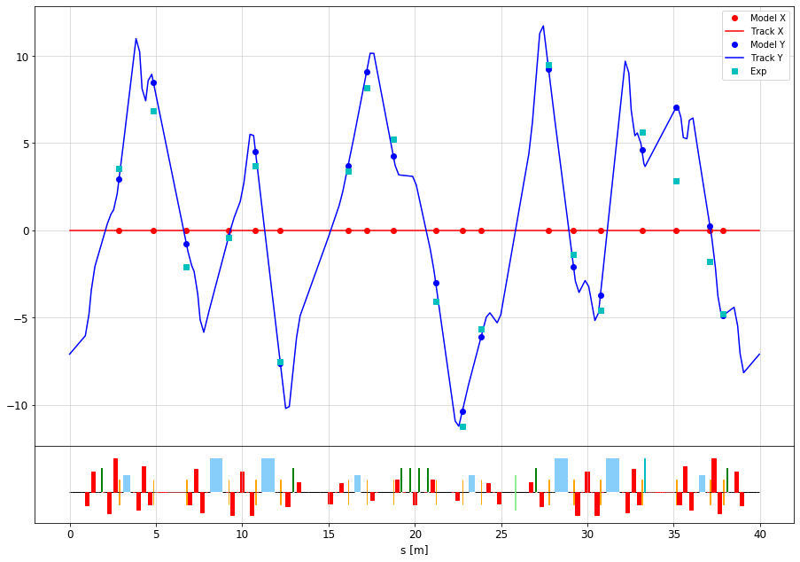
Commissioning – QI
Alignment tested with close orbit responses
Found very large displacements in some magnets
Some not physical (almost 1 mm)!
Closed orbit distortion model/measurement
Magnet offsets (A. Romanov)

Slide 16
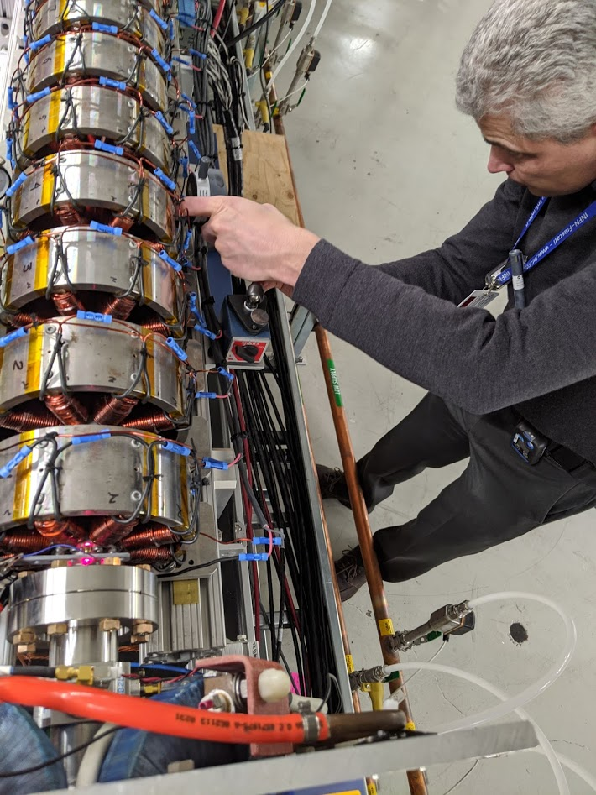
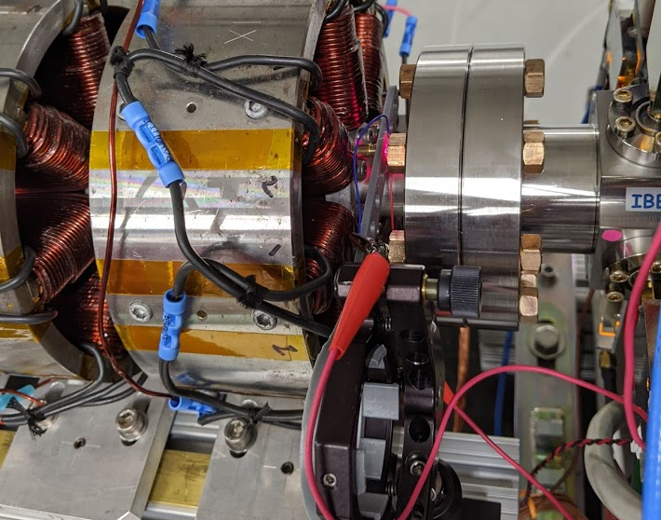
Commissioning – QI
Tried to slide around, demagnetize, test inductance
Realigned in place with laser and left as is
Root cause still unclear
Laser inserted using 3d-printed holder
Sanity checking/moving with indicators

Slide 17
Commissioning summary
Goal for run 2: achieve beam parameters, machine tuning and system performance necessary for the NIO experiments
Octupoles: 10% beta-function accuracy, ~0.01 betatron phase accuracy, 100um orbit centering
NL magnet: 1% beta-function, 0.001-0.003 betatron phase, 50um orbit centering
Variable single-turn kick, H/V
Turn-by-turn BPM system, 100um resolution

Slide 18
Outline
Previous results and run 2 goals
Run 2 configuration
Run 2 commissioning
Data collection
Simulations
Analysis

Slide 19
Data channels
Nominally, 21 BPMs – 19 useful
-1 special pickup, different size/calibration
-1 for anti-damper
Data:
8k turns, triggered at -172 from kick (‘pilot’ signal)
Ring state afterwards saved
284 channels – magnets, beam currents, etc.
Other data available via ACNET

Slide 20
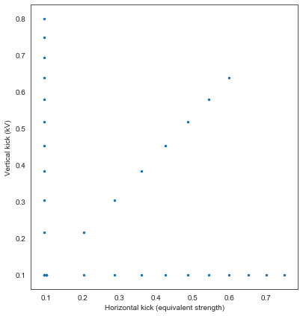
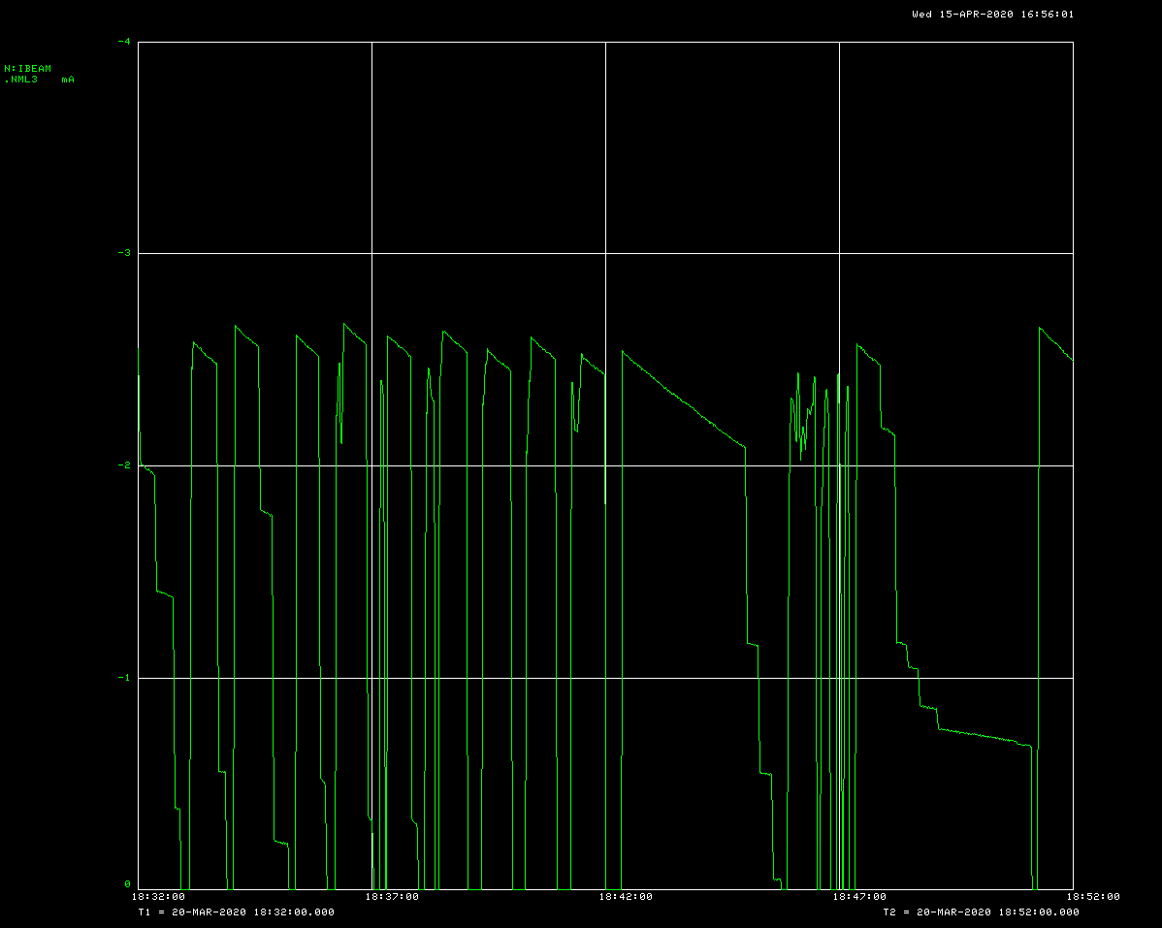
Collection
Typical sequence:
58 nonlinear kicks (2/point)
In 3 lines, slightly nonlinear spacing
~5-10 calibration kicks (insert off)
At start/end + after reinjection – used for optics recovery
Automated collection/injection
Current > 0.8mA
With pyIOTA: github.com/nikitakuklev/pyIOTA “unified modelling/control environment”
This grid was repeated for many configurations
Nominal
Tune/dispersion/etc. errors
QI/NL current errors
Inject
Lattice switch
Bad inject (retry)
Kick
Low current dump
Kick to kick period ~50s, no operator input

Slide 21
Dataset breakdown
Two main collection periods
‘doomsday’: March 15/16 + ‘actual doomsday’: March 20/21
In total:
QI: 2600 kicks / 37 configs
NL: 1100 kicks / 36 configs
~1000 on blank lattice for various calibrations
Around 1-2k other kicks for various studies (RDTs, …)
Stage 1+2 – data mostly collected
Stage 3 was not completed due to covid-19 lab shutdown

Slide 22
Outlier rejection
Observed a variety of anomalies
Example: timing/ADC desync
Solution – veto voting by filters + manual curation
Absolute value threshold
SNR/symmetry
Mean/variance outliers

Slide 23
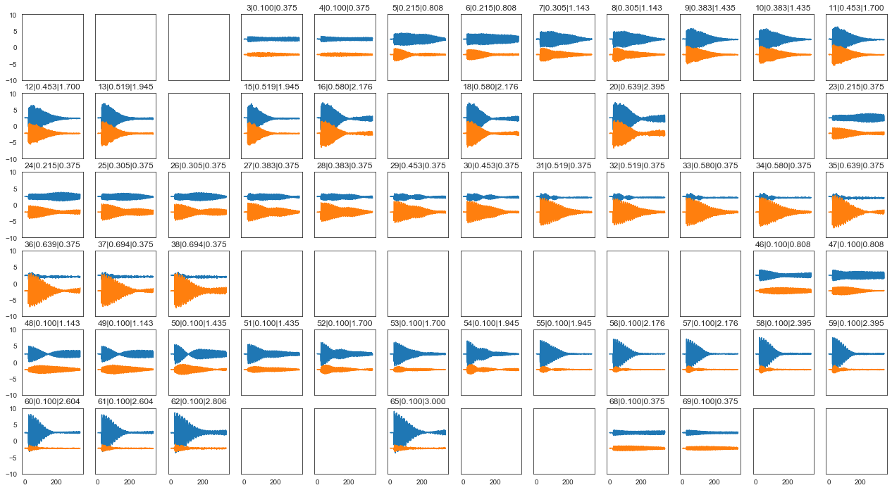
Sample dataset
Example of data remaining after cleaning

Slide 24
Sample dataset
Example of single kick data

Slide 25
Outline
Previous results and run 2 goals
Run 2 configuration
Run 2 commissioning
Data collection
Simulations
Analysis

Slide 26
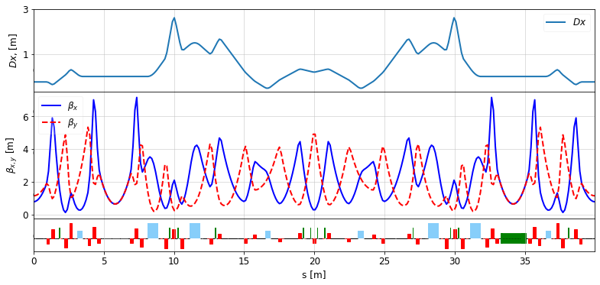
Simulations
Heavy simulations with elegant, via pyIOTA wrapper
Thick symplectic tracking - fringe fields + errors + SR
(Non)linear optics - OCELOT + MADX + custom code

Slide 27
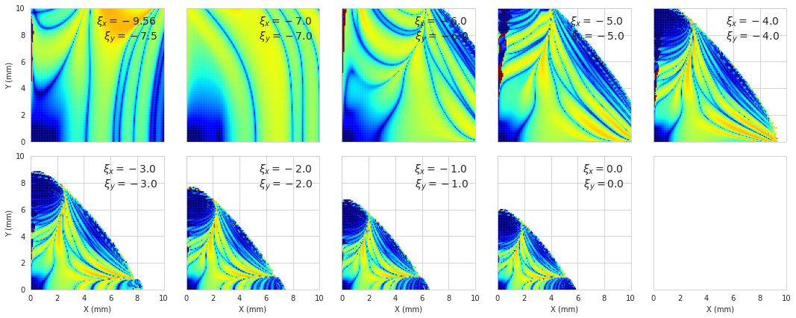
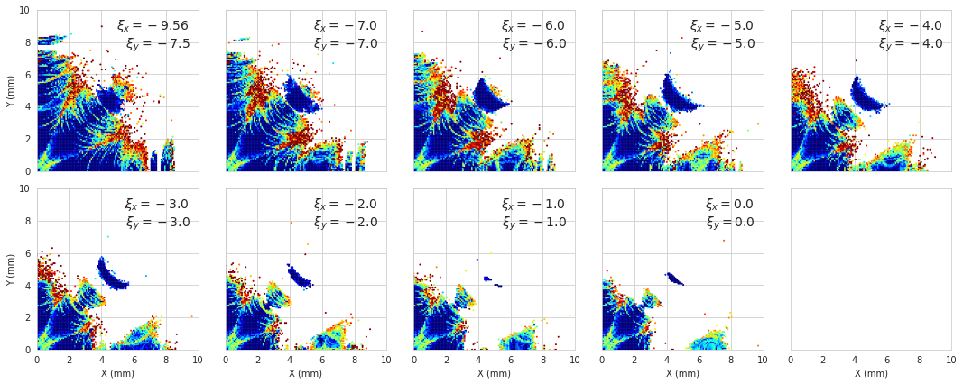
Simulation predictions
Updated simulations to latest v8.6 lattice run 2 config
Predicted strong impact of chromaticity
Need to reduce chroma to get more turns (more data)
But only have 2 families / 4 sextupoles (not properly π-phased) out of 12 possible
Nonlinearities hurt dynamics
Sextupoles only
Sextupoles + octupoles
Color scale – diffusion (how chaotic)

Slide 28
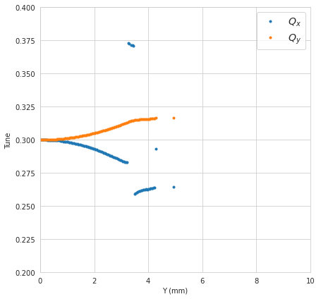
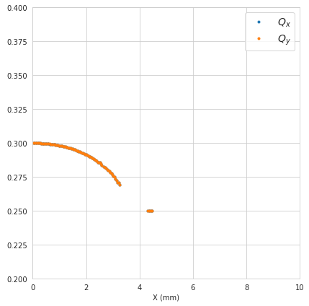
Simulation predictions
Vertical
Of interest to measure in 3 lines, 1 per sector
Observable limit
Diagonal
Horizontal

Slide 29
Outline
Previous results and run 2 goals
Run 2 configuration
Run 2 commissioning
Data collection
Simulations
Analysis

Slide 30
Analysis methods
Methods (briefly)
Preprocessing
SVD cleaning, ROI cut based on SNR
Tunes
Modified adaptive NAFF
Linear optics
Model-independent methods
Phase space
SVD/ICA decomposition
Envelope function – chromatic + octupolar decoherence fit with annealing/bin hopping
Parameter optimization for smallest invariant jitter

Slide 31
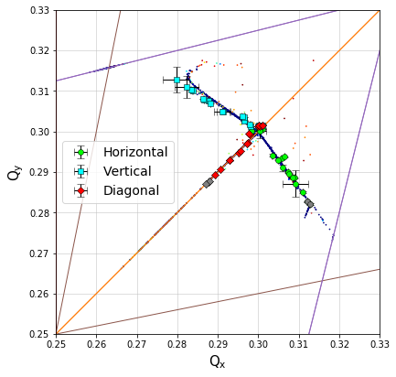
Results – stage 1
Nominal config – 1.0A QI (central octupole)
No time for aperture scans – estimate from BPM sum
Good match with FMA simulations
Similar results at 0.75A/1.25A
Note discrepancy
Ideal lattice FMA + QI data

Slide 32
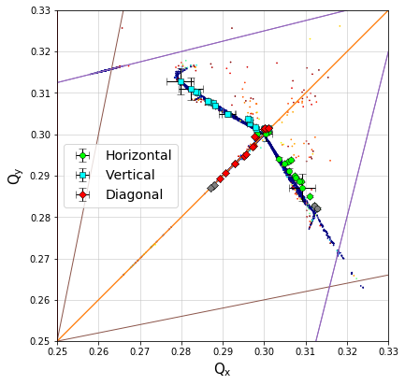
Results – stage 1
Nominal config – 1.0A QI (central octupole)
Discrepancy in H/V due to different (sextupolar) detuning – result of mystery chromaticity
ξ=0 matches H branch
ξ=-2 matches V branch

Slide 33
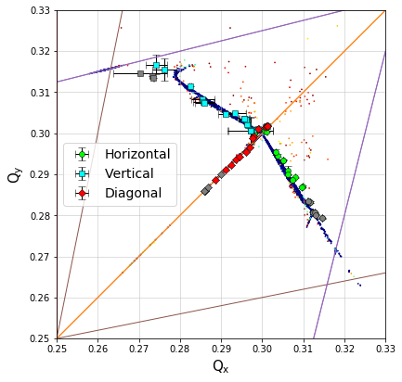
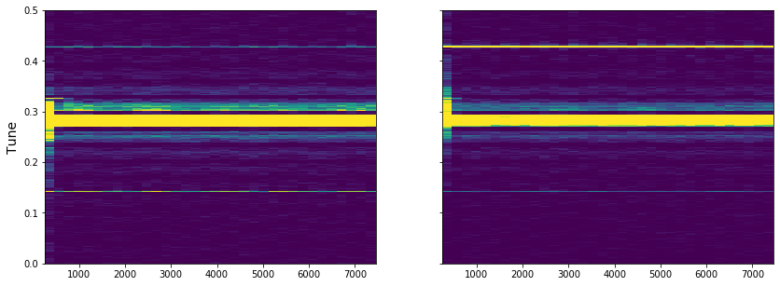
Results – stage 1
Comparison with 0.25A flat distribution (‘conventional octupole’)
Has ~ same detuning strength
But loses more beam at same amplitude
Weird resonant excitations overwhelm signal
Signal spectrogram
Ideal lattice FMA + flat data

Slide 34
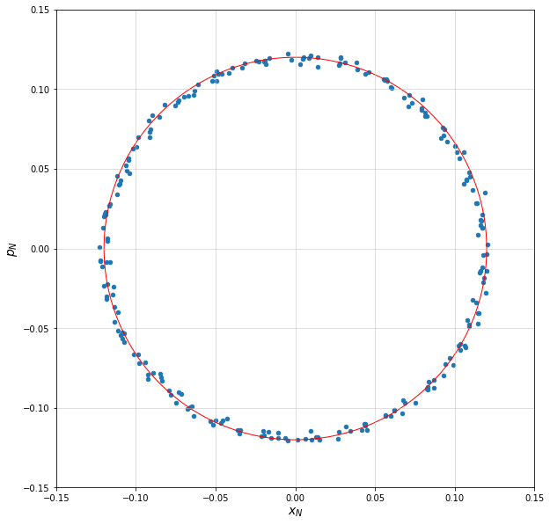
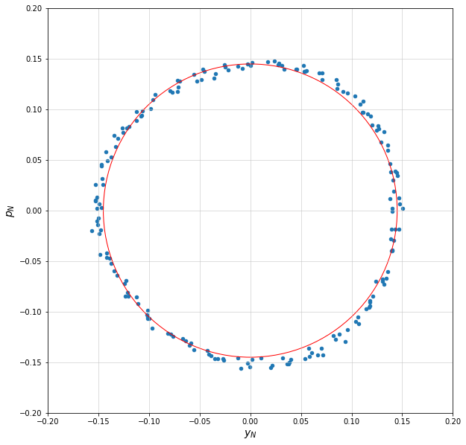
Results – stage 1
Looking at invariants
Analysis ongoing – signal zoo, a lot of manual tweaking, complicated coupling
Preliminary data using SVD modes
Can’t compare to simulations quantitatively yet (beam size matters, need good bunch estimate)
Strength parameter
CS linear part
QI
Diagonal kick data
Normalized phase space after decoherence compensation

Slide 35
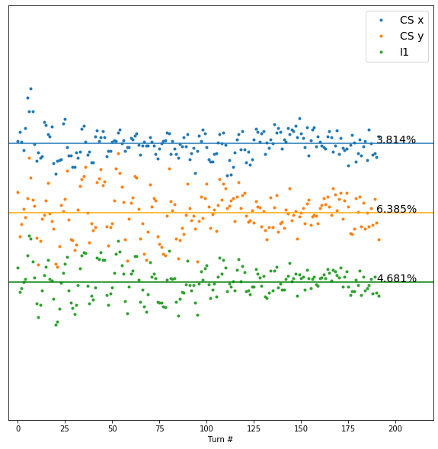
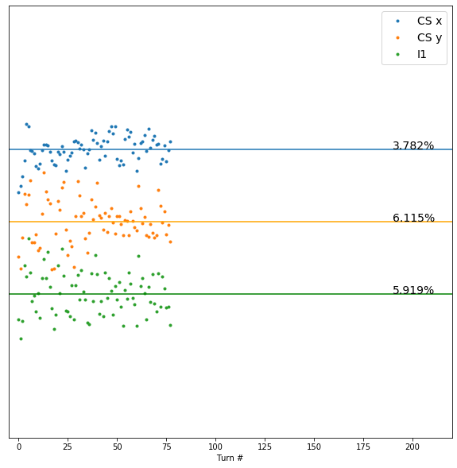
Results – stage 1
Looking at invariants
Flat configuration H-invariant jitter worse while CS invariants ~ same
Simulation work in progress to verify results and estimate sensitivity
=
=
I1
<
I1
Signal too low
1.0A nominal
0.25A flat

Slide 36
Results – stage 2
Available perturbations - a mixed bag, sparse sampling
Δν inside insert
Δν ring (outside insert)
β*
Insert currents (i.e. ν=5.31 curve)
D_{x}

Slide 37
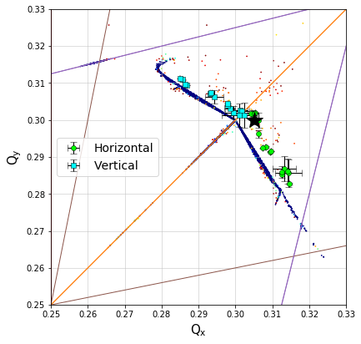
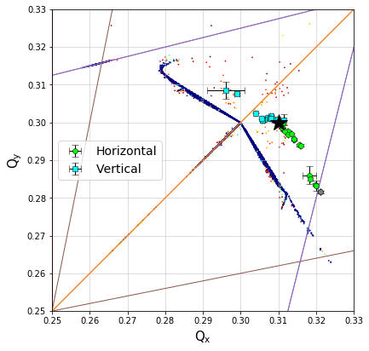
Results – stage 2
Example: tune inside insert
Small shifts – little impact
Large shifts – different behavior, DA reduction, signal anomalies – need stage 3
Qx+0.003 shift
Qx+0.01 shift

Slide 38
Conclusion
Run 2 has produced significant improvements in data quality
We demonstrated performance consistent with simulations
High tune spread
Invariant conservation
Superior performance vs flat arrangement
Stage 2 perturbation analysis ongoing
Further required work
Characterization of ring nonlinearities
Resolving misalignment mysteries
Hardware - optics fluctuations fix + full 12 sextupoles (major DA boost!)

Slide 39
Thanks! Questions?

