Slide 1
Nonlinear Integrable Dynamics and Space Charge
FAST/IOTA Collaboration Meeting
June 15-17, 2020
Chad Mitchell
Lawrence Berkeley National Laboratory

Slide 2
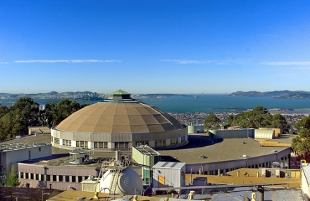
Acknowledgments and Collaborators
Thanks to the organizing committee and to the IOTA collaboration, especially:
LBNL – Kilean Hwang, Robert Ryne (contributors)
Fermilab – Alexander Valishev, Jeffrey Eldrid, Alexander Romanov,
Yuri Alexahin, Eric Stern
U. Chicago, NIU – Nikita Kuklev, Sebastian Szustkowski
Thanks also to D. Bruhwiler, S. Webb, C. Hall, Nathan Cook (RadiaSoft).

Slide 3
Outline
Introduction and Motivation
- comments on nonlinear integrable dynamics in IOTA
- observations regarding space charge and integrability
Dynamics in the IOTA Ring at High Intensity
- assumptions and numerical benchmarks
- beam filamentation and halo formation (4 mA and 8 mA)
- comparison with dynamics in a linearized lattice
Conclusions

Slide 4
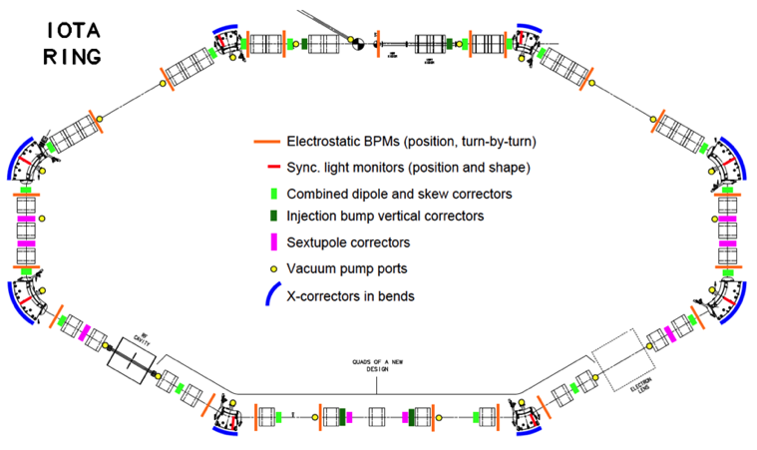
Overview of nonlinear integrable optics in IOTA
Dynamics inside the nonlinear magnetic insert:
first invariant
Courant-Snyder transformation, scaling
D&N give in [1] a realizable potential U
such that H_{N} admits a second invariant I_{N} :
.
drift space for
nonlinear insert
Dynamics in the arc external to the nonlinear magnetic insert:
β_{x} = β_{y} , D = 0 across the nonlinear drift space
nπ phase advance from nonlinear drift space
exit to nonlinear drift space entrance
Assumed linear with a map R_{N} given by:
Thus, the phase advance must be nπ.
(4x4 identity)
H_{N}, I_{N} are invariant under the one-turn map.
¹V. Danilov and S. Nagaitsev, Phys Rev Accel Beams 13, 084002 (2010)

Slide 5
General observations regarding nonlinear integrable dynamics and space charge (work by several individuals)
Toy IOTA lattice (arc = linear map)
perfect integrability without space charge or energy spread
introducing non-integer tune advance in the arc yields a mixture of regular and chaotic orbits
chaotic orbits appear near separatrix-like structures or low-order resonances
nonlinear lattice with space charge shows reduced halo relative to a linearized lattice
Constant focusing channel based on the IOTA nonlinear element
well-defined Vlasov equilibria (hourglass shape, depressed density in the core)
rapid relaxation to equilibrium due to phase mixing
clearly distinct regions of regular and chaotic orbits (bounded)
regular region shrinks with increasing beam current
Physical lattice with s-dependent focusing
rapid relaxation to a Vlasov near-equilibrium due to phase mixing
diffusive spreading on a longer time scale (visible in spread of 2 invariants)
  a) diffusion of invariants is sensitive to the current and number of simulation particles
  b) diffusion of invariants decreases if lattice is corrected for coherent SC tune shift
for weak SC, regular/chaotic regions are similar to those in the IOTA toy lattice with tune error
halo is reduced when multiple nonlinear inserts are used (SC tune dep. bet. magnets is small)

Slide 6
Setup for simulations at high intensity (ΔQ_{x,y}>>0.1)
IOTA v. 8.4 lattice – similar to existing experimental layout (t = 0.4)
  sextupoles off, RF off – long, coasting beam
  drifts treated exactly, including nonlinear kinematic effects
  bends treated through 3rd order, including hard-edge fringe fields
  quads include nonlinear hard-edge fringe fields through ≥3rd order
  nonlinear insert treated as ideal (using 1K integration steps)
2.5 MeV proton beam – initially matched to the nonlinear lattice at zero current
  emittance: <H> = 0.0434, ε_{x} = 1.786 mm-mrad, ε_{y} = 4.016 mm-mrad (unnormalized)
  nominal rms energy spread: ΔE/KE = Δγ/(γ-1) = 2.0×10⁻³
  beam current: 4 mA (ΔQ_{x,y} ≈-0.4, -0.3) and 8 mA (ΔQ_{x,y} ≈-0.9, -0.7)*
Treatment of space charge
  ML/I: 2D particle-in-cell, 128×128 grid, free space, 1M particles
  IMPACT-Z: 2D multi-symplectic spectral solver, 256×256 modes, 1M particles
  10 space-charge kicks within the NLI
  Number of space charge kicks elsewhere chosen to ensure convergence
symplectic
* For an rms-equivalent elliptical beam in the linearized lattice (based on emittances at injection).

Slide 7
Remarks on the initial beam distribution and matching to the (s-dependent) nonlinear lattice at zero current
normalized phase space
variables (x_{N} , p_{xN} , y_{N} , p_{yN})
physical phase space variables (x, p_{x}, y, p_{y})
Waterbag beam distribution
Courant-Snyder
transformation
at s
- Hamiltonian is s-dependent
- distribution varies periodically in s
- value <H> plays the role of emittance
Thermal beam distribution
- Hamiltonian is s-independent
- distribution function is stationary
Waterbag beam
<H> = 0.04
Thermal beam
(cut at H/H₀ = 3)
<H> = 0.04
Beam is matched to the
s-dependent nonlinear lattice
at the NLI entrance.
Tracked backward to the lattice
injection point.
Thermal distribution (truncated) is used for results shown here.
S. Webb et al, IPAC 2013 and C. Mitchell et al, NOCE 2017.

Slide 8
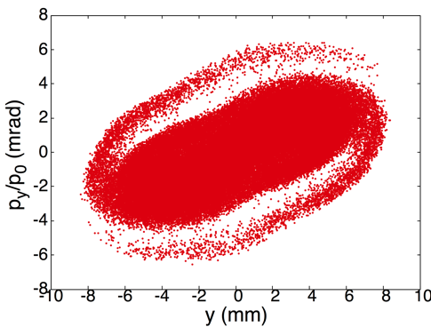
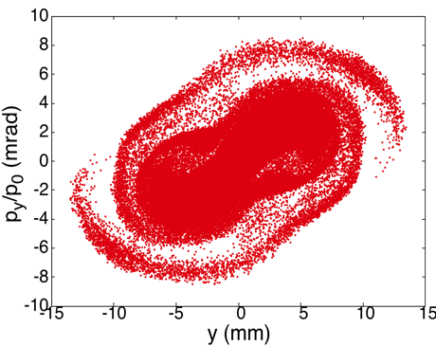
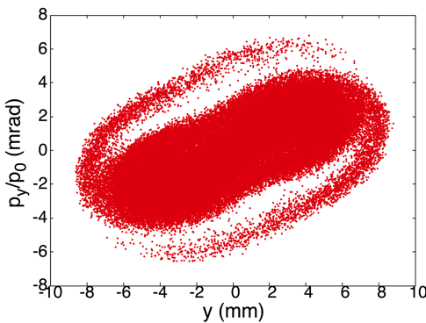
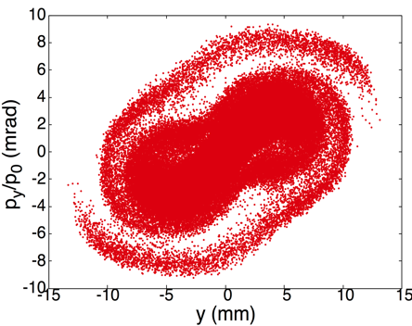
Numerical Benchmarks: Comparison of Vertical Phase Space at Injection Point After 10 Turns at 4 mA, 8 mA Current
4 mA
8 mA
Impact-Z
Impact-Z
- Visible agreement in horizontal,
vertical rms beam envelopes.
- Emittances agree within 3.5%.
- Agreement improves with
increasing number of SC kicks.
ML/I
ML/I
Convergence checked with
respect to:
# grid points/modes (x2),
# particles (x100),
location of Poisson boundary,
# SC kicks

Slide 9
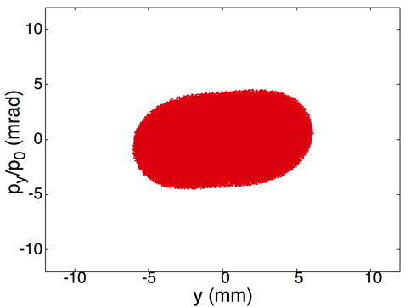
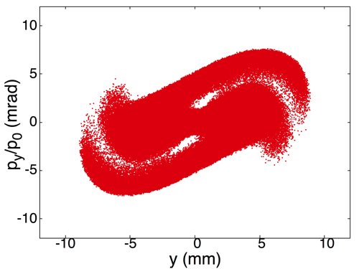
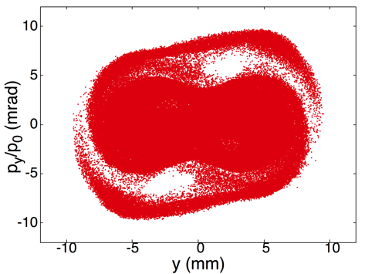
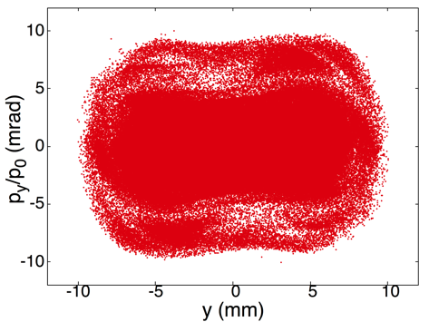
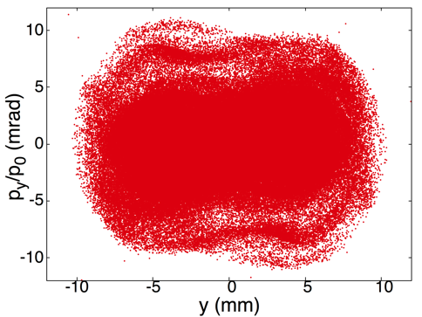
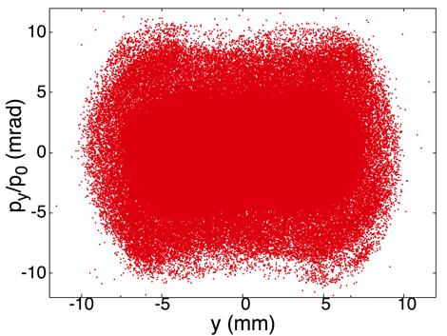
Filamentation at 8 mA Current Over First 50 Turns
(Vertical Phase Space at Nonlinear Insert Midpoint)
1 turn
5 turns
10 turns
20 turns
30 turns
50 turns

Slide 10

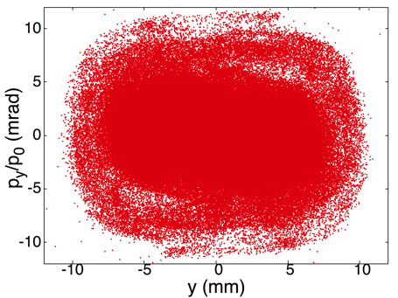
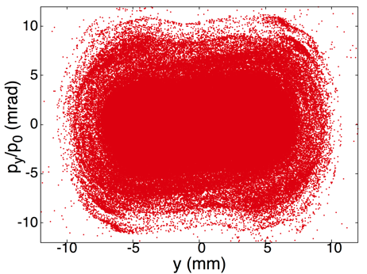
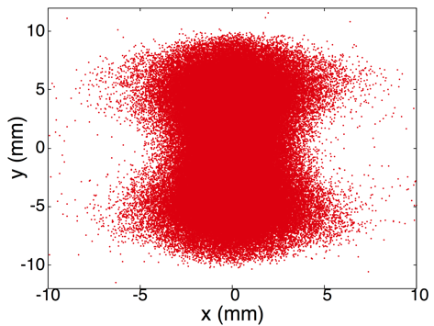
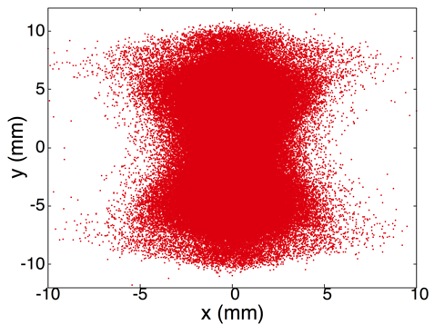
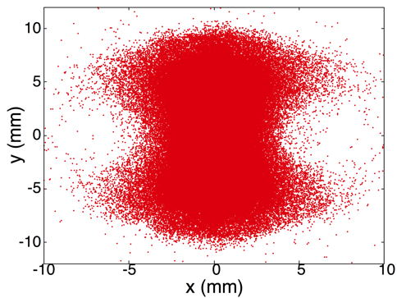
Filamentation at 8 mA Current Over First 50 Turns:
Effects of Non-Ideal Optics and Initial Energy Spread
Nominal optics, w/E spread
Ideal optics, w/E spread
Nominal optics, no E/spread
Vertical phase space
Spatial projection

Slide 11
Filamentation at 8 mA Current Over First 50 Turns
Evolution of Emittances and Invariants (NLI Midpoint)
Horizontal emittance
Vertical emittance
Nominal optics, w/E spread
Ideal optics, w/E spread
Nominal optics, no E spread
energy spread effects
are apparent
Mean first invariant
Mean second invariant
energy spread effects
are apparent

Slide 12
Filamentation at 8 mA Current Over First 50 Turns
Evolution of Beam Density Profiles (NLI Midpoint)
I = 4 mA
I = 8 mA
appearance of
depression in
vertical profile
Relaxation in Constant Focusing Channel
depression
increases with
beam intensity
X, initial
X, final
Y, initial
Y, final
transition to
Vlasov equilibrium
Rapid transition to an equilibrium distribution with depressed vertical profile – similar to dynamics observed in a constant focusing channel.

Slide 13
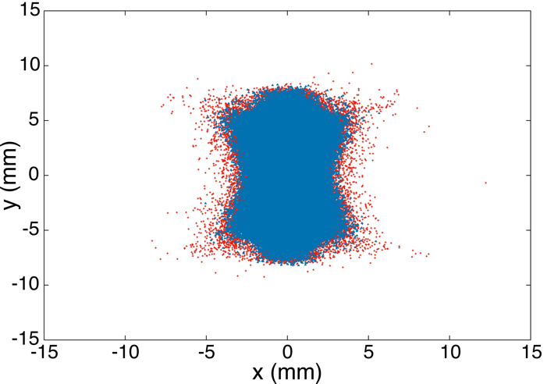
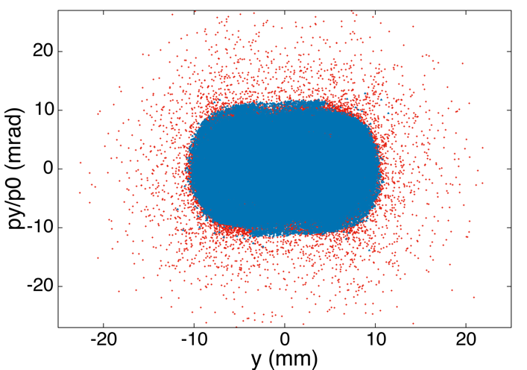
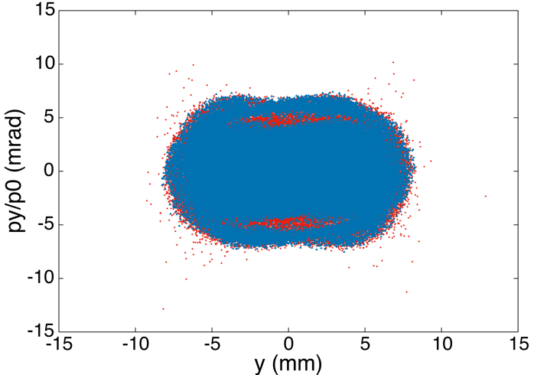
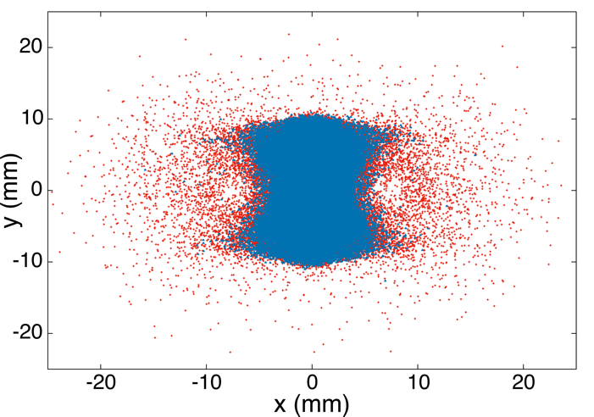
Dynamics on a Longer Time Scale: Formation of Beam Halo
(Shown After 300 Turns, NLI Midpoint)
I = 4 mA
I = 8 mA
Vertical Phase Space
Vertical Phase Space
Spatial Projection
Spatial Projection
turn 50
turn 50
turn 50
turn 50
halo
halo
turn 300
turn 300
turn 300
turn 300
Well-defined core population is nearly stationary after turn 50.
Slowly-growing halo population at I = 8 mA begins to appear between turns 100 – 200.
Forward-backward tracking of individual orbits indicates the presence of chaos.

Slide 14
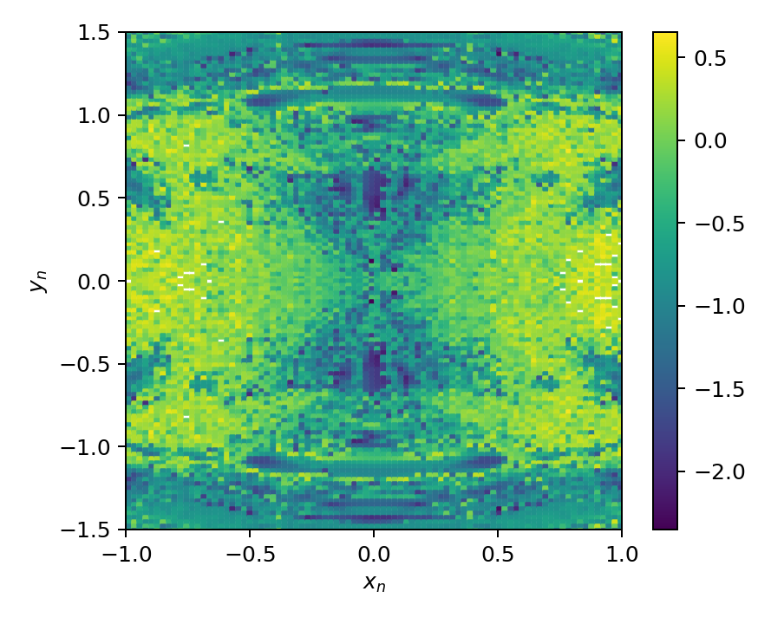
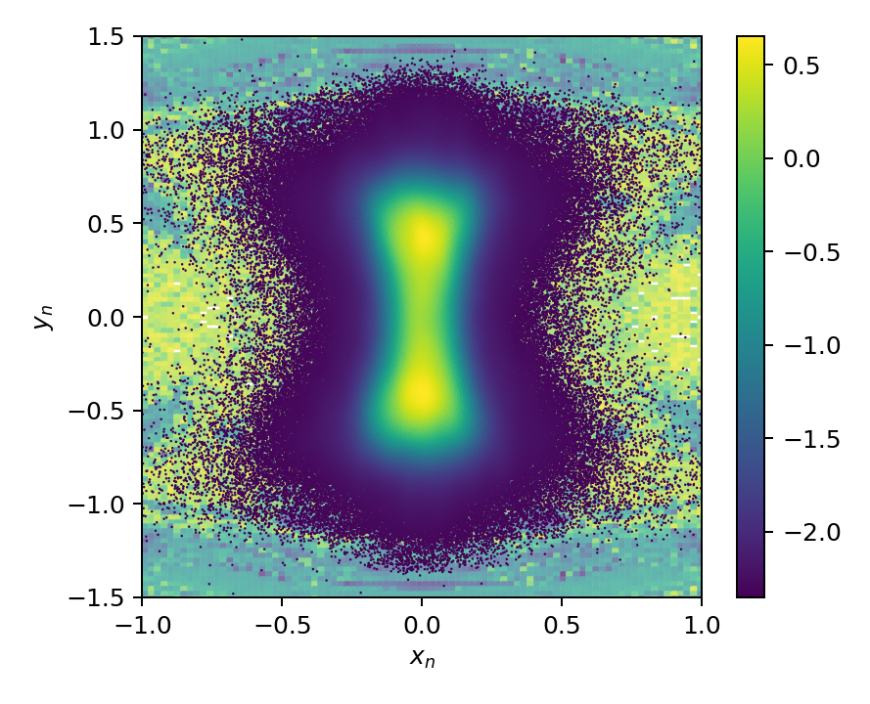
Searching for Chaos in Single-Particle Orbits of the High-Intensity Beam
Test initial conditions (x,0,y,0) initialized at the midpoint of the nonlinear insert.
Test orbits are tracked in the focusing lattice + the space charge fields of the 8 mA beam
(beginning at turn 100) forward, and then backward 100 turns using a reversible integrator.
Chaos yields exponential growth of numerical errors (not observed at zero current).
Test initial conditions
Initial conditions + beam at turn 100

Slide 15
Comparison with Dynamics in a Linearized Lattice
All elements of the lattice are linearized. This includes the nonlinear magnetic insert, which
is treated as an s-dependent quadrupole.
Gaussian beam is rms matched at the midpoint of the magnetic insert at zero current.
  Nominal emittances (ε_{x} = ε_{y} = 3.3 mm-mrad) and energy spread (ΔE/KE = 2.0×10⁻³).
  Beam intensity: 4 mA (ΔQ_{x,y} ≈-0.3, -0.3) and 8 mA (ΔQ_{x,y} ≈-0.6, -0.7)*
X, nonlinear lattice
X, linear lattice
Y, nonlinear lattice
Y, linear lattice
(Left) Beam-based Twiss functions at the
midpoint of the insert section at I = 8 mA.
Beam-based Twiss functions are comparable
in the linear and nonlinear lattice (< 40%).
Vertical mismatch is clearly visible for the
8 mA beam in the linearized lattice.
* For an rms-equivalent uniform elliptical beam.

Slide 16
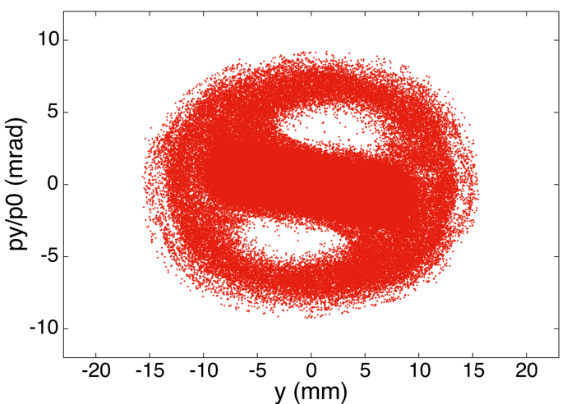
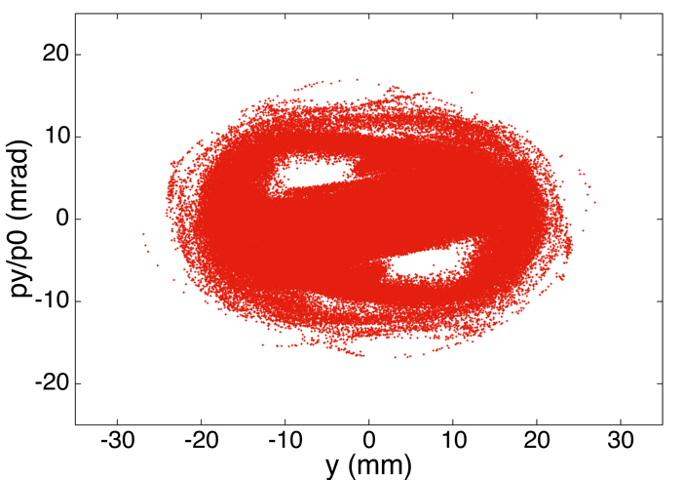
Formation of Beam Halo in the Linearized Lattice
(Shown After 300 Turns, NLI Midpoint)
I = 4 mA
I = 8 mA
Vertical Phase Space
Vertical Phase Space
halo
Persistent oscillation of mismatched core population (as expected).
Halo development driven largely by parametric resonance; needs to be verified.
Space charge is highly nonlinear, leading to slow filamentation/phase mixing.
Large emittance growth (in the 8 mA case, 2× that observed in the nonlinear lattice).

Slide 17
Conclusions
At 8 mA current, a nominal beam in IOTA filaments and relaxes over ~50 turns to a distribution with larger horizontal and vertical emittances and larger vertical beam size (~factor 2).
Near-equilibrium distribution is qualitatively similar to that seen in a constant focusing lattice.
Non-ideal (realistic) optics result in small differences in the equilibrium distribution, with minor effects on the rms beam envelopes, emittances, and invariant statistics. Energy spread has a slightly larger effect. At low intensity, all these effects are more pronounced.
On the scale of ~100s of turns, halo development occurs at high intensity (ΔQ_{x,y} >> 0.1), and appears to be driven by chaotic diffusion. This effect is not visible at low intensity (ΔQ_{x,y} << 0.1), where the beam is confined in a near-equilibrium state over > 3000 turns.
Halo development at 4 mA appears reduced relative to a nominal-emittance beam in the linearized lattice. More systematic comparisons between linear/nonlinear lattice needed.
Areas for further study: i) Search for beam intensity threshold for halo formation in this lattice.
ii) Improve beam matching procedures, and study sensitivity to the initial beam mismatch.
iii) Study losses resulting from physical aperture design, beam collimation strategy (ongoing).

Slide 18
Backup Slides

Slide 19
Questions regarding space charge and nonlinear integrable optics in IOTA (using 2.5 MeV protons)
Will the presence of space charge destroy the integrability of single-particle motion in IOTA?
What are the primary (resonance) mechanisms by which this occurs?
How does space charge affect the structure of the beam distribution at high current?
What consequences will space charge have for beam stability, halo, and losses?
How can we address 1)-4) accurately in the presence of numerical artifacts (particle noise)?
Use fully symplectic tracking methods (including self-consistent space charge*).
Use modeling with high spatial resolution and a large number of particles (≥ 1M).
Study reduced dynamical models to aid in understanding the novel dynamics.
Use multiple methods to distinguish between integrability and chaos (preservation of invariants, sensitive dependence on initial conditions, frequency map analysis).
* J. Qiang, Phys. Rev. ST Accel. Beams 20, 014203 (2017).

Slide 20
Vertical Beam Envelopes on Turn 10 for Increasing
Values of Current
RMS beam size over turn 10
RMS beam size across the insert
(Physical aperture at
midpoint = 5.5 mm)
Here, no attempt is made to rematch
the beam at higher values of current.

Slide 21
Estimates of Space Charge Tune Shift in the
Nonlinear Lattice
Use the corresponding space charge tune shift for a uniform elliptical beam of the
same horizontal and vertical emittances in the linearized lattice. (Estimate only.)
Uniformly-filled circular cylinder beam (unbunched):
Uniformly-filled elliptical cylinder beam (unbunched):
- current
- ring circumference
- unnormalized emit.
- average betatron
amplitude

Slide 22
Comparison with Dynamics in a Linearized Lattice:
Emittances and Zero-Current Invariants (Midpoint of NLI)
Emittances
Mean Invariants
X, nonlinear lattice
X, linear lattice
Y, nonlinear lattice
Y, linear lattice
H, nonlinear lattice
H, linear lattice
I, nonlinear lattice
I, linear lattice

