Slide 1
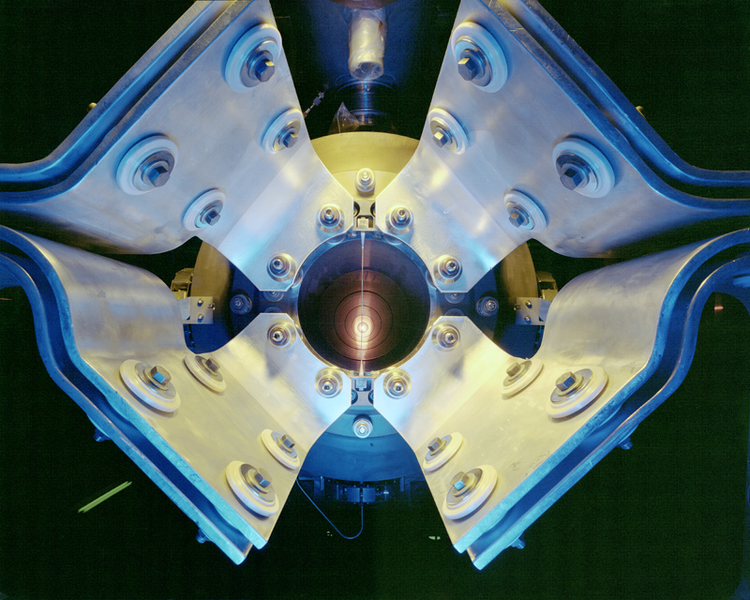
Office of Science Planning Meeting
Washington DC, May 31st, 2011

Slide 2
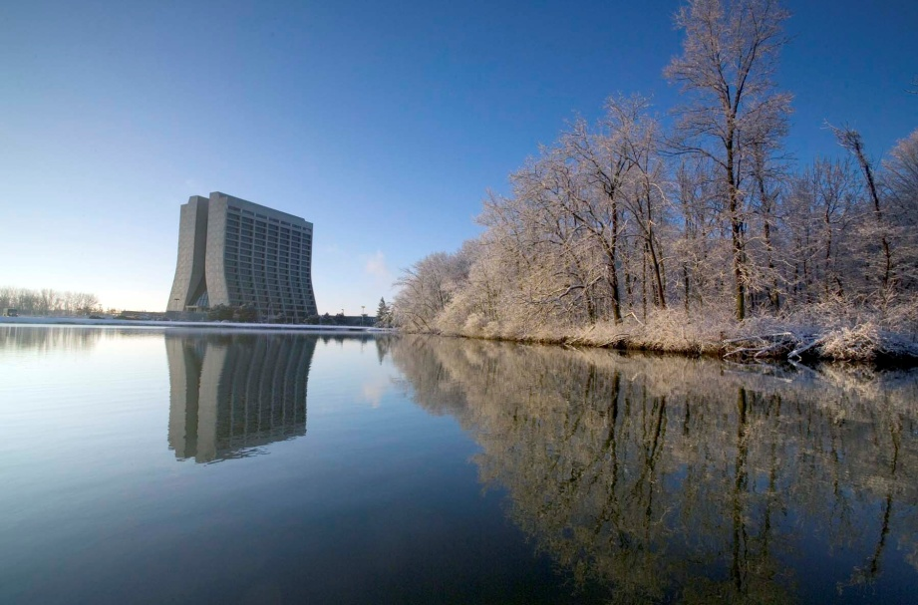
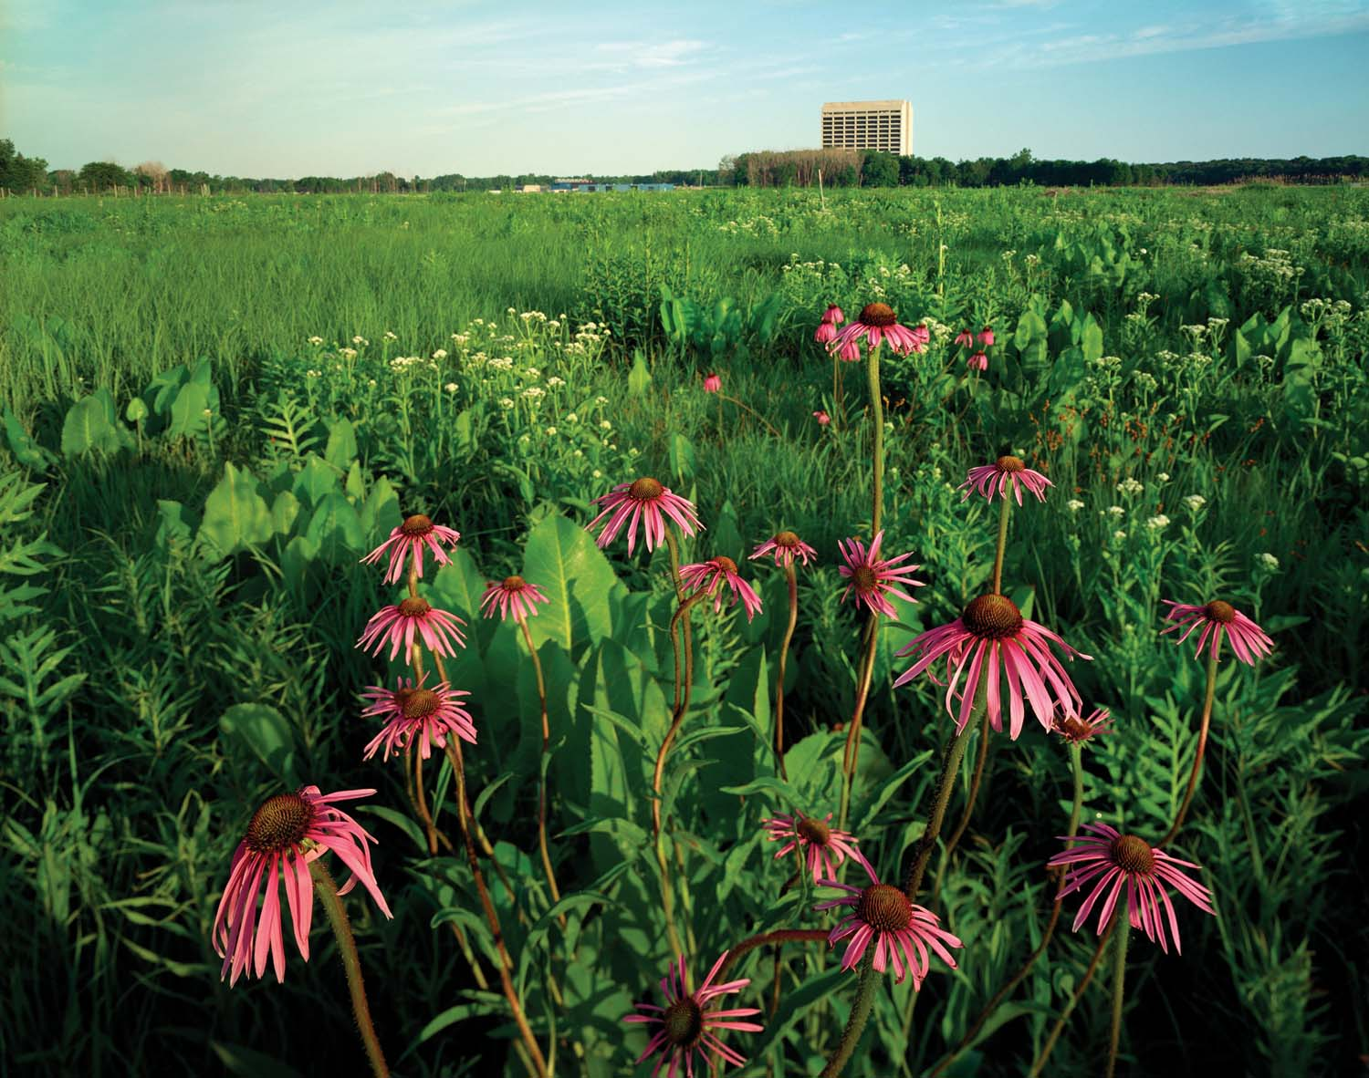
Fermilab characteristics (FY2010)
Highest intensity neutrino beams (low and high energy)
A world class astrophysics, particle theory and computation programs
Advanced detector and accelerator technology
1925 employees; $ 385 M (cost)
2300 users and visiting scientists
6800 acres, park-like site
Tevatron: the only p-p collider through FY 2011

Slide 3
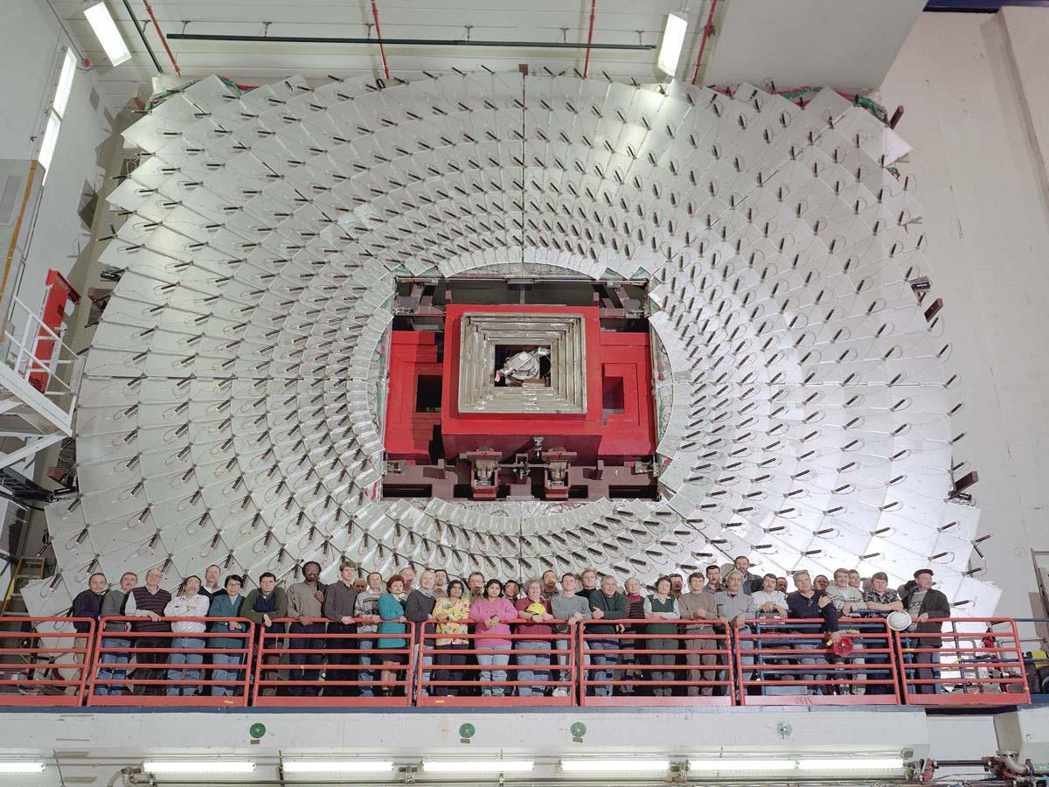
Mission: the national particle physics lab
Enable the US community to tackle the most fundamental physics questions of our era
Interdependence: integrate the universities and other laboratories fully into national and international programs

Slide 4
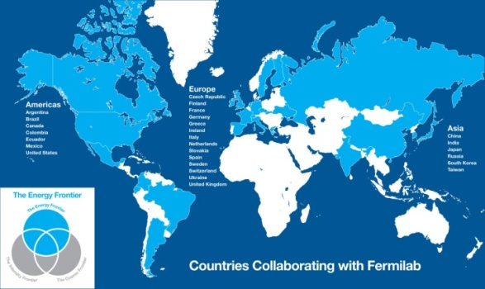
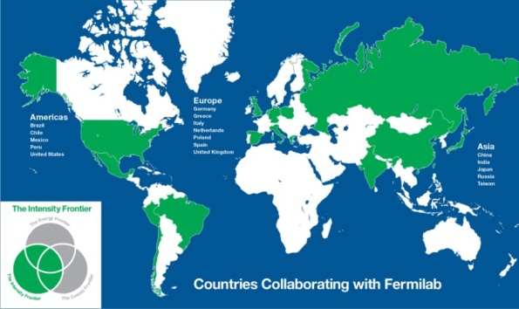
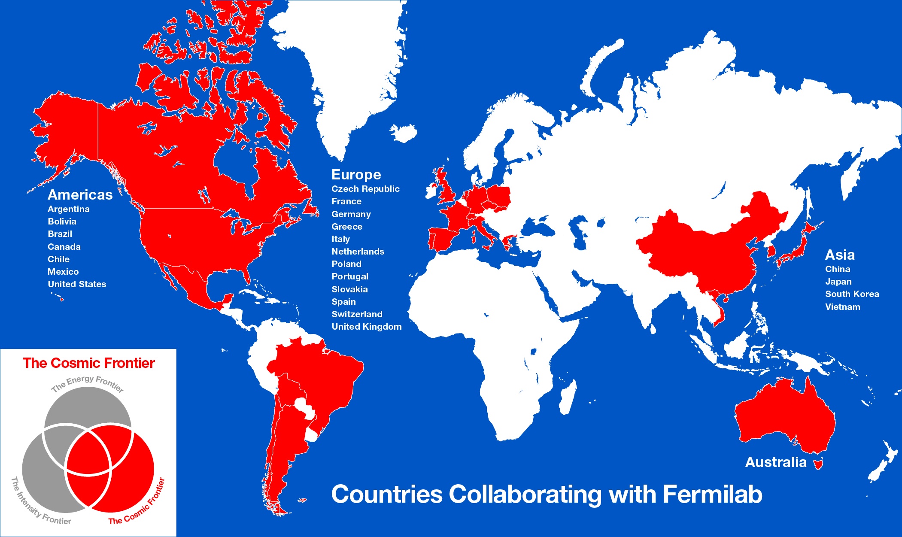
Collaborative Efforts
27 countries
International collaborations
for our programs
Collaboration among DOE laboratories
  Project X, ILC/SRF, Muon collider, neutrino factory, LHC Accelerator, many particle experiments, …
Work for other DOE laboratories
Argonne-UChicago-Fermilab Collaboration
17 countries
24 countries

Slide 5
Program drivers: science
The sense of mystery has never been more acute and evident
  Where does mass come from?
  Are there extra dimensions of space?
  Why only three families of quarks and lepton?
  Why is matter dominant?
  What are the neutrino masses and what do they say?
  Where are the heavy neutrino partners?
  Does nature use supersymmetry?
  Do the forces unify?
  What is dark matter?
  What is dark energy?

Slide 6
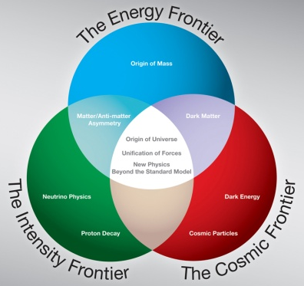
Program drivers: science
These questions fire the imagination of the public and the press
As the national laboratory for particle physics, we place the US in a leadership position in the world
Most elements are in place: exciting opportunities and national strategic plan at each of the three frontiers of particle physics: energy, intensity and cosmic frontiers
Historically many applications in society through development of accelerator, detector and computational technology

Slide 7
Overview of presentation
We will concentrate on the overarching strategy for particle physics, Fermilab’s role in it and what we need in order to achieve it
Particle physics in the US is at a critical juncture: the most important planning issue is to agree on a clear strategy and to obtain the means to support it
Many of the requested details for this presentation are in the planning document we provided. They are important and underpin Fermilab’s ability to implement the proposed strategy

Slide 8
The strategy
Should address critical and exciting questions
Should be bold and establish world leadership in at least one domain
Should attract partners to leverage our investments through international collaboration
Should fit within a global strategy for the field and within reasonable US funding
Should be broad enough to be resilient against physics discoveries and funding fluctuations

Slide 9
In developing the strategy
We need to understand the state of knowledge in particle physics
We need to analyze the international situation to insure we add maximum value to the global program
We need to make realistic budgetary assumptions
We need to think very long term (2-3 decades)

Slide 10
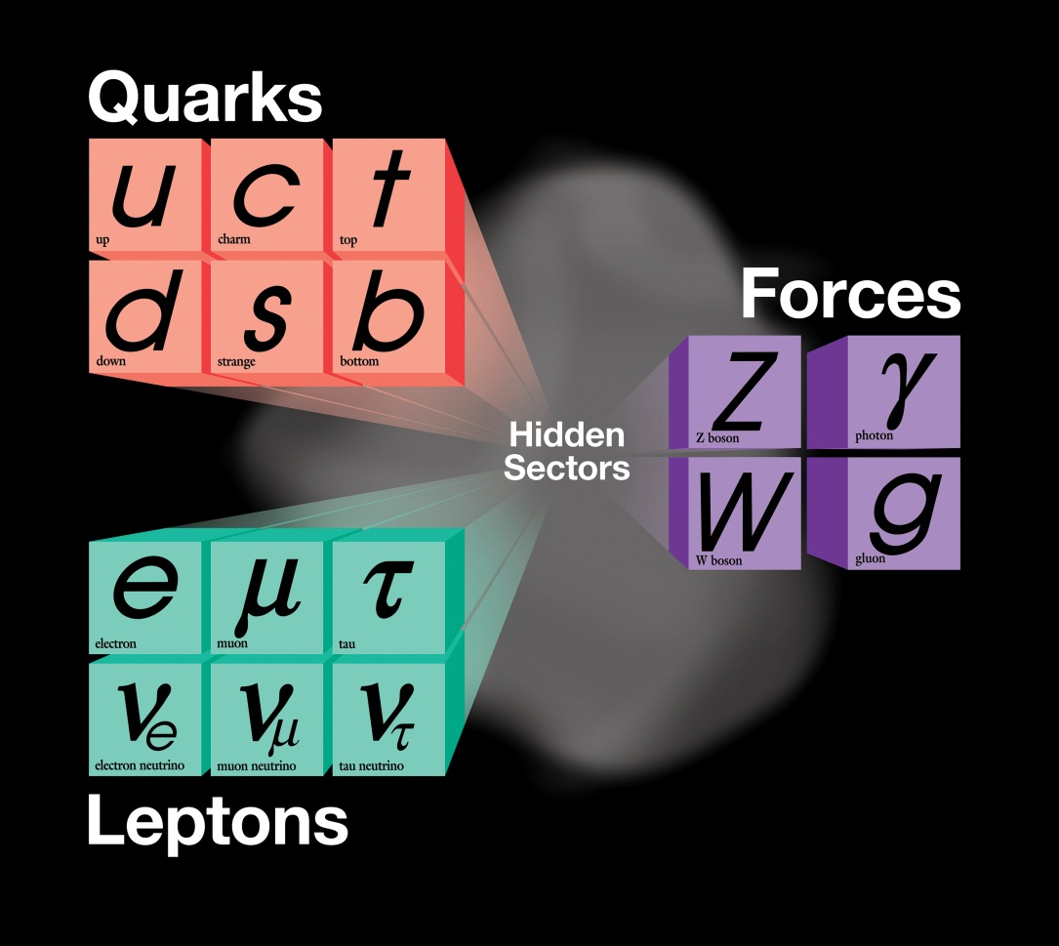
The state of knowledge
The present theory is a remarkable intellectual construction
Every particle experiment ever done fits in the framework
But it is not complete; basic symmetries of the Lagrangian require symmetry breaking

Slide 11
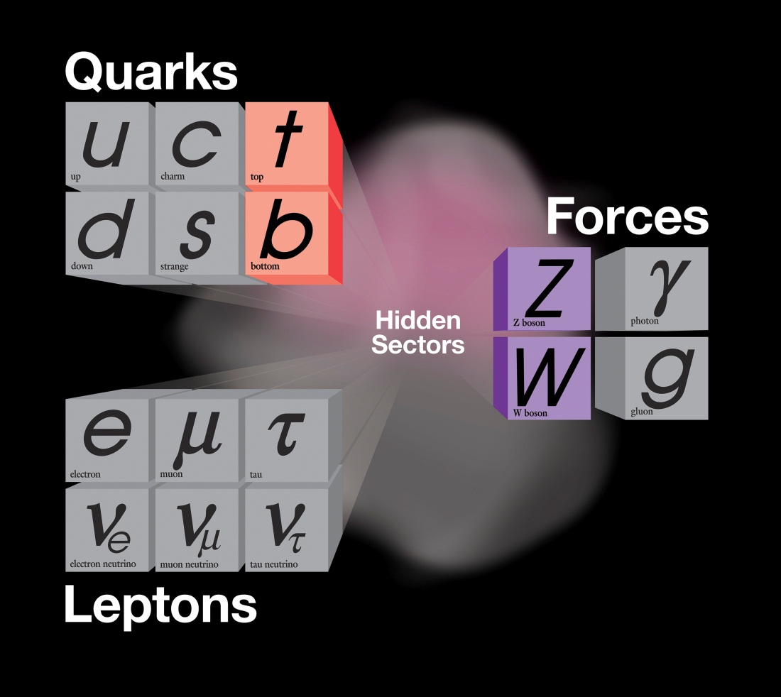
Hunting grounds: energy frontier
Direct production of new phenomena: LHC for the next two decades and future high energy colliders
Energy reach typically limited to 1/10 of total energy for hadron colliders
Very large QCD backgrounds limit many measurements
Dark matter
The top and bottom quarks were discovered at Fermilab

Slide 12
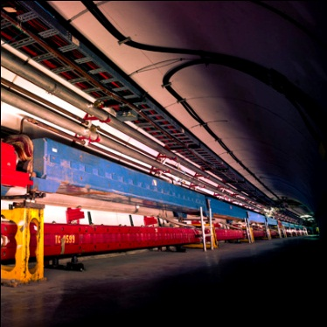
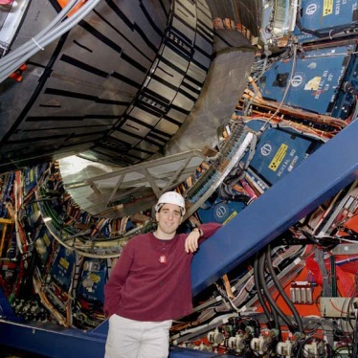
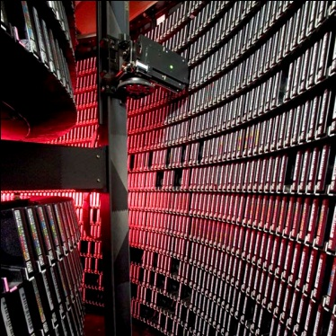
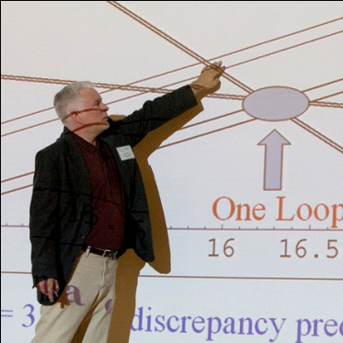
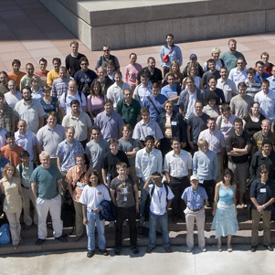
Tevatron: a legendary machine
Accelerator Innovations
  First major SC synchrotron
  Industrial production of SC cable (MRI)
  Electron cooling
  New RF manipulation techniques
Detector innovations
  Silicon vertex detectors in hadron environment
  LAr-U238 hadron calorimetry
  Advanced triggering
Analysis Innovations
  Data mining from Petabytes of data
  Use of neural networks, boosted decision trees
  Major impact on LHC planning and developing
  GRID pioneers
Major discoveries
  Top quark
  B_{s} mixing
  Precision W and Top mass → Higgs mass prediction
  Direct Higgs searches
  Ruled out many exotica
The next generation
  Fantastic training ground for next generation
  More than 500 Ph.D.s
  Produced critical personnel for the next steps, especially LHC

Slide 13
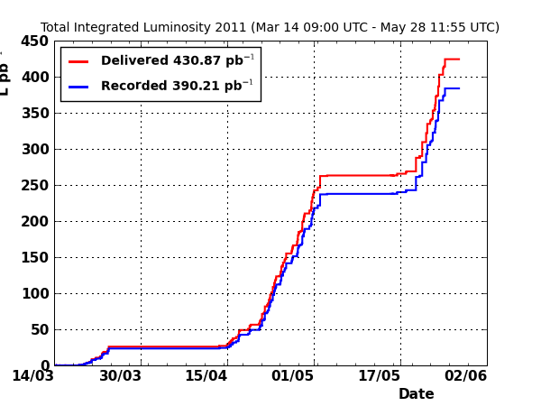
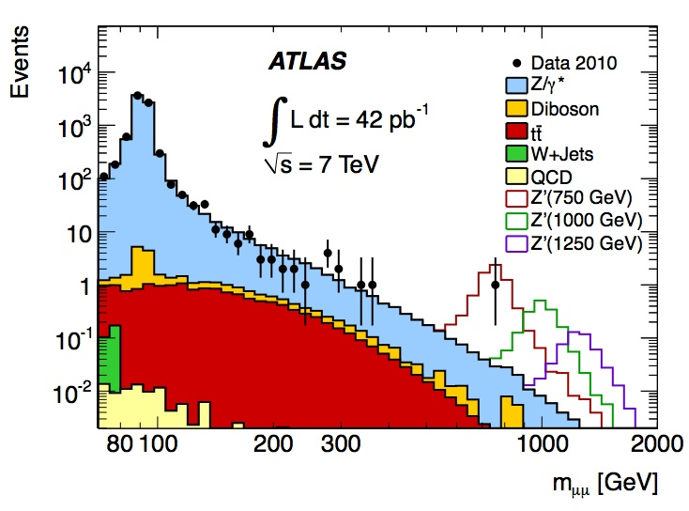
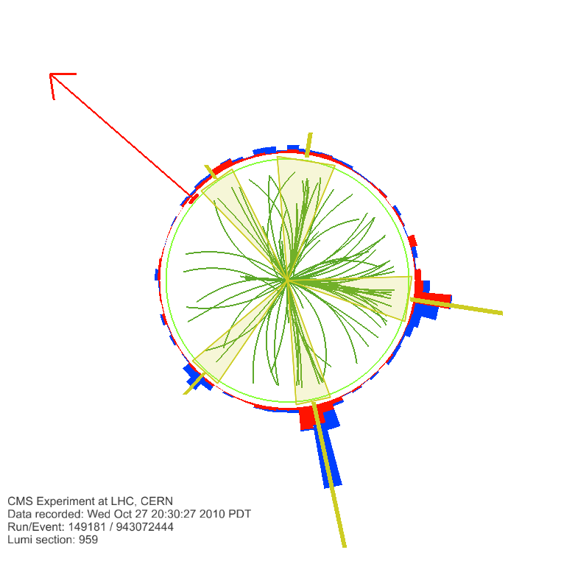
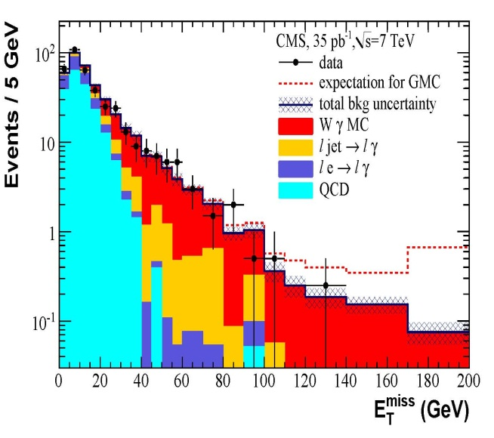
Status of the LHC
The accelerator is performing extraordinarily well – lots of headroom
4 detector collaborations are able to analyze data rapidly – CMS+ATLAS already excluding significant areas of supersymmetry, Z’…….

Slide 14
Range of outcomes from LHC
At one extreme, extraordinarily rich (great expectations):
At the other extreme: shows something only at the highest energy and integrated luminosity (no-lose theorem)
It is the Higgs!
It is stabilized by suppersymmetry
Supersymmetry gives us the dark matter particle
Hundred of searches prove
negative:
the Standard Model Rules!
Unitarity saved by increasing
W_{l}W_{l} scattering

Slide 15
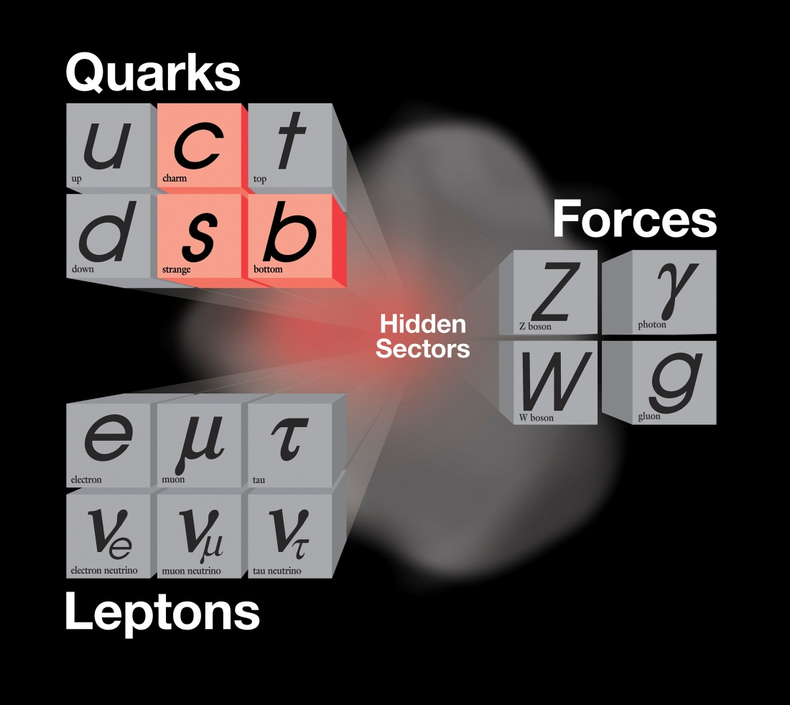
The hunting grounds: quarks
Intensity frontier: rare transformations that happen only with the help from the hidden sectors
Charm quark and bottom quark explored in e+e- colliders (“quark factories”) planned at the state of the art
Strange quark studied with hadron beams: now far from the “state of the art”

Slide 16
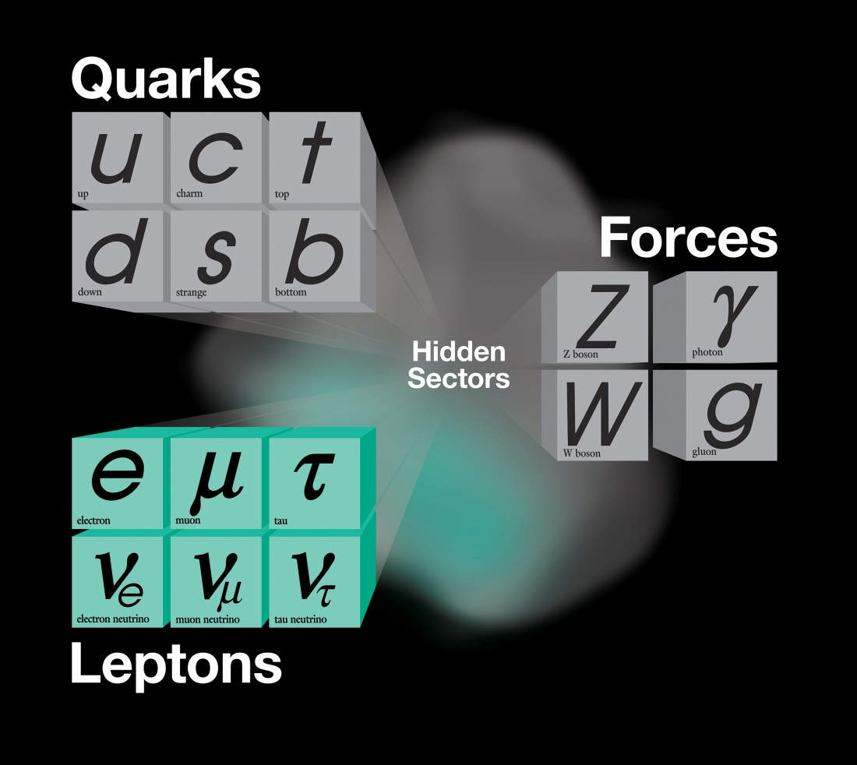
The hunting grounds: leptons
Intensity frontier: the tau lepton studied at e⁺e⁻ b- factories and c-factories at the state of the art
All other charged leptons and neutrinos studied with superbeams presently far from the state of the art:
  Electron dipole moment
  Rare muon decays, muon anomalous magnetic moment
  Neutrino mixing matrix, sterile neutrinos, CP violation
The tau neutrino was discovered at Fermilab

Slide 17
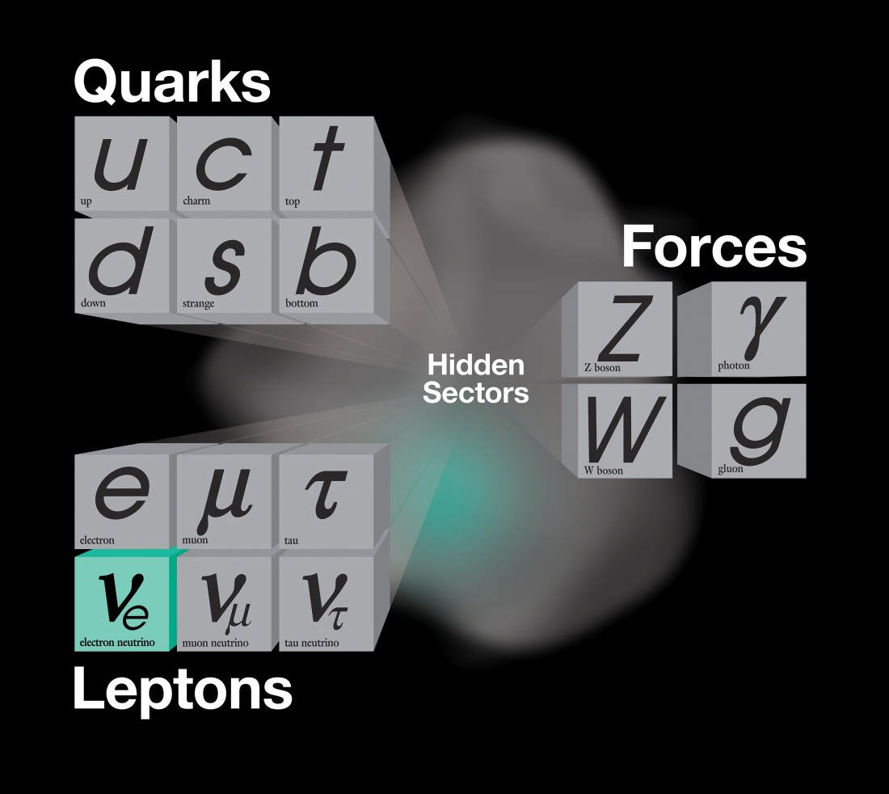
The hunting grounds: cosmic frontier
Nature of neutrinos: neutrinoless double beta decay, far from the possible state of the art
Dark energy: constant or changing? Far from the possible state of the art
Dark matter: direct detection far from the possible state of the art
Proton decay
Dark matter
and
Dark energy

Slide 18
The international context
Europe
  Will be dominant at the energy frontier for the next two decades as the Tevatron was for the last two and a half decades
  Italy has launched an effort to build the next generation B-factory with 50 times the luminosity of previous B factories. It will be a “European” facility
  Has a world class underground laboratory at Grand-Sasso (not adequate for large long base-line neutrino experiments).

Slide 19
The international context
Europe
  The LHC has come into its own. Luminosity is greater than 10³³ cm⁻²sec⁻¹. More importantly it has a lot of head-room: higher beam-beam limit, larger aperture, lower emittance, higher intensity per bunch → several times planned luminosity is possible.
  CERN will be occupied with LHC and LHC upgrades and with developing e⁺e⁻ linear colliders (ILC or CLIC). CERN is unlikely to build next generation intensity frontier experiments (neutrinos and rare decays) unless the LHC results point to an energy scale that is beyond practical machines to reach directly.

Slide 20
The international context
Europe
  The rich get richer: direct investment in CERN is $1.2B, 50% higher than total US program and three times investment in the Fermilab program. However, the effective investment in the program is even larger than that because the whole world is contributing.
  CERN is aggressively pursuing a strategy to become the world’s HEP lab: a) membership now open to all countries, b) associate membership established at 10% normal contribution and c) but CERN is now allowed to invest in international global programs if Europe is involved. Next European Strategy in 2012.

Slide 21
The international context
Europe
  At the cosmic frontier Europe does not have a competitive program in dark energy comparable to the ground-based DES and LSST. It will be competitive with the EUCLID satellite.
  It has a fully competitive, current generation direct dark matter searches (e.g. XENON) and in neutrinoless double beta decay experiments (e.g. CUORE) with plans for upgrades in the future. These are all international projects but hosted in Europe
  In the short term it has a competitive reactor neutrino experiment (DOUBLE CHOOZ)

Slide 22
The international context
Asia
  Japan is building a next-generation e⁺e⁻ B-factory with 50 times previous luminosities at KEK
  Japan has a world competitive neutrino program with J-PARC (present performance one half to one third of Fermilab’s; expected to match Fermilab in the NOvA era at 700 kWatts) and SuperK with 20 kton fiducial at Kamioka. There are long range plans to build larger detectors at longer base-lines.
  China has the best reactor neutrino experiment (DAYA BAY) and Korea an earlier but ultimately less competitive experiment (RENO)

Slide 23
The international context
Asia
  China is developing a very deep underground laboratory (JINPING). It was an idea two years ago, now there are caverns. Beautiful, deep, horizontal access site – but no Fermilab to send neutrinos
  Dark energy experiment at the 8m SUBURU telescope in Hawaii. SUBURU is probably the best 8m telescope in the world. Dark matter survey is limited by availability of time on the telescope.

Slide 24
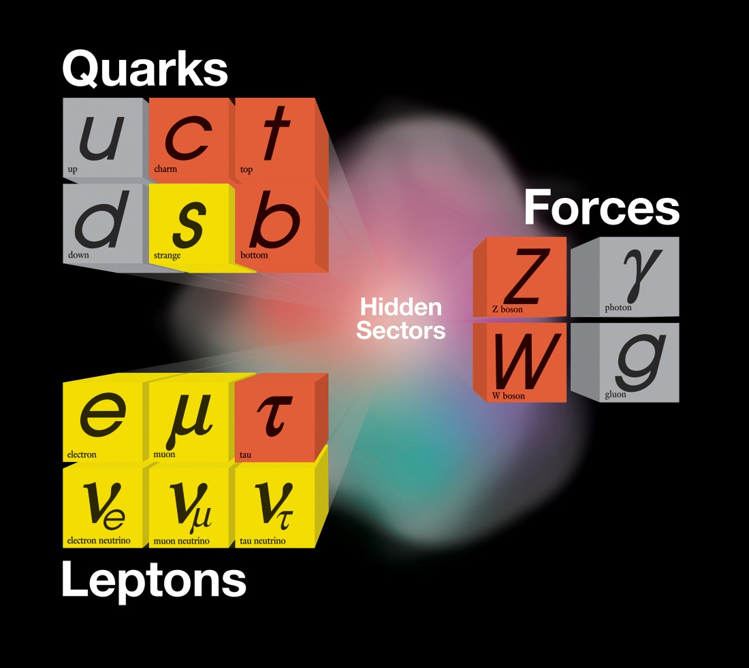
The international context: a map
A lot of territory is covered internationally at the state of the art
The greatest impact and leadership for the US is in neutrinos and rare processes, where major improvements are possible

Slide 25
US leadership domains
Accelerator based program: at the intensity frontier with a series of experiments (long and short baseline neutrino programs, rare kaon and muon decays, g-2, Mu2e, EDM) . LBNE and Project X are the major attractors for international collaboration in the long term program as are energy applications of high intensity proton accelerators
The accelerator based program in the US is quite competent in the next decade even without Project X, with a series of world class experiments. Beyond this decade we need LBNE and Project X to assure leadership of this domain by a large margin. A multi-polar world is important to maintain open use of facilities

Slide 26
US leadership domains
The cosmic frontier: leadership in ground-based dark energy with DES, LSST; unlikely for space based probes. Competitive programs in dark matter and dark energy experiments where we could try to establish the leadership position; similarly we could stake out the leadership position in neutrino-less double beta decay.
The leadership in the cosmic frontier is shared both nationally and internationally. All major ground telescopes are private or operated by NSF. The major future ground based telescopes LSST is primarily an NSF project with important DOE contributions. Space probes are controlled by NASA. Dark matter experiments are international and operate in deep underground laboratories abroad

Slide 27
What is the proposed program?
In the intermediate term, a series of world-class experiments (built upon our current world-class program), exploiting the present complex with modest upgrades (go to afterburners). Produce continuous stream of results
  NOvA: ν vs. ν, next step in oscillation parameters
  MicroBooNE: follow MiniBooNE anomaly; LAr TPC
  MINERvA: ν nuclear cross sections/nuclear structure
  MINOS+ (proposed): ν vs. ν; anomalous interactions
  LBNE (700 kW): neutrino oscilllations, proton decay, SN
  g-2: anomalous magnetic moment of the muon
  Mu2e: direct muon to electron conversion
  SeaQuest: nuclear physics Drell-Yan process

Slide 28
An aside…..
Why multiple neutrino experiments? Many aspects are still unclear in the neutrino sector (neutrinos vs. antineutrinos; mixing matrix; existence of sterile neutrinos; anomalous interactions…..). Their study requires different baselines, different energies, different detector technologies
Unlike charged beams, neutrino beams are not exhausted by placing one experiment in the beam: we can “stack” multiple experiments in one neutrino beam both in line and in angle

Slide 29
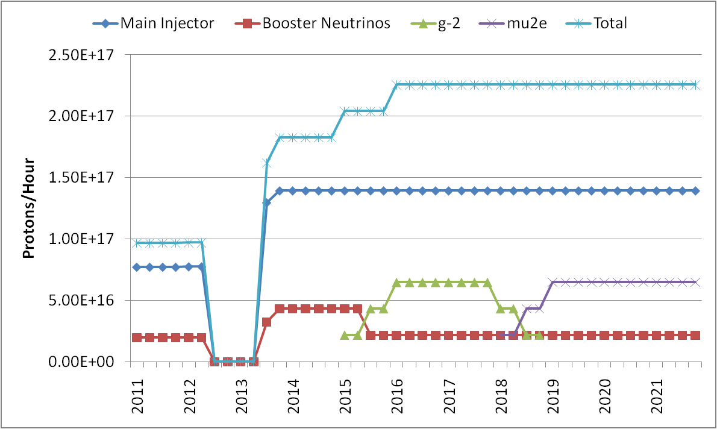
Near and intermediate stages
This decade
Tevatron ends
shutdown for NOvA
NOvA
MINERvA
MINOS+(?)
LBNE(700kW)
MINERvA
MINOS
MiniBooNE
g-2
Mu2e
MicroBooNE
Next Decade Project X: 100 times

Slide 30
Intensity Frontier Today at Fermilab
Take Home Message: we have a set of world-class experiments
over the next decade BEFORE Project starts operating
EXPERIMENT | INSTITUTIONS | NATIONAL LABORATORIES | COLLABORATORS | FOREIGN COUNTRIES
MINOS | 29 | 3 | 148 | U.K, Brazil, Poland, Greece
MiniBooNE | 18 | 2 | 84
MINERvA | 27 | 2 | 127 | Peru, Greece, Brazil, Chile, Mexico, Russia
SeaQuest (NP) | 18 | 4 | 65 | Japan, China
NOVA | 28 | 2 | 180 | Greece U.K, Russia, Germany, Brazil
MicroBooNE | 13 | 3 | 70
g-2 | 20 | 2 | 67 | Russia, U.K, Italy, Germany, Japan
Mu2e | 22 | 3 | 105 | Italy, Russia
LBNE | 58 | 6 | 306 | U.K, Japan, Italy, India

Slide 31
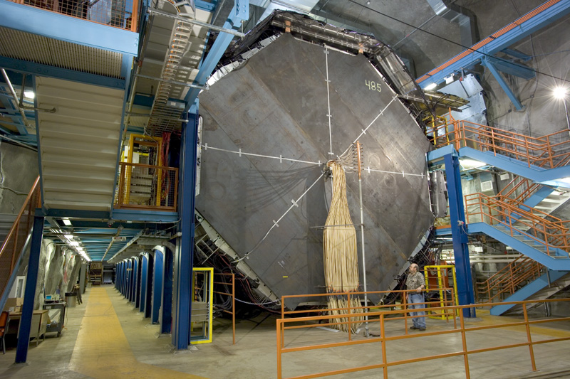
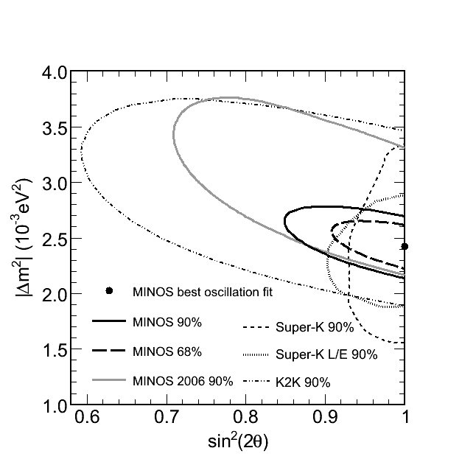
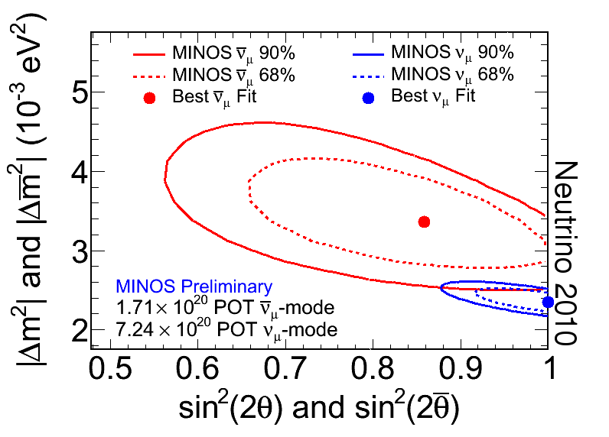
MINOS Results on Δm²₂₃ and θ₂₃
_
Neutrino runs
  best Δm²₂₃
Anti-neutrino runs
  Tension between ν’s and anti-ν’s

Slide 32
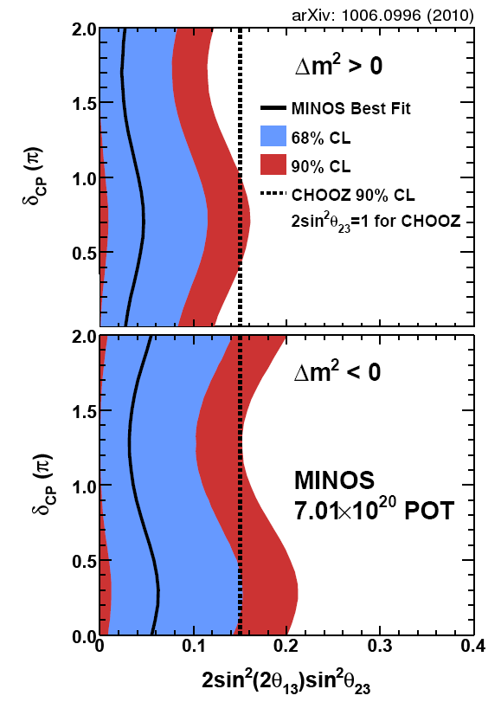
MINOS Results on θ₁₃
    Electron appearance measurement
    Comparable and consistent with the CHOOZ limit

Slide 33
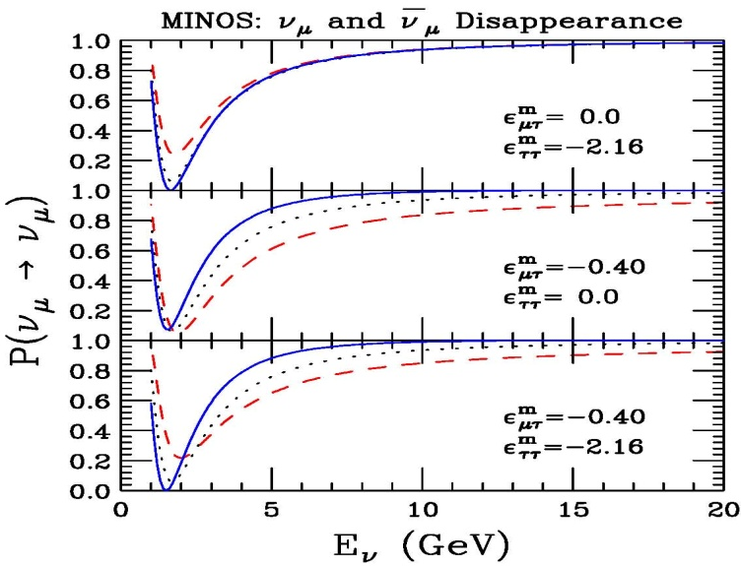
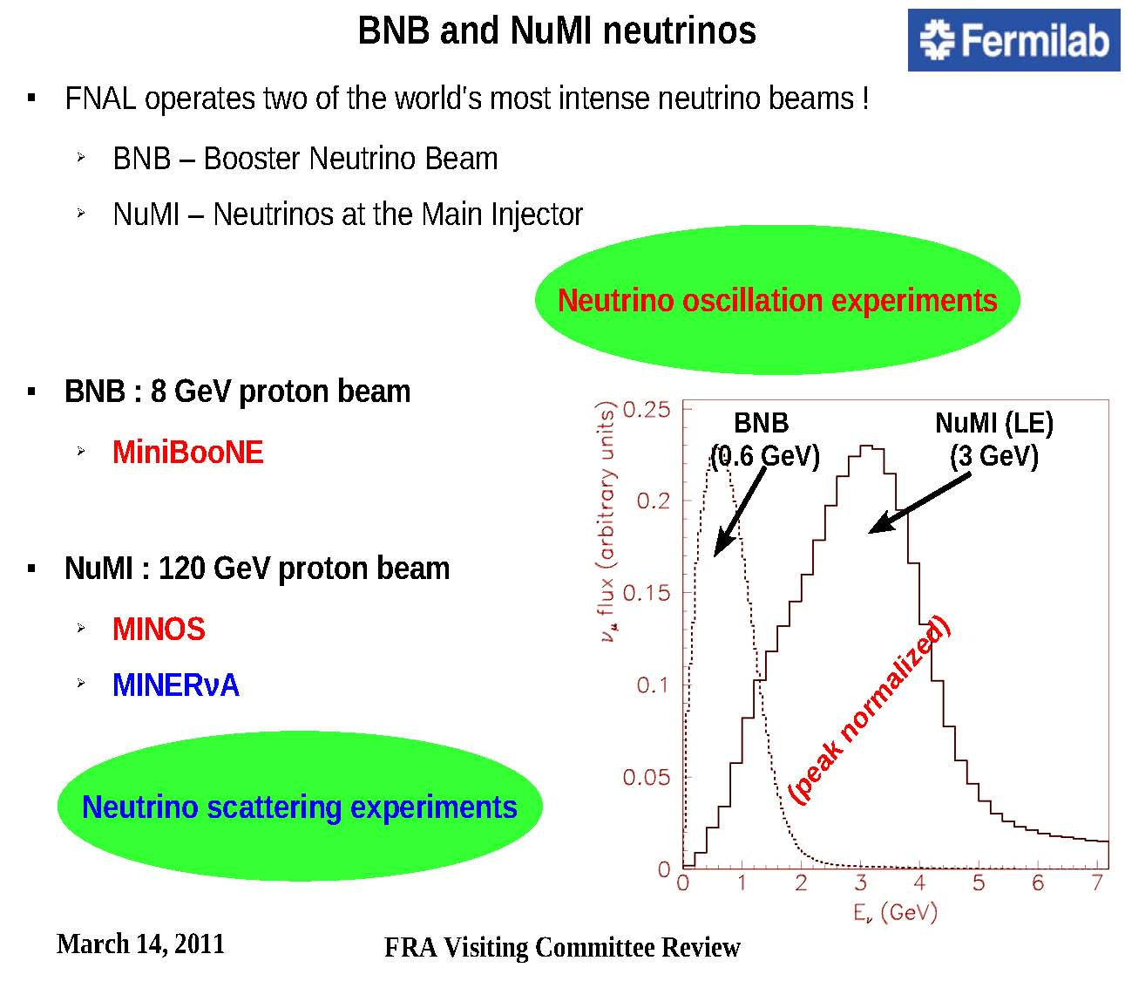
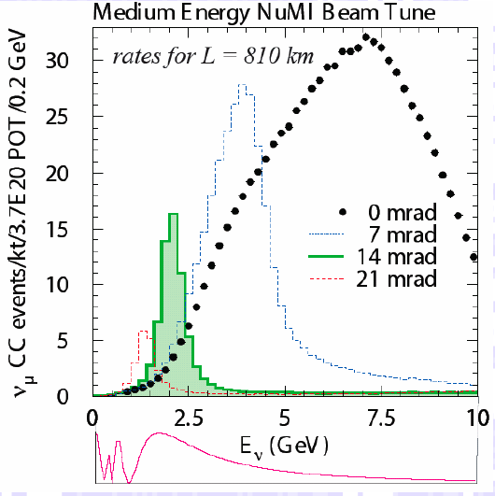
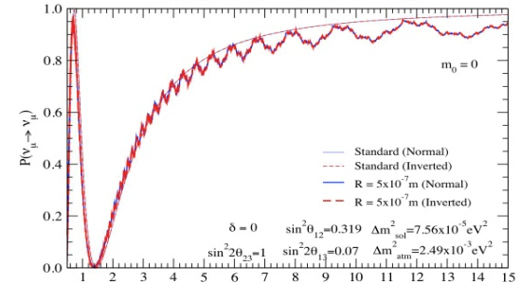
MINOS Run extension (FY13-14) – TBD
Sensitivities to new physics
Kopp, Machado, Parke
MINOS now
MINOS @NOvA time
Machado, Nunokawa, Funchal
NOvA
0 2.5 5 7.5 10
Neutrino Energy (GeV)
0 5 10 15
E_{ν} (GeV)
Will be discussed at the June 2011 PAC meeting

Slide 34
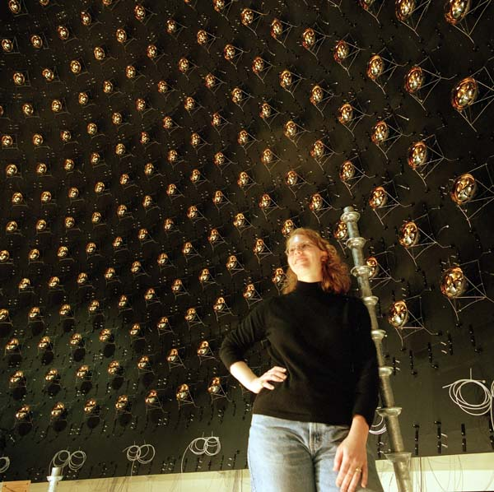
MiniBooNE
Anomaly in low momentum neutrinos
Neutrinos and antineutrinos may be different: neutrinos exclude LSND, antineutrinos consistent with LSND
Sterile neutrinos?

Slide 35
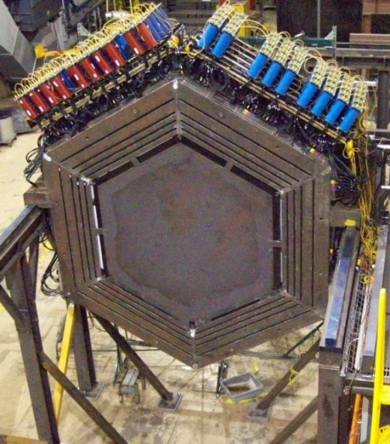
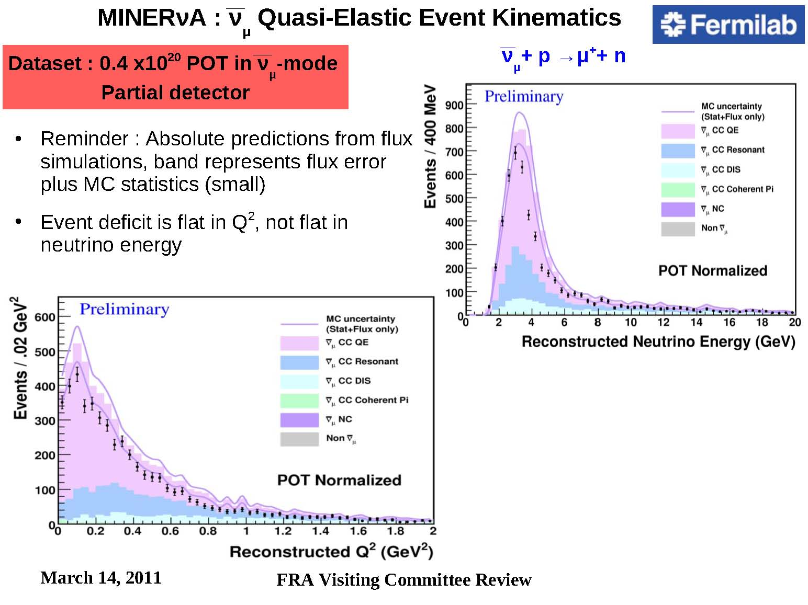
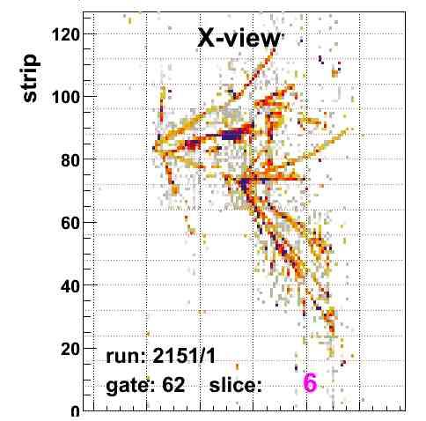
MINERvA program of cross sections
ν_{μ} Quasi-Elastic Kinematics (ν_{μ} + p → μ⁺ + n)
Deficit is flat in Q², not flat in neutrino energy

Slide 36
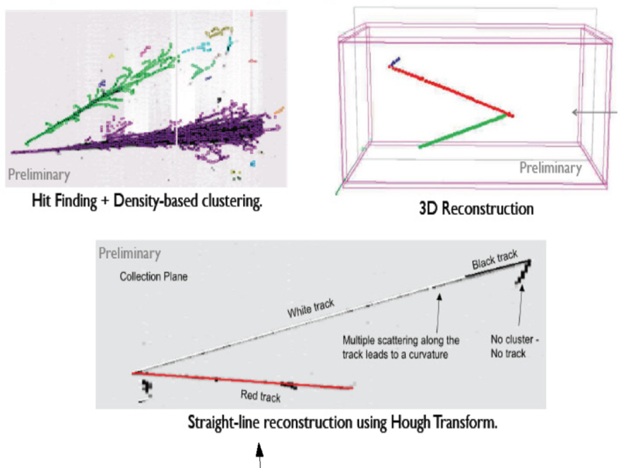
MicroBooNE
Follow excess in MicroBooNE anomaly. Critical to determine it is electrons or photons?
Use Liquid Argon TPC: physics + further development of the technology

Slide 37
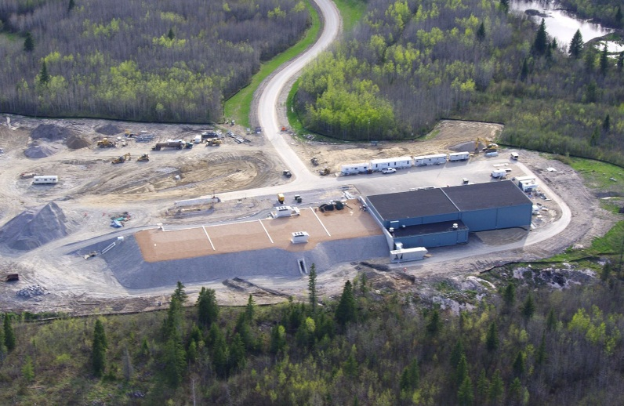
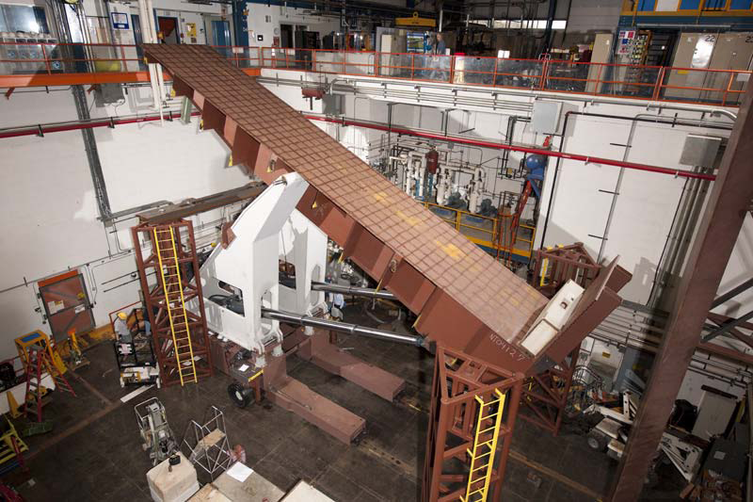
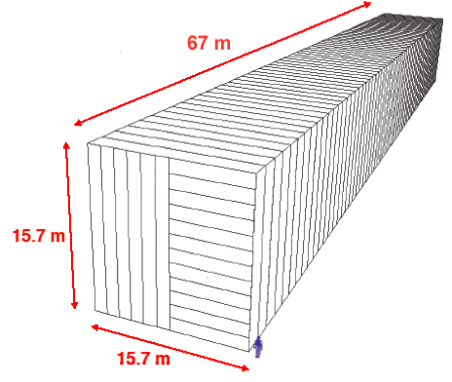
NOvA
Electron appearance and next step in oscillation parameters. Neutrinos vs. antineutrinos: different parameters?

Slide 38
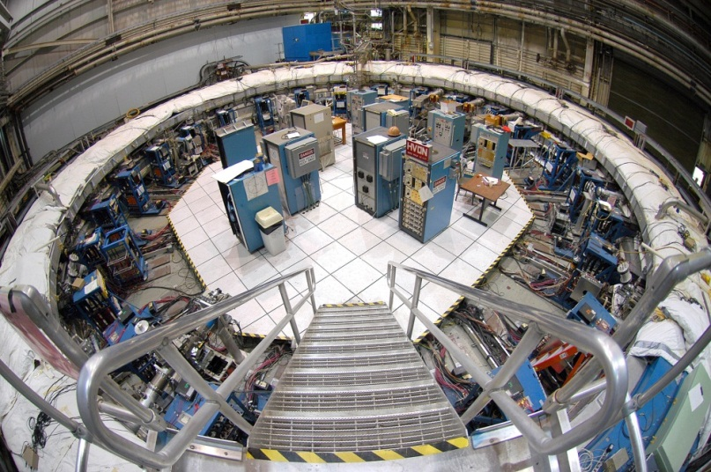
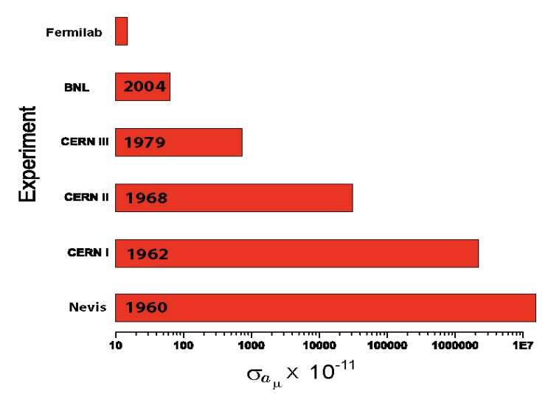
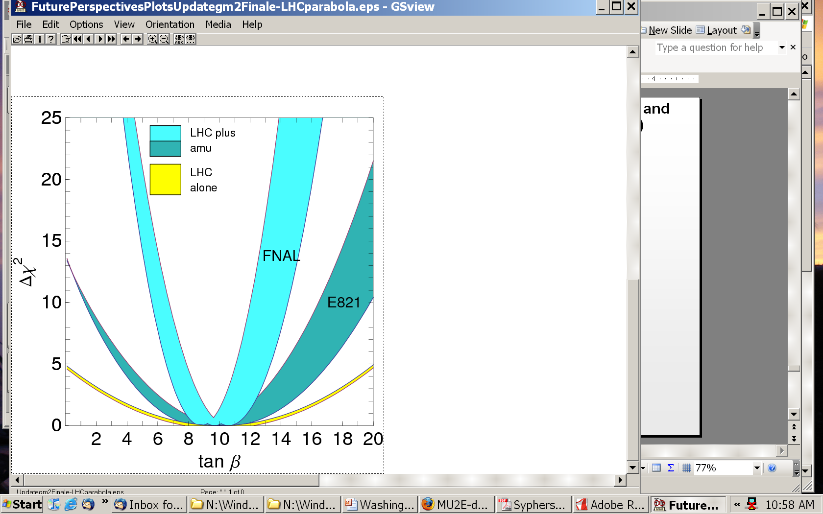
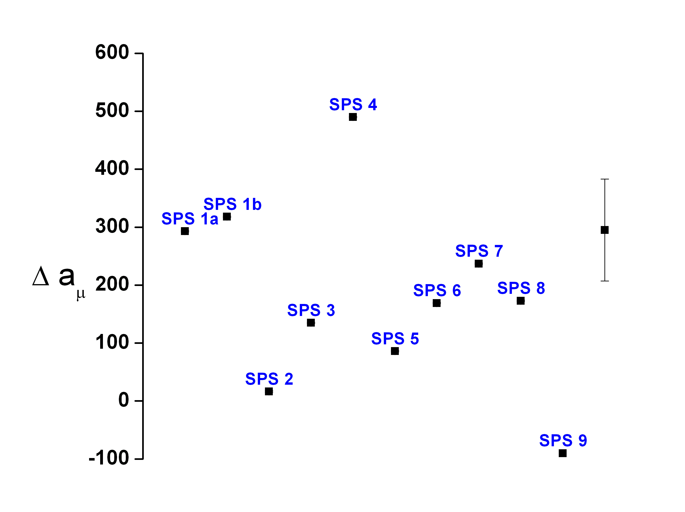
A new (g-2) to uncertainty 0.14*10⁻¹¹
Model
LHC
UED

Slide 39
Mu2e experiment can probe 10³–10⁴ TeV
New Physics
Scale (TeV)
with Project X
pre-Project X
Mu2e
MEG Experiment
SUSY
Compositeness
Model Parameter

Slide 40
Implementing the vision: LBNE
LBNE is a key experiment in the neutrino area and already engages a very broad collaboration
It can start with the 700kW beam developed for NOvA (facilities have to be built towards the DUSEL direction)
It would ultimately use over >2000kW in the Project X era

Slide 41
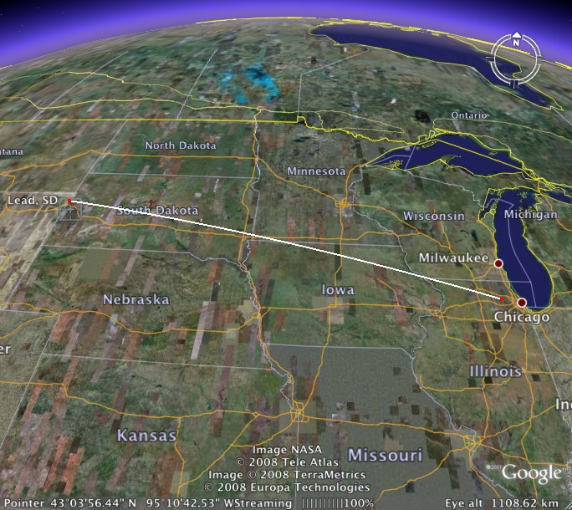
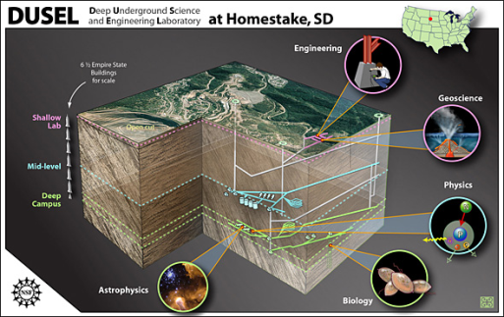
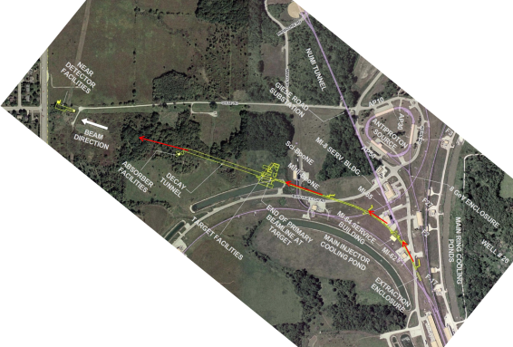
Long Baseline Neutrino Experiment
CD 0: January 2010
1300 km
Collaboration: 306 members
58 institutions (6 US labs) and 5 countries (India, Italy, Japan, UK, US)
Continue to grow!

Slide 42
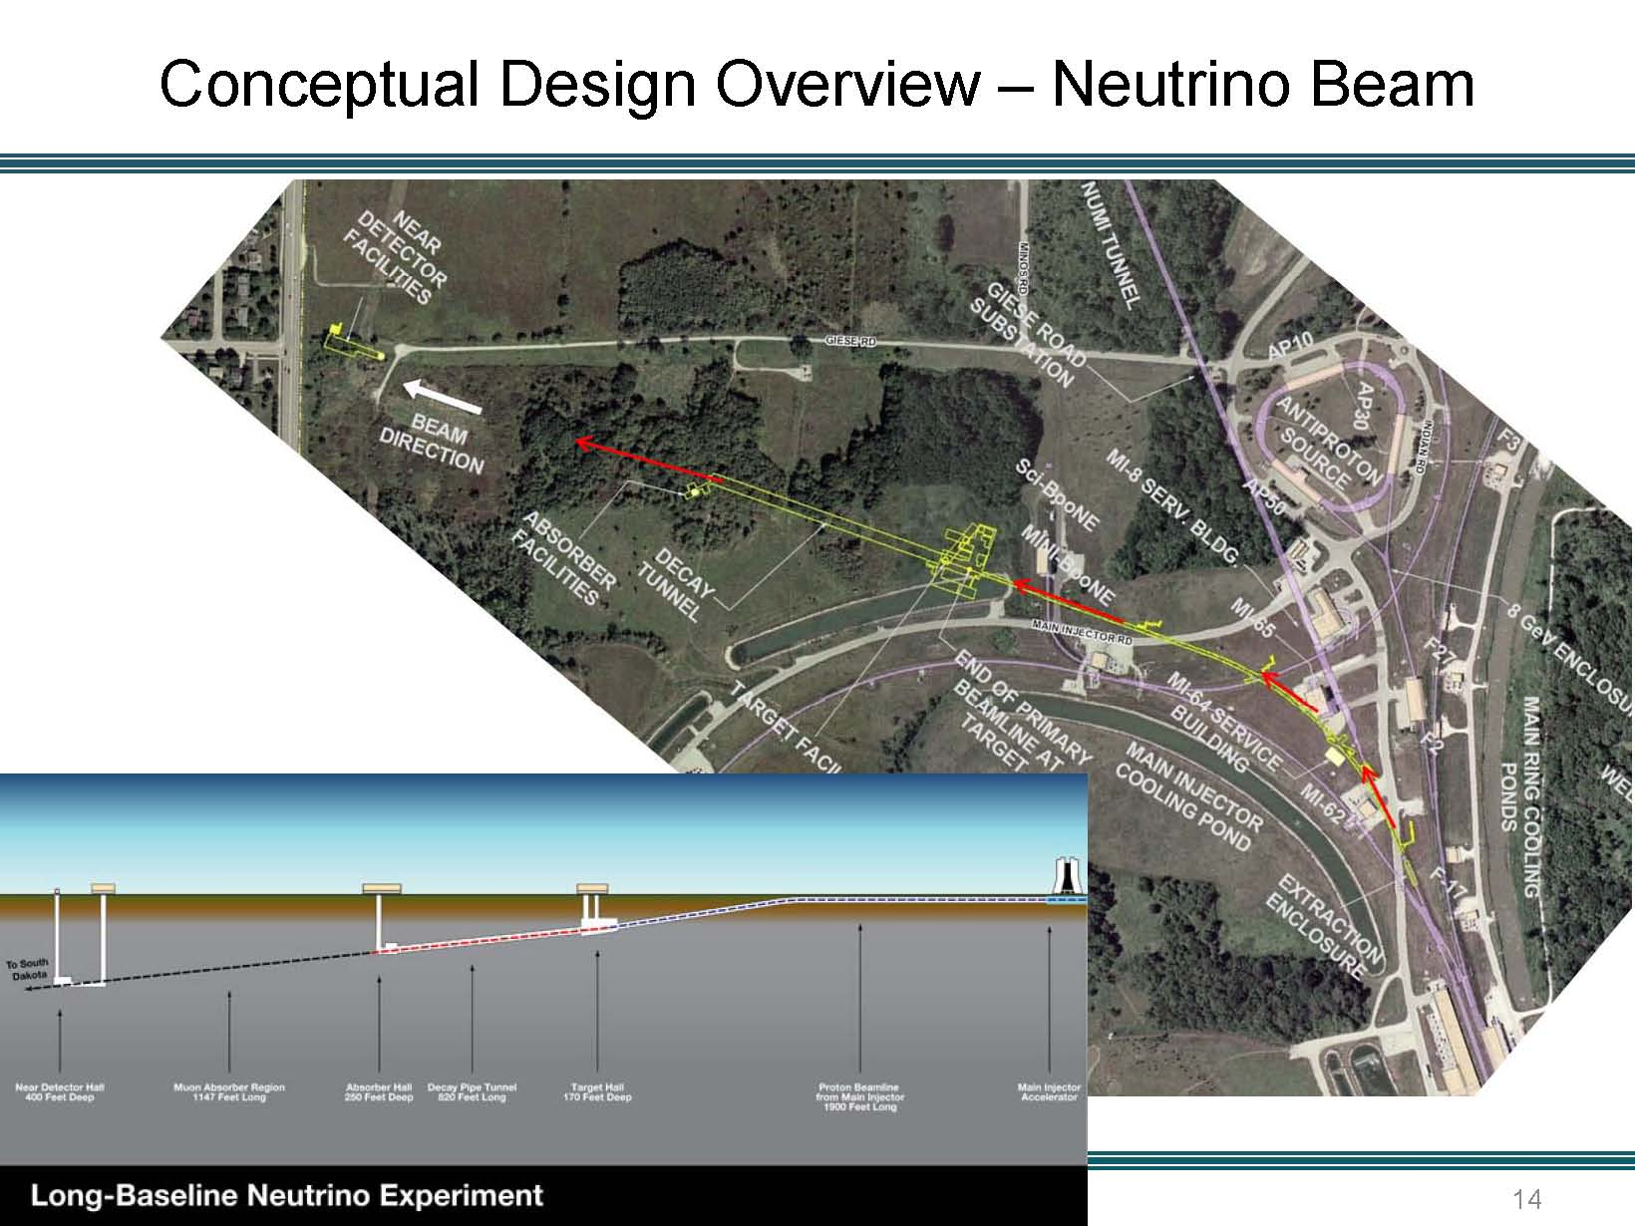

Slide 43
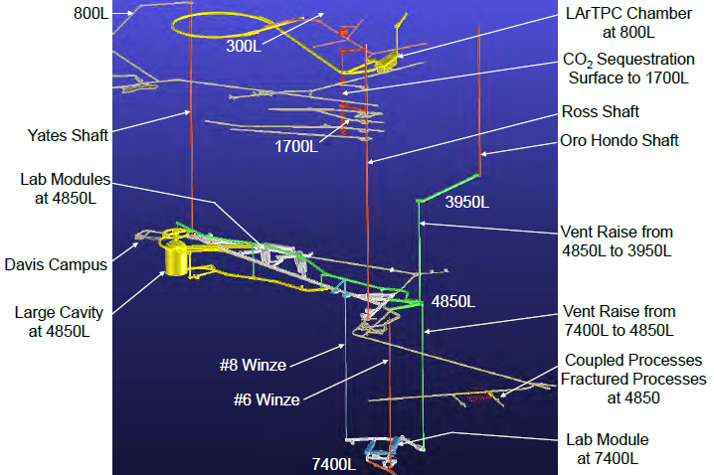
DUSEL Lab Layout

Slide 44
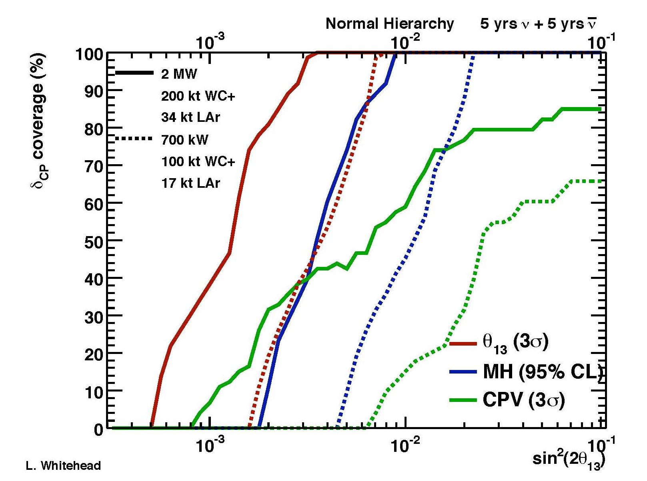
Neutrino physics sensitivities
LBNE ← NOvA ← MINOS
(>2MW ← 0.7MW) (0.7MW) (0.3MW)
With Project X

Slide 45
Consequences of NSF decision
Couples the choice of technology to the development of the underground laboratory
The infrastructure for LBNE enables other underground activities (dark matter searches, neutrino-less double beta decay) with the construction of a deep underground water Cerenkov
The set of activities, LBNE, dark matter searches, neutrino-less double beta decay are long term projects with several generations of experiments
In the long term we can have the best underground laboratory in the world because of the coupling to Fermilab

Slide 46
What is the long term program?
In the longer term, we want to drive the intensity frontier program with Project X:
  with already built experiments (LBNE, short base-line neutrino experiments, g-2);
  modified experiments (Mu2e);
  and new experiments (a series of kaon and muon experiments, measurement of EDMs in exotic nuclei); and applications to other programs
It is important to declare our intent to build this program both with LBNE(already has CD-0) and Project X (needs CD-0) as the main anchors so that we can build the needed international collaborations, especially with Europe and Asia

Slide 47

Project X Reference Design

Slide 48

Project X Siting

Slide 49
Project X: CW linac
Unique facility for rare decays: a continuous wave (CW), very high power, superconducting 3 GeV linac. Will not exist anywhere else
CW linac greatly enhances the capability for rare decays of kaons, muons
CW linac is the ideal machine for other uses: Standard Model tests with nuclei (ISOL targets), possible energy and transmutation applications, cold neutrons

Slide 50
Kgπνν…Past, Present, Future
Facility (Experiment) | Proton Power | Kaon decay rate | Kaon Properties | K→πνν Sensitivity
BNL AGS (E787/E949) | 50kW | 1x10⁶ K⁺/sec | Pure stopped K⁺ source | 7 events (charged)
CERN (NA62) | 20kW | 10x10⁶ K⁺/sec | Un-separated 1- GHz K⁺/p⁺/p⁺ beam | 80 events (charged)
Project X K⁺→πνν | 1500 kW | 100x10⁶ K⁺/sec | Pure stopped K⁺ source | >1000 events (charged)
JPARC (KOTO) | <300 kW | <0.5x10⁶ K_{L}/sec | Pencil beam | 1 event (neutral)
Project X K_{L}→πνν | 1500kW | 50x10⁶ K_{L}/sec | Pencil beam & Precision TOF | 1000 events (neutral)

Slide 51
μ⁻Age⁻A Conversion… (Past, Present, Future)
Facility (Experiment) | Proton Power | Stopped Muon rate | Muon Properties | μΑ γeΑ Sensitivity
PSI (SINDRUM II) | 1000 kW | 10⁷ m/sec | “DC” (50 MHz cyclotron) 52 +/-1 MeV/c | 3x10⁻¹³
Booster & JPARC (Mu2e/COMET) | 25 kW | 5x10¹⁰ m/sec | 1 MHz Pulsed 10-70 MeV/c | 2x10⁻¹⁷
Project X (PRISM-like) | 1000 kW | >10¹² m/sec | Pulsed, narrow-band (30 +/- 1 MeV/c) | <10⁻¹⁸
Mu2e/COMET breakthrough technology:
Large muon yield from production target inside of high field solenoid.
Pulsed beam strongly suppresses pion backgrounds.
Project X breakthrough technology:
Collapse the high flux wide-band muon beam to a narrow-band beam with cooling techniques.

Slide 52
Interplay: LHC Intensity Frontier
nothing
Only handle on the
next energy scale
Intensity
Frontier
LHC
Determine/verify
structure of new
physics. Anything
beyond?
Lots

Slide 53

Large effects in kaon decay rates
d
d
d
d
W
s
d
s
quarks
d
quarks
W
W
Z
lepts
ν
ν
ν
SM: Κ_{L} π⁰ ν ν
ν
d
d
d
d
χ
s
d
s
χ
squarks
χ
d
squarks
χ
slepts
ν
ν
ν
BSM: Κ_{L} π⁰ ν ν
ν

Slide 54


Slide 55


Slide 56
Project X is central to the strategy
The CW linac coupled to an 8 GeV pulsed LINAC and to the Recycler and Main Injector, gives the most intense beams of neutrinos at high energy (LBNE) and low energy (for the successors to Mini and MicroBooNE)
Makes use of modern accelerators at Fermilab (Recycler and Main Injector) and its scope would be difficult to reproduce elsewhere without this established base
Eliminates proton economics as the major limitation: all experiments run simultaneously

Slide 57
Project X and other projects
Project X benefits from the word-wide ILC R&D: SCRF and photo-e cloud. SCRF R&D positions the US to play a leading role in ILC.
Capabilities and infrastructure developed for Project X will be useful for other domestic non HEP projects.
Project X with upgrades can be the front end of a neutrino factory or a muon collider, opening paths for development of the intensity frontier and a road back to the energy frontier

Slide 58
“Plug and play” - physics
3 GeV CW
linac
Muons
Kaons
Nuclei (ISOL)
Materials (ADS)
3-8 GeV pulsed linac
Neutrinos vs. antineutrinos
Muons
8-120 GeV
existing machines
Long base line neutrino oscillations

Slide 59
Sequencing is flexible
LBNE at 700 kW
3 GeV initial program
8 GeV initial program
LBNE at 2300kW
We are capable of doing the whole program at once in the next ten years, or it can be sequenced over a longer period. First part, LBNE, $1.4B with underground development, contingency and escalation.

Slide 60
Fermilab accelerator strategy
NuMI (120 GeV):
350 kW
Booster (8GeV): 35 kW
NuMI (120 GeV)
700 kW
Booster (8GeV): 80 kW
Project-X:
>2MW @ 120 GeV
3MW @ 3 GeV
300 kW @ 8 GeV
Neutrino Factory
To create a world-leading program at the Intensity Frontier…and use this program as a bridge to an Energy Frontier facility
LHC
Tevatron
LHC Upgrades in
luminosity and energy
Lepton Colliders
Fundamental Accelerator Science and Technology Development

Slide 61
How to think about total program ?
Total cost of Project X + LBNE + day one intensity frontier experiments (on the same time frame SNS would be $2.2B)….
Offsets: India + Europe + China(?) + NSF
Net cost for the DOE……………………….
In present Fermilab budget: ramp down of NOvA and Tevatron times ten years…......
Net additional investment on HEP over ten years for the entire program
$3.5B
($0.85B)
$2.65B
($0.9B)
$1.75B

Slide 62
Accelerator activities: aligned with mission
Accelerator Science
Accelerator Technology Development
Future Facilities
Advanced Accelerator R&D Program
Collimation
Ionization cooling
High field magnets
Superconduct-ing RF
Accelerator Operations
Project X
Muon Collider
Tevatron Colliding Beams
120 GeV Neutrino Program
8 GeV Neutrino Program
Beam Instrumentation
Beam dynamics and simulation
Expanding Capability
Proton Improvement Plan
NOvA Upgrades
High-power Targetry
Mu2e and g-2
ILC
RF Systems
Cooling tech.
LBNE

Slide 63



Slide 64
What do we need from DOE
Support the development of world-class facilities in the domain we propose. It is the most cost effective way for the US to maintain a leadership position in the world of HEP
  LBNE: continue to develop the underground option: following the CD-1, CD-2, CD-3……route, now using LBNE as vehicle for future development of the underground. Politically we need the Office of Science to advocate with the administration for this program – we can do our part as well. We understand it is a very difficult time to do this
  Project X: provide CD-0 to help us develop a strong international collaboration; continue with the R&D to be ready to start construction in a few years

Slide 65
What do we need from DOE
The financial pendulum swings: start with LBNE and sequence Project X as appropriate to circumstances at the time.
Support the interim program that runs before Project X, to maintain the productivity of Fermilab during the rest of the decade. This involves full operations of the accelerator complex, the near term improvements, and the development of the planned experiments.
We need your help with the public perception that we are shutting down Fermilab: means understanding and supporting the near term program.

Slide 66
Additional Material

Slide 67

Future program: at the three frontiers

Slide 68
Gaps and roles: energy frontier
Next two decades: dominated by LHC. Upgrades to machine and detectors
Biggest gap: what follows the LHC? Depends on results and at what energy results occur
Fermilab strategy: completion of the Tevatron program and physics exploitation and upgrades of LHC. R&D on future machines: ILC if at “low” energy; muon collider if at high energy; new high field magnets for extension of LHC or future proton colliders at ultra-LHC energies

Slide 69

Roles: energy frontier
Tevatron
LHC
LHC
LHC Upgrades
ILC??
LHC
ILC, CLIC or
Muon Collider
Now
2013
2016
2019
2022

Slide 70
Gaps and roles: cosmic frontier
The principal connection to particle physics today: the nature of dark matter and dark energy
Gap in the direct search for dark matter: get to “zero—background” technology. Gap in understanding dark energy is establishment of time evolution of the acceleration: new major telescopes (ground and space)
Fermilab strategy: establish scalable “zero-background” technology for dark matter. Commission and exploit DES. Participate in future ground and space telescopes (the principal agencies are NSF and NASA, not DOE)

Slide 71





Roles: cosmic frontier
DM: ~1 ton
DE: LSST
WFIRST??
BigBOSS??
DM: ~10 kg
DE: SDSS
P. Auger
DM: ~100 kg
DE: DES
P. Auger
Holometer?
DE: LSST
WFIRST??
Now
2013
2016
2019
2022

Slide 72
Gaps and roles: intensity frontier
Two principal approaches: 1) proton super-beams to study neutrinos and rare decays and 2) quark factories: in e⁺e⁻ and LHCb
Principal gap is the understanding of neutrinos and the observation of rare decays coupled to new physics processes
Fermilab strategy: develop the most powerful set of facilities in the world for the study of neutrinos and rare processes, well beyond the present state of the art. Complementary to LHC and with discovery potential beyond LHC. DOE has the central role. Will define the role of US facilities in the world’s program.

Slide 73







Roles: intensity frontier
NOvA
MicroBooNE
g-2
MINERvA
MINOS
SeaQuest
MINOS
MiniBooNE
MINERvA
SeaQuest
NOvA
g-2
LBNE
Mu2e
Project X+LBNE
μ, K, nuclear, …
ν Factory ??
Now
2013
2016
2019
2022

