Slide 1
BNL restart status as of May 19, 2020
M. Anerella

Slide 2
New York / BNL status as of May 19, 2020
The 7 criteria of ‘NY Forward’ will serve as the signposts to determine regional, staged, re-openings of regions across the State.
A plan (New York Forward) to re-open NY on a regional basis as each region meets seven criteria was released on May 4th. Regions can begin re-opening once the criteria are met. At this point in time, Long Island meets five of the seven criteria. One metric is not yet met and one is rated ‘Expected’ (but not yet met):
14-day reduction in hospital deaths (not met)
30 contact tracers per 100k residents (expected)
BNL continues to be in "Min-Safe" operating mode, which is being extended until at least May 29, 2020.

Slide 3
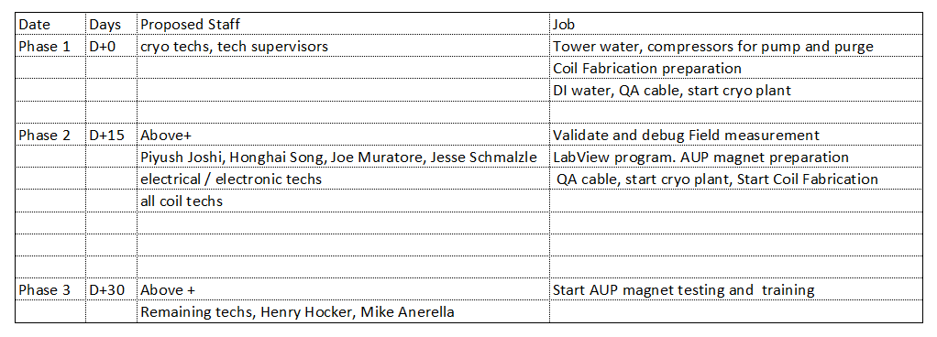
SMD BNL AUP Plan (not yet approved)

