Slide 1
Snowmass 2021
Accelerator Frontier Accelerator Sci, Edu, Outreach
Kick-off/Info Meeting, May 21 2020
In conjunction with GARD ABP Workshops Summary Mtg
Vladimir Shiltsev (FNAL)
Zhirong Huang (SLAC)
et al.

Slide 2
The Snowmass process
Long-term planning exercise for the particle-physics community.
“Develop community long-term physics aspirations.”
“Communicate opportunities for discovery in particle-physics to broader community and to the (US) government.”
(Young-Kee Kim, DPF Chair, Town-Hall Meeting, 2020 April APS meeting)
Physics-driven effort.
Covers all areas of particle physics and facilitates cross-cutting.
Develop overarching physics studies.
Global effort.
Input from non-US community is essential.
Input from recent international studies, for example HL-LHC, European Strategy Particle Physics Update (ESPPU), future colliders etc.

Slide 3
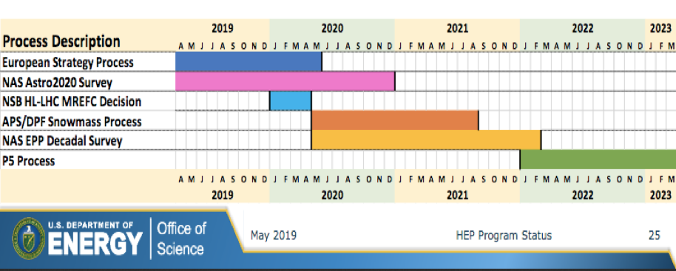
International Timeline
Snowmass Final Report: Fall 2021
NAS (National Academy of Sciences) Decadal Survey Report: end 2020 or very early 2022
Snowmass 2021 results will be used as input to the next P5 (2022)

Slide 4
Snowmass 2021 Timeline
We are ahead of the curve compared to Snowmass 2013
Today
11/19 | 12/19 | 1/20 | 2/20 | 3/20 | 4/20 | 5/20 | 6/20 | 7/20 | 8/20 | 9/20 | 10/20
Preparation
Letters of Interest
Contributed Papers
(Continued…)
Planning Meeting
Nov 4-6, 2020 (Fermilab)
Summer Study
July 11-20, 2021 (UW Seattle)
Snowmass
Report
11/20 | 12/20 | 1/21 | 2/21 | 3/21 | 4/21 | 5/21 | 6/21 | 7/21 | 8/21 | 9/21 | 10/21
Contributed Papers

Slide 5
Past Snowmass and P5
Snowmass 2013: new successful model
Energy Frontier
Intensity Frontier
Cosmic Frontier
Cross-cutting groups: Facilities, Instrumentation, Computing, Theory, Communication.
Report: https://www.slac.stanford.edu/econf/C1307292/
P5 (2014): identified five scientific drivers
Use the Higgs boson as a new tool for discovery.
Pursue the physics associated with neutrino masses.
Identify the new physics of dark matter.
Understand cosmic acceleration: dark energy and inflation.
Explore the unknown: new particles, interaction, and physical principles.
Report: https://www.usparticlephysics.org

Slide 6
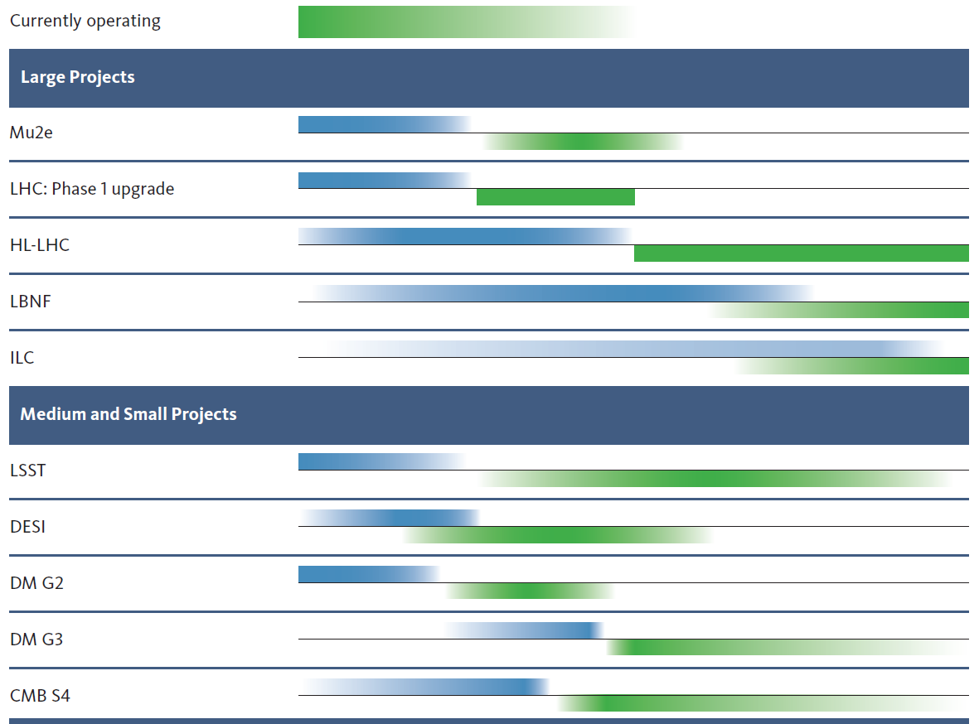
P5 2014 has been very successful !!
10 year plan
Scientific Drivers
HEP Science Output
[>$200M]
The Unknown (U.S.)
construction
operation
Higgs as a tool
The Unknown
(Europe)
Neutrino (U.S.)
LBNF/DUNE (and PIP-II)
LBNF/DUNE & PIP-II schedules advanced
[<$200M]
Cosmic Acceleration (U.S.)
Dark Matter (U.S.)
Cosmic Acceleration (U.S.)
(SuperCDMS, LZ, ADMX)
We are here
Construction
Expected Physics

Slide 7
Snowmass 2021: leading to the next P5
Ten Frontiers (with Liaisons in between).
Energy Frontier
Frontiers in Neutrino Physics
Rare Processes & Precision Measurements
Cosmic Frontier
Theory Frontier
Underground Facilities
Accelerator Frontier
Instrumentation Frontier
Computational Frontier
Community Engagement Frontier
Wiki: https://snowmass21.org/start

Slide 8
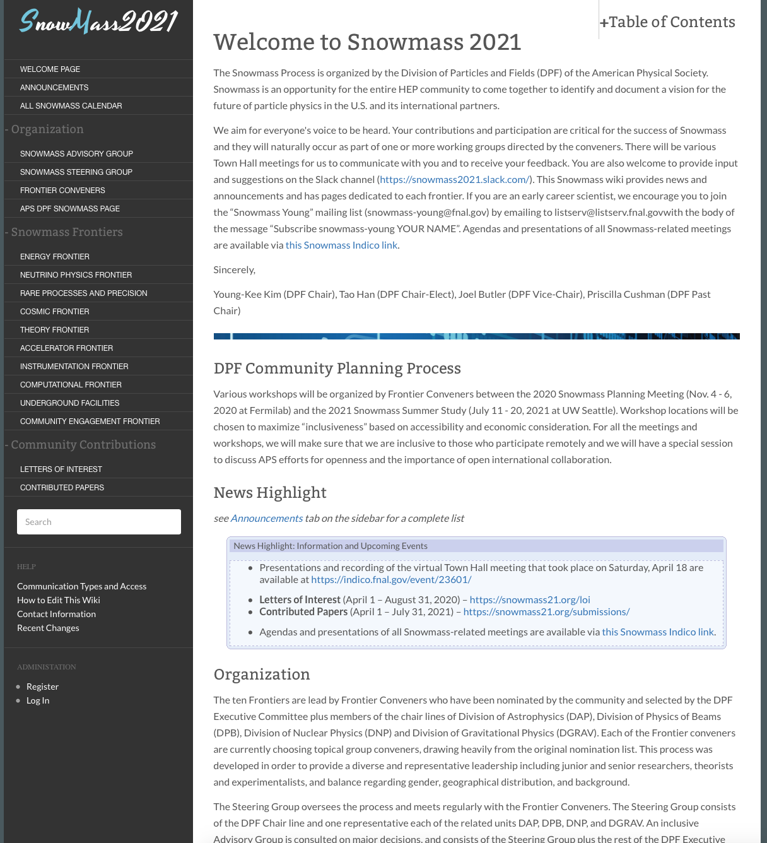
Wiki: https://snowmass21.org/start
→

Slide 9
Accelerator Frontier “Challenges”
How can existing accelerator facilities be upgraded or extended to serve new particle physics experiments and a broader physics base?
What are the next accelerators for particle and nuclear physics on a 10 to 20-year time scale?
What are the most efficient Higgs and electroweak factories that can start operation by the end of the LHC program ~2040?
What are the most efficient options for a beyond-LHC energy-frontier discovery collider facility by 2050/60?
What are the 20-year goals and expectations for core accelerator technologies such as RF, magnets, particle sources and targets?
Are there coherent long-term physics and infrastructure scenarios?
Can ERLs, muon accelerators, wake-field and other advanced technologies deliver on a promise of sustainable and financially feasible next-generation particle physics facilities, i.e. by ~2040?
What are the accelerator technology and accelerator science gaps needed to be overcome to realize such facilities?
https://snowmass21.org/accelerator/start

Slide 10
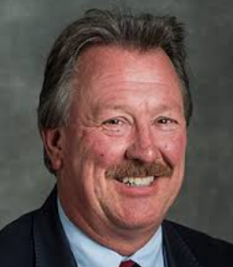
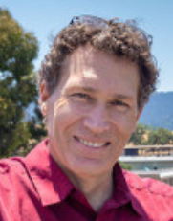
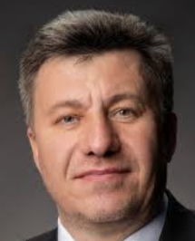
Accelerator Frontier Conveners
Steve Gourlay (LBNL)
Tor Raubenheimer (SLAC)
Vladimir Shiltsev (FNAL)
Topical Group |  | Topical Group co-Conveners
AF01 | Beam Phys & Accel. Education | Z. Huang (Stanford) | M. Bei (GSI) | S. Lund (MSU)
AF02 | Accelerators for Neutrinos | J. Galambos (ORNL) | B. Zwaska (FNAL) | G. Arduini (CERN)
AF03 | Accelerators for EW/Higgs | M. Ross (SLAC) | Q. Qin (IHEP, Beijing) | Georg Hoffstaetter (Cornell)
AF04 | Multi-TeV Colliders | M. Palmer (BNL) | A. Valishev (FNAL) | N. Pastrone (INFN, Torino)
AF05 | Accelerators for PBC and Rare Processes | E. Prebys (UC Davis) | M. Lamont (CERN) | Richard Milner (MIT)
AF06 | Advanced Accelerator Concepts | C. Geddes (LBNL) | M. Hogan (SLAC) | P. Musumeci (UCLA) | R. Assmann (DESY)
AF07 | Accelerator Technology R&D
 | Sub-group RF | E. Nanny (SLAC) | S. Posen (FNAL) | H. Weise (DESY)
 | Sub-Group Magnets | G. Sabbi (LBNL) | S. Zlobin (FNAL) | S. Izquierdo Bermudez (CERN)
 | Sub-Group Targets/Sources | C. Barbier (ORNL) | Y. Sun (ANL) | Frederique Pellemoine (FNAL)

Slide 11
Topical Group Activities
All AF Topical Groups (TG) have:
wiki pages and Indico sites for their meetings
mailing lists (will have)
Everybody’s contribution and participation are vital to the Snowmass process!
How to engage:
Contact the AF1-7 conveners and join the AF1-7 activities (join meetings, discussion).
Bring existing studies and/or new ideas and projects to investigate.
Write a Letter of Interest (LOI): 2 pages, briefly what you want to work on (the AF conveners and the TG conveners will facilitate the process).
This can be done as individuals, user groups or collaborations
We invite collaborations & initiatives to submit (one or multiple) LOIs with a set of open questions and how to get new users involved in the studies.
Various user groups are providing documents with contact informations, available studies, available tools, etc

Slide 12
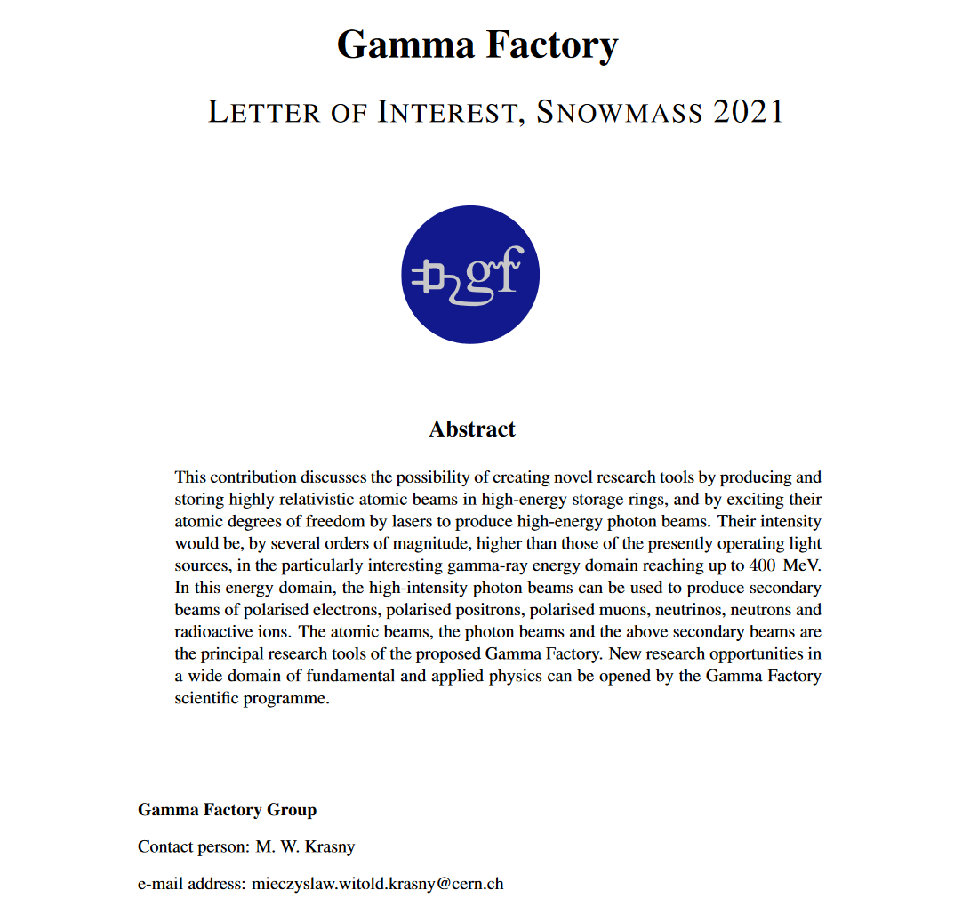
First AF LoI received ! (today)
https://www.snowmass21.org/docs/files/summaries/AF/SNOWMASS21-AF-TOPIC0-001.pdf

Slide 13
Accelerator Frontier Update
All Topical Group Convener slots filled
LoI template distributed and solicitations are being sent out
1st received (GF), some 10 LoIs are in the works (that we know of), more to come…
All Topical Groups have had at least one meeting.
We think of AF own meetings and conferences as well as using various other opportunities: eg these GARD-ABP Workshops !, Neutrino 2020 (June 22-July 2), EF Workshop (July 9-10), HB2020 (Oct 5-9), etc
Liaisons – [already in place with Theory, Energy, Instrumentation, Rare Processes] – many discussions …in process, eg @EF “kick off” meeting today
DPB announcement – early May, also via US PAS, EPS-AG and IEEE
NOMINATE SNOWMASS YOUNG TODAY !!! get your students and postdocs involved

Slide 14
Snowmass Young (I)
From: Sara Simon <smsimon@umich.edu>
Subject: Solicitation for Snowmass Young Representatives
Date: April 7, 2020 at 1:33:09 PM EDT
To: snowmass@fnal.gov, snowmass-young@fnal.gov, snowmasconveners@listserv.fnal.gov
Dear Colleagues,
As part of the Snowmass 2021 process, we are soliciting nominations for representatives for Snowmass Young. The Snowmass 2021 process will develop a long-term strategic plan, so the voices of early career members are critically important and we want them to be heard.
These representatives will have the opportunity to shape how early career members are included in the Snowmass process. This could include finding ways to get early career members engaged with the working groups, incorporating career development opportunities into events, surveying early career members as was done for Snowmass 2013, and integrating other items of interest to early career members into the events.
Nominations can be made by anyone, but nominees should be early career members (e.g. grad students, postdocs, etc.). Nominees need not be APS members to participate in the process. Nominations can include self-nominations and will be open until May 22, 2020 through the google form below:
https://forms.gle/Xpd4jW3Y6oxcXxmD7
Nominees will be reviewed and selected to ensure that the group is representative of the field. More details about the responsibilities and Snowmass process are included below. Please circulate this broadly.
Sincerely, Sara M. Simon & Fernanda Psihas 2019 DPF Executive Committee Early Career Member

Slide 15
Snowmass Young (II)
(from Snowmass wiki) - If you are an early career scientist, we encourage you to join the “Snowmass Young” mailing list (snowmass-young@fnal.gov) by emailing to listserv@listserv.fnal.gov with the body of the message “Subscribe snowmass-young YOUR NAME”.
NOMINATE!
https://docs.google.com/forms/d/e/1FAIpQLScA9zuSNeYTQsWbPtxJ2mdXME01MymoB5DJRzLAi3aM_bG9_w/viewform

Slide 16
We hope you will
join the work of the Snowmass 2021
Accelerator Frontier!

Slide 17
Back up slides

Slide 18
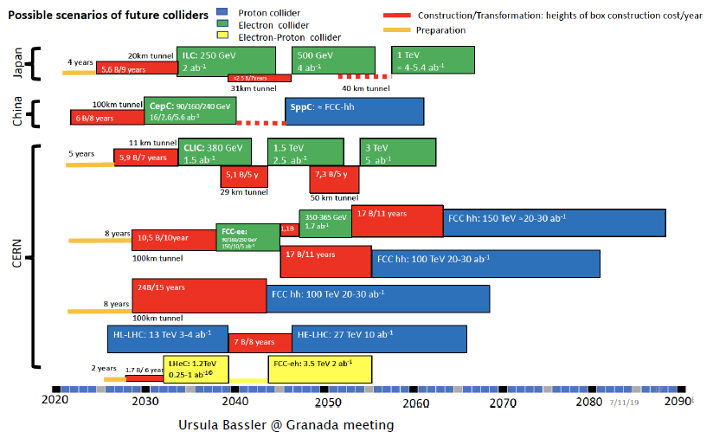
Future Collider Scenarios & Timelines

Slide 19
Future Colliders Scenarios
ESG studies, comparing various options, are detailed in the briefing book
Snowmass21 will expand on these studies and add other collider scenarios, e.g.
muon collider, Electron-Ion Collider, other c.o.m. (if needed)....
Our goal is to:
Identify “Focus Questions” and the “Scientific Merits” of the various collider options.
Develop a global picture and a future roadmap.
Compile existing studies [start from ESG briefing book and confirm with Accelerator Frontier].
Add new studies and information.
For pp future colliders, HL-LHC will serve as a critical baseline. HL-LHC results may be revisited if deemed necessary.

Slide 20
AF: Engaging early career members of the community
The Snowmass process thrives on the participation of young people and offers an ideal environment for young people to get involved and promote their own initiatives.
We strongly encourage young members of the community to get involved!
To all senior members: get your students and postdocs involved!
Snowmass Young: forum of early career members.
Nominations for representatives solicited (closed on May 11).
Nominees: early career members (e.g. graduate students, postdocs).
Coordinated by:
Sara M. Simons (2020 DPF ECEarly Career Member)
Fernanda Psihas (2019 DPF EC Committee Early Career Member)

Slide 21
Liaisons among Frontiers and Projects
They will provide high-level and bi-directional communication b/w Frontiers.
They will be people with interests in both communities.
Official Liaisons:
Neutrino Physics Frontier: TBD
Rare Processes and Precision: Robert Bersntein (FNAL)
Cosmic Frontier: n/a
Theory Frontier: Liantao Wang (Chicago)
Energy Frontier: Dmitri Denisov (BNL), Meenakshi Narain (Brown)
Computational Frontier: TBD
Instrumentation Frontier: Andy White (UTA)
In addition to official Liaison we foresee ‘Link People’
Provide a more technical link between AF2-AF6 and established teams/projects
They will be people who are embedded in both communities based on their personal interests.

Slide 22
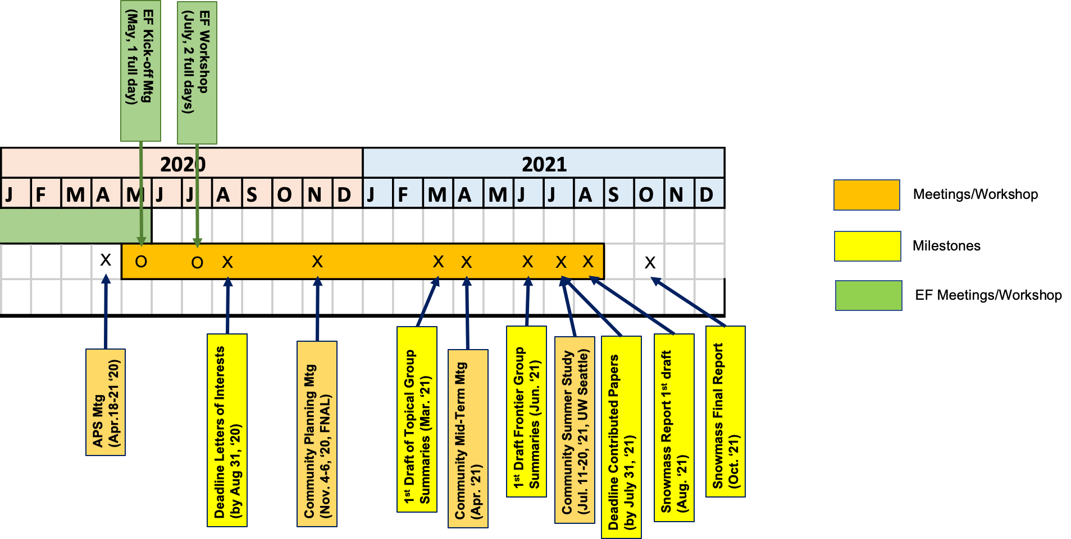
Accelerator Frontier Planning
Two AF community meetings to be arranged before the LoI deadline and in preparation for the Nov 4-6, 2020 Snowmass Planning Meeting:
AF Kick-off meeting ??
EF workshop July 9-10 with common sessions with Accel Frontier
More workshops will follows
EF meeting
↘
Today→

Slide 23
EF Meeting and July Workshop
Kick-off Meeting: Today Thursday May 21, 2020 (full day).
Review of existing studies, and plans to engage communities.
Goal is to lay out our plans, strategy, activities, discuss the organisation of the EF group and TGs, how to communicate within the community.
Summaries of studies that can be considered as stepping stones for TG activities (e.g. surveys of previous or international studies, e.g. ESG results, Yellow Reports etc.) as well as overviews of ideas for studies that can be carried out for Snowmass 2021.
Present plans for and use of letters of intents and contributed papers within the EF group, and the strategy for MC production.
EF Workshop: July 9-10, 2020 (two full days)
First opportunity for the community to present ideas, plans, and results if already available.
Plans to have dedicated joint sessions with other Frontiers, and common session between TGs.

Slide 24
“Letters of Interest” and “Contributed Papers”
Letters of Interest (LOI)
(submission period: April 1, 2020 – August 31, 2020)
“They allow Snowmass conveners to see what proposals to expect and to encourage the community to begin studying them. They will help conveners to prepare the Snowmass Planning Meeting that will take place on November 4 - 6, 2020 at Fermilab. Letters should give brief descriptions of the proposal and cite the relevant papers to study. Instructions for submitting letters are available at
https://snowmass21.org/loi.
Authors of the letters are encouraged to submit a full write-up for their work as a contributed paper.”
Very brief (two pages).
Uploaded by Authors through Snowmass 2021 Wiki.
Index of submitted LOI available on the Snowmass 2021 Wiki.
Could represent existing work (cite) or new ideas.
Will help the EF conveners plan the work of the Frontier (including liaisons with other Frontiers: avoid duplication/build synergy).
If further developed in the context of the Snowmass 2021 exercise could lead to a Contributed Paper.

Slide 25
“Letters of Interest” and “Contributed Papers”
Contributed Papers
(submission period: April 1, 2020 – July 31, 2021)
“Contributed papers will be part of the Snowmass proceedings. They may include white papers on specific scientific areas, technical articles presenting new results on relevant physics topics, and reasoned expressions of physics priorities, including those related to community involvement. These papers and discussions throughout the Snowmass process will help shape the long-term strategy of particle physics in the U.S. Contributed papers will remain part of the permanent record of Snowmass 2021. Instructions for submitting contributed papers are available at
https://snowmass21.org/submissions/”
More extensive studies.
May include white papers, scientific/technical articles, etc.
Can but do not have to be related to a given LOI.
Submitted by Authors following instructions given on Snowmass 2021 Wiki page (submit to arXiv, send email to M. Peskin with subject “Contribution to Snowmass 2021”, etc.)
Will be part of the official Snowmass 2021 records..

Slide 26
Inputs from Collaborations
We need to start receiving inputs from International Collaborations
Plans for analyses, MC samples, framework availability and how to share them with the Snowmass community, contact people etc.
Letters of Interests
Following slides show three contributions received by EF so far – as an example, more are expected from other collaborations
Those contributions will be made available to the whole Snowmass community soon

Slide 27
Inputs from Collaborations: ILC

Slide 28
Inputs from Collaborations: ILC

Slide 29
Inputs from Collaborations: ILC

Slide 30
Inputs from Collaborations: ILC

Slide 31
Inputs from Collaborations: FCC

Slide 32
Inputs from Collaborations: FCC-hh

Slide 33
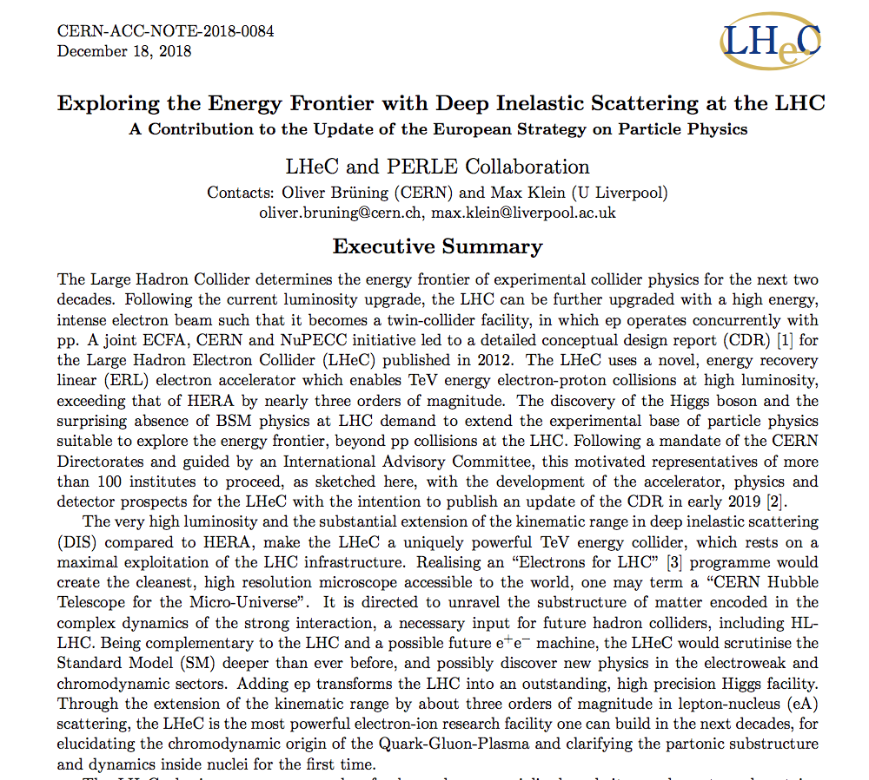
Input from Collaborations: LHeC

Slide 34
Input from Collaborations: EIC
EIC: Study structure and dynamics of matter at high luminosity, high energy with polarized beams and wide range of nuclei
10³⁴
Tomography (p/A) Transverse Momentum Distribution and Spatial Imaging
100
Luminosity (cm⁻² sec⁻¹)
Integrated Luminosity (fb⁻¹/yr)
10³³
Spin and Flavor Structure of the Nucleon and Nuclei
10
10³²
Parton Distributions in Nuclei
QCD at Extreme Parton Densities - Saturation
1
40
80
120
(GeV)
Snowmass Energy Frontier Kick-Off Workshop
Philadelphia, PA, May 21, 2020
Bernd Surrow

Slide 35
EIC CD0 and Site Selection
Announcement by the Department of Energy on January 9, 2020
https://www.energy.gov/articles/us-department-energy-selects-brookhaven-national-laboratory-host-major-new-nuclear-physics
WASHINGTON, D.C. – Today, the U.S. Department of Energy (DOE) announced the selection of Brookhaven National Laboratory in Upton, NY, as the site for a planned major new nuclear physics research facility. The Electron Ion Collider (EIC), to be designed and constructed over ten years at an estimated cost between $1.6 and $2.6 billion, will smash electrons into protons and heavier atomic nuclei in an effort to penetrate the mysteries of the “strong force” that binds the atomic nucleus together.
The EIC’s high luminosity and highly polarized beams will push the frontiers of particle accelerator science and technology and provide unprecedented insights into the building blocks and forces that hold atomic nuclei together. Design and construction of an EIC was recommended by the National Research Council of the National Academies of Science, noting that such a facility “would maintain U.S. leadership in nuclear physics” and “help to maintain scientific leadership more broadly.” Plans for an EIC were also endorsed by the federal Nuclear Science Advisory Committee.
Secretary Brouillette approved Critical Decision-0, “Approve Mission Need,” for the EIC on December 19, 2019. “The Department is excited to be moving forward with an Electron Ion Collider at Brookhaven National Laboratory,” stated Office of Science Director Dr. Chris Fall. “However, participation from many parts of the DOE laboratory complex will be essential if the EIC is to be a success.”
Thomas Jefferson National Accelerator Facility in Newport News, VA will be a major partner in realizing the EIC, and several other DOE laboratories are expected to contribute to EIC construction and to the groundbreaking nuclear physics research program that will be accomplished there.
Snowmass Energy Frontier Kick-Off Workshop
Philadelphia, PA, May 21, 2020
Bernd Surrow

Slide 36
Spinning Glue: QCD and Spin
Engagement in SnowMass2021 process
EIC program provides excellent opportunities for HEP community such as QCD and electro-weak physics in addition to novel instrumentation applications.
The EIC User group is committed through the EICUG Steering Committee to engage in the process of formulating Letters of Interest for various working groups including EF04, EF05, EG06 and EF07, besides Instrumentation Working Groups. Several informal discussions took place between the EICUG Steering Committee and several co-conveners.
The EICUG Steering Committee is committed to help this process to ensure that EIC-related submissions are consistent with the overall EIC planning of a new collider facility in the US at Brookhaven National Laboratory in cooperation with the DOE Office of Nuclear Physics.
Snowmass Energy Frontier Kick-Off Workshop
Philadelphia, PA, May 21, 2020
Bernd Surrow

