Slide 1
HR Updates-
Ilene Winston

Slide 2
HR Updates
The 2020 Performance Review cycle begins in less than a month!
June
Self-evaluations open in FermiWorks
Self Evaluation Demonstrations: Tuesdays in June from 11-11:45 AM (June 2, 9, 16, 23, 30). HR Partners and the FermiWorks HR team will host demos to prepare individuals for the self evaluation portion of the performance review. A brief overview of the performance review process will follow with a demo on how to best navigate the self-evaluation in FermiWorks. Please email Ilene at iwinston@fnal.gov for a zoom link and password.
Mid-July
Manager evaluation due
Goal setting discussions begin for 2021
Early August
Performance reviews submitted for final approval
September 24th – November 1st, 2020
Performance reviews are finalized and ready to be viewed by employees and managers for discussion
Remind supervisors to look in their Fermiworks inbox and approve outstanding goals by the end of May 2020
Unapproved goals may be dropped from the system at the end of the review cycle—very frustrating for employees who took the time to enter goals

Slide 3
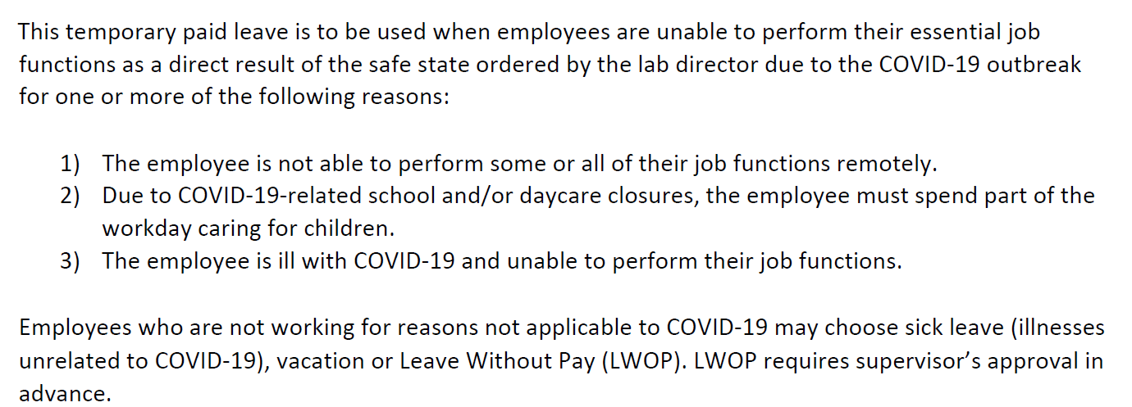
HR Updates
Return To Work
If you have an employee that you are requesting to return back to work on-site and they state they do not feel safe doing so due. First discuss this with your employee to try and understand if there are alternatives available, such as :
Allowing continued telework and choose someone else to perform the function
Allowing continued use of Weather Diff if the person cannot telework, and choose someone else
Allowing return on alternative schedule to reduce exposure to others onsite
Authorize and obtain additional PPE if specifically requested by the employee
If none of the above alternatives above is an option and they or someone in their household may have a medical condition or other factors that might increase their risk working onsite, please contact me for guidance. The employee may be protected under FMLA or ADA and I can assist you and your employee based on their specific situation. Please have the employee contact me and I can assist with facilitating a conversation and
Use of Weather Diff
Vacation Limit Extension to January 2021
Additional Q & A https://hr.fnal.gov/wdrs-virtual-care-package-for-remote-work/

Slide 4
PPD Climate Survey Implementation Team Update
Update
The team has reviewed recommendations and has continued to consolidate, prioritizing and implement recommendations.
Approved items have be assigned for implementation.
The team will continue meeting to continue working on recommendations for implementation in FY20 and moving forward.
We are working on communication to share the progress we have made and what we have already implemented. We will also share what items we plan on implementing moving forward. This communication will be distributed to all of PPD.

Slide 5
May is Mental Health Awareness Month
Resources available: https://hr.fnal.gov/may-is-mental-health-awareness-month/

