Slide 1
PPD Department Heads Meeting ESH/DSO Presentation May 2020
Raymond Lewis & Katie Swanson

Slide 2
Employee COVID website

Slide 3
Employee COVID website

Slide 4
Face Coverings (Face Masks) in Stockroom
Disposable and cloth face coverings (masks) are available for ordering from the Stockroom
2650-051000 MASK, FACE, FABRIC, 3-PLY, DISPOSABLE, ELASTIC EAR LOOPS - Quantity available on 5/26: 8740
Although it says disposable, try to make it last
2650-051500 MASK, FACE, FABRIC, 3-PLY COTTON, LAUNDERABLE, EAR LOOPS, ANTI-MICROBIAL FINISH – Quantity available on 5/26: 1917
Fabric contains silver and copper. Some individuals may have skin sensitivities to metal and ions incorporated in this product.
FESS DSO is monitoring face covering (mask) orders and D/S DSOs approve orders above threshold

Slide 5
Sanitizers in Stockroom
Sanitizer, hand sanitizer, liquid, 75% by volume isopropyl alcohol, in 12 oz. spray bottle
1620-085300
Can be used as a hand or surface sanitizer
Wipes, disinfectant (Lysol)
1620-089500
Basically out of stock at the moment
Spray, disinfectant (Lysol)
1620-089000
1620-089100

Slide 6
Reminders
“Working Safely in the Era of COVID-19 and the Return to On-site Work” [FN000684/CB/01] course has been added to Training Plans of personnel for whom one of these ITNA questions is checked:
This individual works onsite at Fermilab or will soon be working at Fermilab.
The individual's primary work location will be the Sanford Underground Research Facility (SURF)
Currently 2252 people have yet to take the class
Links to online 3rd party safety training are on WDRS’s “Our Curriculum” webpage.
OSHA 10- and 30-hour courses will be linked there
OSHA 30-hour Construction recommended for anyone performing field work/installations
OSHA 10-hour General Industry recommended for everyone and required for Service Coordinators

Slide 7
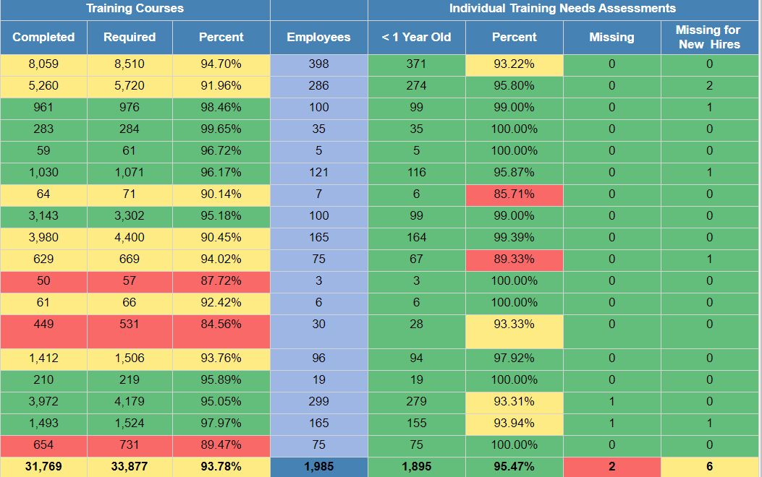
Training and ITNA Status for employees – as of 5/26/2020

Slide 8
Work Planning
IMPACT training- Old HA database will go away someday.
New Work Planning and Control Training: We will start with essential personnel in the next few weeks.

Slide 9
FESHM Updates
QAM Chapter 12050 – Root Cause Analysis (RCA)
Refined and clarified language throughout the document; alignment with other QAM Chapters.
Added a new section (5.9) that provides additional guidance on performing an “extent of condition” exercise.
QAM Chapter 12110 – Human Performance Improvement (HPI)
Initial release of Chapter 12110 describes the requirements of Fermilab’s Human Performance Improvement (HPI) Program. In addition to the standard QAM chapter contents that include an introduction, definitions, and references, there are detailed sections on how the program is implemented, how reviews are completed, personnel expectations, and specific procedures to assist Divisions, Sections and Projects in the determination for when an HPI Review is completed for an unexpected outcome.
QAM Chapter 12100 – Incoming Inspection and Acceptance
Initial release of Chapter 12100 describes the requirements for inspections and tests that are performed to verify that the physical and functional aspects of items, services, and processes meet requirements and are fit for use. Test programs include initial inspections upon delivery, proof tests before installation, pre-operational tests, and operational tests. Test programs are implemented by or for the organization performing the test(s), using a graded approach.
FESHM Chapter 5031.7 – Membrane Cryostats
Updated requirements for quality control, including pressure test. Removed references to 10CFR851.
Removed requirement for PE being employed by a company nonaffiliated with Fermilab or CERN.
Modified language to match requirements of 10CFR851
Clarification for gas pressurization of the insulation space
Clarification for the extent of required documentation
Replace “Guidelines” with “Requirements”
FESHM 10140, Mobile Cranes, is out for lab-wide comment until May 29, 2020.
Added references to new FESHM 10200 – Lift Plans
Included OSHA training/certification requirements
Included ASME medical requirements
Updated crane inspection requirements

Slide 10
HPIs
Cryo burn during cold fitting operation at MI60
Infrequently performed task
Assumptions (inaccurate mental picture): There was an assumption that the employee could retrieve the part quick enough with the cryo PPE so that no cryo liquid would contact his skin
Damage to T992 Chiller in MT6.1a
Assumptions (inaccurate mental picture): The cord fit both the outlet and the chiller and so users assumed the configuration would work.

Slide 11
Electronic RWPs
A system for reviewing and signing electronic Radiation Work Permits for Supervised Access has been implemented by Radiation Safety
Does not apply to Controlled Access
In PPD, will be most applicable to alignment work in AD areas and NM4.
Slide presentations on the system are on the Indico site
We can arrange to give a Zoom presentation on this if any group is interested

