Slide 1
EB and TB Held Requirements
Ettore Segreto and David Warner
TB Requirements Meeting
May 22, 2020

Slide 2
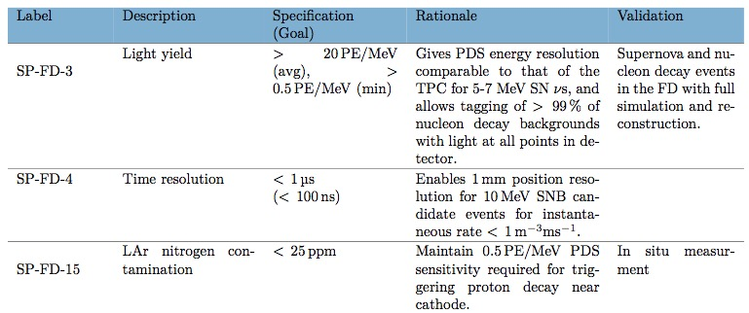
EB Held Requirements (No changes requested)

Slide 3
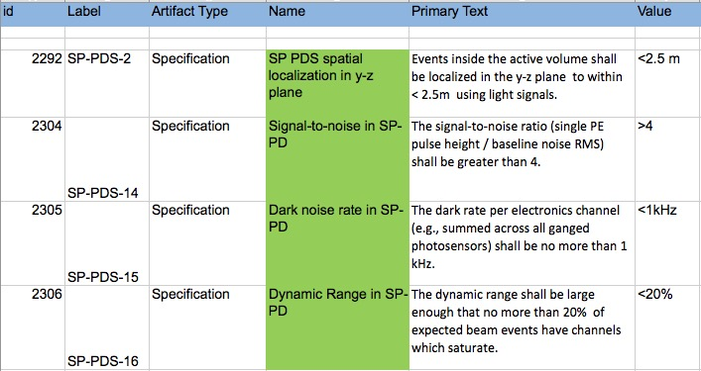
Current TB Held Requirements (i)
These requirements unchanged from TDR
Note-- New numbering scheme probably needed

Slide 4
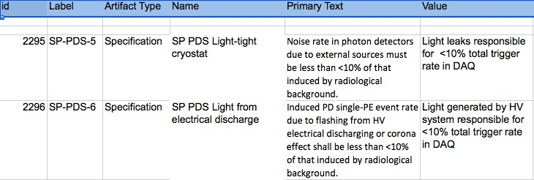
Current TB Held Requirements (ii)
These requirements removed from requirement list.
They are not specifications for the PD, and are addressed in ICDs
n.b.: May want to generate specifications in other consortia?

Slide 5
Current TB Held Requirements (iii)
These requirements removed from TB
They will be included in the PD consortium fabrication requirements
They are addressed in ICDs during I&I
May want to generate specifications in I&I?
Note that humidity spec is changed to match underground
environment specifications.

Slide 6
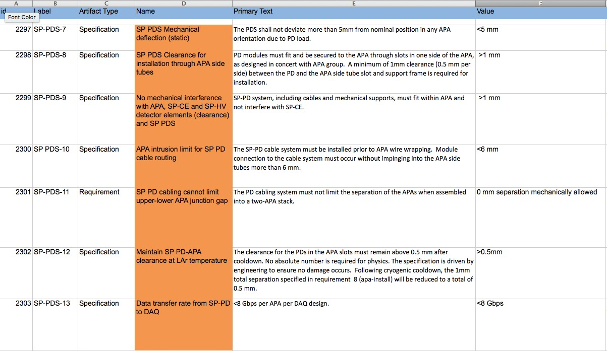
Current TB held Requirements (iv)
These requirements removed from TB
They will be included in the PD consortium design requirements
They represent PD requirements from others and are addressed in ICDs

Slide 7
PD-Held Specifications
We are in the process of generating them.
We plan to follow the standard model, with additions:
Integration requirements
Installation requirements
Transport and storage requirements
Assembly requirements
Design requirements (including electrical, mechanical dimensions, tolerance specifications)
Assembly facility requirements
Other technical specifications

